Slide 1

Improving the Quality of Care for Patients With Atopic Dermatitis
Integrating Measurement-Based Tools Into Your Clinical Practice
Supported by an educational grant
from Sanofi Genzyme and
Regeneron Pharmaceuticals.

Slide 2
CME Outfitters, LLC,
is the accredited provider for this continuing education activity.

Slide 3
The course guide for this activity includes slides, disclosures of faculty financial relationships,
and biographical profiles.
View and/or print the course guide from the Downloads tab on the top right of your window.

Slide 4
To receive CME/CE credits for this activity, participants must complete the post-test and evaluation online.
Go to the Credit Tab at the top of the video box and click on the link to complete the process and
print your certificate

Slide 5

Claim ABIM MOC Credit
3 Things to Do
Actively participate in the meeting by responding to ARS and/or asking the faculty questions
  (It’s ok if you miss answering a question or get them wrong,
  you can still claim MOC)
Complete your post-test and evaluation at the conclusion of the webcast
Be sure to fill in your ABIM ID number and DOB (MM/DD) on the evaluation, so we can submit your credit to ABIM.

Slide 6
Quality Payment Program (QPP)
How to Claim this Activity as a QPP Improvement Activity
Actively participate by responding to ARS and/or asking the
faculty questions
Complete activity posttest and evaluation at the link provided
Over the next 90 days, actively work to incorporate improvements in your clinical practice from this presentation.
Complete the follow-up survey from CME Outfitters in approximately 3 months
CME Outfitters will send you confirmation of your participation to submit to CMS attesting to your completion of a QPP Improvement Activity.

Slide 7
The faculty have been informed of their responsibility to disclose to the audience if they will be discussing off-label or investigational uses (any use not approved by the FDA) of products or devices.

Slide 8
Zelma C. Chiesa Fuxench, MD, MSCE
Assistant Professor
Department of Dermatology
University of Pennsylvania Perelman School of Medicine
Philadelphia, PA

Slide 9
Zelma C. Chiesa Fuxench, MD, MSCE
Disclosures
Advisory Board: Sanofi Genzyme and Regeneron Pharmaceuticals

Slide 10
John J. Russell, MD
Clinical Professor of Family and Community Medicine Sydney Kimmel Medical College
Thomas Jefferson University
School of Medicine
Philadelphia, PA
Program Director
Family Medicine Residency Program
Abington Hospital – Jefferson Health
Jenkintown, PA

Slide 11
John J. Russell, MD
Disclosures
Speakers Bureau: sanofi-aventis U.S. LLC
Consultant: sanofi-aventis U.S. LLC

Slide 12
Jonathan I. Silverberg, MD, PhD, MPH
Associate Professor of Dermatology, Medical Social Sciences and Preventive Medicine
University Feinberg School of Medicine
Director, Northwestern Medicine Multidisciplinary Eczema Center
Director, Contact Dermatitis Clinic, Northwestern Memorial Hospital
Chicago, IL

Slide 13
Jonathan I. Silverberg, MD, PhD, MPH
Disclosures
Grants: GlaxoSmithKline
Research Support: Sanofi Genzyme and Regeneron Pharmaceuticals
Consultant: AbbVie Inc.; AnaptysBio, Inc.; Asana BioSciences, LLC.; Dermavant Sciences, Inc.; Eli Lilly and Company; Incyte Corporation; Galderma; GlaxoSmithKline; Glenmark Pharmaceutical Inc.; Kiniksa Pharmaceuticals; LEO Pharma Inc.; Menlo Therapeutics; Pfizer Inc.; Realm Therapeutics, Inc.; Sanofi Genzyme and Regeneron Pharmaceuticals

Slide 14
Stephen D. Hess, MD, PhD
President/Medical Director
Center City Dermatology
Clinical Associate in Dermatology
Department of Dermatology
Hospital of the University
of Pennsylvania
Philadelphia, PA

Slide 15
Stephen D. Hess, MD, PhD
Disclosures
Speakers Bureau: Celgene Corporation; Janssen Pharmaceuticals, Inc.; Pfizer Inc.; Sanofi Genzyme and Regeneron Pharmaceuticals; Sun Pharmaceutical Industries Ltd.
Consultant: Celgene Corporation; Janssen Pharmaceuticals, Inc.; Verrica Pharmaceuticals
Stock Shareholder (Directly Purchased): Aclaris Therapeutics, Inc.; Celgene Corporation; Verrica Pharmaceuticals

Slide 16
Atopic Dermatitis (AD): Epidemiology¹⁻⁵
AD is a chronic, pruritic, inflammatory skin disease characterized by periods of acute disease flare
Prevalence of AD in the United States:
  Children ~ 20%
  Adults ~ 3.2% to 10.7% (studies vary)
Adult-onset AD is considered rarer
  Occurs more frequently during third decade of life
  30% of all cases of AD are in adult population
1. Eichenfield LF, et al. J Am Acad Dermatol. 2014;70:338-351.
2. Hanifin JM, et al. Dermatitis. 2007;18:82-91.
3. Garmhausen D, et al. Allergy. 2013;68:498-506.
4. Silverberg JI, et al. J Allergy Clin Immunol. 2013;132:1132-1138.
5. Silverberg JI, et al. Br J Dermatol. 2015;173:1400-1404.
Notes:
Studies on prevalence of atopic dermatitis in US population show different estimates, depending on source of population studied and definition used (ie, eczema versus atopic dermatitis).
Whereas the prevalence of AD among children can be as high as 20%, prevalence of eczema or AD in US adult population has been shown to vary between 3.2% and 10.7%.^{3,4}

Slide 17
Pathogenesis of AD¹⁻⁸
Inside-out:
Immune dysregulation,
allergen presentation, and
Th2 sensitization
Barrier dysfunction
Immune dysregulation
Allergens
Genetics
Microbiome
Outside-in:
Skin inflammation,
epidermal barrier dysfunction
Th = T helper cell.
1. Novak N, et al. J Allergy Clin Immunol. 2003;112:252-262. 2. Napolitano M, et al. G Ital Dermatol Venereol. 2016;151:403-411.
3. McLean WH. Br J Dermatol. 2016;175(suppl 2):4-7. 4. Palmer CN, et al. Nat Genet. 2006;38:441-446. 5. Fallon PG, et al. Nat Genet. 2009;41:602-608. 6. Paternoster L, et al. Nat Genet. 2015;47:1449-1456. 7. Tamari M, et al. J Dermatol. 2014;41:213-220. 8. Sasaki T, et al. J Dermatol Sci. 2014;76:10-15.
Notes:
2 seemingly competing explanations: inside-out hypothesis (immune dysregulation with a skewed Th2 profile) or outside-in hypothesis (skin-barrier defect leads to development of AD; epidermal abnormalities are secondary to immunological features).
Outside-in hypothesis: theorizes that a defect in the epidermal barrier results in increased TEWL which explains the associated dryness or xerosis seen in AD, as well as allows greater penetration of allergens and irritants, as well as skin colonizing organisms that can provoke in infection. In addition, this barrier defect can also result in Th2 immune response activation with increased production of pro-inflammatory cytokines such as IL-4 and IL-13.
Inside-out hypothesis: favors immune dysregulation/deviation as the primary hypothesis leads to activation of memory Th2 lymphocytes with increased production of IL-4 and IL-13.
Outside-in hypothesis
Defect in epidermal barrier (FLG mutation)
Increased TEWL → xerosis or dryness
Increased penetration of allergens/irritants → leading to epicutaneous sensitization → immune activation (Th2) → Increased production of proinflammatory cytokines IL-4 and IL-13
Increased penetration of skin colonizing organisms → increased risk of skin infections
Inside-out hypothesis
Immune dysregulation/deviation → primary cause of AD
Activation of memory Th2 lymphocytes → increased IL-4 and IL-13
Increased expression of other T-cell subtypes (Th1, Th17, and Th22)

Slide 18
Key Inflammatory Pathways in AD

Slide 19
ACUTE AD
Itch
Scratch
Lichenification
CHRONIC AD
Gooderham MJ, et al. J Am Acad Dermatol. 2018;78:S28-S36.

Slide 20
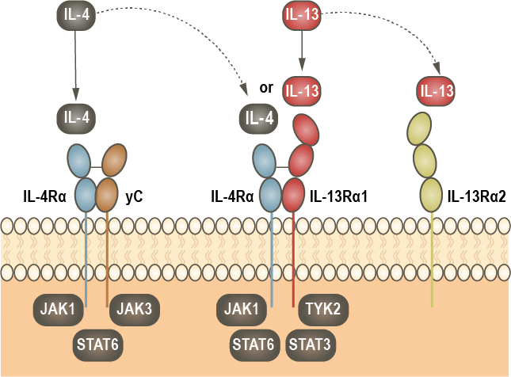
JAK/STAT Pathway
Gandhi NA, et al. Nat Rev Drug Discov. 2016;15:35-50.

Slide 21
Comorbidities in Adults
With AD
Higher rate of other atopic diseases:^{1,2}
  Nasal allergies/hay fever
  Bronchial asthma
Non-atopic diseases:
  Higher rates of skin infections³
  Sleep disturbances⁴
  Neuropsychiatric (anxiety, depression, ADD/ASD)⁵⁻⁹
  Other: cardiovascular disease, cancer (e.g., lymphoproliferative malignancies)^{10,11}
Eczema
Rhinitis
Asthma
Food Allergy
Incidence (%)
0
5
10
18
50
70 yrs
ASD = autism spectrum disorder.
1. Tran M, Sears M. Ann Allergy Asthma Immunol. 2018;120:115-119. 2. Silverberg JI, et al. J Allergy Clin Immunol. 2013;132:1132-1138.
3. Czarnowicki T, et al. J Allergy Clin Immunol. 2017;139:1723-1734. 4. Jeon C, et al. Dermatol Ther (Heidelb). 2017;7:349-364. 5. Sanna L, et al. J Affect Disord. 2014;155:261-265. 6. Klokk M, et al. BMC Dermatol. 2010;10:3. 7. Dalgard FJ, et al. J Invest Dermatol. 2015;135:984-991.
8. Strom MA, et al. Br J Dermatol. 2016;175:920-929. 9. Billeci L, et al. Am J Clin Dermatol. 2015;16:371-388. 10. Silverwood R, et al. BMJ. 2018;361:k1786. 11. Fletcher CL, et al. Arch Dermatol. 2004;140:449-454.
Notes:
Why? Based on the outside-in theory, epithelial cells express PRP which can recognized a number of allergens and results in immune activation with a predominant Th2 response which results in the Atopic March
(anxiety (42.5%
Depression (37.2%-75%)
ADD/ADHD
Relationship is complex and remains to be clearly defined
Prior studies have shown inconsistent results, and they are difficult to interpret due to dissimilarities in study design, small sample sizes, and varying case definitions for identifying eczema.
Underlying mechanism explaining the association between AD and neuropsychiatric disease is not clearly understood. It is thought to be related to the negative impact of AD on HRQoL, persistence of chronic itch and loss of sleep.
Study results: have shown a positive association with development of lymphoma, particularly CTCL, but an inverse or no association with solid-organ malignancies, such as pancreatic, brain, and skin cancers.^{1–8}
Relationship is complex and remains to be clearly defined
Prior studies have shown inconsistent results, and they are difficult to interpret due to dissimilarities in study design, small sample sizes, and varying case definitions for identifying eczema.
Underlying mechanism explaining the association between AD and neuropsychiatric disease is not clearly understood. It is thought to be related to the negative impact of AD on HRQoL, persistence of chronic itch and loss of sleep.
Study results: have shown a positive association with development of lymphoma, particularly CTCL, but an inverse or no association with solid-organ malignancies, such as pancreatic, brain, and skin cancers.^{1–8}

Slide 22
Impact of Atopic Dermatitis on Patient
Video will be shown here

Slide 23
AD: Impact on Quality of Life
Adults with moderate-to-severe AD:¹
  49% experience moderate-to-significant sleep disruption
  ~ 82% underwent lifestyle modifications
  55% experience decreased confidence
14% of adult patients in the ISOLATE study believed that
their career progression had
been hindered by AD.³
Patients (%)²
1. https://www.prnewswire.com/news-releases/new-survey-reveals-the-widespread-and-serious-impact-of-moderate-to-severe-atopic-dermatitis-on-people-living-with-the-disease-300339444.html. 2. Simpson EL, et al. J Am Acad Dermatol. 2016;74:491-498. 3. Zuberbier T, et al. J Allergy Clin Immunol. 2006;118:226-232.
5-D Pruritus Scale (Item 4) (n = 379)
POEM (Item 2)
(n = 378)
Notes:
AD/eczema can have detrimental effects on patients’ QoL.^{1,2}
Studies in adults with AD have shown that patients with this disease have worse QoL scores.^{1–4}
In addition to AD impacting a patient’s health-related QoL, it can^{1,2,5–7}:
Have social, psychological (eg, self-esteem, mood, self-confidence), occupational, and financial impacts
Decreased work productivity
Increased work absenteeism
AD can have AEs on simple ADL, such as choice of clothing, shaving, or use of makeup.³
No-to-modest correlation between objective measures of disease severity with QoL in adult patients with AD.⁴

Slide 24
Learning
Objective
1
Apply the Hanifin and Rajka criteria and/or the American Academy of Dermatology (AAD) criteria to facilitate the diagnosis of AD in clinical practice

Slide 25
Diagnosis
Clinical diagnostic criteria core sets:
  Hanifin and Rajka criteria¹
    3 of 4 major criteria and 3 of 23 minor criteria must be met
    Comprehensive, use limited to clinical trials
  UK Working Party²
    Core set based on Hanifin and Rajka
    Primarily used in epidemiologic/population-based studies
  AAD consensus criteria³
    AAD consensus conference (experts in this field)
1. Rudzki E, et al. Dermatology. 1994;189:41-46.
2. Williams HC, et al. Br J Dermatol. 1996;135:12-17.
3. Eichenfield LF, et al. J Am Acad Dermatol. 2014;70:338-351.
Notes:
Clinical diagnosis
Diagnosis is made clinically, based on historical features, distribution and morphology of skin lesions, and associated clinical signs.¹
UK working party: are used in epidemiological/population-based studies; they can be used by non-dermatologists.
Current limitations²
No clear diagnostic criteria for adult-onset AD
Developed for children and then translated for adults
May lack sensitivity and specificity in this population
UK Working Party:²
An itchy skin condition (parental report of scratching or rubbing in a child) + 3 or more:
1. Onset below 2 years of age
2. History of skin crease involvement
3. Visible flexural dermatitis
4. History of generally dry skin
5. Personal or family history of other atopic disease

Slide 26
Hanifin and Rajka Criteria
Major Criteria
Major Criteria: Must have ≥3 basic features:
  Pruritus
  Typical morphology and distribution
  Flexural lichenification in adults
  Facial and extensor eruptions in infants and children
  Chronic or chronically relapsing dermatitis
  Personal or family history of atopy (asthma, allergic rhinitis, atopic dermatitis)
Tada J. JMAJ. 2002;45(11):460-465.

Slide 27
Hanifin and Rajka Criteria
Minor Criteria
Minor Criteria: Should have ≥ 3 minor features:
  Xerosis
  Ichthyosis/palmar hyperlinearity,
  keratosis pilaris
  Immediate (type 1) skin-test reactivity
  Raised serum IgE
  Early age of onset
  Tendency toward cutaneous infections
  (especially S aureus and herpes simplex),
  impaired cell-mediated immunity
  Tendency toward non-specific hand
  or foot dermatitis
  Nipple eczema
  Cheilitis
  Recurrent conjunctivitis
  Dennie-Morgan infraorbital fold
  Keratoconus
  Anterior subcapsular cataracts
  Orbital darkening
  Facial pallor, facial erythema
  Pityriasis alba
  Anterior neck folds
  Itch when sweating
  Intolerance to wool and lipid solvents
  Perifollicular accentuation
  Food intolerance
  Course influenced by environmental or emotional factors
  White dermographism, delayed blanch
Tada J. JMAJ. 2002;45(11):460-465.

Slide 28
UK Working Party Diagnostic Criteria for Atopic Dermatitis
Must have an itchy skin condition plus ≥3:
Onset before age 2 (criterion not used in children under age 4)
History of flexural involvement
History of generally dry skin
Personal history of other atopic diseases (in children under age 4, history of atopic disease in a first-degree relative may be included)
Visible flexural dermatitis
Williams HC, et al. Br J Dermatol. 1994;131(3):406-416.

Slide 29
AAD
Criteria for
Diagnosing
AD
Eichenfield LF, et al.
J Am Acad Dermatol. 2014;70:338-351.

Slide 30
Atopic Dermatitis in Adults vs. Children
Video will be shown here

Slide 31
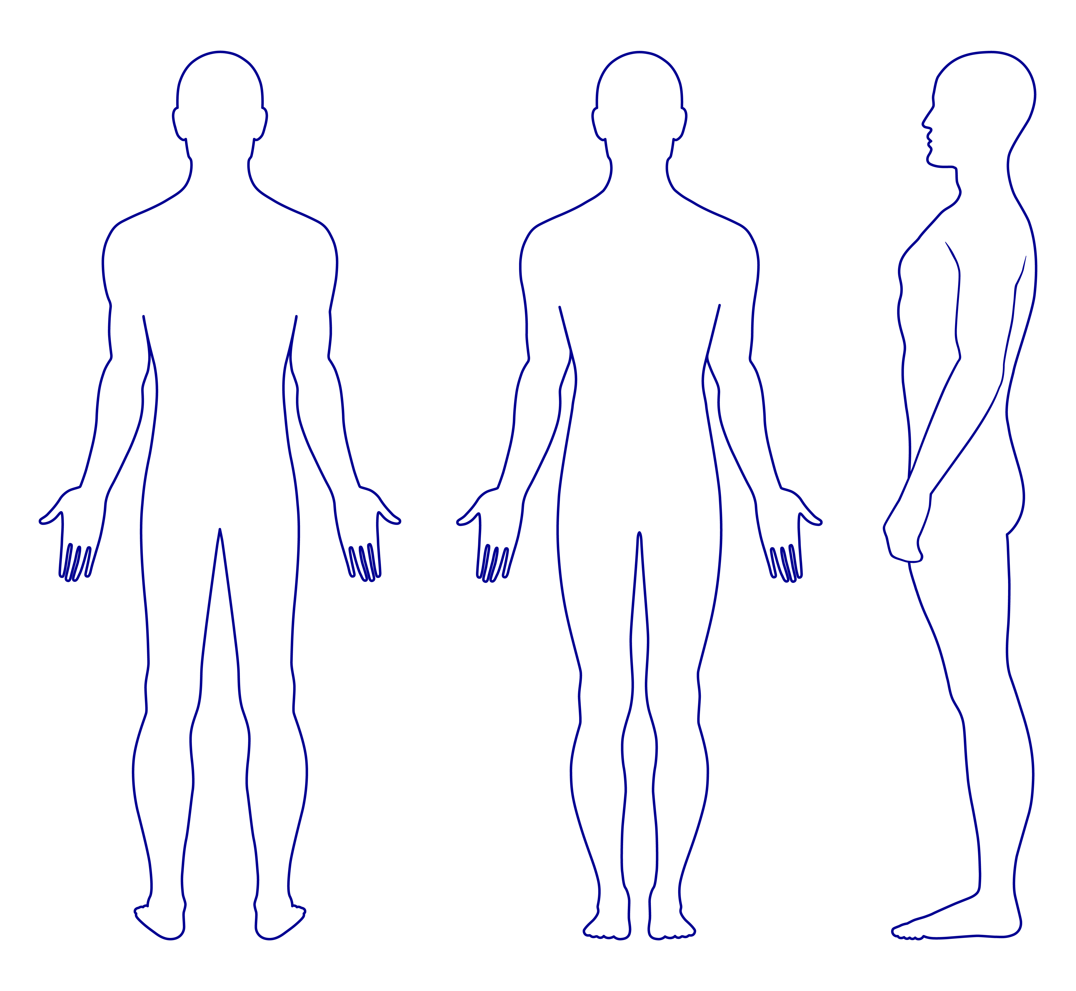
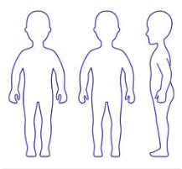
Clinical Manifestations
Adults:
face, neck, hands, feet, trunk (back), eyelids
Infants/early childhood:
face, scalp, trunk, and extensor surfaces
Childhood:
neck, flexors, feet
Image courtesy of Dr. Chiesa Fuxench.

Slide 32
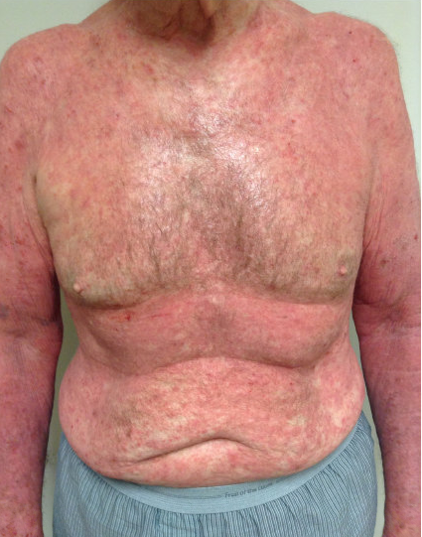
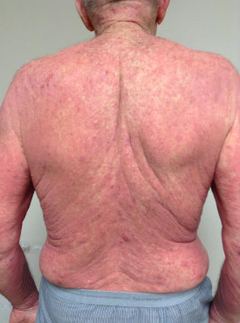
AD in Adult Patient
Notes:
Atopic Dermatitis in an adult patient-notice the widespread involvement of the trunk and upper extremities including neck area and extensor surfaces of the upper extremities.

Slide 33
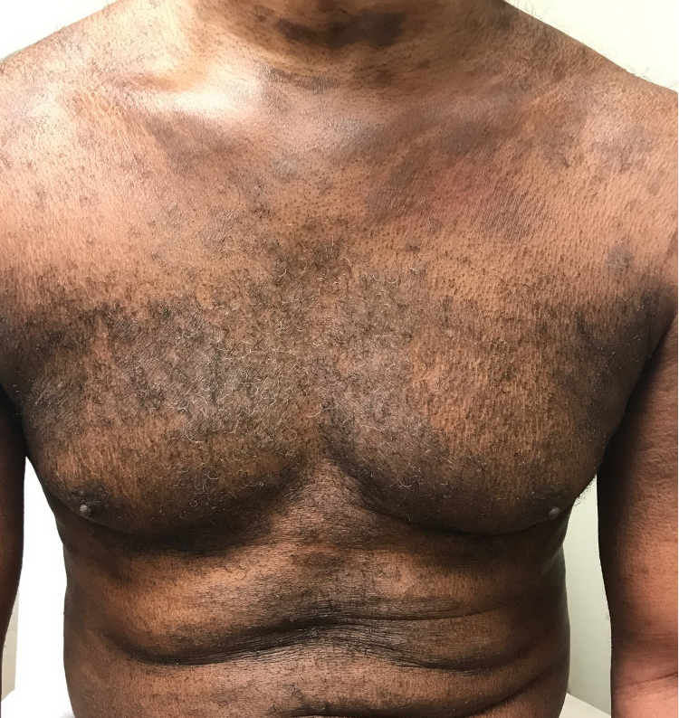
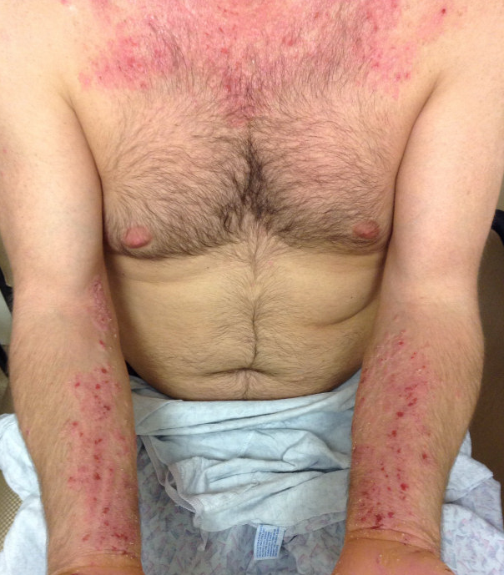
AD in Dark vs. Light Skin
Images courtesy of Dr. Chiesa Fuxench.
Notes:
Atopic Dermatitis in adult-showing neck, chest, abdomen and upper extremity involvement

Slide 34
Differential Diagnosis
INFANCY | CHILDHOOD | ADULTHOOD
Seborrheic dermatitis | Scabies | Seborrheic dermatitis
Scabies | Contact dermatitis | Contact dermatitis
Immunodeficiency syndromes: Wiskott-Aldrich syndrome Hyper-IgE syndrome Omenn syndrome Netherton syndrome | Tinea corporis | Scabies
 | Tinea versicolor | Insect bites
 | Seborrheic dermatitis | Photoallergic or photoirritant dermatitis
 | Psoriasis | HIV-related dermatitis
Langerhans cell histiocytosis | Pityriasis lichenoides/PLEVA/PR | Psoriasis
Acrodermatitis enteropathica | CTCL | CTCL
Metabolic disorders |  | Drug-induced dermatitis
CTCL = cutaneous T-cell lymphoma; PLEVA = pityriasis lichenoides et varioliformis acuta; PR = pityriasis rosea.
Simpson EL, et al. J Am Acad Dermatol. 2017;77:623-633.
Notes:
Wiskott-Aldrich Syndrome
Hyper-IgE syndrome
Omenn syndrome
Netherton syndrome

Slide 35
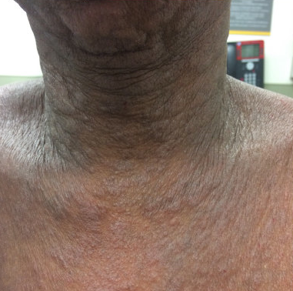
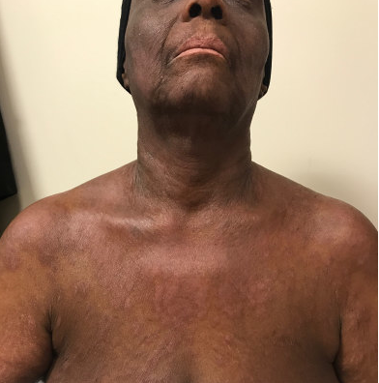
Differential Diagnosis: Contact Dermatitis
Notes:
Adult patient with contact dermatitis to facial products and underlying atopic dermatitis

Slide 36
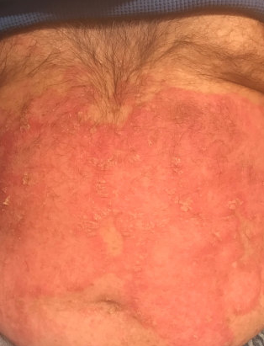
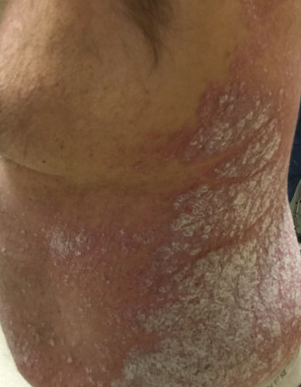
Differential Diagnosis: Psoriasis
Notes:
Psoriasis lesions in a adult patient. Lesions are characterized by more well-defined, erythematous, patches and plaques with an overlying, dry scale of silver color

Slide 37
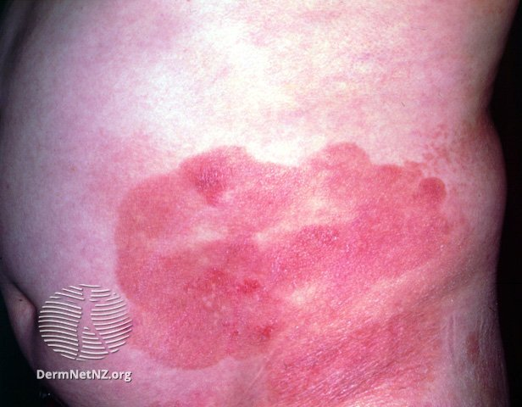
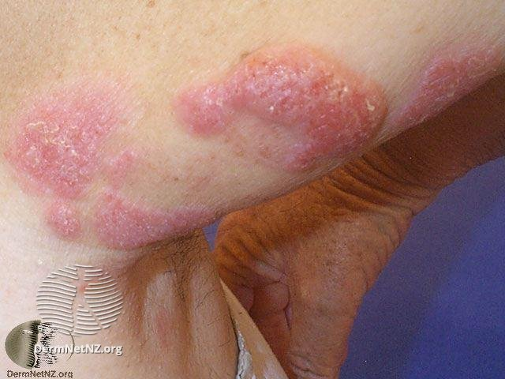
Differential Diagnosis: CTCL
https://creativecommons.org/licenses/by-nc-nd/3.0/nz/legalcode. No changes done to image from original source.
Notes:
Classic CTCL

Slide 38
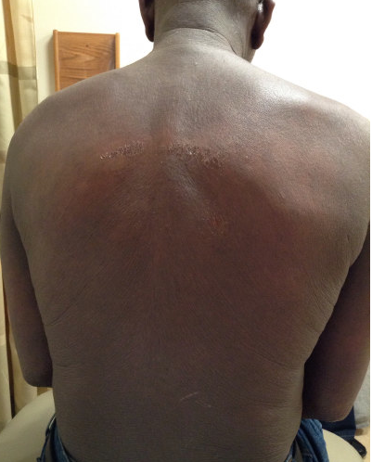
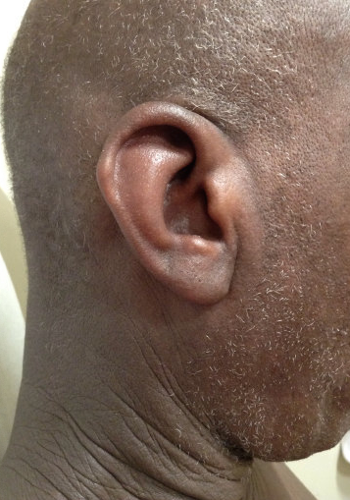
Differential Diagnosis: Exfoliative Erythroderma
Notes:
Exfoliative erythroderma
The differential diagnosis in this case includes Atopic Dermatitis, Psoriasis, CTCL

Slide 39
Learning
Objective
2
Incorporate the Patient Oriented Eczema Measure (POEM) assessment scale into clinical practice to monitor disease severity and response to treatment

Slide 40
Assessment of Disease Severity and Clinical Outcomes in AD
Measures of disease severity:
  SCORAD: SCORing Atopic Dermatitis Index
  EASI: Eczema Area and Severity Index
  IGA: Investigator’s Global Assessment
  SASSAD: Six Area, Six Sign Atopic Dermatitis severity score
  TISS: Three-Item Severity Scale
  POEM: Patient Oriented Eczema Measure
Measures of impact on quality of life (QoL):
  ~ 22 different scales for measuring QoL/psychological outcomes in AD
  Dermatology Life Quality Index
Symptom specific:
  Pruritus Numerical Rating Scale (NRS)
Eichenfield LF, et al. J Am Acad Dermatol. 2014;70:338-351.
Notes:
*SCORAD index, EASI and POEM: most rigorously tested and validated instruments
No single standard; more than 28 scales are reported in the literature.
Recent meeting to determine usefulness of both EASI and POEM (Patient Oriented Eczema Measure) as core outcome instruments for measuring clinician-reported signs of AD in clinical trials and patient-reported symptoms
Limitations
Primarily used in clinical trials
May be cumbersome to use in daily practice and therefore are not recommended according to the most recent AAD guidelines
HOME (Harmonizing Outcome Measures for Eczema):
International effort to develop core outcome set for AD to be used in all clinical trials

Slide 41
Assessment of Disease Severity and Clinical Outcomes in AD
AAD consensus guidelines for diagnosis of AD:¹
  Pragmatic approach for diagnosis in infants, children, and adults
  Well-suited for clinical practice
When practical, use scales to consider disease severity: SCORAD, EASI, POEM²
  POEM: measure severity from the patient perspective
1. Eichenfield LF, et al. J Am Acad Dermatol. 2014;70:338-351.
2. Rehal B, et al. PLoS one. 2011;6:e17520.
Notes:
*SCORAD index, EASI and POEM: most rigorously tested and validated instruments
No single standard; more than 28 scales are reported in the literature.
Recent meeting to determine usefulness of both EASI and POEM (Patient Oriented Eczema Measure) as core outcome instruments for measuring clinician-reported signs of AD in clinical trials and patient-reported symptoms
Limitations
Primarily used in clinical trials
May be cumbersome to use in daily practice and therefore are not recommended according to the most recent AAD guidelines
HOME (Harmonizing Outcome Measures for Eczema):
International effort to develop core outcome set for AD to be used in all clinical trials

Slide 42
Integrating POEM in Clinical Practice
Video will be shown here

Slide 43

Patient
Oriented
Eczema
Measure
(POEM)^{1,2}
Protected by copyright but is freely available and can be downloaded for use: https://www.nottingham.ac.uk/research/groups/cebd/resources/poem.aspx.
1. Charman CR, et al. Br J Dermatol. 2013;169(6):1326-1332. 2. Charman CR, et al. Arch Dermatol. 2004;140:1513-1519.
Notes:
*SCORAD index, EASI and POEM: most rigorously tested and validated instruments
No single standard; more than 28 scales are reported in the literature.
Recent meeting to determine usefulness of both EASI and POEM (Patient Oriented Eczema Measure) as core outcome instruments for measuring clinician-reported signs of AD in clinical trials and patient-reported symptoms
Limitations
Primarily used in clinical trials
May be cumbersome to use in daily practice and therefore are not recommended according to the most recent AAD guidelines
HOME (Harmonizing Outcome Measures for Eczema):
International effort to develop core outcome set for AD to be used in all clinical trials

Slide 44
Patient Oriented Eczema Measure (POEM)^{1,2}
Scoring POEM
(total score max = 28):
  No days = 0
  1-2 days = 1
  3-4 days = 2
  5-6 days = 3
  Every day = 4
What does a POEM
score mean?
  0-2 = Clear or almost clear
  3-7 = Mild eczema
  8-16 = Moderate eczema
  17-24 = Severe eczema
  25-28 = Very severe eczema
Protected by copyright but is freely available and can be downloaded for use: https://www.nottingham.ac.uk/research/groups/cebd/resources/poem.aspx.
1. Charman CR, et al. Br J Dermatol. 2013;169(6):1326-1332. 2. Charman CR, et al. Arch Dermatol. 2004;140:1513-1519.
Notes:
*SCORAD index, EASI and POEM: most rigorously tested and validated instruments
No single standard; more than 28 scales are reported in the literature.
Recent meeting to determine usefulness of both EASI and POEM (Patient Oriented Eczema Measure) as core outcome instruments for measuring clinician-reported signs of AD in clinical trials and patient-reported symptoms
Limitations
Primarily used in clinical trials
May be cumbersome to use in daily practice and therefore are not recommended according to the most recent AAD guidelines
HOME (Harmonizing Outcome Measures for Eczema):
International effort to develop core outcome set for AD to be used in all clinical trials

Slide 45
Considerations for Treatment
Establishment of an adequate diagnosis and extent of disease severity as well as assessment of the impact of AD on QoL will be critical in determining appropriate treatment plan for our patients.
Treat Acute Flares
Patient Preference
Long-Term
Plan
Goals:
Decrease the rate of acute flares or disease exacerbations
Maintain a state in which symptoms are mild with minimal to no impact on QoL
Notes:
Assessing the impact of AD will be critical in determining appropriate treatment plan for our patients.
Treat acute flares
Be planned with a long-term perspective
Consider patient preference and adherence to treatment
Goals for treatment:
Overall, “goal should be to achieve a state in which symptoms are absent or mild without causing disturbance in ADL and where drug therapy is not required”
Maintain a state in which symptoms are mild and to decrease the rate of “acute flares” or disease exacerbations

Slide 46
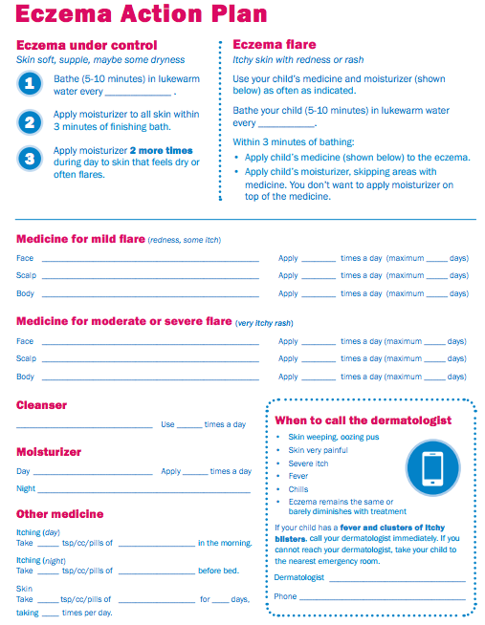
Education is KEY!¹⁻⁴
Engage the patient/ provide written instructions
Skin care IS treatment for atopic dermatitis
Understanding patient preference is critical
1. Bass AM, et al. J Clin Med. 2015;4:231-242. 2. Snyder A, et al. Cutis. 2015;96:397-401. 3. Ellis RM, et al. Pediatr Dermatol. 2011;28:242-244.
4. Smith SD, et al. Med J Aust. 2013;199:467-469.
Notes:
Lack of adherence can result:
worse clinical outcomes
lack of treatment efficacy
poor adherence may be misconstrued as a poor treatment response
Medication cost and side effects (“steroid-phobia”) are listed as most important reasons for non-adherence in certain populations
Poor compliance can also result from:
Time constraints
Unclear or difficult-to-follow instructions
Alternative health

Slide 47
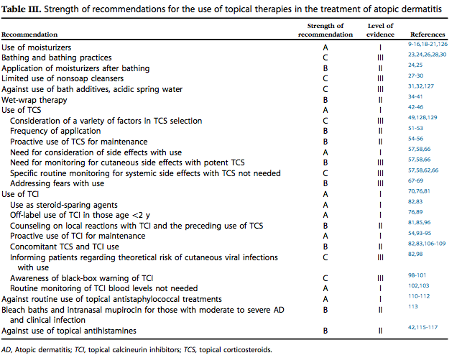
Strength of Recommendation for Use of Topical Therapies in the Treatment of AD
First line: topical moisturizers, topical corticosteroids ± prescription topicals,
as well as other non-pharmacologic interventions
Eichenfield LF, et al. J Am Acad Dermatol. 2014;71:116-132.
Notes:
*limited evidence to support their use
Most patients can be managed with topical moisturizers, topical corticosteroids, and other nonpharmacologic interventions

Slide 48
Role of Proactive Treatment¹⁻⁴
Reactive Approach
Relies on anti-inflammatory therapies administered to active lesions that are then discontinued once visible skin lesions are cleared
Proactive Approach
A combination of predefined, long-term, low-dose, anti-inflammatory treatments applied to previously affected areas of the skin on a regular schedule, in addition to emollients on the entire body
1. Wollenberg A, et al. J Eur Acad Dermatol Venereol. 2016;30:729-747. 2. Torrelo A, et al. Actas Dermosifiliogr. 2013;104:409-417. 3. Thaci D, et al. J Eur Acad Dermatol Venereol. 2010;24:1040-1046. 4. Sidbury R, et al. J Am Acad Dermatol. 2014;71:1218-1233.
Notes:
There has been a recent literature discussion on the use of a proactive treatment approach to AD to complement current reactive approach.
Goals: prevent new flares and achieve longer flare-free intervals
Benefits:
Reduced risk of developing flares, decreased number of flares
Lengthened time-to-flare
Decrease use of TCS
Tacrolimus and mid-potency TCS (eg, fluticasone propionate) are considered adequate/good candidates for proactive treatment.
Prior studies have demonstrated clinical and cost-effectiveness of this approach in AD; however, no head-to-head comparisons between currently available treatments (TCI versus TCS) have been done.

Slide 49
Systemic Agents in AD (Off-label)
 | CsA | AZA | MTX | MPA
Starting dose in adults | 5 mg/kg/day | 50 mg/day | 5 mg/week | MMF 1,000-2,000 mg/day (EC-MPS 1,440 mg/day)
Maintenance dose in adults | 2.5-3 mg/kg/day | 2-3 mg/kg/day* | Increase to max 25 mg/week | MMF 2,000 mg/day† (EC-MPS 1,440 mg/day)
Starting dose in children | 5 mg/kg/day | 50 mg/day | 10-15 mg/m²/week | MMF 20-50 mg/kg/day
Maintenance dose in children | 2.5-3 mg/kg/day | 2-3 mg/kg/day* | Increase by 2.5-5 mg/week to effective dose, taper by 2.5 mg/week to lowest effective dose | MMF increase daily total dose by 500 mg increments every 2-4 weeks
*Non-FDA approved
AZA = azathioprine; CsA = cyclosporine A; EC-MPS = enteric-coated mycophenolic sodium; MMF = mycophenolate mofetil; MPA = mycophenolic acid; MTX = methotrexate. *TPMT heterozygote 1-1.5 mg/kg/day. †Children 30-50 mg/kg/day. Wollenberg A, et al. J Eur Acad Dermatol Venereol. 2016;30:729-747.

Slide 50
Systemic Agents in AD (Off-label) cont.
 | CsA | AZA | MTX | MPA
Decrease in clinical score (%) | 54-95 | 26-39 | 42-52 | 55-68
Treatment period in trials (wks) | Max 52 | Max 24 | Max 24 | Max 30
Time to respond (wks) | 2 | 8-12 | 8-12 | 8-12
Time to relapse (wks) | < 2 | > 12 | > 12 | > 12
Most important side effects | Serum creatinine ↑ Blood pressure ↑ | Hematological Liver enzymes ↑ Gastrointestinal | Hematological Liver enzymes ↑ Gastrointestinal | Hematological Skin infections Gastrointestinal
Pregnancy | Possible | Conflicting data, possible with strict indication | Teratogenic, absolutely contraindicated | Conflicting data, better not to use
Fathering | Possible | Little information, possible with strict indication | Little information, conflicting data, contraindicated | Little information, better not to use
Wollenberg A, et al. J Eur Acad Dermatol Venereol. 2016;30:729-747.
*Non-FDA approved

Slide 51
New Therapeutic Targets: Dupilumab
First FDA-approved systemic therapy for adult patients with moderate-to-severe atopic dermatitis
***
***
DUP^{b} + TCS
(n = 106)
DUP^{b} + TCS
(n = 89)
Similar results observed when used as monotherapy at 16 weeks²
Week 16
Week 52
IGA = Investigator’s Global Assessment; TCS = topical corticosteroids. ªScore of 0 or 1 and ≥2-pt improvement from baseline. ^{b}300 mg q2w (approved dose). ***p < .0001 vs. placebo.
1. Blauvelt A, et al. Lancet. 2017;389:2287-2303. 2. Simpson E, et al. N Engl J Med. 2016;375:2335-2348.
Notes:
Background Dupilumab (an anti-interleukin-4-receptor-α monoclonal antibody) blocks signaling of interleukin 4 and interleukin 13, type 2/Th2 cytokines implicated in numerous allergic diseases ranging from asthma to atopic dermatitis. Previous 16-week monotherapy studies showed that dupilumab substantially improved signs and symptoms of moderate-to-severe atopic dermatitis with acceptable safety, validating the crucial role of interleukin 4 and interleukin 13 in atopic dermatitis pathogenesis. We aimed to evaluate the long-term efficacy and safety of dupilumab with medium-potency topical corticosteroids versus placebo with topical corticosteroids in adults with moderate-to-severe atopic dermatitis.
Methods In this 1-year, randomised, double-blinded, placebo-controlled, phase 3 study (LIBERTY AD CHRONOS), adults with moderate-to-severe atopic dermatitis and inadequate response to topical corticosteroids were enrolled at 161 hospitals, clinics, and academic institutions in 14 countries in Europe, Asia-Pacific, and North America. Patients were randomly assigned (3:1:3) to subcutaneous dupilumab 300 mg once weekly (qw), dupilumab 300 mg every 2 weeks (q2w), or placebo via a central interactive voice/web response system, stratified by severity and global region. All three groups were given concomitant topical corticosteroids with or without topical calcineurin inhibitors where inadvisable for topical corticosteroids. Topical corticosteroids could be tapered, stopped, or restarted on the basis of disease activity. Coprimary endpoints were patients (%) achieving Investigator’s Global Assessment (IGA) 0/1 and 2-point or higher improvement from baseline, and Eczema Area and Severity Index 75% improvement from baseline (EASI-75) at week 16. Week 16 efficacy and week 52 safety analyses included all randomised patients; week 52 efficacy included patients who completed treatment by US regulatory submission cutoff. This study is registered with ClinicalTrials.gov, NCT02260986.
Findings Between Oct 3, 2014, and July 31, 2015, 740 patients were enrolled: 319 were randomly assigned to dupilumab qw plus topical corticosteroids, 106 to dupilumab q2w plus topical corticosteroids, and 315 to placebo plus topical corticosteroids. 623 (270, 89, and 264, respectively) were evaluable for week 52 efficacy. At week 16, more patients who received dupilumab plus topical corticosteroids achieved the coprimary endpoints of IGA 0/1 (39% [125 patients] who received dupilumab plus topical corticosteroids qw and 39% [41 patients] who received dupilumab q2w plus topical corticosteroids vs 12% [39 patients] who received placebo plus topical corticosteroids; p<0·0001) and EASI-75 (64% [204] and 69% [73] vs 23% [73]; p<0·0001). Week 52 results were similar. Adverse events were reported in 261 (83%) patients who received dupilumab qw plus topical corticosteroids, 97 (88%) patients who received dupilumab q2w, and 266 (84%) patients who received placebo, and serious adverse events in nine (3%), four (4%), and 16 (5%) patients, respectively. No significant dupilumab-induced laboratory abnormalities were noted. Injection-site reactions and conjunctivitis were more common in patients treated with dupilumab plus topical corticosteroids-treated patients than in patients treated with placebo plus topical corticosteroids.
Interpretation Dupilumab added to standard topical corticosteroid treatment for 1 year improved atopic dermatitis signs and symptoms, with acceptable safety.

Slide 52
Dupilumab + TCS: Impact on EASI-75
Placebo qw + TCS
Dupilumab 300 mg qw + TCS
Dupilumab 300 mg q2w (approved dose) + TCS
Patients with
EASI-75 (%)
‡p < .0001 vs. PBO + TCS (FAS). §p < .0001 vs. PBO + TCS (FAS-52).
Blauvelt A, et al. Lancet. 2017;389:2287-2303.
Notes:
Background Dupilumab (an anti-interleukin-4-receptor-α monoclonal antibody) blocks signaling of interleukin 4 and interleukin 13, type 2/Th2 cytokines implicated in numerous allergic diseases ranging from asthma to atopic dermatitis. Previous 16-week monotherapy studies showed that dupilumab substantially improved signs and symptoms of moderate-to-severe atopic dermatitis with acceptable safety, validating the crucial role of interleukin 4 and interleukin 13 in atopic dermatitis pathogenesis. We aimed to evaluate the long-term efficacy and safety of dupilumab with medium-potency topical corticosteroids versus placebo with topical corticosteroids in adults with moderate-to-severe atopic dermatitis.
Methods In this 1-year, randomised, double-blinded, placebo-controlled, phase 3 study (LIBERTY AD CHRONOS), adults with moderate-to-severe atopic dermatitis and inadequate response to topical corticosteroids were enrolled at 161 hospitals, clinics, and academic institutions in 14 countries in Europe, Asia-Pacific, and North America. Patients were randomly assigned (3:1:3) to subcutaneous dupilumab 300 mg once weekly (qw), dupilumab 300 mg every 2 weeks (q2w), or placebo via a central interactive voice/web response system, stratified by severity and global region. All three groups were given concomitant topical corticosteroids with or without topical calcineurin inhibitors where inadvisable for topical corticosteroids. Topical corticosteroids could be tapered, stopped, or restarted on the basis of disease activity. Coprimary endpoints were patients (%) achieving Investigator’s Global Assessment (IGA) 0/1 and 2-point or higher improvement from baseline, and Eczema Area and Severity Index 75% improvement from baseline (EASI-75) at week 16. Week 16 efficacy and week 52 safety analyses included all randomised patients; week 52 efficacy included patients who completed treatment by US regulatory submission cutoff. This study is registered with ClinicalTrials.gov, NCT02260986.
Findings Between Oct 3, 2014, and July 31, 2015, 740 patients were enrolled: 319 were randomly assigned to dupilumab qw plus topical corticosteroids, 106 to dupilumab q2w plus topical corticosteroids, and 315 to placebo plus topical corticosteroids. 623 (270, 89, and 264, respectively) were evaluable for week 52 efficacy. At week 16, more patients who received dupilumab plus topical corticosteroids achieved the coprimary endpoints of IGA 0/1 (39% [125 patients] who received dupilumab plus topical corticosteroids qw and 39% [41 patients] who received dupilumab q2w plus topical corticosteroids vs 12% [39 patients] who received placebo plus topical corticosteroids; p<0·0001) and EASI-75 (64% [204] and 69% [73] vs 23% [73]; p<0·0001). Week 52 results were similar. Adverse events were reported in 261 (83%) patients who received dupilumab qw plus topical corticosteroids, 97 (88%) patients who received dupilumab q2w, and 266 (84%) patients who received placebo, and serious adverse events in nine (3%), four (4%), and 16 (5%) patients, respectively. No significant dupilumab-induced laboratory abnormalities were noted. Injection-site reactions and conjunctivitis were more common in patients treated with dupilumab plus topical corticosteroids-treated patients than in patients treated with placebo plus topical corticosteroids.
Interpretation Dupilumab added to standard topical corticosteroid treatment for 1 year improved atopic dermatitis signs and symptoms, with acceptable safety.

Slide 53
Dupilumab + TCS Improves Pruritus
Placebo qw + TCS (n = 264)
Dupilumab 300 mg qw + TCS (n = 270)
Dupilumab 300 mg q2w (approved dose) + TCS (n = 89)
Patients with ≥ 4-point improvement from
baseline in peak pruritus scores (%)
Study week
*p < .0001, DUP q2w + TCS vs. PBO + TCS. §p = .0062, DUP q2w + TCS vs. PBO + TCS. ¶p < .0001, DUP q2w + TCS and DUP qw + TCS vs. PBO + TCS. ||p=.0021, DUP qw + TCS vs. PBO + TCS. **p < .0001, DUP q2w + TCS vs. PBO + TCS and DUP qw + TCS vs. PBO + TCS. Blauvelt A, et al. Lancet. 2017;389:2287-2303.
Notes:
Background Dupilumab (an anti-interleukin-4-receptor-α monoclonal antibody) blocks signaling of interleukin 4 and interleukin 13, type 2/Th2 cytokines implicated in numerous allergic diseases ranging from asthma to atopic dermatitis. Previous 16-week monotherapy studies showed that dupilumab substantially improved signs and symptoms of moderate-to-severe atopic dermatitis with acceptable safety, validating the crucial role of interleukin 4 and interleukin 13 in atopic dermatitis pathogenesis. We aimed to evaluate the long-term efficacy and safety of dupilumab with medium-potency topical corticosteroids versus placebo with topical corticosteroids in adults with moderate-to-severe atopic dermatitis.
Methods In this 1-year, randomised, double-blinded, placebo-controlled, phase 3 study (LIBERTY AD CHRONOS), adults with moderate-to-severe atopic dermatitis and inadequate response to topical corticosteroids were enrolled at 161 hospitals, clinics, and academic institutions in 14 countries in Europe, Asia-Pacific, and North America. Patients were randomly assigned (3:1:3) to subcutaneous dupilumab 300 mg once weekly (qw), dupilumab 300 mg every 2 weeks (q2w), or placebo via a central interactive voice/web response system, stratified by severity and global region. All three groups were given concomitant topical corticosteroids with or without topical calcineurin inhibitors where inadvisable for topical corticosteroids. Topical corticosteroids could be tapered, stopped, or restarted on the basis of disease activity. Coprimary endpoints were patients (%) achieving Investigator’s Global Assessment (IGA) 0/1 and 2-point or higher improvement from baseline, and Eczema Area and Severity Index 75% improvement from baseline (EASI-75) at week 16. Week 16 efficacy and week 52 safety analyses included all randomised patients; week 52 efficacy included patients who completed treatment by US regulatory submission cutoff. This study is registered with ClinicalTrials.gov, NCT02260986.
Findings Between Oct 3, 2014, and July 31, 2015, 740 patients were enrolled: 319 were randomly assigned to dupilumab qw plus topical corticosteroids, 106 to dupilumab q2w plus topical corticosteroids, and 315 to placebo plus topical corticosteroids. 623 (270, 89, and 264, respectively) were evaluable for week 52 efficacy. At week 16, more patients who received dupilumab plus topical corticosteroids achieved the coprimary endpoints of IGA 0/1 (39% [125 patients] who received dupilumab plus topical corticosteroids qw and 39% [41 patients] who received dupilumab q2w plus topical corticosteroids vs 12% [39 patients] who received placebo plus topical corticosteroids; p<0·0001) and EASI-75 (64% [204] and 69% [73] vs 23% [73]; p<0·0001). Week 52 results were similar. Adverse events were reported in 261 (83%) patients who received dupilumab qw plus topical corticosteroids, 97 (88%) patients who received dupilumab q2w, and 266 (84%) patients who received placebo, and serious adverse events in nine (3%), four (4%), and 16 (5%) patients, respectively. No significant dupilumab-induced laboratory abnormalities were noted. Injection-site reactions and conjunctivitis were more common in patients treated with dupilumab plus topical corticosteroids-treated patients than in patients treated with placebo plus topical corticosteroids.
Interpretation Dupilumab added to standard topical corticosteroid treatment for 1 year improved atopic dermatitis signs and symptoms, with acceptable safety.

Slide 54
Dupilumab + TCS Improves POEM Scores
***
***
DUP^{b} + TCS
(n = 106)
DUP^{b} + TCS
(n = 89)
Week 16
Week 52
ªMCID. ^{b}300 mg q2w (approved dose). ***p < .0001 vs. placebo.
Blauvelt A, et al. Lancet. 2017;389:2287-2303.
Notes:
Background Dupilumab (an anti-interleukin-4-receptor-α monoclonal antibody) blocks signaling of interleukin 4 and interleukin 13, type 2/Th2 cytokines implicated in numerous allergic diseases ranging from asthma to atopic dermatitis. Previous 16-week monotherapy studies showed that dupilumab substantially improved signs and symptoms of moderate-to-severe atopic dermatitis with acceptable safety, validating the crucial role of interleukin 4 and interleukin 13 in atopic dermatitis pathogenesis. We aimed to evaluate the long-term efficacy and safety of dupilumab with medium-potency topical corticosteroids versus placebo with topical corticosteroids in adults with moderate-to-severe atopic dermatitis.
Methods In this 1-year, randomised, double-blinded, placebo-controlled, phase 3 study (LIBERTY AD CHRONOS), adults with moderate-to-severe atopic dermatitis and inadequate response to topical corticosteroids were enrolled at 161 hospitals, clinics, and academic institutions in 14 countries in Europe, Asia-Pacific, and North America. Patients were randomly assigned (3:1:3) to subcutaneous dupilumab 300 mg once weekly (qw), dupilumab 300 mg every 2 weeks (q2w), or placebo via a central interactive voice/web response system, stratified by severity and global region. All three groups were given concomitant topical corticosteroids with or without topical calcineurin inhibitors where inadvisable for topical corticosteroids. Topical corticosteroids could be tapered, stopped, or restarted on the basis of disease activity. Coprimary endpoints were patients (%) achieving Investigator’s Global Assessment (IGA) 0/1 and 2-point or higher improvement from baseline, and Eczema Area and Severity Index 75% improvement from baseline (EASI-75) at week 16. Week 16 efficacy and week 52 safety analyses included all randomised patients; week 52 efficacy included patients who completed treatment by US regulatory submission cutoff. This study is registered with ClinicalTrials.gov, NCT02260986.
Findings Between Oct 3, 2014, and July 31, 2015, 740 patients were enrolled: 319 were randomly assigned to dupilumab qw plus topical corticosteroids, 106 to dupilumab q2w plus topical corticosteroids, and 315 to placebo plus topical corticosteroids. 623 (270, 89, and 264, respectively) were evaluable for week 52 efficacy. At week 16, more patients who received dupilumab plus topical corticosteroids achieved the coprimary endpoints of IGA 0/1 (39% [125 patients] who received dupilumab plus topical corticosteroids qw and 39% [41 patients] who received dupilumab q2w plus topical corticosteroids vs 12% [39 patients] who received placebo plus topical corticosteroids; p<0·0001) and EASI-75 (64% [204] and 69% [73] vs 23% [73]; p<0·0001). Week 52 results were similar. Adverse events were reported in 261 (83%) patients who received dupilumab qw plus topical corticosteroids, 97 (88%) patients who received dupilumab q2w, and 266 (84%) patients who received placebo, and serious adverse events in nine (3%), four (4%), and 16 (5%) patients, respectively. No significant dupilumab-induced laboratory abnormalities were noted. Injection-site reactions and conjunctivitis were more common in patients treated with dupilumab plus topical corticosteroids-treated patients than in patients treated with placebo plus topical corticosteroids.
Interpretation Dupilumab added to standard topical corticosteroid treatment for 1 year improved atopic dermatitis signs and symptoms, with acceptable safety.

Slide 55
Dupilumab + TCS Improves POEM Scores in Patients With Inadequate Response or Intolerance to Cyclosporine
Placebo qw + TCS
Dupilumab 300 mg qw + TCS
Dupilumab 300 mg q2w + TCS
 | PBO + TCS (n = 108) | DUP qw + TCS (n = 110) | DUP q2w + TCS (n = 107)
POEM LS mean change from baseline at week 16 ± SE | -4.3 ± .62 | -11.4 ± .59*** | -11.9 ± .60***
Patients with ≥ 4-point improvement
in POEM from baseline (%)
Baseline POEM ± SD
- PBO + TCS: 19.1 ± 5.99
- DUP 300 mg qw + TCS: 18.6 ± 6.97
- DUP 300 mg q2w + TCS: 19.3 ± 6.21
Patients with 4-point improvement in POEM from baseline (%):
> 70% of patients by week 4 achieve this improvement
***p < .001 vs. PBO + TCS. de Bruin-Weller M, et al. Br J Dermatol. 2018;178(5):1083-1101.
Notes:
Background Atopic dermatitis is a chronic inflammatory skin disease that may require
systemic therapy. Ciclosporin A (CsA) is a widely used, potent immunosuppressant
but it is not effective in all patients with atopic dermatitis, and side-effects limit its
use. Dupilumab, a fully human anti-interleukin 4 receptor-alpha monoclonal antibody,
inhibits signaling of IL-4 and IL-13, key drivers of Type 2/Th2-mediated
inflammation, and is approved in the U.S.A. and the European Union for the treatment
of inadequately-controlled moderate-to-severe atopic dermatitis in adults.
Objectives To evaluate efficacy and safety of dupilumab with concomitant topical
corticosteroids (TCS) in adults with atopic dermatitis with inadequate response
to/intolerance of CsA, or for whom CsA treatment was medically inadvisable.
Methods In this 16-week, double-blind, randomized, placebo-controlled, phase III
trial, patients were randomized 1 : 1 : 1 to subcutaneous dupilumab 300 mg
weekly (qw) or every 2 weeks (q2w) or placebo. All received concomitant medium-
potency TCS from Week 2 through Week 16; dosage could be tapered if
lesions cleared, or stopped for adverse reactions to TCS.
Results In total, 390 patients were screened, 325 were randomized, and 318 completed
the trial. Treatment groups had similar baseline characteristics. Significantly
more patients in the dupilumab qw + TCS and q2w + TCS groups achieved ≥ 75%
improvement from baseline in the Eczema Area and Severity Index at Week 16 vs.
the placebo + TCS group (primary end point) (591% and 626% vs. 296%,
respectively; P < 0001 vs. placebo + TCS, both doses). Other clinical outcomes
and atopic dermatitis symptoms were significantly improved in the dupilumab qw + TCS and q2w + TCS groups, including pruritus, pain, sleep disturbance, symptoms
of anxiety and depression, and quality of life (QoL). Treatment groups had
similar overall rates of adverse events (qw + TCS, q2w + TCS and placebo + TCS
groups: 691%, 720% and 694%, respectively) and serious adverse events (18%,
19% and 19%, respectively). Conjunctivitis was more frequent with
dupilumab + TCS; skin infections were more frequent with placebo + TCS.
Conclusions Dupilumab + TCS significantly improved signs and symptoms of atopic
dermatitis and QoL in adults with a history of inadequate response to/intolerance
of CsA, or for whom CsA treatment was medically inadvisable. No new safety
signals were identified.

Slide 56
New Therapeutic Targets: Crisaborole
Topical PDE4 inhibitor approved for treatment of mild-to-moderate atopic dermatitis in patients age ≥2
*
**
Crisaborole
(n = 503)
Crisaborole
(n = 513)
AD-301
AD-302
ISGA = Investigator’s Static Global Assessment.
ªScore of 0 or 1 with ≥ 2-grade improvement. *p < .038 vs. vehicle. **p < .001 vs. vehicle.
Paller A, et al. J Am Acad Dermatol. 2016;75:494-503.
Notes:
Background: Additional topical treatments for atopic dermatitis (AD) are needed that provide relief while
minimizing risks.
Objective: We sought to assess the efficacy and safety of crisaborole ointment, a phosphodiesterase 4
inhibitor, in two phase III AD studies (AD-301: NCT02118766; AD-302: NCT02118792).
Methods: Two identically designed, vehicle-controlled, double-blind studies enrolled and randomly
assigned (2:1, crisaborole:vehicle) patients aged 2 years or older with an Investigator’s Static Global
Assessment (ISGA) score of mild or moderate for twice-daily application for 28 days. The primary end point
was ISGA score at day 29 of clear (0)/almost clear (1) with 2-grade or greater improvement from baseline.
Additional analyses included time to success in ISGA score, percentage of patients achieving clear/almost
clear, reduction in severity of AD signs, and time to improvement in pruritus.

Slide 57
Crisaborole Effects on ISGA:
Pooled Data From AD-301 and AD-302
Crisaborole
(n = 1,016)
Vehicle
(n = 506)
Patients with success in ISGA (%)
Days after dosing
Paller A, et al. J Am Acad Dermatol. 2016;75:494-503.
Notes:
Background: Additional topical treatments for atopic dermatitis (AD) are needed that provide relief while
minimizing risks.
Objective: We sought to assess the efficacy and safety of crisaborole ointment, a phosphodiesterase 4
inhibitor, in two phase III AD studies (AD-301: NCT02118766; AD-302: NCT02118792).
Methods: Two identically designed, vehicle-controlled, double-blind studies enrolled and randomly
assigned (2:1, crisaborole:vehicle) patients aged 2 years or older with an Investigator’s Static Global
Assessment (ISGA) score of mild or moderate for twice-daily application for 28 days. The primary end point
was ISGA score at day 29 of clear (0)/almost clear (1) with 2-grade or greater improvement from baseline.
Additional analyses included time to success in ISGA score, percentage of patients achieving clear/almost
clear, reduction in severity of AD signs, and time to improvement in pruritus.

Slide 58
Crisaborole Effects on Pruritus:
Pooled Data From AD-301 and AD-302
Proportion of patients achieving improvement in pruritus
(score of 0 or 1 with ≥ 1-grade reduction from baseline) (%)
Crisaborole
Vehicle
Paller A, et al. J Am Acad Dermatol. 2016;75:494-503.
Notes:
Background: Additional topical treatments for atopic dermatitis (AD) are needed that provide relief while
minimizing risks.
Objective: We sought to assess the efficacy and safety of crisaborole ointment, a phosphodiesterase 4
inhibitor, in two phase III AD studies (AD-301: NCT02118766; AD-302: NCT02118792).
Methods: Two identically designed, vehicle-controlled, double-blind studies enrolled and randomly
assigned (2:1, crisaborole:vehicle) patients aged 2 years or older with an Investigator’s Static Global
Assessment (ISGA) score of mild or moderate for twice-daily application for 28 days. The primary end point
was ISGA score at day 29 of clear (0)/almost clear (1) with 2-grade or greater improvement from baseline.
Additional analyses included time to success in ISGA score, percentage of patients achieving clear/almost
clear, reduction in severity of AD signs, and time to improvement in pruritus.

Slide 59
Crisaborole: Impact on QoL
Vehicle
9.3
(n = 82)
Crisaborole 2%
9.7
(n = 180)
Baseline Score
Overall DLQI (age ≥ 16)
mean change from baseline
Minimal Clinically Important Difference (MCID) (≥ 3.3-point reduction from baseline)
p = .015
Simpson EL, et al. Dermatol Ther (Heidelb). 2018 Oct 22. [Epub ahead of print].
Notes:
Introduction: The impact of crisaborole ointment,
a nonsteroidal phosphodiesterase 4 inhibitor
for the treatment of mild to moderate atopic
dermatitis (AD), on quality of life (QoL) was
assessed in two identically designed phase 3 studies
(AD-301:NCT02118766; AD-302: NCT02118792,
both at http://www.clinicaltrials.gov).
Methods: In both studies, patients aged
C 2 years with mild to moderate AD per the
Investigator’s Static Global Assessment were
randomly assigned 2:1 to receive crisaborole or
vehicle twice daily for 28 days. QoL was assessed
using the Children’s Dermatology Life Quality
Index (CDLQI) (2–15 years), the Dermatology
Life Quality Index (DLQI) (C 16 years), and the
Dermatitis Family Impact Questionnaire (DFI)
(parents/caregivers/family of patients aged 2–17 years). Established QoL score severity
bands provided clinical context.
Results: Greater mean improvement in QoL
was observed in crisaborole-treated patients
than in vehicle-treated patients at day 29 [mean
change from baseline (DBL), CDLQI: - 4.6 vs.
- 3.0; P\ 0.001; DLQI: - 5.2 vs. - 3.5;
P = 0.015]. At baseline, more than half the
patients had a ‘‘moderate effect’’ or higher of AD
on QoL. At day 29, there was a trend toward
more crisaborole- than vehicle-treated patients
having ‘‘small effect’’ to ‘‘no effect’’, The QoL of
parents/caregivers/family improved more for
crisaborole-treated than for vehicle-treated
patients (DBL, DFI: - 3.7 vs. - 2.7; P = 0.003).
Conclusion: Crisaborole treatment results in
clinically meaningful improvement in QoL for
patients and their parents/caregivers/families.
Trial Registration: AD-301: http://www.clini
caltrials.gov, NCT02118766; AD-302: http://www.
clinicaltrials.gov, NCT02118792.

Slide 60
Impact of New Treatment Options
Video will be shown here

Slide 61
Case Presentation: JC
JC is a 36 y/o man with an itchy, red rash
Duration: Has had intermittent symptoms throughout his entire life and feels that they have been getting progressively worse in recent years
Location: Rash is primarily located on the neck, arms, legs, and back
Symptoms: Extremely itchy, feels as if he cannot stop scratching, results in waking up from sleep almost every night.
Impact on lifestyle and career choices

Slide 62
Medical History
Medical History
No history of cancer or serious infection
No known allergies to foods or other medications
Non-smoker, alcohol intake (4-5 drinks/week)
ROS: Denied any constitutional symptoms, negative in detail
Physical Examination
Presence of multiple, somewhat ill-defined, erythematous patches and plaques with evidence of lichenification and excoriation on the scalp, trunk, arms, and legs

Slide 63
Case Presentation: Assessment of JC’s Disease Severity
EASI Score: 25
IGA: 4
SCORAD: 30
Pruritus NRS: > 4
POEM: 20

Slide 64
Audience Response
How would you classify JC’s AD?
Mild
Moderate
Severe
Very severe
Not sure

Slide 65
Case Presentation:
JC’s Current Treatments
Multiple topical corticosteroids, oral/IM steroid injections
Oral antihistamines
Bathes daily, uses a mild soap and white petrolatum as an emollient

Slide 66
Audience Response
What would be your next step in the management of JC?
Add crisaborole
Add cyclosporine
Add dupilumab
Continue the current treatment for 4 more weeks and then re-assess
Not sure

Slide 67
Does the patient have moderate-to-severe atopic dermatitis?
Defined by lesional severity and extent and/or significant impact on quality of life (including social, emotional, and school/professional functioning)
Has adequate patient education been provided, including the following?
Discuss avoidance of irritants and known triggers
Stress importance of adherence
Optimize topical therapy (under and over treatment)
Address topical steroid phobia
Consider structured educational intervention (eczema school)
Has intensive topical therapy been given in an adequate trial?
Appropriate amounts of medium-to-high potency topical anti-inflammatory therapy for 1-4 weeks followed by proactive therapy for maintenance. Consider wet wrap therapy and soak and seal.
Have alternative diagnoses been considered?
Have infections been managed?
  Bacterial
  Viral
  Yeast
Has patch testing for contact allergy been considered?
Is referral to allergy services required for further testing and optimization of allergic rhinitis/asthma management?
Does the patient still have persistent moderate-to-severe disease/impaired quality of life despite topical therapy?
Consider phototherapy in selected patient groups
Systemic therapy
Choice depends on childbearing capacity, comorbidities (i.e., renal dysfunction, diabetes, alcohol abuse), age, and preferences (e.g., injection vs. tablets)
Is phototherapy unsuccessful / unsuitable / unavailable?
Simpson EL, et al. J Am Acad Dermatol. 2017;77(4):623-633.

Slide 68
AD Referrals
From Primary Care
AS was estimated to affect 12.5% of children (age 0-17) in the United States in 2009-2011, an increase of just over 5% since 1997-1999.^{1,2}
Among these patients, the vast majority (∼67%) are reported to have mild disease and as such may be adequately managed by their pediatrician or other primary care physician (PCP).^{2,3}
However, the majority of pediatricians refer even their mild patients to dermatologists (∼85%) and provide only initial, limited care (81%).^{2,4}
1. Jackson KD, et al. NCHS Data Brief. 2013;May(121):1-8. 2. Eichenfield L, et al. Pediatrics. 2015;136(3):554-565.
3. Silverberg JI, et al. Pediatr Allergy Immunol. 2013;24(5):476-486. 4. Saavedra JM, et al. J Pediatr. 2013;163(6):1747-1753.

Slide 69
AD in Primary Care
UK study of AD management in NHS
  Issues with AD diagnosis not meeting national guideline to confirm diagnosis
  Large discrepancies in the severity ratings of patients
  Only 56% of the patients were using emollients
  No correlation between severity of disease and potency of topical corticosteroids
Jacquet L, et al. BJGP Open. 2017;1(2):BJGP-2017-00821.

Slide 70
Case Presentation:
Next Steps for JC
Due to cost and time constraints, phototherapy was not an option
JC was a candidate for systemic therapy based on disease severity and inadequate response to topical steroids
Dupilumab was added based on risk-benefit analysis
Other off-label systemic therapies were options, but they are associated with side effects and contraindications

Slide 71
Learning
Objective
3
Document the utilization of clinical assessment tools and results from their use in patients’ charts

Slide 72
Audience Response
How often do you document results of the POEM assessment when managing patients with AD?
Never
Sometimes
Frequently
Always

Slide 73
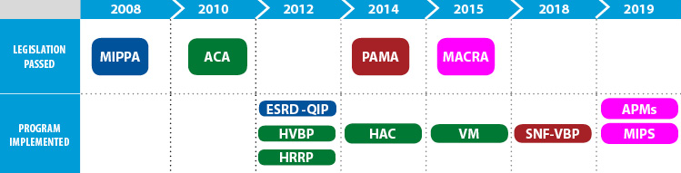
Value-Based Health Care
Programs designed to reward health care providers with incentive payments for the quality of care provided¹
“Value” is derived from measuring health outcomes against the cost of delivering these outcomes²
Value-Based Programs¹
1. CMS. 2018. https://www.cms.gov/Medicare/Quality-Initiatives-Patient-Assessment-Instruments/Value-Based-Programs/Value-Based-Programs.html. 2. NEJM Catalyst. 2017. https://catalyst.nejm.org/what-is-value-based-healthcare/.
Notes:
Goal: improving patient outcomes at lower cost

Slide 74
Value-Based Health Care¹⁻³
Triple Aim:
  Enhancing patient
  experience
  Improving
  population health
  Reducing cost
Quadruple Aim:
  Enhancing patient experience
  Improving population health
  Reducing cost
  Improving work-life of health care providers
Chronic Illnesses: difficult to treat and represent a major cost in
the U.S. health care system
Emerging treatment options are expensive
1. Bodenheimer T, et al. Ann Fam Med. 2014;1573-576. 2. Block J. Value in Health. 2018;21:380-385.
3. https://catalyst.nejm.org/what-is-value-based-healthcare/.
Notes:
Goal: improving patient outcomes at lower cost

Slide 75
Cost-Effectiveness of Biologics for AD
Importance of demonstrating value of health care interventions
Chronic disease
Challenging to treat
High impact on QoL
Benefits of long-term disease control
Improvements on QoL
Kuznik A, et al. Dermatol Ther (Heidelb). 2017;7:493-505.
Notes:
Atopic Dermatitis is a chronic disease, challenging to treat and often results in significant impairments in patient’s quality of life
Benefits of long-term disease control and improvements in QoL need to be considered

Slide 76
Cost-Effectiveness of Biologics for AD
Biologics for AD: high price tag (~$37,000/year)¹
Dupilumab was cost-effective for the treatment of moderate-to-severe AD with a better cost-effectiveness ratio for patients with more severe disease compared to those with moderate disease.^{1,2}
Shown to be an intervention of high value as compared to secukinumab for psoriasis³
  Related to drug efficacy, cost of the intervention, unmet need, and PROs
1. Kuznik A, et al. Dermatol Ther. 2017;7:493-505.
2. Zimmerman M, et al. J Drugs Dermatol. 2018;17:750-756.
3. Zozaya N, et al. BioDrugs. 2018;32:281-291.
Notes:
Atopic Dermatitis is a chronic disease, challenging to treat and often results in significant impairments in patient’s quality of life
Benefits of long-term disease control and improvements in QoL need to be considered

Slide 77
SMART Goals
Specific, Measurable, Attainable, Relevant, Timely
Atopic dermatitis is a chronic disease, challenging to treat, and often results in significant impairments in patient’s quality of life
Treatment strategies:
  Balance of clinical efficacy and safety with individual patient characteristics and preferences
  Expansion in treatment alternatives → new interventions with improved efficacy and safety
Integration of patient outcome measures such as POEM is critical to demonstrate the value of high-cost interventions

Slide 78
Additional Resources
Visit cmeoutfitters.com
for clinical information and
certified educational activities

Slide 79
Questions for Faculty?
Use the “Q&A” widget
on your screen
OR
E-mail:
questions@cmeoutfitters.com

Slide 80

After the live webcast, this activity will be available as a web archive at
www.cmeoutfitters.com

Slide 81
Coming Up...
CME Outfitters
AFTER
THE SHOW

Slide 82
Coming Up...
CME Outfitters
AFTER
THE SHOW
Questions & Answers

Slide 83
To receive CME/CE credits for this activity, participants must complete the post-test and evaluation online.
Go to the Credit Tab at the top of the video box and click on the link to complete the process and
print your certificate

Slide 84
Claim ABIM MOC Credit
3 Things to Do
Actively participate in the meeting by responding to ARS and/or asking the faculty questions
  (It’s ok if you miss answering a question or get them wrong,
  you can still claim MOC)
Complete your post-test and evaluation at the conclusion of the webcast
Be sure to fill in your ABIM ID number and DOB (MM/DD) on the evaluation, so we can submit your credit to ABIM.

Slide 85
Quality Payment Program (QPP)
How to Claim this Activity as a QPP Improvement Activity
Actively participate by responding to ARS and/or asking the
faculty questions
Complete activity posttest and evaluation at the link provided
Over the next 90 days, actively work to incorporate improvements in your clinical practice from this presentation.
Complete the follow-up survey from CME Outfitters in approximately 3 months
CME Outfitters will send you confirmation of your participation to submit to CMS attesting to your completion of a QPP Improvement Activity.

Slide 86
Example of AD Treatment Algorithm: AD Yardstick
Stepping up from mild-to-moderate ADª
Symptomatic despite appropriate use of low- to medium-potency TCS and following basic management recommendations for skin care, antiseptic treatment, and avoidance of allergens and irritants
↑ TCS dose or potency
Add TCI
Add crisaborole
3-month therapeutic trial with reassessment at 4-8 weeks
TCI = topical calcineurin inhibitor.
ªBefore stepping up therapy, the patient should be assessed for nonadherence, potential comorbidities, and other factors that might negatively affect response to therapy.
Boguniewicz M, et al. Ann Allergy Asthma Immunol. 2018;120:10-22.

Slide 87
Example of AD Treatment Algorithm: AD Yardstick (Cont’d)
Stepping up from moderate-to-severe ADª
Symptomatic despite an aggressive course of topical prescription therapy (TCS, TCI, crisaborole) for ≥ 3 weeks and following basic management recommendations for skin care, antiseptic treatment, and avoidance of allergens and irritants, and particularly when there is a severe and negative impact on daily activities, psychosocial health, and quality of life
Refer to specialist^{b}
Phototherapy
Dupilumab
Systemic immunosuppressant therapy
Cyclosporine^{c}
Methotrexate^{c}
MMF^{c}
Azathioprine^{c}
Corticosteroids^{d}
ªBefore stepping up therapy, the patient should be assessed for nonadherence,
potential comorbidities, and other factors that might negatively affect response to therapy.
^{b}Consider for some patients acute treatment to help gain control: wet wrap therapy,
hospitalization.
^{c}Not FDA-approved for AD.
^{d}Approved by the FDA to treat AD but not recommended for long-term maintenance.
Boguniewicz M, et al. Ann Allergy Asthma Immunol. 2018;120:10-22.
3-month therapeutic trial with reassessment at 4-8 weeks

Slide 88
Integration of Tools Into Clinical Practice
Diagnosis and Assessment of Disease Severity in AD
Why integrate these measures?
How to integrate measures to improve diagnosis and assessment of disease severity in daily clinical practice?
Notes:
*SCORAD index, EASI and POEM: most rigorously tested and validated instruments
No single standard; more than 28 scales are reported in the literature.
Recent meeting to determine usefulness of both EASI and POEM (Patient Oriented Eczema Measure) as core outcome instruments for measuring clinician-reported signs of AD in clinical trials and patient-reported symptoms
Limitations
Primarily used in clinical trials
May be cumbersome to use in daily practice and therefore are not recommended according to the most recent AAD guidelines
HOME (Harmonizing Outcome Measures for Eczema):
International effort to develop core outcome set for AD to be used in all clinical trials

Slide 89
“Atopic Dermatitis: You Can’t Improve What You Don’t Measure”
Strategies for improving diagnosis and management in adult patients with AD
Integration of the AAD consensus guidelines in the diagnosis of AD in clinical practice
Integration of the Patient Oriented Eczema Measure (POEM) in clinical practice: determining disease severity and response to treatment

Slide 90
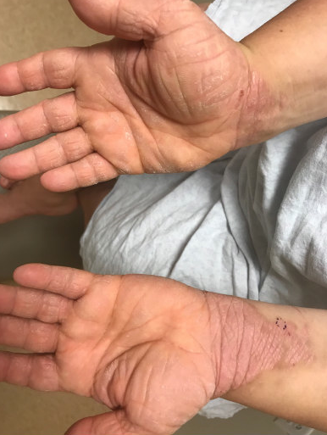
Notes:
AD on wrists

Slide 91
Measurement-Based Care to Achieve an Accurate Diagnosis of Atopic Dermatitis

Slide 92
Case Presentation: JC
JC is a 36 y/o man with an itchy, red rash
Duration: Has had intermittent symptoms throughout his entire life and feels that they have been getting progressively worse in recent years
Location: Rash is primarily located on the neck, arms, legs, and back
Symptoms: Extremely itchy, feels as if he cannot stop scratching, results in waking up from sleep almost every night
Impact on lifestyle and career choices

Slide 93
Medical History
Medical History
No history of cancer or serious infection
No known allergies to foods or other medications
Non-smoker, alcohol intake (4-5 drinks/week)
ROS: Denied any constitutional symptoms, negative in detail
Physical Examination
Presence of multiple, somewhat ill-defined, erythematous patches and plaques with evidence of lichenification and excoriation on the scalp, trunk, arms, and legs

Slide 94
The Importance and Integration of Documentation Processes in AD

Slide 95
Patient
Oriented
Eczema
Measure
(POEM)^{1,2}
1. Charman CR, et al. Br J Dermatol. 2013;169(6):1326-1332. 2. Charman CR, et al. Arch Dermatol. 2004;140:1513-1519.
Notes:
*SCORAD index, EASI and POEM: most rigorously tested and validated instruments
No single standard; more than 28 scales are reported in the literature.
Recent meeting to determine usefulness of both EASI and POEM (Patient Oriented Eczema Measure) as core outcome instruments for measuring clinician-reported signs of AD in clinical trials and patient-reported symptoms
Limitations
Primarily used in clinical trials
May be cumbersome to use in daily practice and therefore are not recommended according to the most recent AAD guidelines
HOME (Harmonizing Outcome Measures for Eczema):
International effort to develop core outcome set for AD to be used in all clinical trials

Slide 96
Patient Oriented Eczema Measure (POEM)^{1,2}
Scoring POEM
(total score max = 28):
  No days = 0
  1-2 days = 1
  3-4 days = 2
  5-6 days = 3
  Every day = 4
What does a POEM
score mean?
  0-2 = Clear or almost clear
  3-7 = Mild eczema
  8-16 = Moderate eczema
  17-24 = Severe eczema
  25-28 = Very severe eczema
Protected by copyright but is freely available and can be downloaded for use:
https://www.nottingham.ac.uk/research/groups/cebd/documents/methodological-resources/poem-for-self-completion-or-proxy-completion.pdf. 1. Charman CR, et al. Br J Dermatol. 2013;169(6):1326-1332. 2. Charman CR, et al. Arch Dermatol. 2004;140:1513-1519.
Notes:
*SCORAD index, EASI and POEM: most rigorously tested and validated instruments
No single standard; more than 28 scales are reported in the literature.
Recent meeting to determine usefulness of both EASI and POEM (Patient Oriented Eczema Measure) as core outcome instruments for measuring clinician-reported signs of AD in clinical trials and patient-reported symptoms
Limitations
Primarily used in clinical trials
May be cumbersome to use in daily practice and therefore are not recommended according to the most recent AAD guidelines
HOME (Harmonizing Outcome Measures for Eczema):
International effort to develop core outcome set for AD to be used in all clinical trials

Slide 97
Economic Burden of
Atopic Dermatitis^{1,2}
Estimated annual cost in United States: ~$5 billion
Health care visits
Prescription costs
Hospital stays
Transportation
DIRECT COSTS
Missed days
Loss of productivity
Career changes
Impact on QoL
INDIRECT COSTS
1. Adamson AS. Adv Exp Med Biol. 20171027:79-92.
2. Drucker AM, et al. J Invest Dermatol. 2017;137:26-30.
Notes:
AD/eczema can have detrimental effects on patients’ QoL.^{1,2}
Studies in adults with AD have shown that patients with this disease have worse QoL scores.^{1–4}
In addition to AD impacting a patient’s health-related QoL, it can^{1,2,5–7}:
Have social, psychological (eg, self-esteem, mood, self-confidence), occupational, and financial impacts
Decreased work productivity
Increased work absenteeism
AD can have AEs on simple ADL, such as choice of clothing, shaving, or use of makeup.³
No-to-modest correlation between objective measures of disease severity with QoL in adult patients with AD.⁴

Slide 98
Assessment of Disease Severity and Clinical Outcomes in AD
AAD consensus guidelines for diagnosis of AD:¹
    Pragmatic approach for diagnosis in infants, children, and adults
    Well-suited for clinical practice
When practical, scales to consider disease severity: SCORAD, EASI, POEM²
  POEM: measure severity from the patient perspective
1. Eichenfield LF, et al. J Am Acad Dermatol. 2014;70:338-351.
2. Rehal B, et al. PLOS One. 2011;6:e17520.
Notes:
*SCORAD index, EASI and POEM: most rigorously tested and validated instruments
No single standard; more than 28 scales are reported in the literature.
Recent meeting to determine usefulness of both EASI and POEM (Patient Oriented Eczema Measure) as core outcome instruments for measuring clinician-reported signs of AD in clinical trials and patient-reported symptoms
Limitations
Primarily used in clinical trials
May be cumbersome to use in daily practice and therefore are not recommended according to the most recent AAD guidelines
HOME (Harmonizing Outcome Measures for Eczema):
International effort to develop core outcome set for AD to be used in all clinical trials

Slide 99
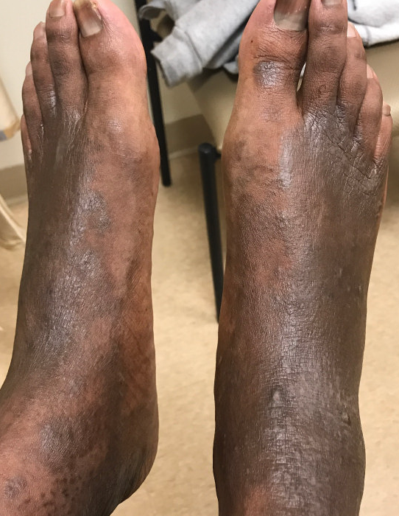
Image courtesy of Dr. Chiesa Fuxench.
Notes:
Atopic Dermatitis in adult with dark skin-widespread involvement of dorsum of feet and ankles

Slide 100
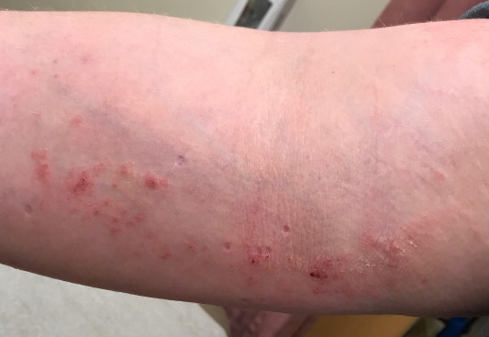
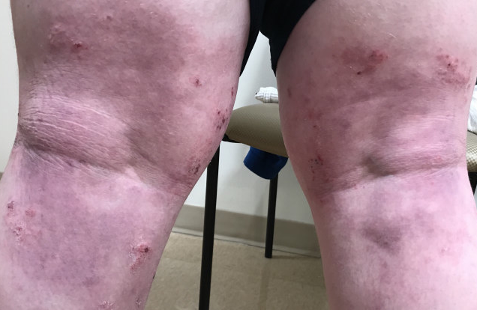
Notes:
Atopic dermatitis in a classical distribution involving the antecubital and popliteal folds. Notice the somewhat ill-defined, erythematous, patches and plaques with areas of excoriation, lichenification or skin thickening and depigmentation

Slide 101
Assessing
Disease Severity and Treatment Response

