Slide 1
PREVENTING THE PREVENTABLE
Safe Mycophenolate Practices
in Patients of Childbearing Potential
This activity is supported by an independent educational grant from the Mycophenolate REMS Group. This activity is intended to be fully compliant with the Mycophenolate REMS education requirements issued by the U.S. Food and Drug Administration (FDA).
Notes:
https://vimeo.com/1121898631/dab4a1d738?share=copy
00:00
Hello, I’m Dr. Diana Girnita…

Slide 2
This activity may include discussions of products or devices that are not currently labeled for use by the U.S. Food and Drug Administration (FDA).
The faculty have been informed of their responsibility to disclose to the audience if they will be discussing off-label or investigational uses (any uses not approved by the FDA) of products or devices.
Notes:
00:39
During our discussion…

Slide 3


Disclosures
PEER REVIEWERS
Rebecca Vargas-Jackson, MD, reports no financial relationships to disclose.
Albert Eubanks, Jr., RN, reports no financial relationships to disclose.
PATIENT PLANNER
Theresa Genovese, reports no financial relationships to disclose.
THE FOLLOWING CMEO STAFF have no financial relationships to disclose:
Nichole Lainhart (planning committee)
Warren Beckman (planning committee)
Scott J. Hershman, MD, FACEHP, CHCP (planning committee)
Sandra Caballero, PharmD (planning committee)
Sharon Tordoff (planning committee)
FACULTY
Diana M. Girnita, MD, PhD, reports no financial relationships to disclose.
Amanuel Kehasse, PharmD, PhD, reports no financial relationships to disclose.
Silvi Shah, MD, MS, FAST, FASN, FNKF, FACP, reports the following financial relationships:
Advisory board—Outset Medical, Inc.
Consultant—Miller Medical Communications, LLC
Grants—National Institutes of Health (NIH)
All identified conflicts of interest have been mitigated.
Notes:
00:49
And here are our disclosures.

Slide 4



Diana M. Girnita, MD, PhD (Moderator)
CEO and Founder
Rheumatologist OnCall
Volunteer Assistant Professor
University of Cincinnati Medical Center
Cincinnati, Ohio
Silvi Shah, MD, MS, FAST, FASN, FNKF, FACP
Associate Professor
Division of Nephrology
Transplant Nephrology Section
University of Cincinnati
Cincinnati, Ohio
Amanuel Kehasse, PharmD, PhD
Director, Clinical Programs and Drug Information
Clearway Health
Assistant Professor of Medicine
Boston University School of Medicine
Notes:
00:56
Once again, I am Dr. Diana Girnita…

Slide 5
Why Are We Still Talking about This?
There is evidence that the Mycophenolate Risk Evaluation and Mitigation Strategy (MREMS) is suboptimal at best in preventing prenatal exposure
“Awareness” of the MREMS is high; clinical "implementation” is low
New and evolving abortion laws restrict options when accidental prenatal exposure occurs
Absolute or 6-week abortion bans leave limited opportunity to consider pregnancy termination, if desired
The potential for malformations is generally not recognized as an exception to strict abortion laws
Sarayani A, et al. Am J Obstet Gynecol. 2022;227(2):263:e1–e38.
Notes:
01:54
So, let’s start by asking us this question…

Slide 6


Mycophenolate REMS Goals (HCPs)
Mitigate the risk of embryofetal toxicity associated with the use of mycophenolate by educating health care providers on:
Increased risks of first trimester pregnancy loss and congenital malformations associated with exposure to mycophenolate during pregnancy
Need to counsel patients of reproductive potential on the importance of pregnancy prevention and planning when taking mycophenolate
Need to report pregnancies to the Mycophenolate Pregnancy Registry
Increased Risk
Need for Counseling
Pregnancy Registry
Mycophenolate REMS. Mycophenolate REMS website. 2025. https://www.mycophenolaterems.com/#Main/Home.
Notes:
02:54
And here are the goals for healthcare providers…

Slide 7


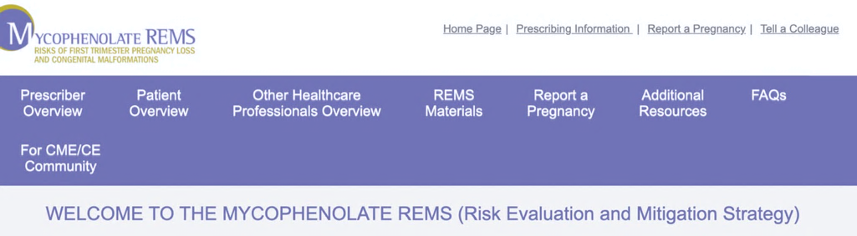
Mycophenolate REMS Goals (Patients)
Informing patients of reproductive potential who are prescribed mycophenolate about:
Increased risks of miscarriage and birth defects
Importance of pregnancy prevention and planning when taking mycophenolate
Patient Education
Pregnancy Prevention
Mycophenolate REMS. Mycophenolate REMS website. 2025. https://www.mycophenolaterems.com/#Main/Home.
Notes:
03:46
But not only that, we also have goals for our patients…

Slide 8
1
Identify the teratogenic risks associated with mycophenolate use during pregnancy
Notes:
04:12
And now, let’s turn to the first…

Slide 9


Mycophenolate Products FDA Indications
Mycophenolate mofetil (MMF)
IV solution, PO capsule/tablet/oral suspension
FDA labeled indications—prophylaxis of organ rejection in allogeneic kidney, heart, or liver transplants in combination with other immunosuppressants
Delayed-release mycophenolic acid (MPA) sodium
PO tablets
FDA labeled indications—prophylaxis of organ rejection in allogeneic kidney transplants
IV, intravenous; PO, by mouth.
Mycophenolic acid (package insert). Revised June 2025. https://www.accessdata.fda.gov/drugsatfda_docs/label/2025/050791s040lbl.pdf.
Mycophenolate mofetil (package insert). Revised May 2025. https://www.accessdata.fda.gov/drugsatfda_docs/label/2025/50722s054lbl.pdf.
Notes:
04:28
Dr. Kehasse, can you provide us…

Slide 10

MMF Most Common Side Effects
Diarrhea
Stomach upset
Nausea
Vomiting
Leukopenia
Enteric-coated mycophenolate sodium tablets introduced in 2004 to address gastrointestinal side effects.
Mayo Clinic. Mayo Clinic website. Last updated September 1, 2025.
https://www.mayoclinic.org/drugs-supplements/mycophenolate-mofetil-oral-route/description/drg-20073191
Manger B, et al. Clin Exp Gastroenterol. 2015;9:205–213.
Notes:
05:32
The most common side effects…

Slide 11

MPA History
First antibiotic purified from any source
Discovered in 1893 by Italian physician Bartolomeo Gosio
“Acidic phenol from a fungus”
Re-discovered as an antibiotic, antifungal, antiviral, antitumor, and at one time considered a mycotoxin
1960s—immunosuppressive properties identified
Bentley R. Chem Rev. 2000;100(10):3801–3826.
Notes:
06:15
The mocrophenolic acid journey in medicine…

Slide 12
MPA Immunosuppressive Effect
MPA inhibits inosine-5′-monophosphate dehydrase (IMPDH)
Proliferation requires DNA synthesis
Inhibiting formation of its building block can prevent organ rejection
PRPP
MMF
Plasma esterases
IMP
IMPDH
MPA
XMP
De novo
purine synthesis
GMP synthase
GMP
GTP and dGTP
DNA synthesis and cell proliferation
dGTP, deoxyguanosine triphosphate;
GMP synthase, guanosine monophosphate synthetase;
GTP, guanosine-5’-triphosphate; IMP, inosine 5’-monophosphate;
PRPP, phosphoribosyl diphosphate; XMP, xanthosine 5’-monophosphate.
Ji Y, et al. J Biol Chem. 2006;281(1):206–212.
Notes:
06:47
And here, we are looking at the…

Slide 13

Organ Procurement and Transplantation Network (OPTN)
In 2023, nearly 15,000 adult females received solid organ transplants
More than 90% currently receive mycophenolate products as one of their maintenance immuno-suppression agents
Organ Procurement and Transplantation Network (OPTN). OPTN website. 2025.
https://optn.transplant.hrsa.gov/data/view-data-reports/national-data/.
Notes:
08:31
Now we know that mycophenolate is still…

Slide 14




Mycophenolate Products Off-Label
Other solid organ transplantation, bone marrow transplantation
Rheumatoid arthritis
Inflammatory bowel disease
Psoriasis
Autoimmune diseases (lupus, vasculitis, etc.)
Lipsky JJ. Lancet. 1996;348(9038):1357–1359.
Notes:
09:04
And as you know…

Slide 15
What percentage of infants born to a mother exposed to mycophenolate during pregnancy are born with congenital abnormalities?
?
~10%–15%
~20%–25%
~45%–50%
More than 50%
I’m not sure
Notes:
09:53
I would like to continue now, and let’s get our audience involved…

Slide 16
What percentage of infants born to a mother exposed to mycophenolate during pregnancy are born with congenital abnormalities?
?
~10%–15%
~20%–25%
~45%–50%
More than 50%
I’m not sure
Notes:
10:49
And the correct answer is…

Slide 17

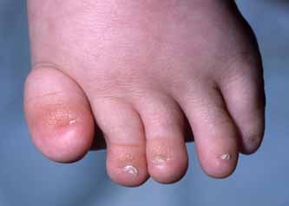
Human Teratogenicity of MPA First Described in 2001
First case report in 2001 was a child born with hypoplastic nails and shortened fingers to a mother who had been exposed to MPA
This was the tip of the iceberg as many other subsequent reports followed
National Institute of Health (NIH), Human Genome Research Institute. NIH website. 2009. https://elementsofmorphology.nih.gov.
Notes:
11:02
So, human teratogenicity of mycophenolate…

Slide 18
Mycophenolate Embryopathy
Microtia or anotia
Auditory canal atresia or conductive deafness
Cleft lip and palate
Other frequent manifestations include dysmorphic features of the face and distal limb anomalies.
Congenital heart defects
Tracheal-esophageal malformation
Anderka MT, et al. Am J Med Genet A. 2009;149A(6):1241–1248.
Notes:
11:28
So, mycophenolate usually causes…

Slide 19
Embryofetal Risk
National Transplantation Pregnancy Registry (NTPR) 2006
24 female transplant patients reported 33 mycophenolate-exposed pregnancies; of these pregnancies, there were
➔ 15/33 (45%) spontaneous miscarriages
➔ 4/18 (22%) structural malformations in live-born infants
Post-marketing data of 77 patients exposed to systemic mycophenolate during pregnancy (1995–2007)
➔ 25 patients (32%) had spontaneous abortions
➔ 14 patients (22%) had a malformed fetus or infant
Armenti VT, et al. Clin Transpl. 2006;57–70.
Notes:
12:08
Now, let’s discuss what we know…

Slide 20
Mycophenolate FDA Boxed Warning
WARNING: EMBRYOFETAL TOXICITY, MALIGNANCIES,
and SERIOUS INFECTIONS
See full prescribing information for complete boxed warning
Use during pregnancy is associated with increased risks of first trimester pregnancy loss and congenital malformations. Avoid if safer treatment options are available. Females of reproductive potential must be counseled regarding pregnancy prevention and planning [see Warnings and Precautions (5.1)].
Increased risk of development of lymphoma and other malignancies, particularly of the skin [see Warnings and Precautions (5.2)].
Increased susceptibility to infections, including opportunistic infections and severe infections with fatal outcomes [see Warnings and Precautions (5.3)].
Mycophenolate REMS. Mycophenolate REMS website. 2025. https://www.mycophenolaterems.com/#Main/Prescribers.
Mycophenolic acid (package insert). Revised June 2025. https://www.accessdata.fda.gov/drugsatfda_docs/label/2025/050791s040lbl.pdf.
Mycophenolate mofetil (package insert). Revised May 2025. https://www.accessdata.fda.gov/drugsatfda_docs/label/2025/50722s054lbl.pdf.
Notes:
13:25
So, Dr. K, we have here the mycophenolate FDA…

Slide 21
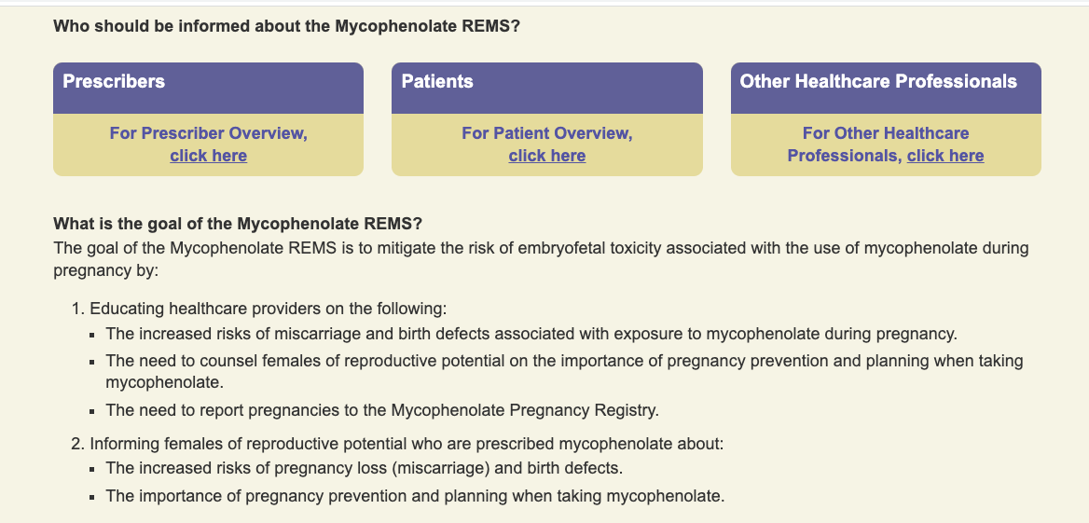
MREMS
Mycophenolate REMS. Mycophenolate REMS website. 2025. https://www.mycophenolaterems.com/#Main/Home.
Notes:
14:49
As a result, the FDA determined that additional…

Slide 22
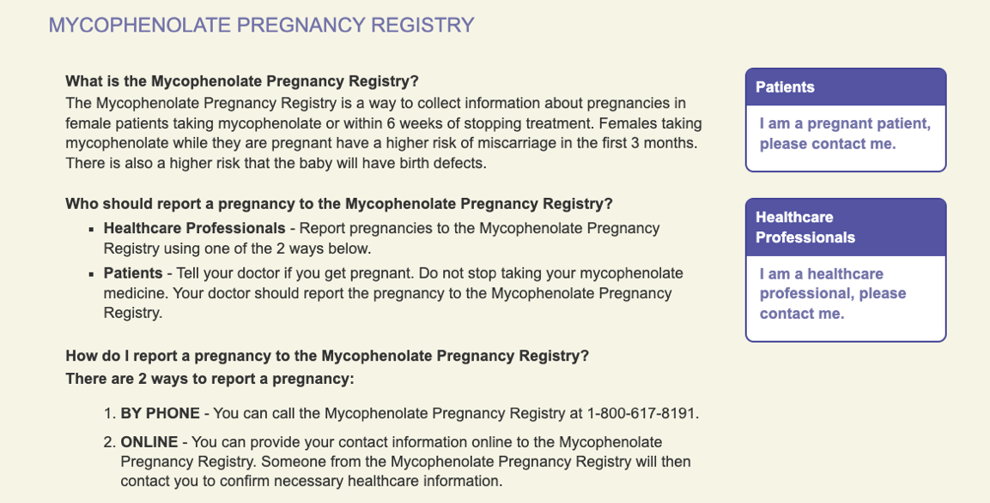
Mycophenolate Pregnancy Registry
Mycophenolate REMS. Mycophenolate REMS website. 2025. https://www.mycophenolaterems.com/#Main/ReportaPregnancy.
Notes:
15:47
And also the mycophenolate REMS also provides a portal…

Slide 23

Risk Mitigation
Persons of reproductive potential/child-bearing potential
Adolescents who have entered puberty and all persons who have a uterus and ovaries and have not passed through menopause
Two negative pregnancy tests (sensitivity of at least 25 mIU/mL)
One prior to start; another 8–10 days after; repeat during routine follow-up
Mycophenolate REMS. Mycophenolate REMS website. 2025. https://www.mycophenolaterems.com/#Main/Prescribers.
Notes:
16:00
And now, as we implement the mycophenolate REMS in practice…

Slide 24
Risk Mitigation Pregnancy Prevention and Planning
NTPR annual report compared pregnancies conceived on MPA to those conceived when MPA was discontinued at least 6 weeks prior to conception
Rate of miscarriages in pregnancies with MPA as high as 48% compared to 22% when MPA was discontinued
Selection of adequate contraception is critical
NTPR, National Transplantation Pregnancy Registry.
Armenti VT, et al. Clin Transpl. 2010;65–85.
Transplant Pregnancy Registry International (TPRI). TPRI website. 2025. https://www.transplantpregnancyregistry.org.
Notes:
16:56
And that is why testing and counseling…

Slide 25
Risk Mitigation (cont’d)
No observable risks of negative fetal and pregnancy outcomes when a male using MPA fathers a child
Prescribing information—sexually active male patients and/or any partners who have reproductive or child-bearing potential should use effective contraception during treatment of the male patient and for at least 3 months after last dose
Mycophenolate REMS. Mycophenolate REMS website. 2025. https://www.mycophenolaterems.com/#Main/Home.
Mycophenolic acid (package insert). Revised June 2025. https://www.accessdata.fda.gov/drugsatfda_docs/label/2025/050791s040lbl.pdf.
Mycophenolate mofetil (package insert). Revised May 2025. https://www.accessdata.fda.gov/drugsatfda_docs/label/2025/50722s054lbl.pdf.
Notes:
17:45
And now in terms of male exposure…

Slide 26

Safer Alternatives to MPA Products?
Notes:
18:20
So, a natural question is to ask…

Slide 27
Safer Alternatives to MPA Products?
Most immunosuppressants ➔ limited embryofetal risk data in humans
Azathioprine (AZA)
Older immunosuppressant
Animal teratogenicity
Longer history of use in pregnancy
Retrospective cohort study comparing pregnancies exposed to MPA to those on AZA during the first trimester
55/111 (49.5%) pregnancy loss vs 113/471 (24%) respectively
Adjusted relative risk of 1.9 (1.6–2.3) compared to AZA: exposure to MPA during early pregnancy associated with a 2-fold increase in pregnancy loss risk
Thai TN, et al. Pharmacoepidemiol Drug Saf. 2020;29(6):716–724.
Notes:
19:29
We should also note that…

Slide 28
2
Counsel patients of childbearing potential before and during mycophenolate administration on appropriate pregnancy testing and acceptable contraception methods
Notes:
24:04
And now we are going to move on to our second…

Slide 29
Which of the following is a positive impact of MREMS to date?
?
Decreased MMF initiation during pregnancy
Improved contraception during MMF therapy
Decreased MMF initiation during pregnancy AND improved contraception during MMF therapy
~90% participation in the MREMS Pregnancy Registry
I’m not sure
Notes:
24:24
And I will start by asking…

Slide 30
Which of the following is a positive impact of MREMS to date?
?
Decreased MMF initiation during pregnancy
Improved contraception during MMF therapy
Decreased MMF initiation during pregnancy AND improved contraception during MMF therapy
~90% participation in the MREMS Pregnancy Registry
I’m not sure
Notes:
25:22
And the correct answer is A…

Slide 31
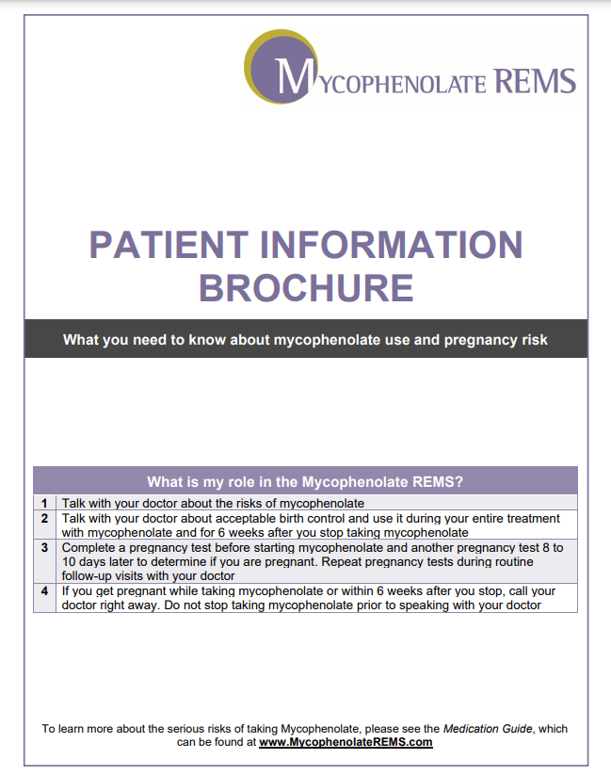
Contraception Counseling
Who do we counsel?
Patients of reproductive potential (puberty ⟹ menopause)
Exclude: hysterectomy, oophorectomy, premature menopause
When to start contraception?
During treatment
At least 6 weeks after ending medication
Frequency of pregnancy screening?
Start of treatment
8–10 days after starting
At every follow-up encounter
Mycophenolate REMS. Mycophenolate REMS website. 2025. https://www.mycophenolaterems.com/#Main/Patients.
Notes:
25:34
And now we are going to talk about counseling and…

Slide 32
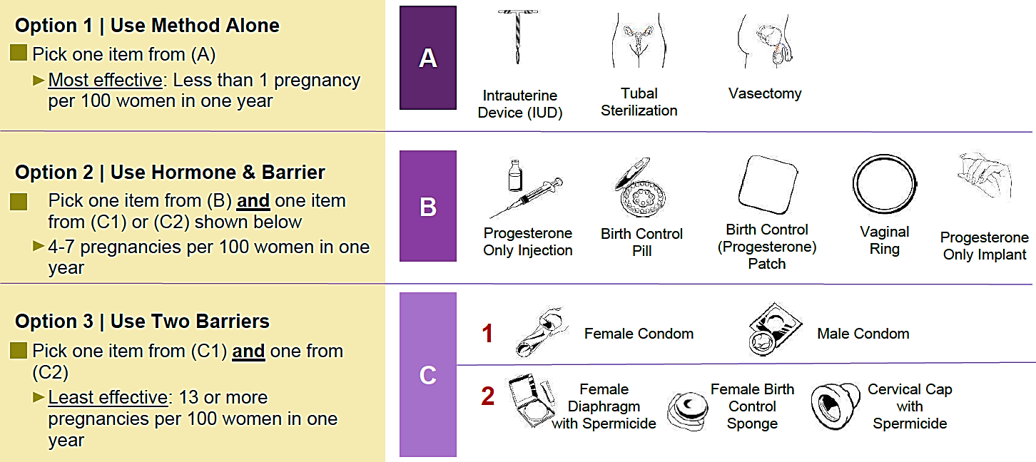
MREMS Birth Control Guide
Contraceptive choice impacted by:
Cost
Access
Compliance
Expected date for desired pregnancy
Mycophenolate REMS. Mycophenolate REMS website. 2025. https://www.mycophenolaterems.com/#Main/Patients.
Notes:
27:02
What is the birth control guide?...

Slide 33
Emergency Contraception
Type of Emergency Contraception | Weight restrictions? | How soon after sexual encounter? | How it works? | How to provide to patient?
Plan B (levonorgestrel) | Ideally <165 lbs | Within 3 days | Prevents ovulation or prevents an egg from attaching to uterus | Over the counter (4-year shelf life)
ELLA (ulipristal) | Ideally <195 lbs | Within 5 days | Prevents ovulation | Prescription (3-year shelf life)
Copper intrauterine device | 100% effective any weight | Within 5 days | Nonhormonal—copper ions mainly affect sperm motility | Referral to a healthcare provider
Fok WK, et al. Curr Opin Obstet Gynecol. 2016;28(6):522–529.
Notes:
29:33
What options patients have for emergency…

Slide 34
3
Monitor and report relevant pregnancies to the Mycophenolate Pregnancy Registry
Notes:
31:30
And now we are gonna move to our last…

Slide 35
What percent of pregnancies are unplanned?
?
18%
25%
40%
54%
I’m not sure
Notes:
31:41
And I’m gonna start again with a question…

Slide 36
What percent of pregnancies are unplanned?
?
18%
25%
40%
54%
I’m not sure
Notes:
32:23
And the correct answer is C…

Slide 37
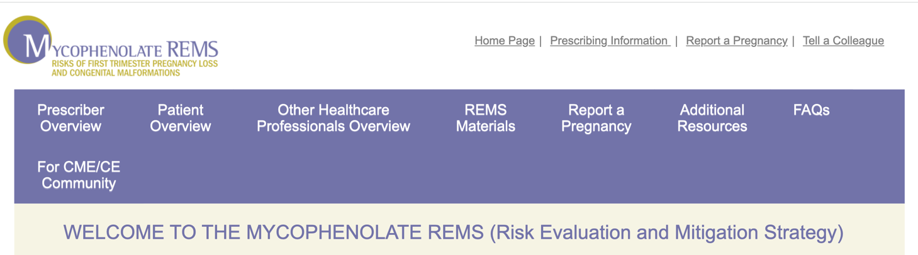
www.MycophenolateREMS.com
Mycophenolate REMS. Mycophenolate REMS website. 2025. https://www.mycophenolaterems.com/#Main/Home.
Notes:
32:32
As we mentioned before, we’re gonna talk a little…

Slide 38

Who on the Team Is Responsible for Reporting a Pregnancy to the Registry?
Any member of the multidisciplinary team may take the lead
Communication and coordination among team members recommended
Mycophenolate REMS. Mycophenolate REMS website. 2025. https://www.mycophenolaterems.com/#Main/ReportaPregnancy.
Notes:
32:51
But the question is, when we have such an event, who is…

Slide 39
Mycophenolate Pregnancy Registry
Assess risks and outcomes
Create a framework for education
Clinicians, patients, other healthcare providers
Mitigate or eliminate exposures to mycophenolate in pregnancy
Mycophenolate REMS. Mycophenolate REMS website. 2025. https://www.mycophenolaterems.com/#Main/FAQs.
Notes:
35:36
As Dr. K mentioned, the mycophenolate pregnancy registry…

Slide 40
Role of Nurse and Non-Clinical Administrators
Support clinician prescribers
Support patients
Team coordination and communication about the mycophenolate registry
When applicable, follow-up throughout pregnancy and post-delivery
Mycophenolate REMS. Mycophenolate REMS website. 2025. https://www.mycophenolaterems.com/#Main/OtherHealthcareProfessionals.
Notes:
36:02
Everybody has a role, from our nurses…

Slide 41


How to Report a Pregnancy
1-800-617-8191
www.mycophenolateREMS.com
Notes:
36:31
and we can use many…

Slide 42
Tips for Patient Communications
Email link to connect patients to the Mycophenolate Pregnancy Registry
Use social media posts to share general information about the registry
Add reminders to patient’s electronic health record notes
When applicable, register patient during clinic visit
Notes:
36:50
We can also use certain tips for…

Slide 43
Challenges Remain
Suboptimal participation to-date
REMS assessment surveys of female patients taking mycophenolate during reproductive age indicate many patients do not understand increased risk of first-trimester pregnancy loss and congenital malformations
Increased participation is critical
Notes:
37:26
But, of course, there are many, many challenges…

Slide 44
SMART Goals Specific, Measurable, Attainable, Relevant, and Timely
Educate and remind! persons of reproductive potential about risk, tailoring discussions based on each patient’s health literacy
Engage in pregnancy prevention and planning, including
Discussion of acceptable methods of contraception during mycophenolate treatment
Introduction of alternative immunosuppressants with less potential for embryofetal toxicity if pregnancy is desired
Report to the Mycophenolate Pregnancy Registry any pregnancies that occur and encourage pregnant patients to participate in the registry
Support collection of evidence to support our understanding of REMS failure and enhance prevention of prenatal exposure to mycophenolate
Read and share additional education resources
Brochure for healthcare providers (https://www.mycophenolaterems.com/ResourceDownloadRaw/HCPBrochure/inline)
Brochure for patients (https://www.mycophenolaterems.com/ResourceDownloadRaw/PatientBrochure/inline)
Notes:
40:53
And by the way of summary…

Slide 45
To Receive Credit
To receive CME/CE credit for this activity, participants must complete the post-test and evaluation online.
Participants will be able to download and print their certificate immediately upon completion.
Notes:
42:30
Now, to receive credit for…

Slide 46
Additional Resources
Visit www.cmeoutfitters.com for clinical information and certified educational activities
Notes:
42:37
Thank you very much for participating…

Slide 47
Visit the
Transplant Hub
Free resources and education
for health care professionals and patients
https://www.cmeoutfitters.com/practice/transplant-hub/
Notes:
42:40
Have a wonderful day…

Slide 48
PREVENTING THE PREVENTABLE
Safe Mycophenolate Practices
in Patients of Childbearing Potential
This activity is supported by an independent educational grant from the Mycophenolate REMS Group. This activity is intended to be fully compliant with the Mycophenolate REMS education requirements issued by the U.S. Food and Drug Administration (FDA).
Notes:
42:42
[End]

