Slide 1
Transforming Cardiovascular Care
Uprooting Misperceptions and Therapeutic Inertia in Lipid Management
This activity is supported through an independent educational grant from Merck & Co., Inc.
Notes:
00:00 [Welcome to this program by CME Outfitters…]

Slide 2
This activity may include discussions of products or devices that are not currently labeled for use by the U.S. Food and Drug Administration (FDA).
The faculty have been informed of their responsibility to disclose to the audience if they will be discussing off-label or investigational uses (any uses not approved by the FDA) of products or devices.
Notes:
00:14: [This activity may]

Slide 3


Christie M. Ballantyne, MD, FACP, FACC
Professor of Medicine
Chief, Section of Cardiovascular Research
Director, Center for Cardiometabolic Disease Prevention
Houston, TX
Peter P. Toth, MD, PhD, FCCP, FESC, FAHA, FACC
Director of Preventive Cardiology
CGH Medical Center
Professor of Clinical Family and Community Medicine
University of Illinois School of Medicine
Adjunct Professor of Medicine
Division of Cardiology
Johns Hopkins University School of Medicine
Baltimore, MD
Notes:
00:21: [I’m Christie Ballantyne…]

Slide 4
1
Evaluate common misperceptions clinicians have regarding lipid management
Notes:
00:46: [Our first learning objective aligns with that. Is [slide]. What are the common misperceptions and how do they impact our practice?

Slide 5

Misperception: The Old Rules Still Apply
The pendulum swing in recommendations → Inertia
Outdated guidance → Missed opportunities for intervention and LDL-C lowering
Guidelines, consensus statements, and treatments are evolving
Keep it simple
LDL-C = low-density lipoprotein cholesterol
Notes:
01:03:[Maybe some of the confusion…]

Slide 6
New Guidance for LDL-C
Lower LDL-C for Longer
Jackson EJ, et al. J Clin Lipidol. 2025. Published online June 18, 2025.
Notes:
01:54: [Yeah, I mean it’s uh not that complicated Lower LDL-C for longer is better…]

Slide 7

Misperceptions vs Medical Realities
Misperception
Medical Reality
Low LDL-C causes dementia, hemorrhagic stroke, malignancies, and neuropsychiatric problems
LDL-C ≤ 40 mg/dL is not associated with these conditions
Statin intolerance is common
The prevalence of statin intolerance is low
Women, under-represented populations, younger patients, and older adults have lower ASCVD risk
Women, under-represented populations, younger patients, older adults are undertreated. They should all be assessed for risk and treated accordingly.
HeFH is rare
~ 30 million people worldwide have HeFH; HoFH is rare
Patients benefit just by taking a statin, the LDL-C goal doesn’t matter that much
The amount of LDL-C lowering is directly tied to lowering ASCVD risk
HeFH = heterozygous familial hypercholesterolemia; HoFH = homozygous hypercholesterolemia
Sabatine MS, Giugliano RP, Keech AC, et al. N Engl J Med. 2017;376(18):1713-1722. Jackson EJ, et al. J Clin Lipidol. 2025. Published online June 18, 2025; Cannon CP, et al. N Engl J Med. 2015;372(25):2387-2397. Goldstein LB, et al. Arterioscler Thromb Vasc Biol. 2023;43(10):e404-e442; Lloyd-Jones DM, et al. J Am Coll Cardiol. 2022;80:1366-1418; Bytyçi I, et al. Eur Heart J. 2022;43(34):3213-3223; Martirossian AN, et al. Best Pract Res Clin Endocrinol Metab. 2023;37(3):101714; Van Lennep R, et al. Eur Heart J. 2023;44:4157-4173; Minhas AMK, et al. Am Heart J. 2022;252:60-69; Nelson AJ, et al. J Am Coll Cardiol. 2022;79(18):1802-1813; Navar AM, et al. Circ Cardiovasc Qual Outcomes. 2023;16(8):533-543; Rosenson RS. J Lipid Res. 2021;62:100060.
Notes:
02:42: [So, there’s a lot of misperceptions here…]

Slide 8
2
Identify the roles of LDL-C and Lp(a) in atherosclerotic disease
Notes:
09:24: [Alright, that takes us to learning objective number 2 Christie…]

Slide 9


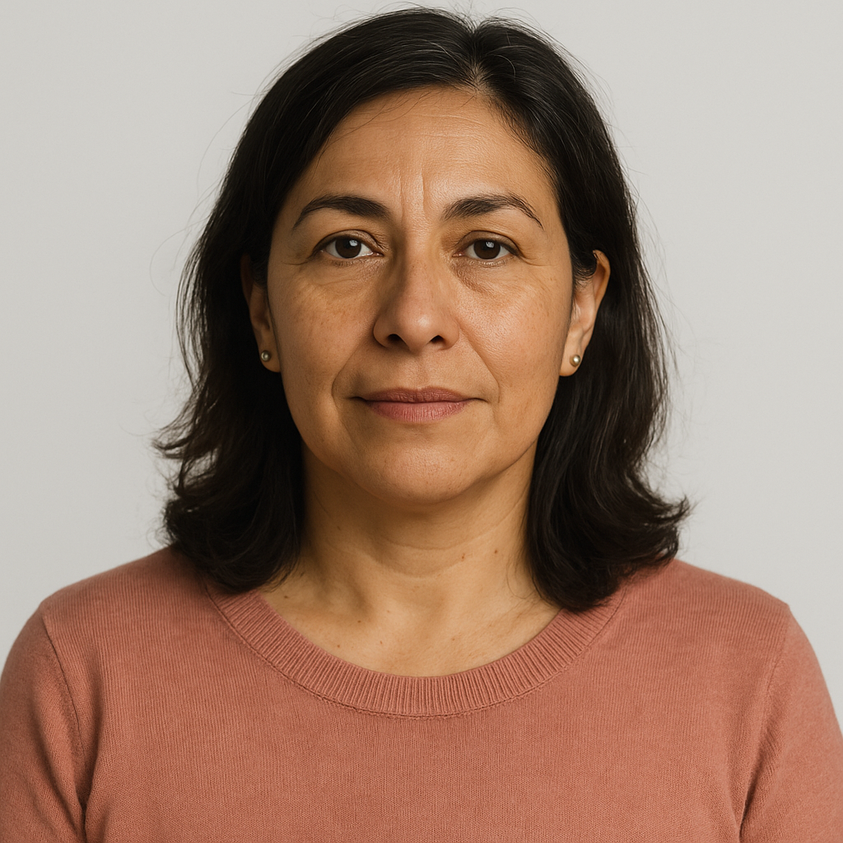



Patient Case: LT
LT is a 48-year-old Hispanic woman with HTN (BP:140/80), and a BMI of 29 kg/m²
No prior ASCVD-related events, never smoked
Father died of an MI at age 54
Labs:
Total cholesterol: 215 mg/dL
LDL-C: 140 mg/dL
HDL-C: 49 mg/dL
Triglycerides: 180 mg/dL
Calculated10-year ASCVD risk: 5%
FBS: 105
Medications:
Lisinopril 40 mg daily
Hydrochlorothiazide 25 mg daily
How would you approach LT’s lipid management based on her risk?
Notes:
09:36: [Let’s take a look at a patient case..]
Non-HDL-C: 143 mg/dL
apoB: 115 mg/dL
Lp(a): 70 mg/dL

Slide 10
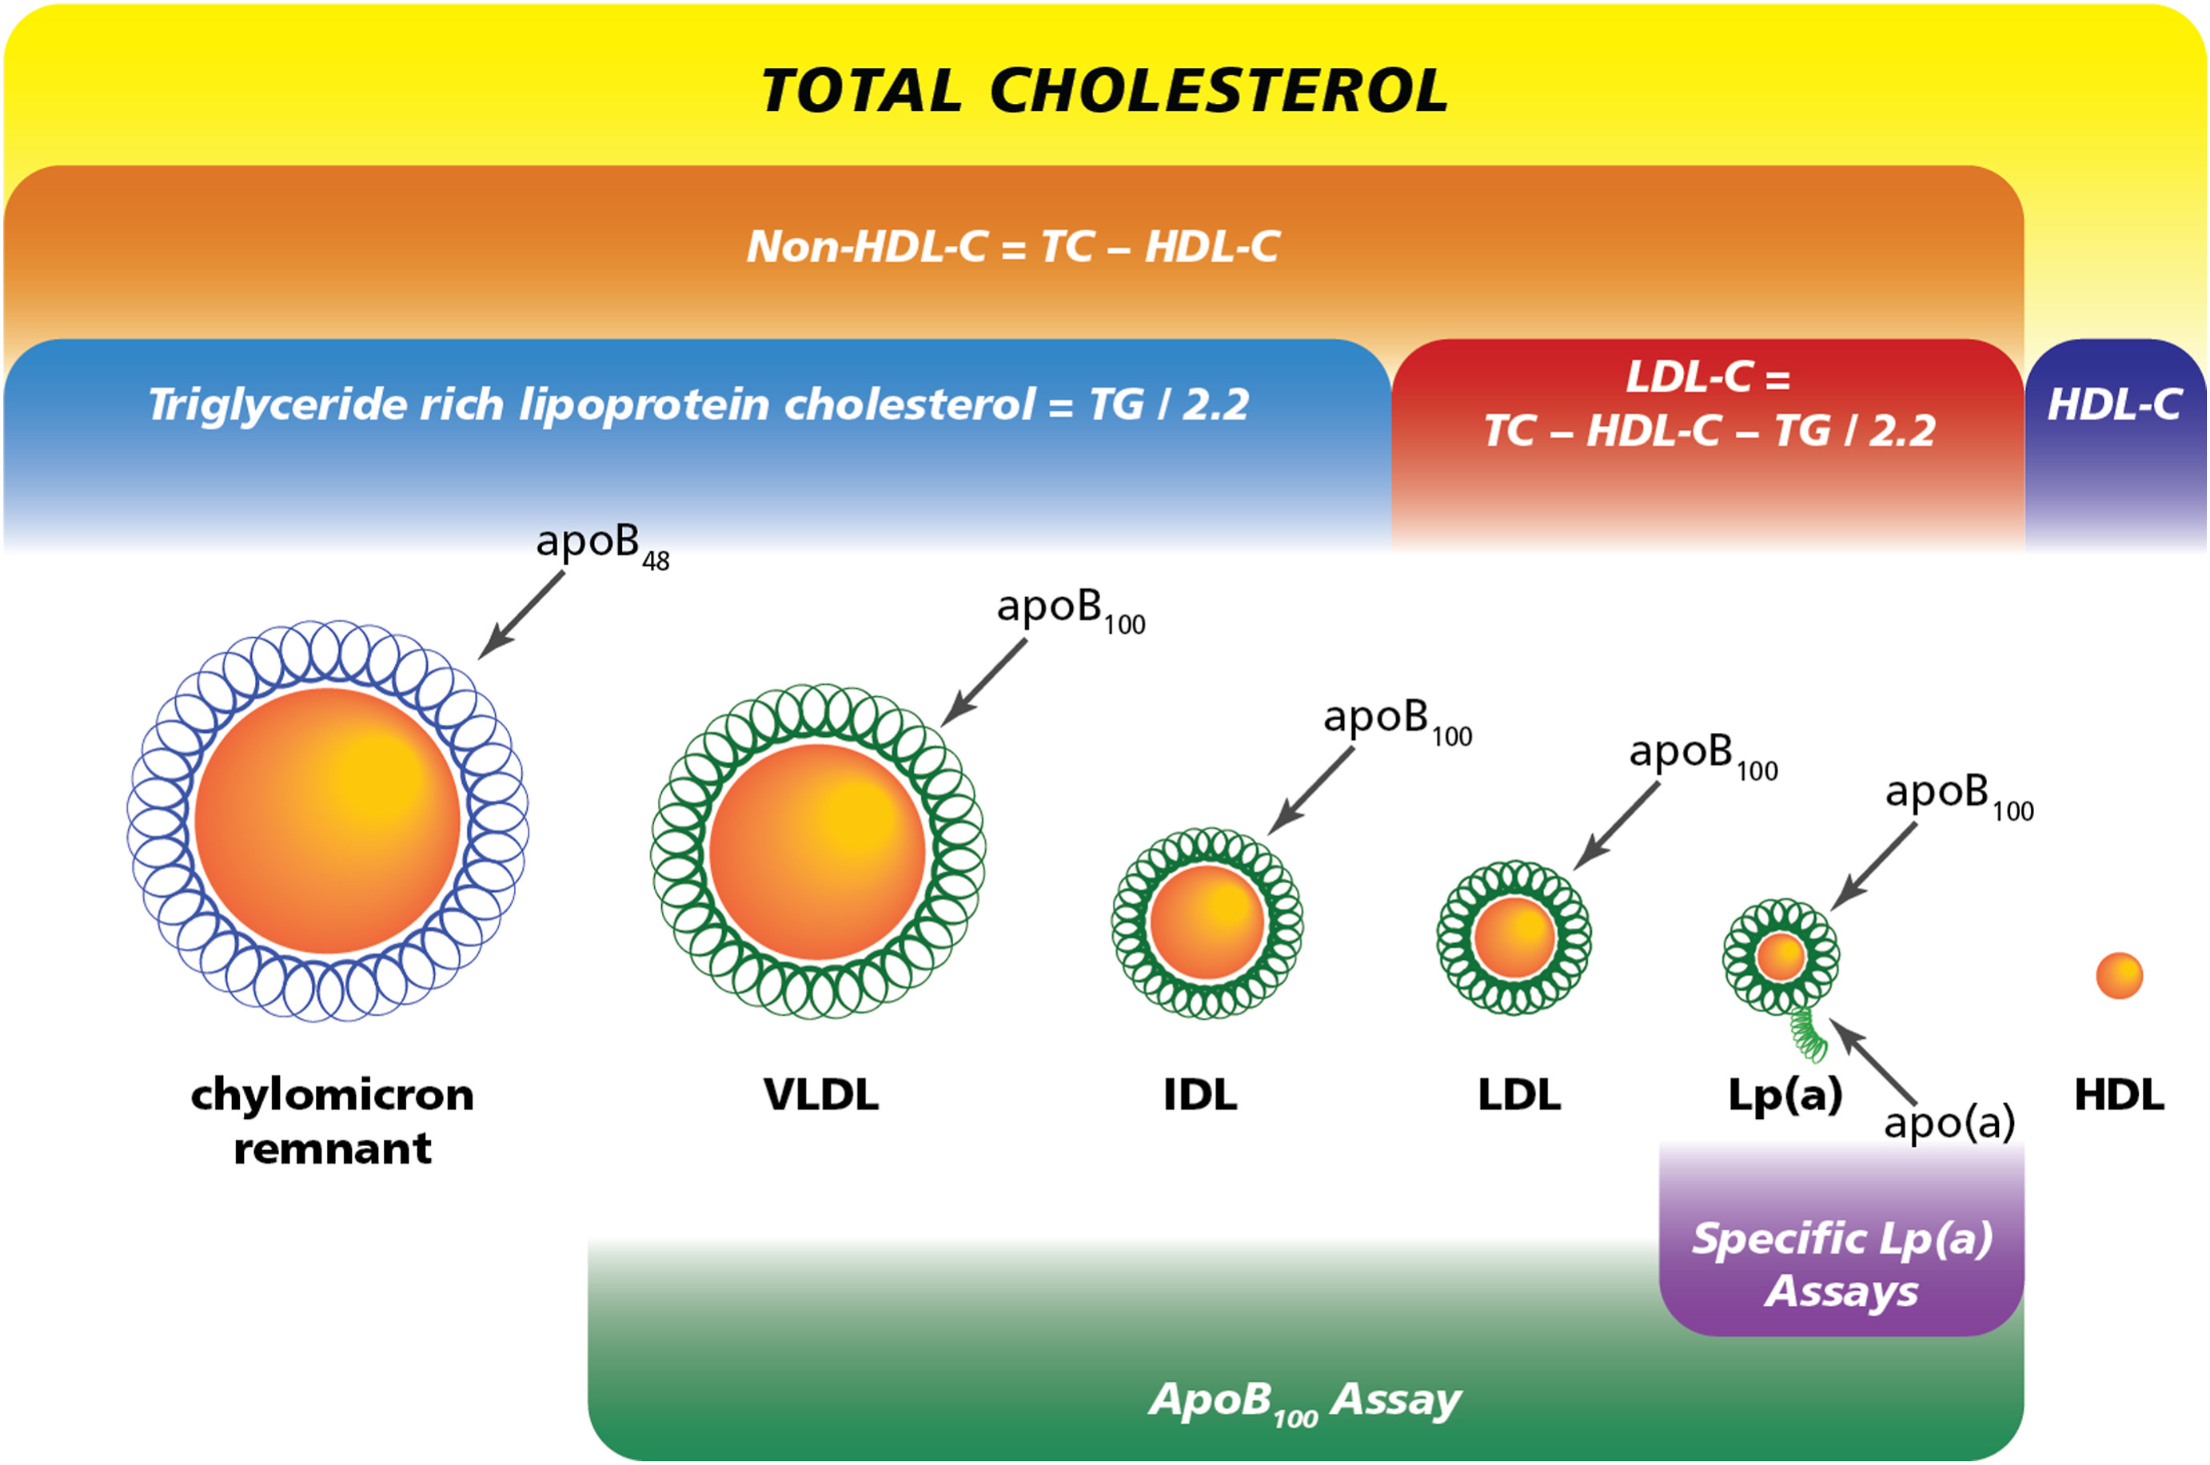
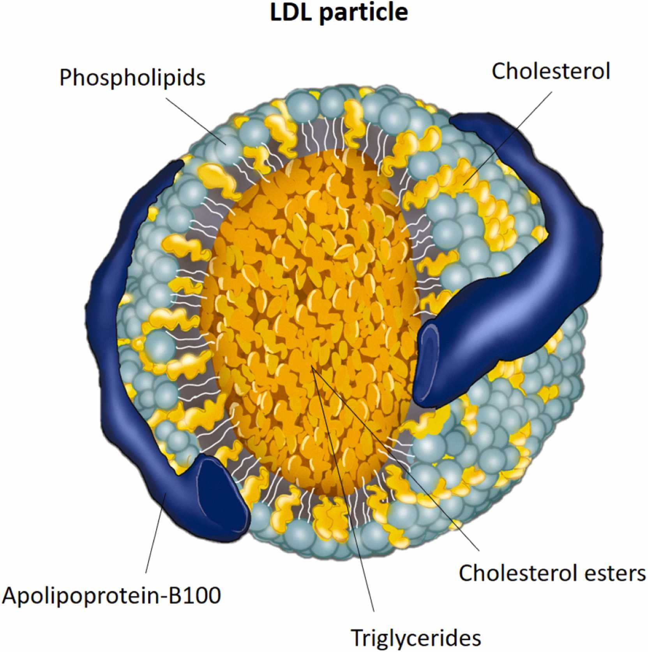
Atherogenic Lipoproteins
apoB = apolipoprotein B; HDL- C: Lp(a) = lipoprotein(a); TC = total cholesterol; non-HDL-C = non–high-density lipoprotein; Lp(a) = lipoprotein(a); TC = total cholesterol; TG = triglyceride
Galimberti F, et al. Pharmacol Res. 2023;195:106873; Mancini JGB, et al. Can J Cardiol. 2024;40:S20-S25
.
Notes:
12:02: [Well, she’s got increased atherogenic lipoproteins…]

Slide 11
Impact of LDL-C on ASCVD
Building block of arterial wall plaque
Surrogate marker of circulating atherogenic lipoproteins and primary biomarker of ASCVD risk
LDL-C
Primary target for lipid-lowering therapies in clinical practice
MACE are reduced proportionately to the degree and duration of LDL-C lowering
Is not representative of the full burden of atherogenic lipoproteins in some patients
ASCVD = atherosclerotic cardiovascular disease; MACE = major adverse cardiovascular events
Jackson EJ, et al. J Clin Lipidol. 2025. Published online June 18, 2025.
Notes:
13:40: [LDL is of course the most important…as they are in this particular patient]

Slide 12
Impact of Non-HDL-C and Apo-B on ASCVD
Non-HDL-C + apo-B account for all atherogenic particles in patients with:
Hypertriglyceridemia
Diabetes
Obesity
Metabolic Syndrome
Major adverse cardiovascular events; Non-HDL-C = non-high-density lipoprotein cholesterol
Jackson EJ, et al. J Clin Lipidol. 2025. Published online June 18, 2025.
Notes:
14:40: [Now non-HDL and ApoB are very important measures…]

Slide 13
Monitoring Non-HDL-C and Apo-B on ASCVD
Consider monitoring non-HDL-C and apo-B:
As secondary targets to assess of risk and effectiveness of lipid-lowering therapy
High-risk patients
Patients with hypertriglyceridemia
ApoB = apolipoprotein B; non-HDL-C = non–high-density lipoprotein
Jackson EJ, et al. J Clin Lipidol. 2025. Published online June 18, 2025.
Notes:
15:10: [So it is important to consider monitoring…]

Slide 14
Impact of Lp(a) on ASCVD
Lp(a): Common independent genetic risk factor for CVD events and aortic stenosis
Lp(a) and LDL-C are independent and additive risk factors for ASCVD
CVD = cardiovascular disease
Koschinsky ML, et al. J Clin Lipidol. 2024;18(3):e308-e319. Bhatia HS, et al. Circulation. 2025;151(4):312-321. Reyes-Soffer G, et al. Arterioscler Thromb Vasc Biol. 2022;42(1):e48-e60. Lloyd-Jones DM, et al. J Am Coll Cardiol. 2022;80(14):1366-1418.
Notes:
15:43: [Christie tell us about the impact of Lp(a) on ASCVD]

Slide 15
Impact of Lp(a) on ASCVD
Failing to monitor Lp(a) can result in underestimation of risk
Monitor at least once in a lifetime for all adults
Monitor selected high-risk children
Suspected FH
First degree relatives with premature ASCVD or elevated Lp(a)
Ischemic stroke of unknown cause
CVD = cardiovascular disease
Koschinsky ML, et al. J Clin Lipidol. 2024;18(3):e308-e319. Bhatia HS, et al. Circulation. 2025;151(4):312-321. Reyes-Soffer G, et al. Arterioscler Thromb Vasc Biol. 2022;42(1):e48-e60. Lloyd-Jones DM, et al. J Am Coll Cardiol. 2022;80(14):1366-1418.
Notes:
16:48: [But really having high levels of Lp(a) is something we talk about..yeah, yeah]

Slide 16

Patient Case: LT
What would be your first and second steps in managing her lipid-related risk, given her risk enhancing factors?
Medications:
Lisinopril 40 mg daily
Hydrochlorothiazide 25 mg daily
Add high-intensity statin and treat to goal LDL-C < 70 mg/dL
Goal non-HDL-C < 100 mg/dL
Labs and Risk Assessment:
Total cholesterol: 215 mg/dL
LDL-C: 140 mg/dL
HDL-C: 49 mg/dL
Triglycerides: 180 mg/dL
FBS: 105, order a HbA1c
Calculated10-year ASCVD risk: 5% → Calculated 30-year risk: 39%
Order a CAC score, Lp(a), apoB, non-HDL-C
CAC = coronary calcium score
Notes:
19:10: [So, Christie now that…]
Non-HDL-C: 143 mg/dL
apoB: 115 mg/dL
Lp(a): 70 mg/dL

Slide 17
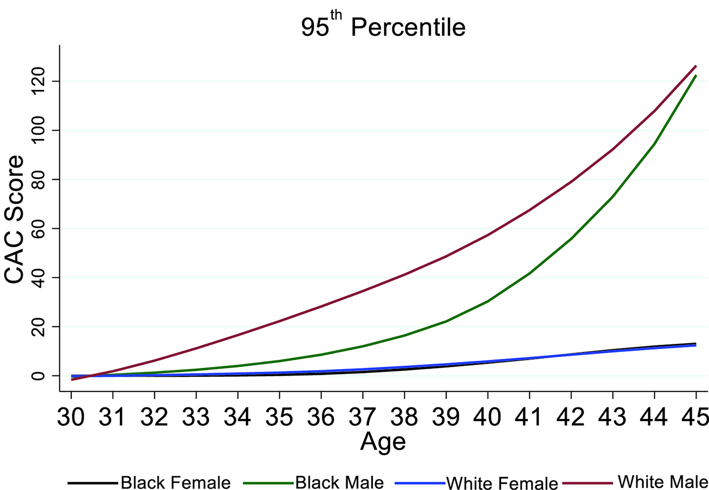
CAC Group Distribution By Age
CAC Risk
CAC Distribution By Age, Race, and Sex
CAC scoring significantly increases early ASCVD risk prediction
Multi-Ethnic Study of Atherosclerosis (MESA):
Any score > 0 increases risk for CV events
Consider race, age, and sex percentiles to interpret risk
Consider risk enhancers: Metabolic syndrome, T2D, HeFH, strong family history of ASCVD events, smoking
Blaha MJ, Naazie IN, Cainzos-Achirica M, et al. J Am Heart Assoc. 2021;10(6):e019351. Goldenberg E, Meng S. National Lipid Association Website. http://bit.ly/4gsUi5K. Javaid A, Dardari ZA, Mitchell JD, et al. J Am Coll Cardiol. 2022;79(19):1873-1886
Notes:
21:57: [And and the other one that comes up is I, I, would get a calcium score…So here in sterling Illinois we can get…]

Slide 18
Patient Case: LT
This patient has metabolic syndrome, what implications does this have for treatment choices and goals?
Medications:
First choice = high-intensity statin instead of fibrates, icosapent ethyl, omega-3 fatty acids, niacin even for combination therapy
Goal: Aggressively lower LDL-C, non-HDL-C
CAC = coronary calcium score
Notes:
23:42: [Yeah, and Christie, you’ve shown…]
Non-HDL-C: 143 mg/dL
apoB: 115 mg/dL
Lp(a): 70 mg/dL

Slide 19
3
Incorporate current guidance to optimize lipid management in clinical practice
Notes:
25:51: [Alright lets go to our third objective ]

Slide 20

Patient Case: MJ
MJ is a 59-year-old Black woman with well-controlled T2D (HbA1c: 6.8%) and HTN (BP:130/82).
Labs and Risk assessment
Total cholesterol: 200 mg/dL
LDL-C: 145 mg/dL
HDL-C: 55 mg/dL
Triglycerides:147 mg/dL
Lp(a): 29 mg/dL
10-year ASCVD Risk: 15.2%
eGFR > 90 mL/min
Never smoked, rarely drinks ETOH
Adopted, family history unknown, no previous ASCVD events
Medication history:
Rosuvastatin 20 mg daily for 3 months in 2020, self-discontinued due to muscle aches
How should we manage MJ’s lipids?
Notes:
25:58: Uh another case here…]

Slide 21
2025 AHA/ACC Chronic Coronary Disease Performance Measures
Measure LDL-C
Treat LDL-C to goal
Ongoing monitoring
ACC = American College of Cardiology; AHA = American Heart Association.
Williams MS, et al. J Am Coll Cardiol. 2025;85(25):2504-2535. Jackson EJ, et al. J Clin Lipidol. 2025. Published online June 18, 2025.
Notes:
26:50: [uh so let’s kind of go back a little bit before we go…]

Slide 22
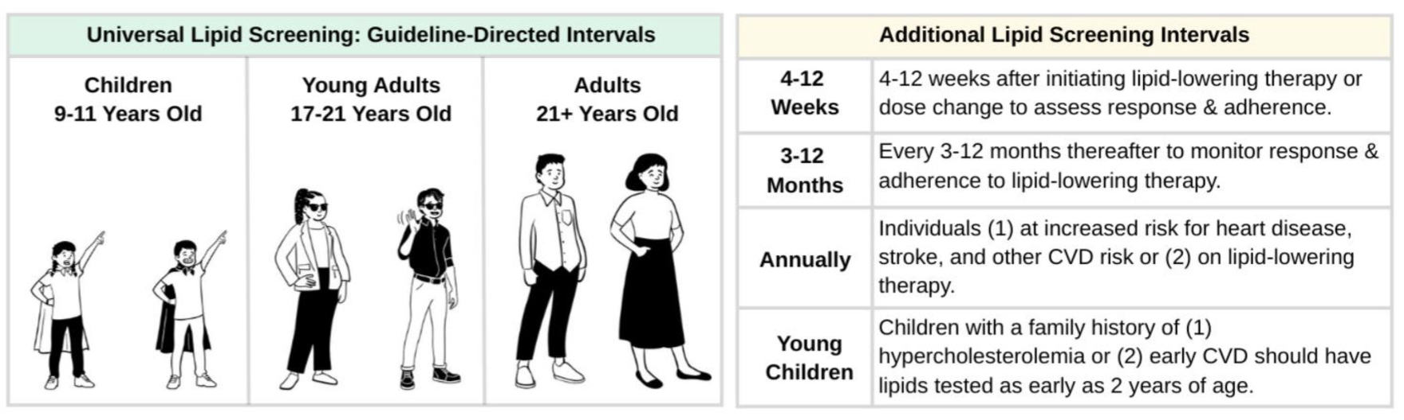
Step 1: Universal Lipid Screening
CVD = cardiovascular disease; NLA = National Lipid Association
Jackson EJ, et al. J Clin Lipidol. 2025. Published online June 18, 2025.
Notes:
27:05: [So let’s go about lipid screening…]

Slide 23
Step 2: Assess Risk and Set LDL-C Goals
Primary severe hypercholesterolemia: LDL-C ≥190 mg/dL
Requires immediate action – Treat LDL-C right away
LDL-C (mg/dL) | FH | HeFH | Action
≥ 190 | May be due to a genetic disorder FH Predisposition for elevated LDL-C and ASCVD at a younger age | HeFH is common ~1 in 300 people | Start high-intensity statin or escalate lipid-lowering therapy as needed Refer to a lipid specialist, coordinate care
FH = familial hypercholesterolemia; HeFH = heterozygous familial hypercholesterolemia ; NLA = National Lipid Association
Jackson EJ, et al. J Clin Lipidol. 2025. Published online June 18, 2025.
Notes:
28:18: [Now Risk assessment…]

Slide 24
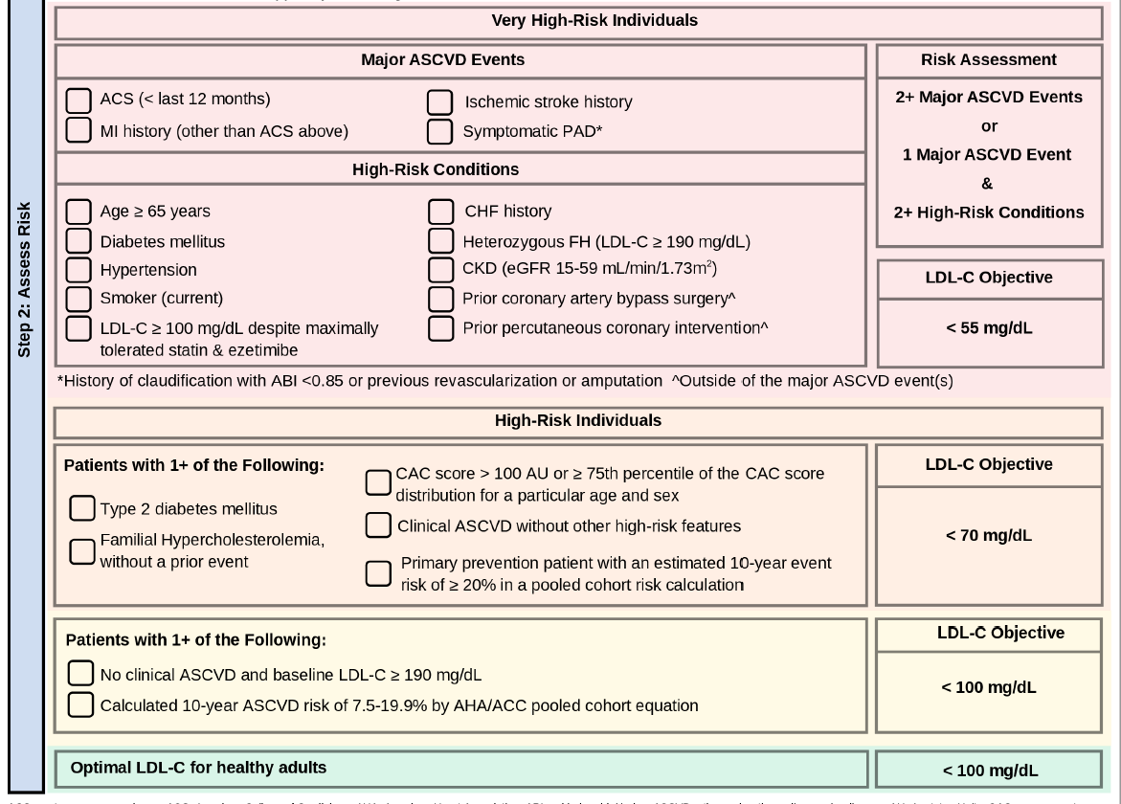
Step 2: Assess Risk and Set LDL-C Goals
ACS = acute coronary syndrome; AU PAD = peripheral arterial disease; NLA = National Lipid Association
Jackson EJ, et al. J Clin Lipidol. 2025. Published online June 18, 2025.
Notes:
30:16: [So what about the other groups in terms of risk?...]

Slide 25
Step 3: Manage LDL-C Based on Risk and Goals - Statins
Low-Intensity Statin Doses
Statin | Dose (mg/day) | Estimated* LDL-C Reduction
Simvastatin | 10 | ≤30%
Pravastatin | 10–20
Lovastatin | 20
Fluvastatin (IR) | 20–40
Pitavastatin | 1
Moderate-Intensity Statin Doses
Statin | Dose (mg/day) | Estimated* LDL-C Reduction
Atorvastatin | 10–20 | 30-49%
Rosuvastatin | 5–10
Simvastatin† | 20–40
Pravastatin | 40–80
Lovastatin | 40–80
Fluvastatin XL | 80
Pitavastatin | 2–4
High-Intensity Statin Doses
Statin | Dose (mg/day) | Estimated* LDL-C Reduction
Atorvastatin | 40–80 | ≥ 50%
Rosuvastatin | 20–40
Jackson EJ, et al. J Clin Lipidol. 2025. Published online June 18, 2025; Grundy SM, et al. Circulation. 2019;139(25):e1082-e1143; Lloyd-Jones DM, et al. J Am Coll Cardiol. 2022;80(14):1366-1418.
Notes:
34:26: [Now, in terms of starting there, Peter]

Slide 26
Step 3: Manage LDL-C Based on Risk and Goals
Intermediate risk without multiple risk factors:
Intermediate risk with multiple risk enhancers:
High risk or very high risk ≤ 75 years old:
High risk or very high risk > 75 years old:
Moderate-intensity statin
Consider high-intensity statin
High-intensity statin
Moderate- or high-intensity statin
ACS = acute coronary syndrome; AU PAD = peripheral arterial disease; NLA = National Lipid Association
Jackson EJ, et al. J Clin Lipidol. 2025. Published online June 18, 2025; Grundy SM, et al. Circulation. 2019;139(25):e1082-e1143; Lloyd-Jones DM, et al. J Am Coll Cardiol. 2022;80(14):1366-1418.
Notes:
34:49: [And you know I, I wouldn’t emphasize low and moderate intensity statin in older patients too much…]

Slide 27
Patient Case: MJ
MJ is a 59-year-old Black woman with well-controlled T2D (HbA1c: 6.8%) and HTN (BP:130/82). No previous ASCVD events
Labs and Risk assessment
Total cholesterol: 200 mg/dL
LDL-C: 145 mg/dL
HDL-C: 55 mg/dL
Triglycerides:147 mg/dL
Lp(a): 29 mg/dL
10-year ASCVD Risk: 15.2%
eGFR > 90 mL/min
Medication history:
Rosuvastatin 20 mg daily for 3 months in 2020, self-discontinued due to muscle aches
How do SDoH factor in? Black women are often not treated as aggressively and have the highest level of disparity in attaining lipid lowering goals, and the highest rate of reinfarction after an ASCVD-related event
Is her HDL protective here? HDL may have reduced functionality in T2D/insulin resistance
SDoH = social determinants of health
Notes:
35:45: [So, I’ll tell you Christie my approach here…]

Slide 28
Patient Case: MJ
Amlodipine 10 mg daily
Liraglutide 1.2 mg SC daily
Metformin 1,000 mg BID
Valsartan 160 mg daily
What should her target LDL-C be? < 55 mg/dL
What is our first choice for a medication? High-intensity statin
Notes:
38:10: [Truth be told here I would be very aggressive…]

Slide 29
Best Practices for Managing Statin Intolerance
Consider a statin rechallenge:
Step 1. Take a detailed symptom history
Investigate previous experience with statin, statin intolerance is over diagnosed
Good communication and support for her previous experience
Step 2. Baseline labs before initiating, re-initiating statin (e.g., creatine kinase, ALT/AST)
Some patients have baseline ALT/AST higher than normal and can still take a statin
Step 3. Perform a systematic rechallenge with ≥ 2 different statins and/or alternative dosing
Consider starting low and rapidly titrating to target statin dose or using dual statin + non-statin therapy.
If true statin intolerance exists non-statin therapy can be used
Over 80% of patients can tolerate a statin when rechallenged in combination with appropriate counseling and guidance
Jackson EJ, et al. J Clin Lipidol. 2025. Published online June 18, 2025. Nissen SE, Stroes E, Dent-Acosta RE, et al. JAMA. 2016;315(15):1580-1590. Mampuya WM, Frid D, Rocco M, et al. Am Heart J. 2013;166(3):597-603.
Notes:
38:21: [Uh, and, and, I would make doggone sure, uh that if she uh, stopped her statin in the past…]

Slide 30
Step 3: Manage LDL-C Based on Risk and Goals – Non-Statin Therapies
Cholesterol absorption Inhibitors (CAI) and Cholesterol Synthesis Inhibitors (CSI) | Dose | Estimated LDL-C Reduction
Ezetimibe (CAI) | 10 mg/day | 15-25%
Ezetimibe/bempedoic acid (CAI/CSI) | 10/180 mg/day | 30-47%
Bempedoic acid (CSI) | 180 mg/day | 14-21%
PSCK-9 Inhibitors: Monoclonal Antibodies
Alirocumab | 75 mg every 2 weeks or 150 mg every 2 weeks or 300 mg every 4 weeks | 47-58%
Evolucumab | 140 mg every 2 weeks or 420 mg every 4 weeks | 60%
PSCK-9 Inhibitors: Small Interfering RNA (siRNA)
Inclisiran | 284 mg X 1, repeat at 3 months, and every 6 months thereafter | 50%
Jackson EJ, et al. J Clin Lipidol. 2025. Published online June 18, 2025; Grundy SM, et al. Circulation. 2019;139(25):e1082-e1143; Lloyd-Jones DM, et al. J Am Coll Cardiol. 2022;80(14):1366-1418.
Notes:
43:34: [But then we had this other possibility about - what about combination therapy…]

Slide 31
Step 2: Assess Risk and Set LDL-C Goals
Should we order a CAC score?
Should her goal be LDL-C < 55 mg/dL or LDL-C < 70 mg/dL?
ACS = acute coronary syndrome; AU PAD = peripheral arterial disease; NLA = National Lipid Association
Jackson EJ, et al. J Clin Lipidol. 2025. Published online June 18, 2025.
Notes:
44:34: [So we’d like to get her LDL cholesterol < 70 here…I sure as heck am]

Slide 32


















Team-based Approach for the Management of Elevated LDL-C
Pharmacist
Physical Activity Specialists
Lipidologist
Endocrinologist
Caregivers
NPs & PAs
Cardiologist
Patient
Primary Care Physicians
Genetic Counselor
Registered Dieticians
NP = nurse practitioners, PA = physician associates
Cheeley MK, et al. J Clin Lipidol. 2025; Published online May 29, 2025.
Notes:
45:22: [We have these cardiology, endocrinology, primary care…]

Slide 33
4
Assess the potential role of emerging non-statin therapies in lipid management
Notes:
46:14: [Ok Peter, lots going on in the pipeline…]

Slide 34
Novel and Emerging Lipid-Lowering Agents
Drug | Primary & secondary lipid targets | LDL-C lowering (key late-phase/near-late data) | Non-HDL-C, apoB, Lp(a)
Enlicitide (MK-0616) Daily oral pill (oral PCSK9 inhibitor) | Primary: LDL-C Secondary: non-HDL-C, apoB, Lp(a) | Phase 3: positive topline phase 3 with clinically and statistically significant LDL-C reductions Phase 2b RCT: up to 60.9% placebo-adjusted at week 8 | Phase 3: Clinically and statistically significant reductions in non-HDL-C, apoB, Lp(a) versus placebo after 24 weeks
Lerodalcibep Monthly SC injection (PCSK9-binding adnectin fusion) | Primary: LDL-C, non-HDL-C, apoB Secondary: Lp(a) | Phase 3 : ~56–63% placebo-adjusted reduction at 52 weeks OLE: ~48–50% from baseline sustained to 48 weeks | Phase 3 and OLE: Clinically and statistically significant non-HDL-C, apoB, and Lp(a) reductions versus placebo at 52 weeks
Obicetrapib Daily oral pill (CETP inhibitor) | Primary: LDL-C Secondary: Reduction in non-HDL-C, apoB, increase in HDL-C | Monotherapy : ~33% placebo-adjusted at 12 weeks. Plus ezetimibe: ~48.6% vs placebo at 12 weeks | Phase 3 (pooled): Clinically and statistically significant reductions in non-HDL-C, apoB, and Lp(a) versus placebo at 12 weeks
SC = subcutaneous; RCT = randomized controlled trial
Tracy D. Applied Clinical Trials Website. https://www.appliedclinicaltrialsonline.com/view/merck-oral-pcsk9-inhibitor-demonstrates-efficacy-hypercholesterolemiaKang J. Oral PCSK9 Inhibitor Significantly Reduces LDL-C in Two Phase 3 Trials. The Cardiology Advisor. 2024. www.thecardiologyadvisor.com Klug EQ, et al. JAMA Cardiol. 2024;9(9):800-807; Ballantyne CM, et al. J Am Coll Cardiol. 2023;81(16):1553-1564; Ahmad Wani S, et al. J Clin Lipidol. 2025; American College of Cardiology (ACC). LIBERATE-HR: Oral PCSK9 Inhibitor Significantly Reduces LDL-C in Phase 3 Trials. ACC website. 2024. www.acc.org.
Notes:
46:20: [And there’s gonna be things that are pretty far along phase 3 uh…]

Slide 35
SMART Goals
Specific, Measurable, Attainable, Relevant, Timely
Put information into action! Consider the following goals; then set a time frame that fits with your work environment and a reasonable improvement target that aligns with your patient population.
Discuss common misperceptions in lipid management with both colleagues and patients
Increase attention to the identification and management of FH in clinical settings
Incorporate comprehensive risk assessments, including LDL-C and Lp(a) measurements, for patients at risk of cardiovascular disease
Enhance the use of appropriate lipid-lowering therapies and support patient adherence to treatment plans
Use shared decision-making to address barriers to effective therapy, including consideration escalating statin dose and adding on non-statin options when appropriate
Notes:
49:43: [Alright, so let’s let’s talk a little bit about about SMART goals]

Slide 36
Visit the
CMEO Cardiology Education Hub
Free resources and education
for health care professionals and patients
https://www.cmeoutfitters.com/cardiology-cardiometabolic-education/
Notes:
51:35: [Thank you for being here with CME Outfitters, please visit the…]

Slide 37
To Receive Credit
To receive CME/CE credit for this activity, participants must complete the post-test and evaluation online.
Participants will be able to download and print their certificate immediately upon completion.
Notes:
51:47: [To receive CME credit for this activity participants…]

