Slide 1
Welcome to the Glow-Up* Era of MASH Management
*Modern term meaning “dramatic, positive change"
Supported by an educational grant from Novo Nordisk Inc.

Slide 2
Spotting the Red Flags: Screening and Risk Strat Like a Pro

Slide 3


Conan Tu, MD, MBA, DACD, BC-ADM
Regional Chief of Adult Primary Care
Eastern Long Island
Optum Medical Care of New York and New Jersey
Bethpage, New York
Arun B. Jesudian, MD
Associate Professor of Clinical Medicine
Director of Liver Quality and Inpatient Liver Services
Weill Cornell Medicine
New York, New York

Slide 4
Identify best practices for optimal screening, identification, and risk stratification of patients at high risk for MASH with fibrosis

Slide 5
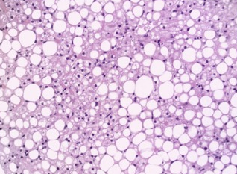

Defining MASLD and MASH
Metabolic Dysfunction-Associated Steatotic Liver Disease (MASLD)
Presence of steatosis in ≥5% hepatocytes; minimal alcohol use
No other etiology for liver disease; no secondary causes of MASLD (e.g., medications, HIV, lipodystrophy)
Global prevalence of MASLD is ~30% among adults
Projected to rise with ↑ rates of obesity, type 2 diabetes, and metabolic syndrome
Ballooned hepatocytes
MASLD (Non-progressive)
MASH (Progressive)
MASLD is often asymptomatic, discovered incidentally during routine labs
HIV = human immunodeficiency virus; MASH = metabolic dysfunction-associated steatohepatitis.
Loomba R, et al. Cell. 2021;184(10):2537-2564. Brouwers B, et al. Diabetes Res Clin Pract. 2024;211:111675.

Slide 6
Other Types of Steatotic Liver Disease
Metabolic dysfunction and alcohol-associated liver disease (MetALD)
Refers to patients with hepatic steatosis, at least one metabolic risk factor, and moderate alcohol consumption, defined as 20-50 g/day for females and 30-60 g/day for males
May result from a combination of metabolic dysfunction and moderate alcohol consumption, representing a spectrum between MASLD-predominant and alcohol-predominant disease
Alcohol-associated liver disease (ALD)
Patients with steatosis and heavy alcohol use (>50 g/day for females, >60 g/day for males), with a standard drink containing ~14g alcohol
Huang DQ, et al. Nat Rev Dis Primers. 2025;11(1):14. Girish V, et al. In: StatPearls [Internet]. Treasure Island (FL): StatPearls Publishing; 2025. https://www.ncbi.nlm.nih.gov/books/NBK459290/.

Slide 7
Defining Metabolic Risk: AASLD
Excess adiposity
BMI: A BMI of ≥25 kg/m² in the general population or ≥23 kg/m² in individuals of Asian ancestry
Central (visceral) obesity (waist circumference thresholds):
Waist circumference of ≥94 cm in men and ≥80 cm in women of European ancestry
Waist circumference of ≥90 cm in men and ≥80 cm in women of South-Asian or Chinese ancestry
Waist circumference of ≥85 cm in men and ≥90 cm in women of Japanese ancestry
Disorders of glucose metabolism
Prediabetes: Glycated hemoglobin (HbA1c) 5.7% to 6.4%; fasting plasma glucose ranging from 100 mg/dL to 125 mg/dL
Type 2 diabetes: A1c of ≥6.5%; fasting plasma glucose of ≥126 mg/dL
Hypertriglyceridemia: Plasma triglycerides ≥150 mg/dL or treatment with lipid-lowering agents
HDL cholesterol: <40 mg/dL in men or ≤50 mg/dL in women
Arterial hypertension: Resting blood pressure of ≥130/85 mm Hg or ongoing antihypertensive treatment
AASLD = American Association for the Study of Liver Diseases; BMI = body mass index; HbA1c = hemoglobin A1c; HDL = high-density lipoprotein.
Diaz LA, et al. Clin Gastroenterol Hepatol. 2025;S1542-S3565(25)00584-1. [Epub ahead of print].

Slide 8




Patient Case: Mr. B
Mr. B is a 61-year-old utilities field crew chief
He presents for a routine follow-up visit
He feels well and has no specific complaints
He denies fatigue, abdominal pain, pruritus, or jaundice
History
Type 2 diabetes, dyslipidemia, hypertension
He is overweight with a BMI of 29.1 kg/m²
He drinks an occasional glass of wine with dinner
Current medications: metformin, valsartan, hydrochlorothiazide
Physical Exam
Physical exam is unremarkable

Slide 9

Patient Case: Mr. B
AST: 28 U/L
ALT: 36 U/L (ALT > AST, both normal)
ALP: 100 U/L
Total bilirubin: 1.0 mg/dL
Albumin: 4.0 g/dL
Platelets: 110,000/μL
LDL: 130 mg/dL
HDL: 36 mg/dL
TG: 235 mg/dL
A1C: 7.1%
ALP = alkaline phosphatase; ALT = alanine aminotransferase; AST = aspartate aminotransferase; HDL = high-density lipoproteins; LDL = low-density lipoproteins; TG = triglycerides.

Slide 10
Audience Response
Which of the following is the FIRST step for risk stratification?
Fibrosis-4 (FIB-4)
Liver biopsy
Magnetic resonance elastography (MRE)
Transient elastography (e.g., FibroScan)
I don’t know
Notes:
Answer: A

Slide 11
Fibrosis-4 (FIB-4) Score
FIB-4
Predicts advanced fibrosis in the liver
Age (years)
ALT (U/L)
AST (U/L)
Platelet count (x10⁹/L)
Understanding the FIB-4 Score
Score <1.3 Rules out advanced fibrosis Sensitivity: 74% Specificity: 71% | Indeterminate | Score >2.67 Predicts advanced fibrosis Sensitivity: 33% Specificity: 98%
Shah AG, et al. Clin Gastroenterol Hepatol. 2009;7:1104-1112. Angulo P, et al. Hepatology. 2007;45:846-854.

Slide 12
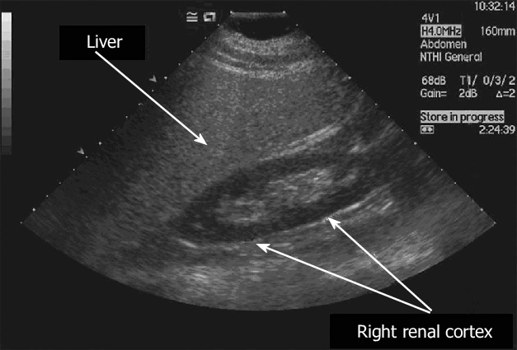
Patient Case: Mr. B
Abdominal ultrasound demonstrates hepatic steatosis without focal hepatic lesions, biliary ductal dilation, or ascites
Image: Mehta S. World J Gastroenterol.

Slide 13
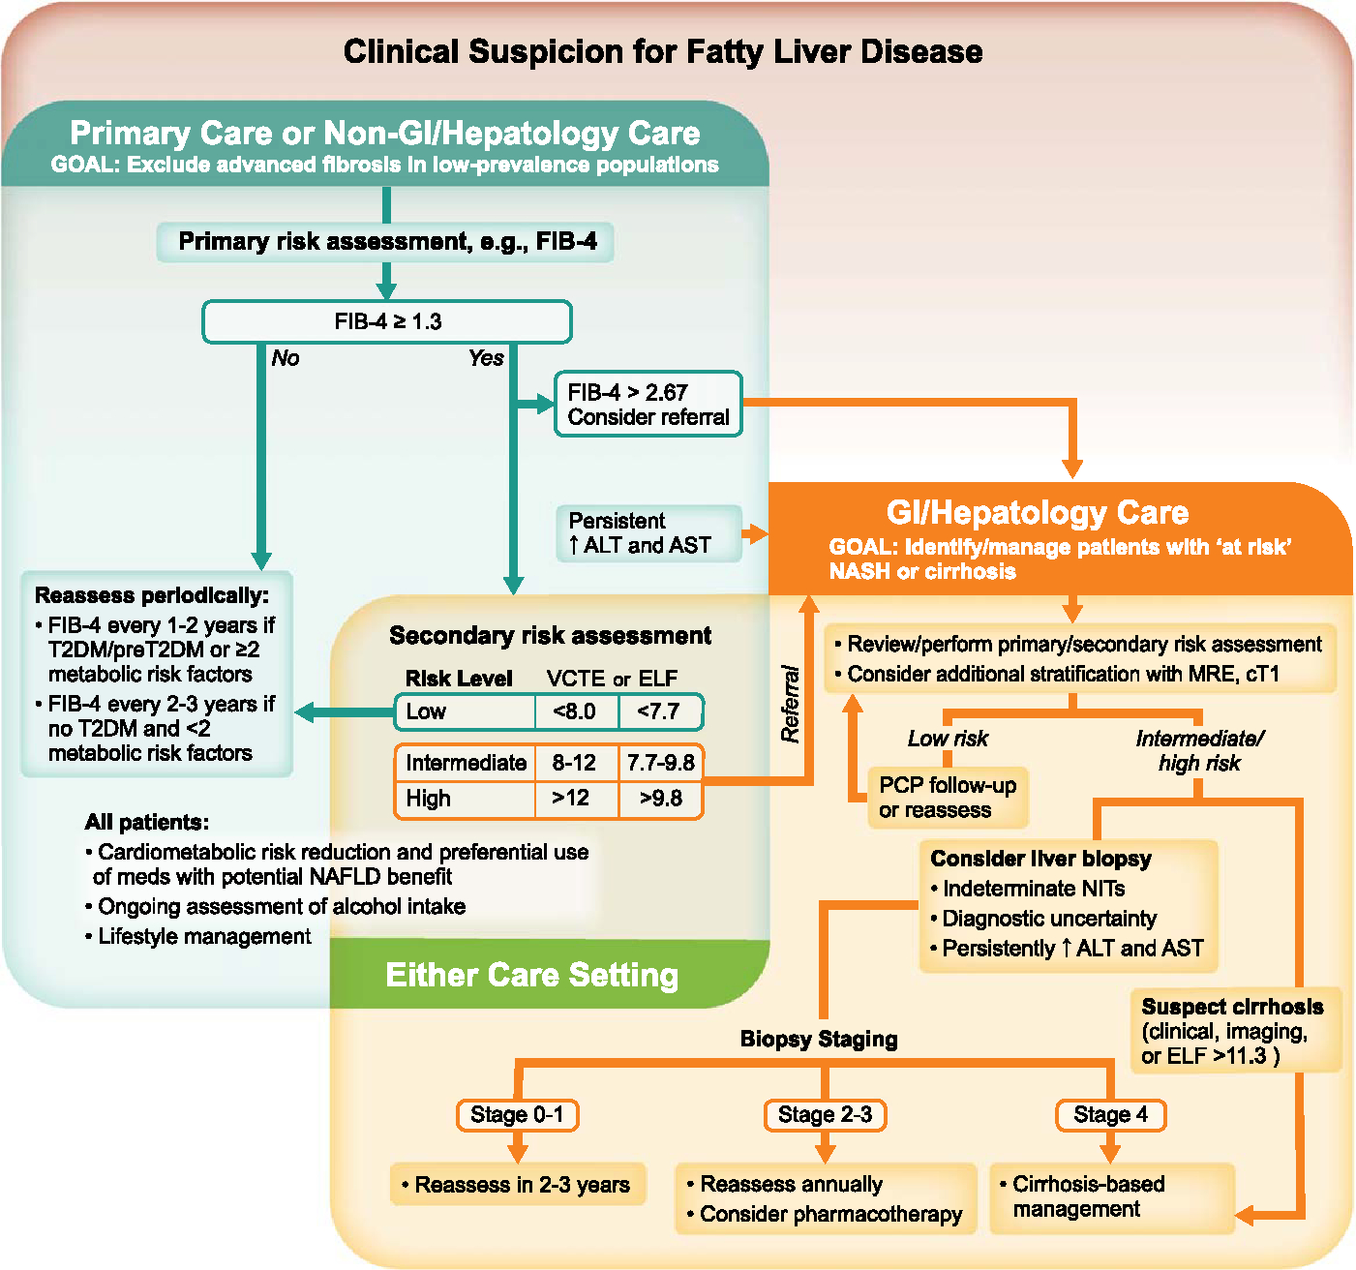
Defining Metabolic Risk: AASLD
MASLD: Algorithm for Evaluation of Patients at Risk Across Practice Settings
Rinella ME, et al. Hepatology. 2023;77(5):1797-1835. Diaz LA, et al. Clin Gastroenterol Hepatol. 2025;S1542-S3565(25)00584-1. [Epub ahead of print].

Slide 14


Put information into action!
Takeaways from this program can be implemented into your practice to improve patient care.
Focus on risk stratification for patients rather than screening for MASLD/MASH, and increase the number of patients assessed in your practice over the next 3-6 months
Evaluate ultrasound findings and FIB-4 calculations to identify patients with fibrosis, including those with less obvious risk factors, and increase the number of patients assessed in your practice over the next 3-6 months

Slide 15
To Receive Credit
To receive CME/CE credit for this activity, participants must complete the post-test and evaluation online.
Participants will be able to download and print their certificate immediately upon completion.

Slide 16
Welcome to the Glow-Up Era of MASH Management
Ditch the Guesswork: Non-Invasive Tools That Slay Diagnosis and Monitoring
Welcome to the Glow-Up Era of MASH Management
Welcome to the Glow-Up Era of MASH Management
What’s Hot and What’s Next: Mastering MASH-Specific Therapies That Deliver
GLP-1s Got That Rizz: The Future of MASH and Metabolic Syndrome Care

Slide 17
Additional Resources
Visit www.cmeoutfitters.com for clinical information and certified educational activities

Slide 18
Visit the
Liver Disease Hub
Free resources and education
for health care professionals and patients
https://www.cmeoutfitters.com/practice/liver-disease-hub/

