Slide 1
Tackling Barriers to Genomic and Biomarker Testing in Precision Cancer Medicine: Integrating the Latest Evidence into Practice for Community Oncology Clinicians
Supported by an educational grant from Merck Sharp & Dohme, LLC, a subsidiary of Merck & Co., Inc.
Notes:
https://vimeo.com/810992561/c894a14be4
00:00: Hello, I’m Doctor…

Slide 2
Part 3: A Guide for Community Oncologists: Interpretation of Genetic and Biomarker Testing Results
Supported by an educational grant from Merck Sharp & Dohme, LLC, a subsidiary of Merck & Co., Inc.
Notes:
00:17: in this episode, we will be discussing

Slide 3
Banu K. Arun, MD, FASCO
Professor, Department of Breast Medical Oncology
Co-Medical Director, Clinical Cancer Genetics Program
Section Chief, Breast Genetics, Prevention and Screening
University of Texas MD Anderson Cancer Center
Houston, TX
Notes:
00:33: Now let me introduce your faculty

Slide 4
Robert L. Coleman, MD
Gynecologic Oncologist
Chief Medical Officer, Sarah Cannon Research Institute (SCRI)
Co-Director, GOG-Partners
Philadelphia, PA
Notes:
00:48: Joining me today is Doctor Robert

Slide 5
Learning Objective
Interpret results of genetic and biomarker tests to better inform and target therapy
Notes:
01:06: So let’s start be reviewing our learning

Slide 6
Biomarkers in Oncology
How can biomarkers guide clinical decisions?
Biomarker is a measurement variable that is associated with disease outcome
Prognostic biomarker informs about a likely cancer outcome (eg, disease recurrence, disease progression, death) independent of received treatment
Predictive biomarker informs about a likely cancer outcome that is related to a received treatment
Biomarkers Definitions Working Group. Clin Pharmacol Ther. 2001;69(3):89-95; Ballman KV.J Clin Oncol. 2015;33(33):3968-3971.
Notes:
01:26: In our previous session

Slide 7
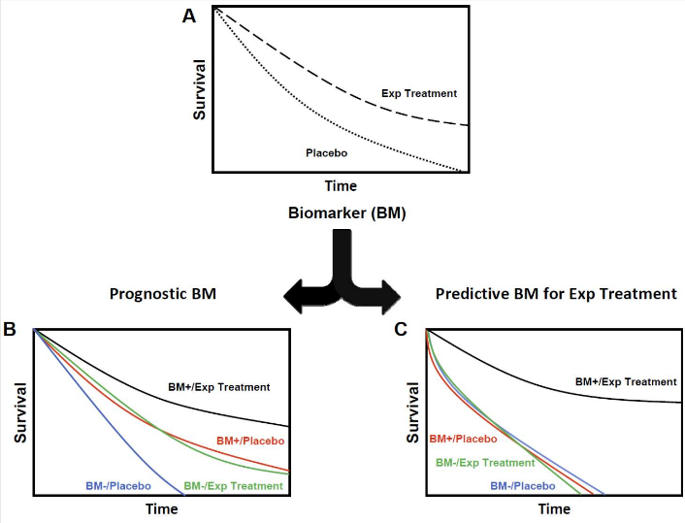
Biomarkers in Oncology: Prognostic
PSA level at the time of a prostate cancer diagnosis
PIK3CA mutation status of HER2+ metastatic breast cancer
Women with PIK3CA-mut tumors had worse PFS outcome compared with women with PIK3CAwt tumors regardless of treatment
HR: Same
Median in control arm is different
Biomarkers Definitions Working Group. Clin Pharmacol Ther. 2001;69(3):89-95. Ballman KV. J Clin Oncol. 2015;33(33):3968-3971.
Notes:
03:02: so a good example might be for instance

Slide 8
Biomarkers in Oncology: Predictive
Erlotinib maintenance treatment for advanced NSCLC (PFS endpoint)
EGFR-mut HR 0.10 (95% CI, 0.04 - 0.25; P < 0.001)
EGFRwt HR 0.78 (95% CI, 0.63 - 0.93; P = 0.019)
Both EGFR-mut and EGFRwt derive PFS benefit from erlotinib; the EGFR-mut group derived much greater benefit
Early-stage HER2+ breast cancer treated with or without trastuzumab, as a function of whether or not the tumors were immune-enriched
Immune-enriched: HR 0.36 (95% CI, 0.23 - 0.56; P < 0.001)
Non–immune-enriched: HR 0.98 (95% CI, 0.68 - 1.41; P = 0.91)
HR_{exp} >> HR_{cntrl}
Median in control arm same
Biomarkers Definitions Working Group. Clin Pharmacol Ther. 2001;69(3):89-95. Ballman KV. J Clin Oncol. 2015;33(33):3968-3971.
Notes:
04:06: Predictive biomarkers and that’s exactly what it sounds like

Slide 9
Biomarkers in Oncology
HR_{exp} >> HR_{cntrl}
Median in controls arms are different
Biomarkers Definitions Working Group. Clin Pharmacol Ther. 2001;69(3):89-95. Ballman KV. J Clin Oncol. 2015;33(33):3968-3971.
Notes:
05:47: So if you put these together

Slide 10
Community Oncologists and Biomarker Testing
Community oncologists must interpret tumor biomarker test results
Tumors are genetically complex
Discern somatic from germline variants
Triage patients for further genetic counseling
Discern actionable mutations from passenger mutations
Identify prognostic and predictive biomarkers
Adopting consensus terms for testing and the use of plain language by clinicians may help improve knowledge and communication, and facilitate share decision making, particularly among patients with low health literacy
Notes:
06:40: in the community setting

Slide 11
Mutation Testing Options
Whole genome sequencing
Offers unbiased analysis
Large amount of information
Targeted gene panels
Catalogs mutations in select genes/regions of genes (mutational hotspots) that are well characterized in terms of cancer biology and clinical relevance
Paired germline testing
Tumor testing alone does not indicate whether or not a mutation is also found in the germline
Incidental mutations may be found in tumor samples
Paired germline testing offers more confidence in the source of the mutation (germline vs somatic)
Damodaran S, et al. Breast J. 2020;26(8):1565-1571.
Notes:
08:02 the mutation testing options

Slide 12
Measuring MSI/dMMR Can be Confusing
IHC test for 4 proteins
MLH1, MSH6, PMS2, MSH2
Present = normal
Missing = consider reflex to gene test
Gene sequencing
Length of microsatellites compared with normal
Can be done using next-generation sequencing platforms
Need normal tissue
Germline vs somatic
Notes:
10:46: To continue on the what type of test are available

Slide 13
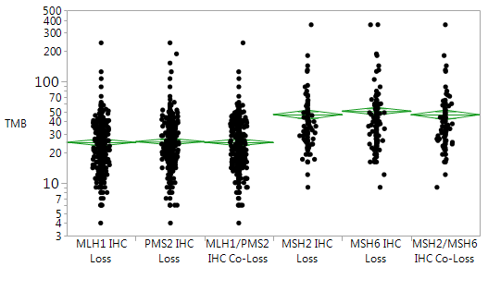
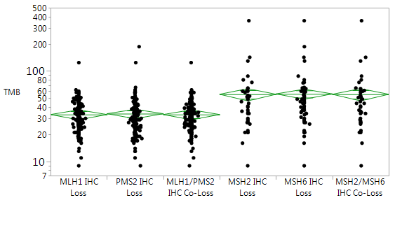
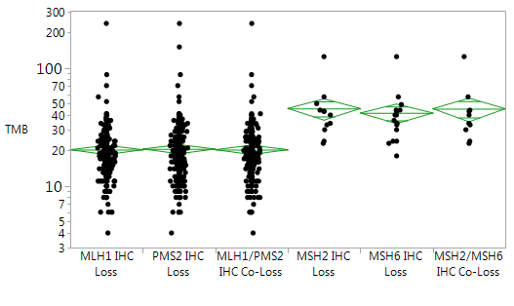
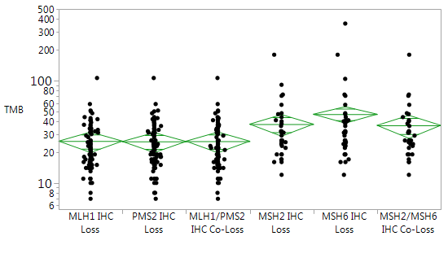
MSI-H Tumors Are Not Created Equal
All Tumors
500
CRC
500
400
400
300
300
200
200
100
100
70
80
50
TMB
40
TMB
60
30
50
20
40
30
10
20
7
5
10
4
7
3
MLH1 IHC
Loss
PMS2 IHC
Loss
MLH1/PMS2
IHC Co-Loss
MSH2 IHC
Loss
MSH6 IHC
Loss
MSH2/MSH6
IHC Co-Loss
MLH1 IHC
Loss
PMS2 IHC
Loss
MLH1/PMS2
IHC Co-Loss
MSH2 IHC
Loss
MSH6 IHC
Loss
MSH2/MSH6
IHC Co-Loss
Mean mut/Mb | 25 | 25 | 25 | 47 | 51 | 47
Mean mut/Mb | 25 | 25 | 25 | 47 | 51 | 47
Endometrial
300
Other Cancers
500
200
400
300
100
200
70
100
50
80
TMB
40
60
30
TMB
50
20
40
30
10
20
7
10
5
8
4
6
3
MLH1 IHC
Loss
PMS2 IHC
Loss
MLH1/PMS2
IHC Co-Loss
MSH2 IHC
Loss
MSH6 IHC
Loss
MSH2/MSH6
IHC Co-Loss
MLH1 IHC
Loss
PMS2 IHC
Loss
MLH1/PMS2
IHC Co-Loss
MSH2 IHC
Loss
MSH6 IHC
Loss
MSH2/MSH6
IHC Co-Loss
Mean mut/Mb | 25 | 25 | 25 | 47 | 51 | 47
Mean mut/Mb | 25 | 25 | 25 | 47 | 51 | 47
Loss of MSH2/6 associated with higher TMB vs loss of MLH1/PMS2
Hall MJ, et al. J Clin Oncol. 2019;37(4_suppl):505.
Notes:
12:14: But we do have these two techniques

Slide 14
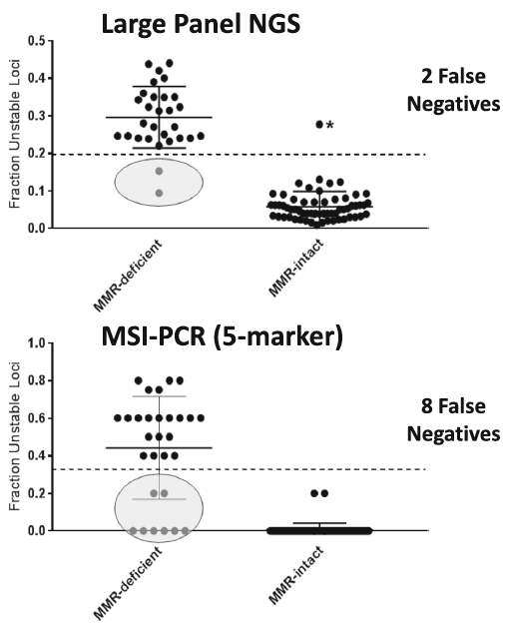
dMMR Testing Methods
Test | Sensitivity | Specificity | Notes
MSI-PCR | 97.0% | 95.0% | 5 marker loci; based on specific disease type Less accurate in noncolon; human interpretation; high DNA requirement
IHC (staining MMR protein) | 92.0% | 99.0% | Cannot detect loss of function mutations that do not affect the antigenicity of the targeted protein; human interpretation
CARIS MI | 95.8% | 99.4% | ≥ 43 altered microsatellite loci
Foundation One | 95.0% | 98.0% | 114 microsatellite loci
MANTIS | 95.4% | 98.9%
MSISensor | 95.4% | 95.5%
NGS
Hempelmann JA. J Immunother Cancer. 2018;6:29. Kautto EA. Oncotarget. 2017; 8:7452. Niu B. Bioinformatics. 2014;30:1015.
Notes:
13:55: So a lot of people say so how do you test

Slide 15
Relationship Between PD-L1, TMB, and MSI in Endometrial Cancer
1. Luchini C, et al. Ann Oncol. 2019;30:1232-1243. 2. Vaderwalde A, et al. Cancer Med. 2018;7(3):746-756.
Notes:
15:15: other people will often say that

Slide 16
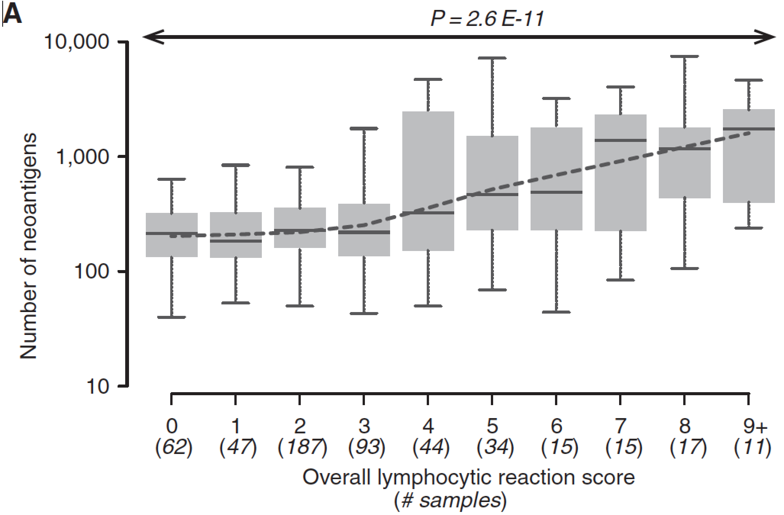
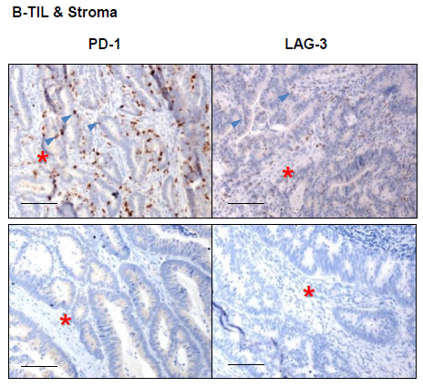
Cancers Associated with MSI Have Greater T-Cell Infiltrate and Checkpoint Expression
More Neoantigens Associated with Higher TIL
Higher Levels of Checkpoint Expression in MSI-H
MSI-H
Number of Neoantigens
MSS
Giannakis, et al. Cell Rep. 2016;15:857. Llosa, et al. Cancer Discov. 2015;5:43.
Notes:
16:12: We think that a lot of this is driven by the fact that

Slide 17
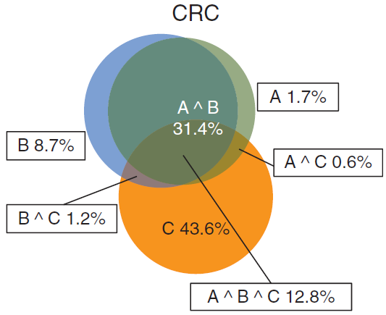
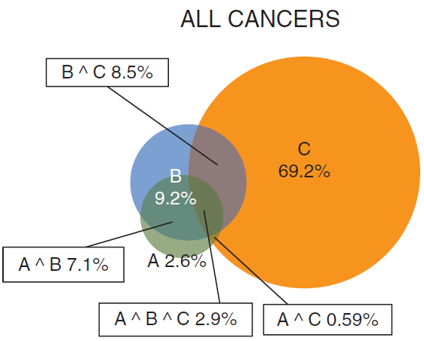
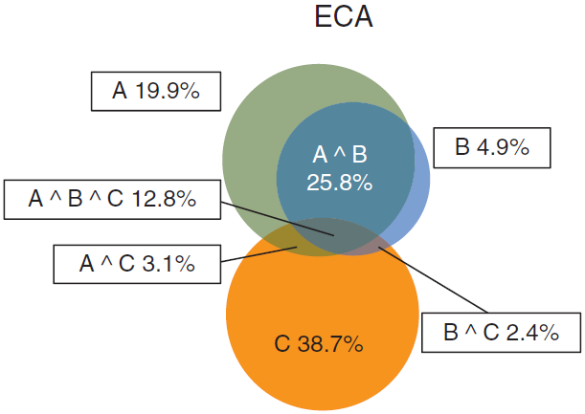
Endometrial and Colorectal Cancers Have High Concordance of TMB-H and MSI-H Expression
Colorectal cancers (44.2%) and endometrial cancers (31%) show high percentage of concordance of TMB-H and MSI-H compared to all cancers (P <0.05)
PD-L1 expression is mostly non-overlapping with dMMR/ MSI-H status and represents a distinct biomarker population
A
MSI
B
TMB
C
PD-1/PD-L1 expression
CRC, colorectasl cancer; dMMR, mismatch repair deficient; ECA, endometrial carcinoma; MSI-H, microsatellite instability-high; PD-1, programmed death-1; PD-L1, programmed death ligand-1; TMB, tumor mutational burden. Luchini C et al. Ann Oncol. 2019;30:1232-1243.
Notes:
16:40: and so in colorectal cancer

Slide 18
Current Treatment of Advanced/Recurrent or High-risk EC
Treatment guidelines recommend platinum-based chemotherapy (carboplatin + paclitaxel) as preferred first-line treatment of advanced/recurrent EC; in second line, guidelines recommend PD-1 regimens based on biomarker (MMR/MSI) status
Guideline recommendations are based on recent approvals of PD-1 agents in the second-line or greater setting
pembrolizumab dMMR/MSI-H solid tumors (US, Argentina, Russia)
pembrolizumab + lenvatinib EC that is not dMMR/MSI-H (US, Canada, Australia, Russia)
dostarlimab dMMR EC (US), dMMR/MSI-H EC (EU)
2017
2018
2019
2020
2021
Colombo N et al. Ann Oncol. 2016;27:16–41. Concin N et al. Int J Gynecol Cancer. 2021;31:13–39.
Notes:
17:22: Yeah, this is a big win for us

Slide 19
PD-1 + Chemotherapy for Advanced/Recurrent or High-risk EC
 | ENGOT EN-6/GOG-3031/RUBY (dostarlimab + CP) | NRG-GY018 (pembrolizumab + CP)
Target N | 470 | 810
Investigational treatment duration | Up to 3 years | Up to 2 years
Chemotherapy duration | 6 cycles | 6 cycles, but can extend up to 10 cycles
Prior radiotherapy | Must be at least 3 weeks since | Must be at least 4 weeks since
Stratification factors | Recurrent vs primary stage III vs primary stage IV disease Prior radiotherapy (yes or no) MMR status (central laboratory) | ECOG PS (0 or 1 and 2) Prior chemo (yes or no) MMR status (local testing)
ECOG criteria | 0–1 | 0–2
Time since chemotherapy for recurrent patients | ≥ 6 months | ≥ 12 months
Disease criteria | Primary stage IIIA to IIIC1 disease with presence of evaluable or measurable disease Primary stage IIIC2 or stage IV, whether or not there is evaluable or measurable disease | Stage III, IV, or recurrent EC: Stage III or IVA, measurable disease Stage IVB or recurrent, whether or not there is measurable disease
Histology criteria | Includes carcinosarcoma | Excludes carcinosarcoma
Primary outcome(s) | PFS (IA), OS (all comers, dMMR) | PFS (IA)
Scan frequency | Every 6 weeks until week 25,then, every 9 weeks until week 52, then every 12 weeks | Every 9 weeks for the first 9 months, then every 12 weeks
dMMR = mismatch repair deficient; CP = carboplatin+paclitaxel
Eskander RN, et al. New Engl J Med. 2023. Mirza MR, et al. New Engl J Med. 2023.
Notes:
19:00: a second drug called dostarlimab was recently also given

Slide 20
PD-1 + Chemotherapy for Advanced/Recurrent or High-risk EC
 | ENGOT EN-6/GOG-3031/RUBY (Dostarlimab + CP) | NRG-GY018 (Pembrolizumab + CP)
dMMR-MSI-H
pMMR-MSS
100
80
60
40
20
0
 | Median PFS, months (95% CI)
Dostarlimab + CP | NE (11.5-NE)
Placebo + CP | 7.7 (5.6-9.7)
Hazard ratio, 95% CI (p value) | HR 0.28, 0.16-0.50 (p<0.0001)
100
80
60
40
20
0
 | Median PFS, months (95% CI)
Pembrolizumab + CP | NR (30.6-NE)
Placebo + CP | 7.6 (6.4-9.9)
Hazard ratio, 95% CI (p value) | HR 0.30, 0.19–0.48 (p<0.00001)
Progression-free survival
63.5%
61.4%
Progression-free survival
63.5%
61.4%
24.4%
24.4%
15.7%
15.7%
0 6 12 18 24 30 36
Months
Months
0 6 12 18 24 30 36
100
80
60
40
20
0
 | Median PFS, months (95% CI)
Dostarlimab + CP | 11.8 (9.6-17.1)
Placebo + CP | 7.9 (7.6-9.5)
Hazard ratio, 95% CI (p value) | HR 0.64, 0.51-0.80 (p<0.0001)
100
80
60
40
20
0
 | Median PFS, months (95% CI)
Pembrolizumab + CP | 13.1 (10.5-18.8)
Placebo + CP | 8.7 (8.4-10.7)
Hazard ratio, 95% CI (p value) | HR 0.54, 0.41-0.71 (p < 0.00001)
Progression-free survival
48.2%
Progression-free survival
63.5%
61.4%
36.1%
29.0%
24.4%
18.1%
15.7%
0 6 12 18 24 30 36
0 6 12 18 24 30 36
Eskander RN, et al. New Engl J Med. 2023. Mirza MR, et al. New Engl J Med. 2023.
Notes:
19:36: And what we saw is that

Slide 21
PD-1 + Chemotherapy for Advanced/Recurrent or High-risk EC
The addition of dostarlimab or pembrolizumab to standard of care chemotherapy, demonstrated statistically significant and clinically meaningful PFS benefit
Substantial, unprecedented benefit in dMMR/MSI-H patients (~70% reduction in the risk of disease progression or death)
Clinically meaningful long-term benefit observed in MMRp/MSS patients (~40% reduction in the risk of disease progression or death )
Early separation of efficacy curves maintained throughout the evaluation period in both populations
Addition of anti-PD-1 did not appear to increase the frequency of AEs commonly associated with chemotherapy
Eskander RN, et al. New Engl J Med. 2023. Mirza MR, et al. New Engl J Med. 2023.
Notes:
19:51: So these kind of three conditions, the two indications in

Slide 22
Summary of Analytical Endpoints for Recurrent Maintenance PARPi Trials in Ovarian Cancer
ARIEL2, part 1 | PFS (median) |  | HR (95% CI) | P value
 | Rucaparib | Placebo
tBRCA | 16.8 mos | 5.4 mos | 0.23 (0.16-0.34) | P < 0.0001
tBRCA + HRD | 13.6 mos | 5.4 mos | 0.32 (0.24-0.42) | P < 0.0001
ITT | 10.8 mos | 5.4 mos | 0.36 (0.30-0.45) | P < 0.0001
ENGOT-OV16/NOVA | Niraparib | Placebo | HR | P
gBRCA | 21.0 mos | 5.5 mos | 0.27 (0.17-0.41) | P < 0.0001
All non-gBRCA (sBRCA+HRD+HRC) | 9.3 mos | 3.9 mos | 0.45 (0.34-0.61) | P < 0.001
ITT (FDA analysis) | 11.3 mos | 4.7 mos | 0.42 (0.34-0.53) | Non-analytic
SOLO2/ENGOT-Ov21 | Olaparib | Placebo | HR | P
gBRCA | 19.1 mos | 5.5 mos | 0.30 (0.22-0.41) | P < 0.0001
HRD/C = homologous recombination deficient/competent; CP = carboplatin+paclitaxel
1. Swisher EM, et al. Lancet Oncol. 2017;18(1):75-87. 2. Mirza MR, et al. N Engl J Med. 2016;375(22):2154-2164. 3. Pujade-Lauraine E, et al. Lancet Oncol. 2017;18(9):1274-1284.
Notes:
20:22: There is great data

Slide 23
Summary of Analytical Endpoints for Front-line Maintenance PARPi Trials in Ovarian Cancer
 | SOLO-1¹ (N = 391) | PRIMA/ ENGOT-OV26² (N = 733) | PRIME³ (N = 384) | ATHENA-Mono⁴ (N = 538) | PAOLA-1/ ENGOT-OV25⁵ (N = 806) | VELIA/GOG-3005⁶ (N = 1140)
Treatment arms | Olaparib vs placebo | Niraparib vs placebo | Niraparib vs placebo | Rucaparib vs placebo | Olaparib + bevacizumab vs Placebo + bevacizumab | Veliparib+CP → veliparib Veliparib+CP → placebo Placebo+CP → placebo
Randomization | 2:1 | 2:1 | 2:1 | 4:1 | 2:1 | 1:1:1
PARP inhibitor duration | Up to 24 months | Up to 36 months | Up to 36 months | Up to 24 months | Up to 24 months | Up to 24 months
Assessment | PFS-Investigator | PFS-BICR | PFS-BICR | PFS-Investigator | PFS-Investigator | PFS-Investigator
Primary endpoint | ITT: 0.30 (0.23 – 0.41) | HRD test +: 0.43 (0.31-0.59) | ITT: 0.45 (0.34-0.60) | HRD test +: 0.47 (0.31-0.72) | ITT: 0.59 (0.49-0.72) | BRCA: 0.44 (0.28-0.68)
Hierarchical Endpoints | - | ITT: 0.62 (0.50-0.76) | - | ITT: 0.52 (0.40-0.68) | PFS2 - ITT: 0.78 (0.64-0.95) | HRD Test +: 0.57 (0.43-0.76)
 |  |  |  |  |  | ITT: 0.68 (0.56-0.83)
dMMR = mismatch repair deficient; CP = carboplatin+paclitaxel
1. Moore K, et al. N Engl J Med. 2018;379(26):2495-2505. 2. González-Martín A, et al. N Engl J Med. 2019;381(25):2391-2402. 3. Li N, et al. Gynecologic Oncology. 2022;166:S50-S51. 4. Monk BJ, et al. Journal of Clinical Oncology. 2022;40(34):3952-3964. 5. Ray-Coquard I, et al. N Engl J Med. 2019;381(25):2416-2428. 6. Coleman RL, et al. N Engl J Med. 2019;381(25):2403-2415.
Notes:
23:36: because that was so positive, we

Slide 24
Summary of Trials for BRCA-mut Breast Cancer
 | OlympiAD (N = 302) | EMBRACA (N = 431) | BROCADE (N = 196) | OlympiA (N = 1836)
Treatment arms | olaparib vs physician's choice | talazoparib vs physician's choice | velaparib + CP vs CP | olaparib vs placebo, following (neo)adjuvant therapy, if indicated
Randomization | 2:1 | 2:1 | 2:1 | 1:1
PARP inhibitor duration | Until progression | Until progression | Until progression | Up to 52 weeks
Primary endpoint | median PFS: 7.0 vs 4.2 months (HR 0.58; 0.43-0.80) | median PFS: 8.6 vs 5.6 months (0.54; 0.41–0.71) | median PFS:14.1 vs 12.3 months (HR 0.79; 0.54-1.16) | 3-yr IDFS: 86% vs 77% (HR 0.58; 0.41-0.82)
Secondary endpoints | ORR: 60% vs 29% median OS: 19.3 vs 17.1 months | ORR: 63% vs 27% median OS: 19.3 vs 19.5 months | ORR: 78% vs 61% median OS: 28.5 vs 25.0 months | 3-yr DDFS: 88% vs 80% 3-yr OS: 92% vs 88%
DDFS = distant disease-free survival; IDFS = invasive disease-free survival
Robson M, et al. N Engl J Med. 2017;377(6):523-533. Robson ME, et al. Ann Oncol. 2019;30(4):558-566. Litton JK, et al. N Engl J Med. 2018;379(8):753-763. Litton JK, et al. Ann Oncol. 2020;31(11):1526-1535. Han HS, et al. Cancer Research. 2017;77(4_Supplement):S2-05-S02-05. Geyer CE, Jr., et al. Ann Oncol. 2022;33(12):1250-1268.
Notes:
25:17: Again, we are just thrilled and excited

Slide 25
Summary
Biomarker is a measurement variable that is associated with disease outcome
Prognostic biomarker is independent of received treatment
Predictive biomarker is related to a received treatment
Germline and somatic testing are complementary
Pairing offers more confidence in the source of a tumor mutation (germline vs somatic)
Notes:
27:36: So what we discussed today

Slide 26
SMART Goals
Specific, Measurable, Attainable, Relevant, Timely
Pair germline with somatic testing where possible
Use consensus terms for biomarker testing and results
Speak in plain language to patients about testing results and the implications for treatment
Encourage genetic counseling in patients with high suspicion of pathogenic germline mutation
Notes:
28:05: I want to now mention our SMART goals

Slide 27
To Receive Credit
To receive CME/CE credit for this activity, participants must complete the post-test and evaluation online. Participants will be able to download and print their certificate immediately upon completion.
Notes:
28:49: To receive CME/CE

Slide 28
Oncology Hub
Free resources and education to educate health care providers and patients on oncology https://www.cmeoutfitters.com/oncology-education-hub/
Diversity and Inclusion Hub
Free resources and education to educate health care providers and patients on health-related inequities https://www.cmeoutfitters.com/diversity-and-inclusion-hub/
Notes:
29:00: Lastly, please visit the CME Outfitters

