Slide 1

Focusing on Function with
Patient-Centered Pain Care:
Revised Guidelines for Opioid Prescribing
Notes:
https://vimeo.com/776638133/28d2fe7e47
00:00 hello everyone

Slide 2
This activity is supported by an independent educational grant from Opioid Analgesic REMS Program Companies.
Please see https://www.opioidanalgesicrems.com/Resources/Docs/List_of_RPC_Companies.pdf
for a listing of REMS Program Companies.
This activity is intended to be fully compliant with the Opioid Analgesic REMS education requirements issued by the US Food and Drug Administration (FDA).
Notes:
00:21 today’s program

Slide 3
Johnathan H. Goree, MD
Director of Chronic Pain Division
Program Director of Chronic Pain Medicine Fellowship
Associate Professor of Anesthesiology
University of Arkansas for Medical Sciences (UAMS)
Little Rock, AR
Notes:
00:30 and I’d like to start

Slide 4
Yvonne D'Arcy, MS, APRN-C, CNS, FAANP
Pain Management and Palliative Care Nurse Practitioner
Ponte Vedra Beach, FL
Notes:
00:57
I’m also very pleased

Slide 5
Melissa J. Durham, PharmD, MACM, APh
Associate Professor of Clinical Pharmacy, University of Southern California (USC)
Clinical Pharmacist, The USC Pain Center
Los Angeles, CA
Notes:
01:48 Hello everyone

Slide 6
Learning Objectives
Apply knowledge of acute and chronic pain pathways and underlying mechanisms to clinical assessment and appropriate management of pain.
Incorporate the updated CDC Guideline for Prescribing Opioids to practice for safe and competent prescribing and improved HRQoL for patients with chronic pain.
Educate patients about their pain to optimize safe and effective, multimodal treatment plans.
Utilize the DSM-5 criteria to identify and diagnose opioid use disorder (OUD) in patients prescribed opioids for acute and chronic pain.
Develop strategies for engaging patients in treatment for OUD.
Notes:
02:30 here are our learning objectives

Slide 7
Audience Response
Which of the following is a proposed change to the CDC 2022 opioid prescribing guidelines?
Patients on doses of opioids over 90 mme/day should be managed by a pain specialist
Opioids should only be utilized when a physical cause for pain is identified
Care of patients on long-term opioids should be individualized with a focus on safety
Patients with subacute and chronic pain should utilize cognitive behavioral therapy (CBT) as part of management
I don’t know
Notes:
02:50 before we do that

Slide 8
Audience Response: Results
Results recorded on October 19, 2022.
Notes:
03:00 well, awesome

Slide 9
Unintended Consequences of 2016 CDC Guideline on Opioid Prescribing
Lack of guidance on safe use of opioids in acute pain and patients already established on long-term opioids
Arbitrary limits superseded medical judgement
  40 states have enacted legislation related to opioid prescription limits
  11 states have laws limiting daily allowable dose
Many pain patients abruptly discontinued or dismissed from care without follow-up plan
“We don’t accept patients on chronic opioids”
“I will see you, but I won’t fill any opioid prescriptions”
“I will see you, but we need to start tapering your opioids right away”
Lagisetty PA, et al. JAMA Netw Open. 2019;2(7):e196928. Lagisetty PA, et al. Pain. 2021;162(5):1379-1386. Dowell D. N Engl J Med. 2019;380(24):2285-2287. Vestal C. Stateline. 2022. https://www.pewtrusts.org/en/research-and-analysis/blogs/stateline/2022/03/01/states-likely-to-resist-cdc-proposal-easing-opioid-access. Accessed October 17, 2022.
Notes:
03:09 I’m going to start
JG
Unintended consequences of 2016 guidelines
Lack of guidance on appropriate acute pain management and established long-term / high dose opioids
Long-term opioid users “punished”/dismissed from care without plan, at times leading to withdrawal, SUD, and overdose
Arbitrary limits imposed in state laws and prescription benefits
Lagisetty PA, Healy N, Garpestad C, Jannausch M, Tipirneni R, Bohnert ASB. Access to Primary Care Clinics for Patients With Chronic Pain Receiving Opioids. JAMA Netw Open. 2019;2(7):e196928. Published 2019 Jul 3. doi:10.1001/jamanetworkopen.2019.6928
Importance: Opioid-prescribing policies and guidelines aimed at reducing inappropriate opioid prescribing may lead physicians to stop prescribing opioids. Patients may thus encounter difficulties finding primary care practitioners willing to care for them if they take opioids.
Objectives: To assess practitioner willingness to accept and continue prescribing opioids to new patients with pain and whether this willingness differs across payer types.
Design, setting, and participants: This survey study used a simulated patient call audit method. A brief telephone survey was administered to all clinics followed by a call using a patient script simulating an adult patient with chronic pain who was taking long-term opioids. The patient had Medicaid or private insurance. Calls were made between June 22 and October 30, 2018, to 667 primary care clinics that served a general adult population in Michigan. Clinics that accepted both Medicaid and private insurance, took new patient appointments, and were successfully recontacted for the simulated call were eligible for the study.
Main outcomes and measures: Prevalence of clinics' acceptance of new patients receiving prescription opioids overall and by clinic characteristics and insurance type.
Results: Of the 194 eligible clinics, 94 (48.4%) were randomized according to insurance type to receive calls from research assistants posing as children of patients with Medicaid and 100 (51.5%) to receive calls from those with private insurance. Overall, 79 (40.7%) stated that their practitioners would not prescribe opioids to the simulated patient. Thirty-three clinics (17.0%) requested more information before making a decision. Compared with single-practitioner clinics, clinics with more than 3 practitioners were more likely (odds ratio [OR], 2.99; 95% CI, 1.48-6.04) to accept new patients currently taking opioids. No difference was found in access based on insurance status (OR, 0.92; 95% CI, 0.52-1.64) or whether the clinic offered medications for opioid use disorders (OR, 1.10; 95% CI, 0.45-2.69).
Conclusions and relevance: The findings suggest that access to primary care may be reduced for patients taking prescription opioids, which could lead to unintended consequences, such as conversion to illicit substances or reduced management of other medical comorbidities.
Lagisetty P, Macleod C, Thomas J, et al. Assessing reasons for decreased primary care access for individuals on prescribed opioids: an audit study. Pain. 2021;162(5):1379-1386. doi:10.1097/j.pain.0000000000002145
Many primary care clinics are resistant to accept new patients taking prescription opioids for chronic pain. It is unclear how much of this practice is specific to individuals who may be perceived to have aberrant opioid use. This study sought to determine whether clinics are more or less willing to accept and prescribe opioids to patients depending on whether their history is more or less suggestive of aberrant opioid use by conducting an audit survey of primary care clinics in 9 states from May to July 2019. Simulated patients taking opioids for chronic pain called each clinic twice, giving one of 2 scenarios for needing a new provider: their previous physician had either (1) retired or (2) stopped prescribing opioids for unspecified reasons. Clinic willingness to continue prescribing opioids and accept the patient for general primary care were assessed. Of 452 clinics responding to both scenarios (904 calls), 193 (43%) said their providers would not prescribe opioids in either scenario, 146 (32%) said their providers might prescribe in both, and 113 (25%) responded differently to each scenario. Clinics responding differently had greater odds (odds ratio = 1.83 confidence interval [1.23-2.76]) of willingness to prescribe when the previous doctor retired than when the doctor had stopped prescribing. These findings suggest that primary care access is limited for patients taking opioids for chronic pain, and differentially further reduced for patients whose histories are suggestive of aberrant use. This denial of care could lead to unintended harms such as worsened pain or conversion to illicit substances.
Dowell D, Haegerich T, Chou R. No Shortcuts to Safer Opioid Prescribing. New England Journal of Medicine. 2019;380(24):2285-2287. doi:10.1056/NEJMp1904190
No abstract
Vestal C. States Likely to Resist CDC Proposal Easing Opioid Access. Stateline. 2022; https://www.pewtrusts.org/en/research-and-analysis/blogs/stateline/2022/03/01/states-likely-to-resist-cdc-proposal-easing-opioid-access
No abstract

Slide 10
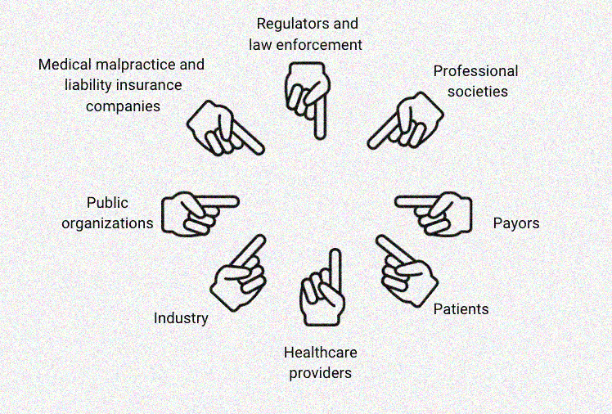
Misapplication of 2016 CDC Guideline
HCPs policed themselves to avoid unwanted scrutiny and liability
Interprofessional tension surfaced out of pressure to apply guidelines and avoid liability
Subjective application of PDMPs neglected SDoH and cultivated discrimination against patients of color
HCP = healthcare professional; PDMP = prescription drug monitoring program; SDoH = social determinants of health
Dowell D. N Engl J Med. 2019;380(24):2285-2287. Ranapurwala SI. Am J Prev Med. 2021;60(3):343-351. Human Rights Watch (HRW). 2018. https://www.hrw.org/report/2018/12/18/not-allowed-be-compassionate/chronic-pain-overdose-crisis-and-unintended-harms-us. Accessed October 17, 2022.
Notes:
05:28 and as we’ve done that
JG
Unintended consequences of 2016 CDC Opioid Prescribing Guideline
Arbitrary limits overtook medical judgement
Pressure from institutions, practice groups, peers, payers to limit prescribing
Unclear roles and responsibilities of different HCPs led to interprofessional frustration and concerns about risks/liability
Subjective application of PDMPs neglected SDoH and discriminated against POC
Dowell D, Haegerich T, Chou R. No Shortcuts to Safer Opioid Prescribing. New England Journal of Medicine. 2019;380(24):2285-2287. doi:10.1056/NEJMp1904190
No abstract
Ranapurwala SI, Ringwalt CL, Pence BW, et al. State Medical Board Policy and Opioid Prescribing: A Controlled Interrupted Time Series. Am J Prev Med. 2021;60(3):343-351. doi:10.1016/j.amepre.2020.09.015
Introduction: In March 2016, the Centers for Disease Control and Prevention issued opioid prescribing guidelines for chronic noncancer pain. In response, in April 2016, the North Carolina Medical Board launched the Safe Opioid Prescribing Initiative, an investigative program intended to limit the overprescribing of opioids. This study focuses on the association of the Safe Opioid Prescribing Initiative with immediate and sustained changes in opioid prescribing among all patients who received opioid and opioid discontinuation and tapering among patients who received high-dose (>90 milligrams of morphine equivalents), long-term (>90 days) opioid therapy.
Methods: Controlled and single interrupted time series analysis of opioid prescribing outcomes before and after the implementation of Safe Opioid Prescribing Initiative was conducted using deidentified data from the North Carolina Controlled Substances Reporting System from January 2010 through March 2017. Analysis was conducted in 2019-2020.
Results: In an average study month, 513,717 patients, including patients who received 47,842 high-dose, long-term opioid therapy, received 660,912 opioid prescriptions at 1.3 prescriptions per patient. There was a 0.52% absolute decline (95% CI= -0.87, -0.19) in patients receiving opioid prescriptions in the month after Safe Opioid Prescribing Initiative implementation. Abrupt discontinuation, rapid tapering, and gradual tapering of opioids among patients who received high-dose, long-term opioid therapy increased by 1% (95% CI= -0.22, 2.23), 2.2% (95% CI=0.91, 3.47), and 1.3% (95% CI=0.96, 1.57), respectively, in the month after Safe Opioid Prescribing Initiative implementation.
Conclusions: Although Safe Opioid Prescribing Initiative implementation was associated with an immediate decline in overall opioid prescribing, it was also associated with an unintended immediate increase in discontinuations and rapid tapering among patients who received high-dose, long-term opioid therapy. Better policy communication and prescriber education regarding opioid tapering best practices may help mitigate unintended consequences of statewide policies.
Chronic Pain, the Overdose Crisis, and Unintended Harms in the US. Human Rights Watch. HRW. 2018; https://www.hrw.org/report/2018/12/18/not-allowed-be-compassionate/chronic-pain-overdose-crisis-and-unintended-harms-us

Slide 11
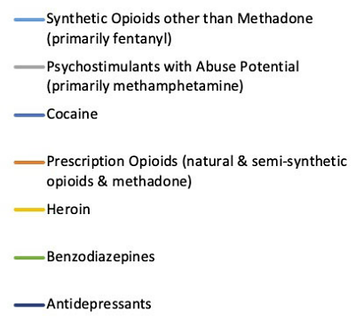
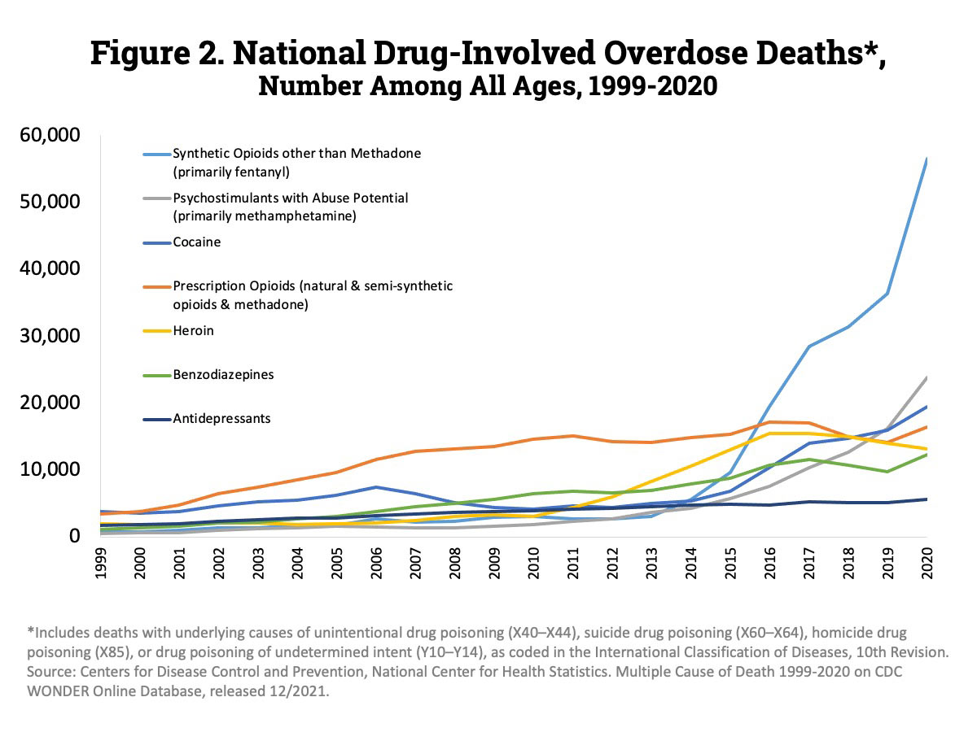
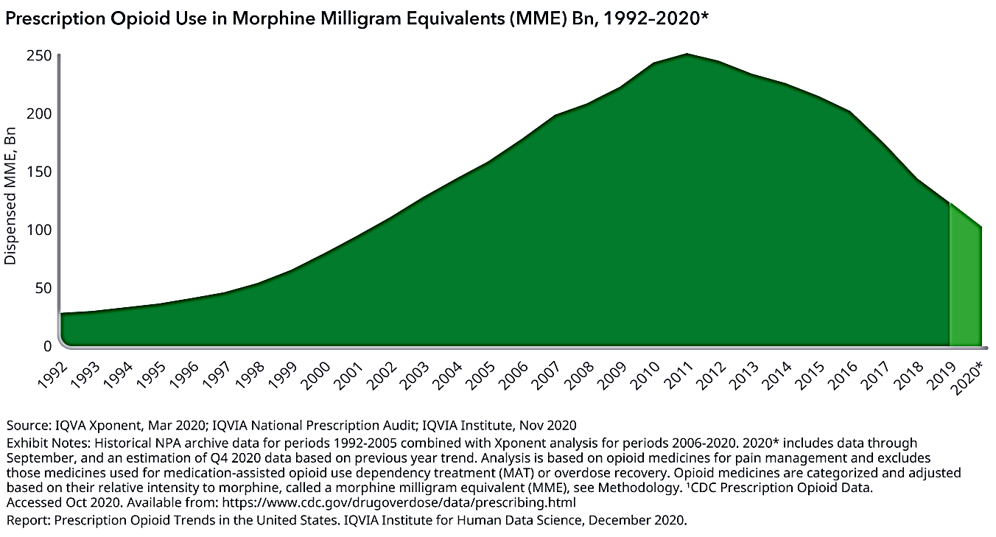

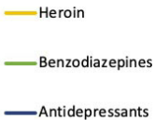
Opioid Prescribing vs Overdose Trends
U.S. Rx Opioid Use (MME)¹
U.S. Drug-Involved Overdose Deaths²
Synthetic opioids other than methadone
(primarily fentanyl)
Release of 2016 CDC Opioid Prescribing Guideline
Synthetic opioids
(natural & semi-synthetic opioids & methadone)
Psychostimulants with abuse potential
(primarily methamphetamine)
Cocaine
Heroin
Benzodiazepines
Antidepressants
1. IQVIA National Prescription Audit; 2020. https://www.iqvia.com/insights/the-iqvia-institute/reports/prescription-opioid-trends-in-the-united-states. Accessed October 17, 2022. 2. Centers for Disease Control and Prevention (CDC). CDC Wonder; 2020.
Notes:
06:44 In this slide
JG
National prescription opioid use declined 60% from 2011-2020
Opioid-related deaths INCREASED, despite decrease in prescribing, primarily due to fentanyl and other illicit opioids
Ultimately, restricting opioid prescribing without addressing pain and OUD is counterproductive
Figure 1. IQVIA National Prescription Audit; IQVIA Institute, Nov 2020. https://www.iqvia.com/insights/the-iqvia-institute/reports/prescription-opioid-trends-in-the-united-states
Figure 2. National Drug-Involved Overdose Deaths by Specific Category—Number Among All Ages, 1999-2020. Overall, drug overdose deaths rose from 2019 to 2020 with 91,799 drug overdose deaths reported in 2020. Deaths involving synthetic opioids other than methadone (primarily fentanyl) continued to rise with 56,516 overdose deaths reported in 2020. Those involving psychostimulants with abuse potential (primarily methamphetamine) also continued to increase to 23,837 (Source: CDC WONDER).

Slide 12





Key Changes In New CDC Guidelines
Emphasis on evaluating pain origin(s) using a biopsychosocial model
Use of medical judgement to weigh risks and benefits of opioid use
Encourage opioid safety with patient education and harm-reduction tools
Screening and treatment recommended for OUD (instead of punishment)
Work toward safe management of patients on long-term opioids
Centers for Disease Control and Prevention (CDC). Proposed 2022 CDC Clinical Practice Guideline for Prescribing Opioids. National Archives Federal Register Journal Website. https://www.federalregister.gov/d/2022-02802. 2022. Accessed October 17, 2022.
Notes:
08:17 So kind of
JG
Key changes in new guidelines
Centers for Disease Control and Prevention [CDC]. Proposed 2022 CDC Clinical Practice Guideline for Prescribing Opioids. National Archives Federal Register Journal Website. https://www.federalregister.gov/d/2022-02802. Published February 10, 2022. Accessed February 16, 2022.

Slide 13
Pain Assessment
“Pain is a complex sensory and emotional experience that can vary widely between people and even within an individual depending on the context and meaning of the pain and the psychological state of the person.” - Bushnell MC, et al.
Notes:
09:48 and were gonna really
JG to YD:
Bushnell MC, Ceko M, Low LA. Cognitive and emotional control of pain and its disruption in chronic pain. Nat Rev Neurosci. 2013;14(7):502-511. doi:10.1038/nrn3516
Chronic pain is one of the most prevalent health problems in our modern world, with millions of people debilitated by conditions such as back pain, headache and arthritis. To address this growing problem, many people are turning to mind-body therapies, including meditation, yoga and cognitive behavioural therapy. This article will review the neural mechanisms underlying the modulation of pain by cognitive and emotional states - important components of mind-body therapies. It will also examine the accumulating evidence that chronic pain itself alters brain circuitry, including that involved in endogenous pain control, suggesting that controlling pain becomes increasingly difficult as pain becomes chronic.

Slide 14
Pain Classification by Duration
Acute
Duration: < 4 weeks
Due to acute injury, disease, or abnormal function
Adaptive response eliciting motivation to minimize harm and allow healing
Subacute
Duration: 4-12 weeks
May be due to attempting to resume normal activities following healing or scar tissue development
Chronic
Duration: > 12 weeks
Maladaptive disorder of the somatosensory pain signaling pathways
May be due to chronic pathology or may occur after original insult has resolved
Centers for Disease Control and Prevention (CDC). Proposed 2022 CDC Clinical Practice Guideline for Prescribing Opioids. National Archives Federal Register Journal Website. https://www.federalregister.gov/d/2022-02802. 2022. Accessed October 17, 2022.King W. Encyclopedia of Pain; 2013:60-63. Chanda ML. J Pain. 2011;12(7):792-800.
Notes:
10:21 I’d be glad to
YD
Duration: acute vs chronic vs subacute (new term in updated Guideline)
Reasons and predictors for acute pain becoming chronic
CDC. National Center for Injury Prevention and Control. Acute Low Back Pain. 2022; https://www.cdc.gov/acute-pain/low-back-pain/index.html
King W. Acute Pain, Subacute Pain, and Chronic Pain. In: Gebhart GF, Schmidt RF, eds. Encyclopedia of Pain. Springer Berlin Heidelberg; 2013:60-63. https://doi.org/10.1007/978-3-642-28753-4_75.
Acute pain is pain that has been present for less than 3 months (Merskey 1979; Merskey and Bogduk 1994). Chronic pain is pain that has been present for more than 3 months (Merskey 1979; Merskey and Bogduk 1994). Subacute pain is a subset of acute pain: It is pain that has been present for at least 6 weeks but less than 3 months (van Tulder et al. 1997).
Chanda ML, Alvin MD, Schnitzer TJ, Apkarian AV. Pain characteristic differences between subacute and chronic back pain. J Pain. 2011;12(7):792-800. doi:10.1016/j.jpain.2011.01.008
Back pain is commonly classified based on duration. There is currently limited information regarding differences in the clinical features of back pain between these duration-based groupings. Here, we compared the pain characteristics of patients with subacute (SBP; pain 6–16 weeks, n = 40) and chronic back pain (CBP; pain ≥ 1year, n = 37) recruited from the general population. CBP patients reported significantly higher pain intensity on the Visual Analogue Scale (VAS) compared to SBP patients. Based on this finding, we investigated group differences and their dependence on VAS for the Beck Depression Inventory (BDI), sensory and affective dimensions of the McGill Pain Questionnaire (MPQ-S and MPQ-A), Neuropathic Pain Scale (NPS) and the variability of spontaneous pain. Correction for VAS abolished significant group differences on the MPQ-S, MPQ-A and NPS. Only a significant difference in the variability of spontaneous pain was independent of VAS. Finally, whereas SBP patients displayed a higher incidence of unilateral pain radiating down the legs/buttocks, there was a shift towards more bilateral pain in CBP patients. In summary, SBP and CBP groups differ on three independent parameters: VAS ratings, pain location and temporal dynamics of spontaneous pain.

Slide 15
Pain Classification by Origin
Neuropathic
Arises from lesion or disease of the somatosensory nervous system
Examples: neuropathy, carpal tunnel, sciatica
Nociceptive
Arises from actual or threatened damage to non-neural tissue and activation of nociceptors
Occurs in the setting of normal somatosensory nerve functioning
Ex: trauma, surgery, osteoarthritis
NEUROPATHIC
Nociplastic
Arises from altered nociception despite no clear evidence of actual or threatened tissue damage
Influenced by biopsychosocial factors
Ex: fibromyalgia, complex pain syndromes
NOCICEPTIVE
NOCIPLASTIC
Mixed pain pathologies associated with development of chronic pain
Stanos S. Postgrad Med. 2016;128(5):502-515. International Association for the Study of Pain (IASP). Task Force on Taxonomy. Terminology. 2021; https://www.iasp-pain.org/resources/terminology/. Accessed Oct 12, 2022. Fitzcharles MA. The Lancet. 2021;397(10289):2098-2110.
Notes:
13:12 Yeah I encourage
YD
Pain origin: nociceptive vs neuropathic vs nociplastic (new term in place of pain of central sensitization)
Stanos S, Brodsky M, Argoff C, et al. Rethinking chronic pain in a primary care setting. Postgrad Med. 2016;128(5):502-515. doi:10.1080/00325481.2016.1188319
Chronic pain substantially impacts patient function and quality of life and is a burden to society at large in terms of increased health care utilization and loss of productivity. As a result, there is an increasing recognition of chronic pain as a public health crisis. However, there remains wide variability in clinical practices related to the prevention, assessment, and treatment of chronic pain. Certain fundamental aspects of chronic pain are often neglected including the contribution of the psychological, social, and contextual factors associated with chronic pain. Also commonly overlooked is the importance of understanding the likely neurobiological mechanism(s) of the presenting pain and how they can guide treatment selection. Finally, physicians may not recognize the value of using electronic medical records to systematically capture data on pain and its impact on mood, function, and sleep. Such data can be used to monitor onset and maintenance of treatments effects at the patient level and evaluate costs at the systems level. In this review we explain how these factors play a critical role in the development of a coordinated, evidence-based treatment approach tailored to meet specific needs of the patient. We also discuss some practical approaches and techniques that can be implemented by clinicians in order to enhance the assessment and management of individuals with chronic pain in primary care settings.
Raja, SN, Carr, DB, Cohen, M, et al. The revised International Association for the Study of Pain definition of pain: concepts, challenges, and compromises. PAIN. 2020;161(9):1976-1982. doi:10.1097/j.pain.0000000000001939
The current International Association for the Study of Pain (IASP) definition of pain as “An unpleasant sensory and emotional experience associated with actual or potential tissue damage, or described in terms of such damage” was recommended by the Subcommittee on Taxonomy and adopted by the IASP Council in 1979. This definition has become accepted widely by health care professionals and researchers in the pain field and adopted by several professional, governmental, and nongovernmental organizations, including the World Health Organization. In recent years, some in the field have reasoned that advances in our understanding of pain warrant a reevaluation of the definition and have proposed modifications. Therefore, in 2018, the IASP formed a 14-member, multinational Presidential Task Force comprising individuals with broad expertise in clinical and basic science related to pain, to evaluate the current definition and accompanying note and recommend whether they should be retained or changed. This review provides a synopsis of the critical concepts, the analysis of comments from the IASP membership and public, and the committee's final recommendations for revisions to the definition and notes, which were discussed over a 2-year period. The task force ultimately recommended that the definition of pain be revised to “An unpleasant sensory and emotional experience associated with, or resembling that associated with, actual or potential tissue damage,” and that the accompanying notes be updated to a bulleted list that included the etymology. The revised definition and notes were unanimously accepted by the IASP Council early this year.
International Association for the Study of Pain (IASP). Task Force on Taxonomy. Terminology. 2021; https://www.iasp-pain.org/resources/terminology/. Accessed Oct 12, 2022
Fitzcharles, M-A, Cohen, SP, Clauw, DJ, et al. Nociplastic pain: towards an understanding of prevalent pain conditions. The Lancet. 2021;397(10289):2098-2110. doi:10.1016/S0140-6736(21)00392-5
Nociplastic pain is the semantic term suggested by the international community of pain researchers to describe a third category of pain that is mechanistically distinct from nociceptive pain, which is caused by ongoing inflammation and damage of tissues, and neuropathic pain, which is caused by nerve damage. The mechanisms that underlie this type of pain are not entirely understood, but it is thought that augmented CNS pain and sensory processing and altered pain modulation play prominent roles. The symptoms observed in nociplastic pain include multifocal pain that is more widespread or intense, or both, than would be expected given the amount of identifiable tissue or nerve damage, as well as other CNS-derived symptoms, such as fatigue, sleep, memory, and mood problems. This type of pain can occur in isolation, as often occurs in conditions such as fibromyalgia or tension-type headache, or as part of a mixed-pain state in combination with ongoing nociceptive or neuropathic pain, as might occur in chronic low back pain. It is important to recognise this type of pain, since it will respond to different therapies than nociceptive pain, with a decreased responsiveness to peripherally directed therapies such as anti-inflammatory drugs and opioids, surgery, or injections.

Slide 16
Patient-Centered Pain Care
Patients with pain from the same condition can present differently and have different responses to the same treatment
Building treatment plans based on unique patient factors improves patient satisfaction and outcomes
Patient A
NSAIDs, yoga, nerve blocks
Patient B
Short term opioids, physical therapy, behavioral health
CHRONIC PAIN
Patient C
Acupuncture, trigger point injections, home exercise
U.S. Department of Health and Human Services. Pain Management Best Practices Inter-Agency Task Force Report:
Updates, Gaps, Inconsistencies, and Recommendations. 2019. https://www.hhs.gov/ash/advisory-committees/pain/reports/index.html. Accessed Oct 17, 2022. Centers for Disease Control and Prevention (CDC). Proposed 2022 CDC Clinical Practice Guideline for Prescribing Opioids. National Archives Federal Register Journal Website. https://www.federalregister.gov/d/2022-02802. 2022. Accessed October 17, 2022.
Notes:
15:07 to help this patient
YD
Importance of pain phenotype in effective treatment planning
U.S. Department of Health and Human Services (2019, May). Pain Management Best Practices Inter-Agency Task Force Report: Updates, Gaps, Inconsistencies, and Recommendations. Retrieved from U. S. Department of Health and Human Services website: https://www.hhs.gov/ash/advisory-committees/pain/reports/index.html
Centers for Disease Control and Prevention [CDC]. Proposed 2022 CDC Clinical Practice Guideline for Prescribing Opioids. National Archives Federal Register Journal Website. https://www.federalregister.gov/d/2022-02802. Published February 10, 2022. Accessed February 16, 2022.

Slide 17
The Biopsychosocial Model of Pain
  Pain pathology
  Inflammation
  Nociception
  Chronic disease
  Stress and coping
  Catastrophizing
  Depression / anxiety
  Cognition
Biological
Psychological
Psychological
PAIN
Behavioral
Social
  Sleep
  Nutrition / diet
  Exercise / mobility
  Substance use
  Social exclusion
  Discrimination
  Stigmatization
  Employment / income
Adams LM, Turk DC. J Appl Behav Res. 2018; 23:e12125. Darnall BD, et al. Pain Med. 2017;18(8):1413-1415.
Robinson-Lane SG, Booker SQ. J Gerontol Nurs. 2017;1-8. McClendon J, et al. Arthritis Care Res. 2021;73(1):11-17.
Notes:
17:05 can you talk
YD
Importance of incorporating biopsychosocial factors of pain perception (depression/anxiety, allosteric load, SDoH, etc.) into pain assessment
Pain is more than just pain - multiple fluid pathways and factors define and influence the pain experience
Depression, anxiety, poor sleep, and adverse social conditions can be the result of chronic pain, but can commonly also predispose patients to chronic pain
Undertreated pain leads to comorbidities, impaired mobility, stress and coping cycles, reduced QoL, catastrophizing, self-medicating, etc.
Long-standing disparities in perception, assessment, and management of pain
Treatment approaches should be tailored to specific patient situations
Adams, LM, Turk, DC. Central sensitization and the biopsychosocial approach to understanding pain. J Appl Behav Res. 2018; 23:e12125. https://doi.org/10.1111/jabr.12125
Medical interventions alone have been largely unsuccessful in treating and curing disorders characterized by chronic pain like central sensitivity syndromes (CSS; e.g., fibromyalgia, chronic migraine, temporomandibular disorders, irritable bowel syndrome). In this article, we discuss how a biopsychosocial perspective adds to understanding people's experiences with chronic pain. A biopsychosocial perspective examines how biological, psychological, social, and contextual factors work independently and jointly to influence the experience, maintenance, and exacerbation of CSS and their symptoms. We highlight several key psychological and social factors relevant to many people who live with CSS, while also emphasizing the heterogeneity in people's experiences, life courses, and symptoms. Furthermore, we emphasize that the psychological, social, and contextual factors that we include are best characterized as contributors to chronic pain experience rather than causes of it.
Darnall BD, Carr DB, Schatman ME. Pain Psychology and the Biopsychosocial Model of Pain Treatment: Ethical Imperatives and Social Responsibility. Pain Med. 2017;18(8):1413-1415. doi:10.1093/pm/pnw166
No abstract
Robinson-Lane SG, Booker SQ. Culturally Responsive Pain Management for Black Older Adults [published online ahead of print, 2017 Mar 2]. J Gerontol Nurs. 2017;1-8. doi:10.3928/00989134-20170224-03
Pain is multi-billion-dollar public health concern and a significant cause of disability—particularly amongst older adults. Older adults with chronic health conditions such as osteoarthritis, diabetes mellitus, peripheral vascular disease, chronic respiratory disease, sickle cell disease, and cancer are most likely to have pain. Of particular concern are Black older adults, or Americans over the age of 65 who are the descendants of US slaves primarily from Africa, as they experience great disparities in pain management and secondary health declines. Though ample research has been completed over the past ten years that links chronic pain to psychological distress and reductions in overall physical health, adequate pain control remains problematic for Black older adults. This concern sheds light on the importance of nursing engagement and persistence in effective pain management for this population. As first line health providers, nurses are in a unique position to push forward national standards for culturally appropriate services for Black elders by ensuring that quality care is not only effective, equitable, understandable, and respectful, but also that this care is responsive to the diverse cultural health beliefs, practices, and health literacy levels of the patients they care for (USDHHS, 2016). The following article provides a framework for the culturally responsive treatment of pain in older Black adults.
McClendon J, Essien UR, Youk A, et al. Cumulative Disadvantage and Disparities in Depression and Pain Among Veterans With Osteoarthritis: The Role of Perceived Discrimination. Arthritis Care Res (Hoboken). 2021;73(1):11-17. doi:10.1002/acr.24481
Objective: Perceived discrimination is associated with chronic pain and depression and contributes to racial health disparities. In a cohort of older adult veterans with osteoarthritis (OA), our objective was to examine how membership in multiple socially disadvantaged groups (cumulative disadvantage) was associated with perceived discrimination, pain, and depression. We also tested whether perceived discrimination mediated the association of cumulative disadvantage with depression and pain.
Methods: We analyzed baseline data from 270 African American veterans and 247 White veterans enrolled in a randomized controlled trial testing a psychological intervention for chronic pain at 2 Department of Veterans Affairs medical centers. Participants were age ≥50 years and self-reported symptomatic knee OA. Measures included the Everyday Discrimination Scale, the Patient Health Questionnaire Depression Scale, the Western Ontario and McMaster Universities Osteoarthritis Index pain subscale, and demographic variables. Cumulative disadvantage was defined as the number of socially disadvantaged groups to which each participant belonged (i.e., self-reported female sex, African American race, annual income of <$20,000, and/or unemployed due to disability). We used linear regression models and Sobel's test of mediation to examine hypotheses.
Results: The mean ± SD number of social disadvantages was 1.3 ± 1.0. Cumulative disadvantage was significantly associated with higher perceived discrimination, pain, and depression (P < 0.001 for all). Perceived discrimination significantly mediated the association between cumulative disadvantage and depression symptoms (Z = 3.75, P < 0.001) as well as pain severity (Z = 2.24, P = 0.025).
Conclusion: Perceived discrimination is an important psychosocial stressor that contributes to worsening OA-related mental and physical health outcomes, with greater effects among those from multiple socially disadvantaged groups.

Slide 18
Comprehensive Pain Assessment
Shared Decision Making
Patient History
Functional Pain Assessment
Physical Examination
Psychosocial Evaluation
Diagnostic Studies
Risk Screening
Populations At Risk For Inaccurate Pain Assessment
People of color - Women - LGBTQ+ - Elderly - End-of-life
Patients with: SUD, cognitive impairment, mental illness, cancer, sickle cell disease (SCD)
U.S. Department of Health and Human Services. Pain Management Best Practices Inter-Agency Task Force Report:
Updates, Gaps, Inconsistencies, and Recommendations. 2019. https://www.hhs.gov/ash/advisory-committees/pain/reports/index.html. Accessed Oct 17, 2022. Centers for Disease Control and Prevention (CDC). Proposed 2022 CDC Clinical Practice Guideline for Prescribing Opioids. National Archives Federal Register Journal Website. https://www.federalregister.gov/d/2022-02802. 2022. Accessed October 17, 2022.
Notes:
19:25 As we talk a little
JG to MD
Elements of a thorough pain assessment
Populations at risk for inaccurate pain assessment
Gaps/limitations with standardized scoring/assessment tools
Team/multidisciplinary approach to pain assessment
U.S. Department of Health and Human Services (2019, May). Pain Management Best Practices Inter-Agency Task Force Report: Updates, Gaps, Inconsistencies, and Recommendations. Retrieved from U. S. Department of Health and Human Services website: https://www.hhs.gov/ash/advisory-committees/pain/reports/index.html
The development of a treatment plan should be preceded by a history and physical examination that aids in proper diagnosis. When clinically indicated, clinicians should consider an integrative and collaborative approach to care. Specialty interdisciplinary pain medicine team consultation, collaborative care, and (when indicated) mental health and addiction services should be readily available in the course of treatment of pain to help ensure the best patient outcomes.
Centers for Disease Control and Prevention [CDC]. CDC clinical practice guideline for prescribing opioids – United States, 2022: overview of community engagement and public comment opportunities. National Archives Federal Register Journal Website. https://www.federalregister.gov/documents/2022/02/10/2022-02802/proposed-2022-cdc-clinical-practice-guideline-for-prescribing-opioids. Published February 10, 2022.

Slide 19
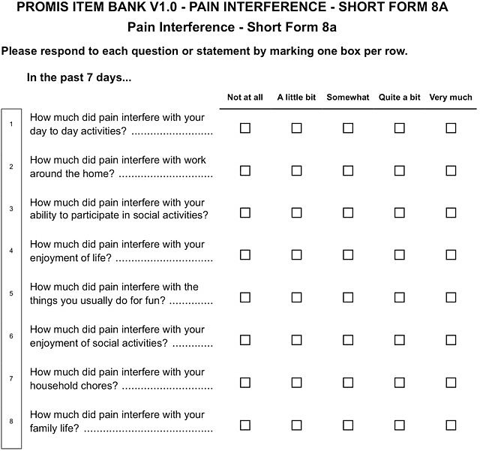
Tools for Assessing Pain-related Functionality
Functional assessment more critical than numeric pain score (NPS)
  Assess for impact of pain on function, daily activities, quality of life, mental health
  Identify comorbidities and patient circumstances contributing to pain sensitivity
Functional scoring tools
  Patient Reported Outcome Measures Information System (PROMIS)
  Short Form Health Survey (SF-36)
  Pain intensity, Enjoyment of life, and General Activity (PEG)
Identify functional goals of the patient
Remember: all standardized scoring systems have gaps and limitations.
Amtmann D, et al. Pain. 2010;150(1):173-182. List of Clinically Tested and Validated Pain Scales. Practical Pain Management. 2019; https://www.practicalpainmanagement.com/resource-centers/opioid-prescribing-monitoring/list-clinically-tested-validated-pain-scales.
Accessed Oct 17, 2022.
Notes:
23:17 can I add as well
JG to YD
Compare function scales to numeric rating scale
Tools and best practices for performing objective (non-bias) pain and function assessment
Identifying patient goals for functioning (helps with treatment planning)
Amtmann D, Cook KF, Jensen MP, et al. Development of a PROMIS item bank to measure pain interference. Pain. 2010;150(1):173-182. doi:10.1016/j.pain.2010.04.025
This paper describes the psychometric properties of the PROMIS-pain interference (PROMIS-PI) bank. An initial candidate item pool (n=644) was developed and evaluated based on the review of existing instruments, interviews with patients, and consultation with pain experts. From this pool, a candidate item bank of 56 items was selected and responses to the items were collected from large community and clinical samples. A total of 14,848 participants responded to all or a subset of candidate items. The responses were calibrated using an item response theory (IRT) model. A final 41-item bank was evaluated with respect to IRT assumptions, model fit, differential item function (DIF), precision, and construct and concurrent validity. Items of the revised bank had good fit to the IRT model (CFI and NNFI/TLI ranged from 0.974 to 0.997), and the data were strongly unidimensional (e.g., ratio of first and second eigenvalue=35). Nine items exhibited statistically significant DIF. However, adjusting for DIF had little practical impact on score estimates and the items were retained without modifying scoring. Scores provided substantial information across levels of pain; for scores in the T-score range 50-80, the reliability was equivalent to 0.96-0.99. Patterns of correlations with other health outcomes supported the construct validity of the item bank. The scores discriminated among persons with different numbers of chronic conditions, disabling conditions, levels of self-reported health, and pain intensity (p<0.0001). The results indicated that the PROMIS-PI items constitute a psychometrically sound bank. Computerized adaptive testing and short forms are available.
List of Clinically Tested and Validated Pain Scales. Practical Pain Management. 2019; https://www.practicalpainmanagement.com/resource-centers/opioid-prescribing-monitoring/list-clinically-tested-validated-pain-scales

Slide 20
Audience Response
Which of the following drug combinations is a risk factor for opioid overdose?
Opioids taken with NSAIDs
Opioids taken with antidepressants
Opioids taken with benzodiazepines
Immediate-release opioids and acetaminophen
I don’t know
Notes:
26:55 go on to the next question
JG

Slide 21
Audience Response: Results
Results recorded on October 19, 2022.
Notes:
27:04 and yeah

Slide 22
Pain Treatment
Notes:
27:13 kind of transition
JG
“Now that we have discussed assessment, lets move forward with a robust discussion of pain therapies”

Slide 23
Effective Patient-HCP Relationships
Informed, involved patients are more likely to commit to health-related behavior change
  Understand context of pain interference with daily activities
  Mutual agreement with goals and expectations
  Tailored, meaningful treatment planning using shared decision making
  Modification of plan based on reassessment and 2-way communication
  Awareness of health care disparities and treatment barriers
Effective pain treatment requires a trusting patient–HCP relationship
Patients may assume HCPs do not believe the severity of their pain or limitations in their function
Show empathy for the patient experience
Validate the belief that
the pain is real
Set agenda to cover all vital topics
Zacharoff KL. PainEDU. 2011. https://www.painedu.org/patient-provider-relationship/. Accessed October 18, 2022. Matthias MS, et al. Eur J Pain. 2014;18(6):835-843. Henry SG, et al. Pain. 2018;159(2):371-379. Hood-Medland EA, et al. BMC Fam Pract. 2021;22(1):4.
Notes:
27:27 both of our panelists
Group discussion – JG, YD, MD
Best practices in building trusting, effective Patient-HCP relationships
How to handle confrontational patients who “demand” inappropriate medications
Zacharoff KL. The Role of the Patient-Health Care Provider Relationship in Chronic Pain Management. PainEDU. 2011; https://www.painedu.org/patient-provider-relationship/
Matthias MS, Krebs EE, Bergman AA, Coffing JM, Bair MJ. Communicating about opioids for chronic pain: a qualitative study of patient attributions and the influence of the patient-physician relationship. Eur J Pain. 2014;18(6):835-843. doi:10.1002/j.1532-2149.2013.00426.x
Background: Chronic pain poses numerous challenges for patients and providers, particularly when opioid treatment is discussed. Despite accounts of antagonistic patient-provider communication, little is known about how communication about opioids unfolds during clinic visits and, importantly, how the relationship history of a patient and physician shapes this communication. This study's objective was to advance understanding of communication about opioid treatment by recording primary care clinic visits and conducting in-depth interviews with patients to gain insight into the patient–provider relationship and its influence on clinical communication.
Method: Forty patients with chronic pain were audio recorded during their primary care clinic appointments and then interviewed about their pain care and relationships with their providers. Ten patients were excluded from analysis because pain was not discussed during the clinic visit.
Results: Qualitative analysis revealed that patients responded in markedly different ways to similar physician treatment decisions about opioids. Some patients attributed limiting or denying opioids to physicians' distrust or lack of caring. Others attributed these limitations to acting out of genuine concern for patients' health. These attributions appeared to be shaped by features of the patient–physician relationship as described by patients. Results are discussed within the framework of attribution theory.
Conclusions: Understanding how patients and providers discuss opioid treatment is critical for optimal pain treatment. Physicians might be able to improve communication by re-framing treatment discussions about opioids around external factors, such as benefits and harms, and engaging in communication that fosters a strong therapeutic alliance and emphasizes concern for the patient.
Henry SG, Bell RA, Fenton JJ, Kravitz RL. Communication about chronic pain and opioids in primary care: impact on patient and physician visit experience. Pain. 2018;159(2):371-379. doi:10.1097/j.pain.0000000000001098
Patients and physicians report that communication about chronic pain and opioids is often challenging, but there is little empirical research on whether patient-physician communication about pain affects patient and physician visit experience. This study video recorded 86 primary care visits involving 49 physicians and 86 patients taking long-term opioids for chronic musculoskeletal pain, systematically coded all pain-related utterances during these visits using a custom-designed coding system, and administered previsit and postvisit questionnaires. Multiple regression was used to identify communication behaviors and patient characteristics associated with patients' ratings of their visit experience, physicians' ratings of visit difficulty, or both. After adjusting for covariates, 2 communication variables-patient-physician disagreement and patient requests for opioid dose increases-were each significantly associated with both worse ratings of patient experience and greater physician-reported visit difficulty. Patient desire for increased pain medicine was also significantly positively associated with both worse ratings of patient experience and greater physician-reported visit difficulty. Greater pain severity and more patient questions were each significantly associated with greater physician-reported visit difficulty, but not with patient experience. The association between patient requests for opioids and patient experience ratings was wholly driven by 2 visits involving intense conflict with patients demanding opioids. Patient-physician communication during visits is associated with patient and physician ratings of visit experience. Training programs focused on imparting communication skills that assist physicians in negotiating disagreements about pain management, including responding to patient requests for more opioids, likely have potential to improve visit experience ratings for both patients and physicians.
Hood-Medland EA, White AEC, Kravitz RL, Henry SG. Agenda setting and visit openings in primary care visits involving patients taking opioids for chronic pain. BMC Fam Pract. 2021;22(1):4. Published 2021 Jan 4. doi:10.1186/s12875-020-01317-4
Background: Agenda setting is associated with more efficient care and better patient experience. This study develops a taxonomy of visit opening styles to assess use of agenda and non-agenda setting visit openings and their effects on participant experience.
Methods: This observational study analyzed 83 video recorded US primary care visits at a single academic medical center in California involving family medicine and internal medicine resident physicians (n = 49) and patients (n = 83) with chronic pain on opioids. Using conversation analysis, we developed a coding scheme that assessed the presence of agenda setting, distinct visit opening styles, and the number of total topics, major topics, surprise patient topics, and returns to prior topics discussed. Exploratory quantitative analyses were conducted to assess the relationship of agenda setting and visit opening styles with post-visit measures of both patient experience and physician perception of visit difficulty.
Results: We identified 2 visit opening styles representing agenda setting (agenda eliciting, agenda reframing) and 3 non-agenda setting opening styles (open-ended question, patient launch, physician launch). Agenda setting was only performed in 11% of visits and was associated with fewer surprise patient topics than visits without agenda setting (mean (SD) 2.67 (1.66) versus 4.28 (3.23), p = 0.03).
Conclusions: In this study of patients with chronic pain, resident physicians rarely performed agenda setting, whether defined in terms of "agenda eliciting" or "agenda re-framing." Agenda setting was associated with fewer surprise topics. Understanding the communication context and outcomes of agenda setting may inform better use of this communication tool in primary care practice.

Slide 24
Non-Opioid Pharmacotherapy for Pain
Medication or Drug Class | Condition for Use
Acetaminophen | Osteoarthritis (not recommended first line)
NSAIDs | Chronic low back pain, osteoarthritis
SNRI antidepressants (duloxetine and milnacipran) | Chronic low, back pain, neuropathic pain, osteoarthritis, fibromyalgia
Tricyclic antidepressants | Neuropathic pain
Gabapentinoids | Post-herpetic neuralgia, neuropathic pain, fibromyalgia
Anticonvulsants | Neuropathic pain
Topical lidocaine or capsaicin | Neuropathic pain
Antispasmodics / muscle relaxers | Spasticity
Ensure dose optimization for all medication treatments
NSAID = non-steroidal anti-inflammatory drug; SNRI = serotonin-norepinephrine reuptake inhibitor
Cheng J, et al . Pain Medicine. 2019;21(1):1-3. Centers for Disease Control and Prevention (CDC). Proposed 2022 CDC Clinical Practice Guideline for Prescribing Opioids. National Archives Federal Register Journal Website. https://www.federalregister.gov/d/2022-02802.2022. Accessed October 17, 2022.
Notes:
32:45 I have another question
JG to MD
Non-opioid pharmacotherapies for pain
Short vs long lasting
Importance of titrating to effect
List above is not comprehensive.
Cheng J, Rutherford M, Singh VM. The HHS Pain Management Best Practice Inter-Agency Task Force Report Calls for Patient-Centered and Individualized Care. Pain Medicine. 2019;21(1):1-3. doi:10.1093/pm/pnz303
No abstract

Slide 25
Non-Pharmacologic Therapies for Pain
Treatment Category | Treatment Options
Lifestyle | Exercise, weight loss, nutrition/diet, sleep hygiene
Physical rehabilitation | Thermal therapies, physical and occupational therapy, massage, yoga, tai chi, postural support
Mind–body | Cognitive–behavioral therapy, muscle relaxation, hypnosis, meditation, music/art therapy, pain reprocessing therapy (PRT)
Complementary and alternative medicine | Acupuncture/acupressure
Device- and procedure-based | Surgery, transcutaneous electrical nerve stimulation, laser therapy, electromyography, biofeedback
Ashar YK, et al. JAMA Psychiatry. 2022;79(1):13-23. U.S. Department of Health and Human Services. Pain Management Best Practices Inter-Agency Task Force Report: Updates, Gaps, Inconsistencies, and Recommendations. 2019. https://www.hhs.gov/ash/advisory-committees/pain/reports/index.html. Accessed Oct 17, 2022.
Notes:
37:31 switching gears
JG to YD
Overview of non-pharmacological options for treating pain and how to best use them
Ashar YK, Gordon A, Schubiner H, et al. Effect of Pain Reprocessing Therapy vs Placebo and Usual Care for Patients With Chronic Back Pain: A Randomized Clinical Trial. JAMA Psychiatry. 2022;79(1):13-23. doi:10.1001/jamapsychiatry.2021.2669
Importance: Chronic back pain (CBP) is a leading cause of disability, and treatment is often ineffective. Approximately 85% of cases are primary CBP, for which peripheral etiology cannot be identified, and maintenance factors include fear, avoidance, and beliefs that pain indicates injury.
Objective: To test whether a psychological treatment (pain reprocessing therapy [PRT]) aiming to shift patients' beliefs about the causes and threat value of pain provides substantial and durable pain relief from primary CBP and to investigate treatment mechanisms.
Design, setting, and participants: This randomized clinical trial with longitudinal functional magnetic resonance imaging (fMRI) and 1-year follow-up assessment was conducted in a university research setting from November 2017 to August 2018, with 1-year follow-up completed by November 2019. Clinical and fMRI data were analyzed from January 2019 to August 2020. The study compared PRT with an open-label placebo treatment and with usual care in a community sample.
Interventions: Participants randomized to PRT participated in 1 telehealth session with a physician and 8 psychological treatment sessions over 4 weeks. Treatment aimed to help patients reconceptualize their pain as due to nondangerous brain activity rather than peripheral tissue injury, using a combination of cognitive, somatic, and exposure-based techniques. Participants randomized to placebo received an open-label subcutaneous saline injection in the back; participants randomized to usual care continued their routine, ongoing care.
Main outcomes and measures: One-week mean back pain intensity score (0 to 10) at posttreatment, pain beliefs, and fMRI measures of evoked pain and resting connectivity.
Results: At baseline, 151 adults (54% female; mean [SD] age, 41.1 [15.6] years) reported mean (SD) pain of low to moderate severity (mean [SD] pain intensity, 4.10 [1.26] of 10; mean [SD] disability, 23.34 [10.12] of 100) and mean (SD) pain duration of 10.0 (8.9) years. Large group differences in pain were observed at posttreatment, with a mean (SD) pain score of 1.18 (1.24) in the PRT group, 2.84 (1.64) in the placebo group, and 3.13 (1.45) in the usual care group. Hedges g was -1.14 for PRT vs placebo and -1.74 for PRT vs usual care (P < .001). Of 151 total participants, 33 of 50 participants (66%) randomized to PRT were pain-free or nearly pain-free at posttreatment (reporting a pain intensity score of 0 or 1 of 10), compared with 10 of 51 participants (20%) randomized to placebo and 5 of 50 participants (10%) randomized to usual care. Treatment effects were maintained at 1-year follow-up, with a mean (SD) pain score of 1.51 (1.59) in the PRT group, 2.79 (1.78) in the placebo group, and 3.00 (1.77) in the usual care group. Hedges g was -0.70 for PRT vs placebo (P = .001) and -1.05 for PRT vs usual care (P < .001) at 1-year follow-up. Longitudinal fMRI showed (1) reduced responses to evoked back pain in the anterior midcingulate and the anterior prefrontal cortex for PRT vs placebo; (2) reduced responses in the anterior insula for PRT vs usual care; (3) increased resting connectivity from the anterior prefrontal cortex and the anterior insula to the primary somatosensory cortex for PRT vs both control groups; and (4) increased connectivity from the anterior midcingulate to the precuneus for PRT vs usual care.
Conclusions and relevance: Psychological treatment centered on changing patients' beliefs about the causes and threat value of pain may provide substantial and durable pain relief for people with CBP.
Pain Management Best Practices, Interagency Task Force Report, US Dept of Health and Human Services. May, 2019. https://www.hhs.gov/ash/advisory-committees/pain/reports/index.html.

Slide 26
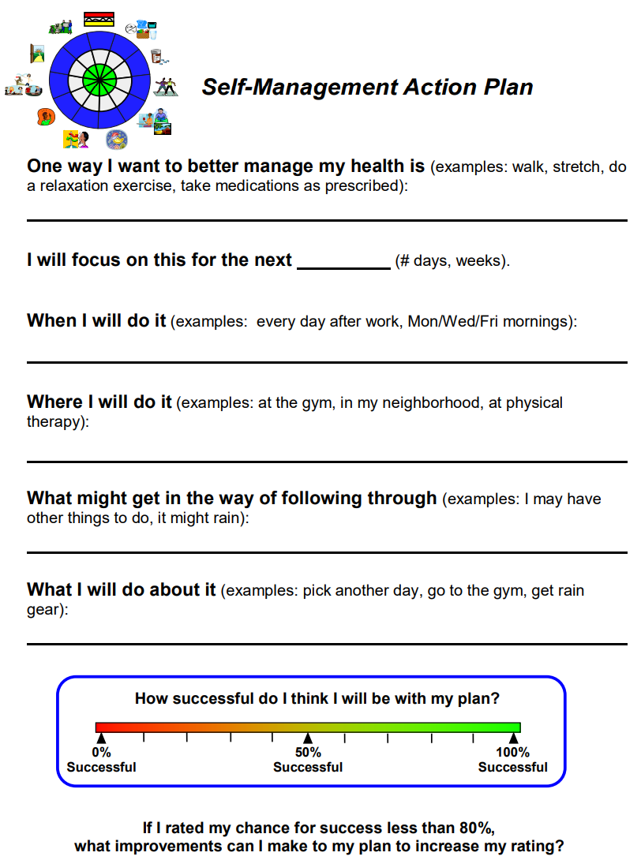
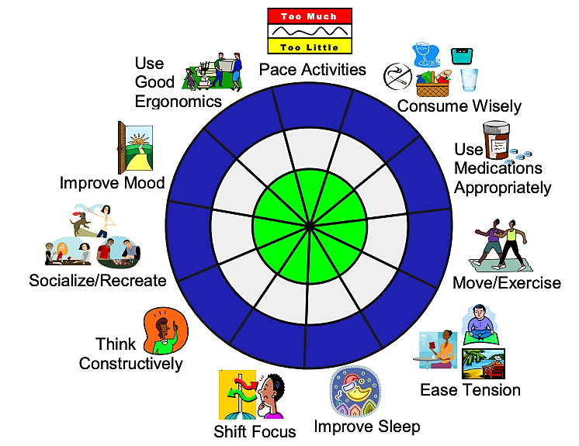
Self-management:
Pain and Functionality
Wanlass W. Fishman D. Turner B, Ogbeide S. Pract Pain Manag. 2018;18(9). Pain Self-Management Strategies. Available at:
https://health.ucdavis.edu/nursing/Research/INQRI_Grant/Long-Term%20Non-Surgery%20Pain%20Management%20Strategies%20Booklet%20WebFINAL082311.pdf
Notes:
42:31 another question
JG to YD
Wanlass W, Fishman D. UC Davis Medical Center, Department of Physical Medicine & Rehabilitation. Pain Self-Management Strategies. https://health.ucdavis.edu/nursing/Research/INQRI_Grant/Long-Term%20Non-Surgery%20Pain%20Management%20Strategies%20Booklet%20WebFINAL082311.pdf. Accessed October 17, 2022.
Turner B, Ogbeide S. Self-Management of Chronic Pain in Primary Care. Pract Pain Manag. 2018;18(9).
Successful self-management requires the patient to develop a mastery of transferable skills and strategies for many aspects of living with chronic pain, such as: goal setting, activity pacing, relaxation, thought challenging, positive self-reinforcement,
self-monitoring, problem-solving, decision-making, and resource identification.
To effectively address the multidimensional effects of chronic pain, patients need self-management training about behaviors, strategies, and activities that may help to control the destructive effects of pain on their quality of life. Use of self-management methods have proven highly effective for people with diabetes mellitus, a similarly complex condition, and has become a well-accepted component of diabetes care, covered by insurance.¹¹ Diabetes self-management training, for example, typically involves certified trainers and a team-based approach.¹¹⁻¹⁵To date, this disease approach has not been implemented broadly to assist patients with chronic pain to more effectively manage this severely disabling condition, even as its value has been recognized by the Institute of Medicine, which defines self-management of chronic pain as involving the following:¹⁶
Adhering to medical treatment
Managing personal, family, and social roles and responsibilities through cognitive and behavioral strategies
Managing emotional consequences of conditions associated with chronic pain.

Slide 27
Acute Pain Management with Opioids
Opioids may be indicated for:
  Severe traumatic injuries (including crush injuries and burns)
  Invasive surgeries associated with moderate to severe postoperative pain
  Severe, acute pain when NSAIDs and other therapies are contraindicated or likely to be ineffective
If using opioids for acute pain:
  Use short acting agents
  Use as needed vs scheduled dosing
  Prescribe the lowest effective dose for the shortest duration
  Maximize non-opioid pharmacologic and nonpharmacologic treatments
  Include a taper if opioids are used around-the-clock for more than a few days
Centers for Disease Control and Prevention (CDC). Proposed 2022 CDC Clinical Practice Guideline for Prescribing Opioids. National Archives Federal Register Journal Website. https://www.federalregister.gov/d/2022-02802. 2022. Accessed October 17, 2022.
Notes:
45:10 I want to take it
MD
Indications for opioid use in acute pain
Safety measures when prescribing opioids

Slide 28
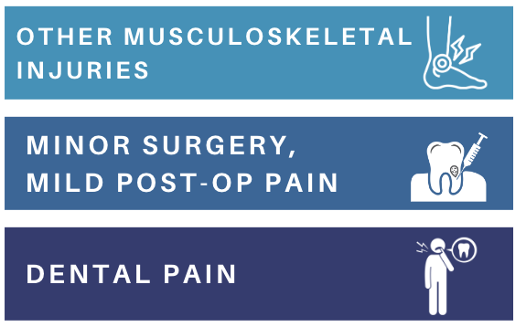
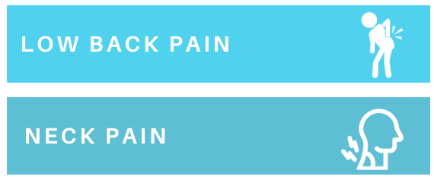
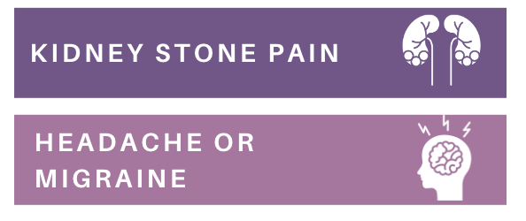
When to Avoid Opioids in Acute Pain
Risks vs. benefits must be weighed
Even with acute low dose opioids (1 – 36 mg/day MED), patients are at increased risk for developing OUD
Opioids not recommended first line
Centers for Disease Control and Prevention CDC. Proposed 2022 CDC Clinical Practice Guideline for Prescribing Opioids. National Archives Federal Register Journal Website. https://www.federalregister.gov/d/2022-02802. 2022. Accessed October 17, 2022.
Notes:
46:52 um and you know the new guidelines
MD
When to avoid opioids in acute pain

Slide 29
Opioids for Chronic Pain: Ongoing Assessments
See patients at regular intervals (i.e., every month)
Review non-opioid therapies for optimization
Discuss plan to continue, adjust, taper or stop opioids
Review the need for specialist referral
Evaluate for risk of harm or opioid misuse
Track pain and function scoring at each visit
Centers for Disease Control and Prevention (CDC). Proposed 2022 CDC Clinical Practice Guideline for Prescribing Opioids. National Archives Federal Register Journal Website. https://www.federalregister.gov/d/2022-02802. 2022. Accessed October 17, 2022.
Notes:
48:16 and I also
JG question for MD

Slide 30
Monitoring Opioid Use: Patient Education
Advise patients of PDMP monitoring that occurs at physician and pharmacy visits
Check PDMP when starting opioids and with every new prescriptions or every 3 months
Advise patients of plans for urine drug screening
Screening will be used to confirm adherence and identify use of illicit drugs or other medications that could interfere with treatment goals
Reinforce that monitoring strategies are designed to improve patient safety
Patient should understand and agree to treatment and monitoring plans
PDMP = prescription drug monitoring program
Centers for Disease Control and Prevention (CDC). Proposed 2022 CDC Clinical Practice Guideline for Prescribing Opioids. National Archives Federal Register Journal Website. https://www.federalregister.gov/d/2022-02802. 2022.
Accessed October 17, 2022.
Notes:
51:27 and then
MD

Slide 31
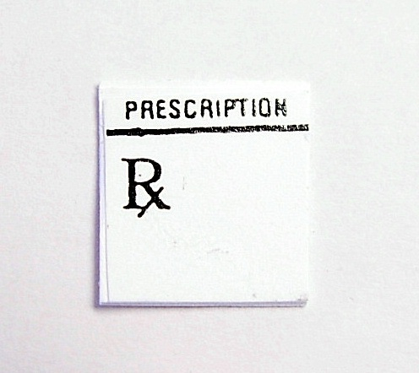
Documentation of PDMP Findings
Document that the PDMP has been checked
Include any relevant findings
  Prescriptions, dates, providers
Document plans to address or follow-up on concerns identified in PDMP review
Document if you are unable to access PDMP systems when a review would normally be required (i.e., website is nonfunctioning)
Systemic PDMP Bias
More urine drug screens, fill restrictions, office visits required for POC
“Red flag“ algorithms discriminate based on SDoH (ex. multiple long-distance providers)
Pain complaints and subsequent denial of pain assessment / treatment not documented in medical records
Assumed criminality → POC more likely to have opioid therapy reduced/stopped and referred for SUD, less likely referred to pain specialist
Morales ME, et al. Pain Med. 2021;22(1):75-90. Netherland J, Hansen H. Biosocieties. 2017;12(2):217-238. Gillispie-Bell V. Obstet Gynecol. 2021;137(2):220-224. Hoffman KM, et al. Proc Natl Acad Sci U S A. 2016;113(16):4296-4301.
Notes:
53:18 PDMP bias
MD

Slide 32
When to Consider Tapering Opioids
New treatment is needed
Dosage reduction or discontinuation requested
No pain reduction or improvement in function with opioid use
Starting a medication that increases risk of overdose (e.g., benzodiazepine)
Non-adherence to treatment plan or engaging in unsafe behavior (e.g., early refills, buying or borrowing opioids, concerning UDT results)
Reported overdose or another serious adverse event
Worsening medical comorbidities: renal disease, sleep apnea, liver disease, lung disease
Mental health conditions that can worsen with opioid therapy (e.g., PTSD, depression, anxiety)
Safety concerns are identified
Comorbidities increase opioid use risk
Centers for Disease Control and Prevention (CDC). Pocket Guide: Tapering Opioids for Chronic Pain. 2016. https://www.cdc.gov/drugoverdose/ pdf/clinical_pocket_guide _tapering-a.pdf. Accessed October 17, 2022. U.S. Department of Veterans Affairs. Pain Management. Opioid Taper Decision Tool. 2016. https://www.pbm.va.gov/PBM/AcademicDetailingService/Documents/Pain_Opioid_Taper_Tool_IB_10_939_P96820.pdf. Accessed October 17, 2022.
Notes:
57:04 can you talk about
JG to YD
CDC Guide : Tapering Opioids for Chronic Pain. 2016
U.S. Department of Veterans Affairs. Pain Management. Opioid Taper Decision Tool. 2016 https://www.pbm.va.gov/PBM/AcademicDetailingService/Documents/Pain_Opioid_Taper_Tool_IB_10_939_P96820.pdf

Slide 33
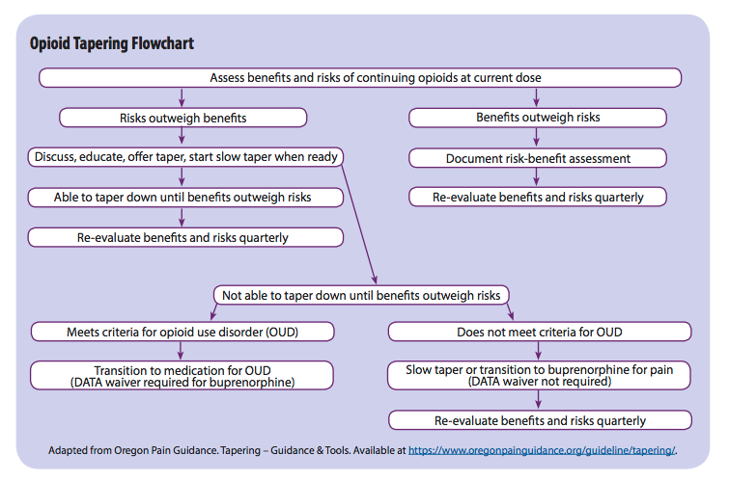
Evaluation for Opioid Tapering
Adapted from Oregon Pain Guidance. 2020. https://www.oregonpainguidance.org/guideline/tapering/. Accessed October 17, 2022.;
United States Department of Health and Human Services (HHS). HHS Guide for Clinicians on the Appropriate Dosage Reduction or Discontinuation of Long-Term
Opioid Analgesics. 2019. https://www.hhs.gov/opioids/sites/default/files/2019-10/Dosage_Reduction_Discontinuation.pdf. Accessed October 2, 2022.
Notes:
59:16 and this algorithm
JG, YD and MD- discussion
Adapted from Oregon Pain Guidance. Tapering – Guidance & Tools. Available at https://www.oregonpainguidance.org/guideline/tapering/. HHS Guide for Clinicians on the Appropriate Dosage Reduction or Discontinuation of Long-Term Opioid Analgesics. Published October 2019. Available at https://www.hhs.gov/opioids/sites/default/files/2019-10/Dosage_Reduction_Discontinuation.pdf.

Slide 34
Tapering Chronic Opioid Therapy
Go slow | A decrease of 10% of the original dose per week is a reasonable starting point Some patients who have taken opioids for a long time might find even slower tapers (e.g., 10% per month) easier Discuss the risk of overdose if patients quickly return to a higher dose
Consult | Coordinate with specialists and treatment experts as needed—especially for patients at high risk of harm (i.e., pregnant women or patients with an opioid use disorder)
Support | Link patients to psychosocial support Offer naloxone for overdose prevention Watch for signs of anxiety, depression, and opioid use disorder during the taper
Encourage | Let patients know that most people have improved function without worse pain after tapering opioids Some patients have improved pain after a taper, even though pain might briefly get worse at first
Centers for Disease Control and Prevention (CDC). Pocket Guide: Tapering Opioids for Chronic Pain. 2016. https://www.cdc.gov/drugoverdose/pdf/clinical_pocket_guide_tapering-a.pdf. Accessed October 17, 2022.
Notes:
59:45 thank you
JG – question for both- tips for tapering
CDC Tips for Successful Opioid Tapering
Address withdrawal and pain concerns as part of the treatment plan
Maximize non-opioid treatment options
Expand use of multi-disciplinary treatments
Plan for follow-up/check-in patients following completion of a taper vs assuming there are no concerns

Slide 35
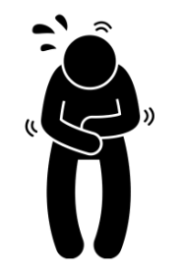
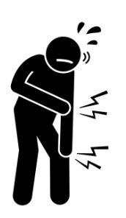
Patient’s Top Concerns with Opioid Tapering
Fear of
withdrawal
Fear of
increased pain
Quinlan J, et al. Br J Pain. 2021;15(2):120-128.
Notes:
1:00:17 I wanted to take a moment
JG – question for both- concerns from patients about tapering
Tapering plan should address both of these concerns up front.
Let patients know that they may experience improved function, sleep, anxiety and mood without worsening pain, or even with decreased pain after a taper, even though pain might initially get worse.
Establish a multidisciplinary approach to pain management. This can include nonpharmacological options, such as exercise and nonopioid therapies, which have been shown to be effective in managing chronic pain.
Provide psychological support, especially cognitive behavioral therapy. If needed, work with mental health providers, arrange for treatment of opioid use disorder, and offer Naloxone for overdose prevention. Finally, monitor your patient for depression, suicidal ideation, anxiety and opioid use disorder during the tapering process.
Treating comorbid mental health disorders can improve the likelihood of opioid tapering success.
Quinlan J, Willson H, Grange K. Hopes and fears before opioid tapering: a quantitative and qualitative study of patients with chronic pain and long-term opioids. Br J Pain. 2021 May;15(2):120-128. doi: 10.1177/2049463720974053. Epub 2020 Nov 29. PMID: 34055333; PMCID: PMC8138618.
Background:
It is clear that the risks of opioids in chronic pain outweigh the benefits, creating a drive for clinicians to support patients taper and stop long-term opioids. However, it is not known how patients who have been taking these medicines for months or years feel about reducing them. Using quantitative and qualitative data, this study describes the psychological complexity of these patients and examines their hopes and fears before opioid reduction.
Methods:
Sixty patients attending the opioid clinic completed psychological and pain questionnaires, providing quantitative data, just before they commenced opioid tapering. They scored the severity of opioid side effects and completed a free text framework to express their beliefs about stopping or continuing opioids. A phenomenological approach was used to identify common qualitative themes.
Results:
Most patients were taking opioid doses above the UK recommended maximum dose and reported severe pain with high pain interference. Over 80% of patients described significant depression and 60% significant anxiety. Negative themes around stopping opioids were more common than positive ones, with 63% patients fearing increased pain. A quarter of patients referred to addiction and 16% feared withdrawal. Five patients hoped for a better quality of life; seven feared a worse one. Opioid side effects were common and severe.
Conclusion:
Patients with chronic pain taking long-term opioids demonstrate high psychological distress and low self-efficacy. Their concerns around opioid tapering relate to pain, quality of life and withdrawal. Identifying and addressing patients’ individual concerns should increase the likelihood of successful opioid tapering.

Slide 36
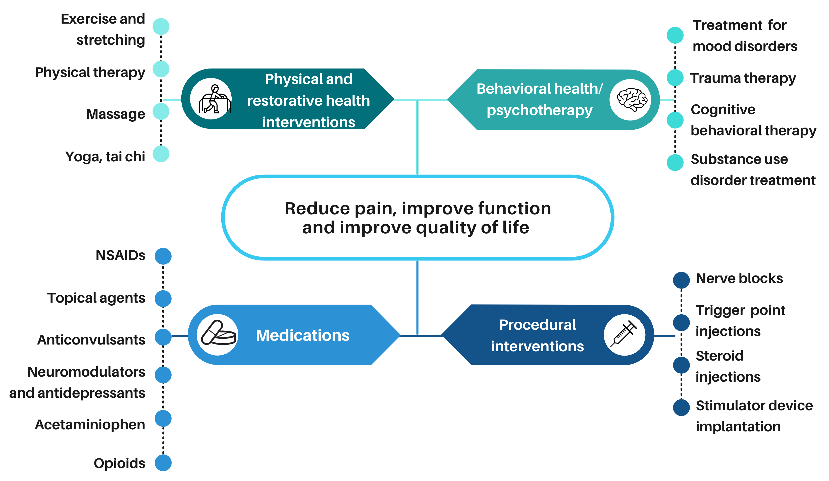
Multimodal Approach to Pain Care
Dale R , Stacey B. Medical Clinics of North America. 2016;100(1):55-64; Centers for Disease Control and Prevention (CDC). Proposed 2022 CDC Clinical Practice Guideline for Prescribing Opioids. National Archives Federal Register Journal Website. https://www.federalregister.gov/d/2022-02802. 2022. Accessed October 17, 2022.
Notes:
1:02:16 stick to that multimodal approach
JG
Summarizing multimodal approach to pain care
Dale R, Stacey B. Multimodal Treatment of Chronic Pain. Med Clin North Am. 2016;100(1):55-64. doi:10.1016/j.mcna.2015.08.012
Most patients with chronic pain receive multimodal treatment. There is scant literature to guide us, but when approaching combination pharmacotherapy, the practitioner and patient must weigh the benefits with the side effects; many medications have modest effect yet carry significant side effects that can be additive. Chronic pain often leads to depression, anxiety, and deconditioning, which are targets for treatment. Structured interdisciplinary programs are beneficial but costly. Interventions have their place in the treatment of chronic pain and should be a part of a multidisciplinary treatment plan. Further research is needed to validate many common combination treatments.

Slide 37
Referring Patients to a Pain Specialist
Consider your expertise and comfort level in managing specific chronic pain patients
Consider referral with high daily dose of opioids (> 90 mme/day) and lack of progress toward pain/function goals
Patients with chronic pain and no readily identified cause (ex. fibromyalgia, chronic daily headaches)
Use of high opioid dosages or lack of response to high dose opioids can trigger a referral
Refer if current management is outside of your scope or comfort zone to manage
Refer to confirm or establish a diagnosis of the suspected condition and obtain suggestions for management
Consider patient ability to feasibly access specialist care before referral
MME = morphine milligram equivalent
AAPM. For the Primary Care Provider: When to Refer to a Pain Specialist. 2016. https://painmed.org/for-the-primary-care-provider-when-to-refer-to-a-pain-specialist/#:~:text=If%20the%20cause%20of%20the, pain%20specialist%20should%20be%20considered. Accessed October 17, 2022.
Notes:
1:02:39 Yvonne I wanted to ask you
JG question for D’arcy:
American Academy of Pain Medicine (AAPM). For the Primary Care Provider: When to Refer to a Pain Specialist. 2016. https://painmed.org/for-the-primary-care-provider-when-to-refer-to-a-pain-specialist/#:~:text=If%20the%20cause%20of%20the, pain%20specialist%20should%20be%20considered. Accessed October 17, 2022.
Chronic pain like all chronic medical illness requires patient self-management. Cure is rare and complete pain relief is rarer. Patients do best when they adopt a new lifestyle not solely dictated by the pain. The provider does best by offering support and encouragement; not necessarily by more testing, more medication, more referrals, or more procedures.
When to refer will depend on the expertise of the primary care provider and the availability of the pain specialist.
All pain practitioners/clinics are not the same. The referral may vary from a referral to a pain specialist who utilizes a single modality to interdisciplinary rehabilitation models. It is important to know who is available for consultation, what the specialist offers, and what expectations both the patient and the provider bring to the referral.
It is important to foster communication and develop relationships between a primary care and a specialist. This encourages collaboration on what may be a challenging patient population. Collaboration includes sharing medical records, jointly determining treatment plans, care coordination, etc.
Chronic pain can be defined in a variety of ways. Most experts agree that pain longer than the expected time of healing is a useful definition. Referral for evaluation and treatment early is important to break the cycle of chronicity and to aid in de-conditioning.
Know your state regulations and guidelines which may require referral at certain milestones such as milligram limits. For example, the CDC guidelines recommend extra precaution when prescribing 50mg or more morphine equivalents a day and avoiding 90mg or more. Referral of
patients hitting these thresholds may be advisable for expert guidance as these thresholds indicate greater risk AND may indicate a failure of opioids to achieve functional goals. The specialist can assist in expanding the self-care training and other portions of the treatment plan.
Chronic pain may not have a known, easily definable cause despite an extensive primary care work up (e.g., low back pain, fibromyalgia, chronic daily headaches, etc.). Referral to a pain specialist to confirm or establish the diagnosis and offer suggestions on management is advisable.
If a procedure is indicated (e.g., low back pain with radiculopathy) or surgery is indicated (progressive neurologic deficit, cauda equina syndrome, etc.), a referral should be considered.
Chronic pain often co-exists with anxiety, depression, bipolar disorder, PTSD, and other psychiatric conditions. A referral to behavioral health services to optimize the management of these conditions may facilitate management of chronic pain.
If the cause of the pain is known (or unknown), serious disease excluded, no curative treatment is readily available, current treatment is not helping, or the pain interferes with daily function, referral should to a pain specialist should be considered.
If the primary care provider begins to feel uncomfortable continuing the current treatment with the chronic pain patient, referral is indicated. A primary care provider should never be compelled to provide treatments beyond his or her level of training or expertise.
A positive urine drug screen for abusable medications and/or clear evidence of misuse or abuse requires a frank, honest discussion with the patient which often means tapering treatment medications. An addiction specialist, rather than a pain specialist, is often a more appropriate consultation.

Slide 38
Opioid Safety and
Opioid Use Disorder
Notes:
1:04:01 I agree 100%
JG

Slide 39


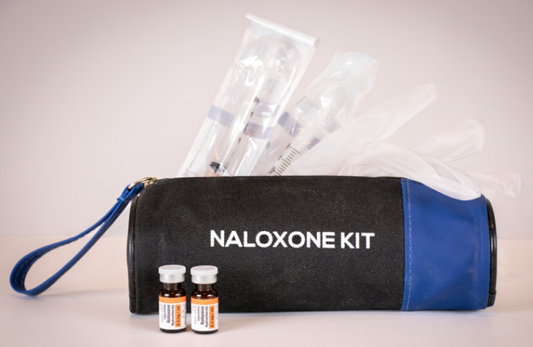
Patient Education: Opioid Safety
Store opioids in a secure (preferably locked) location at all times. Do NOT carry excess doses on your person.
Keep track of everyone who has access.
SECURE
Dispose of unneeded doses at certified DEA take-back locations whenever possible.
(Find locations via DEA website or Google™️ search)
Note: All opioids are on the FDA Flush List.
DISPOSE
Provide patients with at-home naloxone
Educate entire household on signs of opioid overdose and emergency action plan whenever possible.
PREVENT
Centers for Disease Control and Prevention (CDC). Proposed 2022 CDC Clinical Practice Guideline for Prescribing Opioids. National Archives Federal Register Journal Website. https://www.federalregister.gov/d/2022-02802. 2022. Accessed October 17, 2022.
Notes:
1:04:32. I wanted to ask Melissa
JG to MD
Patient education for opioid safety at home
Proper disposal of opioids
Signs of overdose and what to do if it happens (more on naloxone on next slide)

Slide 40

Naloxone Prescribing
Indications for naloxone
History of overdose or behavior concerning for OUD
Recent detox/rehabilitation or release from prison with OUD history
High doses of chronic opioids (> 50 mme/day) or concurrent benzos
History of obstructive sleep apnea
Patient education points
Naloxone is not just for people with OUD
Naloxone administration and its role in opioid safety
Educate both patients and their family members/caregivers on overdose recognition and naloxone use
Remember: Naloxone co-prescribing requirements vary by state.
CDC. 2022. https://www.cdc.gov/opioids/naloxone/factsheets/pdf/naloxone_factsheet_clinicians.pdf. Accessed October 18, 2022. FDA. 2020. https://www.fda.gov/media/140360/download.
Notes:
1:05:42 so um you know
MD
Naloxone education
CDC. When to Offer Naloxone to Patients. 2022. https://www.cdc.gov/opioids/naloxone/factsheets/pdf/naloxone_factsheet_clinicians.pdf
U.S. Food & Drug Administration (FDA) Drug Safety Communication. FDA recommends health care professionals discuss naloxone with all patients when prescribing opioid pain relievers or medicines to treat opioid use disorder. 7-23-2020. https://www.fda.gov/media/140360/download

Slide 41
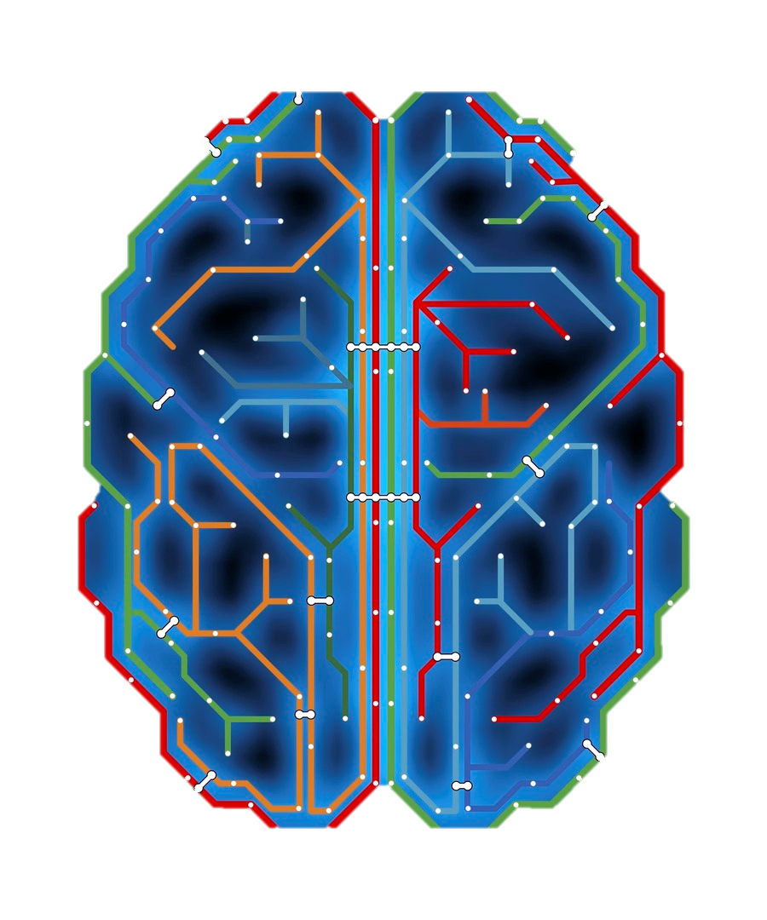


Neurobiology of Opioid Use Disorder (OUD)
Opioid use causes acute and chronic changes in brain neurocircuitry:
Initial use may be driven primarily by reward pathway
Later use is driven by anti-reward pathway (discomfort avoidance)
Brain changes persist long after substance use is stopped
Remember:
Pain relief is
REWARDING
Substance
associated cues
Pleasure/reward
systems
Impulse and emotion
executive control systems
Stress
systems
Blackwood CA, Cadet JL. Curr Res Neurobiol. 2021;2:100023. SAMHSA. 2016. https://www.ncbi.nlm.nih.gov/books/NBK424849/. Accessed October 18, 2022.
Notes:
1:07:51 too deep into this slide
JG – group discussion
Remember, pain relief is rewarding .
Well-supported scientific evidence shows that addiction to alcohol or drugs is a chronic brain disease that has potential for recurrence and recovery.
the addiction process involves a three-stage cycle: binge/intoxication, withdrawal/negative affect, and preoccupation/anticipation. This cycle becomes more severe as a person continues substance use and as it produces dramatic changes in brain function that reduce a person's ability to control his or her substance use.
disruptions in three areas of the brain are particularly important in the onset, development, and maintenance of substance use disorders: the basal ganglia, the extended amygdala, and the prefrontal cortex. These disruptions: (1) enable substance-associated cues to trigger substance seeking (i.e., they increase incentive salience); (2) reduce sensitivity of brain systems involved in the experience of pleasure or reward and heighten activation of brain stress systems; and (3) reduce functioning of brain executive control systems, which are involved in the ability to make decisions and regulate one's actions, emotions, and impulses.
these changes in the brain persist long after substance use stops. It is not yet known how much these changes may be reversed or how long that process may take.
Blackwood CA, Cadet JL. The molecular neurobiology and neuropathology of opioid use disorder. Curr Res Neurobiol. 2021;2:100023. doi:10.1016/j.crneur.2021.100023
The number of people diagnosed with opioid use disorder has skyrocketed as a consequence of the opioid epidemic and the increased prescribing of opioid drugs for chronic pain relief. Opioid use disorder is characterized by loss of control of drug taking, continued drug use in the presence of adverse consequences, and repeated relapses to drug taking even after long periods of abstinence. Patients who suffer from opioid use disorder often present with cognitive deficits that are potentially secondary to structural brain abnormalities that vary according to the chemical composition of the abused opioid. This review details the neurobiological effects of oxycodone, morphine, heroin, methadone, and fentanyl on brain neurocircuitries by presenting the acute and chronic effects of these drugs on the human brain. In addition, we review results of neuroimaging in opioid use disorder patients and/or histological studies from brains of patients who had expired after acute intoxication following long-term use of these drugs. Moreover, we include relevant discussions of the neurobiological mechanisms involved in promoting abnormalities in the brains of opioid-exposed patients. Finally, we discuss how novel strategies could be used to provide pharmacological treatment against opioid use disorder.
Substance Abuse and Mental Health Services Administration (SAMHSA) (US); Office of the Surgeon General (US). Facing Addiction in America: The Surgeon General's Report on Alcohol, Drugs, and Health [Internet]. Washington (DC): US Department of Health and Human Services; 2016 Nov. CHAPTER 2, THE NEUROBIOLOGY OF SUBSTANCE USE, MISUSE, AND ADDICTION. Available from: https://www.ncbi.nlm.nih.gov/books/NBK424849/
A substantial body of research has accumulated over several decades and transformed our understanding of substance use and its effects on the brain. This knowledge has opened the door to new ways of thinking about prevention and treatment of substance use disorders.
This chapter describes the neurobiological framework underlying substance use and why some people transition from using or misusing alcohol or drugs to a substance use disorder—including its most severe form, addiction. The chapter explains how these substances produce changes in brain structure and function that promote and sustain addiction and contribute to relapse. The chapter also addresses similarities and differences in how the various classes of addictive substances affect the brain and behavior and provides a brief overview of key factors that influence risk for substance use disorders.

Slide 42
DSM-V Criteria for Diagnosing OUD
  Failure to fulfill responsibilities
  Use in physically hazardous situations
  Craving or strong desire to use
  Use despite social or interpersonal problems
  Use in larger amounts/longer than intended
Great deal of time spent obtaining, using, or recovering
Cannot cut down
Continued use despite physical or psychological problems
  Giving up interests to use
  *Tolerance
  *Withdrawal
*Criteria do not count if only taking opioids as prescribed
Mild: 2-3 items
Moderate: 4-5 items
Severe: ≥ 6 items
American Psychiatric Association (APA). In: Diagnostic and Statistical Manual of Mental Disorders. 5th ed. 2013: pp.541.
https://psychiatry.org/psychiatrists/practice/dsm. Accessed October 18, 2022.
Notes:
1:08:34 Yvonne can you talk
JG to YD
American Psychiatric Association (APA). In: Diagnostic and Statistical Manual of Mental Disorders. 5th ed. 2013: pp.541.
https://psychiatry.org/psychiatrists/practice/dsm. Accessed October 18, 2022.
The Diagnostic and Statistical Manual of Mental Disorders, Fifth Edition, Text Revision (DSM-5-TR) features the most current text updates based on scientific literature with contributions from more than 200 subject matter experts. The revised version includes a new diagnosis (prolonged grief disorder), clarifying modifications to the criteria sets for more than 70 disorders, addition of International Classification of Diseases, Tenth Revision, Clinical Modification (ICD-10-CM) symptom codes for suicidal behavior and nonsuicidal self-injury, and updates to descriptive text for most disorders based on extensive review of the literature. In addition, DSM-5-TR includes a comprehensive review of the impact of racism and discrimination on the diagnosis and manifestations of mental disorders. The manual will help clinicians and researchers define and classify mental disorders, which can improve diagnoses, treatment, and research.

Slide 43
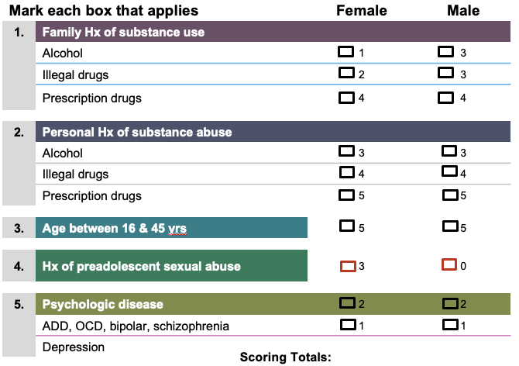
Opioid Risk Tool (ORT)
Presence/absence of one or more aberrant behaviors by risk category, computed from Opioid Risk Tool
Risk Category by Actual Outcome | Females | Males
Patients with no aberrant behaviors | 71 | 38
Low (0–3) | 12 (17%) | 5 (13%)
Moderate (4–7) | 56 (79%) | 32 (84%)
High (≥ 8) | 3 (4%) | 1 (3%)
Patients with 1+ aberrant behaviors | 37 | 39
Low (0–3) | 0 (0%) | 1 (3%)
Moderate (4–7) | 17 (46%) | 18 (46%)
High (≥ 8) | 20 (54%) | 20 (51%)
Remember: Risk prediction tools do NOT diagnose OUD.
Webster LR, Webster RM. Pain Med. 2005;6:432-442.; OUD = opioid use disorder
Notes:
1:10:09 the next slide kind of goes through that
JG to YD and MD
Screening tools should be combined with additional info from discussions with patients, family, and caregivers, clinical records, PDMP data (see Recommendation 9), and toxicology screening data.
Scoring tools are not perfect predictors of whether patients will develop opioid use disorder. ORT was developed to identify risk of aberrant behaviors, not risk of addiction.
Even aberrant behaviors that suggest abuse or addiction may only reflect a patient's attempt to feel normal.
Examples of aberrant behaviors: Solicited opioids from other providers, Used additional opioids than those prescribed , Canceled clinic visit , Unauthorized ER visits, Abnormal urine/blood screen, Resisted therapy changes/alternative therapy .
Webster LR, Webster RM. Predicting aberrant behaviors in opioid-treated patients: preliminary validation of the Opioid Risk Tool. Pain Med. 2005;6(6):432-442. doi:10.1111/j.1526-4637.2005.00072.x
Objective: To provide clinicians with a brief screening tool to predict accurately which individuals may develop aberrant behaviors when prescribed opioids for chronic pain.
Design: One hundred and eighty-five consecutive new patients treated in one pain clinic took the self-administered Opioid Risk Tool (ORT). The ORT measured the following risk factors associated in scientific literature with substance abuse: personal and family history of substance abuse; age; history of preadolescent sexual abuse; and certain psychological diseases. Patients received scores of 0-3 (low risk), 4-7 (moderate risk), or >or= 8 (high risk), indicating the probability of their displaying opioid-related aberrant behaviors. All patients were monitored for aberrant behaviors for 12 months after their initial visits.
Results: For those patients with a risk category of low, 17 out of 18 (94.4%) did not display an aberrant behavior. For those patients with a risk category of high, 40 out of 44 (90.9%) did display an aberrant behavior. The authors used the c statistic to validate the ORT, because it simultaneously assesses sensitivity and specificity. The ORT displayed excellent discrimination for both the male (c = 0.82) and the female (c = 0.85) prognostic models.
Conclusion: In a preliminary study, among patients prescribed opioids for chronic pain, the ORT exhibited a high degree of sensitivity and specificity for determining which individuals are at risk for opioid-related, aberrant behaviors. Further studies in a variety of pain and nonpain settings are needed to determine the ORT's universal applicability.

Slide 44
Addressing Concerns in the PDMP
Confirm the information in the PDMP is correct.
Check for potential data entry errors, use of a nickname or maiden name, or possible identity theft to obtain prescriptions.
Assess for possible misuse or abuse.
Offer or arrange evidence-based treatment (usually medication-assisted treatment + behavioral therapies) for patients with opioid use disorder.
If you suspect diversion, urine drug testing can assist in determining whether opioids can be discontinued without causing withdrawal.
Contact other healthcare practitioners to share findings.
Aim is to share information and ensure patient safety
Contact with the aim of communicating not with obtaining a specific intervention (i.e., “I wanted to make sure you were aware of other medications or duplicate therapy.”)
Review concerns with the patient.
Discuss any areas of concern with your patient and emphasize your interest in their safety.
Notes:
MD

Slide 45
Discussing OUD and Treatment With Patients
Reflect on your own biases and stigmas towards OUD
Approach with nonjudgmental, empathetic support
Ask open ended questions:
  “In what ways has opioid use affected your life?”
  vs.
  “Has opioid use caused trouble in your family life?”
Don’t assume patients lack knowledge of risks
or consequences
Discuss OUD as a health condition with person-centered language
Landry M. Addiction Technology Transfer Center (ATTC) Network. Anti-Stigma Toolkit: A Guide to Reducing Addiction Related Stigma. 2012. https://attcnetwork.org/sites/default/files/2019-04/Anti-Stigma%20 Toolkit.pdf. Accessed October 18, 2022.
Notes:
1:11:37 how you discuss opioid use disorder
JG question to both
First, assess your own bias/stigma regarding OUD/SUD:
Do you believe certain kinds of SUD are worse than others?
Do you believe some people are beyond help?
Do you believe recovery must “look” a certain way?
Do you see SUD as a moral or spiritual deficit?
Do you see SUD as a character disorder or think it is due to lack of willpower?
Landry M. Anti-Stigma Toolkit: A Guide to Reducing Addiction Related Stigma. 2012 Edition [Internet]. Addiction Technology Transfer Center Network; 2012. Available from: https:// attcnetwork.org/sites/default/files/2019-04/Anti-Stigma%20 Toolkit.pdf
Medications for Opioid Use Disorder: For Healthcare and Addiction Professionals, Policymakers, Patients, and Families [Internet]. Rockville (MD): Substance Abuse and Mental Health Services Administration (US); 2018. (Treatment Improvement Protocol (TIP) Series, No. 63.) Part 1, Introduction to Medications for Opioid Use Disorder Treatment. Available from: https://www.ncbi.nlm.nih.gov/books/NBK535270/
Stigma is one of the biggest barriers patients face in obtaining treatment for opioid use disorder.
Patients receiving MOUD often highlight the importance of empathetic, nonjudgmental support for meeting their treatment goals. Ensuring a nonjudgmental treatment atmosphere and fostering mutual or peer support as part of a comprehensive system of care is important, as patients consistently name these as key facilitators of their retention in care.407 Numerous resources are available to assist health care and other service providers in developing a nonjudgmental approach. Language guides, which offer practical advice for reducing OUD-related stigma through compassionate communication, are available.

Slide 46
Options for OUD Treatment
Buprenorphine (partial agonist) Sublingual tablet, film, or 6-month subdermal implant | Ceiling effects on respiratory depression, less potential for euphoria, more rapid induction to steady state (compared to methadone) Can induce withdrawal if first dose given before signs of withdrawal are present Can also be effective for pain symptoms | Treatment program or office based New (April 2021) guidelines allow clinicians to submit a Notice of Intent application to treat 30 or fewer patients without x-waiver training
Methadone (full agonist) Oral liquid | Requires specialized training or extensive experience to safely use for OUD | Treatment program only
Naltrexone (antagonist) Oral tablet or monthly injection | Only recommended to prevent relapse following complete opioid withdrawal Can be helpful for concomitant alcohol use disorder | Treatment program or office based
American Society of Addiction Medicine (ASAM). J Addict Med. 2020;14(2S Suppl 1):1-91.
Department of Health and Human Services (DHHS). Fed Regist. 2021;86(80):22439-22440.
Notes:
1:13:02 Melissa I wanted to ask you
JG question to both
Ongoing maintenance medication, in combination with psychosocial treatment appropriate for the patient’s needs, is the standard of care for treating opioid use disorder.
Using methadone or buprenorphine for opioid withdrawal management is recommended over abrupt cessation of opioids. Abrupt cessation of opioids may lead to strong cravings, and/or acute withdrawal syndrome which can put the patient at risk for relapse, overdose, and overdose death
Opioid withdrawal management (i.e. detoxification) on its own, without ongoing treatment for opioid use disorder, is not a treatment method for opioid use disorder and is not recommended.
Patients should be advised about the risk of relapse and other safety concerns, including increased risk of overdose and overdose death.
Opioid withdrawal management with buprenorphine should not be initiated until there are objective signs of opioid withdrawal. Once signs of withdrawal have been objectively confirmed, a dose of buprenorphine sufficient to suppress withdrawal symptoms is given (an initial dose of 2-4 mg titrated up as needed to suppress withdrawal symptoms
There is no recommended time limit for pharmacological treatment
The ASAM National Practice Guideline for the Treatment of Opioid Use Disorder: 2020 Focused Update [published correction appears in J Addict Med. 2020 May/Jun;14(3):267]. J Addict Med. 2020;14(2S Suppl 1):1-91. doi:10.1097/ADM.0000000000000633
Department of Health and Human Services. Practice guidelines for the administration of buprenorphine for treating opioid use disorder. ﻿ Fed Regist. 2021;86(80):22439-22440. https://www.federalregister.gov/documents/2021/04/28/2021-08961/practice-guidelines-for-the-administration-of-buprenorphine-for-treating-opioid-use-disorder
The Practice Guidelines for the Administration of Buprenorphine for Treating Opioid Use Disorder provides eligible physicians, physician assistants, nurse practitioners, clinical nurse specialists, certified registered nurse anesthetists, and certified nurse midwives, who are state licensed and registered by the DEA to prescribe controlled substances, an exemption from certain statutory certification requirements related to training, counseling and other ancillary services (i.e., psychosocial services).
https://www.samhsa.gov/medication-assisted-treatment/become-buprenorphine-waivered-practitioner/new-practice-guidelines-faqs
Under certain conditions, the attached Practice Guidelines exempt eligible physicians, physician assistants, nurse practitioners, clinical nurse specialists, certified registered nurse anesthetists, and certified nurse midwives (hereinafter collectively referred to as ‘‘practitioners’’), from the certification requirements related to training, counseling and other ancillary services.
This action is needed in order to expand access to buprenorphine for opioid use disorder treatment. Specifically, the exemption allows these practitioners to treat up to 30 patients with OUD using buprenorphine without having to make certain training related certifications. This exemption also allows practitioners to treat patients with buprenorphine without certifying as to their capacity to provide counseling and ancillary services. Providers are still required to submit an application designated as a ‘‘Notice of Intent’’ in order to prescribe buprenorphine for the treatment of Opioid Use Disorder.
Alternatively, a practitioner may seek a waiver from this registration requirement by submitting a notice of intent (NOI), with specific statutorily required certifications, to the Substance Abuse and Mental Health Services Administration (SAMHSA) within HHS. Once SAMHSA approves the waiver request and notifies the Drug Enforcement Administration (DEA) of that approval, DEA issues an X-waiver identification number authorizing that practitioner to treat OUD patients with buprenorphine.

Slide 47
SMART Goals
Specific, Measurable, Attainable, Relevant, Timely
When creating a multi-modal treatment plan, align treatment choice to type of pain—nociceptive, neuropathic, nociplastic.
Apply a biopsychosocial approach to pain management.
Maximize use of nonopioid and nonpharmacologic treatment options for pain management.
Individualize decisions to continue, taper, or discontinue chronic opioid therapy.
Engage patients with signs of opioid use disorder in empathetic and stigma-free discussions.
Notes:
1:16:28 I want to summarize
JG

Slide 48
CME Outfitters
AFTER
THE SHOW
Questions & Answers
Recorded October 19, 2022
Notes:
1:17:44 a few themes that have been
If applicable

Slide 49
Visit the
Opioid Education Hub
Free resources and education for
health care professionals and patients on pain management
https://www.cmeoutfitters.com/rx4pain/
Notes:
1:24:32 You can visit

