Slide 1


Primary Immunodeficiency
in Pediatric Care:
When It’s More Than “Just an Infection”
Supported by an educational grant from
Takeda Pharmaceuticals U.S.A., Inc.

Slide 2

Accreditation
In support of improving patient care,
CME Outfitters, LLC, is jointly accredited by the Accreditation Council for Continuing Medical Education (ACCME), the Accreditation Council for Pharmacy Education (ACPE), and the American Nurses Credentialing Center (ANCC), to provide continuing education for the healthcare team.

Slide 3
Follow us on Twitter!
@CMEOutfitters
for upcoming CME/CE opportunities, health care news, and more

Slide 4
Kenneth Paris, MD, MPH (Moderator)
Professor of Clinical Pediatrics
Allergy and Immunology
Academic Division Head and Clinical Service Line Chief
LSU Health Sciences Center Department of Pediatrics and Children’s Hospital New Orleans
New Orleans, LA

Slide 5
Kristin Epland, MSN, FNP-C
Family Nurse Practitioner
Infectious Disease Associates, PLLC
Minneapolis, MN

Slide 6
Hey Jin Chong, MD, PhD, FAAAAI
Division Director, Allergy & Immunology
Medical Director, Inborn Errors of Immunity Clinic
Associate Professor of Pediatrics
UPMC Children’s Hospital of Pittsburgh
Pittsburgh, PA

Slide 7
LEARNING
OBJECTIVES
1
Assess the signs and symptoms of PI in pediatric patients
2
Implement strategies for timely diagnosis
of PI
3
Incorporate evidence-based treatments for patients with PI

Slide 8
PI Overview
Kenneth Paris, MD, MPH

Slide 9
Primary Immunodeficiency
Group of genetic disorders affecting development and function of the immune system
Frequent, severe, and unusual infections
Delayed diagnosis common (more so in underserved)
Abbreviations:
  PI (Primary Immunodeficiency)
  PID (Primary Immunodeficiency)
  PIDD (Primary Immunodeficiency Disease)
  IEI (Inborn Errors of Immunity)
Raje N, et al. Immunol Allergy Clin North Am. 2015;35(4):599-623. Kobrynski L, et al. J Clin Immunol. 2014;34(8):954-961.

Slide 10
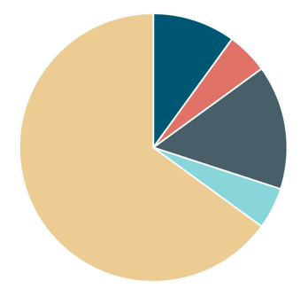
Cumulative Discovery of IEI, Prevalence, and Types of Deficiencies
Prevalence
IgA deficiency: 1/600
Common variable immune deficiencies (CVID): 1/25,000
Severe combined immune deficiencies (SCID): 1/65,000
Types of Deficiencies
Cellular T cell
5%
15%
65%
Humoral/B cell
Cumulative Discovery of IEI
5%
Complement
5%
10%
Phagocyte/PMN
2021: >475 distinct mutations
Tangye SG, et al. J Clin Immunol. 2022;42:1473-1508. Dorsey MJ, et al. Immunol Allergy Clin North Am. 2019;39(1):1-11.

Slide 11
Audience Response
According to the Jeffrey Modell Foundation guidance, which of the following is a warning sign for PI in pediatric patients?
≥ 4 new ear infections in 1 year
≥ 2 new ear infections in 1 year
3 weeks of antibiotics with little effect
1 sinus infection within 12 months
I’m not sure
Notes:
Correct answer is A

Slide 12
Assess the signs and symptoms of primary immunodeficiency in pediatric patients
1
LEARNING
OBJECTIVE
Kenneth Paris, MD, MPH

Slide 13


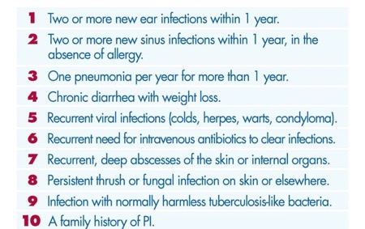
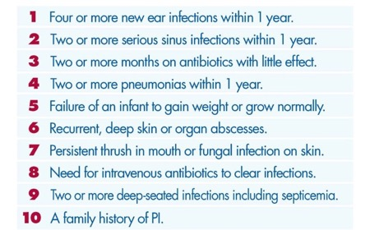
Diagnosing PI: Warning Signs
Jeffrey Modell Foundation. 2021. https://info4pi.org/library/educational-materials/.

Slide 14

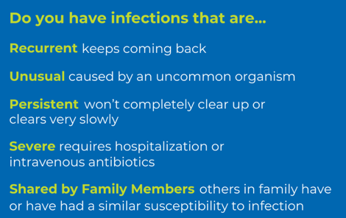

PI Vigilance: Recurrent, Unusual, Persistent, Severe, Shared Infections
Patient Support: Scan to learn more
Adapted from Immune Deficiency Foundation. primaryimmune.org; idf@primaryimmune.org

Slide 15

Racial, Ethnic, and Socioeconomic Disparities in the Diagnosis of PI
Few studies address disparities in patients with PI
Report by AAAAI Committee on Underserved:
  Patients with private insurance in administrative databases ➞ highest rates of PI diagnosis
  White patients >2X more likely to be diagnosed with PI than Black or Hispanic patients
  Under-representation among racial/ethnic underserved populations in clinical studies
Important to assess patient social determinants of health (SDoH) to provide optimal, tailored care
AAAAI = American Academy of Allergy, Asthma & Immunology
Davis CM, et. al. J Allergy Clin Immunol. 2021;147(5):1579-1593.

Slide 16
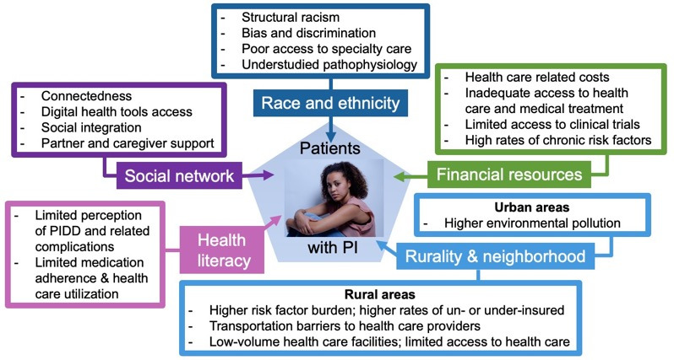

Social Determinants of Health in PI
Adapted from Essien UR, et al. J Natl Med Assoc. 2020;112(1):103-108.

Slide 17
Audience Response
On average, how long does it take for PI to be properly diagnosed?
5 years
10 years
15 years
20 years
I’m not sure
Notes:
Correct answer is C

Slide 18
Implement strategies for timely diagnosis of primary immunodeficiency
2
LEARNING
OBJECTIVE
Kristin Epland, MSN, FNP-C

Slide 19

The Long Road to Diagnosis
IDF survey: on average, diagnosis of PI can take 15 years
More than 50% of people are diagnosed > age 30
In IDF survey, nearly half of respondents reported some type of functional impairment:
  Chronic infection (bronchiectasis)
  Autoimmune disease
  Days in the hospital
  Days missed from work or school
Immune Deficiency Foundation [IDF]. 2013 IDF National Immunoglobulin Treatment Survey.
www.primaryimmune.org/sites/default/files/2013_IDF_National_Immunoglobulin_Treatment_Survey.pdf

Slide 20
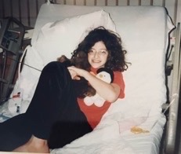
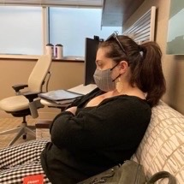
Prompt Diagnosis Matters: Ilana’s Story
Ilana Jacqueline
Patient Advocate and Author of Surviving and Thriving with an Invisible Chronic Illness
19 years waiting for a diagnosis of hypogammaglobulinemia
www.IlanaJacqueline.com

Slide 21

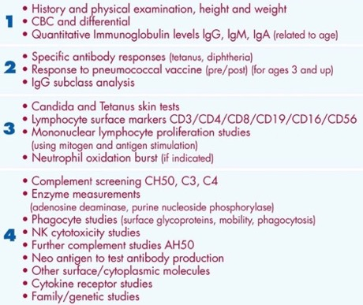
Initial Immune Evaluation: 4 Stages of Testing
History and physical are essential in making the diagnosis
Review growth parameters in children
CBC with differential and serum immunoglobulins
Jeffrey Modell Foundation. 2021. https://info4pi.org/library/educational-materials/.

Slide 22
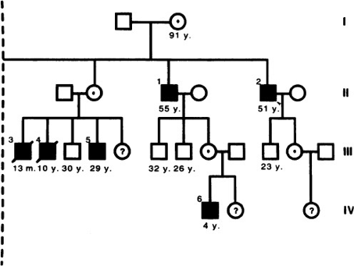

Family History

Slide 23
Autoimmunity
Exclusively focusing on infection-centered warning signs will miss ~25% of patients with PI who initially present with other manifestations
Most common autoimmune conditions: cytopenias, including immune thrombocytopenic purpura and hemolytic anemia
Organ-specific autoimmune/inflammatory complications involve the gastrointestinal tract, skin, joints, connective tissue, and respiratory tract
Bastos S, et al. Int J Mol Biol. 2019;4(5):174-180.

Slide 24
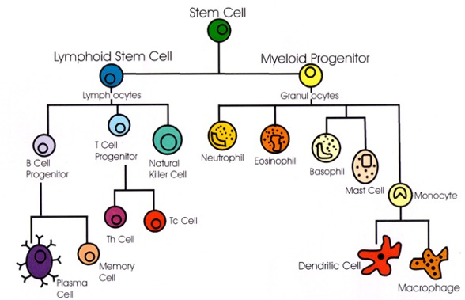
Laboratory Analysis: Start with the Lymphocyte
Cells of the Immune System
Test Cost: $20
Adapted from Todar’s Online Textbook of Bacteriology. https://textbookofbacteriology.net/adaptive_2.html.

Slide 25
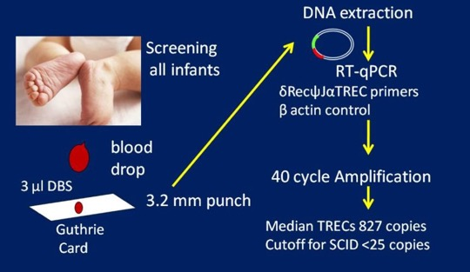
T-Cell Receptor Excision Circle (TREC) Analysis
Screening for SCID using TREC available in all 50 states
Inexpensive assay effectively integrated into public health programs
Without timely treatment, SCID is fatal, with exorbitant healthcare costs even in just 1 year of life
Cancer Therapy Advisor. 2017. https://www.cancertherapyadvisor.com/home/decision-support-in-medicine/pediatrics/scid-syndromes/

Slide 26
Every Abnormal TREC is not SCID
Other causes of positive SCID screening include:
  Leaky SCID/Omenn syndrome
  Prematurity
  Trisomy 21
  DiGeorge Syndrome
  Idiopathic lymphocytopenia
  Infants of mothers with immunosuppression
Confirmatory tests are necessary with T and B lymphocyte and Natural Killer cell profile
  Cost $698
Cancer Therapy Advisor. 2017. https://www.cancertherapyadvisor.com/home/decision-support-in-medicine/pediatrics/scid-syndromes/

Slide 27
Screening Immunoglobulins
Immunoglobulin G (IgG): most abundant type of antibody, found in all body fluids
Immunoglobulin A (IgA): found in the mucous membranes (airway, GI tract, saliva, tears)
Immunoglobulin M (IgM): found in blood and lymph fluid, first antibody made by the body to fight a new infection
Immunoglobulin E (IgE): associated mainly with allergic reactions, found in lungs, skin, and mucous membranes
Test cost: $98
Justiz Vaillant AA, et al. Immunoglobulin. [Updated 2022 Nov 24]. In: StatPearls [Internet]. Treasure Island (FL): StatPearls Publishing; 2023. https://www.ncbi.nlm.nih.gov/books/NBK513460/

Slide 28

Pitfalls of Testing
Reference ranges
  Be aware that a normal Ig level for a 3-month-old is different than that for an 18-month-old
  Quantitative deficiency does not mean a qualitative deficiency
Ig = immunoglobulin
Ludwig-Kraus B, et al. J Clin Lab Anal. 2017;31(6):e22146.

Slide 29
When to Refer to a Specialist
Abnormal laboratory results
Poor response to conservative management
  Antibiotics
  DMARDs
Reproductive considerations
  Genetics counseling
DMARDs = disease-modifying antirheumatic drugs
Bonilla FA, et al. J Allergy Clin Immunol. 2015;136(5):1186-1205.

Slide 30
Interdisciplinary Management of PI
Allergies
Primary care
Allergy/immunology
Pulmonology
Hematology
Gastroenterology
Infectious disease
ENT
Nutritionists/dieticians
Infections
Autoimmunity
Malignancy Lymphoproliferation
Inflammation
Bonilla FA, et al. J Allergy Clin Immunol. 2015;136(5):1186-1205.

Slide 31
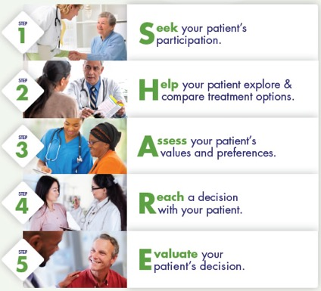
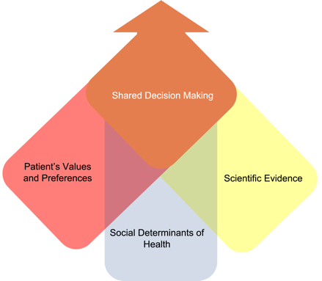
Shared Decision-Making and the SHARE Approach
Optimal Patient Care
Shared Decision Making
AHRQ Publication 14-0034-1-EF. Turkson-Ocran R-A, et al. J Am Heart Assoc. 2021;10:e018183.

Slide 32
Audience Response
Which of the following IgRTs can be dosed in pediatric patients every 3-4 weeks?
IVIg
SCIg
fSCIg
IVIg and fSCIg
I’m not sure
fSCIg = hyaluronidase facilitated immunoglobulin; IgRT = immunoglobulin replacement therapy; IVIg = intravenous immunoglobulin; SCIg = subcutaneous immunoglobulin
Notes:
Correct answer is D

Slide 33
Incorporate evidence-based treatments for patients with primary immunodeficiency
3
LEARNING
OBJECTIVE
Hey Jin Chong, MD, PhD

Slide 34

Case Study: RS
17-year-old high school student
Lifelong history of pneumonias
First few years of life: recurrent ear infections
At 6 years old admitted to ICU with pneumonia
  Required thoracoscopic decortication and pericardial window during this admission

Slide 35
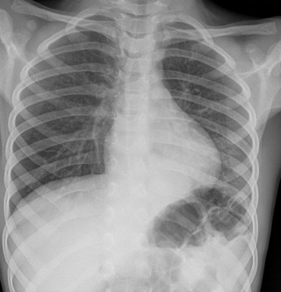
Case Study: RS (cont’d)
Age 7:
  Direct laryngoscopy and bronchoscopy
  Pus noted from trachea
  Unable to be extubated; ventilation for
  1 day
  Chest x-ray consistent with LLL pneumonia
  Culture grew Streptococcus pneumoniae
LLL Pneumonia at Age 7
LLL = left lower lobe
Photo: McEniery J, Left lower lobe pneumonia. Case study, Radiopaedia.org. https://doi.org/10.53347/rID-76746.

Slide 36
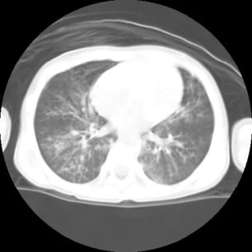
Case Study: RS (cont’d)
Age 8: Developed LLL and RUL PNA with reactive
hilar and mediastinal adenopathy; no organism identified
Age 8-10: Several (7-8) other CXR positive PNAs which would clear with antibiotics and recur within 1-2 months
Age 9: Bronchiectasis on chest CT as well as restrictive airway disease on PFTs; chest physiotherapy, albuterol inhaler started
Age 10: Referred to immunology; started on IVIg for recurrent infections and low pneumococcal titers; also started on trimethoprim-sulfamethoxazole for PJP prophylaxis due to severe T cell lymphopenia
Bronchiectasis on Chest CT
at Age 9
CT = computed tomography; CXR = chest x-ray; LLL = left lower lobe; PFTs = pulmonary function tests; PJP = Pneumocystis jirovecii pneumonia; PNA = pneumonia; RUL = right upper lobe

Slide 37
Selecting Therapies for PI
 | IgRT | HSCT | Gene Tx
Antibody Defects (agammaglobulinemia, others) | YES | No | No
CIDs (SCID [IL2RG, ADA]) | YES | Yes | Yes
Innate Defects (NEMO deficiency, other NF-𝛋B defects) | YES | Yes | No
Phagocytic defects (neutropenia, LAD, MSMD) | No | Yes | No
Complement defects | No | No | No
Other Options*
Antimicrobial prophylaxis
Vaccines (avoid live vaccines in most patients with PI)
Immunomodulators
Enzyme replacement therapy
Rituximab, steroids
*Not currently FDA-approved for PI. (Other options for comorbidities associated with PI may be FDA-approved in some cases.)
CIDs = combined immunodeficiencies; G-CSF = granulocyte colony stimulating factor; HSCT = hematopoietic stem cell transplantation; IFN = interferon; IL2RG = interleukin-2 receptor common gamma chain; IgRT = immunoglobulin replacement therapy; LAD = leukocyte adhesion deficiency; MSMD = Mendelian susceptibility to mycobacterial disease; NEMO = nuclear factor ϰB essential modulator; NF-𝛋B = nuclear factor ϰB. Bonilla FA et al. J Allergy Clin Immunol. 2015;136(5):1186-205.

Slide 38

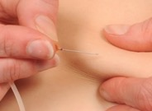
Patient Experience: IVIg, SCIg, fSCIg
Intravenous Immunoglobulin (IVIg) | Subcutaneous Immunoglobulin (SCIg) | Hyaluronidase Facilitated Immunoglobulin (fSCIg)
Indicated for adult and pediatric patients with PI | Indicated for adult and pediatric patients with PI | Indicated for adult and pediatric patients with PI (new indication)
Usually given every 3-4 weeks | Flexible schedule daily to every 2 weeks | Can be given every 3-4 weeks
Fewer needle sticks, less frequent | No need for venous access No wear-off effect Self administration Less/no pre-medication Fewer adverse effects Flexibility (dosing, frequency) Improved quality of life (QoL) Decreased healthcare costs
Patient preference/comfort level | No wear-off effect
Epland K, Perez E. IDF Guide to Ig Therapy. https://primaryimmune.org/sites/default/files/publications/IDF%20Guide%20to%20Ig%20Therapy.pdf. U.S. Food and Drug Administration [FDA]. Prescribing Information (HYQVIA/Immune Globulin Infusion 10% [Human] with Recombinant Hyman Hyaluronidase) Solution, for subcutaneous administration. https://www.fda.gov/media/89844/download.

Slide 39
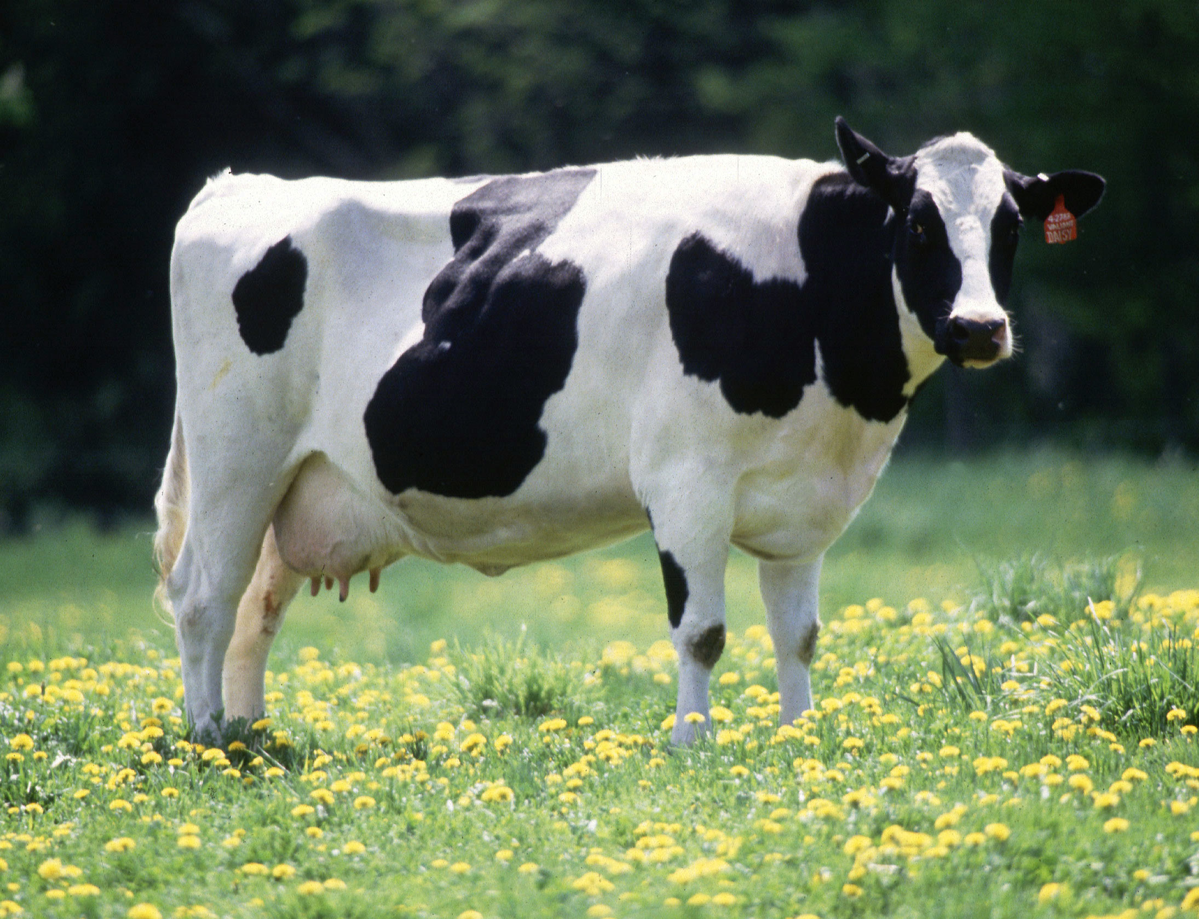
Enzyme Replacement Therapy (ERT)
ADA SCID:
  Deficiency of adenosine deaminase leads to buildup of toxic molecules in cells kills immune cells and can cause damage to the nervous system leading to deafness, developmental delay, and other neurologic problems
  1986: Hershfield, et al. used ADA from cow intestine to treat patients
  1990: Pegademase approved by the FDA
  Treatment cost: up to $400,000/year
  Elapegademase is a newer FDA-approved recombinant enzyme produced in E. coli
Markert ML, et al. J Clin Immunol. 1987;7(5):389-399. Hershfield MS. Immunodeficiency. 1993;4:93-97. Murguia-Favela L, et al. Clin Exp Immunol. 2020;200:176-184. Ferrua F, et al. Hum Gene Ther. 2017;28(11):972-981.

Slide 40

Gene Therapy
Gene therapy for PI
  SCID
  Wiskott-Aldrich
  Chronic granulomatous disease
  Immune dysregulation polyendocrinopathy enteropathy X-linked (IPEX) syndrome
Arlabosse T, et al. J Allergy Clin Immunol Pract. 2023;S2213-S2198(23)00403-9.

Slide 41
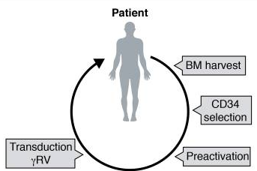
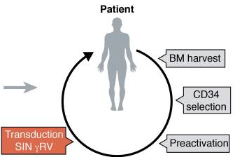
Gene Therapy: X-SCID
X-SCID gene therapy trials (20 patients) in Europe used gamma retroviral vectors: 6 patients developed leukemia (insertional oncogenesis)
Gene therapy used self-inactivating retroviral vectors (SIN) – recent trials switched to SIN lentiviral vectors to be even safer
Fischer A, Hacein-Bey-Abina S. J Exp Med. 2020;217(2):e201. Kohn LA, et al. Front Immunol. 2021;12:648951.

Slide 42
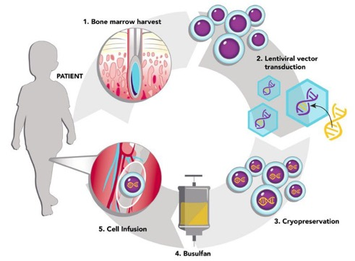
Gene Therapy: X-SCID (cont’d)
Recent trials also cryopreserve cells, allowing for testing before re-introduction to patients, before being sent elsewhere; and to facilitate patient conditioning
Ongoing research is promising
Kohn LA, et al. Front Immunol. 2021;12:648951.
Image: St. Jude Gene Therapy for X-Linked SCID. Ewelina Mamcarz, MD; Designer: Ashley Durand. www.stjude.org

Slide 43


Case Study: (cont’d) RS History After IVIg
Age 12: normal mitogen response, persistent hyper IgM 574 and normalization of CH50, C4, but undetectable C5, C6
Age 13: RS reports periorbital edema occurring in early June each year for several years; hospitalized for initial 3 infections and treated with IV antibiotics for 5 days, but no organisms ever grew
Age 15: Appointment with ENT specialist – CT sinus showed chronic sinus disease; underwent successful sinus surgery, but symptoms continued to recur
Periorbital Edema
ENT = ear, nose, and throat
Photo: Goodyear, P, et al. Emerg Med J. 2004;21:240-242.

Slide 44

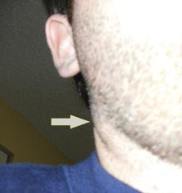
Case Study: RS (History After IVIg)
Age 17: Admitted 1 week for bilateral cervical lymphadenopathy of unknown etiology
Biopsy showed reactive lymph node with follicular, paracortical, and sinus patterns, negative CMV, EBV, Bartonella, and negative bacterial cultures
Imaging showed persistent cervical lymphadenopathy with suppuration, bronchiectasis, atelectasis/scarring in RLL/RUL/LUL, hepatosplenomegaly, bowel wall thickening in terminal ileum/cecum
Suppurative Cervical Lymphadenopathy
CMV = cytomegalovirus; EBV = Epstein-Barr virus; LLL = left lower lobe; RLL = right lower lobe
Photo: Hernandez M, et al. J Am Osteopath Assoc. 2011;111(1):49-51.

Slide 45
Case Study (cont’d): More History After IVIg
What’s unusual? Why is he different? Does he warrant further genetic testing? Why isn’t this just CVID?
Hyper IgM – cannot class switch
Low complement does not fit CVID
Severe lymphopenia not typical for CVID
No more pneumonias (thanks IVIg!) but still having HSM, LAD
LAD = lymphadenopathy; HSM = hepatosplenomegaly

Slide 46
Case Study (cont’d): More History After IVIg
What’s unusual? Why is he different? Does he warrant further genetic testing? Why isn’t this just CVID?
Hyper IgM – cannot class switch
Low complement does not fit CVID
Severe lymphopenia not typical for CVID
No more pneumonias (thanks IVIg!) but still having HSM, LAD
Genetic testing is warranted
Sent for whole exome sequencing (WES)
LAD = lymphadenopathy; HSM = hepatosplenomegaly

Slide 47

Case Conclusion: RS Responds to “Precision Medicine”
WES reveals mutation in Pi3Kinase p110 delta gene
  Diagnosis: Activated Pi3K delta syndrome (APDS)
RS entered into clinical trial at NIH
  Leniolisib/CDZ173 – small molecule inhibitor of Pi3K delta
  Spleen decreased in size, no recurrence of periorbital swelling or LAD
  Able to stop IgRT
  Cough resolved
  For the first time in his life, he walked 4 miles without stopping (while playing Pokemon Go)
  RS says he “feels full of life” for the first time

Slide 48
Precision Medicine in PI
Primary Immunodeficiency | Gene Defect | Biologic
APDS (Activated PI(3)K delta syndrome) | PI3K (p110d) GOF | Leniolisib
CGD (Chronic granulomatous disease) | CYBB (gp91^{phox}) | ɣ-interferon
CTLA-4 (Cytotoxic lymphocyte antigen 4) haploinsufficiency | CTLA4 | Abatacept
LAD1 (Leukocyte adhesion deficiency 1) | ITGB2 | Ustekinumab
LRBA (Lipopolysaccharide-responsive and beige-like anchor) | LRBA | Abatacept
STAT 1 GOF (Signal transducer and activator of transcription 1) | STAT1 | Ruxolitinib
STAT 3 GOF (Stat 3 gain of function) | STAT3 | Tocilizumab
WHIM (warts, hypogammaglobulinemia, infections, myelokathexis) | CXCR4 | Plerixafor
Note: Partial list. These therapies are currently not FDA-approved for PI. -
Pinto M, Neves J. Front Immunol. 2022;13:1029560. Hoyos-Bachiloglu R, Platt C. Immunol Genet J. 2019;2(4):8-22.

Slide 49
Audience Response
According to the Jeffrey Modell Foundation guidance, which of the following is a warning sign for PI in pediatric patients?
≥ 4 new ear infections in 1 year
≥ 2 new ear infections in 1 year
3 weeks of antibiotics with little effect
1 sinus infection within 12 months
I’m not sure
Notes:
Correct answer is A

Slide 50
Audience Response
On average, how long does it take for PI to be properly diagnosed?
5 years
10 years
15 years
20 years
I’m not sure
Notes:
Correct answer is C

Slide 51
Audience Response
Which of the following IgRTs can be dosed in pediatric patients every 3-4 weeks?
IVIg
SCIg
fSCIg
IVIg and fSCIg
I’m not sure
Notes:
Correct answer is D

Slide 52
&
QUESTIONS
ANSWERS
Thank you for joining us.
Don’t forget to collect your credit.

Slide 53
SMART Goals
Specific, Measurable, Attainable, Relevant, Timely
Consider PI in pediatric patients with frequent, severe, and/or unusual infections
Follow diagnostic pathways to confirm PI
Initiate (or refer) pediatric patients with PI for IVIg, SCIg, and now fSCIg, which can be life-saving and life-sustaining
Keep abreast of new and emerging “precision medicine” strategies
Provide patient-centered care that includes shared decision-making and considers social determinants of health

Slide 54
To receive CME/CE credit for this activity, participants must complete the post-test and evaluation.

Slide 55

Visit the
Virtual Education and
Rare Disease Hubs
Free resources and education to educate
health care professionals and patients.
cmeoutfitters.com/practice/rare-diseases/
cmeoutfitters.com/practice/virtual-education-hub/

Slide 56
Primary Immunodeficiency
in Pediatric Care:
When It’s More Than “Just an Infection”
Supported by an educational grant from
Takeda Pharmaceuticals U.S.A., Inc.

