Slide 1
Meeting the Needs of Under-Represented Patients with IBD: Screening and Immunizations
Supported by educational grants from AbbVie Inc.; Janssen Biotech, Inc., administered by Janssen Scientific Affairs, LLC; and Takeda Pharmaceuticals U.S.A., Inc.

Slide 2

In support of improving patient care,
CME Outfitters, LLC, is jointly accredited by the Accreditation Council for Continuing Medical Education (ACCME), the Accreditation Council for Pharmacy Education (ACPE), and the American Nurses Credentialing Center (ANCC), to provide continuing education for the healthcare team.

Slide 3
Engage with us via Twitter!
Follow us on Twitter!
@CMEOutfitters
for upcoming CME/CE opportunities, health care news, and more

Slide 4
Miguel Regueiro, MD, AGAF, FACG, FACP
Chair, Digestive Disease and Surgery Institute
Chair, Department of Gastroenterology, Hepatology, and Nutrition
The Pier C. and Renee A. Borra Family Endowed Chair in Gastroenterology and Hepatology
Professor, Department of Medicine
Cleveland Clinic Lerner College of Medicine of Case Western Reserve University
Cleveland, OH

Slide 5
Patricia Ajayi-Fox, MD
Associate Staff
Department of Gastroenterology, Hepatology, and Nutrition
Cleveland Clinic Foundation
Cleveland, OH

Slide 6
Sophie Balzora, MD, FACG
Clinical Associate Professor of Medicine
NYU Grossman School of Medicine
Division of Gastroenterology and Hepatology
NYU Langone Health
New York, NY

Slide 7
Learning
Objective
1
Integrate recommended immunizations and preventive screenings into practice to improve health outcomes in all patients with inflammatory bowel disease (IBD).

Slide 8
Learning
Objective
2
Implement strategies to address disparities in care in patients with IBD by establishing trust, providing education, and engaging in shared decision-making (SDM).

Slide 9

Case Study: Michael
39-year-old Black male
Mild pancolitis
Chronic ulcerative colitis (UC) x 8 years
Family history of IBD
At risk for colorectal cancer (CRC) due to family history
Has not received flu vaccine

Slide 10
Audience Response
What preventive care information is missing from Michael’s chart?
A. Vaccination history
B. Nutritional assessment information
C. Assessment of Michael’s mental health
D. Smoking status
E. All of the above

Slide 11
Case Study: Michael
39-year-old Black male
Mild pancolitis
Chronic UC x 8 years
Family history of IBD
At risk for CRC due to family history
Has not received flu vaccine
Needs screening assessments completed
Prescribed oral mesalamine; does not want to use rectal mesalamine

Slide 12
Preventive Care for Patients with IBD
Patients with IBD do not receive preventive services at the same rate as general medical patients
Patients with IBD often consider their gastroenterologist to be the primary provider of care
Documentation of up-to-date vaccinations is crucial as patients with IBD are often treated with long-term immune-suppressive therapies and may be at increased risk for infections, many of which are preventable with vaccinations
Health maintenance issues need to be co-managed by both the gastroenterologist and primary care teams
Farraye FA, et. al. Am J Gastroenterol. 2017;112(2):241-258.

Slide 13
Vaccinations and Patients with IBD
IBD places patients at increased risk for developing vaccine-preventable illnesses, which is further exacerbated by immunosuppressive therapy
Inactivated vaccines can be safely administered to patients with IBD who are on immunosuppressive therapy
Ideal time to vaccinate patients is prior to starting immunosuppressive therapy or on initial visit
Commonly needed vaccines include:
Influenza
Pneumococcal pneumonia
Hepatitis A and B
Human papillomavirus
Meningococcal
Tetanus, diphtheria, and pertussis
Measles, mumps, and rubella
Varicella zoster
Herpes zoster
COVID-19
Reich J, et. al. Gastroenterol Hepatol (N Y). 2016;12(9):540-546. Cornerstoneshealth Website.2015. https://www.cornerstoneshealth.org/wp-content/uploads/2020/08/NEW-IBD-Checklist-for-Monitoring-Prevention-526a.pdf. Accessed October 25, 2021.

Slide 14
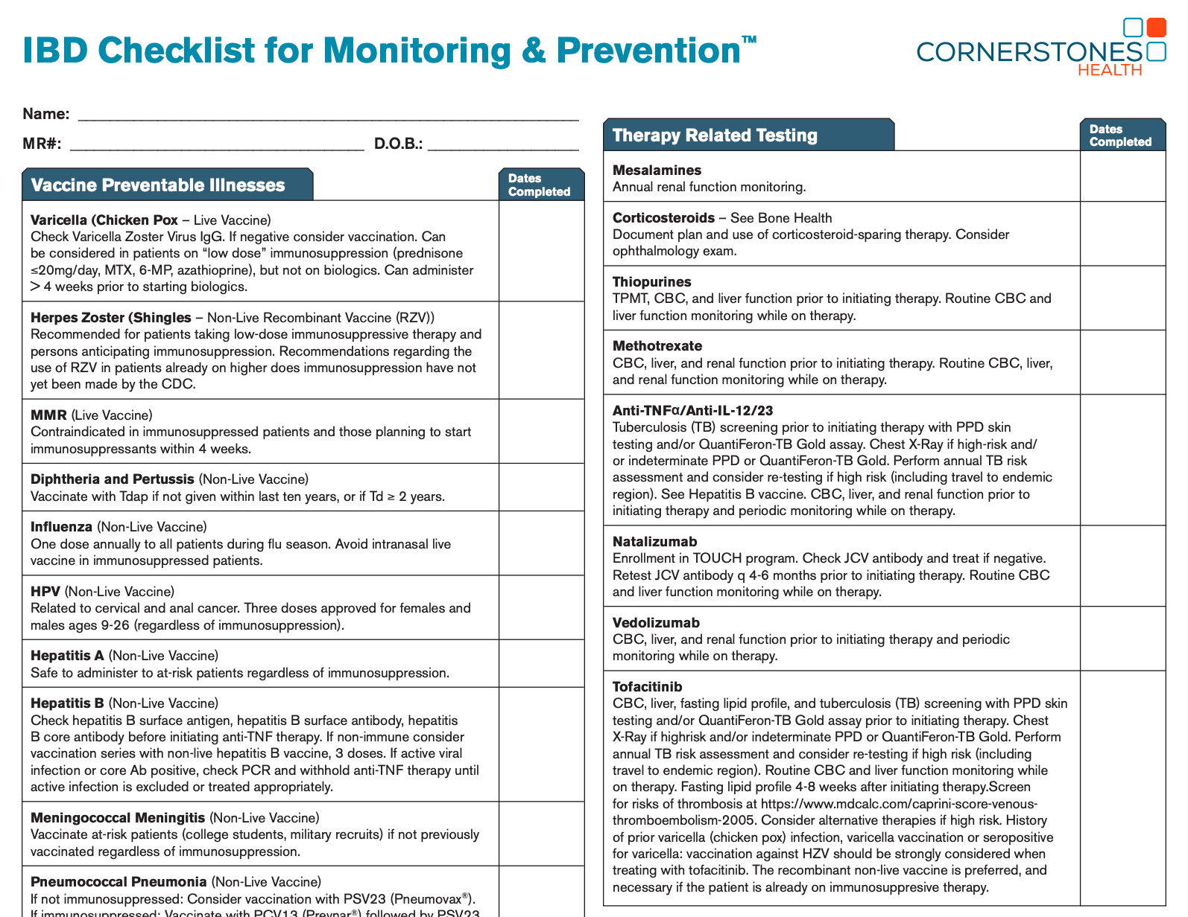
Vaccinations and Patients with IBD (Continued)
Many GIs feel it is the role of the primary care provider (PCP) to administer vaccines, which leads to gaps in care
If unable to provide vaccines in GI practice, the PCP should be sent concise recommendations for vaccines to administer
Educate patient about important role of vaccinations and use checklists with patients so they feel empowered in their care
Reich J, et. al. Gastroenterol Hepatol (N Y). 2016;12(9):540-546. Cornerstoneshealth Website.2015. https://www.cornerstoneshealth.org/wp-content/uploads/2020/08/NEW-IBD-Checklist-for-Monitoring-Prevention-526a.pdf. Accessed October 25, 2021.

Slide 15
Essential Screenings in Patients with IBD
Patients with extensive colitis (> 1/3 of the colon) for ≥ 8 years should undergo surveillance colonoscopy every 1-3 years, depending on cancer risk
Women with IBD who are being treated with systemic immunosuppression* should undergo cervical cancer screening by cytology annually (if cytology alone) or every 3 years (if HPV negative)
All patients being treated with systemic immunosuppression* should have annual total body skin exams to screen for skin cancer
*Systemic immunosuppression refers to current treatment with prednisone (> 20 mg/day for more than 14 days), azathioprine (> 2.5 mg/kg/day), mercaptopurine (> 1.5 mg/kg/day), methotrexate (> 0.4 mg/kg/week), cyclosporine, tacrolimus, infliximab, adalimumab, golimumab, certolizumab, ustekinumab, or tofacitinib
HPV = human papillomavirus
Syal G, et. al. Inflamm Bowel Dis. 2021;27(10):1552-1563.

Slide 16
Essential Screenings in Patients with IBD (Continued)
All patients should undergo screening for latent tuberculosis at baseline
All patients should be screened for osteoporosis by central
(hip and spine) DEXA scan if ANY risk factors for osteoporosis
(i.e., low BMI, > 3 months cumulative steroid exposure, smoker, post-menopausal, hypogonadism) are present, and it should be repeated in 5 years
All patients should be screened for depression (PHQ9) and anxiety (GAD7) at baseline and annually
All patients should be screened for smoking status at baseline, and current smokers should be referred for smoking cessation therapy
BMI = body mass index; DEXA = dual energy X-ray absorptiometry
Syal G, et. al. Inflamm Bowel Dis. 2021;27(10):1552-1563.

Slide 17
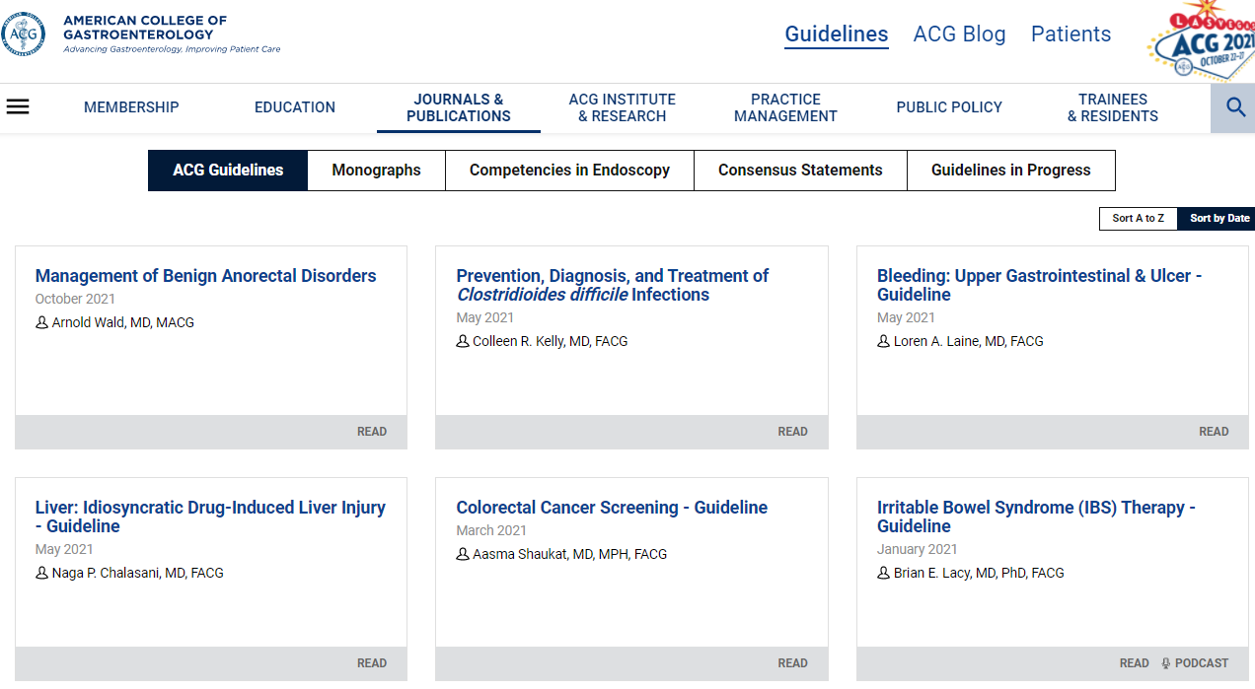
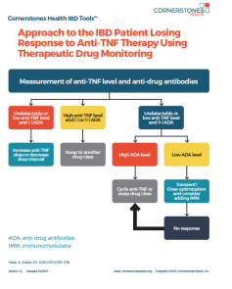
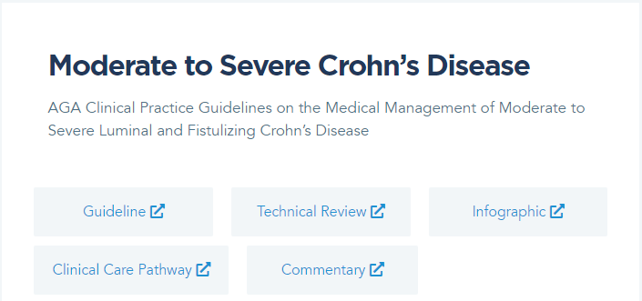
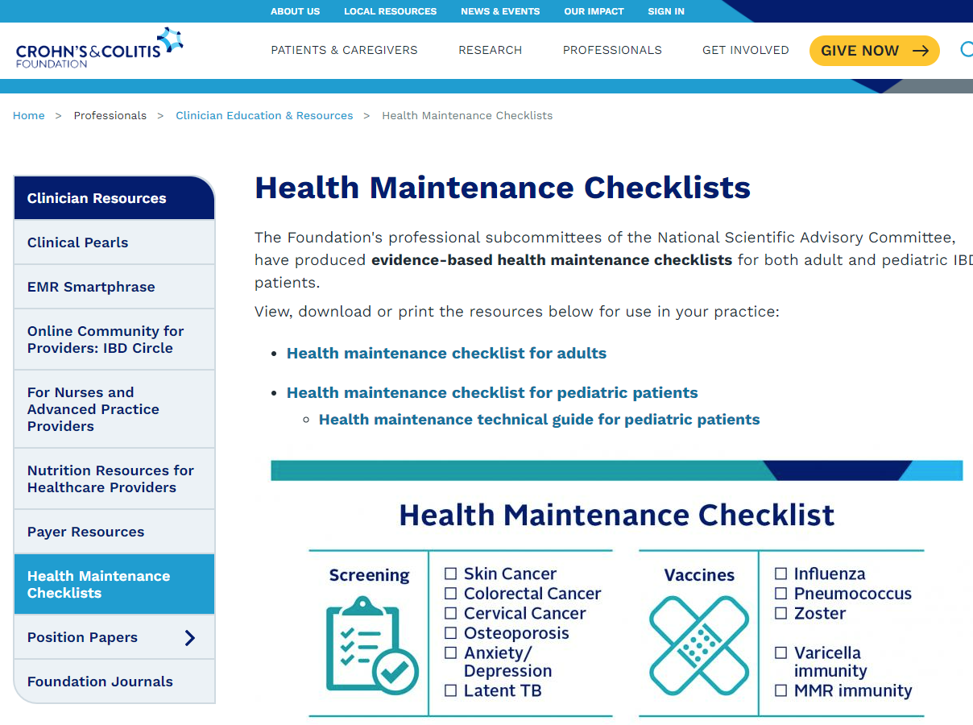
Guidelines and Checklists
American College of Gastroenterology – ACG Guidelines
https://acgcasereports.gi.org/guidelines
Cornerstones Health IBD Checklists & Tools
https://www.cornerstoneshealth.org/ibd-checklists/
American Gastroenterological Association – IBD & Bowel Disorders Guidelines
https://gastro.org/guidelines/ibd-and-bowel-disorders/
Crohn’s & Colitis Foundation – Health Maintenance Checklists
https://www.crohnscolitisfoundation.org/science-and-professionals/education-resources/health-maintenance-checklists

Slide 18

Case Study: Ana
Hispanic female, single parent
Limited English proficiency
Needs colonoscopy
Did not show up for scheduled procedure

Slide 19
Audience Response
Hispanic patients have seen an increased incidence of IBD due to:
A. Environmental exposures
B. Genetic differences
C. Social determinants of health
D. Incidence is not increasing
E. I am not sure

Slide 20
Social Determinants of Health in IBD Care
Race and socioeconomic status
Disparity in IBD-related surgery: insurance coverage a factor
Medication adherence issues
Need for language concordant care
Disparity in clinical trial participation
Sewell JL, et. al. Inflamm Bowel Dis. 2013;19(3):627-643.

Slide 21
Case Study: Ana
Hispanic female, single parent
Limited English proficiency
Needs colonoscopy
Did not show up for scheduled procedure
Has no transportation
Receives a no-show fee from doctor’s office due to missed appointment

Slide 22
Medical Home for Patients with IBD
Patient-centered, team-based, focused on quality and safety
Can include the following specialists:
Have shown improvement in quality-of-life measures
(using SIBDQ), as well as decrease in hospitalization and emergency room visits by nearly 50% in the first year of the medical home
Gastroenterologist
PCP
Behavioral health specialist
Social worker
Nurse practitioner
Dietitian
SIBDQ = Short Inflammatory Bowel Disease Questionnaire
Regueiro M. Gastroenterol Hepatol (N Y). 2017;13(6):375-377.

Slide 23
Creating Medical Home Model in the Community
Can be achieved in following ways:
  Refer the patient to a medical home center of excellence and have them take over care of the patient
  Have an annual visit with a medical home center of excellence with regular care managed by community gastroenterologist and team care provided by medical home
  Have an annual visit with a medical home with team care provided to the patient via telehealth
Fisher ES. N Engl J Med. 2008;359(12):1202-1205.

Slide 24
Case Study: Ana
Hispanic female, single parent
Limited English proficiency
Needs colonoscopy
Did not show up for scheduled procedure
Has no transportation
Receives a no-show fee from doctor’s office due to missed appointment
Does not return for follow-up and falls through the cracks

Slide 25
Providing Optimal Care for Under-Represented Patients
Use team approach to care to assess:
  Health literacy
  Financial constraints
  Work constraints
  Need for language concordant care by translator
  Transportation issues
  Health insurance barriers
Thornton RL, et. al. Health Aff (Millwood). 2016;35(8):1416-1423. Vanderbilt AA, et.al. J Multidiscip Healthc. 2015;8:205-208.

Slide 26
SMART Goals
Specific, Measurable, Attainable, Relevant, Timely
Recognize the need for immunizations and preventive screenings for patients with IBD
Adhere to guidelines for appropriate immunizations and screenings
Educate patients and collaborate with primary care providers regarding the importance of immunizations and screenings
Integrate recommended immunizations and preventive screenings into practice using checklists, guidelines, and other tools
Regularly assess social determinants of health that patients may be facing

Slide 27
Join us for the two remaining programs in this series:
The Important Role of Preventive Screening in IBD: How, Who, and Does It Matter?
November 8, 2021
6:30 PM ET – 7:15 PM ET
The Medical Neighborhood and IBD:
Steps to Improve Care for All Patients
November 16, 2021
6:30 PM ET – 7:15 PM ET

Slide 28
To Ask a Question
Please click on the Ask Question tab and type your question. Please include the faculty member’s name if the question is specifically for them.

Slide 29
CME Outfitters
AFTER
THE SHOW
Questions & Answers
Notes:
If applicable

Slide 30
Visit the
Gastroenterology Hub
Free resources and education to educate
health care providers and patients on IBD
https://www.cmeoutfitters.com/gastrohub/

Slide 31
To Receive Credit
To receive CME/CE credit for this activity, participants must complete the post-test and evaluation online.
Participants will be able to download and print their certificate immediately upon completion.
Notes:
This slide and the last slide (23) should go up during the Q&A

