Slide 1

On Point with Pain Management: Leveraging Change for Positive Outcomes

Slide 2
This activity is supported by an independent educational grant from Opioid Analgesic REMS Program Companies.
Please see https://www.opioidanalgesicrems.com/Resources/Docs/List_of_RPC_Companies.pdf
for a listing of REMS Program Companies.
This activity is intended to be fully compliant with the Opioid Analgesic REMS education requirements issued by the US Food and Drug Administration (FDA).

Slide 3
In support of improving patient care, CME Outfitters, LLC, is jointly accredited by the Accreditation Council for Continuing Medical Education (ACCME), the Accreditation Council for Pharmacy Education (ACPE), and the American Nurses Credentialing Center (ANCC) to provide continuing education for the healthcare team.

Slide 4
Engage with us via Twitter!
Follow us on Twitter!
@CMEOutfitters
for upcoming CME/CE opportunities, health care news, and more

Slide 5
Steven Stanos, DO
Executive Medical Director
Rehabilitation and Performance Medicine
Medical Director, Swedish Pain Services
Swedish Health System
Seattle, WA

Slide 6
David O’Gurek, MD, FAAFP
Associate Professor and Interim Chair
Department of Family & Community Medicine
Lewis Katz School of Medicine at Temple University
Medical Director, TRUST Clinic
Philadelphia, PA

Slide 7
Impact of COVID-19 On Pain Strategies
COVID-19 pandemic forced healthcare systems to redistribute resources – often at the expense of “non-urgent” pain services
Home lockdown impacted treatment access and patients’ psychological health
Telehealth offered a good opportunity for continuity of care, helping to triage urgent or emergent cases
Puntilo F, et al. Best Pract Res Clin Anaesthesiol. 2020;34(3):529-537.

Slide 8
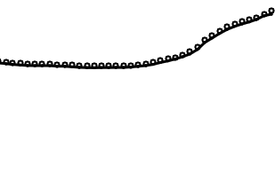
COVID-19 and Rising Overdose Deaths
CDC reports a 30% increase in overdose deaths between January 2020-January 2021
Opioid epidemic intensified by isolation and anxiety
Uncertainty of COVID-19 pandemic, which led to unprecedented job, food, and housing insecurity
100,000
80,000
60,000
Number of Deaths
40,000
20,000
0
Jan 2018
Jan 2019
Jan 2020
Jan 2021
12 Month Ending Period
Ahmad FB, et al. National Center for Health Statistics. 2021. Available at https://www.cdc.gov/nchs/nvss/vsrr/drug-overdose-data.htm#citation. Accessed October 1, 2021.; Roy L. Forbes. 2021. Available at https://www.forbes.com/sites/lipiroy/2021/08/31/overdose-awareness-why-it-matters/?sh=25361b545c84. Accessed October 1, 2021.

Slide 9
Learning
Objective
1
Apply knowledge of acute and chronic pain pathways and underlying mechanisms to clinical assessment and appropriate management.

Slide 10
Complexities of Pain
Pain
Unpleasant thoughts, emotions, and behaviors accompanying nociception
  Anxiety, depression
  Disturbed sleep
  Diminished function
  Catastrophizing
Nociception
Physiology of actual or potential tissue damage
Hsu JR, Mir H, et al. J Orthop Trauma. 2019;33(5):e158-e182.; Suso-Ribera C, et al. Pain Res Manag. 2017;2017:9762864.
Notes:
9:38
Its important too

Slide 11
Pain Terminology and Definitions
Pain Terminology | Definition
Allodynia | Pain due to a stimulus that normally does not provoke pain
Causalgia | Syndrome of sustained burning pain, allodynia, and hyperpathia after a traumatic nerve lesion
Dysesthesia | Unpleasant abnormal sensation, spontaneous or evoked
Hyperalgesia | Increased pain from a stimulus that normally provokes pain
Neuropathic pain | Pain caused by a lesion or disease of somatosensory system
Nociceptive pain | Pain that arises from actual or threatened damage to nonneural tissue; due to activation of nociceptors
Acute pain | Pain that lasts < 3-6 mon, is directly related to tissue damage, and resolves as tissues heal
Chronic pain | Pain that lasts > 3 mon, is primarily mediated by C fibers, may have some element of central sensitization
High impact chronic pain | Daily pain that lasts > 6 mon, affecting function
Sensitization | Increased responsiveness of nociceptive neurons to their normal input resulting in recruitment of response to normally subthreshold inputs
Lee GI, Neumeister MW. Clin Plast Surg. 2020;47(2):173-180.

Slide 12
Chronic Pain Presentations
Predominantly Neuropathic
Postherpetic neuralgia
Painful diabetic peripheral neuropathy
Lumbar or cervical radiculopathy
Stenosis
Tumor-related neuropathy
Chemotherapy-induced neuropathy
Small fiber neuropathy
Persistent postoperative pain
Multiple sclerosis pain
Post-stroke pain
Pain associated with spinal cord injury
Neuropathic Pain
Nociplastic Pain
Nociceptive Pain
Predominantly Nociceptive
Osteoarthritis
Rheumatoid arthritis
Tendonitis, bursitis
Ankylosing spondylitis
Gout
Neck and back pain with structural pathology
Tumor-related nociceptive pain
Sickle-cell disease
Inflammatory bowel disease
Predominantly Nociplastic
Fibromyalgia
Irritable bowel syndrome
Tension-type pain
Interstitial cystitis/pelvic pain syndrome
Tempo-mandibular join disorder
Chronic fatigue syndrome
Restless leg syndrome
Neck and back pain without structural pathology
Mixed pain conditions are frequently associated with multiple pain pathophysiologies once pain becomes chronic
Adapted from Stanos S, et al. Postgrad Med 2016;128(5):502-515.
Notes:
17:00
Adapted from Stanos S, et al. Postgrad Med 2016;128(5):502-515.

Slide 13
Learning
Objective
2
Upon evaluation of your current clinical workflow for opioid prescribing, incorporate two best practice strategies to optimize safe and competent prescribing and minimize potential for abuse and diversion.

Slide 14

Patient Case: Keith
37-year-old male with low back pain for the past 3 months from a work- related injury
Initiated on hydrocodone/APAP 5mg/325mg up to 3/day
Pain not stable, has not regained mobility and function
Difficulty sleeping and has begun sleeping in a recliner

Slide 15
Acute and Chronic Pain Management:
Individualized, Multimodal, Interdisciplinary
Medication
Restorative
Therapies
Interventional
Procedures
Behavioral
Health
Approaches
Complementary
& Integrative
Health
Risk Assessment
Stigma
Access to Care
Education
U.S. Department of Health and Human Services. Pain Management Best Practices Inter-Agency Task Force Report: Updates, Gaps, Inconsistencies, and Recommendations. 2019. Available at https://www.hhs.gov/sites/default/files/pmtf-final-report-2019-05-23.pdf. Accessed October 1, 2021.

Slide 16
2016 CDC Guideline for Prescribing Opioids for Chronic Pain
Determining need for opioids
Opioids are not first-line or routine therapy for chronic pain. Establish and measure goals for pain and function. Discuss benefits and risks of opioid therapy and availability of nonopioid therapies.
Opioid selection, dosage, and duration of therapy
Use immediate-release opioids when starting. Use caution at any dose. Reassess benefits and risk when dose reaches > 50 MME and avoid increasing dose to > 90 MME without carefully justifying decision. Long-term use begins with treatment of acute pain. 3 days or less is often sufficient. Follow-up and re-evaluate risk of harm; reduce dose or taper and discontinue if needed.
Assessing risk and addressing harm
Evaluate risk factors for opioid-related harms. Check PDMP for high dosages and prescriptions from other providers. Use urine drug testing to identify prescribed substances and undisclosed use. Avoid concurrent benzodiazepine and opioid prescribing. Arrange treatment for OUD if needed.
MME = morphine milligram equivalent; PDMP = prescription drug monitoring program
Dowell D, et al. MMWR Recomm Rep 2016;65(1):1-49.

Slide 17
Unintended Consequences: Misapplication of 2016 Guideline
Although not intended to be model legislation, 28 states have enacted legislation related to opioid prescription limits
Has been used to override medical decisions
Patients on high dose opioids discontinued or dismissed from care
Universally stop prescribing opioids even when benefits outweigh risks
Dowell D, et al. N Engl J Med. 2019;380(24):2285-2287.

Slide 18
 | 2016 CDC Opioid Prescribing Guideline | 2021 Draft CDC Opioid Prescribing Guideline
1 | Nonpharmacologic and nonopioid therapy is preferred for chronic pain. Clinicians should consider opioid therapy only if expected benefits for both pain and function are anticipated to outweigh risks to the patient. | Nonopioid therapies are preferred for many common types of acute pain. Clinicians should only consider opioid therapy only for acute pain only if benefits are anticipated to outweigh risks to the patient.
2 | Before starting therapy for chronic pain establish treatment goals with all patients, including realistic goals for pain and function, and should consider how therapy will be discontinued if benefits do not outweigh risks. | Nonopioid therapies are preferred for subacute and chronic pian. Discuss with patients known risks and realistic benefits of opioid therapy, establish treatment goals for pain and function, and consider how opioid therapy will be discontinued if benefits do not outweigh risks.
3 | When starting opioids for chronic pain clinician should prescribe immediate-release opioids instead of extended-release/long-acting (ER/LA) opioids. | Clinicians should prescribe immediate-release opioids instead of 1 extended-release/long-acting (ER/LA) opioids.
4 | When opioids are started . . .Prescribe the lowest effective dosage. Reassess evidence of individual benefits and risks when increasing dosage to ≥50 MME/day, avoid increasing dosage to ≥90 MME/day or carefully justify a decision to titrate dosage to ≥90 MME/day. | For opioid-naïve patients with acute, subacute, or chronic pain, clinicians should prescribe the lowest effective dosage. If opioids are continued, carefully reassess evidence of benefits and risks when increasing dosage to ≥50 MME/day, avoid dosage to ≥90 MME/day or carefully justify a decision to titrate dosage to >90 MME/day.
Dowell D, et al. MMWR Recomm Rep 2016;65(1):1-49.; U.S. Pain Foundation. https://files.constantcontact.com/2476f49d001/d1ec53d7-4cc4-41a4-960e-8858936ca559.pdf. Accessed October 2, 2021.
Notes:
#1
#2
#3
#4

Slide 19
 | 2016 CDC Opioid Prescribing Guideline | 2021 Draft CDC Opioid Prescribing Guideline
5 | Before starting and periodically during opioid therapy, clinicians should discuss know risks and realistic benefits of opioid therapy and patient and clinician responsibilities for managing therapy. | In patients already receiving higher opioid dosages (>90 MME/day), weigh benefits/risks and exercise care when reducing or continuing opioid dosage. Optimize other therapies and work with patients to taper opioids to lower dosages or discontinue opioids.
6 | For acute pain, prescribe the lowest effective dose of IR opioids and no greater quantity than needed for the expected duration of pain. 3 days or less will often be sufficient; > 7 days will rarely be needed. | For acute pain, prescribe no greater quantity than needed for the expected duration of pain severe enough to require opioids. 1-3 days or less will often be sufficient; > 7 days will rarely be needed.
7 | Evaluate benefits and harms within 1-4 wks. Evaluate benefits/harms of continued therapy every 3 mon or more frequently. Optimize other therapies and work with patients to taper opioids to lower dosages or to taper and discontinue opioids. | Continue for subacute or chronic pain opioid therapy only if clinically meaningful improvement in pain and function that outweighs risks. Evaluate benefits and harms within 1-4 wks. Evaluate benefits and harms of continued therapy with patients every 3 mon or more frequently.
8 | Incorporate strategies to mitigate risk, including considering offering naloxone when factors that increase risk for opioid overdose, such as history of overdose, history of SUD, ≥50 MME/day, or concurrent benzodiazepine use are present. | Incorporate strategies to mitigate risk, including (omit “considering”) offering naloxone when factors that increase risk for opioid overdose, history of overdose, history of SUD, ≥50 MME/day, or concurrent benzodiazepine use, are present.
Dowell D, et al. MMWR Recomm Rep 2016;65(1):1-49.; U.S. Pain Foundation. https://files.constantcontact.com/2476f49d001/d1ec53d7-4cc4-41a4-960e-8858936ca559.pdf. Accessed October 2, 2021.
Notes:
#5
#6

Slide 20
 | 2016 CDC Opioid Prescribing Guideline | 2021 Draft CDC Opioid Prescribing Guideline
9 | Review state PDMP data to determine whether the patient is receiving opioid dosages or dangerous combinations that put him/her at high risk for overdose when starting opioid and periodically ranging from every prescription to every 3 mon. | Review history of controlled substance prescriptions using state PDMP data when starting opioid therapy for acute or chronic pain and periodically during opioid therapy for chronic pain, ranging from every prescription to every 3 mon.
10 | Use urine drug testing before starting opioid therapy and at least annually to assess for prescribed medications | Use drug testing before starting opioid therapy and at least annually to assess for prescribed medications as well as other controlled and illicit drugs.
11 | Avoid prescribing opioid pain medication and benzodiazepines concurrently whenever possible. | Avoid prescribing opioid pain medication and benzodiazepines concurrently whenever possible and consider whether benefits outweigh risks of concurrent opioids and other central nervous system depressants.
12 | Offer or arrange evidence-based treatment (usually medication-assisted treatment with buprenorphine or methadone in combination with behavioral therapies) for patients with opioid use disorder. | Clinicians should offer or arrange treatment with medication for patients with opioid use disorder.
Dowell D, et al. MMWR Recomm Rep 2016;65(1):1-49.; U.S. Pain Foundation. https://files.constantcontact.com/2476f49d001/d1ec53d7-4cc4-41a4-960e-8858936ca559.pdf. Accessed October 2, 2021.

Slide 21
Biopsychosocial Models of Pain Management: Pain Reprocessing Therapy (PRT)
As pain becomes chronic, it is increasingly associated with activity in the affective and motivational systems tied to avoidance
PRT targets pain by shifting patients’ beliefs about causes and threat value of pain
Components of PRT include
  In-depth medical and psychological assessment generating personalized evidence for centralized pain
  Reattribution of pain to reversible learning- and affect-related brain processes rather than bodily injury
  Combination of cognitive, somatic, and exposure-based techniques supporting pain reappraisal
Ashar YK, et al. JAMA Psychiatry. 2021 Sep 29. [Epub ahead of print].

Slide 22
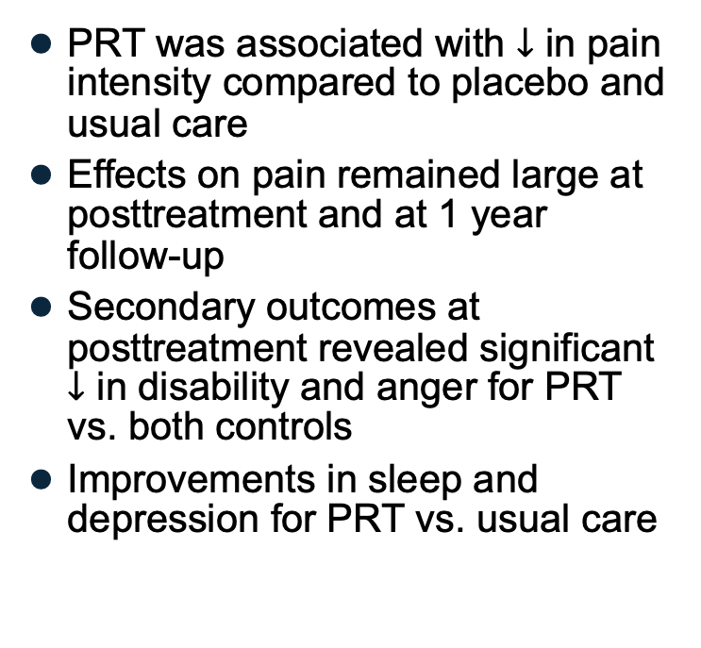

Biopsychosocial Models of Pain Management: PRT
PRT was associated with $↓$ in pain intensity compared to placebo and usual care
Effects on pain remained large at posttreatment and at 1 year follow-up
Secondary outcomes at posttreatment revealed significant $↓$ in disability and anger for PRT vs. both controls
Improvements in sleep and depression for PRT vs. usual care
Randomized with pain $≥$1, %
Ashar YK, et al. JAMA Psychiatry. 2021 Sep 29. [Epub ahead of print].

Slide 23
Patient Case: Keith
Has been taking hydrocodone/APAP 5mg/325mg up to 3-4 per day for 1 yr
His pain has improved, he is adherent to his home exercise program and has taken up tai chi which has been helpful
Sleep has improved
Mood is stable
He is scheduled to return to work

Slide 24
What would be your next step with Keith?
No change, don’t rock the boat
Slow taper, reducing 5 mg/week for 4 weeks
Stop opioids and manage his withdrawal
I’m not sure

Slide 25
Opioid Tapering: When and How
Undertake opioid tapering only after thorough assessment of the risk-benefit ratio
  Consider patient-centered compassionate tapering when risks outweigh the benefits
  Assessment should be conducted in collaboration with the patient
  Opioids should not be tapered rapidly or discontinued suddenly
When tapering, consider underlying comorbidities
Consider maintaining therapy for patients who are stable on long-term opioid therapy and for whom the benefits outweigh the risks
U.S. Department of Health and Human Services. Pain Management Best Practices Inter-Agency Task Force Report: Updates, Gaps, Inconsistencies, and Recommendations. 2019. Available at https://www.hhs.gov/sites/default/files/pmtf-final-report-2019-05-23.pdf. Accessed October 2, 2021.

Slide 26
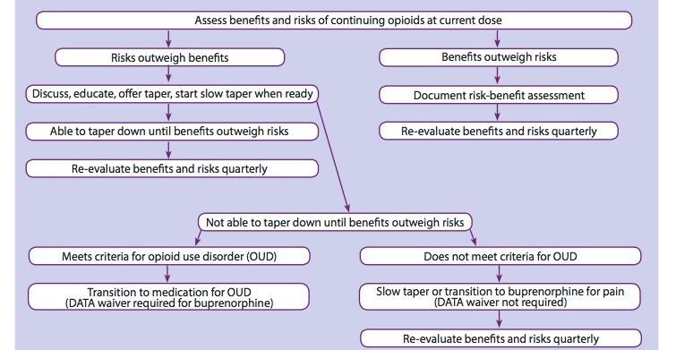
Opioid Tapering Flowchart
Adapted from Oregon Pain Guidance. 2020. Available at https://www.oregonpainguidance.org/guideline/tapering/. Accessed October 8, 2021.;
United States Department of Health and Human Services (HHS). HHS Guide for Clinicians on the Appropriate Dosage Reduction or Discontinuation of Long-Term
Opioid Analgesics. 2019. Available at https://www.hhs.gov/opioids/sites/default/files/2019-10/Dosage_Reduction_Discontinuation.pdf. Accessed October 2, 2021.
Notes:
Adapted from Oregon Pain Guidance. Tapering – Guidance & Tools. Available at https://www.oregonpainguidance.org/guideline/tapering/. HHS Guide for Clinicians on the Appropriate Dosage Reduction or Discontinuation of Long-Term Opioid Analgesics. Published October 2019. Available at https://www.hhs.gov/opioids/sites/default/files/2019-10/Dosage_Reduction_Discontinuation.pdf. Access October 2, 2021.

Slide 27
Learning
Objective
3
Identify risk factors and clinical presentation of opioid use disorder (OUD) in patients prescribed opioids for acute and chronic pain.

Slide 28
A Risk Assessment is Critical to Providing the Best Possible Patient-Centered Outcome While Mitigating Unnecessary Opioid Exposure
Biopsychosocial Approach
Low
Risk
Risk Assessment
Patient History
Medium
Risk
Physical Examination
Diagnostic Screening Tools and PDMP
High
Risk
Deliberation and Discussion
U.S. Department of Health and Human Services. Pain Management Best Practices Inter-Agency Task Force Report: Updates, Gaps, Inconsistencies, and Recommendations. 2019. Available at https://www.hhs.gov/sites/default/files/pmtf-final-report-2019-05-23.pdf. Accessed October 2, 2021.

Slide 29
USPSTF Recommendations for Screening for Unhealthy Drug Use
✓
Screen by asking questions about unhealthy drug use in adults 18 years or older
Screen when services for accurate diagnosis, effective treatment, and appropriate care can be offered or referred. Screening refers to asking questions about unhealthy drug use, not testing biologic specimens
✓
Unhealthy drug use includes using illegal drugs, such as heroin, or using a prescription drug in ways that are not recommended by a doctor, such as to “get high” or affect someone’s mood or way of thinking
✓
US Preventive Services Task Force, Krist AH, et al. JAMA. 2020;323(22):2301-2309.
Notes:
1:46:00:22
Zelma, we all have our own style

Slide 30
Starting a Conversation with Patients About Their Drug Use¹
Step 1: Ask the Patient About Past Drug Use
In the past year, how many times have you used an illicit drugs or used prescription drugs for nonmedical reasons?
Step 2: Determine Risk Level
Opioid Risk Tool (ORT)²
Screener and Opioid Assessment for Patients with Pain (SOAPP-R)³
Current Opioid Misuse Measure (COMM)⁴
CAGE Adapted to Include Drugs (CAGE-AID)⁵
NIDA-Modified Alcohol, Smoking, and Substance Involvement Screening Test (nmASSIST)⁶
1. National Institute on Drug Abuse (NIDA). Available at https://archives.drugabuse.gov/initiatives/about-addiction-performance-project/talking-to-patients-about-their-drug-use. Accessed October 8, 2021.; 2. Webster LR, Webster RM. Pain Med 2005;6:432-442.; 3. Butler SF, et al. J Pain. 2008;9:360-372.; 4. Butler SF, et al. Clin J Pain. 2010;26(9):770-776.; 5. Brown RL, et al. Wisconsin Medical Journal. 1995;94(3):135-140.; 6. National Institute on Drug Abuse (NIDA). NIDA Drug Screening Tool.
Available at https://www.drugabuse.gov/sites/default/files/pdf/nmassist.pdf. Accessed October 2, 2021.

Slide 31
Opioid Risk Tool (ORT)
Mark each box that applies |  | Female | Male
1. | Family Hx of substance use
 | Alcohol | 1 | 3
 | Illegal drugs | 2 | 3
 | Prescription drugs | 4 | 4
2. | Personal Hx of substance abuse
 | Alcohol | 3 | 3
 | Illegal drugs | 4 | 4
 | Prescription drugs | 5 | 5
3. | Age between 16 & 45 yrs | 5 | 5
4. | Hx of preadolescent sexual abuse | 3 | 0
5. | Psychologic disease | 2 | 2
 | ADD, OCD, bipolar, schizophrenia | 1 | 1
 | Depression
Administer
On initial visit
Prior to opioid therapy
Scoring (RISK)
  0-3: low
  4-7: moderate
  ≥8: high
Scoring Totals:
Webster LR, Webster RM. Pain Med. 2005;6:432-42
Available at http://www.opioidrisk.com/node/887. Accessed October 10, 2021.
Notes:
It is commonly believed that risk is uniform across age groups, but this is not so.

Slide 32
Starting a Conversation with Patients About Their Drug Use
Step 3: Depending on Risk Level, Do the Following
Advise: Provide medical advice about the patient’s drug use
Explain that it is your role as his/her medical provider to convey health recommendations.
Recommend quitting before problems (or more problems) develop. Give specific medical reasons.
Refer patients with suspected co-occurring conditions (e.g., depression, pain) to a relevant specialist.
Assess: Determine the patient’s readiness to quit.
Say something like, “Given what we’ve talked about, do you want to change your drug use?”
If the patient is ready to quit, assist his/her in efforts to stop using drugs.
If the patient is unwilling to quit, raise awareness about drugs as a health problem. Let the patient know that you will revisit the issue at future visits.
Assist: Offer help based on the patient’s readiness level
Jointly complete a progress note form with the patient to document the screening results and create a follow-up plan.
Help set concrete and reasonable goals for making a change.
Arrange: Refer the patient to specialty assessment and/or drug treatment, if necessary
National Institute on Drug Abuse (NIDA). Available at https://archives.drugabuse.gov/initiatives/about-addiction-performance-project/talking-to-patients-about-their-drug-use. Accessed October 2, 2021.

Slide 33
Words Matter: Changing Language to Reduce Stigma
Instead of… | Use… | Because….
Addict User Substance or drug abuser Former addict Reformed addict | Person with substance use disorder Person with OUD or person with opioid addiction (when substance is opioids) Patient Person in recovery or long-term recovery Person who previously used drugs | Person-first language Change shows that a person “has” a problem, rather than “is” the problem Terms to avoid eliciting negative associations, punitive attitudes, and individual blame
Habit | Substance use disorder Drug addiction | Inaccurately implied that a person is choosing to use substances “Habit” undermines the seriousness of the disease
Opioid substitution replacement therapy Medication-assisted treatment (MAT) | Opioid agonists therapy Medication for treatment of OUD Pharmacotherapy Medication for OUD (MOUD) | It is a misconception that medications merely “substitute” one drug or “one addiction” for another
National Institute on Drug Abuse (NIDA). 2021. Available at https://www.drugabuse.gov/nidamed-medical-health-professionals/health-professions-education/words-matter-terms-to-use-avoid-when-talking-about-addiction. Accessed October 2, 2021.

Slide 34
FDA-Approved Medications to Treat Opioid Use Disorder
Medication | Receptor Pharmacology | Formulation | Regulations
Methadone | Full mu-opioid receptor agonist | Oral solution, liquid concentrate, tablet/diskette, powder | Available at federally regulated treatment sites
Buprenorphine | Partial mu-opioid receptor agonist | Once monthly injection for subcutaneous use Implant every 6 months | Requires DATA 2000 waiver + DEA X-number
Buprenorphine-naloxone | Partial mu-opioid agonist/mu antagonist | Sublingual film Sublingual tablets | Requires DATA 2000 waiver + DEA X-number
Naltrexone | Mu-opioid receptor antagonist | Extended-release injectable suspension | None, office-based treatment
Prescribing information available at https://www.accessdata.fda.gov.
Substance Abuse and Mental Health Services Administration (US). Pharmacology of medications used to treat opioid addiction. In: Medication-Assisted Treatment for Opioid Addiction in Opioid Treatment Programs. Treatment Improvement Protocol (TIP) Series, No. 43. 2005. Available at https://www.ncbi.nlm.nih.gov/books/NBK64158/.
Accessed October 8, 2021.
Notes:
Note, education no longer needed. If practitioner

Slide 35
FDA-Approved Medications to Treat Opioid Use Disorder
Medication | Receptor Pharmacology | Formulation | Regulations
Methadone | Full mu-opioid receptor agonist | Oral solution, liquid concentrate, tablet/diskette, powder | Available at federally regulated treatment sites
Buprenorphine | Partial mu-opioid receptor agonist | Once monthly injection for subcutaneous use Implant every 6 months | Requires DATA 2000 waiver + DEA X-number
Buprenorphine-naloxone | Partial mu-opioid agonist/mu antagonist | Sublingual film Sublingual tablets | Requires DATA 2000 waiver + DEA X-number
Naltrexone | Mu-opioid receptor antagonist | Extended-release injectable suspension | None, office-based treatment
Changes allow practitioners to forgo the training requirement but are limited to treating no more than 30 patients at any one time. Those who undertake training can treat up to 100 patients.
Prescribing information available at https://www.accessdata.fda.gov.
Substance Abuse and Mental Health Services Administration (US). Pharmacology of medications used to treat opioid addiction. In: Medication-Assisted Treatment for Opioid Addiction in Opioid Treatment Programs. Treatment Improvement Protocol (TIP) Series, No. 43. 2005. Available at https://www.ncbi.nlm.nih.gov/books/NBK64158/.
Accessed October 8, 2021.
Notes:
Note, education no longer needed. If practitioner

Slide 36
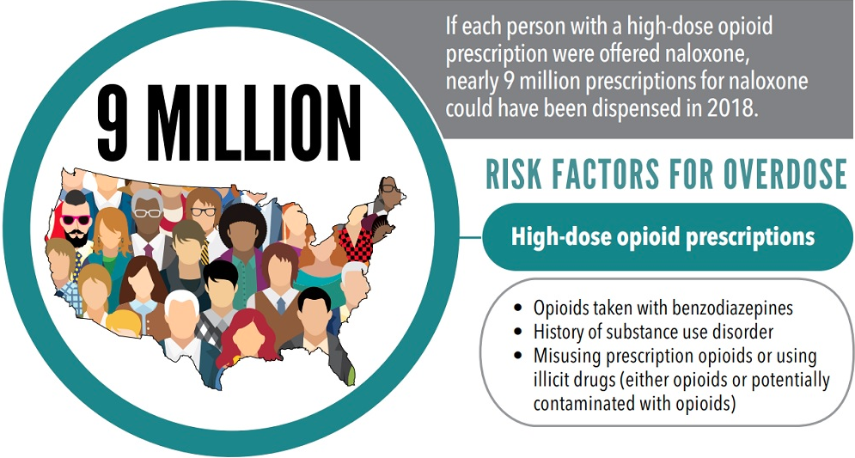
https://www.cdc.gov/vitalsigns/naloxone/images/naloxone-vs-infographic2.jpg

Slide 37
Learning
Objective
4
Educate patients about their pain to optimize safe and effective, multimodal treatment plans.

Slide 38
Setting Treatment Goals in Patients with Chronic Low Back Pain (CLBP)
CLBP is characterized by a complex interaction between pain, function, and biopsychosocial factors such as patient motivation and confidence¹
Putting patients in the principal role of goal setting based on what is directly important to them may have a greater likelihood of behavior change²
Pilot study (n = 20) investigated patient-led goal setting to improve disability, pain, quality of life, pain self-efficacy, and fear avoidance beliefs in CLBP²
1. Hartvigsen J, et al. Lancet. 2018;391:2356-2367.; 2. Gardner T, et al. Br J Sports Med. 2019;0:1-9.

Slide 39
Components of Intervention
Session 1: Wk 1
Sessions 3-4: Wk 5-7
Post-intervention: 3 Mon
YOUR TITLE 01
Orientation
SMART goals
Strategies
History taken
Advice about exercise
Review of goals, progress, barriers to achieving goals
Strategies developed
Review of goals, progress, barriers to achieving goals
12 Mon Outcomes Measured
Session 2: Wk 3
Session 5: 2 Mon
Session 5: 2 Mon
Education and discussion
Review of goals, progress, barriers
Strategies developed
Review of goals, progress, barriers
Strategies developed
Outcomes measured
Review of exercise
Outcomes measured
Review of goals, progress, barriers
Strategies developed
Outcomes measured
Review of exercise
Outcomes measured
Gardner T, et al. Br J Sports Med. 2019;0:1-9.

Slide 40
Change From Baseline for Primary Outcomes of Pain and Disability
Pain intensity-mean (SE) difference in change from baseline
Disability-mean (SE) difference in change from baseline
30
4.5
4
25
3.5
20
3
2.5
15
2
Mean difference change from baseline
(NRS)
Mean difference change from baseline
(QBPDS)
1.5
10
1
5
0.5
0
0
baseline
post treatment
4 mon
12 mon
baseline
post treatment
4 mon
12 mon
usual care
patient led goal setting
usual care
patient led goal setting
N = 20
Gardner T, et al. Br J Sports Med. 2019;0:1-9,
Notes:
To be recreated

Slide 41
Low Health Literacy is Related to
Opioid Misuse
Patient education must be easy to read, understand, and use for patients of all skill levels¹
Tools that are pictorial and/or infographics are effective
Ensuring that online patient education materials are written at an appropriate reading grade level would be expected to improve physician-patient communication²
  Recommend that tools are written at a 6th grade level
1. Prince LY, et al. J Surg Orthop Adv. 2019;28(3):232-236.; 2. Roberts H, et al. J Bone Joint Surg Am. 2016;98(17):e70.

Slide 42
Education on Safe Storage and Disposal of Unused Meds
Opioids should be stored inside lockbox and/or secure location
Medication take-back programs
  DEA-registered collection sites at retail/hospital/clinic pharmacies and law enforcement
  Check www.takebackmymeds.com for additional details
Disposal in household trash
  Mix (do not crush tablets or capsules) with an unpalatable substance such as dirt, cat litter, or used coffee grounds and seal in plastic bag
  Delete personal information from the prescription label before disposing
Disposal in a drug deactivation pouch that utilizes carbon to deactivate and dispose in household trash
FDA endorses flushing, but many oppose due to concerns about aquatic life
US Food and Drug Administration (FDA). Disposal of Unused Medicines: What You Should Know. 2020. Available at: https://www.fda.gov/Drugs/ResourcesForYou/Consumers/BuyingUsingMedicineSafely/EnsuringSafeUseofMedicine/SafeDisposalofMedicines/ucm186187.htm. Accessed October 8, 2021.

Slide 43
SMART Goals
Specific, Measurable, Attainable, Relevant, Timely
When creating a multi-modal treatment plan, align treatment choice to type of pain—nociceptive, neuropathic, nociplastic
Remember, pain isn’t just about the injury. You need to apply a psychosocial approach to pain management
For patients with chronic pain who are stable on long-term opioids, undertake opioid tapering only after a thorough assessment of
risk-benefit
Engage patients on long-term opioid treatment in open and
stigma-free discussions about their drug use
Ensure that patients on opioids have knowledge and access to naloxone
Make your patient a partner in goal-setting and treatment planning

Slide 44
To Ask a Question
Please click on the Ask Question tab and type your question. Please include the faculty member’s name if the question is specifically for them

Slide 45
CME Outfitters
AFTER
THE SHOW
Questions & Answers

Slide 46
Visit the
Opioid Education Hub
Free resources and education to educate both HCPs and patients on
pain & appropriate pain management, substance use, and more.
www.cmeoutfitters.com/RX4Pain

Slide 47
Have more questions?
Dr. Steven Stanos will be hosting a bonus Q&A session to answer more of your questions on pain management!
Wednesday, November 17, 2021
6:30 PM - 7:00 PM ET
Save your spot now to join the Q&A and earn additional CME/CE credit for free:
www.cmeoutfitters.com/painQA

Slide 48
To Receive Credit
To receive CME/CE credit for this activity, participants must complete the post-test and evaluation online.
Participants will be able to download and print their certificate immediately upon completion.
Notes:
This slide and the last slide (23) should go up during the Q&A

Slide 49
Supplemental References
Chang KL, et al. Chronic Pain Management. FP Essentials™, Edition No. 432. Leawood, KS: AAFP; May 2015.
Duke Margolis Center for Health Policy. Strategies for Promoting the Safe Use and Appropriate Prescribing of Prescription Opioids. February 15, 2018. Available at https://healthpolicy.duke.edu/sites/default/files/atoms/files/landscape_analysis_-_opioid_safe_prescribing_strategies.pdf. Accessed October 8, 2021.
PDQ® Supportive and Palliative Care Editorial Board. PDQ Cancer Pain. Bethesda, MD: National Cancer Institute. Available at: https://www.cancer.gov/about-cancer/treatment/side-effects/pain/pain-hp-pdq. Accessed October 8, 2021.
Florida Medical Association (FMA). Prescribing Controlled Substances: Florida Laws and Clinical Guidelines. Tallahassee, FL.
National Center on Addiction and Substance Abuse (CASA) at Columbia University. Addiction Medicine: Closing the Gap between Science and Practice. Available at: https://www.centeronaddiction.org/addiction-research/reports/addiction-medicine-closing-gap-between-science-and-practice. Accessed October 8, 2021.

