Slide 1
Halting Drivers of Chronic Kidney Disease Progression
Supported by an educational grant from Bayer Healthcare Pharmaceuticals Inc.
Notes:
0:00 Hello and welcome …
Link to edited video: https://vimeo.com/cmeoutfitters/review/639483823/b792e5ed4a

Slide 2
In support of improving patient care, CME Outfitters, LLC, is jointly accredited by the Accreditation Council for Continuing Medical Education (ACCME), the Accreditation Council for Pharmacy Education (ACPE), and the American Nurses Credentialing Center (ANCC), to provide continuing education for the health care team.
Notes:
0:00:13
Today’s activity is brought …

Slide 3
Dhiren K. Patel, PharmD, CDCES, BC-ADM
Adjunct Associate Professor of Pharmacy Practice
Massachusetts College of Pharmacy and Health Sciences
Clinical Pharmacy Specialist
Boston, MA
Notes:
0:00:27
As I stated, I’m Dr. Dhiren …

Slide 4
Robert Busch, MD, FACE
Director of Clinical Research
Community Endocrine Group
Albany Med Faculty Practice
Albany, NY
Notes:
0:00:35
Today joining me …

Slide 5
Javier Morales, MD, FACP, FACE
Associate Clinical Professor of Medicine
Donald and Barbara Zucker School of Medicine at Hofstra/Northwell, Uniondale, NY
Vice President
Principal Clinical Trial Investigator Advanced Internal Medicine Group, East Hills, NY
Notes:
0:00:48
Also joining me …

Slide 6
Learning Objective
1
Recognize when a patient should undergo guideline-recommended screening with UACR and eGFR for early diagnosis of CKD in patients with T2DM.
Notes:
0:01:10
The first point ...

Slide 7
Audience Response
Approximately what percentage of patients with T2DM develop CKD?
10%
20%
40%
80%
CKD = Chronic kidney disease. T2DM = Type 2 diabetes myelitis.
Notes:
0:01:33
I want to start by …
Not adding a slide showing the results after this slide- speaker says “so we will show the results later in the program. Leaving that and showing after it has been asked the second time
Reference: Afkarian M, Sachs MC, Kestenbaum B, et al. Kidney disease and increased mortality risk in type 2 diabetes. J Am Soc Nephrol. 2013;24(2):302-308.
Potential question: T2DM as a risk factor for CKD development – 40% of T2DM patients develop CKD.
Answer: C

Slide 8
Patient Case
Patient:
SG is a 62 YO male with HTN, T2DM, prior anterior wall myocardial infarction. EF 40% noted on echocardiogram 2 months ago.
Presenting for follow-up visit.
Medications:
Metformin 1 g
Dapagliflozin 10 mg
Metoprolol XL 50 mg
Rosuvastatin 20 mg
Enteric coated aspirin 81 mg
Clopidogrel 75 mg
Sertraline 50 mg
Sacubitril/valsartan 24/26 twice a day
Furosemide 20 mg
Allergies:
NKDA
EF = Ejection fraction. HTN = Hypertension. NKDA = No known drug allergies. YO =Year old.
Notes:
0:01:54
So we’re going to start off talking …

Slide 9
Patient Case, continued
History:
Social-35-pack-year smoking history, stopped 12 years ago
Three beers weekly
Works as an executive for a shipping company
Married, two children, one grandchild
Walks the dog at least 2 miles twice weekly
Physical Exam:
BP: 120/70
HR: 64
BMI: 31
Labs:
A1C: 6.8%
BUN/serum creatinine: 36/1.6 mg/dL
LDL: 72 mg/dL
eGFR = 43 mL/min
Albumin/creatinine
(2 consecutive measures): 30-300 mg/g
UACR = 275 mg/g
A1C = Hemoglobin A1C. BMI = Body mass index. BP = Blood pressure. BUN = Blood Urea Nitrogen. eGFR = Estimated glomerular filtration rate. HR = Heart rate. LDL = Low density lipoprotein. UACR = Urine albumin-to-creatinine ratio.
Notes:
0:02:37
In terms of other history …

Slide 10
Audience Response
Which medication modification to SG’s regimen would be most beneficial to delay progression of eGFR decline and UACR improvement?
Addition of lisinopril
Addition of finerenone
Change dapagliflozin to canagliflozin
Change combination sacubitril/valsartan to losartan
I don’t know
Notes:
0:03:22
So let me ask you …
Answer B
Revise for archive
Do not add results slide after this. I left the audio in that says “same thing here. We’ll look at the results a little later in the program”
Notes: Reference: Afkarian M, Sachs MC, Kestenbaum B, et al. Kidney disease and increased mortality risk in type 2 diabetes. J Am Soc Nephrol. 2013;24(2):302-308.

Slide 11
Guideline-Recommended Screening
Annual screening for urinary albumin and eGFR
Confirmation of albuminuria or low eGFR requires 2 abnormal measurements ≥ 3 months apart
Calculate eGFR from stable serum creatinine levels
Screen ALL patients with T2DM
Interpreting eGFR Results
CKD may be present if UACR > 30 mg/g
CKD (eGFR < 60 mL/min/1.73 m²⁾
Kidney Failure
60*
15
mL/min/1.73 m²
*NKDEP recommends reporting values greater than or equal to 60 as “≥ 60,” rather than numeric values. Exact values above 60 are not reliable
NKDEP = National Kidney Disease Education Program. American Diabetes Association (ADA). Diabetes Care. 2021;44(suppl 1):S151-S167
Notes:
0:03:40
So I want to get our …
Notes:
Assess urine albumin excretion yearly to diagnose and monitor kidney damage in patients with type 1 diabetes for five years or more or with type 2 diabetes.
https://www.niddk.nih.gov/health-information/professionals/advanced-search/quick-reference-uacr-gfr

Slide 12
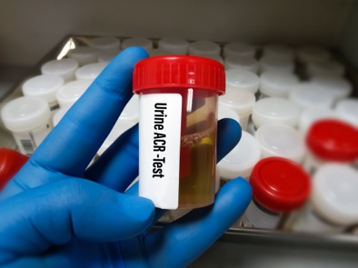
Testing Approaches: UACR and eGFR
GFR Categories in CKD¹
1
120-90
2
90-60
3a
60-45
3b
45-30
4
30-15
5
15-0
Albuminuria Categories in CKD¹
Kidney Failure Normal
1
< 30
2
30-300
3
> 300
Severely Normal Increased
GFR Unit: mL/min/1.73 m²
ACR Unit: mg/g
Stage
CKD = Chronic Kidney Disease. ACR = Albumin Creatinine Ratio. GFR = Glomerular Filtration Rate. 1. Adapted from Ciernik M. Kidney Int Suppl. 2013;3:1-150.
Notes:
0:06:11
Now lets go …
Notes: eGFR is a marker of Kidney FUNCTION – used to stage severity of CKD Twenty-four-hour collection and timed specimens are not necessary. https://www.niddk.nih.gov/health-information/professionals/advanced-search/quick-reference-uacr-gfr Healthy kidney eGFR > 60 ml/min Albuminuria is the sign of kidney disease – doing random spot testing is important
Things that may cause a false positive could be COVID and repeated within 3 months Establish a schedule for follow up testing Increase in albumin often precedes the decline in eGFR, but protein may not be present in urine always; Must check once per year.

Slide 13
CKD Progression Heatmap
 |  |  |  | UACR Categories
 |  |  |  | A1 Normal to mildly increased | A2 Moderately increased | A3 Severely increased
 |  |  |  | 0-29 | 30-300 | > 300
eGFR Categories |  |  |  | mg/g
Normal or high | G1 | ≥ 90 | mL/min/1.73 m²
Mildly decreased | G2 | 60-89
Mildly to moderately decreased | G3a | 45-59
Moderately to severely decreased | G3b | 30-44
Severely decreased | G4 | 15-29
Kidney failure | G5 | < 15
Increasing risk of CKD progression
Increasing risk of CKD progression
Adapted from Ciernik M. Kidney Int Suppl. 2013;3:1-150.
Notes:
0:07:59
We have guidelines and heatmaps …

Slide 14
CKD Progression Heatmap: Patient Case Prognosis
 |  |  |  | UACR Categories
 |  |  |  | A1 Normal to mildly increased | A2 Moderately increased | A3 Severely increased
 |  |  |  | 0-29 | 30-300 | > 300
eGFR Categories |  |  |  | mg/g
Normal or high | G1 | ≥ 90 | mL/min/1.73 m²
Mildly decreased | G2 | 60-89
Mildly to moderately decreased | G3a | 45-59
Moderately to severely decreased | G3b | 30-44
Severely decreased | G4 | 15-29
Kidney failure | G5 | < 15
Increasing risk of CKD progression
Increasing risk of CKD progression
Adapted from Ciernik M. Kidney Int Suppl. 2013;3:1-150.
Notes:
0:10:25
Now, where does the patient fall …

Slide 15
CME Outfitters
Questions & Answers
Recorded on October 6, 2021
Notes:
0:11:50
The first question that we have …

Slide 16
Identification of CKD: 9 Out of 10 Patients Don’t Know They Have CKD¹
Only 40.7% of patients with 2 eGFR measurements < 60 mL/min/1.73 m² had diagnostic coding for CKD²
20.5% of those with CKD diagnosis were prescribed an ACEi or ARB²
43.2% of Medicare beneficiaries with DM and HTN, but without CKD, had a urine albumin test in 2017³
One-third of patients with ESKD received little or no pre-ESKD nephrology care³
48% of people with severely reduced kidney function and not on dialysis are not aware of having CKD⁵
Approximately 40% of patients with T2DM develop CKD⁶
ACEi = Angiotensin-converting enzyme inhibitor. ARB = Angiotensin-receptor blocker. ESKD = End-stage kidney disease. 1. Centers for Disease Control and Prevention [CDC]. Chronic Kidney Disease in the United States, 2021. 2021. www.cdc.gov/kidneydisease/publications-resources/ckd-national-facts.html. Accessed September 29, 2021. 2. Tuttle KR, et al. JAMA Netw Open. 2019;2:e1918169. 3. Saran R, et al. Am J Kidney Dis. 2020;75(suppl 1):A6-A7. 4. Chu CD, et al. Am J Kidney Dis. 2020;76:174-183. 5. Centers for Disease Control and Prevention [CDC]. Chronic kidney disease basics. 2021. www.cdc.gov/kidneydisease/basics.html. Reviewed August 19, 2021. Accessed September 29, 2021. 6. Afkarian M, et al. J Am Soc Nephrol. 2013;24(2):302-308.
Notes:
0:13:13
Dr. Busch, going back …
Next slide: benefits of early interventions in kidney disease <10-15 % are diagnosed even in stage 3

Slide 17
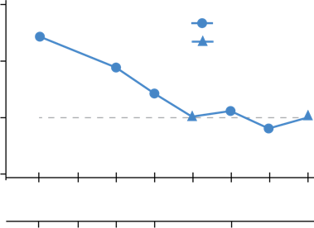
Potential Benefit of Slowing Progression of CKD Lower CV Event Rate
Independent Association of Kidney Function with CVD Mortality
Incidence and prevalence of cardiovascular events is significantly higher in patients with CKD of any stage
Risk of developing CVD is even greater than risk of developing ESRD in patients with CKD, therefore, CKD is one of the strongest independent risk factors for development of CVD.
Patients with CKD with preserved eGFR have a lower HR for CVD mortality
4
Significant values
Non-significant values
2
HR for CVD mortality
1
0.5
15
30
45
60
75
90
105
120
eGFR (mL/min per 1.73 m²)
5
4
3b
3a
2
1
CKD Stage
CVD = Cardiovascular disease. ESRD = End-stage renal disease. HR = Hazard ratio. Jankowski J, et al. Circulation. 2021;143(11):1157-1172.
Notes:
0:16:25
So you know that’s a great …
Notes:
Sudden cardiac death is higher in patients with ESRD.
Goal: Intervene soon enough to delay kidney disease and prevent kidney failure
Patients with DM have a decline in eGFR and can more rapidly be in CKD
Need to provide therapies that are proven to slow progression
Despite SOC, Still had large group go on to kidney failure so need something more
CV mortality much greater in CKD
Risk of sudden cardiac death 50.0% (ESRD) vs 10.1% (GFR <60 mL/min) vs 10.3% (GFR ≥60 mL/min), χ2 P=0.010.
https://www.ahajournals.org/doi/10.1161/CIRCULATIONAHA.120.050686
-Although the incidence and prevalence of cardiovascular events is already significantly higher in patients with early CKD stages (CKD stages 1–3) compared with the general population, patients with advanced CKD stages (CKD stages 4–5) exhibit a markedly elevated risk. Cardiovascular rather than end-stage kidney disease (CKD stage 5) is the leading cause of death in this high-risk population.
-“CKD mimics an accelerated aging of the cardiovascular system”
-FIGURE ON THE LEFT- A meta-analysis of cohort studies involving >1.4 million individuals28,29 yielded an association of not only low eGFR but also higher albuminuria with cardiovascular disease. Thus, the risk of developing CVD in patients with CKD surpasses the risk of reaching end-stage kidney disease, and therefore, CKD must be considered one of the strongest risk factors for the development of CVD.
-FIGURE ON THE RIGHT- More than two-thirds of mortality in advanced (not just ESRD) CKD stages are a result of sudden cardiac death. Sudden cardiac death refers to the unexpected natural death from a cardiac cause within 1 hour after onset of symptoms in a person who has no lethal underlying disease. Sudden cardiac death is mainly caused by ventricular arrhythmias. The rate of sudden cardiac death is 59 deaths in 1000 patient-years in the CKD stage 5D population, whereas it is 1 death in 1000 patient-years in the general population. Independent association of kidney function with cardiovascular mortality. ACR indicates albumin-to-creatinine ratio; CKD, chronic kidney disease; CVD, cardiovascular disease; eGFR, estimated glomerular filtration rate; and HR, hazard ratio. Adapted and modified from Gansevoort et al.30

Slide 18
CME Outfitters
Questions & Answers
Recorded on October 6, 2021
Notes:
0:18:20
We have one here that …

Slide 19
Learning Objective
2
Describe the pathophysiological features of CKD giving rise to renal, CV, and mortality risks in patients with CKD and T2DM, despite optimized management, according to current standards of care (SOC).
Notes:
0:19:38
And what we want to focus now on …

Slide 20
Audience Response
Which of the following theories may cause CKD in a patient with diabetes?
Overexpression of IL-5
Increased mesangial contraction
Overexpression of mineralocorticoid receptor
Podocyte fusion
I don’t know
Notes:
0:20:20
So I want to start off with another question …
I left the statement about reviewing the responses later, so do not add the ARS results slide after this one for the archive
Answer C

Slide 21
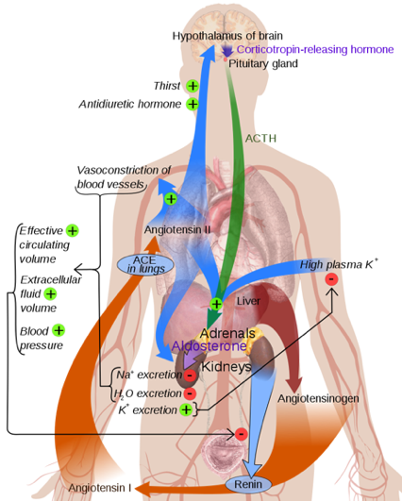
Contributors to CKD
Renin-angiotensin-aldosterone system
HTN
Diabetes
Systemic disease
Infections
Medications
Toxins
Image: Wikimedia Commons contributors. 2021. https://commons.wikimedia.org/w/index.php?title=File:Renin-angiotensin_system_in_man_shadow.svg&oldid=558932343. Accessed September 29, 2021.
Notes:
0:20:35
So, Dr. Morales, could you walk us through …
Notes: Hypertension: can cause narrowing of the walls of the arteries – less blood/oxygen to kidney can cause ischemic injury to the glomerulus
Diabetes: excess sugar in the blood narrows efferent arteriole and causes glomerulosclerosis
CKD is progressive deterioration of the nephrons in the kidney that occurs over time, leading to loss of kidney function
The renin–angiotensin–aldosterone system (RAAS) is a powerful hormone regulatory mechanism serving multiple functions as a key determinant of tissue perfusion pressure and cellular homeostasis. There is a role of MR in CKD Pathophysiology

Slide 22
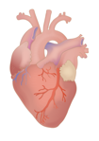
Renal and CV Functional Change with CKD: RAS and MR Overexpression as Contributors
Kidney | Glomerulosclerosis Interstitial fibrosis Proteinuria Renal failure
Heart | Ventricular hypertrophy inflammation Oxidative stress Cardiac fibrosis Contractile dysfunction Heart failure
Kidney image: Wikimedia Commons. 2021. https://commons.wikimedia.org/w/index.php?title=Special:CiteThisPage&page=File%3AKidneyStructures.svg&id=465533896&wpFormIdentifier=titleform. Accessed September 29, 2021. Heart image: Wikimedia Commons. 2021. https://commons.wikimedia.org/wiki/File:Human_Heart.png. Accessed September 29, 2021.
Notes:
0:23:12
But more recently …
REFERNCE: Activation of RAAS causes MR Activation; increasing Aldosterone.
Aldosterone expression can have adverse renal and CV effects, causing interstitial fibrosis, cardiac fibrosis

Slide 23
Drivers of Fibrosis and Kidney Damage
Biodigital.com. 2021. https://human.biodigital.com/view?id=production/maleAdult/chronic_kidney_disease&lang=en. Accessed September 29, 2021.
Notes:
0:26:39
Is to walk you through a short video …
Editor’s Note: Janan to recreate a video without sound from BioDigital https://human.biodigital.com/view?id=production/maleAdult/chronic_kidney_disease&lang=en
Dhiren to voiceover the video here: What are the main drivers of Fibrosis and Kidney disease?
Normally, the kidney acts to filter the blood through a nephron.
Patients normal glomerular filtration rate levels are above 60 ml/min.
Patients who have Hypertension or Diabetes may get Kidney Damage: During Hypertension, the vessels thicken and there is a narrowed path where the blood enters an afferent arteriole, so that’s one reason you see a decrease in GFR.
A decreased GFR then increase Renin, which activates the RAAS System.
RAAS Activation ultimately leads to glomerulosclerosis – which leads to ischemic injury and loss of the nephron.
In Diabetes: Diabetic Nephropathy causes 4 changes:
Mesangial Expansion
Podocytopathy
GBM Thickening
Sclerosis
------------------------------------------------------------------
Hyperglycemia reads to Oxidative species, which increase proinflammatory cytokines that can cause the above changes.

Slide 24
The Science: Advancements in CKD
Traditional SOC strategy:
Implement lifestyle modifications
Exercise
Nutrition
Smoking cessation
Control co-morbid conditions like HTN, diabetes, and dyslipidemia because they are known contributors to kidney damage
We’ve been doing this a long time!
Where’s the science taking us now?
Notes:
0:28:12
So with that being said …

Slide 25
CME Outfitters
Questions & Answers
Recorded on October 6, 2021
Notes:
0:34:10
I actually have a related question …

Slide 26
Consequences of MR Overactivation
Changes in:
Endothelial function
Smooth muscle tone
Vascular remodeling
Fibrosis
BP
Buonafine M, et al. Am J Hypertens. 2018;31:1165-1174.
Notes:
35:27
The next sequence that we want to talk about …
Notes:
Under normal conditions, MR is activated by aldosterone binding and triggering an intracellular signaling cascade ultimately regulates electrolyte and fluid balance by controlling sodium reabsorption and potassium secretion in the kidneys. In patients with albuminuria, MR expression is increased, and MR overactivation may lead to accumulation of pro-inflammatory and pro-fibrotic proteins, hardening and thickening of glomeruli, tissue expansion and increased pressure within the vasculature and internal structure, scarring interfering with efficient filtration, and injury to kidney tubules all contributing to progressive decline in kidney function.²

Slide 27
Addressing Control: CKD Drivers
Drivers of CKD
HTN¹
Elevated blood glucose²
Renal oxidative stress/ Inflammation
Fibrosis
1. Kidney Disease: Improving Global Outcomes (KDIGO) Diabetes Work Group. Kidney Int. 2020;98(4S):S1-S115. 2. American Diabetes Association. Diabetes Care. 2021;44(Suppl 1):S111-S124.
Notes:
0:37:02
So then when we think about …
Desired state: Pharmacists understand the residual burdens of renal, CV, and mortality risks in patients with CKD and T2DM despite optimized management according to current SOC and recognize the need for new therapies targeting pathophysiological features of CKD such as MR overactivation, leading to inflammation and fibrosis.
LO: Describe the pathophysiological features of CKD giving rise to renal, CV, and mortality risks in patients with CKD and T2DM, despite optimized management according to current SOC.
Gap: Clinicians need education on the complex pathophysiology of CKD, including the associations between MR overactivation and renal and CV outcomes for patients with CKD and T2DM.

Slide 28
CME Outfitters
Questions & Answers
Recorded on October 6, 2021
Notes:
0:39:13
I just want to show one example …

Slide 29
Renal Protective Mechanisms
SGLT2 Inhibitor¹ Reduce sodium resorption, progressive recovery, and stabilization of renal function
RAS Inhibitor³ Modulate renal blood flow and tubular function
GLP-1 RA² Reduce emergence/progression of proteinuria
MR Antagonist⁴ Prevents MR overactivation; decrease inflammation and kidney fibrosis
GLP-1 RA = Glucagon-like peptide-1 receptor agonist. . MRA =Mineralocorticoid receptor antagonist. RAS = Renin-angiotensin system. SGTL2 = Sodium-glucose cotransporter-2. 1. Fioretto P, et al. Diabetes Care. 2016;39 Suppl 2:S165-S171. 2. Greco EV, et al. Medicina (Kaunas). 2019;55(6):233. May 31. 3. Weir MR. Postgrad Med. 2009;121(1):96-103. 4. Agarwal R, et al.. Eur Heart J. 2021;42(2):152-161. Kidney image: Wikimedia Commons. 2021. https://commons.wikimedia.org/w/index.php?title=Special:CiteThisPage&page=File%3AKidneyStructures.svg&id=465533896&wpFormIdentifier=titleform. Accessed September 29, 2021.
Notes:
0:40:22
We go into the 4 key types of …
SGLT2: Fioretto P, Zambon A, Rossato M, Busetto L, Vettor R. SGLT2 Inhibitors and the Diabetic Kidney. Diabetes Care. 2016;39 Suppl 2:S165-S171. doi:10.2337/dcS15-3006 GLP1: Greco EV, Russo G, Giandalia A, Viazzi F, Pontremoli R, De Cosmo S. GLP-1 Receptor Agonists and Kidney Protection. Medicina (Kaunas). 2019;55(6):233. Published 2019 May 31. doi:10.3390/medicina55060233
RAS Inhibitor: Weir MR. The renoprotective effects of RAS inhibition: focus on prevention and treatment of chronic kidney disease. Postgrad Med. 2009;121(1):96-103. doi:10.3810/pgm.2009.01.1958
MRA Inhibitor: Agarwal R, Kolkhof P, Bakris G, et al. Steroidal and non-steroidal mineralocorticoid receptor antagonists in cardiorenal medicine. Eur Heart J. 2021;42(2):152-161. doi:10.1093/eurheartj/ehaa736MRA action
MR receptor plus aldosterone leads to overactivation of MR, thus increased and fibrosis of kidneinflammationy
Action of finerenone- binds instead of aldosterone preventing overactivation of MR, thus decreasing inflammation and fibrosis of kidney

Slide 30
Learning Objective
3
Assess new efficacy and safety data for current and emerging therapies for CKD in patients with T2DM.
Notes:
0:42:30
So why don’t we go right into it …

Slide 31
Current Standard of Care
A comprehensive strategy to reduce risks of kidney disease progression and CV disease:
ADA Guideline Recommendations²
SOC Timeline in CKD:
2001 - RAS Blockade (ACEi or ARB)
2008 - concomitant SGLT2 in patients with CKD and T2DM
2021 - addition of MR antagonist to SOC?
Diabetes with CKD¹
Some patients
Antiplatelet therapies
Most patients
SGLT2 inhibitors or GLP-1 RA
RAS blockade
All patients
Glycemic control
Exercise
BP control
Nutrition
Lipid management
Smoking cessation
1. de Boer IH, et al. Kidney Int. 2020;98(4S):S1-S15. 2. American Diabetes Association. Diabetes Care. 2021;44(Suppl 1):S111-S124.
Notes:
0:42:45
So what are we doing right now …
my notes from the faculty planning call say that ADA recommends either SGLT2i or GLP-1 RAs for most patients. Also need to reword second bullet point. We need to confirm. They also wanted a timeline style breakout of year for intro of RAS blockade, SGLT2i, and finerenone to SOC. Also see note in original slide to check in KDIGO to be sure finerone's place isn't newly established as SOC. If it's there we need to add it. Suggestions on how to effectively add the concept of date intro into SOC for patients with diabetes and CKD?
Notes: Figure - Kidney–heart risk factor management. Glycemic control is based on insulin for type 1 diabetes and a combination of metformin and SGLT2 inhibitors (SGLT2i) for type 2 diabetes, when eGFR is $30 ml/min per 1.73 m2. SGLT2i are recommended for patients with type 2 diabetes and chronic kidney disease (CKD). Renin–angiotensin system (RAS) inhibition is recommended for patients with albuminuria and hypertension. Aspirin generally should be used lifelong for secondary prevention among those with established cardiovascular disease and may be considered for primary prevention among high-risk individuals, with dual antiplatelet therapy used in patients after acute coronary syndrome or percutaneous coronary intervention. RAS, renin-angiotensin system; SGLT2, sodium–glucose cotransporter-2
From KDIGO BP EXEC Summary 2021 Update to BP management in CKD
Diuretics are often used in CKD patients with high BP because many of them have fluid overload, but the literature on the effects of diuretics on major clinical outcomes in this population is limited. The mineralocorticoid receptor antagonist finerenone was examined for kidney and cardiovascular outcomes in CKD with diabetes in a randomized trial. In the Finerenone in Reducing Kidney Failure and Disease Progression in Diabetic Kidney Disease (FIDELIO-DKD) study, finerenone showed kidney and cardiovascular protection with modest effects on SBP (2–3 mm Hg lower) but a higher incidence of hyperkalemia.27 At the writing of this guideline, finerenone has not been approved for clinical use. The trial was published after the evidence review cutoff for the guideline but will be assessed in future updates.

Slide 32
Residual Risk Despite RAS Blockade
RENAAL Study
Effects of losartan on renal and CV outcomes in patients with T2DM and nephropathy
16% (p = .02) reduction in the primary endpoint (composite of a doubling of the base-line serum creatinine concentration, end-stage renal disease, or death)
Reduced the incidence of doubling of the serum creatinine by 25% (p = .006) and ESRD by 28% (p = .002)
Proteinuria declined by 35% with losartan (p < .001 for the comparison with placebo).
Decrease in eGFR is not enough
Brenner BM, et al. N Engl J Med. 2001;345:861-869.
Notes:
0:45:09
Dr. Busch, you know we heard a little bit about …

Slide 33
CREDENCE Study Population: T2DM & CKD
 |  |  |  | UACR Categories²
 |  |  |  | A1 Normal to mildly increased | A2 Moderately increased | A3 Severely increased
 |  |  |  | 0-29 | 30-300 | > 300
eGFR Categories² |  |  |  | mg/g
Normal or high | G1 | ≥ 90 | mL/min/1.73 m²
Mildly decreased | G2 | 60-89
Mildly to moderately decreased | G3a | 45-59
Moderately to severely decreased | G3b | 30-44
Severely decreased | G4 | 15-29
Kidney failure | G5 | < 15
≥ 30 years of age
T2DM (HbA1C 6.5%-12.0%)
Max tolerated dose of ACEi or ARB
eGFR ≥ 30 to < 90 mL/min/1.73m²
UACR > 300 mg/g and ≤ 5000 mg/g
Study Population¹
Increasing risk of CKD progression
Increasing risk of CKD progression
Hb = Hemoglobin. 1. Perkovic V, et al. N Engl J Med. 2019;380(24):2295-2306. 2. Adapted from Ciernik M. Kidney Int Suppl. 2013;3:1-150.
Notes:
0:47:48
CREDENCE and maybe even give us …

Slide 34
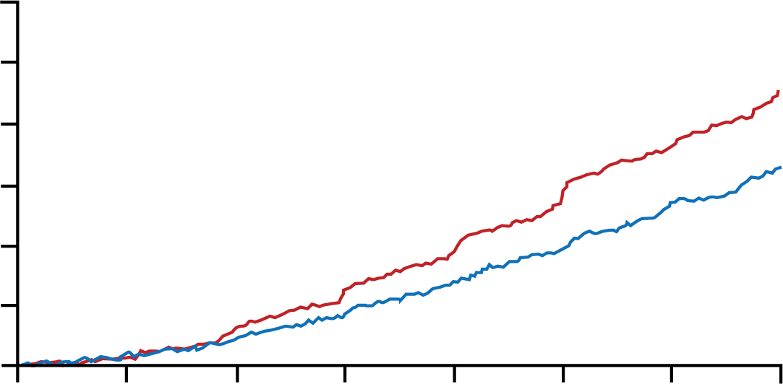
SGLT-2 Inhibitor Trial: CREDENCE Canagliflozin in T2DM & CKD
30
Primary Composite Outcome
Primary Endpoint: Composite of ESKD, doubling of SCr, and renal or CV death
30% RRR
25
Hazard ratio, 0.70 (95% CI, 0.59-0.82)
p = .00001
20
Placebo
15
Patients with an Event (%)
10
Canagliflozin
5
0
0
6
12
18
24
30
36
42
Months since Randomization
No. at Risk
Placebo
Canagliflozin
2199
2202
2178
2181
2132
2145
2047
2081
1725
1786
1129
1211
621
646
170
196
RRR = Relative risk reduction. SCr = Serum creatinine. Adapted from Perkovic V, et al. N Engl J Med. 2019;380(24):2295-2306.
Notes:
0:49:07
And the punchline of the study is here …
speaker note: primary outcome includes both renal and CV endpoints- trialsl in CKD we're evaluating each have different endpoints

Slide 35
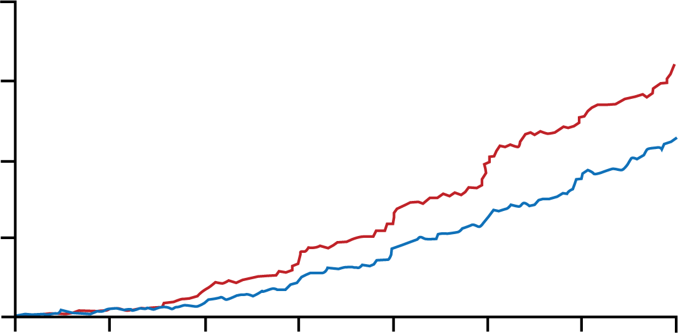
SGLT-2 Inhibitor Trial: CREDENCE Canagliflozin in T2DM & CKD
20
Renal-Specific Composite Outcome
Secondary Endpoints: Composite of CV death and hospitalized CHF CV death All-cause death Renal composite of ESKD, doubling of SCr, or renal death CV composite of CV death, nonfatal MI, nonfatal stroke, hospitalized CHF, and hospitalized unstable angina
34% RRR
Hazard ratio, 0.66 (95% CI, 0.53-0.81)
p < .001
15
Placebo
10
Patients with an Event (%)
Canagliflozin
5
0
0
6
12
18
24
30
36
42
Months since Randomization
No. at Risk
Placebo
Canagliflozin
2199
2202
2178
2181
2131
2144
2046
2080
1724
1786
1129
1211
621
646
170
196
CHF = Congestive heart failure. Adapted from Perkovic V, et al. N Engl J Med. 2019;380(24):2295-2306.
Notes:
0:49:38
There were also …

Slide 36
CREDENCE: Subgroup Analysis by eGFR and UACR
Perkovic V, et al. N Engl J Med. 2019;380(24):2295-2306.
Notes:
0:50:02
Shows the subgroup analysis …
Figure 2. Subgroup Analysis, According to Estimated Glomerular Filtration Rate (GFR) at Screening and Albuminuria at Baseline. Shown are the primary composite outcome and renal-specific composite outcome, according to the patients’ estimated GFR at screening and urinary albumin-to-creatinine ratio (UACR) at baseline, in the canagliflozin group and the placebo group. The albumin-to-creatinine ratio was calculated with albumin measured in milligrams and creatinine measured in grams. CV denotes cardiovascular, and ESKD end-stage kidney disease.

Slide 37
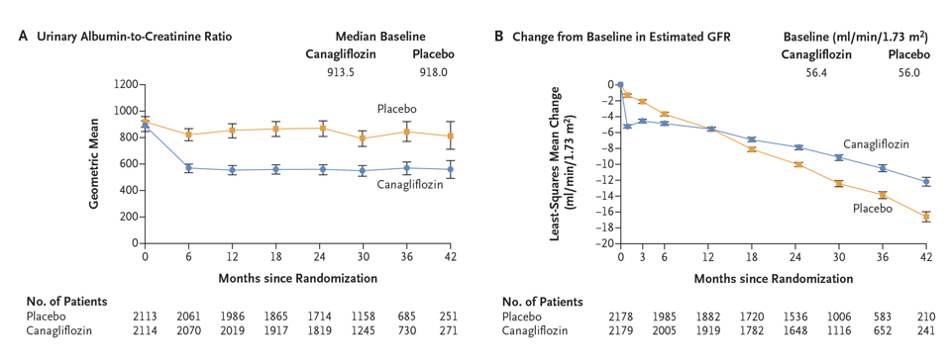
Canagliflozin Effects on UACR and eGFR in T2DM & CKD
Perkovic V, et al. N Engl J Med. 2019;380(24):2295-2306.
Notes:
0:50:44
And the last thing is …
Figure 3. Effects on Albuminuria and Estimated GFR.
Panel A shows the effects of canagliflozin and placebo on the urinary albumin-to-creatinine ratio in the intention-to-treat population. Panel B shows
the change from the screening level in the estimated GFR in the on-treatment population. The I bars indicate the 95% confidence interval in Panel
A and the standard error in Panel B. The albumin-to-creatinine ratio was
calculated with albumin measured in milligrams and creatinine measured
in grams.

Slide 38
DAPA-CKD Study Population: Dapagliflozin in CKD ± T2DM
 |  |  |  | UACR Categories²
 |  |  |  | A1 Normal to mildly increased | A2 Moderately increased | A3 Severely increased
 |  |  |  | 0-29 | 30-300 | > 300
eGFR Categories² |  |  |  | mg/g
Normal or high | G1 | ≥ 90 | mL/min/1.73 m²
Mildly decreased | G2 | 60-89
Mildly to moderately decreased | G3a | 45-59
Moderately to severely decreased | G3b | 30-44
Severely decreased | G4 | 15-29
Kidney failure | G5 | < 15
≥ 18 years of age
Max tolerated ACEi or ARB
eGFR ≥ 25 and ≤ 75 mL/min/1.73 m²
UACR ≥ 200 and ≤ 5000 mg/g
Study Population¹
Increasing risk of CKD progression
Increasing risk of CKD progression
1. Heerspink HJL, et al. N Engl J Med. 2020;383:1436-1446. 2. Adapted from Ciernik M. Kidney Int Suppl. 2013;3:1-150.
Notes:
0:53:44
So, Dr. Morales, If you could walk …
Notes: Consider both eGFR and UACR when assessing risk of CKD Progression
https://clinicaltrials.gov/ct2/show/NCT03036150
Inclusion Criteria:
Provision of signed informed consent prior to any study specific procedures
Female or male aged ≥18 years at the time of consent
eGFR ≥25 and ≤75 mL/min/1.73m2 (CKD-EPI Formula) at visit 1
Evidence of increased albuminuria 3 months or more before visit 1 and UACR ≥200 and ≤5000 mg/g at visit 1
Stable, and for the patient maximum tolerated labelled daily dose, treatment with ACE-I or ARB for at least 4 weeks before visit 1, if not medically contraindicated,
Exclusion Criteria:
Autosomal dominant or autosomal recessive polycystic kidney disease, lupus nephritis or ANCA-associated vasculitis
Receiving cytotoxic therapy, immunosuppressive therapy or other immunotherapy for primary or secondary renal disease within 6 months prior to enrolment
History of organ transplantation
Receiving therapy with an SGLT2 inhibitor within 8 weeks prior to enrolment or previous intolerance of an SGLT2 inhibitor
Type 1 diabetes mellitus
New York Heart Association (NYHA) class IV Congestive Heart Failure at the time of enrolment
MI, unstable angina, stroke or transient ischemic attack within 12 weeks prior to enrolment

Slide 39
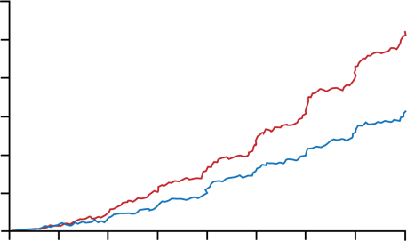
SGLT-2 Inhibitor Trial: DAPA-CKD Dapagliflozin in CKD With or Without T2DM
24
Primary Composite Outcome
Primary Endpoints: Composite of sustained ≥50% eGFR decline, ESKD, and renal or CV death
20
Hazard ratio, 0.61 (95% CI, 0.51-0.72)
p < .001
39% RRR
16
Placebo
12
Cumulative Incidence (%)
8
Dapagliflozin
4
0
0
4
8
12
16
20
24
28
32
Months since Randomization
No. at Risk
Placebo
Dapagliflozin
2152
2152
1993
2001
1936
1955
1858
1898
1791
1841
1664
1701
1232
1288
774
831
270
309
Adapted from Heerspink HJL, et al. N Engl J Med. 2020;383:1436-1446.
Notes:
0:55:07
And when we move ahead …

Slide 40
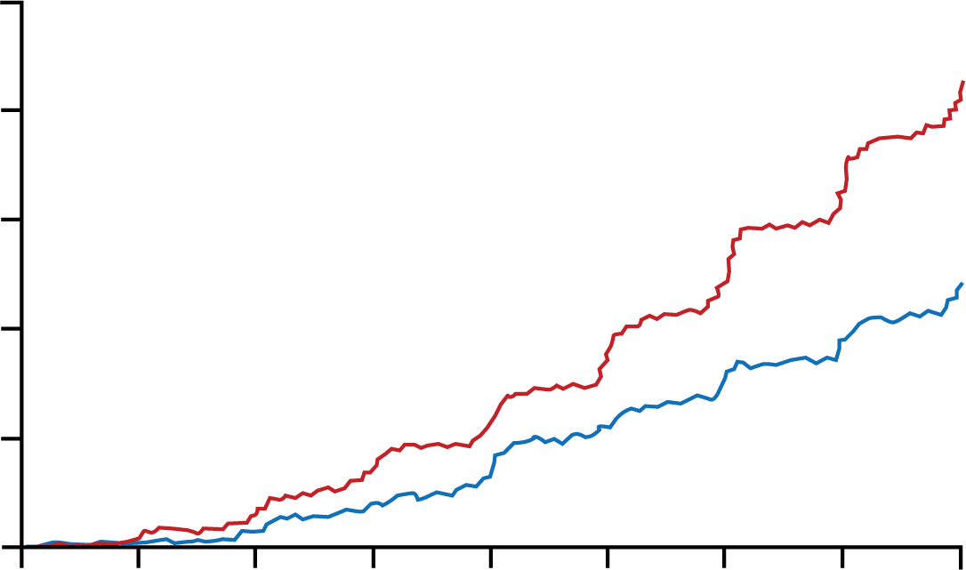
SGLT-2 Inhibitor Trial: DAPA-CKD Dapagliflozin in CKD With or Without T2DM
20
Renal-Specific Composite Outcome
Secondary Endpoints: Composite of sustained ≥50% eGFR decline, ESKD, or renal death Composite of CV death or hospitalizations for heart failure
44% RRR
16
Hazard ratio, 0.56 (95% CI, 0.45-0.68)
p < .001
12
Placebo
Cumulative Incidence (%)
8
Dapagliflozin
4
0
0
4
8
12
16
20
24
28
32
Months since Randomization
No. at Risk
Placebo
Dapagliflozin
2152
2152
1993
2001
1936
1955
1858
1898
1791
1841
1664
1701
1232
1288
774
831
270
309
Adapted from Heerspink HJL, et al. N Engl J Med. 2020;383:1436-1446.
Notes:
0:55:51
And if we look at renal specific …

Slide 41
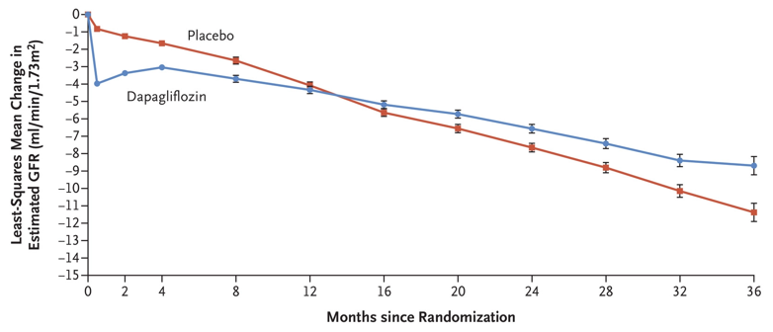
Dapagliflozin Effects on eGFR in CKD With or Without T2DM
Heerspink HJL, et al. N Engl J Med. 2020;383:1436-1446
Notes:
0:56:19
Very important is the effect on the …
Figure 3. Change from Baseline in Estimated GFR.
Shown is the least-squares mean change from baseline in the estimated GFR, calculated with the use of a repeated measures analysis including terms for trial group, baseline measurement, visit, and interaction between visit and
trial group. The I bars indicate standard errors. The mean estimated GFR at baseline was 43.2 ml per minute per
1.73 m2 of body-surface area in the dapagliflozin group and 43.0 ml per minute per 1.73 m2
in the placebo group.

Slide 42
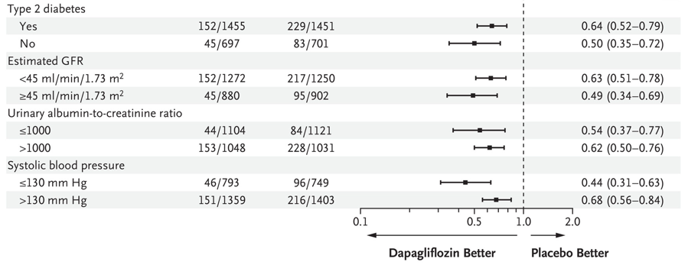
DAPA-CKD: Subgroup Analysis by eGFR and UACR
Mm Hg = Millimeters of mercury. No. = Number Heerspink HJL, et al. N Engl J Med. 2020;383:1436-1446.
Notes:
0:57:03
And if we’re looking at this Forest Plot …
Figure 2. Primary Outcome According to Prespecified Subgroups at Baseline. Shown are forest plots of the hazard ratios for the primary outcome (a composite of a sustained decline in the estimated GFR of ≥50%, end-stage kidney disease, or death from renal or cardiovascular causes) according to prespecified baseline subgroups. Hazard ratios and confidence intervals were calculated with a Cox proportional-hazards model with stratification according to diabetes status and urinary albumin-to-creatinine ratio adjusted for baseline estimated GFR, with factors for trial group, subgroup, and the interaction between trial group and the subgroup variable. Race was reported by the investigators. The albumin-to-creatinine ratio was calculated with albumin measured in milligrams and creatinine measured in grams.

Slide 43
EMPA-KIDNEY Study Population: Empagliflozin in CKD ± T2DM
 |  |  |  | UACR Categories²
 |  |  |  | A1 Normal to mildly increased | A2 Moderately increased | A3 Severely increased
 |  |  |  | 0-29 | 30-300 | > 300
eGFR Categories² |  |  |  | mg/g
Normal or high | G1 | ≥ 90 | mL/min/1.73 m²
Mildly decreased | G2 | 60-89
Mildly to moderately decreased | G3a | 45-59
Moderately to severely decreased | G3b | 30-44
Severely decreased | G4 | 15-29
Kidney failure | G5 | < 15
≥ 18 years of age
Max tolerated ACEi or ARB
eGFR ≥ 20 and < 45 mL/min/1.73 m² OR
eGFR ≥ 45 and < 90 mL/min/1.73 m²
UACR ≥ 200 mg/g
Study Population¹
Increasing risk of CKD progression
Primary Endpoint: Composite of ESKD, decline in eGFR to < 10 mL/min/1.73m², renal death, decline in eGFR ≥ 40%, or CV death
Increasing risk of CKD progression
1. Taliercio JJ, et al. CCJM. 2021;88(1):59-63. 2. Adapted from Ciernik M. Kidney Int Suppl. 2013;3:1-150.
Notes:
0:57:40
And that other SGLT-2 Inhibitor …
https://consultqd.clevelandclinic.org/sglt-2-inhibitors-a-new-era-in-managing-diabetic-kidney-disease-starts-now/
Taliercio JJ, et al. SGLT-2 inhibitors: A new era in managing diabetic kidney disease starts now. CCJM. 2021;88(1):59-63.
RC Phase 3 Trial evaluating the effect of semaglutide versus placebo on the progression of renal impairment in subjects with Type 2 Diabetes and CKD.
Primary Outcome Measures: Time to first occurrence of a composite primary outcome event defined as persistent eGFR decline of greater than or equal to 50 percentage from trial start, reaching ESRD, death from kidney disease or death from cardiovascular disease

Slide 44
Differences in SGLT-2 Inhibitor Approvals in CKD
Canagliflozin
FDA indicated to reduce the risk of ESKD, doubling of SCr, CV death, and hospitalization for heart failure in adults with T2DM and diabetic nephropathy with albuminuria.¹
Dapagliflozin
FDA indicated to reduce the risk of sustained eGFR decline, ESKD, CV death, and hospitalization for heart failure in adults with chronic kidney disease at risk of progression.²
1. Invokamet® (Canagliflozin). Titusville, NJ: Janssen Pharmaceuticals, Inc; 2020. https://www.janssenlabels.com/package-insert/product-monograph/prescribing-information/INVOKAMET+XR-pi.pdf. Accessed September 29, 2021. 2. Forxiga® (Dapagliflozin). Wilmington, DE; AstraZeneca Pharmaceuticals LP; 2021. https://www.astrazeneca.ca/content/dam/az-ca/downloads/productinformation/forxiga-product-monograph-en.pdf. Accesssed September 29, 2021.
Notes:
0:57:56
Dr. Busch, now we have …

Slide 45
GLP-1 RAs in CVOTs Suggest Kidney Protection
Trials |  | ELIXA^{1,2} (N = 6068) | EXSCEL^{1,2} (N = 14,752) | LEADER^{1,2} (N = 9340) | REWIND^{1,2} (N = 9901) | SUSTAIN-6^{1,2} (N = 3297) | PIONEER-6³ (N = 3183)
Treatment (vs. PBO) |  | Lixisenatide 20 mcg | Exenatide ER 2 mg | Liraglutide 1.8 mg | Dulaglutide 1.5 mg | Semaglutide SC 0.5-1 mg | Oral semaglutide 14 mg
Baseline renal function | Mean eGFR | 77 mL/min/1.73 m² | 77 mL/min/1.73 m² | 80 mL/min/1.73 m² | 77 mL/min/1.73 m² | 80 mL/min/1.73 m² | 74 mL/min/1.73 m²
 | Albuminuria | 25.3% | 22% | 11% | 34.5% | NR | 33.0%
Renal outcomes |  | UACR reduction Lixisenatide: 34%ª Placebo: 24% UACR reduction in people with macroalbuminuria Lixisenatide: 42%ª Placebo: 2% | New onset macroalbuminuria Exenatide: 2.2% Placebo: 2.5% Composite renal outcome Exenatide: 5.8% Placebo: 6.5% | New onset/ persistent macroalbuminuria^{c} Liraglutide: 9ª Placebo: 12 Composite renal outcome^{b,c} Liraglutide: 15ª Placebo: 19 | New onset macroalbuminuria Dulaglutide: 8.9% Placebo: 11.3% Sustained decline in eGFR ≥30% Dulaglutide: 8.9% Placebo: 11.3% Chronic renal replacement therapy Dulaglutide: 0.3% Placebo: 0.4% | New or worsening nephropathy^{b,d} Semaglutide SC: 3.8%ª Placebo: 6.1% | eGFR ratio (CoV %) from baseline to end of treatment Oral semaglutide: 0.98 Placebo: 0.98
a. Significant versus Placebo (p < .05). b. Composite renal outcome: new onset persistent macroalbuminuria, persistent doubling of serum creatinine and eGFR < 45 mL/min/1.73 m², requirement for kidney replacement therapy or kidney disease death (rate/1000 patient-years of observation). c. Number/1000 patient-years of observation. d. Number/100 patient-years of observation. CoV = Coefficient of variation. NR = not reported. 1. Mosterd CM, et al. J Nephrol. 2020;33:965-975. 2. Yin WL, et al. Diabetes Ther. 2020;11:835-844. 3. Husain M, et al. N Engl J Med. 2019;381:841-51.
Notes:
1:00:42
So Dr. Busch, while you have the mike …
https://www.frontiersin.org/articles/10.3389/fphar.2020.00967/full
speaker note: effects largely due to decrease in albuminuria
a recent meta-analysis that included LEADER (liraglutide), SUSTAIN-6 (semaglutide), REWIND (dulaglutide), EXSCEL (exenatide), ELIXA (lixisenatide), Harmony outcomes (albiglutide), and PIONEER-6 (oral semaglutide), demonstrated that treatment with GLP-1 RAs reduced the composite kidney outcome (development of new-onset macroalbuminuria, decline in eGFR or increase in creatinine, ESRD, or renal death by 17% [HR0.83 (95% CI: 0.78–0.89, p < 0·0001)], mainly driven by a reduction in albuminuria (Kristensen et al., 2019).

Slide 46
FLOW Study Population: Semaglutide in T2DM & CKD
 |  |  |  | UACR Categories²
 |  |  |  | A1 Normal to mildly increased | A2 Moderately increased | A3 Severely increased
 |  |  |  | 0-29 | 30-300 | > 300
eGFR Categories² |  |  |  | mg/g
Normal or high | G1 | ≥ 90 | mL/min/1.73 m²
Mildly decreased | G2 | 60-89
Mildly to moderately decreased | G3a | 45-59
Moderately to severely decreased | G3b | 30-44
Severely decreased | G4 | 15-29
Kidney failure | G5 | < 15
≥ 18 years of age
HbA1C ≤ 10%
Max tolerated ACEi or ARB
eGFR ≥ 50 and ≤ 75 mL/min/1.73 m²
UACR ≥ 300 and ≤ 5000 mg/g OR
eGFR ≥ 25 and ≤ 50 mL/min/1.73 m²
UACR ≥ 100 and ≤ 5000 mg/g
Study Population¹
Increasing risk of CKD progression
Primary Endpoint: Composite of eGFR decline of ≥ 50%, ESRD, renal or CV death
Increasing risk of CKD progression
1. Williams DM, et al. Diabetes Ther. 2020;11(10):2221-2235. 2. Adapted from Ciernik M. Kidney Int Suppl. 2013;3:1-150.
Notes:
1:01:56
Called the FLOW trial …
RC Phase 3 Trial evaluating the effect of semaglutide versus placebo on the progression of renal impairment in subjects with Type 2 Diabetes and CKD.
Primary Outcome Measures: Time to first occurrence of a composite primary outcome event defined as persistent eGFR decline of greater than or equal to 50 percentage from trial start, reaching ESRD, death from kidney disease or death from cardiovascular disease

Slide 47
SGLT-2 Inhibitor or GLP-1 RA?
Recommended Use in People With T2DM With Existing CV/Renal Disease
Presence of high ASCVD risk, established ASCVD, established CKD, or HF guides selection of glucose-lowering agent, independency of baseline, or individualized A1C level or metformin use^{1,2}
If HF or CKD predominates^{1,2}
SGLT2 inhibitor with evidence of reducing HF and/or CKD progression, if eGFR is adequate
GLP-1 RA with proven CVD benefit if SGLT2 inhibitor is contraindicated, not tolerated, or eGFR not adequate
If ASCVD predominates^{1,2}
GLP-1 RA with proven CVD benefit
SGLT2 inhibitor with proven CVD benefit, if eGFR is adequate
HF = Heart failure. 1. American Diabetes Association. Diabetes Care. 2021;44(suppl 1):S1-S232; 2. Garber AJ, et al. Endocr Pract. 2020;26:107-139.
Notes:
1:02:58
So then what do you do here …
a Label indication of reducing CVD events in those with established CVD (liraglutide, semaglutide SC, dulaglutide) or multiple CV risk factors (dulaglutide); b Canagliflozin, dapagliflozin, empagliflozin.

Slide 48
GLP-1 RAs and SGLT2 Inhibitors Under-Prescribed When Indicated
Real World Retrospective Analysis
1,202,596 people with T2DM
42.5% with established ASCVD
57.5% without established ASCVD
GLP-1 RA: 7.9%
SGLT2i: 8.8%
GLP-1 RA: 9.2%
SGLT2i: 11.8%
ASCVD = Atherosclerotic cardiovascular disease. Weng W, et al. Endocrinol Diabetes Metab. 2019;2:e00076.
Notes:
1:04:31
And Dr. Morales, is that some of the reasons …
Retrospective, cross-sectional analysis of a large, nationwide US administrative claims database using 2015 data.
Adults with T2DM in a large US administrative claims database. Patients were divided into ASCVD and non‐ASCVD groups. Subgroup analyses were conducted for three age groups (18‐44, 45‐64 and 65+ years).

Slide 49
Comparison of MRAs
 | Spironolactone | Eplerenone | Finerenone
Properties | Steroidal, non-selective | Steroidal, more selective | Non-steroidal, selective
Side Effects (most notable in patients with CKD) | Notable, particularly gynecomastia and hyperkalemia | Hyperkalemia | Lower rates of hyperkalemia
Effect on markers of cardiac function | NT-proBNP | NT-proBNP | NT-proBNP
Effect on urine albumin | albuminuria | albuminuria | albuminuria
NT-proBNP = N-terminal pro hormone BNP. Agarwal R, et al. Eur Heart J. 2021;42(2):152-161.
Notes:
1:05:52
But moving forward, aside from the GLP-1 …
Make sure that this is incorporated into the MOA slides and reinforced in audio discussion again on this slide. MRAs inhibit the action of aldosterone at the mineralocorticoid receptor, preventing receptor activation.

Slide 50
FIDELIO-DKD Study Population: Finerenone in T2DM & CKD
 |  |  |  | UACR Categories²
 |  |  |  | A1 Normal to mildly increased | A2 Moderately increased | A3 Severely increased
 |  |  |  | 0-29 | 30-300 | > 300
eGFR Categories² |  |  |  | mg/g
Normal or high | G1 | ≥ 90 | mL/min/1.73 m²
Mildly decreased | G2 | 60-89
Mildly to moderately decreased | G3a | 45-59
Moderately to severely decreased | G3b | 30-44
Severely decreased | G4 | 15-29
Kidney failure | G5 | < 15
Adult patients with CKD + T2DM, defined as either having:
UACR of 30-300 mg/g
eGFR of 25-60 mL/min/1.73 m²
Diabetic retinopathy
OR
UACR of ≥ 300 mg/g
eGFR of 25-75 mL/min/1.73 m²
Study Population¹
Increasing risk of CKD progression
Increasing risk of CKD progression
1. Bakris GL, et al. N Engl J Med. 2020;383(23):2219-2229. 2. Adapted from Ciernik M. Kidney Int Suppl. 2013;3:1-150.
Notes:
1:09:09
So there’s a pair of studies …

Slide 51
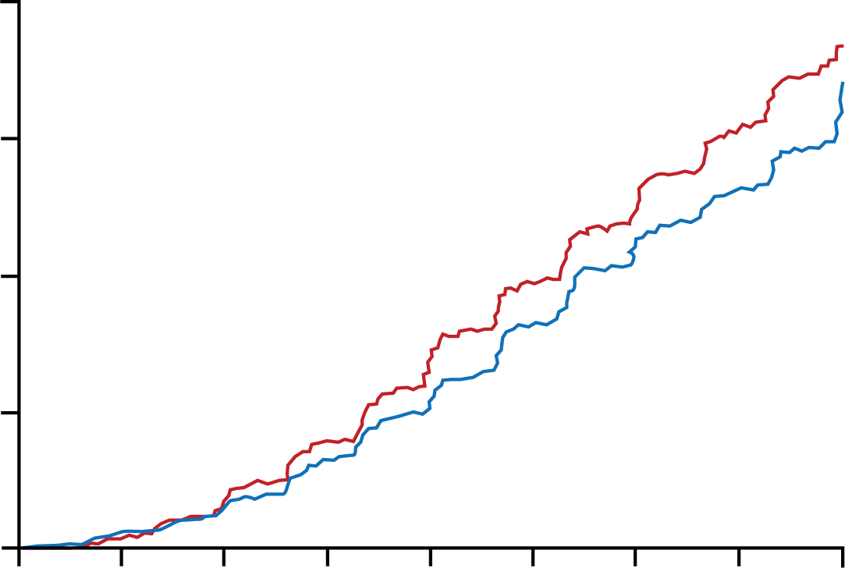
MRA Trial: FIDELIO-DKD Finerenone in T2DM & CKD
40
Primary Composite Outcome
Primary Endpoints: Composite of kidney failure, sustained ≥ 40% eGFR decline, or renal death
Hazard ratio, 0.82 (95% CI, 0.73-0.93)
p = .001
30
18% RRR
20
Placebo
Cumulative Incidence (%)
Finerenone
10
0
0
6
12
18
24
30
36
42
48
Months to First Event
No. at Risk
Placebo
Finerenone
2841
2833
2724
2705
2586
2607
2379
2397
1758
1808
1248
1274
792
787
453
441
82
83
Adapted from Bakris GL, et al. N Engl J Med. 2020;383(23):2219-2229.
Notes:
1:11:30
And as we’ll see the punchline …
Notes:
FIDELIO-DKD trial allowed SGLT2 inhibitor treatment, whereas the CREDENCE trial excluded patients treated with mineralocorticoid receptor antagonists
Figure 1. Kidney Outcomes. Outcomes were assessed in time-to-event analyses. Panel A shows the primary composite outcome of kidney failure, a sustained decrease of at least 40% in the estimated glomerular filtration rate (eGFR) from baseline, or death from renal causes in the finerenone and placebo groups. Panel B shows a sustained decrease of at least 40% in the eGFR from baseline maintained for at least 4 weeks (a component of the primary composite outcome). Panel C shows kidney failure (defined as end-stage kidney disease or a sustained eGFR of <15 ml per minute per 1.73 m2 of body-surface area, confirmed by a second measurement ≥4 weeks after the initial measurement); endstage kidney disease was defined as the initiation of long-term dialysis or kidney transplantation.

Slide 52
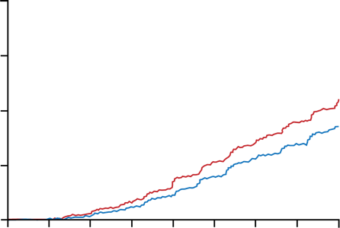
MRA Trial: FIDELIO-DKD Finerenone in T2DM & CKD
40
Secondary Composite Outcome
Secondary and Exploratory Endpoints: Composite of CV death, non-fatal MI, non-fatal stroke, hospitalization for HF Composite of kidney failure, sustained ≥ 57% eGFR decline, death from renal causes
Hazard ratio, 0.76 (95% CI, 0.65-0.90)
24% RRR
30
Cumulative Incidence (%)
20
Placebo
10
Finerenone
0
0
6
12
18
24
30
36
42
48
No. at Risk
Placebo
Finerenone
Months to First Event
2841
2833
2740
2732
2636
2655
2490
2492
1887
1915
1364
1377
873
883
499
501
98
101
MI = Myocardial infarction. Adapted from Bakris GL, et al. N Engl J Med. 2020;383(23):2219-2229.
Notes:
1:12:26
And if just looked at specifically …
Editor’s Note: Chart remake please
Notes: Panel D shows the secondary composite kidney outcome of kidney failure, a sustained decrease of at least 57% in the eGFR from baseline (equivalent to a doubling of the serum creatinine level) maintained for at least 4 weeks, or death from renal causes. Insets show the same data on an enlarged y axis. CI denotes confidence interval.

Slide 53
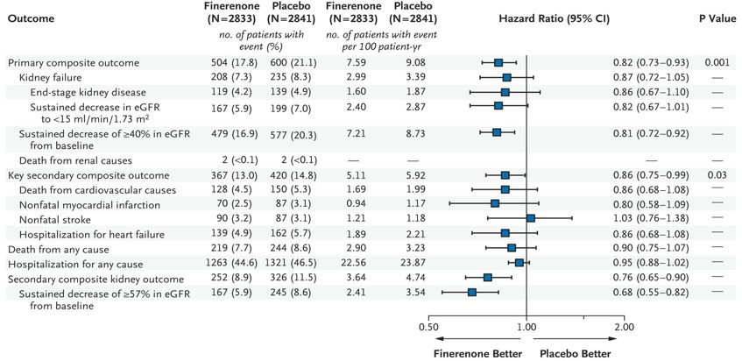
FIDELIO-DKD: Subgroup Analysis
Bakris GL, et al. N Engl J Med. 2020;383(23):2219-2229.
Notes:
1:13:03
And here’s the subanalysis like we showed you before …
Notes: Figure 2. Efficacy Outcomes. Shown are the hierarchical prespecified efficacy outcomes of the trial, including the components of the composite outcomes. Outcomes were assessed in time-to-event analyses. The key secondary outcome was a composite of death from cardiovascular causes, nonfatal myocardial infarction, nonfatal stroke, or hospitalization for heart failure.

Slide 54
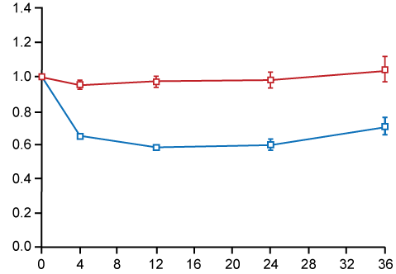
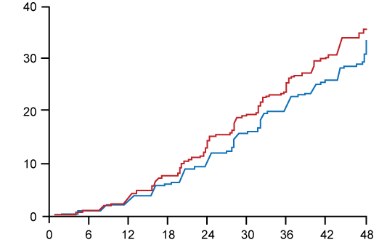
Finerenone Effects on UACR and eGFR in T2DM & CKD
A Urinary Albumin-to-Creatinine Ratio
B Sustained Decrease of ≥ 40% in the eGFR from Baseline
Placebo
Hazard ratio, 0.81
(95% CI, 0.72–0.92)
Placebo
Least-Squares Mean Ratio to Baseline
Cumulative Incidence (%)
Finerenone
Finerenone
Finerenone, 798.79 (geometrics SD, 2.65)
Placebo, 814.73 (geometrics SD, 2.76)
Months since Randomization
No. of Patients
Finerenone 2831 2725 2582 1841 836
Placebo 2840 2726 2598 1825 834
Months to First Event
No. at Risk
Placebo 2841 2722 2588 2379 1758 1249 793 453 82
Finerenone 2833 2703 2606 2396 1808 1275 788 442 83
Mean Change from Baseline (percent)
Finerenone Ref. -34.7 -41.3 -39.9 -29.3
Placebo Ref. -4.7 -3.0 -2.0 4.1
SD = Standard deviation. Bakris GL, et al. N Engl J Med. 2020;383(23):2219-2229.
Notes:
1:13:38
And finally, as you showed with the …
Figure 3. Effects on Albuminuria and Serum Potassium over Time.
Panel A shows the effects of finerenone and placebo on the urinary albumin-to-creatinine ratio in the full analysis set. The urinary albumin-to-creatinine
ratio was calculated with albumin measured in milligrams and creatinine
measured in grams. Shown is the ratio of the urinary albumin-to-creatinine
ratio at specific time points to the urinary albumin-to-creatinine ratio at
baseline. Plus–minus values are means
±SD. The I bars indicate 95% confidence intervals.
Panel B shows a sustained decrease of at least 40% in the eGFR from baseline maintained for at least 4 weeks (a component of the primary composite outcome).

Slide 55
FIDELITY: Pooled Analysis of FIDELIO-DKD and FIGARO-DKD
FIDELIO-DKD found finerenone slowed kidney disease progression and improved CV outcomes in patients with predominantly advanced kidney disease and T2DM²
FIGARO-DKD found finerenone reduced risk of CV events in patients with mild-to-moderate kidney disease and T2DM³
FIDELITY evaluated relationship between stage of kidney disease and efficacy of finerenone on composite CV and renal endpoints in 13,026 patients followed for 3 years¹
1. European Society of Cardiology Website. 2021. https://www.escardio.org/The-ESC/Press-Office/Press-releases/Finerenone-benefits-patients-with-diabetes-across-spectrum-of-kidney-disease. Accessed September 29, 2021. 2. Bakris GL, et al. N Engl J Med. 2020;383(23):2219-2229. 3. Pitt B, et al. N Engl J Med. August 28, 2021 [Epub ahead of print].
Notes:
1:14:22
And Dr. Morales, you know …
Speaker notes: the analysis encompassed the full range of kidney disease severity experienced by patients with type 2 diabetes
https://www.escardio.org/The-ESC/Press-Office/Press-releases/Finerenone-benefits-patients-with-diabetes-across-spectrum-of-kidney-disease
Finerenone benefits patients with diabetes across spectrum of kidney disease
FIDELITY analysis presented in a Hot Line Session today at ESC Congress 2021
28 Aug 2021
Topic(s):Pharmacology and Pharmacotherapy
Sophia Antipolis, France – 28 Aug 2021: Finerenone reduces the risk of cardiovascular and renal outcomes compared to placebo in patients with type 2 diabetes and all stages of kidney disease. That’s the finding of late breaking research presented in a Hot Line session today at ESC Congress 2021.1
The nonsteroidal mineralocorticoid receptor antagonist finerenone has been evaluated in two trials of patients with chronic kidney disease and type 2 diabetes. The FIDELIO-DKD trial previously reported that the drug slowed progression of kidney disease and improved cardiovascular outcomes in patients with predominantly advanced kidney disease and type 2 diabetes.2,3 The results of FIGARO-DKD, reported at ESC Congress 2021, showed that finerenone reduced the risk of cardiovascular events in patients with mild-to-moderate kidney disease and type 2 diabetes.
FIDELITY was a prespecified meta-analysis combining individual patient data from FIDELIO-DKD and FIGARO-DKD. The aim was to evaluate the relationship between the stage of kidney disease and the efficacy of finerenone on composite cardiovascular and renal endpoints. Stages of kidney disease were defined according to categories of estimated glomerular filtration rate (eGFR) and urine albumin-to-creatinine ratio (UACR).
Study author Professor Gerasimos Filippatos of the National and Kapodistrian University of Athens Medical School, Greece said: “More than 13,000 patients were included in this analysis, enabling more robust estimates of the cardiorenal efficacy and safety of finerenone than either trial alone. In addition, the analysis encompassed the full range of kidney disease severity experienced by patients with type 2 diabetes.”
Both trials enrolled adults with type 2 diabetes and chronic kidney disease treated with optimised renin-angiotensin system blockade and with a serum potassium of 4.8 mmol/L or below.4 Patients with symptomatic chronic heart failure with reduced ejection fraction were excluded. Participants were randomised 1:1 to receive oral finerenone or placebo, once daily.
The primary endpoint for this analysis was time to first occurrence of a composite of cardiovascular death, nonfatal myocardial infarction, nonfatal stroke or hospitalisation for heart failure, and its relationship with eGFR and UACR categories. The secondary endpoint was time to first occurrence of a composite of kidney failure, decrease in eGFR by 57% or more from baseline sustained for at least four weeks, or renal death, and its relationship with eGFR and UACR categories.
A total of 13,026 patients were followed-up for a median of 3.0 years. The composite cardiovascular endpoint occurred in 825 (12.7%) patients receiving finerenone and 939 (14.4%) receiving placebo. Finerenone reduced the risk of this outcome by 14% compared with placebo (hazard ratio [HR] 0.86; 95% confidence interval [CI] 0.78–0.95; p=0.0018).
The composite kidney endpoint occurred in 360 (5.5%) patients receiving finerenone and 465 (7.1%) receiving placebo. The risk of this outcome was 23% lower with finerenone than placebo (HR 0.77; 95% CI 0.67–0.88; p=0.0002). All components of the composite kidney outcome were significantly lower with finerenone than placebo, except renal death which occurred too infrequently to make a comparison between groups.
Regarding safety, outcomes were generally similar between treatment arms. Hyperkalaemia was more common with finerenone (14.0%) than placebo (6.9%). However, permanent discontinuation of treatment due to hyperkalaemia was infrequent (1.7% in the finerenone group versus 0.6% in the placebo group).
Professor Filippatos said: “The FIDELITY analysis demonstrates that finerenone reduced the risk of cardiovascular and kidney outcomes compared with placebo across the spectrum of chronic kidney disease in patients with type 2 diabetes. The cardiovascular benefits of the drug were consistent across eGFR and UACR categories, indicating that treatment should be initiated in the early stages of renal disease.”
References and notes
¹FIDELITY Analysis: finerenone in mild-to-severe chronic kidney disease and type 2 diabetes.
²Bakris GL, Agarwal R, Anker SD, et al. Effect of finerenone on chronic kidney disease outcomes in type 2 diabetes. N Engl J Med. 2020;383:2219–2229.
³Filippatos G, Anker SD, Agarwal R, et al. Finerenone and cardiovascular outcomes in patients with chronic kidney disease and type 2 diabetes. Circulation. 2021;143:540–552.
⁴Chronic kidney disease was defined as either a urine albumin-to-creatinine ratio (UACR) ≥30–<300 mg/g and an estimated glomerular filtration rate (eGFR) ≥25–≤90 ml/min/1.73 m² or UACR ≥300–≤5000 mg/g and eGFR ≥25 ml/min/1.73 m²

Slide 56
FIDELITY Analysis Results
Finerenone reduced risk of CV and renal outcomes compared with placebo across mild-to-severe CKD in patients with T2DM
14% reduced risk of composite CV endpoint (HR 0.86; 95% CI 0.78–0.95; p = .0018)
23% reduced risk of composite renal endpoint (HR 0.77; 95% CI 0.67–0.88; p = .0002)
CV benefits were consistent across eGFR and UACR categories, suggesting treatment should be initiated in early stages of renal disease.
Renal death occurred too infrequently to assess
All other individual renal endpoints significant
Discontinuation due to hyperkalemia:
1.7% of finerenone and 0.6% of placebo group
European Society of Cardiology Website. 2021. https://www.escardio.org/The-ESC/Press-Office/Press-releases/Finerenone-benefits-patients-with-diabetes-across-spectrum-of-kidney-disease. Accessed September 29, 2021. Accessed September 29, 2021.
Notes:
1:15:28
So if we’re looking at …
The primary endpoint for this analysis was time to first occurrence of a composite of cardiovascular death, nonfatal myocardial infarction, nonfatal stroke or hospitalization for heart failure, and its relationship with eGFR and UACR categories. The secondary endpoint was time to first occurrence of a composite of kidney failure, decrease in eGFR by 57% or more from baseline sustained for at least four weeks, or renal death, and its relationship with eGFR and UACR categories.
Number needed to treat = 46 at 36 months according to a bayer press release

Slide 57
Differences in MRA Approvals
Finerenone¹
Spironolactone²
Eplerenone³
FDA indicated to reduce risk of sustained eGFR decline, ESKD, CV death, non-fatal MI, and hospitalization for HF in adult patients with chronic kidney disease CKD associated with T2DM
FDA indicated to manage edema in adult patients with nephrotic syndrome when treatment of underlying disease, restriction of fluid, sodium intake, and use of other diuretics produce an inadequate response.
FDA indication specific to treat HTN and improve survival of patients with LV systolic dysfunction and CHF after an acute MI.
1. Kerendia® (finerenone). Whippany, NJ: Bayer Healthcare Pharmaceuticals Inc.; 2021. https://labeling.bayerhealthcare.com/html/products/pi/Kerendia_PI.pdf. Accessed September 29, 2021. 2. Aldactone® (spironolactone). New York, NY; Pfizer Labs; 2021. https://www.accessdata.fda.gov/drugsatfda_docs/label/2018/012151s075lbl.pdf. Accessed September 29, 2021. 3. Inspra® (eplerenone). New York, NY; Pfizer G.D. Searle; 2016. https://www.accessdata.fda.gov/drugsatfda_docs/label/2016/021437s013lbl.pdf. Accessed September 29, 2021.
Notes:
1:16:42
So then where does that leave us in terms of …

Slide 58
Audience Response
Approximately what percentage of patients with T2DM develop CKD?
10%
20%
40%
80%
Notes:
1:18:53
So we’re going to go back to the original …
Even though the platform shifts to the iSpring view of the poll, leave the slide in so they can pull the responses.
Reference: Afkarian M, Sachs MC, Kestenbaum B, et al. Kidney disease and increased mortality risk in type 2 diabetes. J Am Soc Nephrol. 2013;24(2):302-308.
Potential question: T2DM as a risk factor for CKD development – 40% of T2DM patients develop CKD.
Answer: C

Slide 59
Approximately what percentage of patients with T2DM develop CKD?
Results recorded on October 6, 2021.
Notes:
1:19:01
So the Correct answer is C…
This slide needs to be added. Data pulled from the “Onsight Report” from Ed Measures that resides in the Outcomes Folder in iMeet.

Slide 60
Audience Response
Which medication modification to SG’s regimen would be most beneficial to delay progression of eGFR decline and UACR improvement?
Addition of lisinopril
Addition of finerenone
Change dapagliflozin to canagliflozin
Change combination sacubitril/valsartan to losartan
I don’t know
Notes:
1:19:47
We’ll go to our next …
Answer: B

Slide 61
Which medication modification to SG’s regimen would be most beneficial to delay progression of eGFR decline and UACR improvement?
Results recorded on October 6, 2021.
Notes:
1:19:59
Oh. Wow look at that …
This slide needs to be added. Data pulled from the “Onsight Report” from Ed Measures that resides in the Outcomes Folder in iMeet.

Slide 62
Audience Response
Which of the following theories may cause CKD in a patient with diabetes?
Overexpression of IL-5
Increased mesangial contraction
Overexpression of MR
Podocyte fusion
I don’t know
Notes:
1:20:26
And we’ll go to our next question …
Answer: C

Slide 63
Which of the following theories may cause CKD in a patient with diabetes?
Results recorded on October 6, 2021.
Notes:
1:20:37
Excellent, Dr. Morales what do you think …
This slide needs to be added. Data pulled from the “Onsight Report” from Ed Measures that resides in the Outcomes Folder in iMeet.

Slide 64
SMART Goals
Specific, Measurable, Attainable, Relevant, Timely
Patients with T2DM need annual screening of eGFR and UACR per guidelines
In patients with T2DM + CKD, remember to treat drivers of CKD: HTN, ↑ HbA1C, and MR overactivation, which lead to kidney damage
Consider a multimodal approach of treatments to slow CKD progression, including ACEi or ARB, SGLT-2 or GLP-1 RA, and finerenone, in addition to lifestyle modifications
Notes:
1:21:29
What are some parting thoughts …

Slide 65
Additional Resources
Visit www.cmeoutfitters.com for clinical information and certified educational activities
Notes:
1:22:30
Excellent. So we have some additional resources …

Slide 66
To Receive Credit
To receive CME/CE credit for this activity, participants must complete the post-test and evaluation online. Participants will be able to download and print their certificate immediately upon completion.
Notes:
1:22:51
And to receive credit …

