Slide 1
The Patient Voice:
Defining Health Care Disparities in Atopic Dermatitis Care
Supported by an educational grant from
Sanofi Genzyme and Regeneron Pharmaceuticals

Slide 2
CME Outfitters, LLC,
is the accredited provider
for this continuing education activity.

Slide 3
Engage with us via Twitter!
Follow us on Twitter!
@CMEOutfitters
for upcoming CME/CE opportunities, health care news, and more

Slide 4
Jenna C. Lester, MD
Assistant Professor
Director, Skin of Color Program
Watson Faculty Scholar
Department of Dermatology
University of California San Francisco
San Francisco, CA

Slide 5
Junko Takeshita, MD, PhD, MSCE
Assistant Professor of Dermatology
Assistant Professor of Epidemiology
University of Pennsylvania Perelman School of Medicine
Philadelphia, PA

Slide 6
She was about 9 years old and I noticed that she was having a lot of redness and itchiness, and everything that we tried didn't work. When she turned 10, we went back to the doctor because we tried a home remedy and he diagnosed her with atopic dermatitis, eczema.
It took nearly 15 years to get diagnosed, and it was a long time before I could get a referral to a dermatologist. I believe this is the experience for most patients who often begin their symptoms in childhood or infancy and may not get diagnosed until at least 5 to 10 years later, and without seeing a specialist.
It caused me a great deal of distress because it affected my appearance. But it was not properly diagnosed and treated until my college years. I do not feel like that dermatologist or any of the dermatologists I have visited accurately diagnosed or treated or really addressed my skin issues as a woman of color.

Slide 7
Learning
Objective
1
Recognize the clinical presentation of atopic dermatitis and its impact on quality of life in patients of color.

Slide 8
Audience Response
How confident do you feel in assessing the severity of AD in people of color?
Not confident
Somewhat confident
Confident
Very confident

Slide 9
Skin of Color (SoC) and Disparities in Atopic Dermatitis (AD) Care
AD/eczema U.S. prevalence:
  Pediatric up to 20%¹; adults: 10.2%²
  Highest among African American/Black pediatric population³
Black individuals more likely to have untreated or treatment-resistant AD
AD in SoC misdiagnosed/diagnosed later in disease progression; poorer outcomes compounded by comorbidities/other health disparities⁴
1. Silverberg JI, et al. Ann Allergy Asthma Immunol. 2021;126(4):417-428.e2. 2. McGregor SP, et al. J Drugs Dermatol. 2017;16(3):250-255. 3. Margolis DJ, et al. J Investig Dermatol. 2018;138(7):1501-1506. 4. Buster KJ, et al. Dermatol Clin. 2012;30:53-59.

Slide 10
Prevalence of Eczema in Minority Populations
Childhood AD Prevelance²
Pediatric AD higher in¹:
  Metropolitan areas
  Higher household education levels
  Black race²
Adult AD higher in¹:
  Females
  Higher education levels
Prevalence (%)
1. Shaw TE, et al. J Invest Dermatol. 2011;131(1):67-73. 2. Centers for Disease Prevention and Control (CDC) Website. 2014. https://www.cdc.gov/nchs/data/health_policy/eczema_skin_problems_tables.pdf. Accessed July 21, 2021.

Slide 11
Racial/Ethnic Minority Children Have More Severe AD
Prevalence (%)
Silverberg JI, et al. Dermatitis. 2014;25(3):107-114.

Slide 12
Factors Associated with Moderate-to-
Severe AD Among Children
Factor | Adjusted Odds Ratio | 95% Confidence Interval (CI)
Older age | 1.05 | 1.03-1.07
Lower household income by federal poverty level (FPL) vs. ≥ 400% FPL 0%-99% 100%-199% 200%-399% | 1.91 1.60 1.39 | 1.39-2.63 1.20-2.12 1.06-1.83
Fair/poor maternal health | 2.16 | 1.47-3.16
Birthplace outside the United States | 0.44 | 0.22-0.89
Silverberg JI, et al. Dermatitis. 2014; 25:107.
Silverberg JI, et al. Dermatitis. 2014;25(3):107-114.
Notes:
It’s important to at least talk about this information if not show the slide. When adjusting for these other factors, race is no longer associated with more severe eczema among children.

Slide 13
Black Children Less Likely to Have Outpatient Visits for AD
1.5
1
1 = no difference compared to
non-Hispanic White
Adjusted Odds Ratio* for Outpatient Visit (95% CI)
Care Gap
0.5
0.90
(0.64-1.28)
0.69
(0.51-0.92)
0
Non-Hispanic Black
Hispanic White
*Adjusted for age, gender, region, insurance status, income, history of asthmas, duration of eczema follow-up, survey panel number
Fischer AH, et al. J Am Acad Dermatol. 2017;77(6):1060-1067.
Wan J, …, Takeshita J. J Invest Dermatol. 2019; 139:1906.

Slide 14

Disparities in Pediatric AD Care
In comparison to White children, Black and Hispanic children with AD are:
  3x more likely to receive medical care for AD across most levels of disease control¹
  More likely to have primary care and emergency visits
  More likely to have school and activity absences²
Black children with poorly controlled AD significantly less likely to see dermatologist than White children with similarly poorly controlled AD¹
1. Wan J, et al. J Invest Dermatol. 2019;139(9):1906-1913. 2. Wan J, et al. JAMA Dermatol. 2019;155(8):973-975.
Image: Nationaleczema.org

Slide 15

More Than Skin Deep: Psychosocial Burden
Post-inflammatory hyperpigmentation due to AD in SoC may increase distress¹
Chronic moderate-to-severe AD can be debilitating; linked to mental health across all races
Adults with AD more likely to develop²:
  14% ↑ depression
  17% ↑ anxiety
Review of patients with AD in 15 studies:
  44% ↑ suicidal ideation
  36% ↑ suicide attempts³
1. Eckert L, et al. J Am Acad Dermatol. 2017;77(2):274-279.e3. 2. Schonmann Y, et al. J Allergy Clin Immunol Pract. 2020;8(1):248-257.e16. 3. Armstrong A, et al. JAMA Dermatol. 2019;155(2):178-187.
Image: Natalie Abbey-Allan/Getty

Slide 16
There is emotional pain derived from this. Whenever somebody treats you like you're some kind of a dirty beast, if you will, for not having perfectly clear skin, you definitely feel judged and you feel like an outsider upon society, and it hurts quite a lot.
My atopic dermatitis/eczema has held me back in so many different ways because when you have a serious skin condition you cannot live a normal life. Every single thing that you do, you have to think twice about if your skin is going to flare up, or if it's going to react to a chemical or something that you eat or anything. There’s so many different elements to why eczema plays a mental toll on your health, and let’s face it, the world is not set up for people that have chronic skin conditions.

Slide 17
Black Adults with AD and QoL
DLQI scores are 75% higher among Black vs. White adults with greater symptoms of anxiety/depression
Race/ Ethnicity* | Dermatology Life Quality Index Median (IQR)
White (56%) | 1.4 (0.4, 5.2)
Black (15%) | 2.1 (0.5, 9.2)
Hispanic (17%) | 1.7 (0.5, 8.7)
Other (9%) | 2.1 (0.4, 3.6)
1
0.8
0.6
0.4
0.2
1 = no difference compared to White patients
0
-0.2
Black
Hispanic
Other
Reference = White
Adjusted for age, gender, annual household income, education level, health insurance, history of asthma, history of hay fever, history of food allergies, number of comorbidities, perceived health status, and PO-SCORAD
IQR = interquartile range; PO-SCORAD = patient-oriented scoring AD; QoL = quality of life
*White, Black, Other refer to non-Hispanic White, Black, or other race
Oluwole S, Takeshita J, et al. J Invest Dermatol. 2021;141(5 Suppl):S98. Abstract 562.
Do not distribute slide

Slide 18
AD Patient Burden and QoL
People of color may be undiagnosed/misdiagnosed or have delayed diagnosis¹
Reduced health-related QoL²
  Pain and discomfort
  Hyperpigmentation/hypopigmentation
  Disfiguring/skin scarring
  Increased skin and systemic infections
  Mental health and depression
Severe PO-SCORAD, POEM, or PO-SCORAD-itch = very low mental health, high DLQI scores³
DLQI = dermatology life quality index; POEM = patient-oriented eczema measure
1. Institute for Clinical and Economic Review (ICER), 2017 Final Evidence Report – Atopic Dermatitis. ICER Website.2017. https://icer.org/assessment/atopic-dermatitis-2017/. Accessed July 21, 2021. 2. Eckert L, et al. J Am Acad Dermatol. 2017;77(2):274-279.e3.
3. Silverberg JI, et al. Ann Allergy Asthma Immunol. 2018;121(3):340-347.

Slide 19
Disparities in Education: Clinical Presentation of AD in SoC
Survey: 47% of U.S. dermatologists and dermatology residents said training inadequate to identify and treat skin conditions in darker skin tones¹
  SoC under-represented in dermatology text and clinical images
  4.5% of images in medical textbooks showed darker skin types²
Study: Medical students correctly identified AD and other dermatologic conditions more frequently in Fitzpatrick (FP) skin type I-III photos than FP skin type IV-VI photos³
  Students who identified as FP skin type IV-VI more likely to correctly identify dermatologic conditions in lighter skin tones than in SoC
1. Buster KJ, et al. Dermatol Clin. 2012;30(1):P53-P59. 2. Louie P, Wilkes R. Soc Sci Med. 2018;202:38-42. 3. Mamo A, et al. J Am Acad Dermatol. 2021:S01909622(21)021015-6.

Slide 20
Learning
Objective
2
Implement best practices to diagnose, evaluate, and treat atopic dermatitis in child and adult patients of color.

Slide 21
I am Latina and I have darker skin. I think there was some initial misdiagnosis as to what was going on. They thought maybe dry skin…and this was through my general practitioner. It was not until I went to the dermatologist that they were able to give me an accurate description.
I do not feel like my dermatologist or primary care physicians over the years have been skilled in diagnosing skin disorders in persons of color. I don't think that they get adequate education in medical school, and continuing education is lacking in how these issues present on darker skin for persons of color.

Slide 22




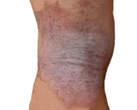
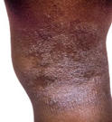
Racial Differences in Severity Assessments of AD Affect Treatment Recommendations
Patient Race | Confident in Diagnosis |  | Severe AD |  | Treatment with Phototherapy, Oral Systemic or Biologic
 | N (%) | OR (95% CI) | N (%) | OR (95% CI) | N (%) | OR (95% CI)
White N = 299 | 290 (98.0) | Reference | 180 (61.4) | Reference | 127 (42.5) | Reference
Black N = 297 | 286 (98.3) | 1.56 (0.44-5.56) | 112 (38.9) | 0.41 (0.29-0.58) | 105 (35.4) | 0.67 (0.45-0.99)
CI = confidence interval; OR = odds ratio
Takeshita J, et al. J Invest Dermatol. 2019;140(7 Suppl):S98.
Do not distribute slide
Please do not distribute.

Slide 23
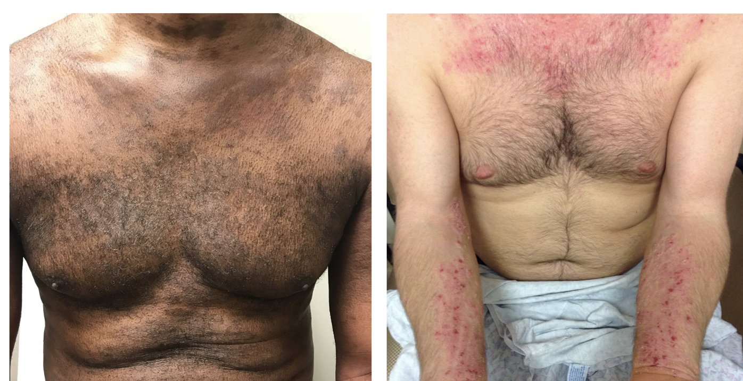
AD Presentation on Different Skin Types
AD can appear differently on SoC
Descriptions based on White skin presentation: “salmon-colored,” “shades of pink to red”
AD-related erythema can be more difficult to detect on non-White skin
Erythema on darker skin may appear:
  Grayish violet, red-brown, or very dark brown
Hyperpigmented/hypopigmented
Kaufman BP, et al. Am J Clin Dermatol. 2017;19(3):405-423.

Slide 24
Assessment of Disease Severity and Clinical Outcomes in AD
Measures of disease severity
  SCORAD: SCORing Atopic Dermatitis Index
  EASI: Eczema Area and Severity Index
  IGA: Investigator’s Global Assessment
Measures of impact on QoL:
  ~ 22 different scales for measuring QoL/psychological outcomes in AD
  DLQI: Dermatology Life Quality Index/Children’s Dermatology Quality of Life Index
Symptom-specific:
  POEM: Patient-Oriented Eczema Measure
  PP-NRS (itch): Peak Pruritis Numerical Rating Scale
    Includes pain and sleep on a scale of 1-10
Mental health
  HADS: Hospital Anxiety and Depression Scale
  PHQ-2 or PHQ-9: Patient Health Questionnaire
Eichenfield LF, et al. J Am Acad Dermatol. 2014;70:338-351.
Notes:
All three in an interactive discussion. What do you use in practice.

Slide 25
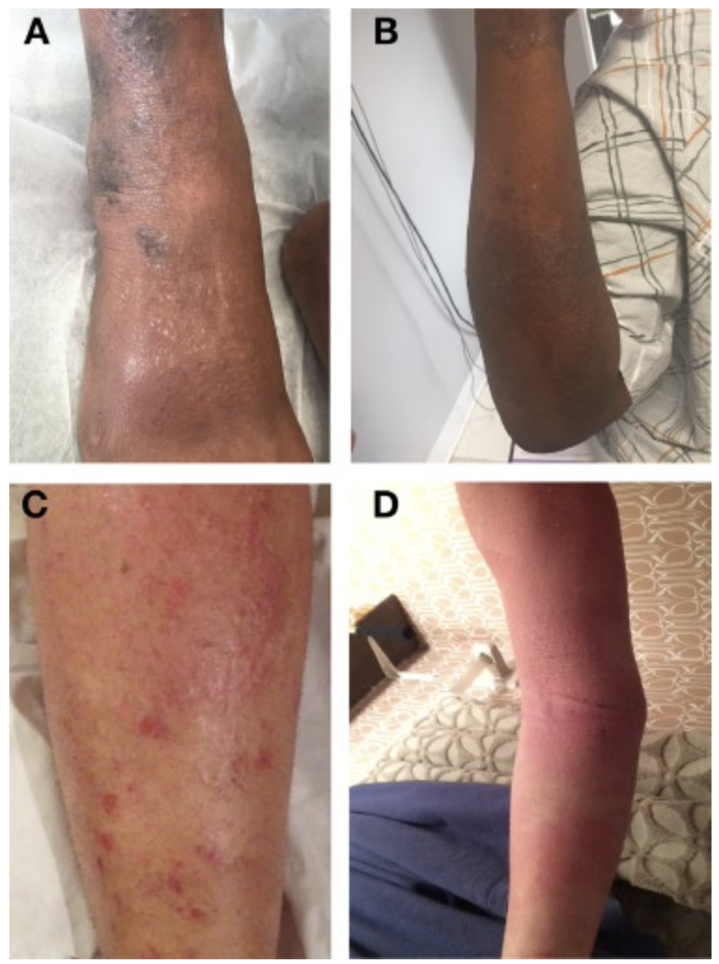
Not Seeing Red: Impact on AD Scores
Erythema scores may mask AD severity in SoC
  Assessment challenges due to skin pigmentation
  Skew visual diagnosis/assessment and use of SCORAD index/other tools (redness = intensity)
Also used as clinical sign in some patient-reported outcome (PRO) tools
  Three Item Severity (TIS) Score: excoriations, erythema, and edema/papulation²
Study: Significantly increased risk for severe AD in Black children after adjusting for erythema score¹
Compare lesions to non-lesioned skin for more accurate AD assessment
Images representative of Black (A, B) and
White (C, D) patients with AD
1. Ben-Gashir MA. Br J Dermatol. 2002;147(5):920-925. 2. Charman C, et al. Arch Dermatol. 2005;141(9):1146-1151.
Images from Sanyal RD, et al. Ann Allergy Asthma Immunol. 2019;122(1):99-110.e6.

Slide 26
Assessing Patients with Moderate-to-Severe AD
Defined by lesional severity and extent and/or significant impact on QoL (including social, emotional, and school/professional functioning)
Has adequate patient education been provided, including the following?
Avoid triggers
Stress importance of adherence
Optimize topical therapy (undertreatment and overtreatment)
Address topical steroid phobia
Consider structured educational intervention (eczema school)
Has intensive topical therapy been given in an adequate trial?
Appropriate amounts of medium- to high-potency topical anti-inflammatory therapy for 1-4 weeks
followed by proactive therapy for maintenance;
consider wet wrap therapy and soak and seal
Have alternative diagnoses been considered?
Have infections been managed?
Has patch testing for contact allergy been considered?
Is referral to allergy services required for further testing and optimization of allergic rhinitis/asthma management?
Simpson EL, et al. J Am Acad Dermatol. 2017;77(4):623-633.
Notes:
The top box should remain in bold letters by the others should be greyed out to keep the focus on the top bar.

Slide 27
Stepping Up from Moderate-to-Severe AD
Refer to specialist or interdisciplinary care
Consider acute treatment to help control:
- Wet wrap therapy
- Hospitalization
Patient is symptomatic despite aggressive course of topical prescription therapy (corticosteroid, calcineurin inhibitor, crisaborole) for ≥ 3 weeks and following basic management recommendations for skin care, antiseptic treatment, and avoidance of allergens and irritants, and particularly when there is severe and negative impact on daily activities, psychosocial health, and QoL*
Phototherapy
Dupilumab
Systemic immunosuppressant therapy
3-month therapeutic trial with reassessment at 4-8 weeks
Cyclosporine†
Methotrexate†
Mycophenolate mofetil†
Azathioprine†
Corticosteroids‡
*Before stepping up therapy, assess for nonadherence, potential comorbidities, and other factors that might negatively affect response to therapy;†Not FDA-approved; ‡FDA-approved but should be used only in acute flares or as rescue therapy
Boguniewicz M, et al. Ann Allergy Asthma Immunol. 2018;120(1):10-22.

Slide 28
Considering that there's not too much medication to help eczema at the moment, as far as I'm aware, other than topical steroids, I don't believe it was the doctor's fault, but more the amount of variety of medications for atopic dermatitis.
Most dermatologists that you come across, this is not a patient-doctor communication. This is a ‘doctor knows best,’ and the patient is just there to take what is given to them.

Slide 29
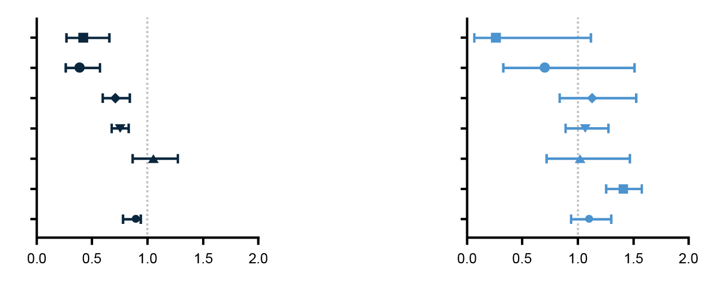
Recognize Disparities in AD Treatment
Black adults with AD less likely than White adults to be treated with non-steroidal topicals and dupilumab
AD Treatment:
Black vs. White
AD Treatment:
Hispanic vs. Non-Hispanic
Dupilumab
Dupilumab
Crisaborole
Crisaborole
Pimecrolimus
Pimecrolimus
Tacrolimus
Tacrolimus
Fluocinolone
Fluocinolone
Hydrocortisone
Hydrocortisone
Desonide
Desonide
Odds Ratio (95% CI)
Odds Ratio (95% CI)
Bell MA, et al. J Natl Med Assoc. 2020;112(6):650-653.

Slide 30
Learning
Objective
3
Evaluate the latest evidence regarding health care disparities in patients with AD and the impact of COVID-19 on the care for patients of color with AD.

Slide 31
Audience Response
How confident do you feel in using telehealth to assess AD in people of color?
Not confident
Somewhat confident
Confident
Very confident

Slide 32
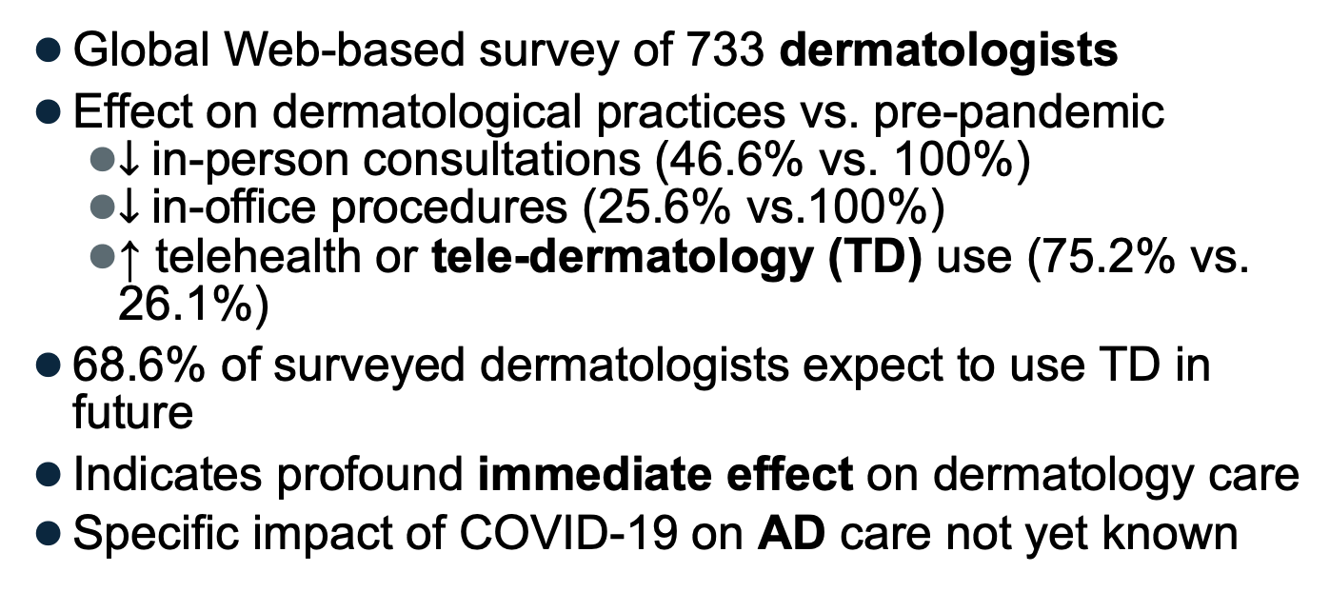
Impact of COVID-19 Pandemic on AD Care
Global Web-based survey of 733 dermatologists
Effect on dermatological practices vs. pre-pandemic
  $↓$in-person consultations (46.6% vs. 100%)
  $↓$in-office procedures (25.6% vs.100%)
  ↑ telehealth or tele-dermatology (TD) use (75.2% vs. 26.1%)
68.6% of surveyed dermatologists expect to use TD in future
Indicates profound immediate effect on dermatology care
Specific impact of COVID-19 on AD care not yet known
Bhargava S, et al. Int J Womens Dermatol. 2021;7(2):217-223.

Slide 33
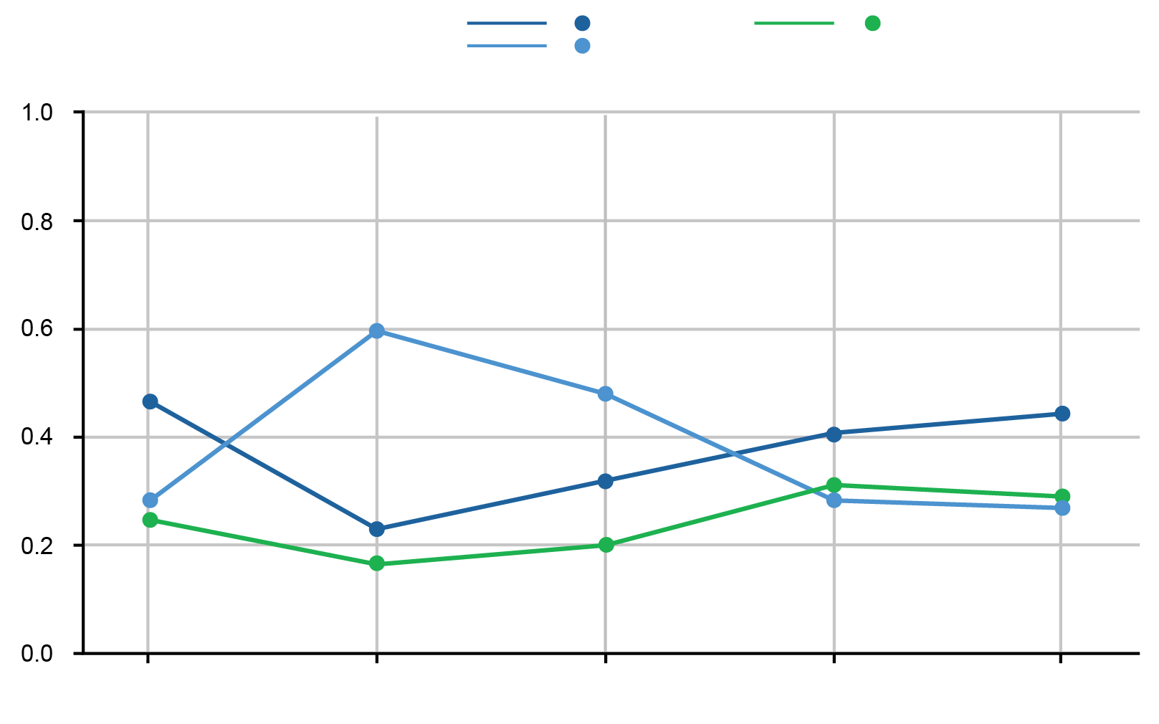
Digital Divide: Telehealth Use in Minority Populations
Unprecedented expansion in telehealth in response to COVID-19¹
Many benefits, but may also create or worsen health disparities
  Elderly adults, lower socioeconomic status, minority population disadvantaged
  Patients with Limited English Proficiency (LEP) have lower rates of telehealth compared to those with proficient English (4.8% vs. 12.3%)²
  Built-in racial bias in webcams/photography³
Telehealth
Other
ER
First Encounter Type (Probability)
White
Black/
African American
Hispanic/Latinx Race Ethnicity
Asian
Other/Unknown
ER = emergency room
1. Campos-Castillo C, et al. J Am Med Inform Assoc. 2021;28(1):119-125. 2. Rodriguez JA, et al. Health Affairs. 20,21;40(3):487-495.
3. Sheehan T. Color matters. In: Gockel B, ed. The Colors of Photography. De Gruyter; 2020:55-72.

Slide 34

PRO Tools for AD Assessment in Telehealth?
Patient self-evaluation may help improve AD severity assessment in-person and TD
May need to calibrate for SoC
No single PRO captures all aspects of disease
Validated measuring tools include
  PO-SCORAD: Subjective and objective criteria assess extent and severity of symptoms
  DLQI: Measurement of quality-of-life burden of skin disease in adults
  NRS-itch: Numerical rating scale itch intensity
  POEM: Patient Oriented Eczema Measure
PO-SCORAD = Patient-Oriented SCORing Atopic Dermatitis
Silverberg J, et al. Br J Dermatol. 2020;182(1):104-111. Image Credit: First Derm AI Dermatology API
Notes:
Dr. Silverberg, please use this slide to support that it doesn’t take that much time to use these tools in practice)

Slide 35
Stepping Up from Moderate-to-Severe AD
Refer to specialist or interdisciplinary care
Consider acute treatment to help control:
- Wet wrap therapy
- Hospitalization
Patient is symptomatic despite aggressive course of topical prescription therapy (corticosteroid, calcineurin inhibitor, crisaborole) for ≥ 3 weeks and following basic management recommendations for skin care, antiseptic treatment, and avoidance of allergens and irritants, and particularly when there is severe and negative impact on daily activities, psychosocial health, and QoL*
Phototherapy
Dupilumab
Systemic immunosuppressant therapy
3-month therapeutic trial with reassessment at 4-8 weeks
Cyclosporine†
Methotrexate†
Mycophenolate mofetil†
Azathioprine†
Corticosteroids‡
*Before stepping up therapy, assess for nonadherence, potential comorbidities, and other factors that might negatively affect response to therapy;†Not FDA-approved; ‡FDA-approved but should be used only in acute flares or as rescue therapy
Boguniewicz M, et al. Ann Allergy Asthma Immunol. 2018;120(1):10-22.

Slide 36
COVID-19 Implications for AD Treatment
Recommendations for immunosuppressant treatments during pandemic and pre/post vaccinations¹:
  Initiate/continue symptomatic topical therapy, including corticosteroids according to patient needs
  Avoid systemic corticosteroid therapy, especially at dose > 10 mg/day or use with very strict indication and only for short duration²
1. American College of Rheumatology Website. 2021. https://www.rheumatology.org/About-Us/Newsroom/Press-Releases/ID/1138.
Accessed July 26, 2021. 2. Buhl T, et al. J Dtsch Dermatol Ges. 2020;18(8):815-824.

Slide 37
Dupilumab: Long-Term Therapy for Moderate-to-Severe AD
Open-label study: continuous treatment sustained improvements for up to 3 years in adults
  EASI: 1.4 (3.2, -95.4%) and weekly
  NRS-Itch: 2.2 (1.8, -65.4%) at week 148^{1,2}
Dupilumab approved for AD in patients age ≥ 6³
Systemic anti-inflammatory; inhibits interleukin (IL)-4, IL-13 signal⁴
Not an immunosuppressant
Common adverse events in ≥ 5% of patients: nasopharyngitis, conjunctivitis, headache, oral herpes, injection-site reactions²
1. Deleuran M, et al. J Am Acad Dermatol. 2020;82(2):377-388. 2. Beck LA, et al. Am J Clin Dermatol. 2020;21(4):567-577. 3. Guttman-Yassky E, et al. J Allergy Clin Immunol. 2019;143:155-172. 4. Cuellar-Barboza A, et al. J Drugs Dermatol. 2020;19(2):209-210.

Slide 38
Dupilumab: Safety and Efficacy in SoC
Pooled analysis of three trials assessed efficacy and safety of dupilumab for adults with moderate-to-severe AD by race¹
  Improved all assessed outcomes in White and Asian subgroups
  In smaller Black subgroup, significantly (p < .0001) improved EASI endpoints, mean changes in Peak Pruritus NRS and DLQI
  Well-tolerated, acceptable safety profile in all subgroups
Alexis AF, et al. J Drugs Dermatol. 2019;18(8):804-813.

Slide 39
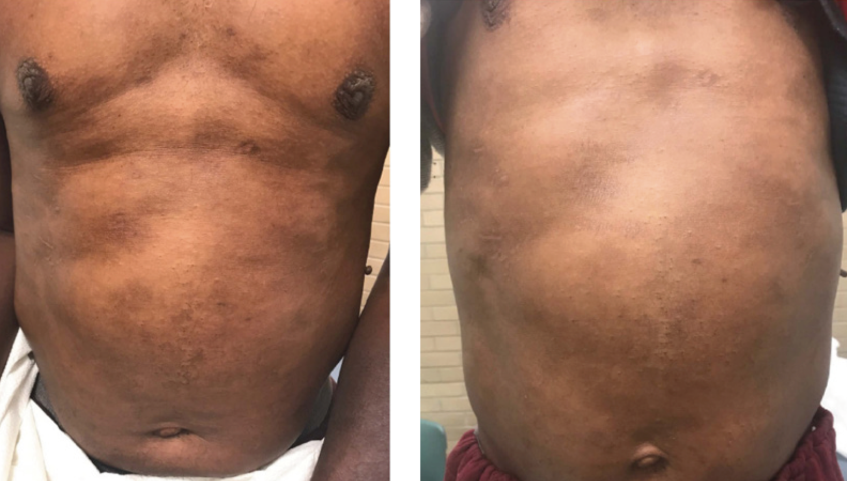
Case Report: Dupilumab Improved Post-Inflammatory Hyperpigmentation
53-year-old Black male with
1-year history of worsening pruritic rash diagnosed with moderate-to-severe AD
  Received 600 mg loading dose
  2 weeks later, 200 mg dose subcutaneous every 2 weeks
Improvement of all symptoms, including hyperpigmentation during treatment
Grayson C, Heath CR. J Drugs Dermatol. 2020;19(7):776-778.

Slide 40
SMART Goals
Specific, Measurable, Attainable, Relevant, Timely
Identify inequitable processes and pathways that contribute to racial/ethnic differences in the prevalence, assessment, and treatment of AD in adults and children.
Integrate best practices to eliminate disparities in the diagnosis, assessment, and management of moderate-to-severe AD in patients of color.
Assess changes in dermatological practices and treatment due to the COVID-19 pandemic, especially in those that may exacerbate health inequities.

Slide 41
To Ask a Question
Please click on the Ask Question tab and type your question. Please include the faculty member’s name if the question is specifically for him/her.

Slide 42
CME Outfitters
AFTER
THE SHOW
Questions & Answers
Notes:
If applicable

Slide 43
Visit the
Dermatology Hub
Free resources and education to educate
health care providers and patients on psoriasis
https://www.cmeoutfitters.com/dermatology-hub/

Slide 44
To Receive Credit
To receive CME/CE credit for this activity, participants must complete the post-test and evaluation online.
Participants will be able to download and print their certificate immediately upon completion.
Notes:
This slide and the last slide (23) should go up during the Q&A

