Slide 1
Adapting and Adjusting: Best Practices for Utilizing Telehealth in Osteoarthritis Management
Supported by an educational grant from Pfizer Inc.
Notes:
https://vimeo.com/501609655/b98980a0c2
0:00

Slide 2
Jason J. Wilcox, MD
Orthopedic Surgeon, Sports Medicine
Orthopedic Physician Associates
Seattle, WA
Notes:
0:12:04
My name is Jason Wilcox. I am an orthopedic surgeon

Slide 3
Learning Objective
Apply strategies to manage osteoarthritis during the COVID-19 pandemic.
Notes:
0:27:04
Our learning objective today

Slide 4
The Burden of Osteoarthritis
Osteoarthritis (OA) is the most common form of arthritis, affecting 1 in 3 people over the age of 65
OA is the third most rapidly rising cause of disability
10% of ambulatory visits were for OA
Most common reason for decrease in ambulation
Hip/knee OA is the highest risk for all-cause and CV related death
Concomitant OA in patients with diabetes mellitus predicts higher risk of diabetic complications
$128 billion (1.2% GDP) attributed to arthritis in 2003
GDP = gross domestic product Hawker GA. Clin Exp Rheumatol,. 2019;37 Suppl 120(5):3-6.
Notes:
0:33:02
Now, what is osteoarthritis

Slide 5
Risk Factors That Lead to the Development of OA
Modifiable Risk Factors
Muscle strength
Physical activity
Occupation
Joint injury
Joint alignment
Non-Modifiable Risk Factors
Age
Gender
Genetics
Ethnicity
Joint alignment
Increased Risk of OA
Susceptibility
Predisposition
Systemic Risk Factor
Diet
Systemic Risk Factors
Obesity
Bone metabolism
Adapted from Musumeci G, et al. Int J Mol Sci. 2015;16(3):6096.; Abramoff B, Caldera FE. Med Clin North Am. 2020;104(2):293-311.
Notes:
1:22:01
If you saw part 1 of this talk

Slide 6
Patients with OA: Caught in a Cycle of Chronicity
King LK, et al. Arthritis Care Res (Hoboken). 2018;70:71-79.
Notes:
1:38:23
Why does this matter?

Slide 7
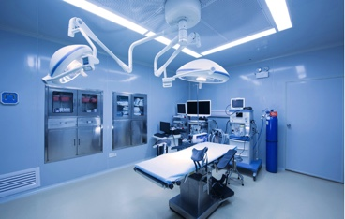
US Surgeon General Recommended Elective Surgery Cancellations March 14, 2020
Estimates of as many as 150,000 postponed surgeries per month: What is the impact on patients?
Survey of 360 patients at 6 surgical centers who had to cancel their hip or knee surgery
30% would have surgery despite COVID-19 risks
15% had no help at home
21% felt isolated or lonely as a result
Brown TS, et al. J Arthoplasty. 2020;35(7S):S49-S55.
Notes:
2:42L22
There was a study done

Slide 8
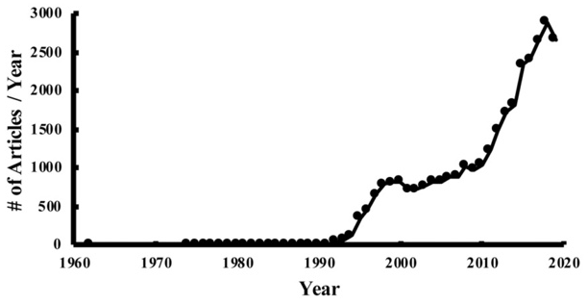
Accelerated Uptake of Telemedicine During COVID-19 Pandemic
Telemedicine has origins in late 19th century
Technology has outpaced adoption of this potentially useful tool
27% of large employers covered telehealth benefits in 2015, 82% in 2019
2.4% of employees used one telehealth visit in 2018, < 10% in 2019
Increased interest from insurance companies, health systems, and large tech companies
COVID-19 potentially sped up adoption/interest in telehealth
Telemedicine Publications Have Significantly Increased Telemedicine
3000
2500
2000
1500
# of Articles/Year
1000
500
0
1960
1970
1980
1990
2000
2010
2020
Year
Makhni MC, et al. J Bone Joint Surg Am. 2020;102:1109-1115.
Notes:
3:38:11
Now telemedicine has been a big

Slide 9
Benefits of Telemedicine in the Management of Osteoarthritis
High patient satisfaction
Majority of patients prefer
Up to 99% satisfaction
Up to 86% preferred telehealth
Cost effective
Finnish study suggested 45% savings
Argentinian study found reduction in cost between 12-72%
Efficacious and Accurate
Similar rate of surgical procedure
Satisfaction rates good for patient and surgeon
Makhni MC, et al. J Bone Joint Surg Am. 2020;102(13):1109-1115.
Notes:
4:39:04
The benefits of telemedicine

Slide 10
Challenges of Telemedicine in the Management of Osteoarthritis
Technology literacy
Implementation and cost
Efficiencies
Inability to perform examination
Financial implications
Regulatory barriers
Makhni MC, et al. J Bone Joint Surg Am. 2020;102:1109-1115.
Notes:
5:46:22
The difficulty is also very clear

Slide 11
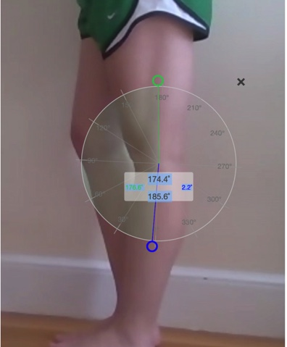
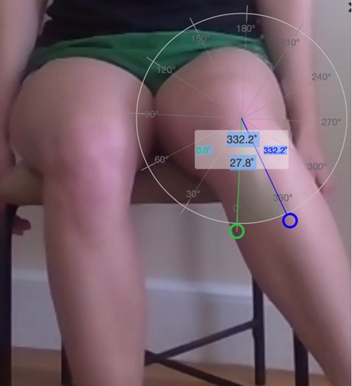
Telemedicine Options and Limitations
Tenderness
Erythema
Range of motion (ROM)
Strength
Gait
Tanaka MJ, et al. J Bone Joint Surg Am. 2020:102(12):e57.
Notes:
7:36
As technology has moved on

Slide 12
Telehealth Tips
Get to know your technology
Schedule appointments without distractions
Reinforce positives
Experiential learning
Complementary resources
Setting goals
Integrate self-help activities
Remember context & be flexible
Eccleston C, et al. Pain. 2020;161(5):889-893.
Notes:
8:02
Tips and going forward

Slide 13
SMART Goals
Specific, Measurable, Attainable, Relevant, Timely
Best practices for assessment and monitoring of OA via telehealth
Specific: Maximize mobility in time of isolation
Measurable: Increase in video capability & wearable tech
Attainable: First step is understanding the problem. Operative and non-operative measures for treatment
Relevant: Cost of burden, increasing % of population, etc.
Timely: The problem is now. The solution can also be now.
Notes:
10:02:20
If you saw part 1

Slide 14
Resources for Telemedicine and Osteoarthritis
Coverage | Useful Resources
State laws and reimbursement policies | https://www.cchpca.org/telehealth-policy/current-state-laws-and-reimbursement-policies#
Medicare | https://www.medicare.gov/coverage/telehealth https://www.cms.gov/newsroom/fact-sheets/medicare-telemedicine-health-care-provider-fact-sheet
Medicaid | www.medicaid.gov/medicaid/benefits/telemedicine/index.html
AAOS CPT code guide | https://www.aaos.org/about/covid-19-information-for-our-members/practice-management-and-telehealth-resources/
AAOS telemedicine startup checklist for practice management | https://www.aaos.org/quality/practice-management/telemedicine
AAOS = American Academy of Orthopaedic Surgeons; CPT = current procedural code
Makhni MC, et al. J Bone Joint Surg Am. 2020;102:1109-1115.
Notes:
12:08:19
If you have any interest

Slide 15
If you missed part 1….
Adopting a Tailored Approach to Managing Unmet Needs in Osteoarthritis
https://www.cmeoutfitters.com/rheumatology-digital-hub/
Notes:
12:27:14
I’d like to thank you again

Slide 16
How to Collect Credit for this Activity
To receive CME/CE credit, click on the link to complete the post-test and evaluation online.
www.cmeoutfitters.com/TST43772
Participants can print their certificate or statement of credit immediately.
Notes:
12:42:02
Click on the link

