Slide 1

EPISODE 4
Castration-Sensitive Prostate Cancer: Navigating the Current Diagnostic and Treatment Landscape
Management of Patients with Metastatic CSPC
Supported by an educational grant from Astellas and Pfizer, Inc.
Notes:
AG

Slide 2
Cora N. Sternberg MD, FACP
Clinical Director
Englander Institute for Precision Medicine
Professor of Medicine
Sandra and Edward Meyer Cancer Center
Weill Cornell Medicine
New York, NY

Slide 3
William K. Oh, MD
Clinical Professor of Medicine
Division of Hematology and Medical Oncology
Tisch Cancer Institute
Icahn School of Medicine at Mount Sinai
New York, NY
Chief Medical Science Officer, Sema4
Stamford, CT

Slide 4
Learning
Objective
1
Select appropriate therapy for men with metastatic CSPC.

Slide 5
Learning
Objective
2
Appraise molecular diagnostic approaches to risk stratify patients with metastatic CSPC.

Slide 6
Androgen Deprivation Therapy for CSPC
Androgen deprivation therapy (ADT)
  ADT is highly effective, convenient, durable, and associated with an acceptable quality of life
  Standard first-line treatment of patients with metastatic CSPC
    Used in combination with antiandrogen therapy or chemotherapy
  However, castration resistance inevitably develops
CSPC = castration-sensitive prostate cancer

Slide 7
STAMPEDE Trial
1.00
0.80
0.60
0.40
0.20
0.00
Patients: metastatic CSPC
Arms: standard of care + placebo
standard of care + docetaxel (6 cycles)
Total population
Control
Docetaxel
Control
Docetaxel
 | Total population
 | Control | Docetaxel
Median OS | 43 mo | 59 mo
5-yr survival | 37% | 49%
Survival
 | Low-burden |  | High-burden
 | Control | Docetaxel | Control | Docetaxel
Median OS | 76 mo | 93 mo | 35 mo | 40 mo
5-yr survival | 57% | 72% | 24% | 34%
HR 0.81, 95% CI 0.69 - 0.95; P=0.009
0123456789
Time since randomization (years)
Clarke NW, et al. Ann Oncol. 2019;30(2),1992-2003.

Slide 8
Chemohormonal Therapy
CHAARTED¹ | GETUG-15² | STAMPEDE³
ADT vs. ADT plus docetaxel (6 cycles) | ADT vs. ADT plus docetaxel (up to 9 cycles) | ADT vs. ADT + zoledronic acid + docetaxel (6 cycles)
47.2 months vs. 57.6 months | 35.1 months vs. 39 months | 71 months vs. 81 months
Control
Treatment
Hazard ratio (95% CI)
CHAARTED
136/393
101/399
0.61 (0.47-0.80)
GETUG-15
NA/193
NA/192
0.90 (0.69-1.81)
STAMPEDE (SOC+/-Doc)
350/724
144/362
0.76 (0.62-0.93)
Overall⁴
0.77 (0.68-0.87)
Heterogeneity x² = 4.80; df = 3; p = 0.187; I² = 37.5%
0.5
1
2
Favors SOC + docetaxel
Favors SOC
SOC = standard of care
1. Kyriakopoulos CE, et al. J Clin Oncol. 2018;36(11):1080-1087. 2. Gravis G, et al. J Clin Oncol. 2015;33(suppl7):140-140.
3. James ND, et al. Lancet. 2016;387(10024):1163-1177. 4. Vale CL, et al. Lancet Oncol. 2016;17(2):243-256.

Slide 9
Antiandrogen Therapy
Abiraterone – LATITUDE^{1,2}
 | Abiraterone | Placebo
Median OS | 53.3 months | 36.5 months
Time to PSA progression | 33.2 months | 7.4 months
Apalutamide – TITAN³ | Apalutamide – TITAN
 | Apalutamide | Placebo
24-month survival | 82% | 74%
PSA = prostate specific antigen
1. Fizazi K, et al. Lancet Oncol. 2019;20(5):686-700. 2. Matsubara N, et al. Eur Urol. 2020;77(4):494-500.
3. Agarwal N, et al. Lancet Oncol. 2019;20(11):1518-1530.

Slide 10
Enzalutamide
ENZAMET¹
ARCHES²
100
100
90
80%
72%
80
Enzalutamide + ADT
75
70
60
Placebo + ADT
Percent Alive
rPFS (%)
50
50
40
30
Median, months (95% CI)
25
Enzalutamide
Control
Enzalutamide + ADT NR (NR-NR)
Placebo + ADT 19.0 (16.6-22.2)
20
HR, 0.67 (95% CI, 0.52-0.86); p = 0.002
10
HR, 0.39 (0.30 to 0.50); p < 0.001
0
0
6
12
18
24
30
36
42
48
0
3
5
9
12
15
18
21
24
27
30
33
Months
Months
rPFS = radiographic progression-free survival
1. Davis, et al. N Engl J Med. 2019;381(2):121-131. 2. Armstrong, et al. J Clin Oncol. 2019;37(32):2974-2986.

Slide 11
PEACE-1
rPFS (years) | bPFS (years) | HR (95% CI); p value
2.0 | 1.5 | 0.50 (0.40-0.62); p < 0.0001
4.5 | 3.2 | 0.38 (0.31-0.47); p < 0.0001
De novo
mCSPC
ADT + docetaxel
ADT + docetaxel + abiraterone acetate + prednisone
Grade 3/4 AEs | Abiraterone | Control
Neutropenic fever | 4.5% | 5.4%
Liver toxicity | 19.7% | 13%
Hypertension | 12.2% | 8.6%
Fizazi K, et al. J Clin Oncol. 2021;39(suppl 15):5000.

Slide 12
Emerging Therapies: Darolutamide
ARAMIS: ADT + darolutamide or placebo in nonmetastatic CRPC¹
  3-yr survival: 83% darolutamide, 77% placebo
ARASENS²
  Study continuing, but not recruiting
1300 men w/ metastatic hormone-sensitive PC
ADT + docetaxel +
darolutamide
Symptomatic progressive disease, unacceptable toxicity, death, or withdrawal
ADT + docetaxel +
placebo
1. Fizazi K, et al. N Engl J Med. 2020;383(11):1040-1049. 2. Smith MR, et al. J Clin Oncol. 2018;36(6_suppl):TPS383-TPS383.

Slide 13
Patient Selection
Impact of comorbidities on tolerability
  Age
  Cardiovascular disease
Patient preferences
  Cost of antiandrogens
  Tablets vs. infusion
  Duration of therapy

Slide 14
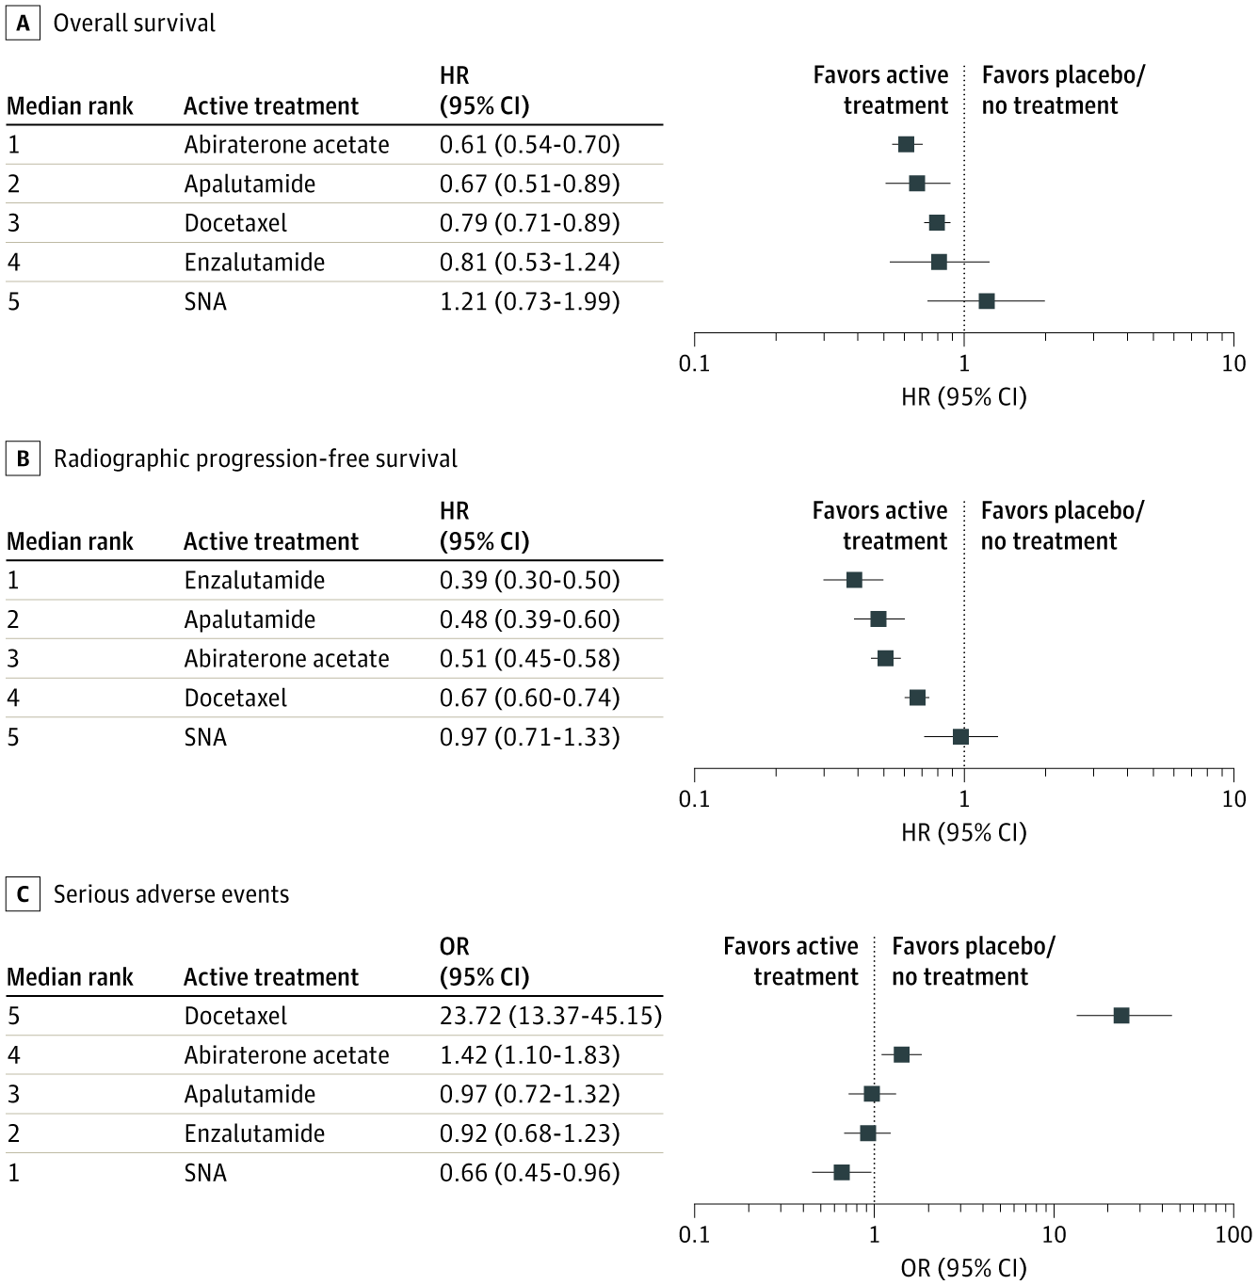
Comparison of Available Therapy Options
Network meta-analysis
  7 trials
  7,287 patients mCSPC
SAEs relative to placebo
Fewer SAEs with active
treatment
Rank | Active treatment | OR (95% CI)
5 | Docetaxel | 23.72 (13.37-45.15)
4 | Abiraterone acetate | 1.42 (1.10-1.83)
3 | Apalutamide | 0.97 (0.72-1.32)
2 | Enzalutamide | 0.92 (0.68-1.23)
1 | SNA | 0.66 (0.45-0.96)
More SAEs with active treatment
0.1
1
10
100
OR (95% CI)
SAE, serious adverse event
Wang L, et al. JAMA Oncol. 2021;7(3):412-420.

Slide 15
Comparison of Available Therapy Options (cont.)
Overall survival
Favors active
treatment
Favors placebo/
no treatment
Rank | Active treatment | HR (95% CI)
1 | Abiraterone acetate | 0.61 (0.54-0.70)
2 | Apalutamide | 0.67 (0.51-0.89)
3 | Docetaxel | 0.79 (0.71-0.89)
4 | Enzalutamide | 0.81 (0.53-1.24)
5 | SNA | 1.21 (0.73-1.99)
Abiraterone and apalutamide may provide the largest OS benefits with relatively low SAE risks
Enzalutamide may provide the largest rPFS
  Longer follow-up is needed
0.1
1
10
HR (95% CI)
Radiographic progression-free survival
Favors active treatment
Favors placebo/no treatment
Rank | Active treatment | HR (95% CI)
1 | Enzalutamide | 0.39 (0.30-0.50)
2 | Apalutamide | 0.48 (0.39-0.60)
3 | Abiraterone acetate | 0.51 (0.45-0.58)
4 | Docetaxel | 0.67 (0.50-0.74)
5 | SNA | 0.97 (0.71-1.33)
0.1
1
10
HR (95% CI)
Wang L, et al. JAMA Oncol. 2021;7(3):412-420.

Slide 16
Patient Disparities
Treatment Rates by Race for Metastatic CSPC
 | White, non-Hispanic (n = 3,537) | Black (n = 447) | Hispanic (n = 194)
ADT alone | 68.2% | 68.0% | 65.4%
ADT + AA | 10.1% | 16.3% | 19.6%
ADT + docetaxel | 5.3% | 4.7% | < 5.7%
ADT + NHT | 16.5% | 11.0% | 15.5%-16.5%
AA = 1st-gen AA; NHT = 2nd-gen AA
AA = antiandrogen; NHT = novel hormonal therapy
Levitan D. ASCO Daily News. 2021. https://dailynews.ascopubs.org/do/10.1200/ADN.21.200549/full/?cid=DM7642&bid=80069402.
(Accessed June 15, 2021).

Slide 17
NCCN Guidelines on Molecular Testing
Regional disease (N1, M0): Consider tumor testing for
  Homologous recombination gene mutations (HRRm)
  Microsatellite instability (MSI)
  Mismatch repair deficiency (dMMR)
Metastatic (Any N, M1): Recommend tumor testing for HRRm and consider tumor testing for MSI or dMMR
Germline testing for patients with
  High-risk localized or regional PC
  Metastatic PC
  Family history of prostate, pancreatic, breast, and ovarian cancers
  Ductal PC
  Some ethnic groups
1. National Comprehensive Cancer Network (NCCN). NCCN Clinical Practice Guidelines in Oncology (NCCN Guidelines®),
Prostate Cancer, Version 2.2021. https://www.nccn.org/professionals/physician_gls/pdf/prostate.pdf. (Accessed June 15, 2021).

Slide 18
Patient Who Might Benefit from
Molecular Testing
Low or favorable intermediate-risk prostate cancer considering active surveillance
Unfavorable intermediate-risk patients considering add-on ADT or radiation
Adverse pathology at prostatectomy, with early postoperative continence, and undetectable PSA
Eggener SE, et al. J Clin Oncol. 2020;38(13):1474-1494.

Slide 19
SMART Goals
Specific, Measurable, Attainable, Relevant, Timely
Utilize second-generation antiandrogen or chemotherapies for mCSPC
Ensure patients with high-risk local/regional or metastatic disease, or with a family history of cancer, receive molecular testing
Be cognizant of systemic barriers and patient preferences when talking to patients about therapy options

Slide 20

Claim ABIM MOC Credit
3 Things to Do
Actively participate in the meeting by responding to questions and/or asking the faculty questions
  (It’s ok if you miss answering a question or get them wrong;
  you can still claim MOC)
Complete your post-test and evaluation at the conclusion of the webcast
Be sure to fill in your ABIM ID number and DOB (MM/DD) on the evaluation so we can submit your credit to ABIM
Notes:
If ABIM MOC is applicable

Slide 21

EPISODE 1
Disease States and Staging of CSPC
EPISODE 2
Treatment Options and Clinical Dilemmas in Biochemical Recurrence
EPISODE 3
Management of Locally Advanced CSPC
www.CMEOutfitters.com/

