Slide 1
EPISODE 2
Castration-Sensitive Prostate Cancer: Navigating the Current Diagnostic and Treatment Landscape
Treatment Options and Clinical Dilemmas in BCR of Prostate Cancer
Supported by an educational grant from Astellas and Pfizer, Inc.
Notes:
AG

Slide 2
Cora N. Sternberg MD, FACP
Clinical Director, Englander Institute for Precision Medicine
Professor of Medicine
Sandra and Edward Meyer Cancer Center
Weill Cornell Medicine
New York, NY

Slide 3
Peter R. Carroll, MD, MPH
Donna Derr-Chevron Distinguished Professor
Taube Family Distinguished Professor in Urology
Department of Urology UCSF Helen Diller Family Comprehensive Cancer Center University of California, San Francisco
San Francisco, CA

Slide 4
Learning Objective
1
Stratify patients with early prostate cancer for risk of progression, based on pathological, molecular, and clinical findings.

Slide 5
Learning Objective
2
Identify optimal treatment strategies in the management of patients with prostate cancer experiencing BCR.

Slide 6
Biochemical Recurrence
Biochemically recurrent prostate cancer is an increasingly common disease state
Increasing use of radical prostatectomy for the treatment of high-risk localized disease
Adjuvant RT is underutilized (< 10% of eligible men)
Survival advantage
Support for adjuvant RT from the American Urological Association (AUA), the American Society for Radiation Oncology (ASRO), and American Society of Clinical Oncology (ASCO)
RT = radiation therapy
Spratt DE, et al. Am Soc of Clin Oncol Educ Book. 2018;38:355-362.

Slide 7
Anticipating Risk of BCR at Time of Diagnosis
NCCN Algorithm
Risk Level | Features
Very low | Has all of the following: • T1c • Grade Group 1 • PSA < 10 ng/mL • PSA density < 0.15 ng/mL/g • Fewer than 3 prostate biopsy fragments/cores positive, ≤ 50% cancer in each fragment/core
Low | Has all of the following but does not qualify for very low risk: • T1 – T2a • Grade Group 1 • PSA < 10 ng/mL
Intermediate | Has all of the following: • No high-risk group features • No very-high-risk group features • Has one or more intermediate risk factors (IRF): T2b – T2c Grade Group 2 or 3 PSA 10–20 ng/mL | Favorable intermediate has all of the following: • 1 IRF • Grade Group 1 or 2 • < 50% biopsy cores positive
 |  | Unfavorable intermediate has ≥ 1 of the following: • 2 or 3 IRFs • Grade Group 3 • ≥ 50% biopsy cores positive
High | Has no very-high-risk features and has exactly 1 high-risk feature: • T3a OR • Grade Group 4 or Grade Group 5 OR • PSA > 20 ng/mL
Very high | Has ≥ 1 of the following: • T3b – T4 • Primary Gleason pattern 5 • 2 or 3 high-risk features • > 4 cores with Grade Group 4 or 5
BCR = biochemical recurrence; PSA = prostate-specific antigen

Slide 8
Anticipating Risk of BCR at Time of Diagnosis (cont.)
UCSF-CAPRA Algorithm
Low-risk: 0-2
Intermediate-risk: 3-5
High-risk: 6-10
Variable | Specific patient's level | Points to be assigned
Age at diagnosis | Under 50 | 0
 | 50 or older | 1
PSA at diagnosis (ng/ml) | Less than or equal to 6 | 0
 | Between 6.1 and 10 | 1
 | Between 10.1 and 20 | 2
 | Between 20.1 and 30 | 3
 | More than 30 | 4
Gleason score of the biopsy | No pattern 4 or 5 | 0
 | Secondary pattern 4 or 5 | 1
 | Primary pattern 4 or 5 | 3
Clinical stage | T1 or T2 | 0
 | T3a | 1
% Biopsy cores with cancer | Less than 34% | 0
 | 34% or more | 1
CAPRA = Cancer of the Prostate Risk Assessment

Slide 9
Advances in Imaging Refine Risk of Recurrence
Conventional CT
MRI
PET/CT and PET/MRI
18F-FDG
11C- and 18F-choline
68Ga-PSMA
18F-NaF
18F-DHT
CT = computerized tomography; DHT = dihydrotestosterone; FDG = fludeoxyglucose; MRI = magnetic resonance imaging; NaF = sodium fluoride; PET = positron emission tomography; PSMA = prostate-specific membrane antigen Perez-Lopez R, et al. Radiology. 2019;292(2):273-286.

Slide 10
Oligometastatic Disease
Oligometastatic disease is ≤ 5 detectable metastases
De novo oligometastatic prostate cancer
Oligorecurrent prostate cancer
Oligoprogressive prostate cancer
Focal treatments (radiation therapy or surgery) have been postulated to debulk metastatic tumor, slow disease progression, and delay start of systemic treatment¹
On the other hand, the oligometastatic state may be just a feature of limited sensitivity in disease detection
Advanced imaging may allow better detection of oligometastatic disease and better treatment selection²
1. Sritharan K, et al. Ann Palliat Med. 2021;10(5):5969-5987. 2. Evangelista L, et al. Abdom Radiol (NY). 2021 May 28 [Epub ahead of print].

Slide 11
BCR is a Spectrum of Disease
BCR after prior therapy (surgery or radiation) varies
Role of hypersensitive PC detection¹
PSA assays
18F-DCFPyL
68Ga-PSMA-PET/CT
Surgery
PSA ≥ 0.2 ng/mL
Localized disease
Radiation
PSA nadir + 2
Metastatic disease
1. Spratt DE, et al. Am Soc of Clin Oncol Educ Book. 2018(38):355-362.

Slide 12
Risk of Disease Progression
Primary tumor at time of diagnosis (CAPRA score, PSA)
Time to BCR
PSA kinetics
Is PSA detected immediately after surgery?
Doubling time ≤ 6 months vs. > 6 months

Slide 13
Treatment Decision
Based on:
Life expectancy
Comorbidities
Tumor characteristics
Patient preferences
Lowrance, et al. J Urol. 2021;205(1):14-21.; Lowrance, et al. J Urol. 2021;205(1):22-29.

Slide 14
Adjuvant vs. Salvage Radiotherapy for BCR
 | GETUG-AFU17¹ | TROG 08.03/ ANZUP RAVES² | RADICALS–RT³
Endpoint | 5-yr EFS | 5-yr biochemical PFS | 5-yr biochemical PFS
Adjuvant | 92% | 86% | 85%
Salvage | 90% | 87% | 88%
 | HR 0.81, 95%CI 0.48-1.36 p = 0.42 | HR 1.12, 95%CI 0.65-1.90 p = 0.15 | HR 1.10, 95%CI 0.81-1.49 p = 0.56
Adjuvant radiotherapy increased the risk of genitourinary toxicity and erectile dysfunction
EFS = event-free survival; PFS = progression-free survival 1. Sargos P, et al. Lancet Oncol. 2020;21(10):1341-1352. 2. Kneebone A, et al. Lancet Oncol. 2020;21(10):1331-1340. 3. Parker CC, et al. Lancet. 2020;396(10260):1413-1421.

Slide 15
Adjuvant Radiotherapy Associated with Lower All-cause Mortality (ACM)
50
40
30
20
10
0
2,424 men with adverse pathology, including pN1 prostate cancer
50
40
30
20
10
0
933 men with adverse pathology, excluding pN1 prostate cancer
50
40
30
20
10
0
23,694 men without adverse pathology
Percentage ACM
Percentage ACM
Percentage ACM
4 5 6 7 8 9 10 11 12 13 14
Time Following Radical Prostatectomy (years)
4 5 6 7 8 9 10 11 12 13 14
Time Following Radical Prostatectomy (years)
4 5 6 7 8 9 10 11 12 13 14
Time Following Radical Prostatectomy (years)
No radiation therapy
aRT, adjuvant radiation therapy
sRT, salvage radiation therapy
Adjuvant radiation therapy should be considered in men with pN1 or Gleason score 8 to 10 and pT3/4 PC after radical prostatectomy and pelvic lymph node assessment
Possibility of significant reduction in all-cause mortality risk
Tilki, et al. J Clin Oncol. 2021 Jun 4. [Epub ahead of print].

Slide 16
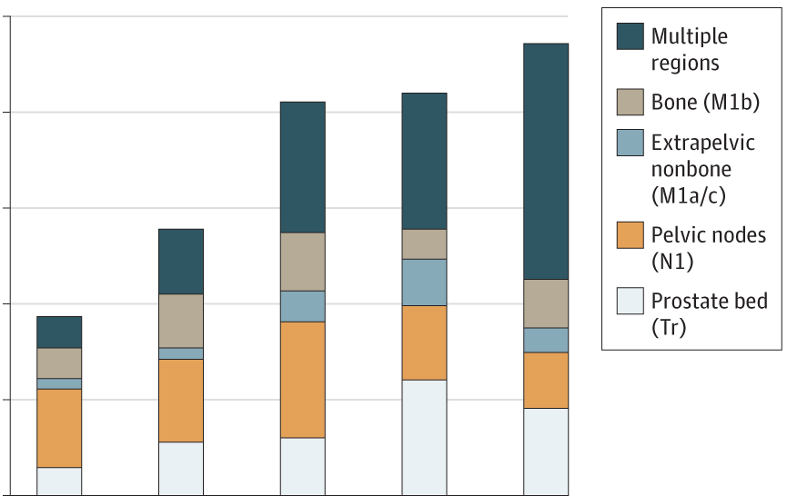
⁶⁸Ga-PSMA-11 PET Accuracy in Identifying Recurrent Prostate Cancer
Detection Rate on a Patient Basis Stratified by
PSA and Region¹
100
Multiple
regions
80
Bone M1b
About half of patients with BCR had management changes as a result of ⁶⁸Ga-PMSA PET²
The effect of management change on survival is not yet established
Extrapelvic nonbone (M1a/c)
60
Pelvic nodes (N1)
Proportion PSMA PET Positive %
40
Prostate bed (Tr)
20
0
< 0.5
< 0.5 to < 10
< 1.0 to < 2.0
2.0 to < 5.0
≥ 5.0
PSA Range, ng/mL
1. Fendler, et al. JAMA Oncol. 2019;5(6):856-863. 2. Fendler, et al. J Nucl Med. 2020;61(12):1793-1799.

Slide 17
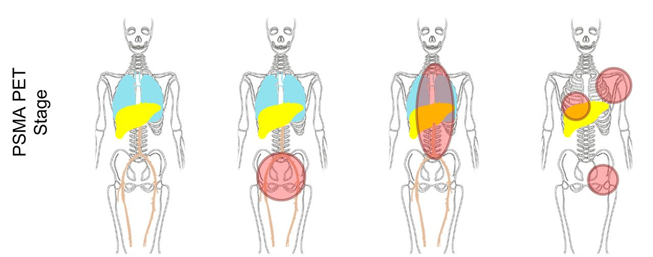
Advance Imaging Plays a Role in Guiding Treatment Decisions
Impact of ⁶⁸Ga-PSMA-11 PET on the Management of Recurrent Prostate Cancer
T0N0M0
TR/N1
M1a
M1b/c
PSMA PET Stage
Towards surveillance
Towards local
Towards systemic
Towards combination
6%
7%
Type of Major Change
PSMA PET = prostate-specific membrane antigen positron emission tomography Fendler, et al. J Nucl Med. 2020;61(12):1793-1799.

Slide 18
Genomic Profiling Complements Imaging
Decipher¹
22-gene signature
Genomic testing changed treatment recommendation for 39% of patients²
Decipher GRID incorporates Post-Operative Radiation Therapy Outcomes Score (PORTOS)³
24-gene signature
Histology (PAM50 classifier) is associated with response to ADT
 | Incidence | 10-yr bRFS | DMFS | PCSS | OS
Luminal A | 33% | 41% | 73% | 89% | 82%
Luminal B | 33% | 29% | 53% | 78% | 69%
Basal | 34% | 39% | 73% | 86% | 80%
bRFS = biochemical recurrence-free survival; DMFS = distant metastasis-free survival; PCSS = prostate cancer-specific survival; OS = overall survival
1. Knudsen, et al. J Mol Diagn. 2016;18(3):395-406. 2. Marascio, et al. Prostate Cancer Prostatic Dis. 2020;23(2):295-302. 3. Zhao, et al. Lancet Oncol. 2016;17(11):1612-1620. 4. Zhao, et al. JAMA Oncol. 2017;3(12):1663-1672.

Slide 19
SMART Goals
Specific, Measurable, Attainable, Relevant, Timely
Incorporate risk assessment algorithms into routine use
Utilize advanced imaging to detect site and extent of disease at BCR to guide treatment choice
Consider use of genomic profiling to assess risk and guide treatment
Consider adjuvant radiotherapy in men with adverse pathology after radical prostatectomy

Slide 20
To Receive Credit
To receive CME/CE credits for this activity, participants must complete the post-test and evaluation online.
Go to the Evaluations tab and click on the link to complete the process and print your certificate.

Slide 21
EPISODE 1
Disease States and Staging of CSPC
EPISODE 3
Management of Locally Advanced CSPC
EPISODE 4
Management of Patients with Metastatic CSPC
www.CMEOutfitters.com/

