Slide 1
EPISODE 1
Castration-Sensitive Prostate Cancer: Navigating the Current Diagnostic and Treatment Landscape
Disease States of CSPC
Supported by an educational grant from Astellas and Pfizer, Inc.
Notes:
AG

Slide 2
Cora N. Sternberg MD, FACP
Clinical Director, Englander Institute for Precision Medicine
Professor of Medicine
Sandra and Edward Meyer Cancer Center
Weill Cornell Medicine
New York, NY

Slide 3
Anthony E. Sisk, Jr., DO
Assistant Professor in Pathology
University of California, Los Angeles
Los Angeles, CA

Slide 4
Learning Objective
1
Outline the current state of pathologic characterization of CSPC.

Slide 5
Learning Objective
2
Interpret the findings of reports detailing the pathology of prostate cancer specimens.

Slide 6
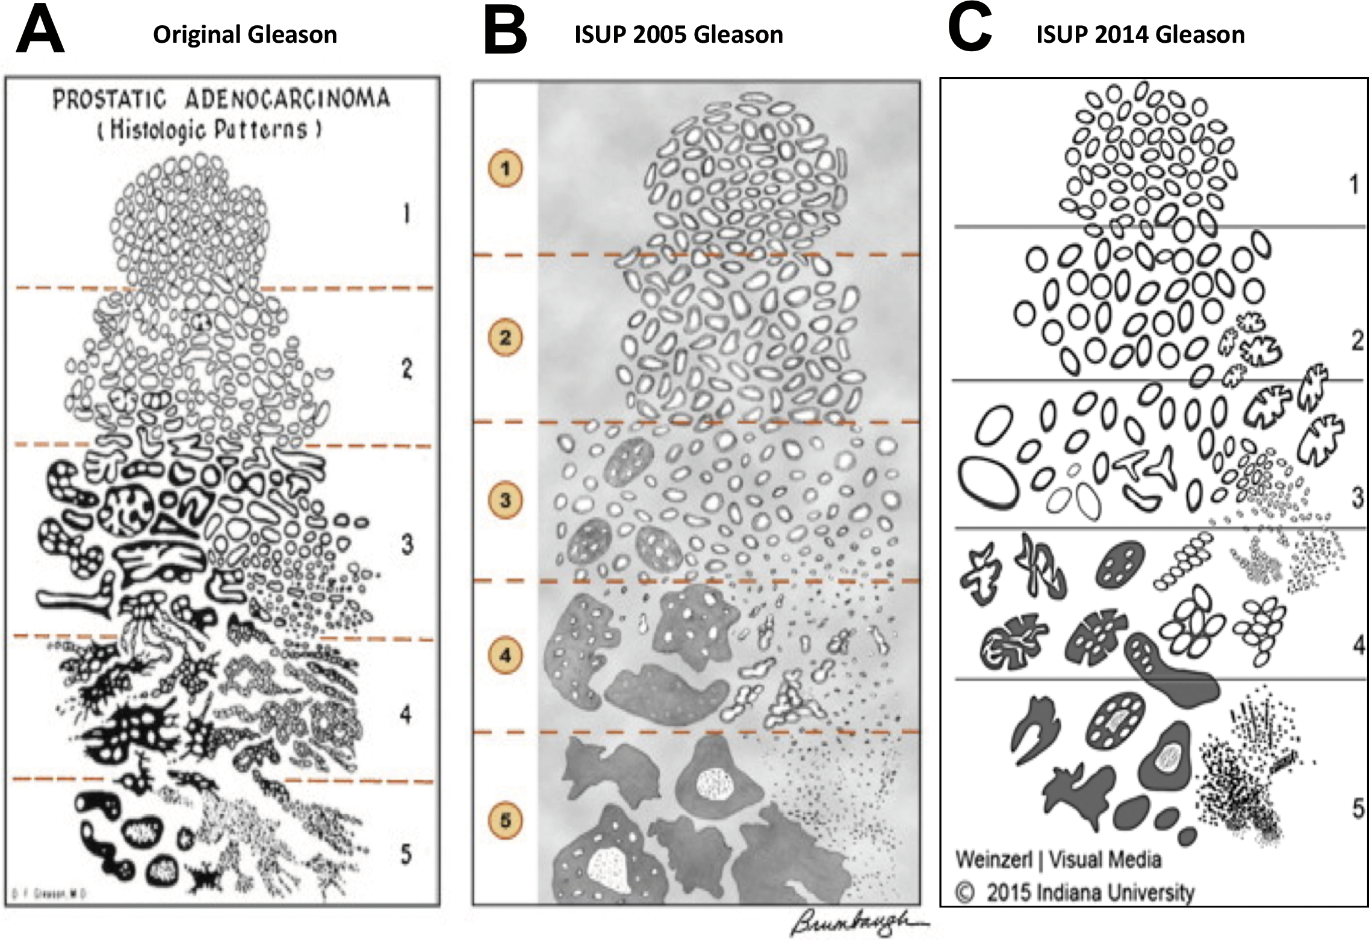
Evolution of Gleason Score
Original Gleason ISUP 2005 Gleason ISUP 2014 Gleason
Well differentiated
Prostatic Adenocarcinoma
(Histologic Patterns)
Small, uniform glands
1.
1.
1.
2.
More stroma between glands
2.
2.
Distinctly infiltrative margins
Moderately differentiated
3.
3.
3.
4.
Irregular masses of neoplastic glands
4.
4.
Poorly differentiated/ anaplastic
5.
5.
Only occasional gland formation
5.
Paner GP, et al. Arch Pathol Lab Med. 2019;143(5):550-564.

Slide 7
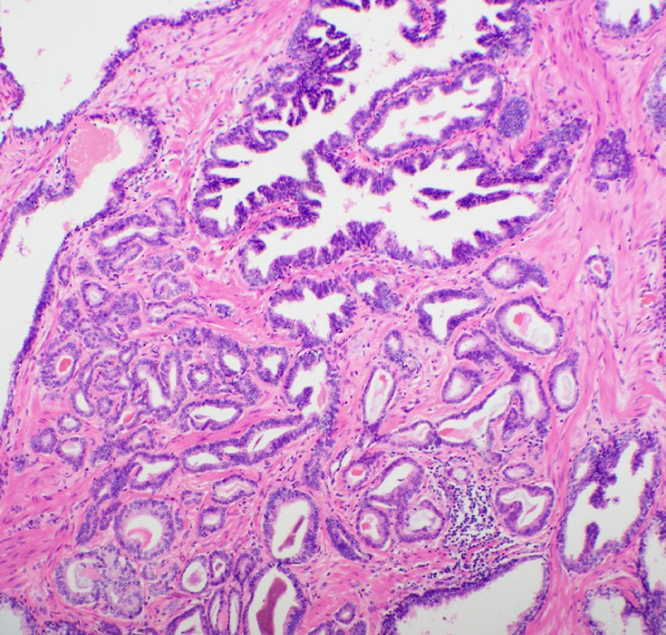
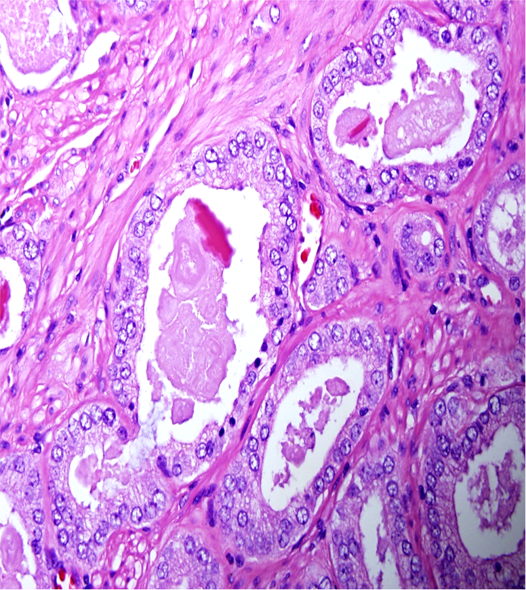
Gleason Pattern
3
4
4 (Aggressive)
5
5 (Comedonecrosis)
Poorly Formed Glands
Large Cribriform Glands (> 12 lumens)
Ductal Phenotype
Single Cells
Small Cribriform Glands

Slide 8
Histologic Definitions of Grade Groups (GGs)
Grade Group | Gleason Score | Definition
1 | 3 + 3 = 6 | Only individual, discrete, well-formed glands
2 | 3 + 4 = 7 | Predominantly well-formed glands with lesser component of poorly formed/fused/cribriform/glomeruloid glands
3 | 4 + 3 = 7 | Predominantly poorly formed/fused/cribriform/glomeruloid glands with lesser component of well-formed glandsª
4 | 4 + 4 3 + 5 =8 5 + 3 | Only poorly formed/fused/cribriform/glomeruloid glands or Predominantly well-formed glands and lesser component lacking glands^{b} or Predominantly lacking glands with lesser component of well-formed glands^{b}
5 | 4 + 5 5 + 4 9-10 5 + 5 | Lack of gland formation (or with necrosis) with or without poorly formed/fused/cribriform glandsª
a. For cases with > 95% poorly formed/fused/cribriform glands or lack of glands on a core or at radical prostatectomy, the component of < 5% well-formed glands is not factored into the grade. b. Poorly formed/fused/cribriform glands can be more a minor component.
Paner GP, et al. Arch Pathol Lab Med. 2019;143(5):550-564.

Slide 9
Grade Group Validation
Multi-institutional study (> 20,800 men) with prostate cancer radical prostatectomy specimens¹
Higher GG ranking is associated with increased risk of prostate cancer-specific mortality and bone metastasis²
SEER data from > 330,000 racially diverse patients with prostate cancer showed the GG system is predictive of prostate cancer-specific mortality regardless of therapy received and clinical stage at diagnosis.³
 | GG2 | GG3 | GG4 | GG5
Hazard ratio for BCR relative to GG1 | 1.9 | 5.1 | 8.0 | 11.7
BCR = biochemical recurrence 1. Epstein JI , et al. Eur Urol. 2016;69(3):428-435. 2. Leapman S, et al. Eur Urol. 2017;71(5):750-759. 3. He J, et al. Eur Urol. 2017;71(5):760-763.

Slide 10
5-Year BCR-free Progression Probabilities for Radical Prostatectomy
GG# 5-yr RFP
1.00
1 96%
2 88%
0.75
Prob. of Recurrence-free Progression (RFP)
3 63%
0.50
4 48%
0.25
5 26%
0.00
0
1
2
3
4
5
6
7
8
9
10
Years Since Surgery
Epstein JI, et al. Eur Urol. 2016;69(3):428-35.

Slide 11
Advantages and Limitations of Grading Groups
GG should be reported with GS [e.g., GS 3 + 4 = 7 (GG2)]
Baseline GG is 1, as opposed to 6 with GS
Patients may misperceive a GS 6 as an intermediate grade because the overall GS scale is 2 – 10
GGs now represent the most clinically relevant cutoffs important for prostate cancer management
Separation of 3 + 4 and 4 + 3 can be important for radiation therapy, and prognostically distinct GS 8 is separated from GS 9 and 10
GG lumps clinically similar 4 + 5, 5 + 4, and 5 + 5
GG4 (GS 3 + 5, 4 + 4, and 5 + 3) is highly heterogeneous and controversial group

Slide 12
Gleason Grade Reporting
One grade only
Primary and secondary grades are the same
Ex: 3 + 3 = 6 or 4 + 4 = 8
More than one grade
Gleason Score is the sum of the two Gleason Grades
Biopsy primary (dominant) and secondary (highest)
Ex: grades 3 (60%), 4 (35%), 5 (<5%): 3 + 5 = 8
Resection: primary, secondary, tertiary (< 5%)
However, tertiary grade 5 > 5% becomes secondary grade
Ex: grade 4 (60%), 3 (35%), 5 (< 5%): 4 + 3 = 7, with tertiary 5
Ex: grade 4 (60%), 3 (30%), 5 (10%): 4 + 5 = 9

Slide 13
Contemporary Gleason Grading
Recommends reporting pattern 4 percentage
3 + 4 mostly, but 4 + 3 also recommended
Not needed if another core is over score 8 or 9
Pattern 5 percentage is not necessary
Don’t need to report < 5% of a lower grade
Ex: 4 + 3 with a couple of grade 3 glands is best called 4 + 4
Epstein JI, et al. Am J Surg Pathol. 2017 Apr;41(4):e1-e7.

Slide 14
Reporting Changes and Controversies (ISUP 2019)¹⁻³
Minority advocate removing tertiary 4 and calling 3 + 4 even with < 5% grade 4
Most studies show no significant difference to 3+3
Tertiary 5 is significantly worse than 4+4
Targeted biopsy scoring
Most ISUP members favor global score and grading group based on tumor percentages for each lesion
But in general practice, most would likely disagree
ISUP = International Society of Urological Pathology
1. Epstein JI, Kryvenko ON. Eur Urol. 2021;79(1):3-5. 2. Smith SC, et al. Adv Anat Pathol. 2021;28(1):1-7. 3. van Leenders GJLH, et al. Am J Surg Pathol. 2020;44(8):e87-e99.

Slide 15
Reporting Changes and Controversies (cont.)¹⁻³
Recommended to include presence of large Cribriform glands (score 7 and 8) and IDC
Large cribriform glands have worse prognosis than poorly formed glands
2019 ISUP 83% agreement to include IDC into grading when invasive is also present
Report specific benign findings in PI-RADS 4-5
Stromal nodule, inflammation, adenosis, atrophy
IDC = intraductal carcinoma; PI-RADS = Prostate Imaging–Reporting and Data System
1. Epstein JI, Kryvenko ON. Eur Urol. 2021;79(1):3-5. 2. Smith SC, et al. Adv Anat Pathol. 2021;28(1):1-7. 3. van Leenders GJLH, et al. Am J Surg Pathol. 2020;44(8):e87-e99.

Slide 16
Skip Foci
Two well-separated foci (skip foci)
4 mm aggregate length with 20% involved (spanning 90% of core)
Misleading to claim 90% involved
Should establish in report
No standard method accepted
Tumor
Tumor

Slide 17
Reporting Suggestions
Multiple cores from same site
Multiple cores in same container
Multifocal tumors
Location, size, dominant nodule
Margins
On resections only, margins can be challenging
Can be as thin as a fibroblast nucleus
Need to see gland touching or cut in half at the ink/cautery

Slide 18
Neuroendocrine Tumors
Adenocarcinoma with Paneth cell-like neuroendocrine differentiation
Small cell neuroendocrine carcinoma

Slide 19
Intraductal Carcinoma
Basal Cells
Gleason 4 + 5 carcinoma
Basal Cells

Slide 20
Mucinous Carcinoma
Versus acinar with mucin

Slide 21
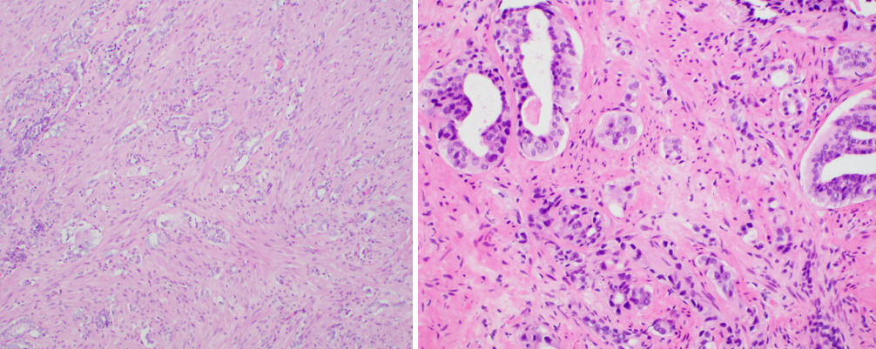
Pathology After ADT or Radiation Therapy
ADT Effect
Radiation Changes

Slide 22
SMART Goals
Specific, Measurable, Attainable, Relevant, Timely
Adenocarcinoma with some neuroendocrine features is different from neuroendocrine prostate cancer (NEPC), which carries a worse prognosis
IDC tends to have worse outcomes and is associated with high grade carcinoma; treatment should include immediate re-biopsy or definitive therapy
Large cribriform glands is an aggressive pattern 4 feature and should be included in the pathology report

Slide 23
EPISODE 2
Treatment Options and Clinical Dilemmas in Biochemical Recurrence
EPISODE 3
Management of Locally Advanced CSPC
EPISODE 4
Management of Patients with Metastatic CSPC
www.CMEOutfitters.com/

