Slide 1

THE COMPLETE RESPONSE
Addressing Antidepressant Selection for Patients with Major Depressive Disorder
Supported by an educational grant from Takeda Pharmaceuticals U.S.A, Inc. and Lundbeck
Notes:
Video located at: https://cmeoutfitters.imeetcentral.com/mm117mmq117/folder/WzIwLDEzODk4MTA1XQ/WzIsODE0MTk4ODVd/
0:00 Hello, I’m

Slide 2
CME Outfitters, LLC, is the accredited provider for this continuing education activity.
Notes:
0:25 [dead air]

Slide 3

In support of improving patient care,
CME Outfitters, LLC, is jointly accredited by the Accreditation Council for Continuing Medical Education (ACCME), the Accreditation Council for Pharmacy Education (ACPE), and the American Nurses Credentialing Center (ANCC), to provide continuing education for the healthcare team.
Notes:
0:27 CME Outfitters

Slide 4
Michael E. Thase, MD (Moderator)
Professor of Psychiatry
Department of Psychiatry
Perelman School of Medicine at the University of Pennsylvania
Corporal Michael J. Crescenz Veterans Affairs Medical Center
Philadelphia, PA
Notes:
0:37 As I mentioned

Slide 5
Karen Hyden, PhD, APN-BC, MSN, MEd, ACHPN
Area Vice President of Palliative Care, Amedisys, Inc.
Nashville, TN
Notes:
00:56 I’d like to also welcome

Slide 6
W. Clay Jackson, MD, DipTh
Clinical Assistant Professor
Family Medicine and Psychiatry
University of Tennessee College of Medicine
Memphis, TN
Notes:
1:21 Also joining

Slide 7
Incorporate MBC into primary care settings to identify suboptimal treatment responses with initial antidepressant therapy for MDD that can impede remission and functional recovery.
1
LEARNING
OBJECTIVE
Notes:
2:02 So let’s

Slide 8
Depression is Prevalent and Disabling
2017 past-year prevalence estimates for experiencing one or more major depressive episodes¹
  17.3 million adults in the US, or 7.1% of all US adults
  3.2 million adolescents aged 12 to 17 in the US, or
  13.3% of US adolescents
Adults and adolescents frequently
experience severe impairment¹
Depression is a leading cause of disability in
the US, second only to musculoskeletal disorders²
30%-70% of those who die by suicide
have a depressive disorder³
Adults
Adolescents
29%
36%
71%
64%
With severe impairment
Without severe impairment
1. NIMH. Major Depression. 2017. www.nimh.nih.gov/health/statistics/major-depression.shtml. Accessed September 27, 2021.;
2. GBD 2015 Disease and Injury Incidence and Prevalence Collaborators. Lancet. 2016;388:1545-602.;
3. Mental Health America. Suicide. www.mentalhealthamerica.net/suicide. Accessed September 27, 2021.
Notes:
2:29 I absolutely

Slide 9
Seek and Ye Shall Find
MDD “Prevalence” Increases With Careful, Prospective Assessment
40
New Zealand^{2,b}
35
30
25
Major Depression
Lifetime Prevalence, %
20
USA^{1,a}
15
10
5
0
Retrospective
Assessment
Prospective
Assessment
ªDoes not include Alaska and Hawaii.
^{b}Includes only the South Island.
1. Kessler RC, et al. JAMA. 2003;289:3095-105.; 2. Jaffee SR, et al. Arch Gen Psychiatry. 2002;59:215-22.
Notes:
3:20 You know

Slide 10
Who Do Patients See for Major Depressive Episodes?
Among adults aged 18 or older with a major depressive episode who received treatment in the past year: 2010
0
30
60
Percent among Adults with Major Depressive Episode (MDE) Who Received Treatment in the Past Year
Substance Abuse and Mental Health Services Administration, Results from the 2010 National Survey on Drug Use and Health:
Mental Health Findings, NSDUH Series H-42, HHS Publication No. (SMA) 11-4667. Rockville, MD: Substance Abuse and Mental Health
Services Administration, 2012. https://www.samhsa.gov/data/sites/default/files/2k10MH_Findings/2k10MH_Findings/2k10MHResults.htm#Fig2-7.
Accessed September 27, 2021.
Notes:
4:30 Not at all
https://www.samhsa.gov/data/sites/default/files/2k10MH_Findings/2k10MH_Findings/2k10MHResults.htm#Fig2-7
Fig 2.7. Type of Professional Seen among Adults Aged 18 or Older with a Major Depressive Episode Who Received Treatment in the Past Year: 2010

Slide 11

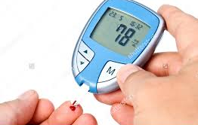
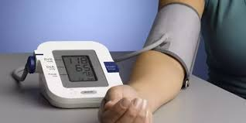
It’s Nice to Know Your Individual Patient’s Number!
Notes:
5:25 Yeah, and actually

Slide 12
Health Care Effectiveness Data and Information Set (HEDIS) Measures for Depression
Depression screening and follow-up for adolescents and adults (annual screening of all patients age ≥ 12, and if screened positive, who received follow-up care)
Utilization of the PHQ-9 to monitor depression symptoms for adolescents and adults (use of PHQ-9 to assess depression symptoms ≥ 1 every 4 months)
Depression remission or response for adolescents and adults (evidence of response or remission on PHQ-9 within 4 - 8 months of initial elevated PHQ-9 score)
National Committee for Quality Assurance (NCQA). HEDIS Depression Measures for Electronic Clinical Data. https://www.ncqa.org/hedis/
the-future-of-hedis/hedis-depression-measures-specified-for-electronic-clinical-data/. Accessed September 23, 2021.
Notes:
6:43 You know, I
Depression Screening and Follow-Up for Adolescents and Adults (DSF)
Adapted from a provider-level measure developed by Quality Insights of Pennsylvania (QIP) (NQF #0418, CMS2), first implemented in HEDIS 2018.
The percentage of members 12 years of age and older who were screened for clinical depression using a standardized tool and, if screened positive, who received follow-up care.
Denominator: All members ≥12 years of age.
Numerator: Screened for depression using a standardized tool and, if screened positive, received follow-up care within 30 days.
Utilization of the PHQ-9 to Monitor Depression Symptoms for Adolescents and Adults (DMS)
Adapted from a depression measure developed by Minnesota Community Measurement(NQF #0712), first implemented in HEDIS 2016.
The percentage of members 12 years of age and older with a diagnosis of depression, who had an outpatient encounter with a PHQ-9 score present in their record in the same assessment period as the encounter.
Denominator: All members ≥12 years of age who had an encounter during a 4-month period with a diagnosis of major depressive disorder or dysthymia.
Numerator: Documented results of a PHQ-9 tool that was administered at least once during the 4-month period.
Depression Remission or Response for Adolescents and Adults (DRR)
Adapted from depression measures developed by Minnesota Community Measurement (NQF #0711 and #1884), first implemented in HEDIS 2017.
The percentage of members 12 years of age and older with a diagnosis of depression and an elevated PHQ-9 score, who had evidence of response or remission within 4–8 months after the initial elevated PHQ-9 score.
Denominator: All members ≥12 years of age with a diagnosis of major depressive disorder or dysthymia who had an initial elevated PHQ-9 score of >9.
Numerator: A follow-up PHQ-9 score documented at 4–8 months after the initial elevated score; a PHQ-9 score <5 documented at 4–8 months following the initial elevated score; a ≥50% reduction in the PHQ-9 score documented at 4–8 months following the initial elevated score.

Slide 13
Essentials of Measurement-Based Care (MBC)
MBC consists of several simple components:
  Accurately assessing symptom severity
  Ensuring adequate antidepressant dosage
  Assessing medication tolerability
  Monitoring and promoting treatment adherence
  Ensuring treatment safety
Treatment can be monitored quickly and easily with empirically validated assessment tools
MBC has been shown to improve outcomes compared with
usual treatment
Morris DW, et al. Curr Psychiatry Rep. 2011;13:446-58.
Notes:
7:56 I’ve actually determined

Slide 14
Care That is Metrics-Based,
Algorithmic-Guided – and Better
Change in IDS-C₃₀ Scores From Baseline to 1 Year With Algorithm-Guided
Treatment vs Treatment as Usual, Categorized by Depression Severity
Limitations: Lack of randomization in this matched-clinic, prospective, observational study
Trivedi MH, et al. Arch Gen Psychiatry. 2004;61:669-680.
Notes:
8:34 You know I
Clinical results for patients with major depressive disorder in the Texas Medication Algorithm Project
Abstract
Context: The Texas Medication Algorithm Project is an evaluation of an algorithm-based disease management program for the treatment of the self-declared persistently and seriously mentally ill in the public mental health sector.
Objective: To present clinical outcomes for patients with major depressive disorder (MDD) during 12-month algorithm-guided treatment (ALGO) compared with treatment as usual (TAU).
Design: Effectiveness, intent-to-treat, prospective trial comparing patient outcomes in clinics offering ALGO with matched clinics offering TAU.
Setting: Four ALGO clinics, 6 TAU clinics, and 4 clinics that offer TAU to patients with MDD but provide ALGO for schizophrenia or bipolar disorder. Patients Male and female outpatients with a clinical diagnosis of MDD (psychotic or nonpsychotic) were divided into ALGO and TAU groups. The ALGO group included patients who required an antidepressant medication change or were starting antidepressant therapy. The TAU group initially met the same criteria, but because medication changes were made less frequently in the TAU group, patients were also recruited if their Brief Psychiatric Rating Scale total score was higher than the median for that clinic's routine quarterly evaluation of each patient.
Main outcome measures: Primary outcomes included (1) symptoms measured by the 30-item Inventory of Depressive Symptomatology-Clinician-Rated scale (IDS-C(30)) and (2) function measured by the Mental Health Summary score of the Medical Outcomes Study 12-item Short-Form Health Survey (SF-12) obtained every 3 months. A secondary outcome was the 30-item Inventory of Depressive Symptomatology-Self-Report scale (IDS-SR(30)).
Results: All patients improved during the study (P<.001), but ALGO patients had significantly greater symptom reduction on both the IDS-C(30) and IDS-SR(30) compared with TAU. ALGO was also associated with significantly greater improvement in the SF-12 mental health score (P =.046) than TAU.
Conclusion: The ALGO intervention package during 1 year was superior to TAU for patients with MDD based on clinician-rated and self-reported symptoms and overall mental functioning.

Slide 15
Assessment Tools for Depression
Beck Depression Inventory (BDI)¹
  21-question self-report inventory
  Remission: < 9
Hamilton Rating Scale for Depression (HAMD)²
  17 or 21-item scale given by health care professionals
  Remission: HAMD17 < 7
Patient Health Questionnaire (PHQ-9)³
  9-item scale based; patient administered
  Remission: < 4
Quick Inventory of Depressive Symptoms-Self Report (QIDS-SR) or Clinician Administered
(QIDS-C)²
  16-item scale
  Remission: < 5
Montgomery-Asberg Depression Rating Scale (MADRS)²
  10-item scale
  Remission: < 10
1. Beck AT, et al. Arch Gen Psychiatry. 1961;4:561-571; 2. Trivedi MH. Prim Care Companion J Clin Psychiatry. 2004;6(Suppl 1):12-16;
3. Kroenke K, et al. J Gen Intern Med. 2001;16:606-613.
Notes:
9:40 Now there are

Slide 16

Barbara: Visit 1
47-year-old African American female; hypothyroidism; obesity
Diagnosed with MDD after husband contracted COVID and became disabled from work
Complains of tearfulness, anxiety, reduced appetite, and lassitude: “My get up and go has just got up and gone”
Assessment scores:
  Mood Disorders Questionnaire (MDQ) is negative
  Generalized Anxiety Disorder Assessment (GAD-7) = 8
  Patient Health Questionnaire (PHQ-9) = 16 (item 9 score of 1)
Notes:
10:07 [after he says… case of Barbara]

Slide 17
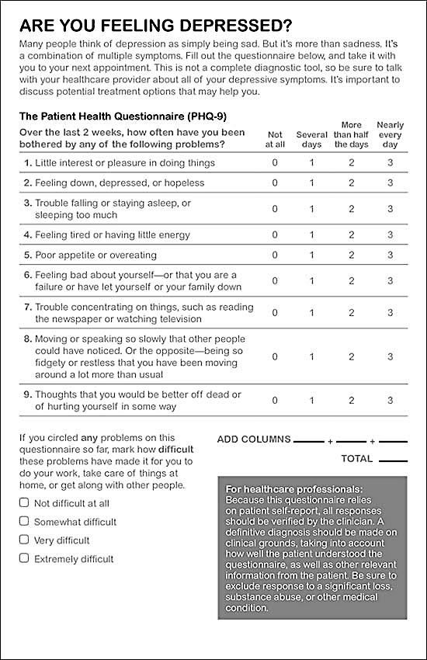
Barbara’s PHQ-9 Score: Visit 1
Notes:
10:14 We are seeing

Slide 18
Audience Response
Given that Barbara has a PHQ-9 score of 16, how would you characterize her depression severity?
Mild
Moderate
Moderate-to-severe
Severe
Notes:
10:48 [After she says … depression severity]
Correct answer: C

Slide 19
Given that Barbara has a PHQ-9 score of 16, how would you characterize her depression severity?
Results recorded on September 29, 2021.
N = xx
Notes:
10:49 Ok, so this is

Slide 20
PHQ-9 Designed to Help Primary Care Clinicians Diagnose Depression and Grade Symptom Severity
9 items
0 to 3 on each item
Max score of 27
Kroenke K, et al. J Gen Intern Med. 2001; 16(9):606-613.;
Kroenke K, et al. Psychiatr Ann. 2002; 32(9):509-515.
Notes:
11:39 You know

Slide 21
PHQ-9: Interpreting the Total Score
Total PHQ-9 Score | Depression Severity
1 - 4 | Minimal
5 - 9 | Mild
10 - 14 | Moderate
15 - 19 | Moderate-Severe
20 - 27 | Severe
Scoring the PHQ-9
Not at all | (#) ___ x 0 | =
Several days | (#) ___ x 1 | =
More than half the days | (#) ___ x 2 | =
Nearly every day | (#) ___ x 3 | =
TOTAL SCORE |  | ___
Kroenke K, et al. J Gen Intern Med. 2001;16(9):606-613.
Notes:
13:12 Think of it

Slide 22
Impact of Integrating Depression Care Management with Management for Chronic Medical Conditions
p < .001
p < .001
p = .006
p = .08
Patient With Medication
Adjustments, %
p = .07
Katon WJ, et al. N Engl J Med. 2010; 363(27):2611-2620.
Notes:
14:20 You know we
A component of MBC is addressing procedural problems, such as adjusting medication doses. Integrating depression care management with care management of other chronic conditions has made treatment adjustment in primary care settings easier and more effective. There is a marked increase in the number of medications and management steps, so technology, integration, measurement, communication, and guidance should all work together to determine the best next step for patients.
Katon WJ, et al. Collaborative care for patients with depression and chronic illnesses. N Engl J Med. 2010 Dec 30; 363(27):2611-2620.

Slide 23
Sample Strategy to Incorporate MBC into Your Clinical Practice
Step 1: Identify target condition(s)
Step 2: Identify best measures validated for your clinical setting
Step 3: Create methods to improve ease of administration of instruments and data extraction
Step 4: Establish and implement standard operating procedure for screening and MBC
Step 5: Engage in continuous quality improvement processes to evaluate implementation
Notes:
16:09 Well you know

Slide 24
Evaluate the impact of antidepressants with unique MOAs on safety, efficacy, and tolerability relative to traditional antidepressants.
2
LEARNING
OBJECTIVE
Notes:
17:34 So Karen, why don’t

Slide 25
Principles of MDD Treatment
Remission and functional recovery are the goals – patients tell us that they value quality of life more than symptom reduction
Measurement based care points the way to remission
Many established therapies to pick from
Patient preference often determines entry point and is important for both adherence and likelihood of benefit
Safer, less expensive proven treatments often used first
Subsequent interventions tend toward greater complexity and higher side effect burden
Notes:
17:48 Sure, well first of all

Slide 26
Treating Depression in the “Real World”
Remission and recovery, not response, are the goals
Should first treatment fail to produce desired outcome, either switching or adjunctive strategies are reasonable
For many patients, sequential trials of “sustained, vigorously dosed” antidepressant medications are necessary for remission
Likelihood of remission progressively decreases after 2 adequate treatment trials, suggesting need to maximize/optimize efforts during the first few months of therapy
Gaynes B, et al. Cleve Clin J Med. 2008;75(1):57-66.
Notes:
18:01 So we want them

Slide 27
Is Barbara Doing Better?
Visit 2 (week 3)
  Started on sertraline 50 mg po qd; titrated to 100 mg
  po qd at 3 weeks
  Mild nausea and some delayed sexual response; otherwise, tolerates medication ok
  PHQ-9 = 14
Visit 3 (week 5)
  Returns for visit 3 after 2 weeks on 100 mg dose and says, “I’m maybe a little better, but just not myself”
  PHQ-9 = 11
Notes:
18:56 So we started her

Slide 28
Audience Response Question
What is the ideal next step for Barbara?
Increase the dosage of her sertraline
Augment her sertraline with a tricyclic antidepressant (TCA) such as amitriptyline
Switch her to a selective serotonin-norepinephrine reuptake inhibitor (SNRI) like levomilnacipran
Switch her to an agent with mixed serotonergic effects like vilazodone or vortioxetine
Refer her to a psychiatrist
Notes:
20:30 [After he says… step for Barbara]
*cut 20:31 – 21:00 [reading of answer options]

Slide 29
What is the ideal next step for Barbara?
Results recorded on September 29, 2021.
N = xx
Notes:
21:01 The majority

Slide 30
Management Strategies for MDD
Pharmacotherapy¹ | Psychotherapy^{2,3} | Other Nonpharmacologic Treatments^{1,2,4}
Antidepressants | Cognitive behavioral therapy (CBT) | Exercise/lifestyle
Adjunctive strategies (e.g., lithium, T3,ª atypicals) | Interpersonal therapy | Electroconvulsive therapy
Novel therapies (e.g., intranasal esketamine or IV ketamineª) | Mindfulness-based cognitive therapy (MBCT) | Bright White Light (phototherapy)
 |  | Vagus nerve stimulation
 |  | Repetitive transcranial magnetic stimulation
T3 = triiodothyronine.
ªT3 and IV ketamine are not FDA-approved for the management of MDD.
1. VandenBerg AM, et al. Major depressive disorder. In: Pharmacotherapy: A Pathophysiologic Approach. 11th ed. 2020. https://accesspharmacy.mhmedical.com/book.aspx?bookID=2577#219306023. Accessed September 27, 2021.
2. Loosen PT, et al. In: Ebert MH, et al, eds. Current Diagnosis & Treatment: Psychiatry. 2nd ed. 2008.;
3. MacKenzie MB, et al. Neuropsychiatr Dis Treat. 2018;14:1599-605.; 4. Golden RN, et al. Am J Psychiatry. 2005;162:656-62.
Notes:
22:38 You know we

Slide 31
Commonly Used Antidepressants
Drug Class and Representative Agents | Select Safety and Efficacy Information for the Class
Selective serotonin reuptake inhibitors (SSRIs)
Citalopram, escitalopram, fluoxetine, fluvoxamine, paroxetine, sertraline | Comparable efficacy to other classes Side effects include GI symptoms, anxiety, headache, somnolence, insomnia, and sexual dysfunction
Serotonin-norepinephrine reuptake inhibitors (SNRIs)
Desvenlafaxine, duloxetine, venlafaxine, levomilnacipran | May have modestly greater efficacy than SSRIs Safety similar to SSRIs (nausea, sexual dysfunction, activation) but also increased sweating, hypertension
Tricyclic antidepressants (TCAs)
Amitriptyline, desipramine, doxepin, imipramine, nortriptyline | Comparable efficacy to SSRIs but with known side effects, such as anticholinergic effects, sedation, weight gain, sexual dysfunction, and orthostatic hypotension
Monoamine oxidase inhibitors (MAOI)
Phenelzine, selegilineª tranylcypromine, isocarboxazid | More effective than TCAs for atypical symptoms of depression Side effects include orthostatic hypotension, weight gain, and sexual side effects
VandenBerg AM, et al. Major depressive disorder. In: Pharmacotherapy: A Pathophysiologic Approach. 11th ed. 2020. https://accesspharmacy.mhmedical.com/book.aspx?bookID=2577#219306023. Accessed September 27, 2021.
Anderson IM, et al. J Psychopharmacol. 2008;22:343-396.; Gelenberg AJ, et al. Practice Guideline for the Treatment of Patients with Major Depressive Disorder (3rd edition).
American Psychiatric Association. 2010. https://psychiatryonline.org/pb/assets/raw/sitewide/practice_guidelines/guidelines/mdd.pdf.
Accessed Septermber 27, 2021
Notes:
25:29 I think your
Andersom IM, et al. Evidence-based guidelines for treating depressive disorders with antidepressants: a revision of the 2000 British Association for Psychopharmacology guidelines. J Psychopharmacol. 2008 Jun;22(4):343-96.
A revision of the 2000 British Association for Psychopharmacology evidence-based guidelines for treating depressive disorders with antidepressants was undertaken to incorporate new evidence and to update the recommendations where appropriate. A consensus meeting involving experts in depressive disorders and their management was held in May 2006. Key areas in treating depression were reviewed, and the strength of evidence and clinical implications were considered. The guidelines were drawn up after extensive feedback from participants and interested parties. A literature review is provided, which identifies the quality of evidence to inform the recommendations, the strength of which are based on the level of evidence. These guidelines cover the nature and detection of depressive disorders, acute treatment with antidepressant drugs, choice of drug versus alternative treatment, practical issues in prescribing and management, next-step treatment, relapse prevention, treatment of relapse, and stopping treatment
Gelenberg AJ, et al. PRACTICE GUIDELINE FOR THE Treatment of Patients With Major Depressive Disorder Third Edition.

Slide 32
Limitations of Conventional Antidepressants
Limited efficacy even as first line therapies
  50%-60% intention-to-treat response rates
  Modest (~10%-20%) advantage vs placebo
Intolerable side effects for up to 10%
Inconsistent effects on key symptoms
(e.g., insomnia, anxiety, cognition)
Relatively slow onset of action tied to mechanism(s) of action
Trivedi MH, et al. Am J Psychiatry. 2006;163(1):28-40.; Rush AJ, et al. Am J Psychiatry. 2006;163(11):1905-1917.;
Park LT, et al. N Engl J Med. 2019;380:559-568.
Notes:
27:21 Well for me

Slide 33
Commonly Used Antidepressants with Unique Mechanisms of Action
Drug Class and Representative Agents |  | Select Safety and Efficacy Information for the Class
Norepinephrine and dopamine reuptake inhibitor (NDRI)
Bupropion | One of the most activating antidepressants; may be useful for decreased motivation, low energy, and fatigue Side effects include nausea, vomiting, tremor, insomnia, and dry mouth | One of the most activating antidepressants; may be useful for decreased motivation, low energy, and fatigue Side effects include nausea, vomiting, tremor, insomnia, and dry mouth
Mixed serotonergic effects (Mixed 5-HT)
Vilazodone Vortioxetine | SSRI and 5-HT1A partial agonists Vortioxetine is also a 5-HT3, 5-HT1D, and 5-HT7 antagonist, 5-HT1B partial agonist, and 5-HT transporter inhibitor; may have fewer cognitive side effects than other agents Efficacious and well-tolerated in older patients Side effects similar to those of SSRIs | SSRI and 5-HT1A partial agonists Vortioxetine is also a 5-HT3, 5-HT1D, and 5-HT7 antagonist, 5-HT1B partial agonist, and 5-HT transporter inhibitor; may have fewer cognitive side effects than other agents Efficacious and well-tolerated in older patients Side effects similar to those of SSRIs
Noradrenergic and specific serotonergic antidepressant (NaSSA)
Mirtazapine | Alpha2, histamine H1, and 5-HT2A, 5-HT2C, and 5-HT3 antagonist No monoamine reuptake inhibitor As effective as SSRIs and SNRIs, with earlier onset of action Side effects include increased appetite, weight gain dry mouth, constipation, somnolence, and dizziness | Alpha2, histamine H1, and 5-HT2A, 5-HT2C, and 5-HT3 antagonist No monoamine reuptake inhibitor As effective as SSRIs and SNRIs, with earlier onset of action Side effects include increased appetite, weight gain dry mouth, constipation, somnolence, and dizziness
Danielak D. Expert Opin Pharmacother. 2021;22(9):1167-1177.; VandenBerg AM, et al. Major depressive disorder. In: Pharmacotherapy: A Pathophysiologic Approach. 11th ed. 2020. https://accesspharmacy.mhmedical.com/book.aspx?bookID=2577#219306023. Accessed September 27, 2021; Drugs@FDA.gov.; Nomikos GC, et al. CNS Spectrums. 2017;22:348–362.
Notes:
28:54 And two of our
Vilazodone is 5-HT_{1A} partial agonist, SERT inhibitor
Chapter 85: Major Depressive Disorder
Nomikos GC, et al. Efficacy, safety, and tolerability of vortioxetine for the treatment of major depressive disorder in patients aged 55 years or older. CNS Spectrums (2017), 22, 348–362.
Objective. These post hoc analyses evaluate the efficacy, safety, and tolerability of vortioxetine versus placebo in patients aged ≥55 years with major depressive disorder (MDD). Methods. Study-level efficacy data from 12 short-term, fixed-dose, randomized, placebo-controlled trials of vortioxetine 5–20 mg/day were assessed using a random-effects meta-analysis. Adverse events (AEs), vital signs, ECG values, liver enzymes, and body weight were pooled from the same studies. Patients had baseline Montgomery–Åsberg Depression Rating Scale (MADRS) total scores ranging from 22–30. Results. 1508 patients (mean age = 62.4 years; range, 55–88 years) were included. Mean differences from placebo in change from baseline to study end (6/8 weeks) in MADRS were –2.56 (5 mg, n = 324, P = 0.035), –2.87 (10 mg, n = 222, P = 0.007), –1.32 (15 mg, n = 90, P = NS), and –4.65 (20 mg, n = 165, P = 0.012). Odds ratios for response versus placebo were 1.6 (5 mg, P = NS), 1.8 (10 mg, P = 0.002), 1.2 (15 mg, P = NS), and 2.5 (20 mg, P < 0.001), and for remission versus placebo were 1.5 (5 mg, P = NS), 1.5 (10 mg, P = NS), 1.4 (15 mg, P = NS), and 2.7 (20 mg, P = 0.001). The proportion of patients with AEs for placebo and vortioxetine 5–20 mg was 61.5% and 62.3%, respectively, with no increase at increased doses. Vortioxetine demonstrated a placebo-level incidence of serious AEs (1.2%). AEs occurring in ≥5% of any treatment group were nausea, headache, diarrhea, dizziness, dry mouth, constipation, fatigue, vomiting, and anxiety. No clinically significant mean changes in vital signs, ECG values, liver enzymes, or body weight emerged during treatment. Conclusion. Vortioxetine 5–20 mg/day is efficacious and well tolerated in MDD patients aged ≥55 years, a group that is often comorbid with other conditions and treated with other medications.

Slide 34
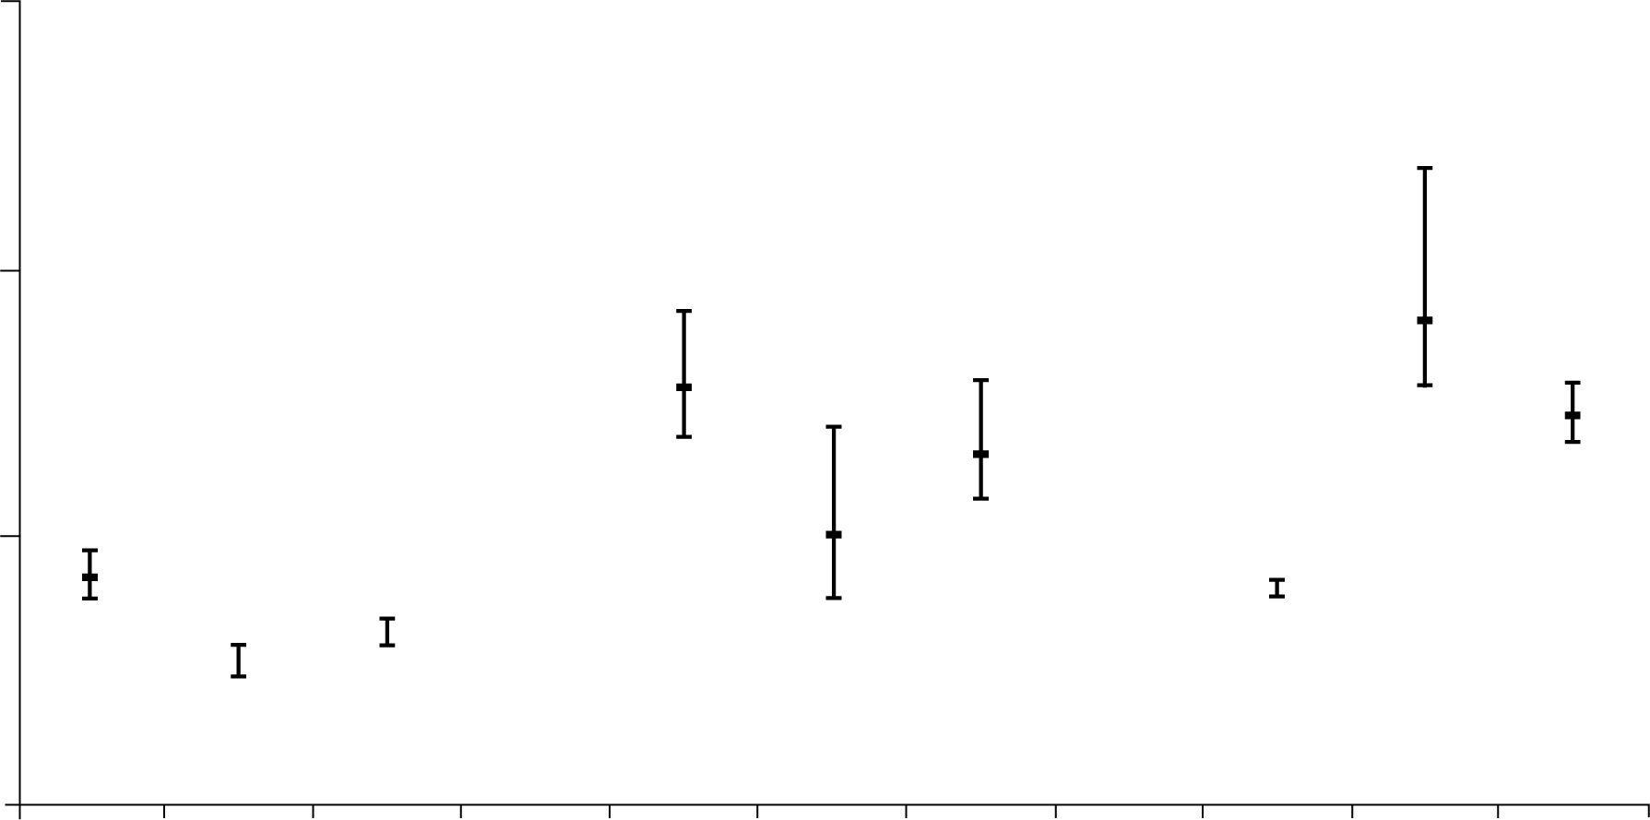
Relative Efficacy/Safety of Vortioxetine
1000
100
64
Number needed to treat or harm vs. Placebo
36
28
20
10
10
7
6
4
3
1
Vortioxetine
response
Venlafaxine
response
Duloxetine
response
Vortioxetine
D/C AE
Venlafaxine
D/C AE
Duloxetine
D/C AE
Nausea
Constipation
Vomiting
Efficacy - NNT
Tolerability - NNH
D/C = discontinuation
Citrome L. Int J Clin Pract. 2014 Jan;68(1):60-82.
Notes:
29:28 I have a slide
Vortioxetine for major depressive disorder: a systematic review of the efficacy and safety profile for this newly approved antidepressant - what is the number needed to treat, number needed to harm and likelihood to be helped or harmed?
Abstract
Objective: To describe the efficacy and safety of vortioxetine for the treatment of major depressive disorder (MDD).
Data sources: The pivotal registration trials were accessed by querying http://www.ncbi.nlm.nih.gov/pubmed/, http://www.clinicaltrialsregister.eu and http://www.clinicaltrials.gov for the search terms 'vortioxetine' and 'Lu AA21004', and by obtaining posters presented at congresses. Product labelling provided additional information.
Study selection: All available clinical reports of studies were identified.
Data extraction: Descriptions of the principal results and calculation of number needed to treat (NNT) and number needed to harm (NNH) for relevant dichotomous outcomes were extracted from the available study reports and other sources of information.
Data synthesis: Vortioxetine is a multi-modal antidepressant that functions as a human 5-HT3A and 5-HT7 receptor antagonist, 5-HT1B receptor partial agonist, 5-HT1A receptor agonist, and inhibitor of the serotonin transporter. The recommended dose range is 5-20 mg/day. Approval for the treatment of MDD was based on a clinical development programme that included six positive 6-8 week studies, including one study in elderly people, and one positive maintenance study in adults. In the informative short-term studies in non-elderly patients, NNT for response with vortioxetine vs. placebo was 7 (95% CI 6-9), and NNT for remission vs. placebo was 11 (95% CI 8-17). NNH for discontinuation because of an adverse event (AE) was 36 (95% CI 24-70). The most commonly encountered AEs (incidence ≥ 5% and at least twice the rate of placebo) as identified in product labelling were nausea, constipation and vomiting, with NNH values vs. placebo of 6 (95% CI 6-7), 64 (95% CI 37-240), and 28 (95% CI 23-38), respectively. Changes in weight were not clinically relevant.
Conclusions: Vortioxetine represents another option for the treatment of MDD. Vortioxetine appears to have a favourable weight-gain profile. Additional information regarding the time course of response/remission and for the commonly occurring AE of nausea would be helpful to better characterise this agent. Pending clinical trials include those examining cognitive dysfunction that can accompany MDD.

Slide 35
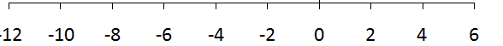
Vortioxetine: Linear Dose-Response Relationship
Meta-analysis of the results of 11* short-term studies show:
The superiority of vortioxetine compared with placebo at doses of 5, 10 and 20 mg
A dose–response across the therapeutic range of 5 to 20 mg/day vortioxetine
Change from baseline in MADRS total score at Week 6/8 (FAS, MMRM)¹
Study | Vortioxetine dose
Meta-analysis | 5 mg
 | 10 mg
 | 15 mg
 | 20 mg
Meta-analysis (non-US) | 5 mg
 | 10 mg
 | 15 mg
 | 20 mg
The dashed line indicates the target of a 2 point difference to placebo
Difference to placebo
← Better than placebo
Worse than placebo →
*HLu 12541A in elderly patients (≥ 65 y)² not included
FAS = Full-analysis set; MADRS = Montgomery–Åsberg Depression Rating Scale scores; MMRM = Mixed model for repeated measurements
Thase ME et al. Eur Neuropsychopharmacol. 2016;26 (6):979-993.; Katona C et al. Int Clin Psychopharmacol 2012;27:215–223.
Notes:
29:55 Now with respect
Thase ME et al. A meta-analysis of randomized, placebo-controlled trials of vortioxetine for the treatment of major depressive disorder in adults. Eur Neuropsychopharmaco
The efficacy and safety of vortioxetine, an antidepressant approved for the treatment of adults with major depressive disorder (MDD), was studied in 11 randomized, double-blind, placebo-controlled trials of 6/8 weeks׳ treatment duration. An aggregated study-level meta-analysis was conducted to estimate the magnitude and dose-relationship of the clinical effect of approved doses of vortioxetine (5-20mg/day). The primary outcome measure was change from baseline to endpoint in Montgomery-Åsberg Depression Rating Scale (MADRS) total score. Differences from placebo were analyzed using mixed model for repeated measurements (MMRM) analysis, with a sensitivity analysis also conducted using last observation carried forward. Secondary outcomes included MADRS single-item scores, response rate (≥50% reduction in baseline MADRS), remission rate (MADRS ≤10), and Clinical Global Impressions scores. Across the 11 studies, 1824 patients were treated with placebo and 3304 with vortioxetine (5mg/day: n=1001; 10mg/day: n=1042; 15mg/day: n=449; 20mg/day: n=812). The MMRM meta-analysis demonstrated that vortioxetine 5, 10, and 20mg/day were associated with significant reductions in MADRS total score (Δ-2.27, Δ-3.57, and Δ-4.57, respectively; p<0.01) versus placebo. The effects of 15mg/day (Δ-2.60; p=0.105) were not significantly different from placebo. Vortioxetine 10 and 20mg/day were associated with significant reductions in 9 of 10 MADRS single-item scores. Vortioxetine treatment was also associated with significantly higher rates of response and remission and with significant improvements in other depression-related scores versus placebo. This meta-analysis of vortioxetine (5-20mg/day) in adults with MDD supports the efficacy demonstrated in the individual studies, with treatment effect increasing with dose.l. 2016;26 (6):979-993.;
Katona C et al. Int Clin Psychopharmacol 2012;27:215–223
The efficacy and tolerability of Lu AA21004 at 5 mg/day, a novel multimodal antidepressant, were assessed in elderly patients with recurrent major depressive disorder. Patients were randomly assigned (1:1:1) to Lu AA21004 5 mg/day, duloxetine 60 mg/day (reference) or to placebo in an 8-week double-blind study. The primary efficacy measure was the 24-item Hamilton Depression Scale (HAM-D(24)) total score (analysis of covariance, last observation carried forward). Patients (mean age 70.6 years) had a mean baseline HAM-D(24) score of 29.0. Lu AA21004 showed significantly (P = 0.0011) greater improvement on the primary efficacy endpoint compared with placebo at week 8 (3.3 points). Duloxetine also showed superiority to placebo at week 8, thereby validating the study. HAM-D(24) response (53.2 vs. 35.2%) and HAM-D(17) remission (29.2 vs. 19.3%) rates at endpoint were higher for Lu AA21004 than for placebo. Lu AA21004 showed superiority to placebo in cognition tests of speed of processing, verbal learning and memory. The withdrawal rate due to adverse events was 5.8% (Lu AA21004), 9.9% (duloxetine) and 2.8% (placebo). Whereas nausea was the only adverse event with a significantly higher incidence on treatment with Lu AA21004 (21.8%) compared with placebo (8.3%), the incidence of nausea, constipation, dry mouth, hyperhidrosis and somnolence was higher for duloxetine. In conclusion, Lu AA21004 was efficacious and well tolerated in the treatment of elderly patients with recurrent major depressive disorder.

Slide 36
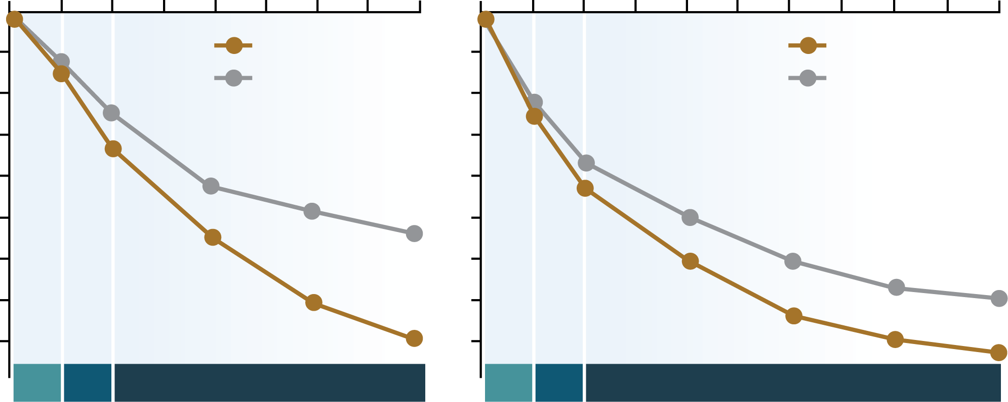
Vilazodone Efficacy Studies
Treatment Week¹
Treatment Week²
0
1
2
3
4
5
6
7
8
0
1
2
3
4
5
6
7
8
9
10
-2
Vilazodone (n = 253)
-2
Vilazodone (n = 284)
-4
Placebo (n = 252)
-4
Placebo (n = 281)
-6
-6
-8
-8
Improvement
LS Mean Change from Baseline
-10
-10
-12
-12
p < .01 vs placebo
p < .05 vs placebo
-14
p < .001 vs placebo
-14
p < .001 vs placebo
-16
p < .00001 vs placebo
-16
p < .01 vs placebo
10
Mg/d
20
Mg/d
40
Mg/d
Recommended dose
10
Mg/d
20
Mg/d
40
Mg/d
Recommended dose
Baseline scores: 30.7 for Vilazodone and 30.9 for placebo
Baseline scores: 31.2 for Vilazodone and 31.4 for placebo
1. Croft HA, et al. J Clin Psychiatry. 2014 Nov;75(11):e1291-1298.
2. Mathews M, et al. Int Clin Psychopharmacol. 2015;30(2):67-74.
Notes:
30:34 Vilazodone has

Slide 37
Rates of Switching by Antidepressant Class in MDD
 |  | Switched to SSRI (expected: 76.3%) |  |  | Switched to SNRI (expected: 7.6%) |  |  | Switched to tricyclics (expected: 2.0%) |  |  | Switched to others (expected: 14.1%)
Initial antidepressant classª | N | N | % | 99% CI | N | % | 99% CI | N | % | 99% CI | N | % | 99% CI | X^{2b} | p
Total | 4,617 | 2,943 | 63.7 | 61.9-65.5 | 671 | 14.5 | 13.3-15.9 | 59 | 1.3 | .9-18 | 944 | 20.4 | 19.0-22.0 | 535.5 | < 0.001
SSRI | 3,525 | 2,133 | 60.5 | 58.4-62.2 | 520 | 14.8 | 13.3-16.4 | 41 | 1.2 | .8-1.7 | 832 | 23.6 | 21.8-25.5 | 592.8 | < 0.001
SNRI | 350 | 235 | 67.1 | 60.4-73.3 | 17 | 4.9 | 2.6-8.8 | 8 | 2.3 | .9-5.6 | 90 | 25.7 | 20.2-32.3 | 41.1 | < 0.001
Tricyclic | 92 | 70 | 76.1 | 62.9-85.7 | 12 | 13.0 | 6.3-25.0 | 3 | 3.3 | .7-13.3 | 7 | 7.6 | 2.9-18.5 | 7.1 | .07
Other^{c} | 650 | 505 | 77.7 | 73.2-81.6 | 122 | 18.8 | 15.1-23.0 | 7 | 1.1 | .4-2.8 | 16 | 2.5 | 1.3-4.6 | 172.6 | < 0.001
a = Expected values within the class are based on distribution before antidepressant switch. The analysis excluded 267 patients who switched to more than one antidepressant. SSRI; b = df = 3; c = includes mirtazapine, bupropion, and trazodone.
Marcus SC, et al. Psychiatric Services. 2009;60:617–623.
Notes:
31:58 You know I

Slide 38
Meta-analysis Comparing within (2nd SSRI) vs. Across (Non-SSRI) Class Switches
(P < 0.05)
(P = 0.1)
Patients (%)
SSRI
Non-SSRI
*N = 1496; 4 RTCs.
Papakostas GI, et al. Biol Psychiatry. 2008;63:699-704.
Notes:
33:08 The next
Treatment of SSRI-resistant depression: a meta-analysis comparing within- versus across-class switches. Biol Psychiatry
. 2008 Apr 1;63(7):699-704.

Slide 39
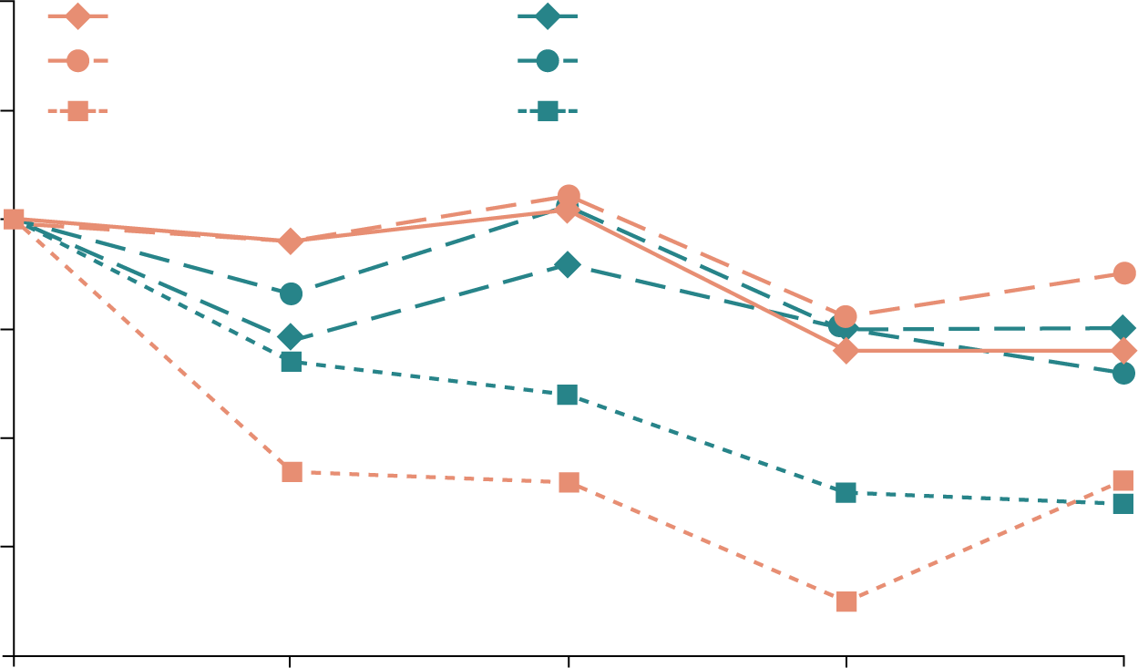
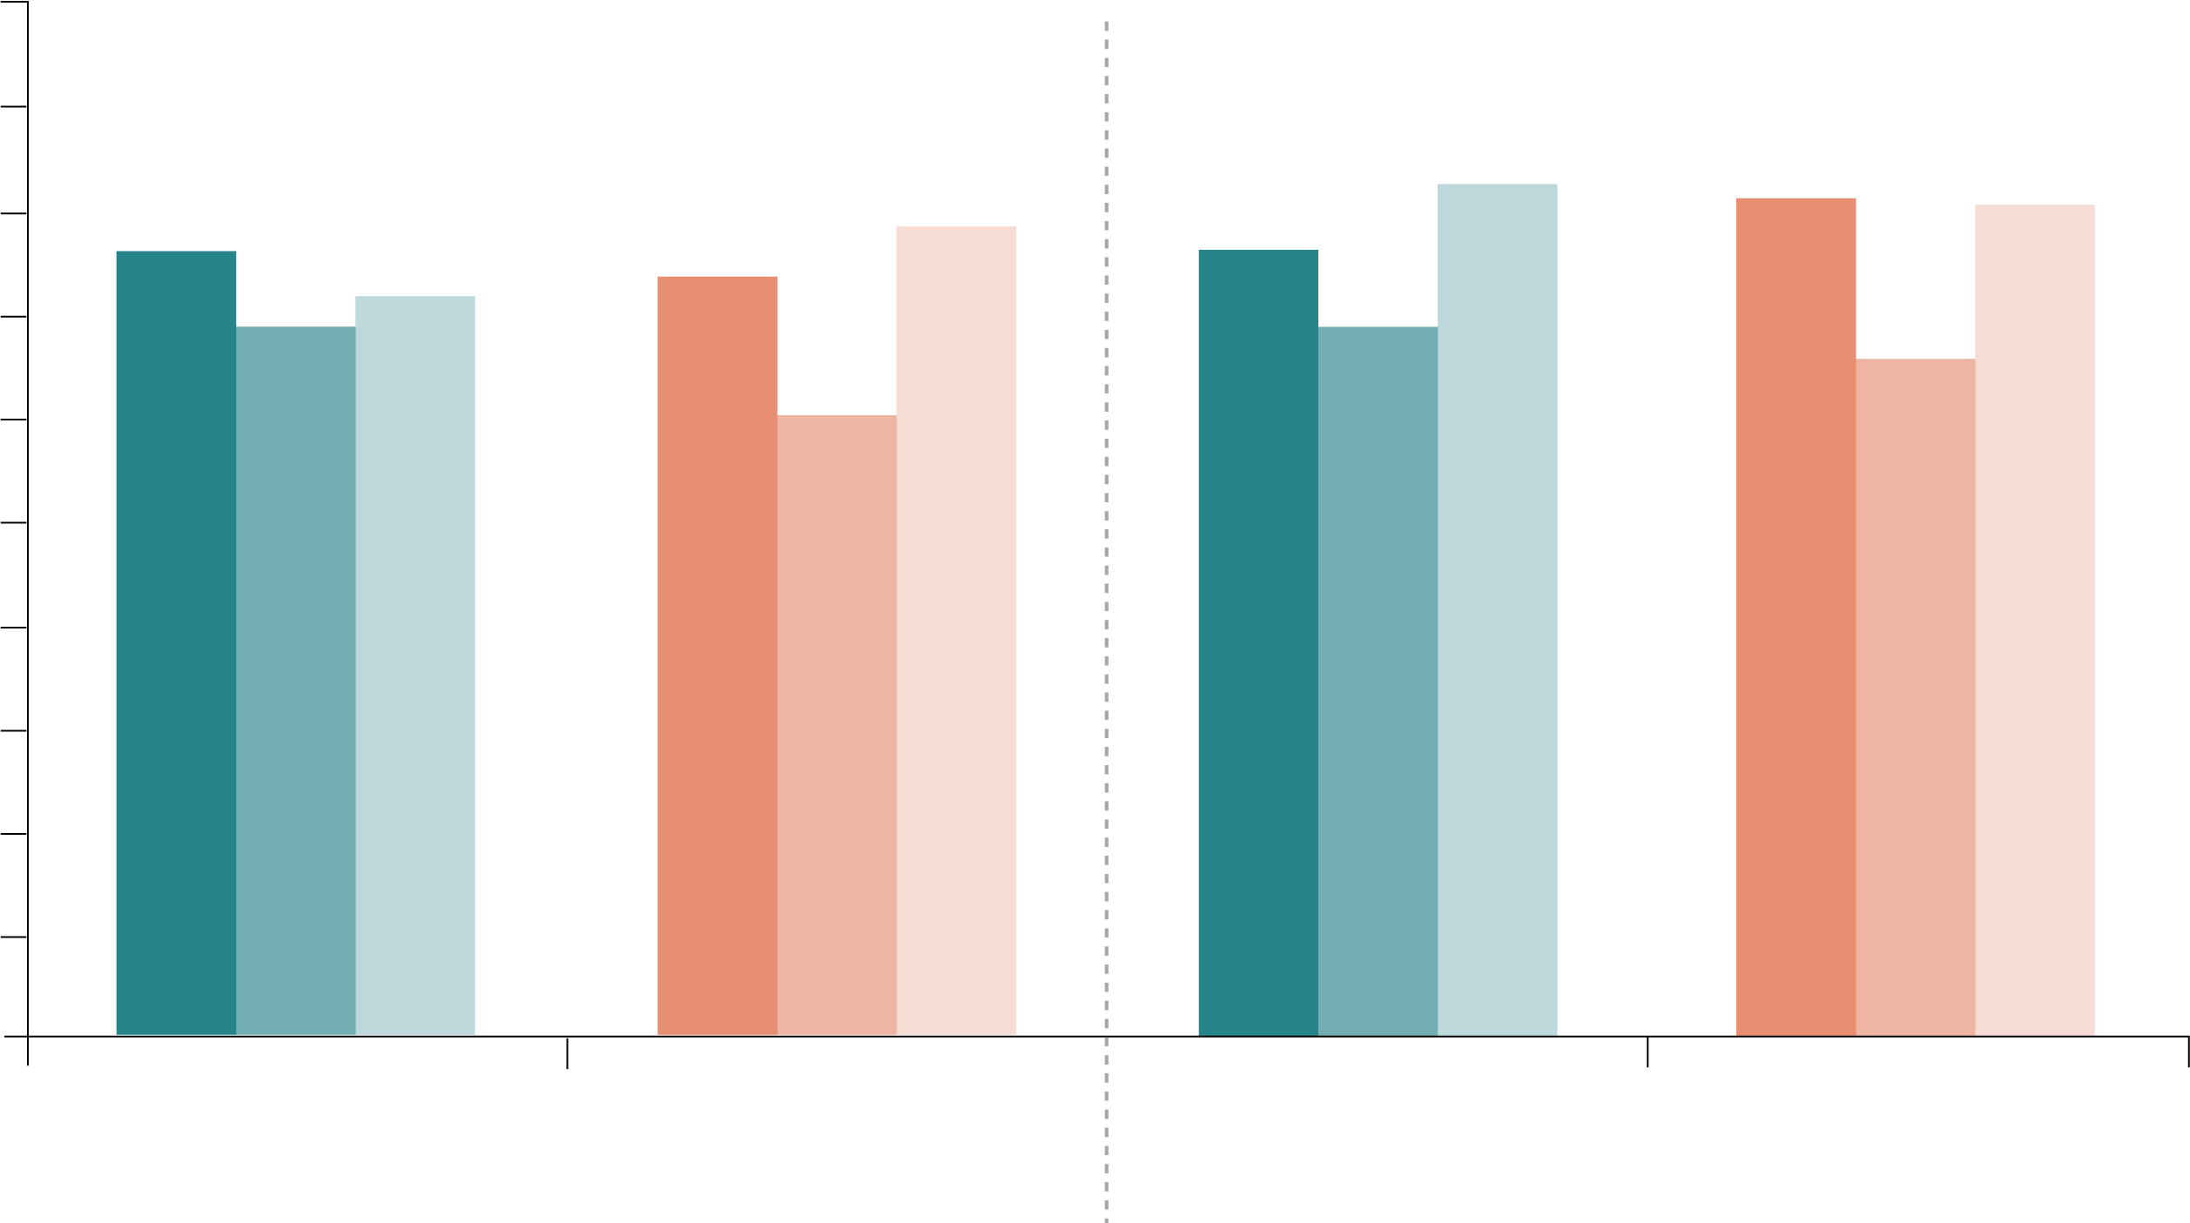
Efficacy of Switching from SSRIs to Vortioxetine or Escitalopram
2.0
Citalopram/Vortioxetine
Paroxetine/Vortioxetine
Sertraline/Vortioxetine
Citalopram/Escitalopram
Paroxetine/ Escitalopram
Sertraline/ Escitalopram
Citalopram/ Escitalopram
Paroxetine/ Escitalopram
Sertraline/ Escitalopram
Citalopram/Vortioxetine
Paroxetine/Vortioxetine
Sertraline/Vortioxetine
1.0
100
90
82.6
81.2
80.6
0.0
80
75.9
73.5
78.5
76.2
70
69
71.4
69
65.6
-1.0
60
Change From Baseline in MADRS Total Score
60
50
Patients in MADRS Remission, %
-2.0
40
30
-3.0
20
10
108
29
70
117
35
65
105
29
69
117
32
62
-4.0
0
N =
0
2
4
6
8
ESC
VOR
ESC
VOR
Weeks in Study
Baseline
Week 8
citalopram, p = 0.394; paroxetine, p = 0.877; sertraline p = 0.435
ESC = escitalopram; MADRS = Montgomery–Åsberg Depression Rating Scale; VOR = vortioxetine
Jacobsen P, et al. CNS Spectrums. 2020. 25(1):50-63.
Notes:
33:22 And then
(A) Change from baseline through week 8 in MADRS total score by study visit and SSRI received before randomization, i.e., pre-switch (MMRM, LS means); week 8 comparison between vortioxetine and escitalopram by subgroup: citalopram, P = 0.832; paroxetine, P = 0.590; sertraline, P = 0.916 (B) Patients in MADRS remission (MADRS ≤10) at baseline and at week 8, analyzed by SSRI received before randomization, i.e., pre-switch (LOCF); week 8 comparison between vortioxetine and escitalopram by subgroup: citalopram, P = 0.394; paroxetine, P = 0.877; sertraline P = 0.435: LOCF = last observation carried forward; LS mean = least-squares mean; MADRS = Montgomery–Åsberg Depression Rating Scale; MMRM = mixed model for repeated measurements.
The greatest mean reductions in MADRS total scores was observed in both treatment groups for participants who switched from sertraline (sertraline/vortioxetine: −2.4; sertraline/escitalopram: −2.6)
Jacobsen, P., Nomikos, G., Zhong, W., Cutler, A., Affinito, J., & Clayton, A. (2020). Clinical implications of directly switching antidepressants in well-treated depressed patients with treatment-emergent sexual dysfunction: A comparison between vortioxetine and escitalopram. CNS Spectrums, 25(1), 50-63.
Objective:The objective of this work was to describe treatment-emergent sexual dysfunction (TESD) and tolerability following a switch from selective serotonin reuptake inhibitor (SSRI: citalopram, paroxetine, or sertraline) monotherapy to vortioxetine or escitalopram monotherapy in adults with well-treated major depressive disorder (MDD) and SSRI-induced sexual dysfunction.
Methods:Data were analyzed from the primary study, an 8-week, randomized, double-blind, head-to-head study in which participants with well-treated depressive symptoms but experiencing TESD with SSRIs were directly switched to flexible doses (10/20 mg) of vortioxetine or escitalopram. Sexual functioning was assessed by the Changes in Sexual Functioning Questionnaire-14 (CSFQ-14), efficacy by the Montgomery–Åsberg Depression Rating Scale scores (MADRS) and Clinicians Global Impression of Severity/Improvement (CGI-S/CGI-I), and tolerability by adverse events. Efficacy and tolerability were assessed by pre-switch SSRI therapy where possible, and by participant characteristics.
Results:Greater improvements in TESD were seen in the vortioxetine compared with escitalopram groups based on: participant demographics (≤45 years, women; P = 0.045), prior SSRI treatment (P = 0.044), number of prior major depressive episodes (MDEs) (1–3; P = 0.001), and duration of prior SSRI therapy (>1 year; P = 0.001). Prior SSRI treatment did not appear to influence the incidence or severity of TEAEs, except for nausea. Regardless of prior SSRI, both treatments maintained antidepressant efficacy after 8 weeks.
Conclusion:Results suggest that vortioxetine is a safe and effective switch therapy for treating SSRI-induced sexual dysfunction in adults with well-treated MDD. Also, improvement in sexual dysfunction with vortioxetine or escitalopram may be influenced by prior SSRI usage, sex, age, and history of MDEs.

Slide 40
Vortioxetine as a Switch Therapy for MDD
Comparator (Source Studies
Risk Difference (95% CI)
Agomelatine
(Direct comparison in REVIVE)
-11.0%
(-19.4%, -2.6%)
Sertraline
(ITC combining REVIVE and
Kasper 2013)
-14.4%
(-29.9%, 1.1%)
Venlafaxine
(ITC combining REVIVE, Kasper
2013, STAR*D)
-7.2%
(-24.3%, 9.9%)
Bupropion
(ITC combining REVIVE, Kasper
2013, STAR*D)
-10.7%
(-27.8%, 6.4%)
Citalopram
(ITC combining REVIVE, Kasper
2013, STAR*D, Lenox-Smith 2008)
-16.8%
(-41.1%, 7.5%)
20%
10%
0%
-10%
-20%
-30%
-40%
-50%
Thase ME, et al. Eur Neuropsychopharmacol. 2017;27(8):773-781.
Notes:
33:36 And then
Risk difference for remission, vortioxetine versus comparator.
These results translated to a statistically significantly higher probability of achieving remission in the vortioxetine group compared with the agomelatine group (risk difference [RD], −11%; P<0.01)
Comparative evaluation of vortioxetine as a switch therapy in patients with major depressive disorder
Abstract
Switching antidepressant therapy is a recommended strategy for depressed patients who neither respond to nor tolerate an initial pharmacotherapy course. This paper reviews the efficacy and tolerability of switching to vortioxetine. All three published studies of patients with major depressive disorder (MDD) switched from SSRI/SNRI therapy to vortioxetine due to lack of efficacy or tolerability were selected. Vortioxetine was evaluated versus agomelatine directly (REVIVE) and versus sertraline, venlafaxine, bupropion, and citalopram in an indirect treatment comparison (ITC) from switch studies retrieved in a literature review. Vortioxetine׳s impact on SSRI-induced treatment-emergent sexual dysfunction (TESD) was assessed directly versus escitalopram (NCT01364649) in stable patients with MDD. Vortioxetine׳s tolerability in the switch population was compared to the overall MDD population. Vortioxetine showed significant benefits over agomelatine on efficacy, functioning, and quality-of-life outcomes, with fewer withdrawals due to adverse events (AEs) (REVIVE). Vortioxetine had numerically higher remission rates versus all therapies included (ITC). Withdrawal rates due to AEs were significantly lower for vortioxetine versus sertraline, venlafaxine, and bupropion, and numerically lower versus citalopram. Switching to vortioxetine was statistically superior to escitalopram in improving TESD (NCT01364649). Tolerability was similar in the switch and overall MDD populations. These findings suggest that vortioxetine is an effective switch therapy for patients with MDD whose response to SSRI/SNRI therapy is inadequate. Vortioxetine was well tolerated and, for patients with a history of TESD, showed significant advantages versus escitalopram. Vortioxetine appears to be a valid option for patients with MDD who have not been effectively treated with first-line pharmacotherapies.

Slide 41
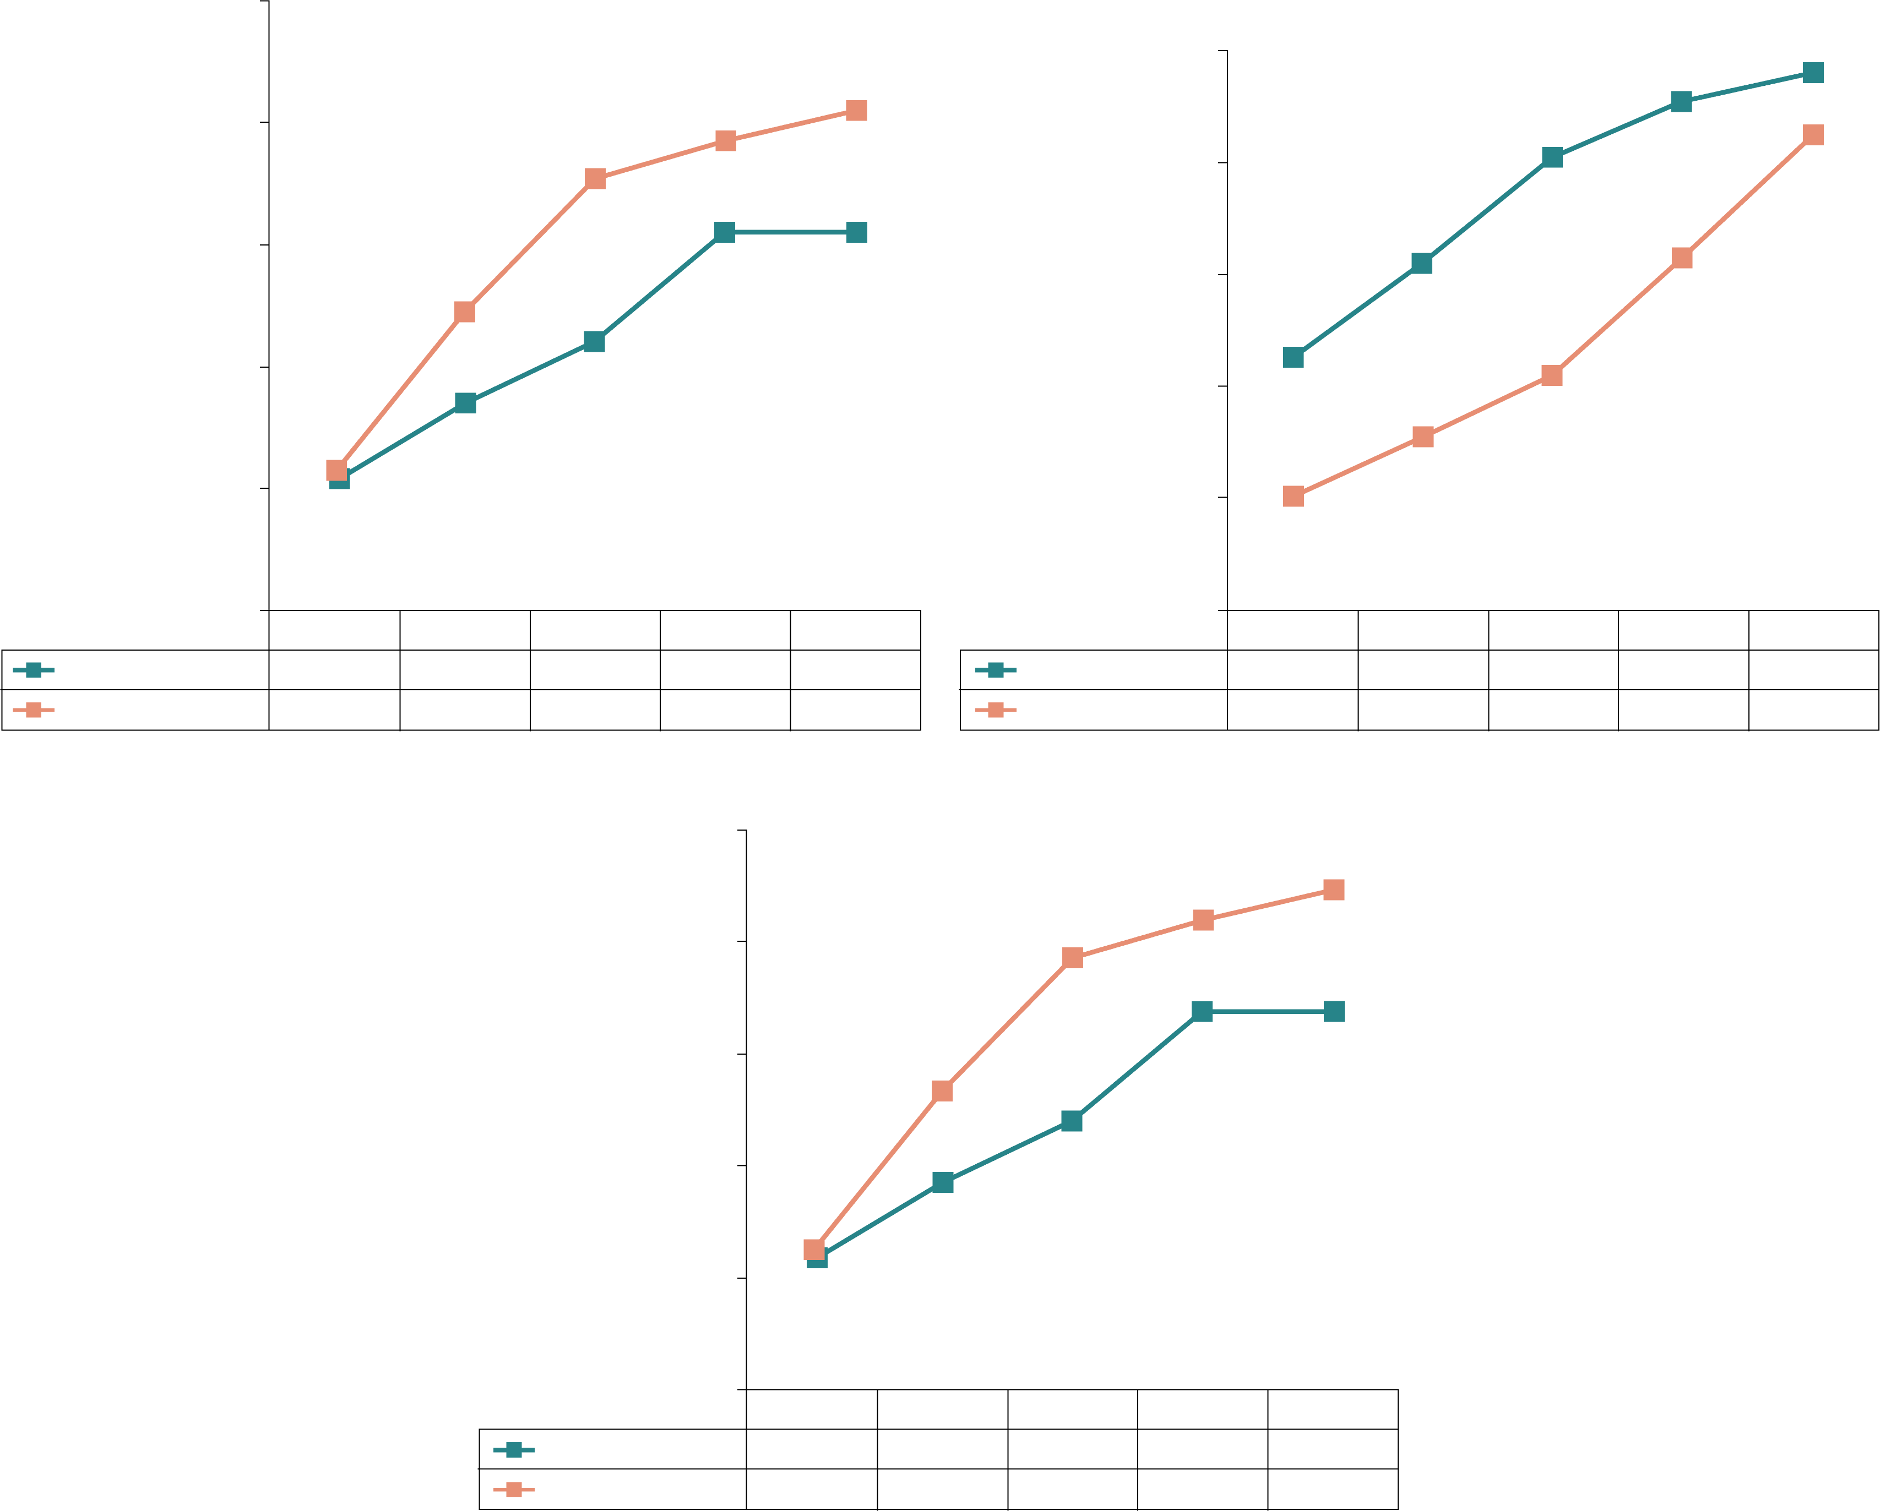
Vortioxetine as a Switch Therapy for SSRI-Induced Sexual Dysfunction
10
CITALOPRAM
PAROXETINE
10
8
8
6
6
Change From Baseline
In CSFQ-14 Total Score
Change From Baseline
In CSFQ-14 Total Score
4
4
2
2
0
0
Escitalopram
Week 1
Week 2
Week 4
Week 6
Week 8
Escitalopram
Week 1
Week 2
Week 4
Week 6
Week 8
108
103
96
91
88
29
28
26
25
25
Vortioxetine
116
111
102
94
91
Vortioxetine
34
32
28
24
21
10
SERTRALINE
8
6
Change From Baseline
In CSFQ-14 Total Score
4
2
0
Week 1
Week 2
Week 4
Week 6
Week 8
Escitalopram
69
69
66
60
60
Vortioxetine
63
60
57
57
53
*p < .05 vs. escitalopram
Jacobsen P, et al. CNS Spectrums. 2020;25(1):50-63.
Notes:
33:44 And here you see
(A–C) Analysis of change from baseline in CSFQ-14 total score by SSRIs received before randomization, i.e., pre-switch (MMRM, FAS). Changes from baseline in CSFQ-14 total scores were assessed at weeks 1, 2, 4, 6, and 8 for (A) citalopram, (B) paroxetine, and (C) sertraline subgroups. The tables below each graph show the number of patients analyzed at each time point in the vortioxetine and escitalopram treatment groups. P-values shown are for the differences between treatment groups. CIT = citalopram; CSFQ-14 = Changes in Sexual Functioning Questionnaire–Short Form; ESC = escitalopram; PAR = paroxetine; SER = sertraline; VOR = vortioxetine; wk = week; *P<0.05 vs escitalopram.
Clinical implications of directly switching antidepressants in well-treated depressed patients with treatment-emergent sexual dysfunction: a comparison between vortioxetine and escitalopram
Abstract
Objective:The objective of this work was to describe treatment-emergent sexual dysfunction (TESD) and tolerability following a switch from selective serotonin reuptake inhibitor (SSRI: citalopram, paroxetine, or sertraline) monotherapy to vortioxetine or escitalopram monotherapy in adults with well-treated major depressive disorder (MDD) and SSRI-induced sexual dysfunction.
Methods:Data were analyzed from the primary study, an 8-week, randomized, double-blind, head-to-head study in which participants with well-treated depressive symptoms but experiencing TESD with SSRIs were directly switched to flexible doses (10/20 mg) of vortioxetine or escitalopram. Sexual functioning was assessed by the Changes in Sexual Functioning Questionnaire-14 (CSFQ-14), efficacy by the Montgomery–Åsberg Depression Rating Scale scores (MADRS) and Clinicians Global Impression of Severity/Improvement (CGI-S/CGI-I), and tolerability by adverse events. Efficacy and tolerability were assessed by pre-switch SSRI therapy where possible, and by participant characteristics.
Results:Greater improvements in TESD were seen in the vortioxetine compared with escitalopram groups based on: participant demographics (≤45 years, women; P = 0.045), prior SSRI treatment (P = 0.044), number of prior major depressive episodes (MDEs) (1–3; P = 0.001), and duration of prior SSRI therapy (>1 year; P = 0.001). Prior SSRI treatment did not appear to influence the incidence or severity of TEAEs, except for nausea. Regardless of prior SSRI, both treatments maintained antidepressant efficacy after 8 weeks.
Conclusion:Results suggest that vortioxetine is a safe and effective switch therapy for treating SSRI-induced sexual dysfunction in adults with well-treated MDD. Also, improvement in sexual dysfunction with vortioxetine or escitalopram may be influenced by prior SSRI usage, sex, age, and history of MDEs.

Slide 42
Efficacy of Switching from SSRIs or SNRIs to Vilazodone
Scale | Baseline Scores | End of Study Scores
Montgomery-Asberg Depression Rating Scale (MADRS) | Increased | Decreased
Hamilton Depression Rating Scale (HDRS) | Increased | Decreased
Hamilton Anxiety Rating Scale (HARS) | Increased | Decreased
Clinical Global Impressions–Severity (CGI-S) | Increased | Decreased
Clinical Global Impressions–Improvement (CGI-I) | Increased | Decreased
Arizona Sexual Experience Scale (ASEX) | Increased | Significant improvement
Discontinuation Emergent Signs and Symptoms (DESS) | Increased | Significant improvement
N = 60. Patients were previously on fluoxetine, citalopram, escitalopram, paroxetine, sertraline, and venlafaxine, and vilazodone was initiated
the next day at 10, 20, and 40 mg.
Rele S, et al. Prim Care Companion CNS Disord. 2015;17(4):10.4088/PCC.14m01734.
Notes:
33:48 And vilazodone
Overall, there was a significant reduction in mean ± SD MADRS score from baseline (26.08 ± 1.1) to week 8 (9.86 ± 1.2) in the entire sample (P < .001) (Figure 1). Similarly, there was a significant improvement in CGI-S scores (P < .001), CGI-I scores (P < .001) (Figure 2), and HDRS scores (P < .001) (Figure 3) from baseline to the end of the trial. There were no significant differences between the 3 vilazodone dose-initiation groups in changes in MADRS scores (P = .95) or changes in CGI-S (P = .83), CGI-I (P = .51), or HARS (P = .61) scores. SDS-associated symptoms of work (baseline: 4.8 ± 3.3, week 8: 4.10 ± 3.0, P < .01), social life (baseline: 5.20 ± 2.9, week 8: 4.4 ± 2.859, P < .01), and family and home responsibility (baseline: 4.9 ± 3.3, week 8: 4.5 ± 3.0, P < .01) showed improvement from extreme disability to mild/moderate disability. DESS scores showed a decrease from baseline (5.9 ± 9.9) to endpoint (2.2 ± 5.5, P < .01). ASEX scores showed a decrease from baseline (17.5 ± 5.2) to endpoint (15.9 ± 6.3, P = .01). There were no significant differences between the 3 vilazodone dose groups in changes in DESS score (P = .55) and ASEX scores (P = .77).
An 8-Week Randomized, Double-Blind Trial Comparing Efficacy, Safety, and Tolerability of 3 Vilazodone Dose-Initiation Strategies Following Switch From SSRIs and SNRIs in Major Depressive Disorder. Prim Care Companion CNS Disord. 2015; 17(4): 10.4088/PCC.14m01734.
Introduction:
Vilazodone, a selective and potent 5-HT_{1A} partial agonist and 5-HT reuptake inhibitor, has been approved for treatment of major depressive disorder (MDD) in adults. The primary objective of the study was to compare the efficacy and tolerability of switching to 3 different doses of vilazodone from an equivalent dose range of generic selective serotonin reuptake inhibitors (SSRIs) or serotonin-norepinephrine reuptake inhibitors (SNRIs) in adult subjects with MDD.
Method:
This was an 8-week, randomized, double-blind, parallel-group, 3-arm trial to compare vilazodone 10 mg/d, 20 mg/d, and 40 mg/d as starting doses. Data were collected from December 2012 to December 2013. There was no washout phase, prior medications were stopped at the baseline visit, and vilazodone was started the next day in adults with MDD (DSM-IV criteria). The 10-mg/d and 20-mg/d dose was increased to 40 mg/d by week 3 and week 1, respectively, and the 40-mg/d initiation dose continued unchanged. The primary efficacy measure was change in Montgomery-Asberg Depression Rating Scale (MADRS) score between the 3 dose groups. The secondary efficacy measures were changes in Clinical Global Impressions–Severity (CGI-S), CGI-Improvement (CGI-I), and Hamilton Anxiety Rating Scale (HARS) scores. Safety measures were obtained by spontaneously reported adverse events, vital signs recording, and laboratory tests. Multivariate tests were used for statistical analysis.
Results:
Seventy subjects were randomized, and 60 subjects completed the study (n = 20 in each group). Overall, there was a significant reduction in MADRS score from baseline (26.08 ± 1.1) to week 8 (9.86 ± 1.2) in the entire sample (P < .001). Similarly, there was a significant improvement in CGI-S (P < .001), CGI-I (P < .001) and HDRS (P < .001) scores from baseline to the end of the trial. There were no significant differences between the 3 vilazodone dose-initiation groups in changes in MADRS scores (P = .95) or changes in CGI-S (P = .83), CGI-I (P = .51), or HARS scores (P = .61). Dry mouth (n = 55), nausea (n = 10), and diarrhea (n = 5) were the most common side effects, with diarrhea reported in 5 subjects in the 40-mg/d initiation group. No serious adverse events were reported.
Conclusions:
The present study indicates the potential benefit of switching to vilazodone in patients with MDD who are inadequate responders to SSRIs or SNRIs. There were no meaningful differences in efficacy or tolerability between the 3 different dose-initiation strategies with vilazodone; however, diarrhea appeared to be more frequently reported with the 40-mg/d dose. Given the modest sample size, larger studies are required to confirm our findings.

Slide 43
Comparative Clinical Outcomes of Switching to Vortioxetine, Levomilnacipran, or Vilazodone
Outcome | Vortioxetine | Levomilnacipran | Vilazodone
Efficacy
Remission at 8 weeks, % | 40.5 | 37.6 | 38.2
Recovery after initial line of treatment, % | 34.1 | 28.3 | 28.8
Time in remission/recovery, months | 0.439 | 0.434 | 0.438
Relapse conditional to being in remission, % | 13.9 | 12.5 | 12.5
Tolerability
Cognitive dysfunction | 49.3 | 58.0 | 63.7
Overall short-term AEs, % | 55.4 | 74.7 | 96.9
Overall long-term AEs, % | 3.2 | 21.8 | 22.2
Atsou K, et al. Expert Rev Pharmacoecon Outcomes Res. 2021;21(1):29-42.
Notes:
33:58 I think importantly

Slide 44
Apply best practices for switching to antidepressants with a different mechanism of action when initial response to SSRIs/SNRIs treatment results in residual symptoms, inadequate response, or intolerable side effects.
3
LEARNING
OBJECTIVE
Notes:
34:21 So why don’t

Slide 45
Considerations for Initial Medication Selection
Prior positive response
Response in other family members
Short-term side effects
Long-term side effects
Interaction with nonpsychiatric medication(s)
Patient preference
Patient age
Cost of medication
Concurrent medical disorders
Concurrent psychiatric disorders
VandenBerg AM, et al. Major depressive disorder. In: Pharmacotherapy: A Pathophysiologic Approach. 11th ed. 2020. https://accesspharmacy.mhmedical.com/book.aspx?bookID=2577#219306023. Accessed September 27, 2021.
Notes:
34:54 Well I think

Slide 46
Commonly Used Antidepressants
Drug Class and Representative Agents | Select Safety and Efficacy Information for the Class
Selective serotonin reuptake inhibitors (SSRIs)
Citalopram, escitalopram, fluoxetine, fluvoxamine, paroxetine, sertraline | Comparable efficacy to other classes Side effects include GI symptoms, anxiety, headache, somnolence, insomnia, and sexual dysfunction
Serotonin-norepinephrine reuptake inhibitors (SNRIs)
Desvenlafaxine, duloxetine, venlafaxine, levomilnacipran | May have modestly greater efficacy than SSRIs Safety similar to SSRIs (nausea, sexual dysfunction, activation) but also increased sweating, hypertension
Tricyclic antidepressants (TCAs)
Amitriptyline, desipramine, doxepin, imipramine, nortriptyline | Comparable efficacy to SSRIs but with known side effects, such as anticholinergic effects, sedation, weight gain, sexual dysfunction, and orthostatic hypotension
Monoamine oxidase inhibitors (MAOI)
Phenelzine, selegilineª tranylcypromine, isocarboxazid | More effective than TCAs for atypical symptoms of depression Side effects include orthostatic hypotension, weight gain, and sexual side effects
VandenBerg AM, et al. Major depressive disorder. In: Pharmacotherapy: A Pathophysiologic Approach. 11th ed. 2020. https://accesspharmacy.mhmedical.com/book.aspx?bookID=2577#219306023. Accessed September 27, 2021.
Anderson IM, et al. J Psychopharmacol. 2008;22:343-396.; Gelenberg AJ, et al. Practice Guideline for the Treatment of Patients with Major Depressive Disorder (3rd edition).
American Psychiatric Association. 2010. https://psychiatryonline.org/pb/assets/raw/sitewide/practice_guidelines/guidelines/mdd.pdf.
Accessed Septermber 27, 2021
Notes:
36:08 Our most widely
Andersom IM, et al. Evidence-based guidelines for treating depressive disorders with antidepressants: a revision of the 2000 British Association for Psychopharmacology guidelines. J Psychopharmacol. 2008 Jun;22(4):343-96.
A revision of the 2000 British Association for Psychopharmacology evidence-based guidelines for treating depressive disorders with antidepressants was undertaken to incorporate new evidence and to update the recommendations where appropriate. A consensus meeting involving experts in depressive disorders and their management was held in May 2006. Key areas in treating depression were reviewed, and the strength of evidence and clinical implications were considered. The guidelines were drawn up after extensive feedback from participants and interested parties. A literature review is provided, which identifies the quality of evidence to inform the recommendations, the strength of which are based on the level of evidence. These guidelines cover the nature and detection of depressive disorders, acute treatment with antidepressant drugs, choice of drug versus alternative treatment, practical issues in prescribing and management, next-step treatment, relapse prevention, treatment of relapse, and stopping treatment
Gelenberg AJ, et al. PRACTICE GUIDELINE FOR THE Treatment of Patients With Major Depressive Disorder Third Edition.

Slide 47
Commonly Used Antidepressants with Unique Mechanisms of Action
Drug Class and Representative Agents |  | Select Safety and Efficacy Information for the Class
Norepinephrine and dopamine reuptake inhibitor (NDRI)
Bupropion | One of the most activating antidepressants; may be useful for decreased motivation, low energy, and fatigue Side effects include nausea, vomiting, tremor, insomnia, and dry mouth | One of the most activating antidepressants; may be useful for decreased motivation, low energy, and fatigue Side effects include nausea, vomiting, tremor, insomnia, and dry mouth
Mixed serotonergic effects (Mixed 5-HT)
Vilazodone Vortioxetine | SSRI and 5-HT1A partial agonists Vortioxetine is also a 5-HT3, 5-HT1D, and 5-HT7 antagonist, 5-HT1B partial agonist, and 5-HT transporter inhibitor; may have fewer cognitive side effects than other agents Efficacious and well-tolerated in older patients Side effects similar to those of SSRIs | SSRI and 5-HT1A partial agonists Vortioxetine is also a 5-HT3, 5-HT1D, and 5-HT7 antagonist, 5-HT1B partial agonist, and 5-HT transporter inhibitor; may have fewer cognitive side effects than other agents Efficacious and well-tolerated in older patients Side effects similar to those of SSRIs
Noradrenergic and specific serotonergic antidepressant (NaSSA)
Mirtazapine | Alpha2, histamine H1, and 5-HT2A, 5-HT2C, and 5-HT3 antagonist No monoamine reuptake inhibitor As effective as SSRIs and SNRIs, with earlier onset of action Side effects include increased appetite, weight gain dry mouth, constipation, somnolence, and dizziness | Alpha2, histamine H1, and 5-HT2A, 5-HT2C, and 5-HT3 antagonist No monoamine reuptake inhibitor As effective as SSRIs and SNRIs, with earlier onset of action Side effects include increased appetite, weight gain dry mouth, constipation, somnolence, and dizziness
Danielak D. Expert Opin Pharmacother. 2021;22(9):1167-1177.; VandenBerg AM, et al. Major depressive disorder. In: Pharmacotherapy: A Pathophysiologic Approach. 11th ed. 2020. https://accesspharmacy.mhmedical.com/book.aspx?bookID=2577#219306023. Accessed September 27, 2021; Drugs@FDA.gov.; Nomikos GC, et al. CNS Spectrums. 2017;22:348–362.
Notes:
36:38 The two newer
Vilazodone is 5-HT_{1A} partial agonist, SERT inhibitor
Chapter 85: Major Depressive Disorder
Nomikos GC, et al. Efficacy, safety, and tolerability of vortioxetine for the treatment of major depressive disorder in patients aged 55 years or older. CNS Spectrums (2017), 22, 348–362.
Objective. These post hoc analyses evaluate the efficacy, safety, and tolerability of vortioxetine versus placebo in patients aged ≥55 years with major depressive disorder (MDD). Methods. Study-level efficacy data from 12 short-term, fixed-dose, randomized, placebo-controlled trials of vortioxetine 5–20 mg/day were assessed using a random-effects meta-analysis. Adverse events (AEs), vital signs, ECG values, liver enzymes, and body weight were pooled from the same studies. Patients had baseline Montgomery–Åsberg Depression Rating Scale (MADRS) total scores ranging from 22–30. Results. 1508 patients (mean age = 62.4 years; range, 55–88 years) were included. Mean differences from placebo in change from baseline to study end (6/8 weeks) in MADRS were –2.56 (5 mg, n = 324, P = 0.035), –2.87 (10 mg, n = 222, P = 0.007), –1.32 (15 mg, n = 90, P = NS), and –4.65 (20 mg, n = 165, P = 0.012). Odds ratios for response versus placebo were 1.6 (5 mg, P = NS), 1.8 (10 mg, P = 0.002), 1.2 (15 mg, P = NS), and 2.5 (20 mg, P < 0.001), and for remission versus placebo were 1.5 (5 mg, P = NS), 1.5 (10 mg, P = NS), 1.4 (15 mg, P = NS), and 2.7 (20 mg, P = 0.001). The proportion of patients with AEs for placebo and vortioxetine 5–20 mg was 61.5% and 62.3%, respectively, with no increase at increased doses. Vortioxetine demonstrated a placebo-level incidence of serious AEs (1.2%). AEs occurring in ≥5% of any treatment group were nausea, headache, diarrhea, dizziness, dry mouth, constipation, fatigue, vomiting, and anxiety. No clinically significant mean changes in vital signs, ECG values, liver enzymes, or body weight emerged during treatment. Conclusion. Vortioxetine 5–20 mg/day is efficacious and well tolerated in MDD patients aged ≥55 years, a group that is often comorbid with other conditions and treated with other medications.

Slide 48
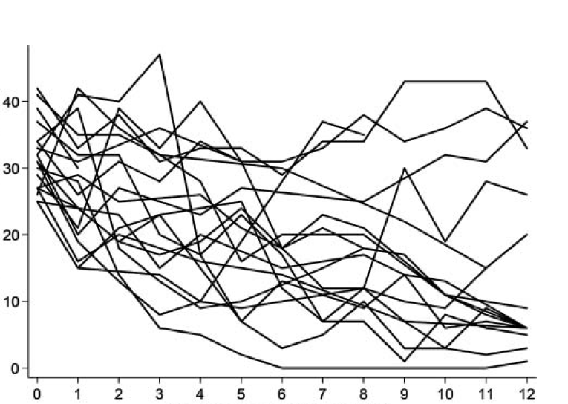
Patients with MDD Vary in Their Response to the Same Antidepressant
Samples of MADRS Total Scores of Individuals Over 12 Weeks on the Same SSRI
Tan, teal, and blue lines are examples of low, medium, and high patient responses, respectively, to the same SSRI.
Depression Severity (MADRS)
N = 20
Time from Treatment Start (Weeks)
Uher R. Harv Rev Psychiatry. 2011;19(3):109-124.
Notes:
38:15 I affectionately
Key Takeaway:
Individual patients with MDD have shown very different responses to the same treatment
Additional Information:
The figure shows that the time-course of change in depression severity in 20 subjects with MDD receiving the same SSRI for 12 weeks
Although some individuals experience satisfactory outcomes, others improve very little, and a few get worse
The reason for individual variation in response to the same antidepressant is largely unknown

Slide 49
Factors Associated With Nonresponse
Misdiagnosis (e.g., bipolar disorder)
Severity and chronicity of index episode
Specific depressive subtypes
  Psychotic depression, atypical depression, melancholic features
Psychiatric comorbidities
  Anxiety disorders, panic disorder, personality disorder
Medical comorbidities or unrecognized illness
Age at onset before 18 years
Alcohol or other substance abuse
Nonadherence (typically 80+% of prescribed doses must be taken)
Pharmacokinetics, pharmacogenetics
Gaynes B. J Clin Psychiatry. 2009;70(S6):10-15.
Notes:
39:36 You know if

Slide 50
What Does Failure to Remit Look Like in Those Who Respond to an Antidepressant?
Proportion of responders who had symptoms at baseline that persisted at exit*
*Percentages are reported as the remaining percent of those with each symptom at baseline that continued to have the symptoms at exit. Response was defined as ≥ 50% reduction in QIDS-SR₁₆. Presence of symptoms was indicated by a QIDS-SR₁₆ domain score ≥ 1.
McClintock SM, et al. J Clin Psychopharmacol. 2011;31:180-186.
Notes:
41:31 Well I think

Slide 51
Do We Reassess Too Late?
Early improvement at 2 weeks predicts response
  Lack of improvement in the first 2 weeks of treatment may indicate the need to consider changes in management
  Limitations: Included primarily patients with acute MDD; results may not apply to chronic or complicated depression.
Went on to have a stable response at 4-8 weeks
Did NOT go on to have a stable response at 4-8 weeks
Szegedi A, et al. J Clin Psychiatry. 2009;70:344-353.
Notes:
43:05 You know I
Early improvement in the first 2 weeks as a predictor of treatment outcome in patients with major depressive disorder: a meta-analysis including 6562 patients
Objective: New evidence indicates that treatment response can be predicted with high sensitivity after 2 weeks of treatment. Here, we assess whether early improvement with antidepressant treatment predicts treatment outcome in patients with major depressive disorder (MDD).
Data sources: Forty-one clinical trials comparing mirtazapine with active comparators or placebo in inpatients and outpatients (all-treated population, N = 6907; intent-to-treat population, N = 6562) with MDD (DSM-III-R or DSM-IV Criteria) were examined for early improvement (>or= 20% score reduction from baseline on the 17-item Hamilton Rating Scale for Depression [HAM-D-17] within 2 weeks of treatment) and its relationship to treatment outcome.
Study selection: Data were obtained from a systematic search of single- or double-blind clinical trials (clinical trials database, Organon, a part of Schering-Plough Corporation, Oss, The Netherlands). All included trials (a total of 41) employed antidepressant treatment for more than 4 weeks and a maximum of 8 weeks. The studies ranged from March 1982 to December 2003. Trials were excluded if there were no HAM-D-17 ratings available, no diagnosis of MDD, or if the study was not blinded. Trials were also excluded if HAM-D-17 assessments were not available at week 2, week 4, and at least once beyond week 4.
Data synthesis: Early improvement predicted stable response and stable remission with high sensitivity (>or= 81% and >or= 87%, respectively). Studies utilizing rapid titration vs. slow titration of mirtazapine demonstrated improved sensitivity for stable responders (98%, [95% CI = 93% to 100%] vs. 91% [95% CI = 89% to 93%]) and stable remitters (100%, [95% CI = 92% to 100%] vs. 93% [95% CI = 91% to 95%]). Negative predictive values for stable responders and stable remitters were much higher (range = 82%-100%) than positive predictive values (range = 19%-60%).
Conclusions: These results indicate that early improvement with antidepressant medication can predict subsequent treatment outcome with high sensitivity in patients with major depressive disorder. The high negative predictive values indicate little chance of stable response or stable remission in the absence of improvement within 2 weeks. A lack of improvement during the first 2 weeks of therapy may indicate that changes in depression management should be considered earlier than conventionally thought.

Slide 52
Case Presentation:
Barbara Gets Her Bounce Back
Adherence query revealed very good (not perfect) adherence
She agreed to switch from sertraline 100 mg qd to vortioxetine 10 mg po qd
When presented with non-pharmacologic options, she declined referral for formal MBCT, but agreed to some options:
  Exercise (goal of 150 min walking per week)
  Self-guided meditation (with an app)
  Anti-inflammatory diet (with secondary goal of weight loss)
At visit 4 (2 weeks after starting vortioxetine), her PHQ-9 was down to 8, with item 9 score of 0; GAD-7 was 4
Notes:
45:47 Let’s hope so

Slide 53
Barbara’s PHQ-9 Score: Visit 1
Barbara’s PHQ-9 Score: Visit 4
Notes:
47:30 PHQ-9 was down

Slide 54
STAR*D Trial: Remission Rates Double With Stepwise, Algorithmic Treatment
Broadly representative sample of adult outpatients with MDD (N = 3,671)
Employed ≥ 1 acute treatment step(s) in succession, aimed at achieving remission (defined as QIDS-SR₁₆ ≤ 5)of adult outpatients with MDD (N = 3,671)
Remaining in Depression
Estimated Cumulative
Rate of Remission
100%
100%
1
3 months
Monotherapy (SSRI)
63%
63%
37%
2
3 months
Switch to one of the following:
Monotherapy
(3 options)
Augmentation therapy
(2 options)
Augmentation with CBT
CBT
44%
Treatment Steps
44%
56%
3
3 months
Switch to one of the following:
Monotherapy
(4 options)
Augmentation therapy
(2 options)
38%
62%
38%
3 months
Switch to one of the following:
4
Monotherapy
(3 options)
Augmentation therapy
(3 options)
33%
67%
“The present results serve to highlight the need for more effective short- and longer-term treatments to both achieve and sustain remission in more depressed patients sooner in the treatment sequence.”
Limitations: May include open-label design and self-reported assessment of the QIDS-SR₁₆.
Rush AJ, et al. Am J Psychiatry. 2006;163:1905-1917.
Notes:
48:29 So that brings

Slide 55
Medication Selection After Initial Treatment Failure: Another Antidepressant or Add an Adjunctive Medication?
Consider adjunctive medication when:
Consider switching when:
≥ 2 antidepressant trials
Current treatment is well tolerated
Response is > 25%
Specific residual symptoms can be targeted
Patient prefers adjunctive medication
It is the first medication trial
The antidepressant is not tolerable
Response to initial treatment is < 25%
Patient prefers to switch
Kennedy SH, et al. Can J Psychiatry. 2016;61-540-560.
Notes:
50:30 Well one of mine

Slide 56
The Comparative Benefits of Adjunctive Therapies, Combinations and Switching
Adjunctive and combination strategies
  Avoid loss of any therapeutic benefits from
  first-line agent
  No risk of withdrawal symptoms
  May target side effects of first-line treatment
Switching
  Better compliance
  Lower risk of drug interactions
  Resolution of side effects
  Lower cost?
Mills NT, et al. Int J Neuropsychopharmacol. 2021;24(4):314-321.; Connolly KR, et al. Drugs. 2011;71(1):43-64.;
Atsou K, et al. Expert Rev Pharmacoecon Outcomes Res. 2021;21(1):29-42.
Notes:
54:38 Best reasons to switch

Slide 57
Audience Response Question
What would be your approach to switch Barbara from sertraline to vortioxetine?
Immediately stop sertraline and start vortioxetine the next day
Gradually taper sertraline then start vortioxetine immediately after discontinuation
Gradually withdraw sertraline then start vortioxetine after a washout period
Taper sertraline for 2 weeks while slowly increasing the dose of vortioxetine simultaneously
Notes:
56:33 [After he says…. for that matter]

Slide 58
What would be your approach to switch Barbara from sertraline to vortioxetine?
Results recorded on September 29, 2021.
N = xx
Notes:
56:34 By an overwhelming

Slide 59
Working Together to Pick the Best Treatment:
What is Shared Decision Making?
Is collaborative
  Allows patients and their providers
  to make decisions together
  Takes into account:
    Best scientific evidence available
    Patient’s values and preferences
Honors
  Provider’s expert knowledge
  Patient’s right to be fully informed of all care options and their potential harms and benefits
Provides patients with support to make the best individualized care decisions
Allows providers to feel confident in the care they prescribe
Notes:
57:56 Sure, well we use

Slide 60
Increasing Adherence for Antidepressants
Patient medication nonadherence often goes unrecognized by physicians:
  Only 19% adherence shown at 6-months; 50% discontinuation; 89% of patients did not inform their doctor
Primary care physician communication associated with adherence
  How to take the medication (e.g., daily)
  Short-term, long-term expected effects of the medication
    May take 2-4 weeks to see effect
  Medication must be continued even when patient is feeling better
  Patient must not stop the medication without calling first
  Instructions on resolving questions and concerns
  How the medication is thought to work
  Antidepressants are not “addictive”
Hunot VM, et al. Prim Care Companion J Clin Psychiatry. 2007;9:91-99.;
Brown C, et al. Med Care. 2005;43:1203-7; Lin EH, et al. Med Care. 1995;33:67-74.
Notes:
59:14 Absolutely, so for

Slide 61
Conclusions
MBC is an evidence-based strategy proven effective not only in optimizing the management of MDD but likewise associated medical comorbidities.
A significant number of patients suffering with MDD do not achieve remission and functional recovery with conventional antidepressants such as SSRIs and SNRIs.
Serotonin agonists and reuptake inhibitors such as vortioxetine are safe, effective switch strategies when initial antidepressants fail.
Notes:
1:01:53 I would just highlight

Slide 62
SMART Goals
Specific, Measurable, Attainable, Relevant, Timely
Identify at least 1 MDD symptom scale and administer at every visit with patients with MDD
Use MBC to engage patients in shared decision-making, optimize care delivery, and facilitate remission and recovery
When SSRIs or SNRIs treatment outcomes are not ideal, consider therapies with unique mechanisms of action to achieve treatment goals
Apply appropriate switching strategies when treatment outcomes with SSRIs or SNRIs are suboptimal
Notes:
1:03:45 And speaking of new

Slide 63
Additional Resources
Visit www.cmeoutfitters.com
for clinical information and
certified educational activities
Notes:
1:40:23 Thanks to everybody

Slide 64
To receive CME/CE credit for this activity, participants must complete the post-test and evaluation online.
Participants will be able to download and print their certificate immediately upon completion.
To Receive Credit
Notes:
1:40:43 I will remind you

