Slide 1
Real-World Data for Real-World Patients: A Broadened Lens to Informed Decision-Making in VTE

Slide 2
Addressing Disparities in Care: Assessing Patient Characteristics When Determining Next Steps for Anticoagulant Treatment Selection
2

Slide 3
Gregory Piazza, MD, MS
Director, Vascular Medicine Section
Brigham and Women’s Hospital
Associate Professor of Medicine
Cardiovascular Medicine
Harvard Medical School
Boston, MA

Slide 4
Karol E. Watson, MD, PhD, FACC, FAHA
Professor of Medicine/Cardiology
Co-Director, UCLA Program in Preventive Cardiology
Director, UCLA Barbra Streisand Women’s Heart
Health Program
John C. Mazziotta Term Chair in Medicine
David Geffen School of Medicine at UCLA
Los Angeles, CA

Slide 5
Learning
Objective 1
Recognize the impact of racial and ethnic disparities on the care of individuals who are candidates for anticoagulation therapy.
Notes:
1:28 Lets start first

Slide 6
Learning
Objective 2
Apply patient selection criteria for anticoagulation treatment that minimizes disparities and unconscious bias to optimize outcomes.

Slide 7
VTE: Scope of the Problem
Venous thromboembolism (VTE) comprises deep vein thrombosis (DVT) and pulmonary embolism (PE)
More than 1 million physician office visits and 211,000 emergency department visits with a principal diagnosis of VTE in 2016
Incidence will continue to rise with an aging population and as people live longer with chronic conditions
VTE incidence varies by race/ethnicity: Blacks are at greatest risk, followed by Whites, Hispanics, and Asians
Studies suggest provider interactions with patients of color are less patient-centered, with fewer requests for patient input about VTE treatment decisions
1. Virani SS, et al. Circulation. 2021;143(8):e254-e743. 2. Maynard G. Agency for Health care Research and Quality. 2018.
http://www.ahrq.gov/patient-safety/resources/vtguide/index.html. Accessed June 5, 2021. 3. Nathan AS, et al. Circ Cardiovasc
Qual Outcomes. 2019;12(4):e005600.

Slide 8
Anticoagulants in VTE
Role of Anticoagulation
Reduces risk for thrombus extension, recurrence,
and embolization
Prevents post-thrombotic syndrome
Parenteral Anticoagulants
Unfractionated heparin (UFH)
Low molecular weight heparin (LMWH)
Fondaparinux
Oral Anticoagulants
Vitamin K antagonists (eg, warfarin)
Direct-acting oral anticoagulants (DOACs)
  apixaban, dabigatran, edoxaban, and rivaroxaban
1. Witt DM, et al. Blood Adv. 2018;2(22):3257-3291. 2. Kahn SR, et al. J Thromb Haemost. 2009;7(5):879-883.
3. Nicholson M, et al. J Clin Med. 2020;9(8):2467-2493. 4. Kearon C, et al. Chest. 2016;149(2):315-352.
Notes:
Witt DM, Nieuwlaat R, Clark NP, et al. American Society of Hematology 2018 guidelines for management of venous thromboembolism: optimal management of anticoagulation therapy. Blood Adv. 2018;2(22):3257-3291.
Kahn SR, Partsch H, Vedantham S, Prandoni P, Kearon C, Subcommittee on Control of Anticoagulation of the Scientific and Standardization Committee of the International Society on Thrombosis and Haemostasis. Definition of post-thrombotic syndrome of the leg for use in clinical investigations: a recommendation for standardization. Thromb Haemost. 2009;7(5):879. Epub 2009 Jan 19.
Abstract: The post-thrombotic syndrome (PTS) is increasingly recognized to be a common and important complication of deep venous thrombosis (DVT). Because there is no 'gold standard' objective test to establish its presence, PTS is diagnosed primarily on the basis of the presence of typical symptoms and clinical signs in a limb that was affected by DVT. As a wide variety of definitions of PTS have been used by researchers, it is difficult to compare data across studies and to formally combine data in meta-analyses. In a step towards standardization of the measurement of PTS in clinical studies, available scales and evidence to support their utility to diagnose PTS and to classify its severity were reviewed and discussed at the Control of Anticoagulation Subcommittee of the International Society on Thrombosis and Haemostasis (Vienna, July 2008).

Slide 9
Audience Response
Which of the direct-acting oral anticoagulants (DOACs) have garnered the most clinical use over the past decade based on real-world evidence (RWE)?
Apixaban and dabigatran
Apixaban and rivaroxaban
Dabigatran and edoxaban
Edoxaban and rivaroxaban
I’m not sure

Slide 10
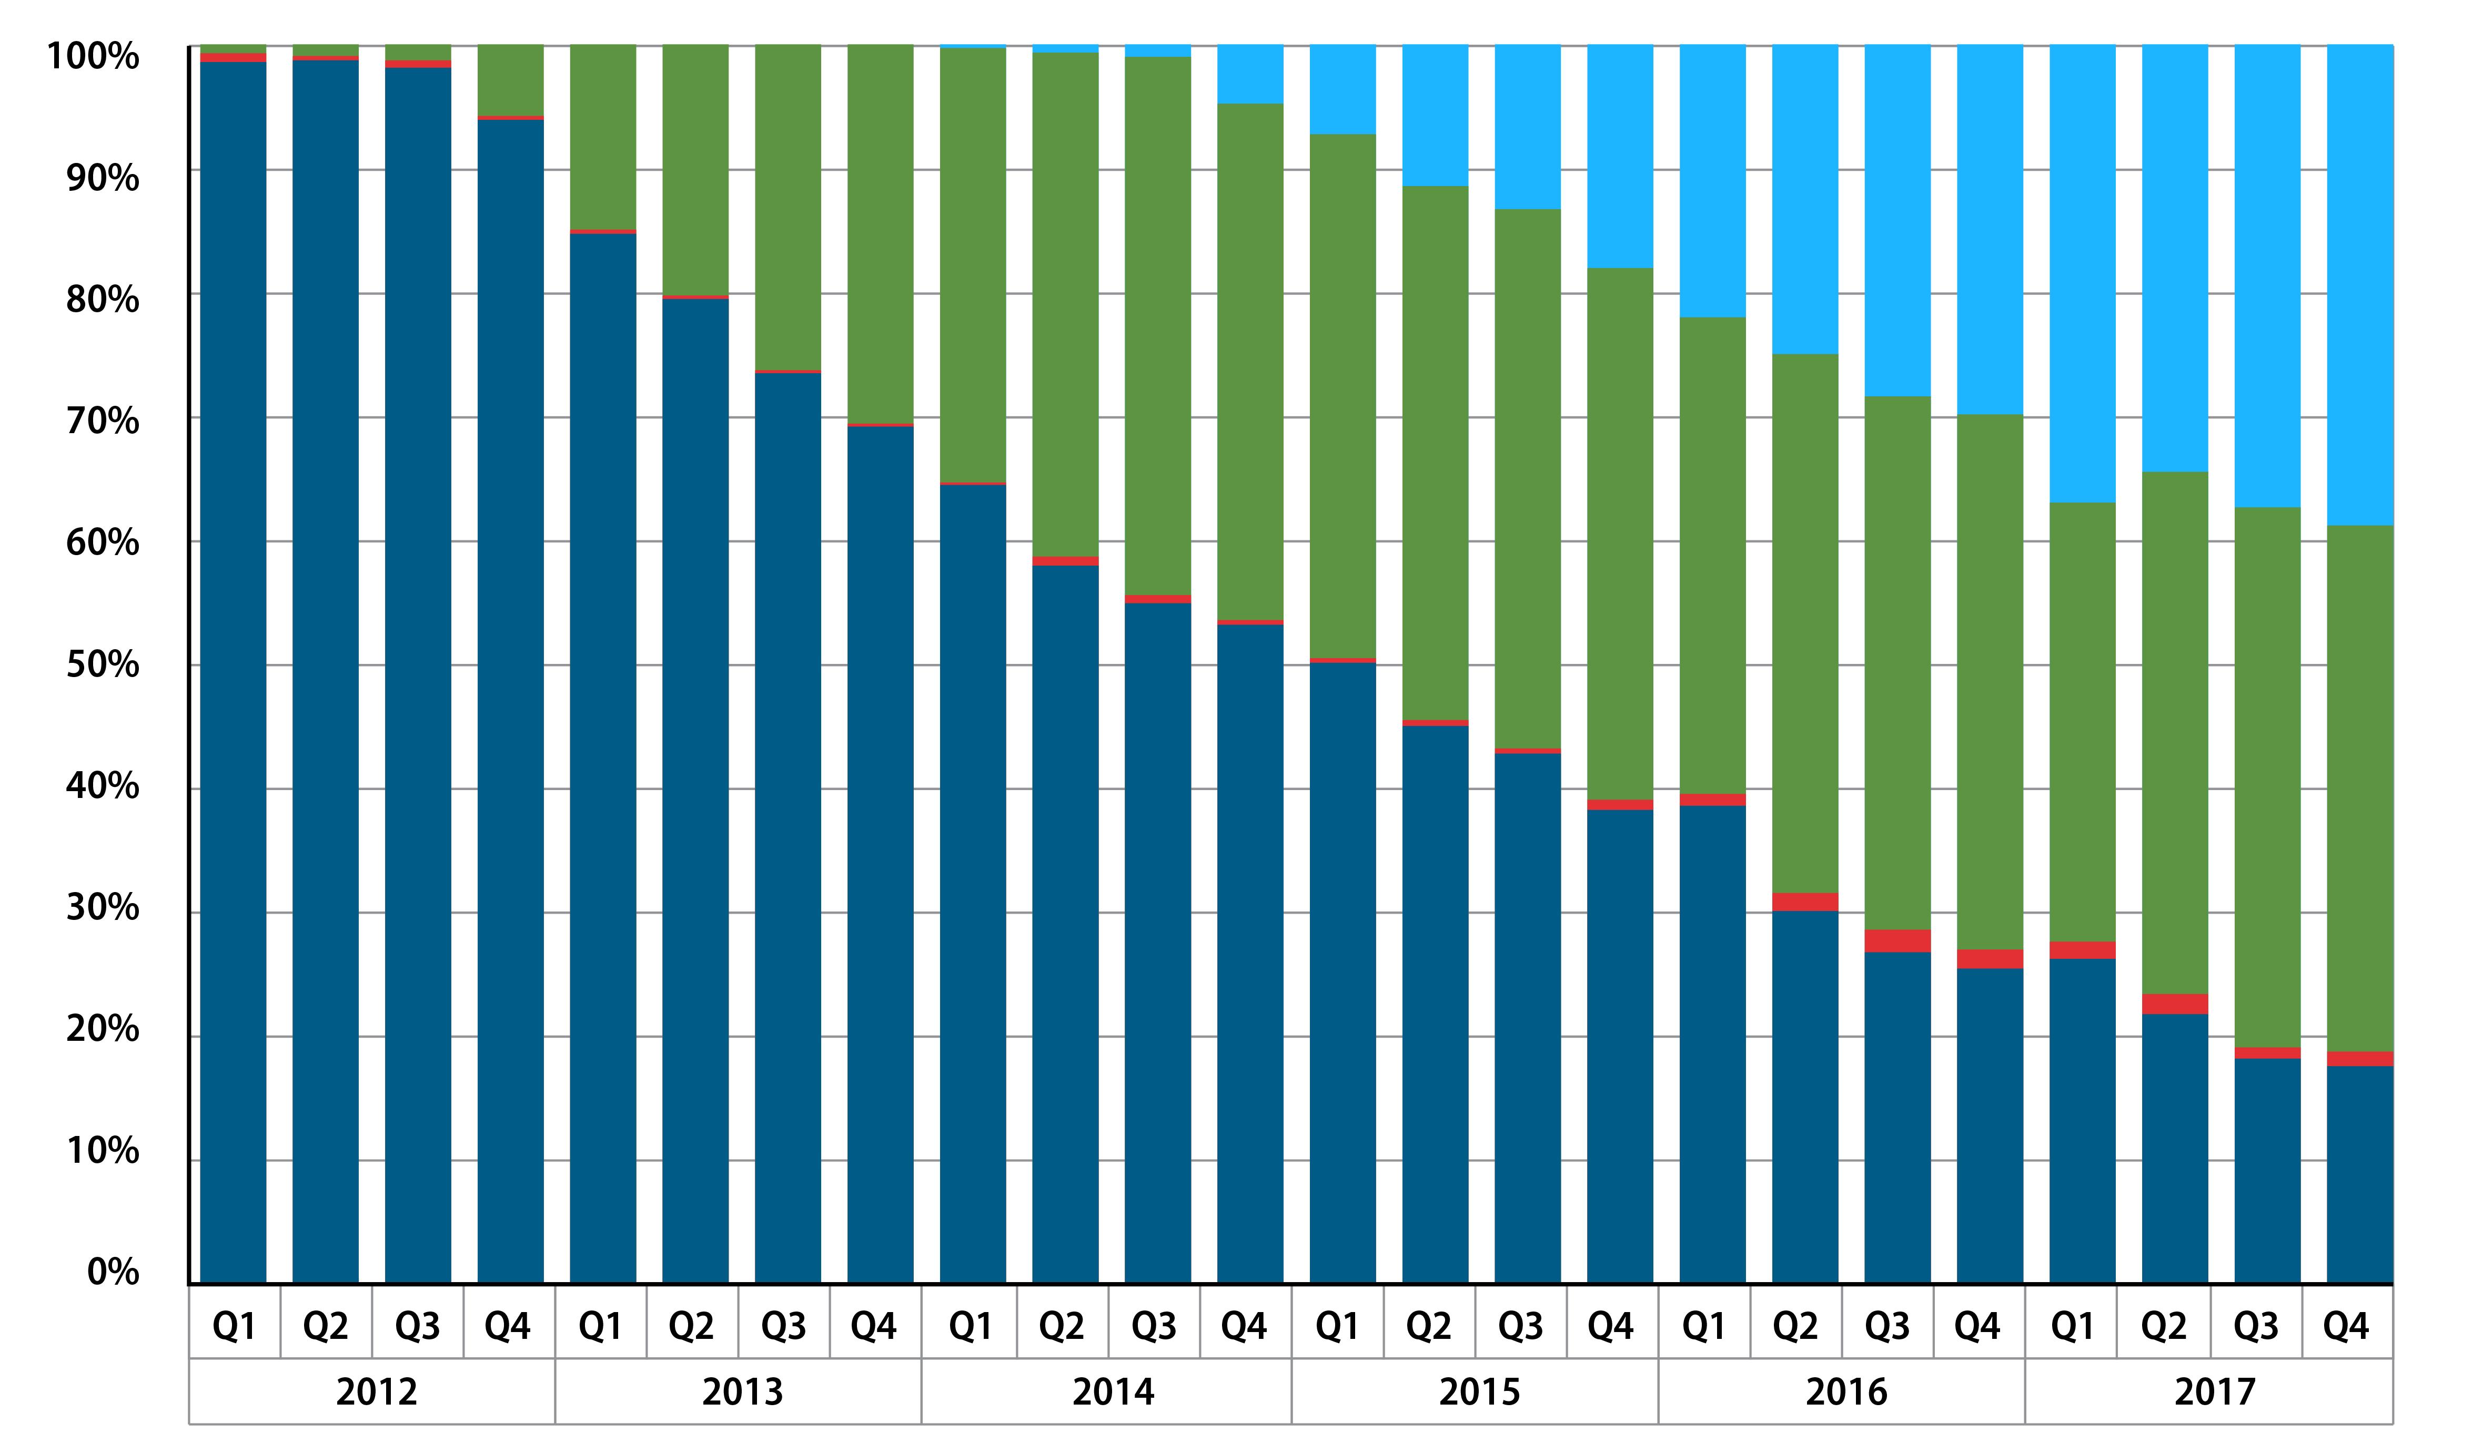
RWE Influence on Anticoagulation Over Time
Warfarin
Dabigatran
Rivaroxaban
Apixaban
Edoxaban
Lutsey PL, et al. Res Pract Thromb Haemost. 2019;3(4):668-673.

Slide 11

Patient Case: Gordon
Black male, age 67
Complains of pain/swelling in right leg that
began 3 days ago
Medical history
  Hypertension
  Type 2 diabetes mellitus
  Hypercholesterolemia
  Unprovoked DVT 3 years ago
Social history
  2-3 alcoholic drinks each evening
  Never smoked
  Telemarketer at call center (sits for extended periods)
  Does not exercise regularly

Slide 12
Patient Case: Gordon (cont’d)
Physical Examination
  Height: 5 ft 9 in; weight: 214 lbs; BMI: 31.6 kg/m²
  Temperature: 98.9° F
  HR: 88 bpm; BP: 138/86
  Lungs: clear
  O₂ saturation on room air: 95%
Medications
  Atorvastatin: 40 mg once daily
  HCTZ: 25 mg once daily
  Irbesartan: 300 mg once daily
  Metformin: 1000 mg once daily
  Insulin degludec: once daily 100 U/mL SC injection
BMI = body mass index; BP = blood pressure; bpm = beats per minute; F = Fahrenheit; ft = feet; HCTZ = hydrochlorothiazide; HR = heart rate;
in = inch; kg = kilogram; lbs = pounds; m² = square meter; mg = milligram; mL = milliliter; O₂ = oxygen; SC = subcutaneous; U = units

Slide 13

Patient Case: Gordon (cont’d)
Let’s hear from Gordon

Slide 14
Faculty Discussion

Slide 15
Factors Associated With Increased Risk of VTE
Gordon’s Risk Factors
Acute medical illness requiring hospitalization
African-American
Cancer chemotherapy
Central venous lines
Comorbid condition (eg, cancer, CVD,T2DM, IBD, CKD, COVID-19)
Decreased mobility
Genetic risk factors
Heparin-induced thrombocytopenia
Injury or trauma to a vein
Age ≥ 65
Male
Obesity or being overweight
Polycythemia vera
Pregnancy or postpartum period
Sedentary lifestyle
Surgery
Thrombophilia disorders (Factor V Leiden mutation, antithrombin deficiency)
Use of estrogen-based medication
CKD = chronic kidney disease; CVD = cardiovascular disease ; IBD = inflammatory bowel disease; T2DM = Type 2 diabetes mellitus
1. Crous-Bou M, et al. Semin Thromb Hemost. 2016;42(8);808-820; 2. Zakai NA, et al. J Thromb Haemost. 2011;9:1877-1882.
3. Piazza G, et al. JAMA. 2020;324(24):2548-2549.

Slide 16
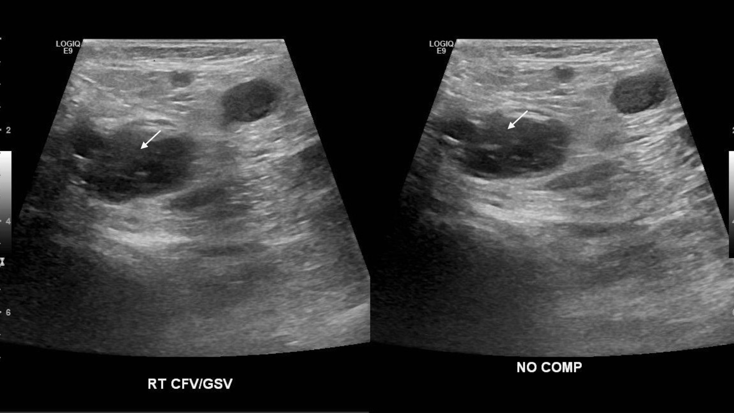
Gordon’s Compression Ultrasound Findings
Gordon’s right common femoral vein is shown to be non-compressible, indicative of DVT
Image shows compression of the vein is prevented by the DVT, which would otherwise appear flat with compression
Cabrera R, et al. Cureus. 2019;11(3):e4337.

Slide 17
Patient Case: Gordon (cont’d)
Let’s hear again from Gordon

Slide 18
Faculty Discussion

Slide 19
Efficacy of DOACs vs VKAs: Meta-Analysis
Outcome Study | RR | Lower limit | Upper limit | Weight (%)
Recurrent VTE
Re-Cover (dabigatran) | 1.1 | .66 | 1.84 | 11.2
Einstein-DVT (rivaroxaban) | .7 | .46 | 1.07 | 16.7
Einstein-PE (rivaroxaban) | 1.13 | .76 | 1.69 | 18.4
Amplify (apixaban) | .84 | .60 | 1.18 | 25.4
Hokusai (edoxaban) | .83 | .60 | 1.14 | 28.3
Sub-total (I² = 0%, p = .46) | .88 | .74 | 1.05 | 100
Fatal PE
Re-Cover (dabigatran) | .33 | .03 | 3.18 | 18
Einstein-DVT (rivaroxaban) | 2.98 | .12 | 73.04 | 9
Einstein-PE (rivaroxaban) | 2 | .18 | 21.99 | 16
Amplify (apixaban) | .5 | .05 | 5.57 | 16
Hokusai (edoxaban) | 1.33 | .3 | 5.96 | 41.1
Sub-total (I² = 0%, p = .71) | 1.02 | .39 | 5.96 | 100
Overall mortality
Re-Cover (dabigatran) | .99 | .55 | 1.81 | 7.1
Einstein-DVT (rivaroxaban) | .77 | .51 | 1.17 | 14.6
Einstein-PE (rivaroxaban) | 1.16 | .80 | 1.68 | 18.3
Amplify (apixaban) | .79 | .53 | 1.19 | 15.6
Hokusai (edoxaban) | 1.05 | .82 | 1.33 | 44.4
Sub-total (/² = 0%, p = .5) | .97 | .83 | 1.14 | 100
  R R (95% CI)
  0.1
  Favors DOACs
  Favors VKAs
  10
van der Hulle T, et al. J Thromb Haemost. 2014;12(3):320-328.

Slide 20
Safety of DOACs in VTE: Meta-Analysis
Relative Risk
ICH = intracerebral hemorrhage
van der Hulle T, et al. J Thromb Haemost. 2014;12(3):320-328.

Slide 21
Anticoagulation Strategy in Evolution
Overlapping
LMWH/Warfarin Bridge¹
UFH/Warfarin Bridge¹
Switching
LMWH to Dabigatran
(RE-COVER)²
LMWH to Edoxaban
(HOKUSAI-VTE)³
Oral Monotherapy
Rivaroxaban (15 mg 2x/d for 3 wks, then 20 mg/d) (EINSTEIN)⁴
Apixaban (10 mg 2x/d for 1 wk, then 5 mg 2x/d) (AMPLIFY)⁵
d = day; mg = milligram; wks = weeks; x = times
1. Streif MB, et al. J Thromb Thrombolysis. 2016;41(1):32-67. 2. Schulman S, et al. N Engl J Med. 2009;361:2342-2352.
3. Hokusai-VTE Investigators, et al. N Engl J Med. 2013;369(15):1406-1415. 4. EINSTEIN Investigators, et al. N Engl J Med.
2010;363(26):2499-2510. 5. Agnelli, et al. N Engl J Med. 2013;369(19):799-808..

Slide 22
Audience Response
On average, what percentage of risk reduction for VTE do DOACs provide when used for secondary prevention?
About 25-30%
Nearly 50%
About 80-90%
More than 95%
I’m not sure

Slide 23
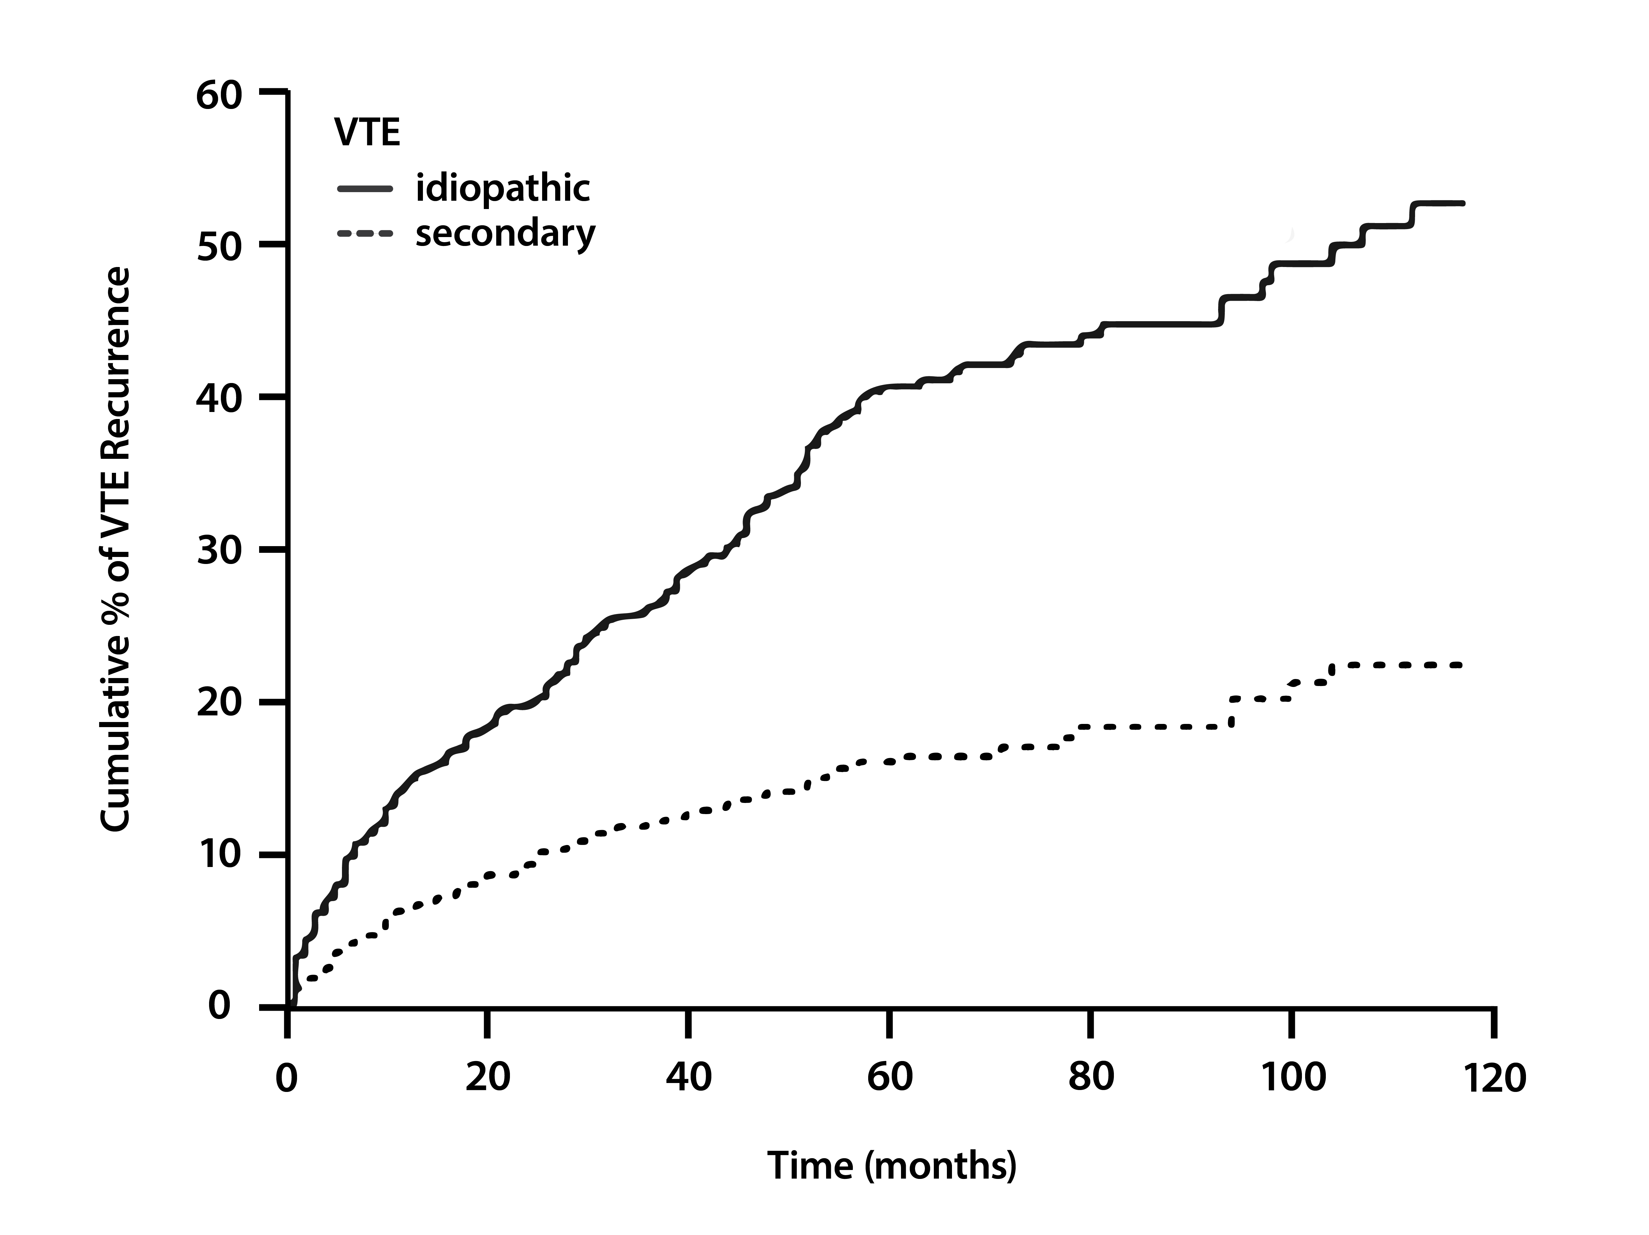
Prevention of Recurrent Unprovoked VTE
Study | Intervention | Recurrent VTE*
PREVENT | Warfarin, INR 1.5 - 2 vs placebo | ↓ 6︎8%
ELATE | Warfarin, INR 2 - 3 vs INR 1.5 - 2 | ↓ 63%
THRIVE III | Ximelagatran vs placebo | ↓ 84%
EINSTEIN-DVT | Rivaroxaban vs placebo | ↓ 82%
EINSTEIN-CHOICE | Rivaroxaban vs aspirin | ↓ 74%
AMPLIFY-EXT | Apixaban vs placebo | ↓ 81%
RE-SONATE | Dabigatran vs placebo | ↓ 93%
RE-MEDY | Dabigatran vs warfarin, INR 2 - 3 | Non-inferior
Cumulative incidence of recurrent thromboembolism separately in patients with idiopathic (unprovoked) and secondary VTE
*regardless of thrombophilia status
INR = international normalized ratio
1. Prandoni P, et al. Haematologica. 2007;92(2):199-205. 2. Goldhaber SZ, Piazza G. Circulation. 2011;123(6):664-667.
3. Robertson L, et al. Cochrane Database Syst Rev. 2017;12(12):CD011088; 4. Weitz JI, et al. N Engl J Med. 2017;376(13):1211-1222.

Slide 24
Audience Response
What did a 2019 study by Nathan, et al. reveal about the use of DOACs for VTE in communities of color?
Annual household income of < $75,000 was associated with a reduced likelihood of being prescribed a DOAC
Black patients were less likely than White patients to be prescribed a DOAC
Disparities were evident only in patients without commercial insurance
Unlike studies in AF, there was not a significant difference in prescribing frequency between Black patients and White patients
I’m not sure

Slide 25
Disparities in Uptake of DOACs for VTE
Nathan, et al. assessed the association of racial/ethnic and socioeconomic factors with DOAC use in VTE
Data was reviewed on 14,140 commercially-insured patients who had an incident diagnosis of VTE between 2010 and 2016
Rate of DOAC use increased from .1% in 2010 to 65.6% in 2016
Race/ethnicity and socioeconomics were found to influence uptake
Black patients less likely than White patients to be prescribed a DOAC (OR 0.86%; 95% CI, 0.77-0.97; p = .02) consistent with prior studies in AF
Annual household income > $100,000 versus < $40,000 associated with greater likelihood of being prescribed a DOAC (OR 1.50; 95% CI 1.33 – 1.69; p < .0001)
Nathan AS, et al. Circ Cardiovasc Qual Outcomes. 2019;12(4):e005600.

Slide 26
Racial/Ethnic Disparities and Implicit Bias
Racial inequities in U.S. medical care are pervasive
Studies suggest provider interactions with patients of color are less patient-centered, with fewer requests for patient input about treatment decisions in general
  Black patients may not be given the same voice to express their preference for DOACs, when preconceived notions exist about preferences and ability to afford newer therapies
Efforts to improve equitable medication uptake and utilization among all racial, ethnic, and socioeconomic groups is needed
Clinicians need to consider social determinants of health
1. Pokorney SD, et al. Am Heart J. 2015;170(1):141-148. 2. EINSTEIN-PE Investigators, et al. N Engl J Med. 2012;366(14):1287-1297.
3. Nathan AS, et al. Circ Cardiovasc Qual Outcomes. 2019;12(4):e005600.

Slide 27
Social Determinants of Health Impact Outcomes
Obesity
Sub-optimal Outcomes
Chronic Diseases
Diabetes
Hypertension
Cardiovascular disease (MI, stroke, VTE)
Pulmonary dysfunction
Social Determinants of Health
Racial and ethnic discrimination; access to healthy food; access to health care; location and physical environment; socioeconomic status; education; social and community context
MI = myocardial infarction
Belanger MJ, et al. N Engl J Med. 2020;383(11):e69.
Notes:
Maynard G. Preventing hospital-associated venous thromboembolism: a guide for effective quality improvement, 2nd ed. Rockville, MD: Agency for Healthcare Research and Quality; August 2016. AHRQ Publication No. 16-0001-EF.
Heit JA. Epidemiology of venous thromboembolism. Nat Rev Cardiol. 2015:12(8):464-474.
Horsted F, West J, Grainge MJ. Risk of venous thromboembolism in patients with cancer: a systematic review and meta-analysis. PLoS Med. 2012;9(7):e1001275.
Horsted, F.;West, J.; Grainge, M.J. Risk of venous thromboembolism in patients with cancer: A systematic
review and meta-analysis. PLoS Med. 2012, 9, 1–19.

Slide 28
Patient Case: Gordon (cont’d)
Let’s hear again from Gordon

Slide 29




Evidence for Shared Decision-Making
Known Benefits
Improve knowledge
Improve patient & provider satisfaction
Decrease decisional conflict/uncertainty
Reduce unnecessary tests/procedures
Clinicians perceive
more discussion than actually occurs
MDs = medical doctors
1. Bouma AB, et al. J Am Board Fam Med. 2014;27(2):292-294. 2. Greenfield S, et al. Ann Intern Med. 1985;102(4):520-528.
3. Lipkin M. JAMA Intern Med. 2013;173(13):1204-1205. 4. Seaburg L, et al. Circulation. 2014;129(6):704-710.

Slide 30
Patient Case: Gordon (Conclusion)
Gordon is treated as an outpatient and
responds well with DOAC therapy
Given his comorbidities and likelihood of
a future VTE, secondary prevention with a DOAC is recommended, perhaps indefinitely
He is taking steps to lose some weight and exercise more
He follows his clinician’s recommendations for regular follow-up appointments

Slide 31
SMART Goals
Specific, Measurable, Attainable, Relevant, Timely
Reflect on your own clinical training and practice and consider ways unconscious bias impacts patient care
Engage patients in shared-decision making, keeping in mind how social determinants of health can impact quality of care and outcomes
Stratify risk for VTE based on patient characteristics and comorbidities
Apply results of randomized controlled trials and RWE to patient care for VTE
Assess the role of DOACs in primary management and secondary prevention of VTE

Slide 32
How to Collect Credit for this Activity
To receive CME/CE credit, click on the
Apply for Credit link to complete
the post-test and evaluation online.
You can print your certificate or
statement of credit immediately.

Slide 33
Visit the
Cardiology Hub
Free resources for HCPs
and patients on VTE
and other cardiology topics
www.cmeoutfitters.com/cardiology

Slide 34

Real-World Data for Real-World Patients: A Broadened Lens to Informed Decision-Making in VTE
Cutting Through Comorbidities: Clearing the Way to Appropriate Anticoagulant Therapy in Patients at Risk for DVT and PE
1
www.cmeoutfitters.com

