Slide 1
Real-World Data for Real-World Patients: A Broadened Lens to Informed Decision-Making in VTE

Slide 2
Cutting Through Comorbidities: Clearing the Way to Appropriate Anticoagulant Therapy in Patients at Risk for DVT and PE
1

Slide 3
Gregory Piazza, MD, MS
Director, Vascular Medicine Section
Brigham and Women’s Hospital
Associate Professor of Medicine
Cardiovascular Medicine
Harvard Medical School
Boston, MA

Slide 4
Geoffrey Barnes, MD, MSc
Assistant Professor, Cardiovascular Medicine
and Vascular Medicine
Department of Internal Medicine
Division of Cardiovascular Medicine
University of Michigan Health System
Ann Arbor, MI

Slide 5
Margot Savoy, MD, MPH, FAAFP, FABC, CPE, CMQ, FAAP
Chair and Associate Professor
Department of Family and Community Medicine
Lewis Katz School of Medicine at Temple University
Philadelphia, PA

Slide 6
Learning
Objective 1
Assess common comorbidities in patients requiring anticoagulants.
Notes:
1:28 Lets start first

Slide 7
Learning
Objective 2
Apply anticoagulant strategies to the care of patients that reflect RCTs, real-world data, and individual patient characteristics.

Slide 8
VTE: A Major U.S. Health Care Imperative
Venous thromboembolism (VTE) comprises deep vein thrombosis (DVT) and pulmonary embolism (PE)
Affects up to 900,000 individuals in the U.S. each year, leading to nearly 100,000 annual VTE-related deaths
Most preventable cause of death in hospitalized patients
Incidence will continue to rise with aging population and as people live longer with chronic conditions
1. Centers for Disease Control and Prevention. Data and statistics on venous thromboembolism. CDC Website. 2020. http://www.cdc.gov/ncbddd/dvt/data.html. Accessed May 10, 2021. 2. Maynard G. Preventing hospital-associated venous
thromboembolism. 2018. http://www.ahrq.gov/patient-safety/resources/vtguide/index.html. Accessed May 10, 2021.

Slide 9
Virtual Consult 1

Slide 10

Patient Case: Walter
Black male, age 71
Presents to primary care physician’s office with pain and
swelling in right leg
Medical history
  Dyslipidemia
  Hypertension
  Type 2 diabetes mellitus
  Surgery for carpal tunnel syndrome 20 years ago
  Social history
  Drinks 2 glasses of wine each evening
  Smoked 1 pack/day cigarettes when in his 20s/30s
  Sedentary job environment (accountant)

Slide 11
Patient Case: Walter (cont’d)
Physical Examination
  Height: 5 ft 10 in; weight: 225 lbs; BMI: 32.3 kg/m²
  Temperature: 98.6° F
  HR: 84 bpm; BP: 134/84
  Lungs: clear
  O₂ saturation on room air: 96%
Medications
  Atorvastatin: 40 mg once daily
  HCTZ: 25 mg once daily
  Valsartan: 80 mg once daily
  Metformin: 1000 mg once daily
  Dulaglutide: 3 mg once-weekly SC injection
BMI = body mass index; BP = blood pressure; bpm = beats per minute; F = Fahrenheit; ft = feet; HCTZ = hydrochlorothiazide; HR = heart rate;
in = inch; kg = kilogram; lbs = pounds; m² = square meter; mg = milligram; O₂ = oxygen; SC = subcutaneous

Slide 12
Audience Response
Which one of the following factors increases Walter’s risk for VTE?
His daily alcohol consumption
His BMI (in obesity range)
His surgical history
Possible Factor V Leiden mutation
I’m not sure

Slide 13
Factors Associated With Increased Risk of VTE
Acute medical illness requiring hospitalization
African-American
Cancer chemotherapy
Central venous lines
Comorbid condition (eg, cancer, CVD,T2DM, IBD, CKD, COVID-19)
Decreased mobility
Genetic risk factors
Heparin-induced thrombocytopenia
Injury or trauma to a vein
Age ≥ 65
Male
Obesity or being overweight
Polycythemia vera
Pregnancy or postpartum period
Sedentary lifestyle
Surgery
Thrombophilia disorders (Factor V Leiden mutation, antithrombin deficiency)
Use of estrogen-based medication
CKD = chronic kidney disease; CVD = cardiovascular disease ; IBD = inflammatory bowel disease; T2DM = Type 2 diabetes mellitus
1. Crous-Bou M, et al. Semin Thromb Hemost. 2016;42(8);808-820; 2. Zakai NA, et al. J Thromb Haemost. 2011;9:1877-1882.
3. Piazza G, et al. JAMA. 2020;324(24):2548-2549.

Slide 14
Factors Associated With Increased Risk of VTE
Walter’s Risk Factors
Acute medical illness requiring hospitalization
African-American
Cancer chemotherapy
Central venous lines
Comorbid condition (eg, cancer, CVD,T2DM, IBD, CKD, COVID-19)
Decreased mobility
Genetic risk factors
Heparin-induced thrombocytopenia
Injury or trauma to a vein
Age ≥ 65
Male
Obesity or being overweight
Polycythemia vera
Pregnancy or postpartum period
Sedentary lifestyle
Surgery
Thrombophilia disorders (Factor V Leiden mutation, antithrombin deficiency)
Use of estrogen-based medication
CKD = chronic kidney disease; CVD = cardiovascular disease ; IBD = inflammatory bowel disease; T2DM = Type 2 diabetes mellitus
1. Crous-Bou M, et al. Semin Thromb Hemost. 2016;42(8);808-820; 2. Zakai NA, et al. J Thromb Haemost. 2011;9:1877-1882.
3. Piazza G, et al. JAMA. 2020;324(24):2548-2549.

Slide 15
Virtual Consult 1

Slide 16
Anticoagulants in VTE
Parenteral Anticoagulants
Unfractionated heparin (UFH)
Low molecular weight heparin (LMWH)
Fondaparinux
Oral Anticoagulants
Vitamin K antagonists (eg, warfarin)
Direct-acting oral anticoagulants (DOACs)
  apixaban, dabigatran, edoxaban, and rivaroxaban
1.Nicholson M, et al. J Clin Med. 2020;9(8):2467-2493. 2. Kearon C, et al. Chest. 2016;149(2):315-352.
Notes:
Witt DM, Nieuwlaat R, Clark NP, et al. American Society of Hematology 2018 guidelines for management of venous thromboembolism: optimal management of anticoagulation therapy. Blood Adv. 2018;2(22):3257-3291.
Kahn SR, Partsch H, Vedantham S, Prandoni P, Kearon C, Subcommittee on Control of Anticoagulation of the Scientific and Standardization Committee of the International Society on Thrombosis and Haemostasis. Definition of post-thrombotic syndrome of the leg for use in clinical investigations: a recommendation for standardization. Thromb Haemost. 2009;7(5):879. Epub 2009 Jan 19.
Abstract: The post-thrombotic syndrome (PTS) is increasingly recognized to be a common and important complication of deep venous thrombosis (DVT). Because there is no 'gold standard' objective test to establish its presence, PTS is diagnosed primarily on the basis of the presence of typical symptoms and clinical signs in a limb that was affected by DVT. As a wide variety of definitions of PTS have been used by researchers, it is difficult to compare data across studies and to formally combine data in meta-analyses. In a step towards standardization of the measurement of PTS in clinical studies, available scales and evidence to support their utility to diagnose PTS and to classify its severity were reviewed and discussed at the Control of Anticoagulation Subcommittee of the International Society on Thrombosis and Haemostasis (Vienna, July 2008).

Slide 17
Virtual Consult 1

Slide 18
Audience Response
Which of the following DOACs do not require parenteral anticoagulation bridging?
Apixaban and edoxaban
Apixaban and rivaroxaban
Dabigatran and edoxaban
Dabigatran and rivaroxaban
I’m not sure

Slide 19
Anticoagulation Strategy in Evolution
Overlapping
LMWH/Warfarin Bridge¹
UFH/Warfarin Bridge¹
Switching
LMWH to Dabigatran
(RE-COVER)²
LMWH to Edoxaban
(HOKUSAI-VTE)³
Oral Monotherapy
Rivaroxaban (15 mg 2x/d for 3 wks, then 20 mg/d) (EINSTEIN)⁴
Apixaban (10 mg 2x/d for 1 wk, then 5 mg 2x/d) (AMPLIFY)⁵
d = day; mg = milligram; wks = weeks; x = times
1. Streif MB, et al. J Thromb Thrombolysis. 2016;41(1):32-67. 2. Schulman S, et al. N Engl J Med. 2009;361:2342-2352.
3. Hokusai-VTE Investigators, et al. N Engl J Med. 2013;369(15):1406-1415. 4. EINSTEIN Investigators, et al. N Engl J Med.
2010;363(26):2499-2510. 5. Agnelli, et al. N Engl J Med. 2013;369(19):799-808.

Slide 20
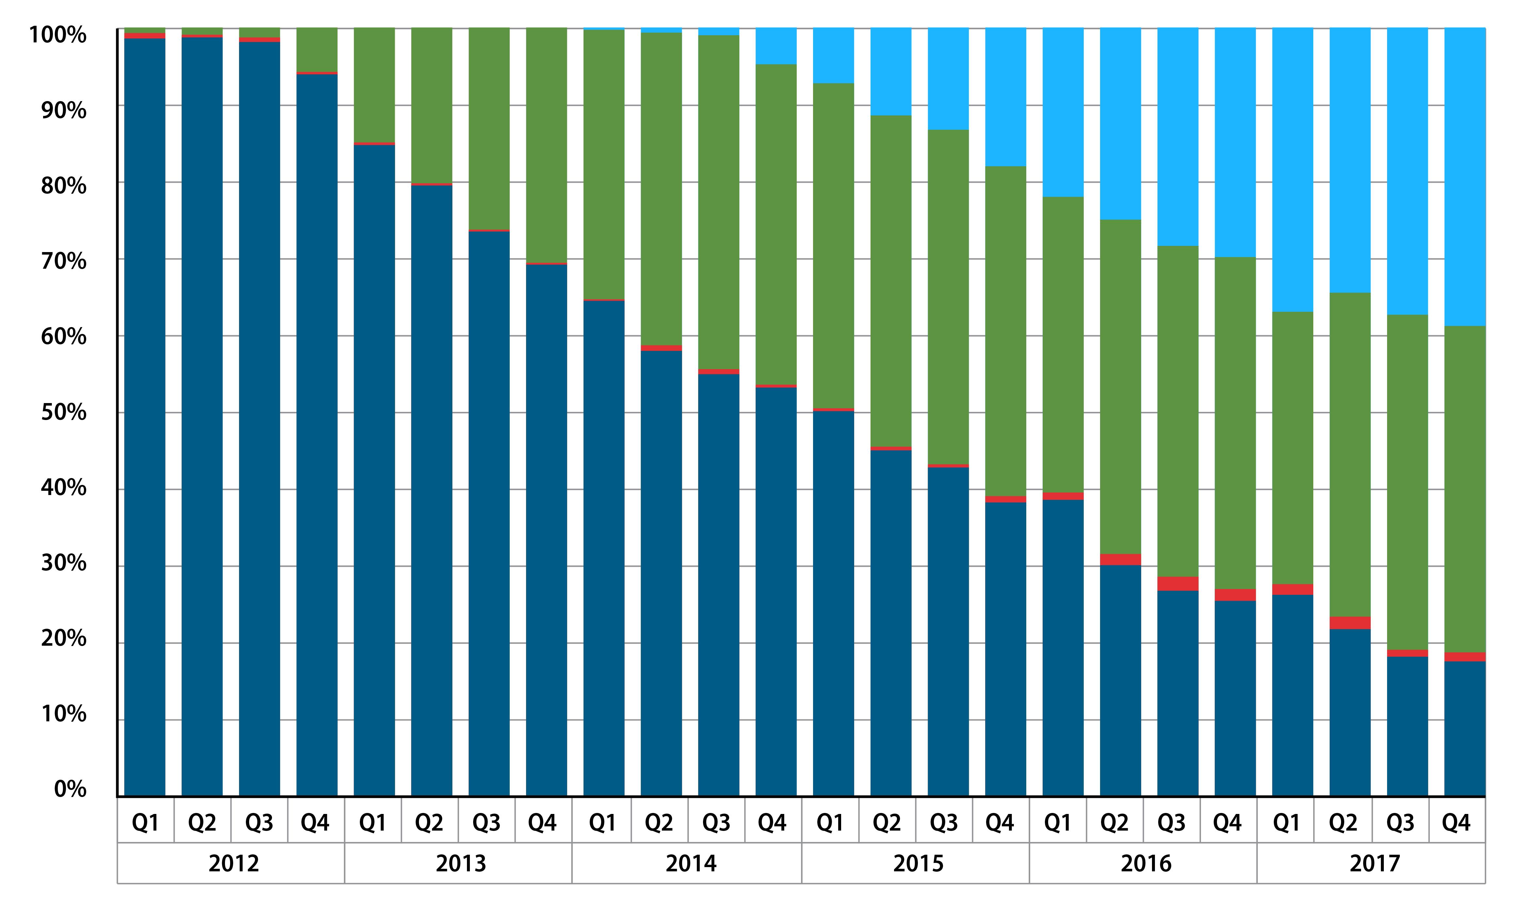
RWE Influence on Anticoagulation Over Time
Warfarin
Dabigatran
Rivaroxaban
Apixaban
Edoxaban
Lutsey PL, et al. Res Pract Thromb Haemost. 2019;3(4):668-673.

Slide 21




Evidence for Shared Decision-Making
Known Benefits
Improve knowledge
Improve patient & provider satisfaction
Decrease decisional conflict/uncertainty
Reduce unnecessary tests/procedures
Clinicians perceive
more discussion than actually occurs
1. Bouma AB, et al. J Am Board Fam Med. 2014;27(2):292-294. 2. Greenfield S, et al. Ann Intern Med. 1985;102(4):520-528.
3. Lipkin M. JAMA Intern Med. 2013;173(13):1204-1205. 4. Seaburg L, et al. Circulation. 2014;129(6):704-710.

Slide 22
Audience Response
Should Walter’s anticoagulation therapy be extended beyond 6 months?
Yes, because of his age and ongoing chronic risk factors
No, because of increased bleeding risk
No, because data does not currently support extended therapy
I’m not sure

Slide 23
Virtual Consult 2

Slide 24
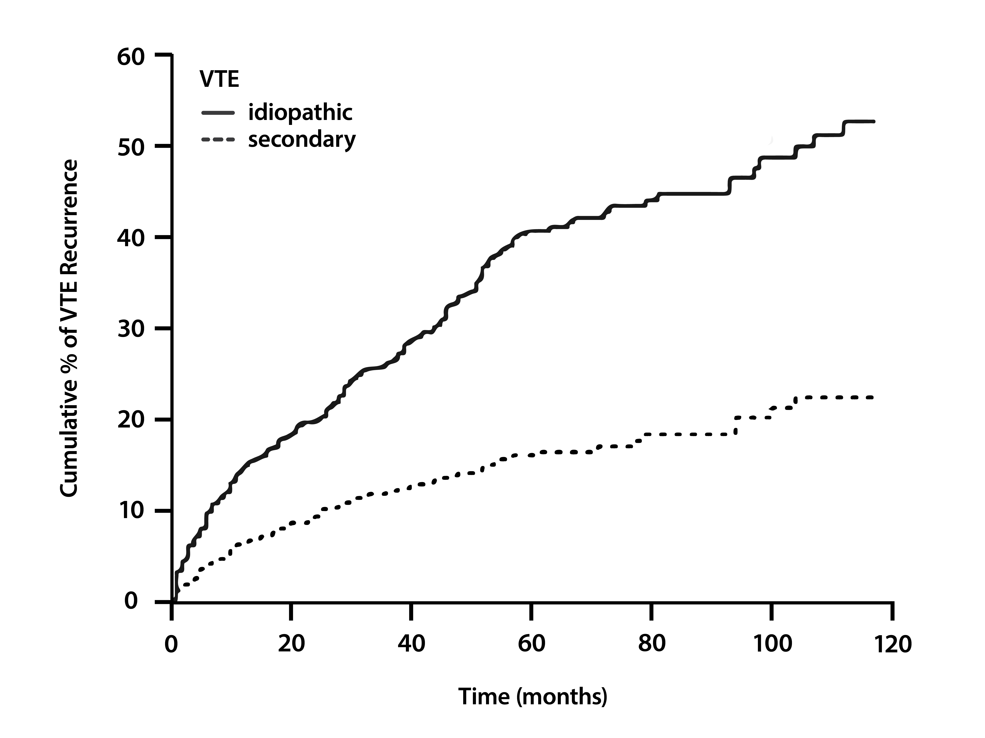
Prevention of Recurrent Unprovoked VTE
Study | Intervention | Recurrent VTE*
PREVENT | Warfarin, INR 1.5 - 2 vs placebo | ↓ 6︎8%
ELATE | Warfarin, INR 2 - 3 vs INR 1.5 - 2 | ↓ 63%
THRIVE III | Ximelagatran vs placebo | ↓ 84%
EINSTEIN-DVT | Rivaroxaban vs placebo | ↓ 82%
AMPLIFY-EXT | Apixaban vs placebo | ↓ 81%
RE-SONATE | Dabigatran vs placebo | ↓ 93%
RE-MEDY | Dabigatran vs warfarin, INR 2 - 3 | Non-inferior
Cumulative incidence of recurrent thromboembolism separately in patients with idiopathic (unprovoked) and secondary VTE
*regardless of thrombophilia status
INR = international normalized ratio
1. Prandoni P, et al. Haematologica. 2007;92(2):199-205. 2. Goldhaber SZ, Piazza G. Circulation. 2011;123(6):664-667.
3. Robertson L, et al. Cochrane Database Syst Rev. 2017;12(12):CD011088.

Slide 25
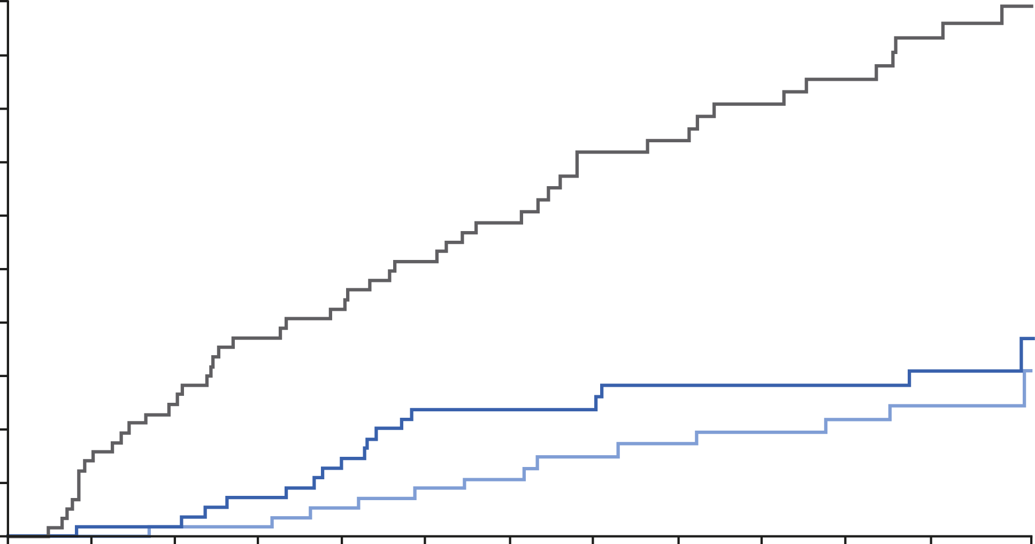
EINSTEIN CHOICE Study
Fatal or Nonfatal VTE
5
74% relative risk reduction: rivaroxaban vs aspirin [HR (95% CI): 0.26 (0.14-0.47) P<.001
Similar rates of bleeding
Aspirin 4.4% (50/1131)
4
3
Cumulative incidence (%)
2
Rivaroxaban 20 mg 1.5% (17/1107)
1
Rivaroxaban 10 mg 1.2% (13/1127)
0
1
30
60
90
120
150
180
210
240
270
300
330
367
Days
Weitz JI, et al. N Engl J Med. 2017;376(13):1211-1222.

Slide 26
ESC Guidelines: Risk Factors for VTE Based on the Risk of Recurrence Over the Long-Term
Estimated Risk | Risk Factor Category for Index PE | Examples
Low ≤3% per year | Major transient or reversible factors associated with >10-fold increased risk for index VTE event (compared to patients without the risk factor) | Surgery with general anesthesia for >30 min Confined to bed in hospital (only “bathroom privileges”) for ≥3 days due to an acute illness; acute exacerbation of chronic illness Trauma with fractures
Intermediate 3-8% per year | Transient or reversible factors associated with ≤10-fold increased risk for first (index) VTE | Minor surgery (general anesthesia for <30 min) Admission to hospital for <3 days with an acute illness Estrogen therapy/contraception Pregnancy or puerperium Confined to bed out of hospital for ≥3 days with an acute illness Leg injury (w/o fracture) associated with ↓ mobility for ≥3 days Long-haul flight
 | Non-malignant persistent risk factors | Inflammatory bowel disease Active autoimmune disease
 | No identifiable risk factor
High >8% per year |  | Active cancer One or more previous episodes of VTE in the absence of a major transient or reversible factor Antiphospholipid antibody syndrome
ESC = European Society of Cardiology
Konstantinides SV, et al. Eur Health J. 2019;00:1-61.
Notes:
16:33 it is also recommended

Slide 27
SMART Goals
Specific, Measurable, Attainable, Relevant, Timely
Stratify risk for VTE based on patient characteristics and comorbidities
Apply results of anticoagulation RCTs and RWE to the care of patients with VTE
Assess the utility of DOACs in short- and long-term management and secondary prevention of VTE
Engage patients with or at risk for VTE in shared-decision making and ongoing patient education
Consult with or refer to specialists for VTE management when appropriate

Slide 28
Visit the
Cardiology Hub
Free resources for HCPs
and patients on VTE
and other cardiology topics
www.cmeoutfitters.com/cardiology

Slide 29
How to Collect Credit for this Activity
To receive CME/CE credit, click on the link to complete the post-test and evaluation online.
You can print your certificate or
statement of credit immediately.

Slide 30

Real-World Data for Real-World Patients: A Broadened Lens to Informed Decision-Making in VTE
2
Addressing Disparities in Care: Assessing Patient Characteristics When Determining Next Steps for Anticoagulant Treatment Selection
www.cmeoutfitters.com

