Slide 1

EPISODE 1
Breakthroughs in the Management of Idiopathic Hypersomnia: The Future is Now
Supported by an educational grant from Jazz Pharmaceuticals, Inc.
Notes:
AG

Slide 2
Richard K. Bogan, MD, FCCP, FAASM
President of Bogan Sleep Consultants, LLC
Medical Officer, SleepMed, Inc.
Associate Clinical Professor, University of South Carolina
School of Medicine, Columbia, SC
Associate Clinical Professor,
Medical University of South Carolina
Charleston, SC

Slide 3
Yves Dauvilliers, MD, PhD
Professor of Neurology and Physiology
University of Montpellier
Director, Sleep-Wake Disorders Centre
Department of Neurology
Gui de Chauliac Hospital
Montpellier, France

Slide 4
Learning
Objective
1
Assess the clinical significance of trial results of emerging therapies for idiopathic hypersomnia.

Slide 5
How to Treat IH
Main symptoms of IH: EDS, long sleep at night, and sleep inertia
No approved drugs for the treatment of IH*
No standard to treat long sleep and sleep inertia
Treatment approaches for EDS in IH similar to narcolepsy
AASM 2021 draft guideline updates recommends the following for IH:
  Use modafinil for the treatment of idiopathic hypersomnia in adults. (Strong)
  Use clarithromycin for the treatment of idiopathic hypersomnia in adults. (Conditional)
  Use methylphenidate for the treatment of idiopathic hypersomnia in adults. (Conditional)
  Use pitolisant for the treatment of idiopathic hypersomnia in adults. (Conditional)
  Use sodium oxybate for the treatment of idiopathic hypersomnia in adults. (Conditional)
*Lower-sodium oxybate was FDA-approved on August 12, 2021 for the treatment of idiopathic hypersomnia in adults after this activity launched.
EDS = excessive daytime sleepiness; IH = idiopathic hypersomnia
Maski K, et al. J Clin Sleep Med. 2021 Mar 15. [Epub ahead of print].
Notes:
Treatment of Central Disorders of Hypersomnolence:
An American Academy of Sleep Medicine Clinical Practice Guideline
Introduction: This guideline establishes clinical practice recommendations for the treatment of central disorders of hypersomnolence in adults and children.
Methods: The American Academy of Sleep Medicine (AASM) commissioned a task force of experts in sleep medicine to develop recommendations and assign strengths of treatment based on a systematic review of the literature and an assessment of the evidence using the GRADE process. The task force provided a summary of the relevant literature and the quality of evidence, the balance of benefits and harms, patient values and preferences, and resource use considerations that support the recommendations. The AASM Board of Directors approved the final recommendations.
Recommendations: The following recommendations are intended as a guide for clinicians in choosing a specific treatment for central disorders of hypersomnolence in adults and children. Each recommendation statement is assigned a strength (“Strong” or “Conditional”). A “Strong” recommendation (i.e., “We recommend…”) is one that clinicians should follow under most circumstances. A “Conditional” recommendation (i.e. “We suggest…”) is one that requires that the clinician use clinical knowledge and experience, and strongly considers the individual patient’s values and preferences to determine the best course of action.
Adult patients with narcolepsy
1. We recommend that clinicians use modafinil for the treatment of narcolepsy in adults. (Strong)
2. We recommend that clinicians use pitolisant for the treatment of narcolepsy in adults. (Strong)
3. We recommend that clinicians use sodium oxybate for the treatment of narcolepsy in adults. (Strong)
4. We recommend that clinicians use solriamfetol for the treatment of narcolepsy in adults. (Strong)
5. We suggest that clinicians use armodafinil for the treatment of narcolepsy in adults. (Conditional)
6. We suggest that clinicians use dextroamphetamine for the treatment of narcolepsy in adults. (Conditional)
7. We suggest that clinicians use methylphenidate for the treatment of narcolepsy in adults. (Conditional)
8. We suggest that clinicians not use clomipramine for the treatment of narcolepsy in adults. (Conditional)
Adult patients with idiopathic hypersomnia
9. We recommend that clinicians use modafinil for the treatment of idiopathic hypersomnia in adults. (Strong)
10. We suggest that clinicians use clarithromycin for the treatment of idiopathic hypersomnia in adults. (Conditional)
11. We suggest that clinicians use methylphenidate for the treatment of idiopathic hypersomnia in adults. (Conditional)
12. We suggest that clinicians use pitolisant for the treatment of idiopathic hypersomnia in adults. (Conditional)
13. We suggest that clinicians use sodium oxybate for the treatment of idiopathic hypersomnia in adults. (Conditional)

Slide 6
LXB:* Efficacy in IH Study Design
Treatment at study entry
SXB only
SXB + alerting agent
Alerting agent only
Treatment naive
LXB
LXB
LXB
OLT
SDP
LXB
OLE
Safety
follow-up
Randomization
Placebo
DBRWP
(2 weeks)
(24 weeks)
(2 weeks)
(10-14 weeks)
(2 weeks)
Screening period
(≤ 30 days)
*LXB was FDA-approved on August 12, 2021 for the treatment of IH in adults.
DBRWP = double-blind randomized withdrawal period; LXB = lower-sodium oxybate; OLE = open-label safety extension;
OLT = open-label titration and optimization period; SDP = stable-dose period; SXB = sodium oxybate
Bogan RK, et al. SLEEP 2021 Annual Meeting. Abstract 487.; Dauvilliers Y, et al. SLEEP 2021 Annual Meeting. Abstract 494.

Slide 7
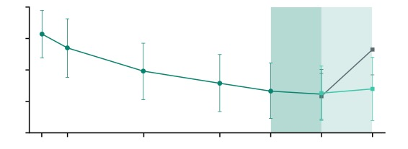
LXB:* Efficacy in IH – Epworth Sleepiness Scale (ESS)
20
OL LXB (n = 115)
OLT
SDP
DBRWP
DB LXB (n = 56)
15
DB Placebo (n = 59)
p < .0001
Improvement
10
Worsening
Mean ESS Score (SD)
5
0
D1
W1
W4
W8
End OLT
End SDP
End DBRWP
Mean ESS score decreased (improved) from study entry to end of SDP with LXB
Mean ESS score worsened from end of SDP to end of DBRWP with placebo;
improvement was maintained with LXB
Statistically significant least squares mean difference (95% CI) between LXB and placebo from end of SDP to end of DBRWP: −6.51 (−7.99, −5.03); p < .0001
*LXB was FDA-approved on August 12, 2021 for the treatment of IH in adults.
Dauvilliers Y, et al. SLEEP 2021 Annual Meeting. Abstract No: 494.
Notes:
Titration and optimization period (OLT)
Dauvilliers Y, et al. AAN Virtual Annual Meeting; 2021.
Efficacy and Safety of Lower-Sodium Oxybate in a Phase 3, Placebo-Controlled, Double-Blind, Randomized Withdrawal Study in Adult Participants With Idiopathic Hypersomnia
Objective:
Evaluate efficacy/safety of calcium, magnesium, potassium, and sodium oxybates (lower-sodium oxybate [LXB], XywavTM; previously designated JZP-258), a novel oxybate treatment with 92% less sodium than sodium oxybate (SXB; Xyrem®) in adults with idiopathic hypersomnia (IH).
Background:
IH is a rare central hypersomnolence disorder characterized by severe daytime sleepiness, prolonged nighttime sleep, and sleep inertia. No treatment is currently approved for IH.
Design/Methods:
Eligible participants aged 18–75 years with IH began LXB treatment with an open-label titration and optimization period (10–14 weeks), followed by a 2-week, open-label, stable-dose period (SDP). Participants were randomized to placebo or to continue LXB treatment during a 2-week, double-blind, randomized withdrawal period (DBRWP). The primary efficacy endpoint was change in Epworth Sleepiness Scale (ESS) score; key secondary endpoints included proportion of participants who reported worsening (minimally/much/very much worse) on Patient Global Impression of Change (PGIc) and change in Idiopathic Hypersomnia Severity Scale (IHSS) score, all from end of SDP to end of DBRWP.
Results:
The safety population included 154 participants (mean±SD age: 40±14 years; 68% female; mean±SD ESS: 16±3.6); mean±SD dose was 6.0±1.6 g/night. At the end of the DBRWP, significant worsening was observed in participants randomized to placebo vs LXB in ESS scores (n=115; LS mean difference [95% CI] in change from SDP: −6.51 [−7.99,−5.03]; P<0.0001), PGIc (88.1% for placebo vs 21.4% for LXB; P<0.0001), and IHSS score (estimated median difference [95% CI]: −12.00 [−15.0,−8.0]; P<0.0001). Common treatment-emergent adverse events (TEAEs) included nausea (21.4%), headache (16.2%), dizziness (11.7%), anxiety (10.4%), and vomiting (10.4%). Serious TEAEs occurred in 4 participants (non-cardiac chest pain, rhabdomyolysis, syncope, and nephrolithiasis/pyelonephritis); none were deemed related to study drug.
Conclusions:
In participants with IH, LXB demonstrated a clinically meaningful effect on excessive daytime sleepiness, self-reported global change, and overall IH symptom severity. The overall safety profile was consistent with that of SXB.

Slide 8
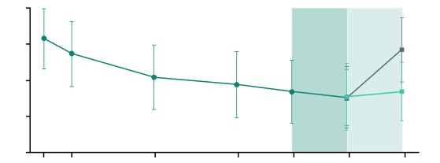
LXB: Efficacy in IH – Idiopathic Hypersomnia Severity Scale (IHSS)
40
OL LXB (n = 115)
OLT
SDP
DBRWP
DB LXB (n = 56)
30
DB Placebo (n = 59)
p < .0001
Improvement
20
Mean IHSS Score (SD)
Worsening
10
0
D1
W1
W4
W8
End OLT
End SDP
End DBRWP
Mean IHSS score decreased (improved) from study entry to end of SDP with LXB
Mean IHSS score worsened from end of SDP to end of DBRWP with placebo; improvement was maintained with LXB
Statistically significant median difference (95% CI) in IHSS between LXB and placebo in change from end of SDP to end of DBRWP was −12.00 (−15.00, −8.00); p < .0001
*LXB was FDA-approved on August 12, 2021 for the treatment of IH in adults.
Dauvilliers Y, et al. SLEEP 2021 Annual Meeting. Abstract 494.
Notes:
Dauvilliers Y, et al. AAN Virtual Annual Meeting; 2021.
Efficacy and Safety of Lower-Sodium Oxybate in a Phase 3, Placebo-Controlled, Double-Blind, Randomized Withdrawal Study in Adult Participants With Idiopathic Hypersomnia
Objective:
Evaluate efficacy/safety of calcium, magnesium, potassium, and sodium oxybates (lower-sodium oxybate [LXB], XywavTM; previously designated JZP-258), a novel oxybate treatment with 92% less sodium than sodium oxybate (SXB; Xyrem®) in adults with idiopathic hypersomnia (IH).
Background:
IH is a rare central hypersomnolence disorder characterized by severe daytime sleepiness, prolonged nighttime sleep, and sleep inertia. No treatment is currently approved for IH.
Design/Methods:
Eligible participants aged 18–75 years with IH began LXB treatment with an open-label titration and optimization period (10–14 weeks), followed by a 2-week, open-label, stable-dose period (SDP). Participants were randomized to placebo or to continue LXB treatment during a 2-week, double-blind, randomized withdrawal period (DBRWP). The primary efficacy endpoint was change in Epworth Sleepiness Scale (ESS) score; key secondary endpoints included proportion of participants who reported worsening (minimally/much/very much worse) on Patient Global Impression of Change (PGIc) and change in Idiopathic Hypersomnia Severity Scale (IHSS) score, all from end of SDP to end of DBRWP.
Results:
The safety population included 154 participants (mean±SD age: 40±14 years; 68% female; mean±SD ESS: 16±3.6); mean±SD dose was 6.0±1.6 g/night. At the end of the DBRWP, significant worsening was observed in participants randomized to placebo vs LXB in ESS scores (n=115; LS mean difference [95% CI] in change from SDP: −6.51 [−7.99,−5.03]; P<0.0001), PGIc (88.1% for placebo vs 21.4% for LXB; P<0.0001), and IHSS score (estimated median difference [95% CI]: −12.00 [−15.0,−8.0]; P<0.0001). Common treatment-emergent adverse events (TEAEs) included nausea (21.4%), headache (16.2%), dizziness (11.7%), anxiety (10.4%), and vomiting (10.4%). Serious TEAEs occurred in 4 participants (non-cardiac chest pain, rhabdomyolysis, syncope, and nephrolithiasis/pyelonephritis); none were deemed related to study drug.
Conclusions:
In participants with IH, LXB demonstrated a clinically meaningful effect on excessive daytime sleepiness, self-reported global change, and overall IH symptom severity. The overall safety profile was consistent with that of SXB.

Slide 9
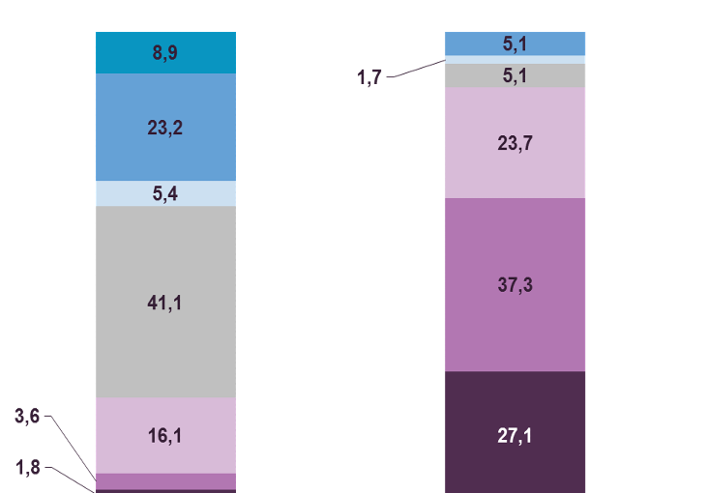

LXB*: Efficacy in IH – Patient Global Impression of Change (PGI-C)
From End of SDP to End of DBRWP
100
8.9
5.1
Improved
1.7
5.1
Very much improved
80
23.2
Much improved
23.7
Minimally improved
60
5.4
p < .0001
No change
Percentage of Participants
Minimally worse
37.3
88.1%
40
41.1
Much worse
Very much worse
20
Worsened
3.6
16.1
21.4%
27.1
1.8
0
LXB (n = 56)
Placebo (n = 59)
At the end of DBRWP, statistically significant worsening in PGI-C ratings was observed in participants randomized to placebo vs. LXB (88.1% vs. 21.4% rated minimally/much/very much worse); p < 0.0001
*LXB was FDA-approved on August 12, 2021 for the treatment of IH in adults.
Dauvilliers Y, et al. SLEEP 2021 Annual Meeting. Abstract 494.
Notes:
Dauvilliers Y, et al. AAN Virtual Annual Meeting; 2021.
Efficacy and Safety of Lower-Sodium Oxybate in a Phase 3, Placebo-Controlled, Double-Blind, Randomized Withdrawal Study in Adult Participants With Idiopathic Hypersomnia
Objective:
Evaluate efficacy/safety of calcium, magnesium, potassium, and sodium oxybates (lower-sodium oxybate [LXB], XywavTM; previously designated JZP-258), a novel oxybate treatment with 92% less sodium than sodium oxybate (SXB; Xyrem®) in adults with idiopathic hypersomnia (IH).
Background:
IH is a rare central hypersomnolence disorder characterized by severe daytime sleepiness, prolonged nighttime sleep, and sleep inertia. No treatment is currently approved for IH.
Design/Methods:
Eligible participants aged 18–75 years with IH began LXB treatment with an open-label titration and optimization period (10–14 weeks), followed by a 2-week, open-label, stable-dose period (SDP). Participants were randomized to placebo or to continue LXB treatment during a 2-week, double-blind, randomized withdrawal period (DBRWP). The primary efficacy endpoint was change in Epworth Sleepiness Scale (ESS) score; key secondary endpoints included proportion of participants who reported worsening (minimally/much/very much worse) on Patient Global Impression of Change (PGIc) and change in Idiopathic Hypersomnia Severity Scale (IHSS) score, all from end of SDP to end of DBRWP.
Results:
The safety population included 154 participants (mean±SD age: 40±14 years; 68% female; mean±SD ESS: 16±3.6); mean±SD dose was 6.0±1.6 g/night. At the end of the DBRWP, significant worsening was observed in participants randomized to placebo vs LXB in ESS scores (n=115; LS mean difference [95% CI] in change from SDP: −6.51 [−7.99,−5.03]; P<0.0001), PGIc (88.1% for placebo vs 21.4% for LXB; P<0.0001), and IHSS score (estimated median difference [95% CI]: −12.00 [−15.0,−8.0]; P<0.0001). Common treatment-emergent adverse events (TEAEs) included nausea (21.4%), headache (16.2%), dizziness (11.7%), anxiety (10.4%), and vomiting (10.4%). Serious TEAEs occurred in 4 participants (non-cardiac chest pain, rhabdomyolysis, syncope, and nephrolithiasis/pyelonephritis); none were deemed related to study drug.
Conclusions:
In participants with IH, LXB demonstrated a clinically meaningful effect on excessive daytime sleepiness, self-reported global change, and overall IH symptom severity. The overall safety profile was consistent with that of SXB.

Slide 10
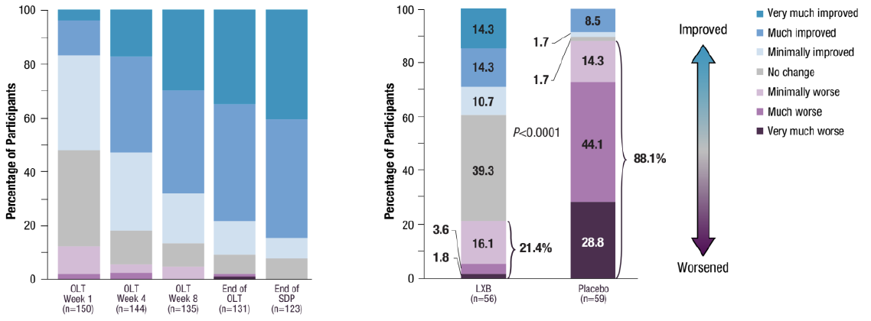
LXB*: Efficacy in IH – Clinical Global Impression of Change (CGI-C)
From End of SDP to End of DBRWP
100
14.3
8.5
Improved
1.7
Very much improved
80
14.3
14.3
Much improved
1.7
Minimally improved
10.7
60
No change
p < .0001
44.1
Percentage of Participants
Minimally worse
88.1%
40
39.3
Much worse
Very much worse
20
3.6
Worsened
16.1
21.4%
28.8
1.8
0
LXB (n = 56)
Placebo (n = 59)
At the end of DBRWP, worsening in CGI-C ratings was observed in participants randomized to placebo vs. LXB
(88.1% vs. 21.4% rated minimally/much/very much worse); p < .0001
*LXB was FDA-approved on August 12, 2021 for the treatment of IH in adults.
Dauvilliers Y, et al. SLEEP 2021 Annual Meeting. Abstract No. 494.

Slide 11
LXB: Efficacy in IH – Visual Analog Scale for Sleep Inertia (VAS-SI)
100
LS mean difference (95% CI)^{b,c}:
–22.2 (–29.7, –14.8)
p < .0001
Open-label LXB (all participants)
90
Placebo during DBRWP
80
LXB during DBRWP
70
60
54.4
55.3
50
More severe sleep inertia
Mean (SD) VAS-SI Score
40
30
32.3
28.5
28.3
20
24.8
10
0
Baseline
(Last Week of Screening)
(n = 105)
Last Week
of SDP
(n = 102)
Last Week
of DBRWR
(n = 53/group)
Study Week
ªModified intent-to-treat population.
^{b}Difference in change from end of SDP to end of DBRWP. ^{c}LXB, n = 49; placebo, n = 51.
*LXB was FDA-approved on August 12, 2021 for the treatment of IH in adults.
Bogan RK, et al. SLEEP 2021 Annual Meeting. Abstract No. 487.
Notes:
Bogan RK, et al. Effect of Lower-Sodium Oxybate on Sleep Inertia in Idiopathic Hypersomnia in a Double-Blind Randomized Withdrawal Study. Sleep 2021, 35th Annual Meeting of APSS; 2021. Abstract 487.
487 EFFECT OF LOWER-SODIUM OXYBATE ON SLEEP INERTIA IN IDIOPATHIC HYPERSOMNIA IN A DOUBLEBLIND, RANDOMIZED WITHDRAWAL STUDY. A192
Richard Bogan,1 Yves Dauvilliers,2 Michael Thorpy,3 Patricia Chandler,4 Abby Chen,4 Dan Chen,4 Isabelle Arnulf5
1University of South Carolina School of Medicine, 2Sleep and Wake Disorders Centre, Department of Neurology, Gui de Chauliac Hospital, 3Albert Einstein College of Medicine, 4Jazz Pharmaceuticals, Inc., 5Sleep Disorder Unit, Piti.-Salp.tri.re Hospital and Sorbonne University
Introduction: Idiopathic hypersomnia (IH) is a rare central hypersomnolence disorder characterized by excessive daytime sleepiness. A common feature is sleep inertia, which is prolonged difficulty waking up accompanied by confusion, disorientation, poor motor coordination, and repeated returns to sleep. Sleep inertia is burdensome to patients, resulting in missed work or school, and patients may be dependent on others to wake them. No treatment is currently approved for IH. The efficacy and safety of lower-sodium oxybate (LXB; Xywav™), a novel oxybate treatment with 92% less sodium than sodium oxybate (Xyrem.), was evaluated in a phase 3 study (NCT03533114) in adults with IH. We focus here on the drug effect on sleep inertia.
Methods: Eligible participants aged 18–75 years with IH began LXB treatment with an open-label treatment titration and optimization period (OLTTOP; 10–14 weeks), followed by a 2-week, open-label, stable-dose period (SDP). Participants were randomized to placebo or to continue LXB treatment during a 2-week, double-blind, randomized withdrawal period (DBRWP). The primary efficacy endpoint was change in Epworth Sleepiness Scale score. The visual analog scale for sleep inertia (VAS-SI) was included as an exploratory endpoint. The VAS-SI, administered daily during the last 2 weeks of screening before baseline, SDP, and DBRWP, is a self-reported retrospective measure of difficulty awakening each morning using a 100-mm line with anchors 0 (very easy) and 100 (very difficult).
Results: The safety population included 154 participants (mean+SD age, 40+14 years; 68% female); modified intent-to-treat population, n=115. VAS-SI scores gradually decreased from week 2 of screening
(mean+SD, 56.6+25.1) to week 2 of SDP (29.0+20.8). During week 2 of DBRWP, VAS-SI scores worsened in participants randomized to placebo (n=59) compared with maintenance of improvement in participants
continuing LXB treatment (n=56); LS mean difference (95% CI) in change from SDP, −22.2 (−29.7, −14.8); P<0.0001 (nominal). Common adverse events included nausea (21.4%), headache (16.2%), anxiety (14.9%), dizziness (11.7%), insomnia (11.7%), and vomiting (10.4%).
Conclusion: Sleep inertia improved with LXB treatment and significant differences were seen between placebo and LXB after DBRWP. The overall safety profile in participants with IH is consistent with thatof LXB in narcolepsy.

Slide 12
LXB: Safety in IH
 |  | Treatment at Study Entry
TEAE, n (%) | Entire Safety Population (N = 154) | Taking Baseline IH Medication (n = 88) | Treatment Naïve (n = 66)
Participants with ≥ 1 TEAE | 123 (79.9) | 73 (83.0) | 50 (75.8)
Nausea | 33 (21.4) | 20 (22.7) | 13 (19.7)
Headache | 25 (16.2) | 15 (17.0) | 10 (15.2)
Dizziness | 18 (11.7) | 8 (9.1) | 10 (15.2)
Anxiety | 16 (10.4) | 9 (10.2) | 7 (10.6)
Vomiting | 16 (10.4) | 13 (14.8) | 3 (4.5)
Decreased appetite | 14 (9.1) | 7 (8.0) | 7 (10.6)
Diarrhea | 12 (7.8) | 9 (10.2) | 3 (4.5)
Upper respiratory tract infection | 12 (7.8) | 7 (8.0) | 5 (7.6)
Urinary tract infection | 12 (7.8) | 6 (6.8) | 6 (9.1)
Bogan RK, et al. SLEEP 2021 Annual Meeting. Abstract No. 487.; Dauvilliers Y, et al. SLEEP 2021 Annual Meeting. Abstract No. 494.

Slide 13
LXB: Safety in IH (cont.)
 |  | Treatment at Study Entry
TEAE, n (%) | Entire Safety Population (N = 154) | Taking Baseline IH Medication (n = 88) | Treatment Naïve (n = 66)
Insomnia | 11 (7.1) | 9 (10.2) | 2 (3.0)
Dry Mouth | 10 (6.5) | 8 (9.1) | 2 (3.0)
Nasopharyngitis | 10 (6.5) | 5 (5.7) | 5 (7.6)
Fatigue | 9 (5.8) | 6 (6.8) | 3 (4.5)
Night Sweats | 8 (5.2) | 6 (6.8) | 2 (3.0)
Tremor | 8 (5.2) | 8 (9.1) | 0 (0.0)
Bogan RK, et al. SLEEP 2021 Annual Meeting. Abstract No. 487.; Dauvilliers Y, et al. SLEEP 2021 Annual Meeting. Abstract No. 494.

Slide 14
Conclusions
There are currently no FDA-approved treatments for IH, but promising data is emerging.*
Lower-sodium oxybate demonstrated statistically significant and clinically meaningful improvements in several domains:
  Excessive daytime sleepiness
  IH symptom severity
  Self-reported global impression of change
  Sleep inertia
Results were significant in patients with IH with and without long sleep time
The safety profile of LXB was consistent with that of LXB for narcolepsy
*LXB was FDA-approved on August 12, 2021 for the treatment of IH in adults.

Slide 15
SMART Goals
Specific, Measurable, Attainable, Relevant, Timely
When making treatment decisions, consider therapies that not only improve symptoms and their severity but also impact functional outcomes
Incorporate the latest clinical trial evidence into treatment planning for patients with IH

Slide 16
Visit the
Sleep Disorders Hub
Free resources, education, and tools for both HCPs and patients about narcolepsy.
www.cmeoutfitters.com/sleep-disorders-hub/

Slide 17
EPISODE 2
Cardiovascular Comorbidities in Narcolepsy:
The Latest Insights on Treatment Options to Mitigate Risks
EPISODE 3
Real-World Strategies for the Management of Narcolepsy: Highlights from the 2021 Sleep Meeting on Dosing and Titration
EPISODE 4
Putting Idiopathic Hypersomnia Treatment Challenges to Rest: The Latest Evidence on the Safety and Efficacy of Emerging Therapies
www.CMEOutfitters.com

