Slide 1

Matching Treatment Choice to the Pathophysiology of Sleep
EPISODE 2
Supported by an educational grant from Jazz Pharmaceuticals, Inc.
Notes:
https://vimeo.com/472253292/0dc9f424b8
0:00 Hello I am

Slide 2
Richard K. Bogan, MD, FCCP, FAASM
President of Bogan Sleep Consultants, LLC
Medical Officer, SleepMed, Inc.
Director, SleepMed of South Carolina
Associate Clinical Professor, University of South Carolina
School of Medicine, Colombia, SC
Associate Clinical Professor,
Medical University of South Carolina
Charleston, SC
Notes:
0:37
Again, I’m Richard Bogan

Slide 3
Yves Dauvilliers, MD, PhD
Professor of Neurology and Physiology
University of Montpellier
Director, Sleep-Wake Disorders Centre
Department of Neurology
Gui de Chauliac Hospital
Montpellier, France
Notes:
1:04
I’m very pleased

Slide 4
Learning
Objective
Evaluate the significance of mechanism of action when selecting optimal treatment of EDS in patients with OSA or narcolepsy.
Notes:
1:30
So let’s get started

Slide 5
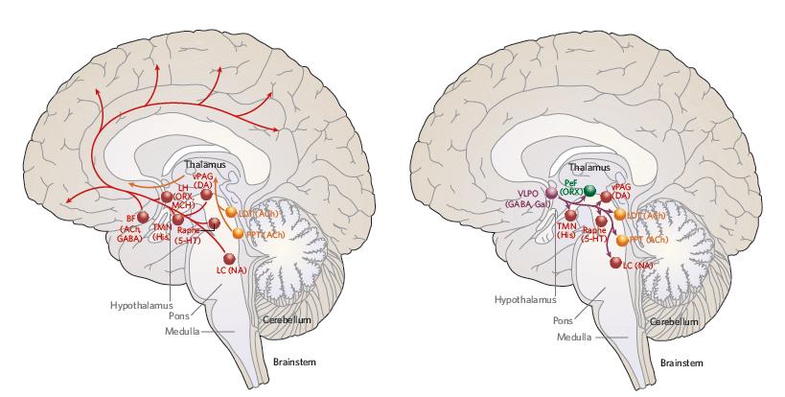
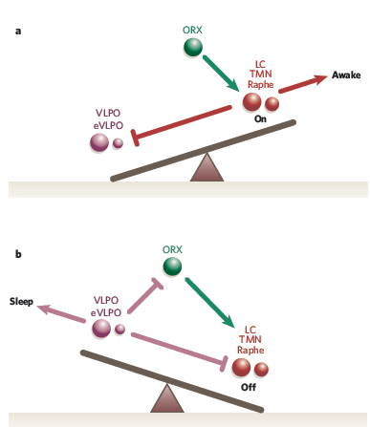
Normal Regulations of Sleep and Wake Systems
Arousal System
Sleep Onset System
Awake
On
Sleep
Hypothalamus
Hypothalamus
Pons
Pons
Medulla
Medulla
Brainstem
Brainstem
Off
ORX = orexin
Saper CB, et al. Nature. 2005;437(7063):1257-1263.
Notes:
2:09
So Yves let’s begin
Neurobiology of Sleep and wake is known in normal population with many players as function of sleep or wake states
Does hypersomnolence reflect a brain circuit dysfunction ?

Slide 6
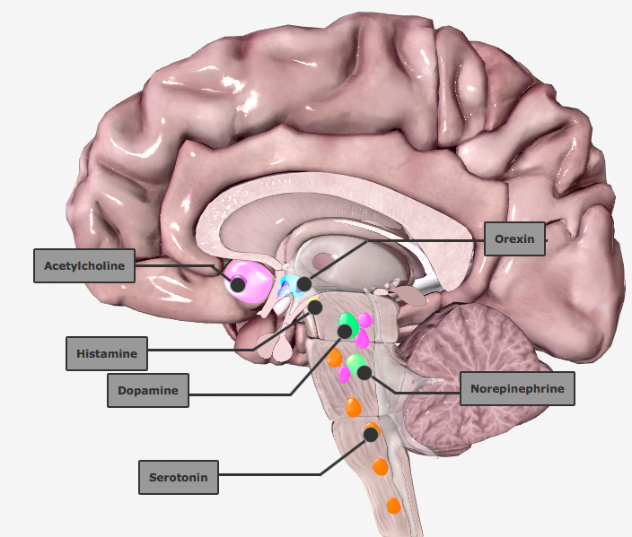
Neurotransmitters Involved in the Sleep-Wake Cycle
Orexin
Acetylcholine
Histamine
Dopamine
Norepinephrine
Serotonin
Notes:
3:07
So again histamine
”Wake-promoting pathways are found in the basal forebrain (from which acetylcholine projects), the tuberomammilary nucleus (housing histamine), the ventral tegmental area (housing dopamine), the dorsal and median raphe (housing serotonin), the locus coeruleus (housing norepinephrine), and the orexin neurons located predominately in the lateral hypothalamus.”

Slide 7
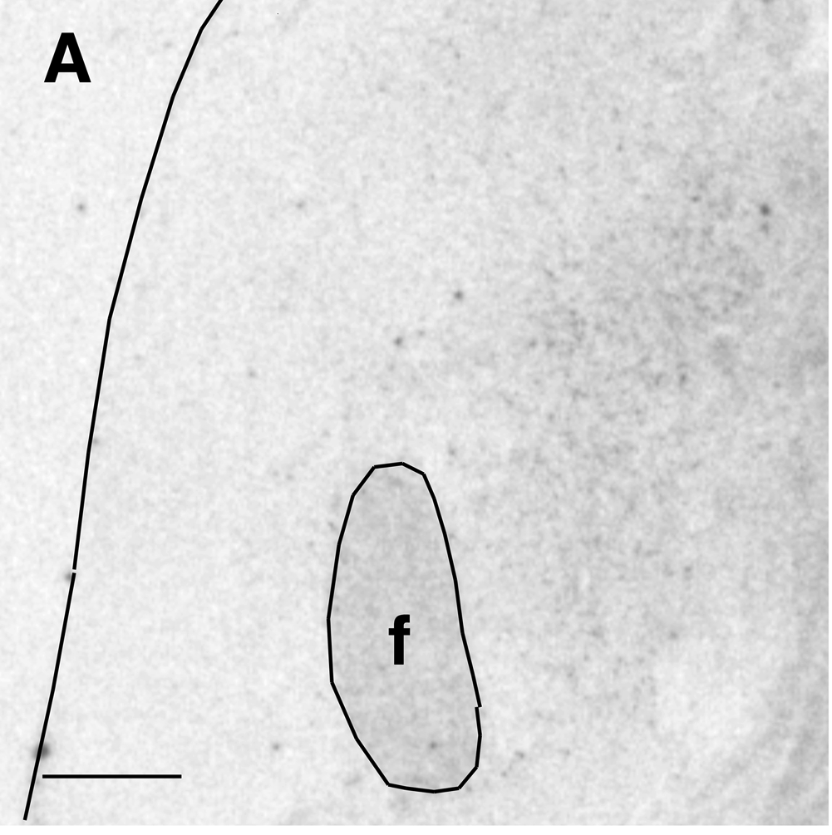
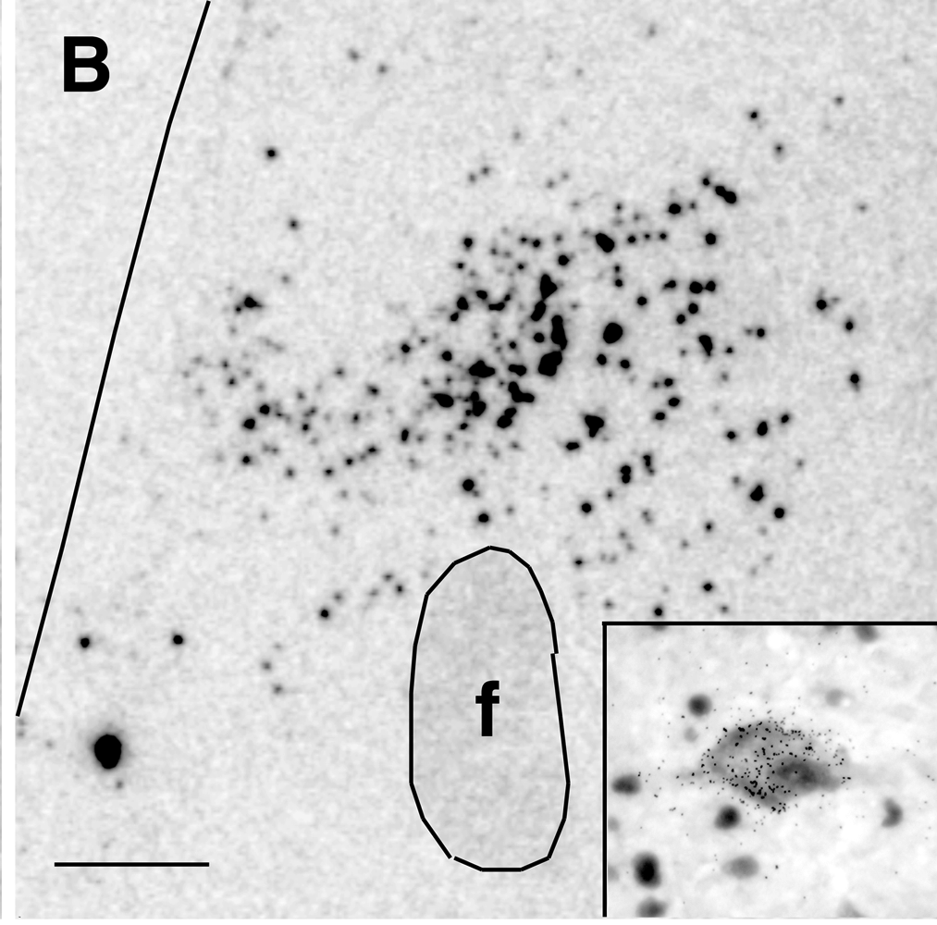
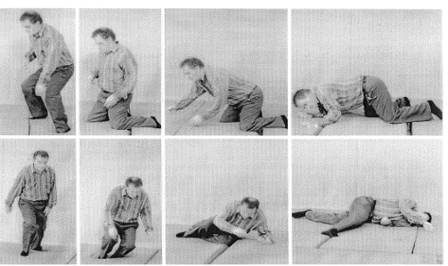
Neurobiology of NT1:
Loss of Orexin/Hypocretin Neurons
Narcoleptics
Controls
Destruction of hypocretin (Hcrt) neurons
Absence of CSF hypocretin
EDS
Cataplexy
SOREMP
NARCOLEPSY TYPE 1 (NT1)
CSF = cerebrospinal fluid; EDS = excessive daytime sleepiness; SOREMP = sleep onset REM periods
Sakuri T, et al. Orexin (hypocretin) and narcolepsy. In: The Genetic Basis of Sleep and Sleep Disorders. 2013.
Notes:
3:47
What actually happens
Neurobiology of NT1 is known with loss of orexin neurons and related clinical symptoms
Sakuri T, et al. Orexin (hypocretin)and narcolepsy (242-253). In The Genetic Basis of Sleep and Sleep Disorders. Cambridge University Press. 2013

Slide 8
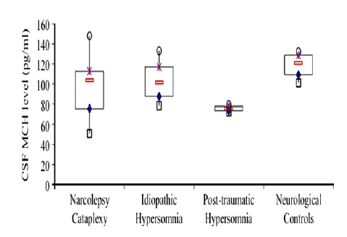
Neurobiology of NT2:
Pathology of Lateral Hypothalamus?
Sleep-wake instability with high REM sleep propensity
  Partial lesion of Hcrt neurons? Increased activity of MCH neurons?
Circadian disturbances to explain the high REM sleep propensity
Is there biological dysfunction?
GABA
Hypocretin
CSF MCH level (pg/ml)
HA / NA / 5HT
Sleep
Wake
Narcolepsy
Cataplexy
Idiopathic
Hypersomnia
Post-traumatic
Hypersomnia
Neurological
Controls
No association between MCH, histamine, and hypocretin levels, EDS, SOREMPs, cataplexy
NT2: Problem with phenotyping and stability of NT2. Unclear pathophysiology? No identified specific biomarker.
GABA = gamma-aminobutyric acid; MCH = melanin concentrating hormone; REM = rapid eye movement
Peyron C, et al. Sleep Med. 2011;12(8):768-772.
Notes:
4:59
Narcolepsy Type 2
Neurobiology of NT2 is unknown ?
Is there a pathology of lateral hypothalamus ?
Is there an Sleep-wake instability with high REM sleep propensity due to Partial lesion of Hcrt neurons and / or increased activity of MCH neurons
Several players may be involved but hypocretin levels were never as deficient as in NT1
CSF MCH and Histamin are also normal also
So its neurobiology remains unclear as based on problem of phenotyping and stability of NT2
Fig. 1. Box plot illustrating the level of MCH (median ± quartiles) in 4 different groups of patients, i.e. narcolepsy with cataplexy (n = 14), idiopathic hypersomnia (n = 6), post-traumatic hypersomnia (n = 2) and controls with neurological disease but without sleep disorders (n = 14).
Peyron C, et al. Sleep Med. 2011;12(8):768-772.
Melanin concentrating hormone in central hypersomnia
Abstract
Background: Narcolepsy with cataplexy (NC) is a disabling disorder characterized by excessive daytime sleepiness and abnormal rapid eye movement (REM) sleep manifestations, due to a deficient hypocretin/orexin neurotransmission. Melanin concentrating hormone (MCH) neurons involved in the homeostatic regulation of REM sleep are intact. We hypothesized that an increased release of MCH in NC would be partly responsible for the abnormal REM sleep manifestations.
Methods: Twenty-two untreated patients affected with central hypersomnia were included: 14 NC, six idiopathic hypersomnia with long sleep time, and two post-traumatic hypersomnia. Fourteen neurological patients without any sleep disorders were included as controls. Using radioimmunoassays, we measured hypocretin-1 and MCH levels in cerebrospinal fluid (CSF).
Results: The MCH level was slightly but significantly lower in patients with hypersomnia (98 ± 32 pg/ml) compared to controls (118 ± 20 pg/ml). After exclusion of patients affected with post-traumatic hypersomnia the difference became non-significant. We also failed to find any association between MCH level and hypocretin level, the severity of daytime sleepiness, the number of SOREMPs, the frequency of cataplexy, and the presence of hypnagogic hallucinations or sleep paralysis.
Conclusion: This study reports the first measurement of MCH in CSF using radioimmunoassay technology. It appears to be a non-informative tool to differentiate etiologies of central hypersomnia with or without REM sleep dysregulation.

Slide 9
Neurobiology of EDS in OSA
Problem with phenotyping
Assessment of EDS:
  Interviews, questionnaires (e.g., Epworth Sleepiness Scale)
  Objective data: MSLT, MWT, Osler…
First exclusion
  Residual AHI, bad compliance with CPAP, leaks…
  Comorbid depression, obesity, drug intake
  Insufficient sleep syndrome
  Central hypersomnolence disorders
Need to define homogeneous criteria for this condition between sleep centers
No identified pathophysiology: Really unique?
AHI = apnea-hypopnea index; CPAP = continuous positive airway pressure; MSLT = Multiple Sleep Latency Test;
MWT = Maintenance of Wakefulness Test; OSA = obstructive sleep apnea
Garbarino S, et al. Front Neurol. 2018;9:505.
Notes:
6:12
And then we move on to
Neurobiology of residual EDS in OSAS remains also unknown ?
Is there a deficeincy in the wake systems or an excess in tghe sleep system ?
How assessment of EDS is performed in routine ?
How differential diagnoses are excluded in this specific population
How to better understand its pathophysiology ?
Garbarino S, et al. Front Neurol. 2018; https://doi.org/10.3389/fneur.2018.00505
Obstructive Sleep Apnea With or Without Excessive Daytime Sleepiness: Clinical and Experimental Data-Driven Phenotyping
Introduction: Obstructive sleep apnea (OSA) is a serious and prevalent medical condition with major consequences for health and safety. Excessive daytime sleepiness (EDS) is a common—but not universal—accompanying symptom. The purpose of this literature analysis is to understand whether the presence/absence of EDS is associated with different physiopathologic, prognostic, and therapeutic outcomes in OSA patients.
Methods: Articles in English published in PubMed, Medline, and EMBASE between January 2000 and June 2017, focusing on no-EDS OSA patients, were critically reviewed.
Results: A relevant percentage of OSA patients do not complain of EDS. EDS is a significant and independent predictor of incident cardiovascular disease (CVD) and is associated with all-cause mortality and an increased risk of metabolic syndrome and diabetes. Male gender, younger age, high body mass index, are predictors of EDS. The positive effects of nasal continuous positive airway pressure (CPAP) therapy on blood pressure, insulin resistance, fatal and non-fatal CVD, and endothelial dysfunction risk factors have been demonstrated in EDS-OSA patients, but results are inconsistent in no-EDS patients. The most sustainable cause of EDS is nocturnal hypoxemia and alterations of sleep architecture, including sleep fragmentation. These changes are less evident in no-EDS patients that seem less susceptible to the cortical effects of apneas.
Conclusions: There is no consensus if we should consider OSA as a single disease with different phenotypes with or without EDS, or if there are different diseases with different genetic/epigenetic determinants, pathogenic mechanisms, prognosis, and treatment.The small number of studies focused on this issue indicates the need for further research in this area. Clinicians must carefully assess the presence or absence of EDS and decide accordingly the treatment. This approach could improve combination therapy targeted to a patient's specific pathology to enhance both efficacy and long-term adherence to OSA treatment and significantly reduce the social, economic, and health negative impact of OSA.

Slide 10
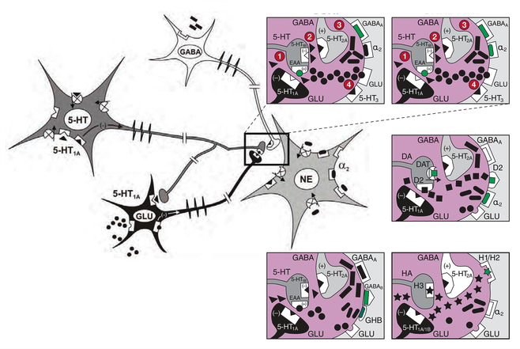
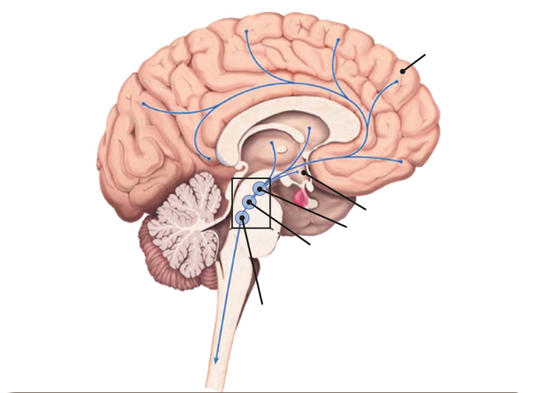
Determining a Target for Therapeutic Intervention
Based on:
    Symptom (EDS) severity?
    Background disorder (narcolepsy, OSA…)?
SSRI
SNRI/TCA
Stimulants/Solriamfetol
Cortex
GHB/SXB/JZP-258
Pitolisant
Hypothalamu
Ventral tegmenta
Dorsal raphe
nucleus
Spinal motor neurons
Locus coeruleus
SXB = sodium oxybate; GHB = gamma-hydroxybutyrate
Szabo ST, et al. Sleep Med Rev. 2019;43:23-36.
Notes:
9:03
But some of the patients
Image located at https://pubmed.ncbi.nlm.nih.gov/30503715/#&gid=article-figures&pid=fig-2-uid-1
We need to define the best Target for therapeutic intervention to treat EDS but this may depend on
- on symptom (EDS) severity ?
On the underlying disorder (NT1, NT2, IH, OSA…)?
Several drugs exist and work with different mechanisms of action
Modafinil and methylphenidate: Inhibit the DAT : transportor of DA
Solriamfetol: Inhibit the DAT and NET
SSRI and SNRI: Inhibit transporter of NET and/or SERT
Sodium oxybate: Agonsit GABA-B receptor
Pitolisant: inverse agonist of H3 receptor being loclized at presynaptic levels that increase HA in the brain but also otehr mononamines
Szabo ST, et al. Sleep Med Rev. 2019;43:23-36.
Neurobiological and immunogenetic aspects of narcolepsy: Implications for pharmacotherapy
Abstract
Excessive daytime sleepiness (EDS) and cataplexy are common symptoms of narcolepsy, a sleep disorder associated with the loss of hypocretin/orexin (Hcrt) neurons. Although only a few drugs have received regulatory approval for narcolepsy to date, treatment involves diverse medications that affect multiple biochemical targets and neural circuits. Clinical trials have demonstrated efficacy for the following classes of drugs as narcolepsy treatments: alerting medications (amphetamine, methylphenidate, modafinil/armodafinil, solriamfetol [JZP-110]), antidepressants (tricyclic antidepressants, selective serotonin reuptake inhibitors, serotonin-norepinephrine reuptake inhibitors), sodium oxybate, and the H₃-receptor inverse agonist/antagonist pitolisant. Enhanced catecholamine availability and regulation of locus coeruleus (LC) norepinephrine (NE) neuron activity is likely central to the therapeutic activity of most of these compounds. LC NE neurons are integral to sleep/wake regulation and muscle tone; reduced excitatory input to the LC due to compromise of Hcrt/orexin neurons (likely due to autoimmune factors) results in LC NE dysregulation and contributes to narcolepsy/cataplexy symptoms. Agents that increase catecholamines and/or LC activity may mitigate EDS and cataplexy by elevating NE regulation of GABAergic inputs from the amygdala. Consequently, novel medications and treatment strategies aimed at preserving and/or modulating Hcrt/orexin-LC circuit integrity are warranted in narcolepsy/cataplexy.

Slide 11
Mechanisms of Action of Current and Novel Therapies for EDS
 |  | Affinities and Selectivity
Traditional stimulants (e.g., methylphenidate, dextroamphetamine) | High affinity, non-selective for the DAT, NET, and SERT¹
Wake-promoting agents (e.g., modafinil) | Low affinity, DAT selective²
Solriamfetol | Low affinity, DAT and NET selective³
Sodium oxybate | High affinity, GABA_{B} selective⁴
JZP-258 | High affinity, GABA_{B} selective⁵
DAT = dopamine transporter; NET = noradrenaline transporter; SERT = serotonin transporter; GABA = gamma-aminobutyric acid
1. Rothman RB, et al. Synapse. 2001;39(1):32-41.; 2. Wisor J. Front Neurol. 2013;4:139.; 3. Markham A. Drugs. 2019;79:785-790.;
4. Jazz Pharmaceuticals. Product Monograph Including Patient Medication Information: Xyrem (Sodium Oxybate Oral Solution). 2018.
http://pp.jazzpharma.com/pi/xyrem.ca.PM-en.pdf.; 5. Drugs@FDA.gov.
Notes:
10:39
Certainly we have

Slide 12
Mechanism of Action and Clinical Impact on EDS: Dopamine, Norepinephrine, Serotonin
Monoaminergic neurons: generally high rates of firing during wake (especially active wake), slow firing during non-rapid eye movement (NREM) sleep, and a virtual cessation of firing during REM sleep
  High dopamine (DA) tone promotes wakefulness, while low DA tone promotes sleep.
  Norepinephrine (NE) is key in arousal and maintaining normal sleep states
  Serotonin precursors and reuptake inhibitors promote wakefulness.
Malhotra A, et al. Sleep. 2019;43(2):zsz220.; Thorpy MJ, et al. Ann Neurol. 2019;85(3):359-370.;
Sukhal S, et al. J Clin Sleep Med. 2015;11(10):1179-1186.; Avellar A, et al. Sleep Med Rev. 2016;30:97-107.
Notes:
11:37
And methylphenidate data

Slide 13
Mechanisms of Action of Current and Novel Therapies for EDS
 |  | Affinities and Selectivity
Traditional stimulants (e.g., methylphenidate, dextroamphetamine) | High affinity, non-selective for the DAT, NET, and SERT¹
Wake-promoting agents (e.g., modafinil) | Low affinity, DAT selective²
Solriamfetol | Low affinity, DAT and NET selective³
Sodium oxybate | High affinity, GABA_{B} selective⁴
JZP-258 | High affinity, GABA_{B} selective⁵
DAT = dopamine transporter; NET = noradrenaline transporter; SERT = serotonin transporter; GABA = gamma-aminobutyric acid
1. Rothman RB, et al. Synapse. 2001;39(1):32-41.; 2. Wisor J. Front Neurol. 2013;4:139.; 3. Markham A. Drugs. 2019;79:785-790.;
4. Jazz Pharmaceuticals. Product Monograph Including Patient Medication Information: Xyrem (Sodium Oxybate Oral Solution). 2018.
http://pp.jazzpharma.com/pi/xyrem.ca.PM-en.pdf.; 5. Drugs@FDA.gov.
Notes:
11:54
In contrast

Slide 14
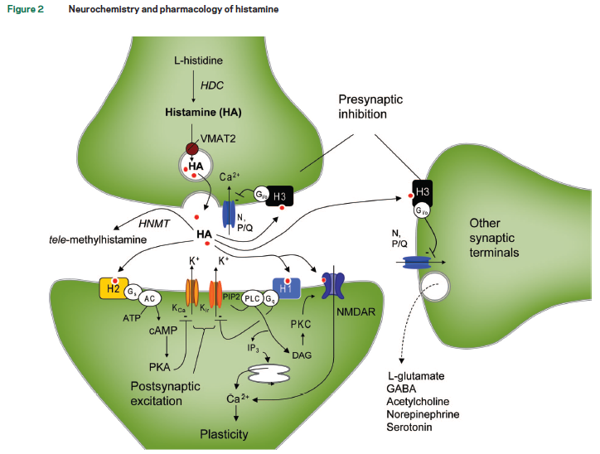
Mechanism of Action and Clinical Impact on EDS: Histamine
Histamine is a wake-promoting neurotransmitter
Histamine neurons
promote arousal
  Partial cataplexy
  REM sleep latency
  EDS
Dauvilliers Y, et al. Sleep. 2019;42(11).pii:zsz174.
Notes:
13:10
Would you comment on
Several drugs exist and work with different mechanisms of action
Modafinil and methylphenidate: Inhibit the DAT : transportor of DA
Solriamfetol: Inhibit the DAT and NET
SSRI and SNRI: Inhibit transporter of NET and/or SERT
Sodium oxybate: Agonsit GABA-B receptor
Pitolisant: inverse agonist of H3 receptor being loclized at presynaptic levels that increase HA in the brain but also other mononamines
With major increase of tmMHA in the brain
Dauvilliers Y, et al. Long-term use of pitolisant to treat patients with narcolepsy: Harmony III Study. Sleep. 2019 Oct 21;42(11). pii: zsz174.
Abstract
STUDY OBJECTIVES:
To assess the long-term safety and efficacy of pitolisant, a histamine H3-receptor inverse agonist/antagonist, on narcolepsy.
METHODS:
This open-label, single-arm, pragmatic study, recruited adult patients with narcolepsy and Epworth Sleepiness Scale (ESS) score ≥12. After a titration period, patients were treated for up to 1 year with oral pitolisant once-a-day at up to 40 mg. Concomitant stimulants and anti-cataplectic agents were allowed. The primary endpoint was safety; secondary endpoints included ESS, cataplexy, and other diary parameters.
RESULTS:
Patients (n = 102, 75 with cataplexy) received pitolisant, for the first time in 73 of them. Sixty-eight patients (51 with cataplexy) completed the 12-month treatment. Common treatment-emergent adverse events were headache (11.8% of patients), insomnia (8.8%), weight gain (7.8%), anxiety (6.9%), depressive symptoms (4.9%), and nausea (4.9%). Seven patients had a serious adverse effect, unrelated to pitolisant except for a possibly related miscarriage. One-third of patients stopped pitolisant, mostly (19.6%) for insufficient benefit. ESS score decreased by 4.6 ± 0.6. Two-thirds of patients completing the treatment were responders (ESS ≤ 10 or ESS decrease ≥ 3), and one third had normalized ESS (≤10). Complete and partial cataplexy, hallucinations, sleep paralysis, and sleep attacks were reduced by 76%, 65%, 54%, 63%, and 27%, respectively. Pitolisant as monotherapy (43% of patients) was better tolerated and more efficacious on ESS than on add-on, but efficacy was maintained in this last case.
CONCLUSIONS:
Long-term safety and efficacy of pitolisant on daytime sleepiness, cataplexy, hallucinations, and sleep paralysis is confirmed.

Slide 15
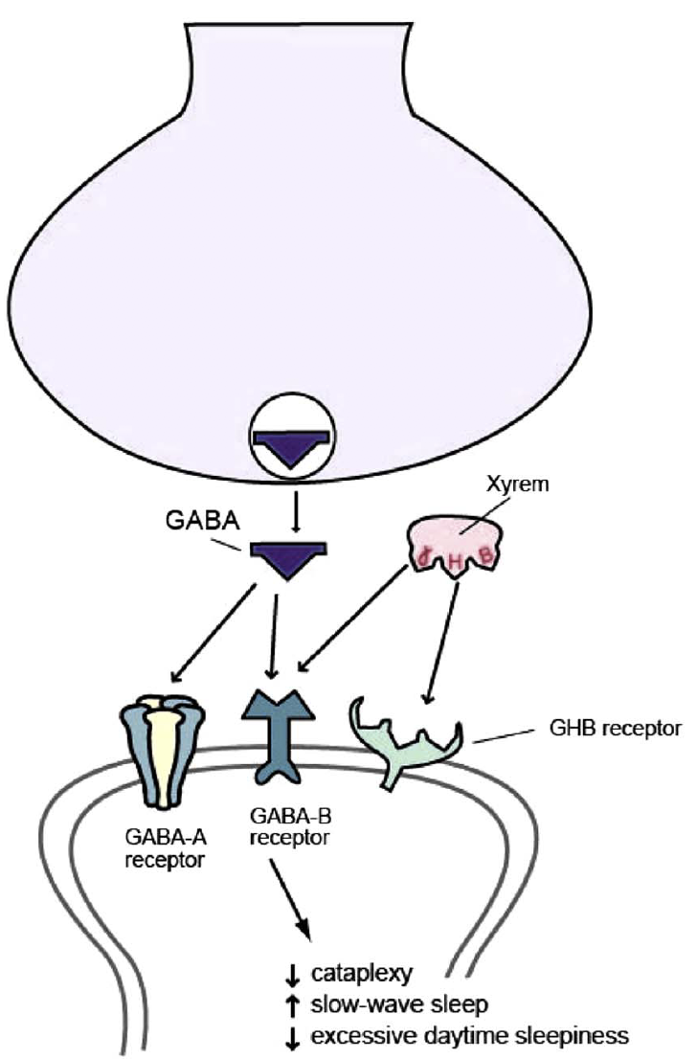
Mechanism of Action and Clinical Impact on EDS: GABA-B
GABA shuts off wake-promoting impact during the sleep-wake cycle
GABA-B selectivity results in OSA and narcolepsy:
  Cataplexy
  Slow-wave sleep
  EDS
SXB, JZP-258
Gowda CR, et al. CNS Spectrums. 2014;19:28–34.
Notes:
14:19
Interestingly, when we attempt
Reprinted from Stahl’s Essential Psychopharmacology: Neuroscientific Basis and Practical Applications (Essential Psychopharmacology Series). Cambridge, UK: Cambridge
Adapted from Gowda CR, et al. CNS Spectrums. 2014;19:28–34.
Figure located at https://www.semanticscholar.org/paper/Mechanism-of-action-of-narcolepsy-medications.-Gowda-Lundt/74813af67bd3e2b7d8b9d1411a30bf57778cca3a/figure/1

Slide 16
SMART Goals
Specific, Measurable, Attainable, Relevant, Timely
Identify key neurotransmitters involved in the sleep-wake cycle, particularly those involved in narcolepsy (type 1 and type 2) and OSA
Recognize how therapies targeted to the key neurotransmitters in the sleep-wake cycle exert their therapeutic effect on EDS in narcolepsy and OSA
Notes:
16:27
But I think what you’ve done

Slide 17
Additional Abbreviations
5-HT = 5-hyroxytryptamine
AC = anterior commissure
Ach = acetylcholine
BF = basal forebrain
Ca = calcium
cAMP = cyclic adenosine monophosphate
DAG = diglyceride
GHB = gamma-hydroxybutyrate
GLU = glutamine
H = hydrogen
HA = hyaluronic acid
HDC = histidine decarboxylase
HNMT = histamine N-methyltransferase
ir = iridium
K = potassium
LDT = laterodorsal tegmental hormone
LH = lateral hypothalamus
MAO = monoamine oxidases
NA = nucleus accumbens
Na = sodium
NMDAR = N-methyl-D-aspartate receptor
ORX = orexin
PAG = periagueductal gray
PIP2 = phosphatidylinositol diphosphate
PKA = protein kinase A
PKC = protein kinase C
PLC = phospholipase C
PPT = pedunculopontine tegmental nucleus
TMN = tuberomammillary nucleus
VLPO = ventrolateral preoptic nucleus
VMAT = vesicular monoamine transporter
Notes:
17:36 – 17:39

Slide 18
To receive CME/CE credit, click on the link to complete the post-test and evaluation online. Be sure to fill in your ABIM ID number and DOB (MM/DD) on the evaluation, so we can submit your credit to ABIM. http://www.cmeoutfitters.com/TST43735
Participants can print their certificate or statement of credit immediately.
How to Collect Credit for this Activity

Slide 19
Visit the
Sleep Disorders Hub
Free resources, education, and tools for both HCPs and patients about EDS.
www.cmeoutfitters.com/sleep-disorders-hub/
Notes:
17:49
Please visit the

Slide 20
EPISODE 1
“I Shouldn’t Be This Sleepy”: A Look Into EDS
EPISODE 3
Differentiators When Choosing Novel Treatment Options for EDS
EPISODE 4
Diagnosis and Treatment of Pediatric Narcolepsy with Cataplexy
www.CMEOutfitters.com
Notes:
18:02
Thank you for joining

