Slide 1
Prior Treatment Failure: Addressing the Challenge in HIV Care
Supported by an educational grant from Gilead Sciences, Inc.
Notes:
https://vimeo.com/582341563/1c50be100e

Slide 2
Eric S. Daar, MD
Chief, Division of HIV Medicine
Harbor-UCLA Medical Center
Investigator, Lundquist Institute
Professor of Medicine
David Geffen School of Medicine at UCLA
Los Angeles, CA
Notes:
0:24
I’m the chief of the division

Slide 3
Learning
Objective
1
Integrate best practices for initiating and switching ART in patients based on safety and efficacy data.
Notes:
0:37:03
Our first learning objective

Slide 4
Learning
Objective
2
Translate emerging data from national conferences to treatment decisions in clinical practice
Notes:
0:48:09
And our second learning objective

Slide 5

Patient Case: Luke
      Luke is a 41-year-old man (MSM) diagnosed with HIV 20 years ago
  He has had many years of antiretroviral therapy (ART) experience with virologic failure on nucleoside reverse transcriptase inhibitors (NRTIs), a non-boosted protease inhibitor (PI),
  non-nucleoside reverse transcriptase inhibitor (NNRTI), and an integrase strand transfer inhibitor (INSTI)
  He is persistently viremic despite reported good adherence
MSM = men who have sex with men
Notes:
0:59:04
Let me start by

Slide 6
ART History
Started on ART regimen with zidovudine/lamivudine and efavirenz
Experienced virologic failure and was treated with tenofovir disoproxil fumarate/emtricitabine + nelfinavir with transient reduction in viral load and then rebound
Subsequently treated with zidovudine/lamivudine/abacavir + lopinavir/ritonavir with suppression for 1 year, but complaints of mild diarrhea
Notes:
1:40:01
In his case

Slide 7
ART History
He was then switched to zidovudine/lamivudine/abacavir + raltegravir with subsequent virologic failure
During the course of his treatment, he had drug resistance testing performed several times with tropism test sent approximately 2 years prior to this visit when found to have dual/mixed plasma virus
Notes:
4:14:12
So he was switched

Slide 8
ART History
His most recent regimen for the last 8 months includes
Dolutegravir twice daily
Darunavir/ritonavir twice daily
Etravirine twice daily
    Tenofovir alafenamide/emtricitabine once daily
  Recent viral loads consistently between 1000 and 2500 copies/mL
  CD4 cell count of between 220 and 300 cells/uL
mL = milliliter; uL = microliter
Notes:
5:03:01
So his most recent

Slide 9
Current Clinic Visit: Luke
His most recent regimen for the last 8 months includes
Dolutegravir twice daily
Darunavir/ritonavir twice daily
Etravirine twice daily
    Tenofovir alafenamide/emtricitabine once daily
  Virologic failure:
  Viral load: 2200 copies/mL (repeatedly >1000 copies/mL)
  CD4 cell count: 275 cells/uL
Notes:
5:55:07
At his current clinic

Slide 10
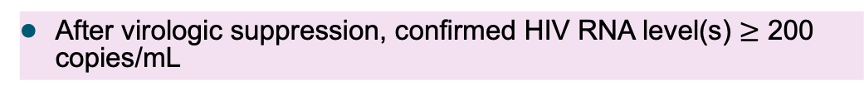
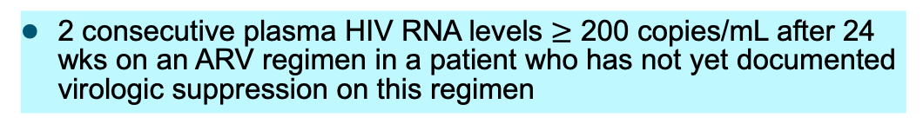
Defining Virologic Response
Virologic Suppression
A confirmed HIV RNA level below the lower limits of detection (LLOD)
Virologic Failure
Inability to achieve or maintain suppression of viral replication to an HIV RNA level < 200 copies/mL
Incomplete Virologic Response
2 consecutive plasma HIV RNA levels $≥$ 200 copies/mL after 24 wks on an ARV regimen in a patient who has not yet documented virologic suppression on this regimen
Virologic Rebound
After virologic suppression, confirmed HIV RNA level(s) $≥$ 200 copies/mL
Low-Level Viremia
Confirmed detectable HIV RNA level < 200 copies/mL
Guidelines for the Use of Antiretroviral Agents in Adults and Adolescents Living with HIV. Centers for Disease Control and Prevention (CDC). https://clinicalinfo.hiv.gov/en/guidelines/adult-and-adolescent-arv/whats-new-guidelines. Accessed July 22, 2021.
Notes:
6:32:03
So when we think about

Slide 11
Factors Associated with Virologic Failure
Patient-Related
HIV-Related
ART Regimen-Related
Comorbidities (substance use, mental health, neurocognitive impairment)
Unstable housing and other psychosocial factors
Missed clinic appts
Interruption of, or intermittent access to ART
Affordability of ARV drugs
Adverse drug effects
High pill burden and/or dosing frequency
Presence of transmitted or acquired drug-resistant virus documented by current or past resistance test results
Prior treatment failure
Innate resistance to prescribed ARV drugs
Higher pretreatment HIV RNA level (some regimens may be less effective at higher levels)
Suboptimal pharmacokinetics (variable absorption, metabolism, or penetration into reservoirs)
Suboptimal virologic potency
Low barrier to resistance
Reduced efficacy due to prior exposure to suboptimal regimens
Food requirements
Drug-drug interactions (DDIs)
Prescription (prescribing or dispensing) errors
Guidelines for the Use of Antiretroviral Agents in Adults and Adolescents Living with HIV. Centers for Disease Control and Prevention (CDC). https://clinicalinfo.hiv.gov/en/guidelines/adult-and-adolescent-arv/whats-new-guidelines. Accessed July 22, 2021.
Notes:
8:59:19
So when we think about

Slide 12
Audience Response
Should further resistance testing be done?
Yes
No
I’m not sure
Notes:
13:06:24
After he says…..should be done
Correct answer: Yes

Slide 13
Audience Response Rationale
Should further resistance testing be done?
Yes
No
I’m not sure
Notes:
13:07:12 THIS IS A SLIDE TO BE SHOWN AS HE DESCRIBES THE RATIONALE
When in reality
Correct answer: Yes

Slide 14
Audience Response
When should resistance testing be done?
While the patient is taking the current regimen
Immediately after discontinuation of treatment
Within 4 weeks of discontinuation of treatment
I’m not sure
Notes:
13:59:05
After he says….when should it e
Correct answer A

Slide 15
Audience Response Rationale
When should resistance testing be done?
While the patient is taking the current regimen
Immediately after discontinuation of treatment
Within 4 weeks of discontinuation of treatment
I’m not sure
Notes:
14:00:06 THIS IS A SLIDE TO BE SHOWN AS HE DESCRIBES THE RATIONALE
One of the important things
Correct answer A

Slide 16
Which type of resistance testing should be done?
Genotype
Phenotype
Genotype and phenotype
No resistance testing is needed at this time
Notes:
15:23:14
After he says…should it be

Slide 17
Audience Response Rationale
Which type of resistance testing should be done?
Genotype
Phenotype
Genotype and phenotype
No resistance testing is needed at this time
Notes:
15:24:09 THIS IS A SLIDE TO BE SHOWN AS HE DESCRIBES THE RATIONALE
Well we already
Correct answer C

Slide 18
Should tropism test be performed?
Yes
No
I’m not sure
Notes:
16:52:18
After he says…..be performed
Correct answer: B

Slide 19
Audience Response Rationale
Should tropism test be performed?
Yes
No
I’m not sure
Notes:
16:53:12 THIS IS A SLIDE TO BE SHOWN AS HE DESCRIBES THE RATIONALE
So the role of a tropism
Correct answer: B

Slide 20
Management of ARV Failure: First Line
Failing regimen (+ NRTIs)
Boosted PI
NNRTI
INSTI
Enforce adherence
Modify for convenience or toxicity
DTG + NRTIs (if one fully active)
Boosted PI + NRTIs¹
Boosted PI + INSTI
Boosted PI + NRTIs¹
Boosted PI + active INSTI²
¹Preferably one active NRTI
²If RAL or EVG resistance detected, DTG + boosted PI can be used if DTG susceptible.
Adapted from the Panel on Antiretroviral Guidelines for Adults and Adolescents. Guidelines for the Use of Antiretroviral Agents in Adults and Adolescents with HIV. Department of Health and Human Services. http://www.aidsinfo.nih.gov/ContentFiles/ AdultandAdolescentGL.pdf. Accessed July 26, 2021.
Notes:
18:29:04
So let’s talk about

Slide 21
Management of ARV Failure: Second Line and Beyond
Boosted PI and/or DTG susceptible
Yes
Neither*
DTG† + 2 NRTIs‡
Boosted PI + 2 NRTIs‡
Boosted PI + active INSTI
DTG only
2 and preferably 3 fully active drugs
PI only
DTG† + 2 NRTIs‡
2 and preferable 3 fully active drugs
Boosted PI + 2 NRTIs‡
*Rare in patients never exposed to unboosted PIs (eg, NFV, DHHS alternative since 2003 and not recommended since 2008).
†If INSTI naive or in patients with no INSTI resistance (limited data in patients with resistance to RAL or EVG but susceptibility to DTG).
‡Ideally with at least 1 fully active NRTI.
Adapted from the Panel on Antiretroviral Guidelines for Adults and Adolescents. Guidelines for the Use of Antiretroviral Agents in Adults and Adolescents with HIV. Department of Health and Human Services. Available at http://www.aidsinfo.nih.gov/ContentFiles/ AdultandAdolescentGL.pdf. Accessed July 26, 2021.
Notes:
21:18:24
Obviously, Luke doesn’t

Slide 22
Luke’s Cumulative Drug Resistance History
Drug Class | Mutations | Predicted Susceptibility
NRTIs | M4IL, K70R, M184V, L210W, T215Y | Abacavir and tenofovir: Intermediate
NNRTIs | K103N, Y188L | Etravirine: Potential low-level resistance
PIs | D30N, 150V, L76V, V82A | Darunavir and atazanavir: Intermediate
INSTIs | G140S, Q148H | Dolutegravir and bictegravir: Intermediate
CCR5 antagonist | Dual/mixed tropic | Maraviroc resistant
Notes:
23:28:02
So here is

Slide 23
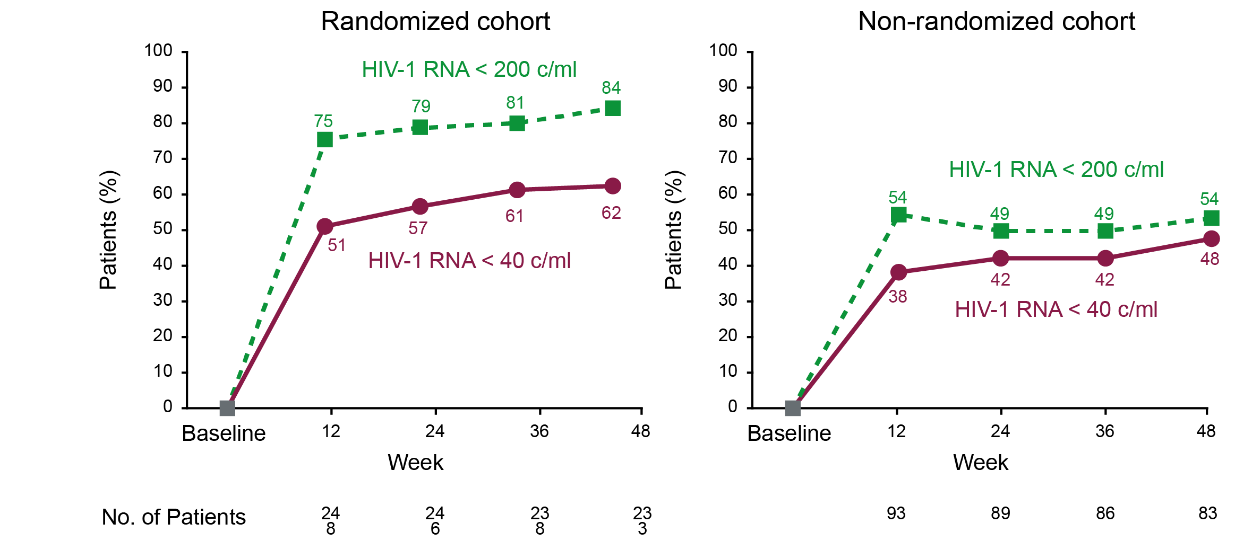
Fostemsavir in Adults with Multi-Drug Resistant HIV-1 Infection
Patients with multidrug-resistant HIV-1 infection, who received fostemsavir had a significantly greater decrease in the HIV-1 RNA level than placebo during first 8 days
At wk 48, a virologic response (HIV-1 RNA level, < 40 c/mL) occurred in 54% of patients in the randomized cohort and 38% of those in the non-randomized cohort
Virologic Response Through Week 48
c = copies; No. = number; RNA = ribonucleic acid
Kozal M, et al. N Engl J Med. 2020;382(13):1232-1243.
Notes:
25:48:19
So fortunately we

Slide 24
Efficacy and Safety of Ibalizumab
Ibalizumab is a humanized IgG4 mAb that binds noncompetitively to CD4 (post attachment inhibitor)
N = 40 adults with multidrug-resistant HIV (documented resistance to ≥ 1 drug in ≥ 3 classes) and HIV RNA > 1000 c/mL
Patients (%)
Ibalizumab maintenance dose, 800 mg intravenously every 14 days until wk 25
Ibalizumab loading dose, 2000 mg intravenously
Add optimized background regimen
Control Period
Functional monotherapy Period
Screening
Maintenance Period
Wk - 6
Day 0
Day 7
Day 14
Day 21
Wk 25
Emu B, et al. N Engl J Med. 2018;379(7):645-654.
Notes:
26:52:22
And then ibalizumab

Slide 25
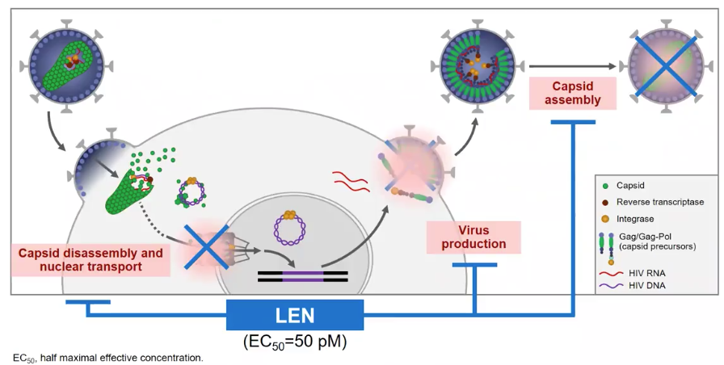
Lenacapavir (LEN): Novel HIV Capsid Inhibitor
New MOA for heavily treatment-experienced people with multi-drug resistant HIV¹
Non-overlapping resistance profile with full activity against NRTI-, NNRTI-, INSTI-, and PI resistance^{2,3,4}
No observed pre-existing resistance³
Single SC doses for 26 weeks supporting use once every 6 months⁵
Potent antiviral activity with up to 2.3 log₁₀ copies/mL decline in HIV-1 RNA
  Near maximal antiviral activity observed at IQ > 1.1⁶
EC₅₀ = half maximal effective concentration; IQ = inhibitory quotient; SC = subcutaneous
1. Segal-Maurer S, et al. Virtual 2021 Conference on Retroviruses and Opportunistic Infections. Abstract No. 127. Top Antivir Med. 2021;29(1):483. Accessed July 23, 2021. https://www.croiconference.org/abstract/potent-antiviral-activity-of-lenacapavir-in-phase-2-3-in-heavily-art-experienced-pwh/. 2. Yant SR, et al. CROI 2019. Poster No. 480. Accessed July 23, 2021. 3. Margot N, et al. CROI 2020. Poster No. 529. Accessed July 23, 2021. 4. VanderVeen L, et al. CROI 2021. No. 01781. Accessed July 23, 2021. 5. Begley R, et al. PEB0265 AIDS 2020. Accessed July 23, 2021. 6. Daar E, et al. CROI 2020. Poster No. 3691. Accessed July 23, 2021.
Notes:
28:24:07
There are other drugs

Slide 26
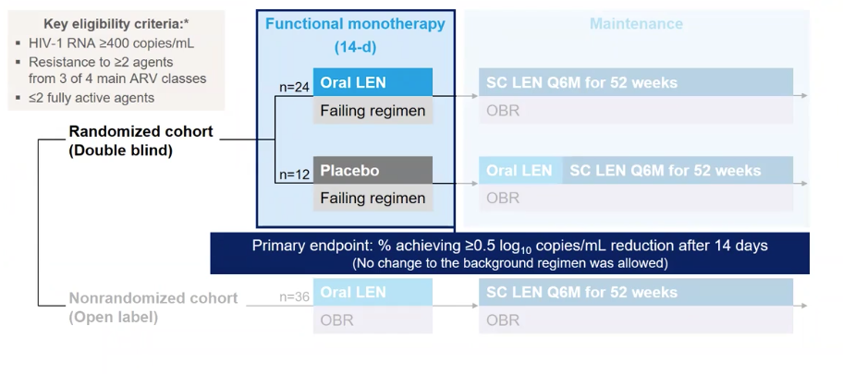
Lenacapavir: Emerging Treatment for Heavily ART-Experienced PWH
Key eligibility criteria:*
HIV-1 RNA ≥ 400 copies/mL
Resistance to ≥ 2 agents from 3 of 4 main ARV classes
≤ 2 fully active agents
Not FDA-approved for treatment of HIV
*HIV-1 RNA was repeated prior to randomization to determine the cohort: only participants with < 0.5 log₁₀ copies/mL decline and HIV RNA $≥$400 copies/mL were enrolled to Cohort 1; otherwise they were enrolled to Cohort 2
Segal-Maurer S, et al. Virtual 2021 Conference on Retroviruses and Opportunistic Infections. Abstract No.127. Top Antivir Med. 2021;29(1):483. Audio available at http://www.croiwebcasts.org/console/player/48167?mediaType=slideVideo&. Accessed July 23, 2021.
Notes:
29:08:02
So this is the key

Slide 27
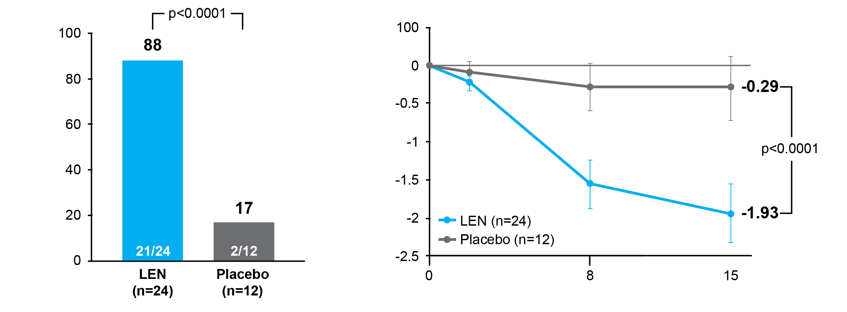
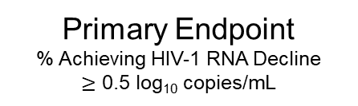
Lenacapavir*: Emerging Treatment for Heavily ART-Experienced PWH
Primary Endpoint
% Achieving HIV-1 RNA Decline
$≥$ 0.5 log₁₀ copies/mL
Mean Change
In HIV-1 RNA visit (95% CI)
%
Participants, %
Change in HIV-1 RNA,
log₁₀, copies/ml (95% CI)
Participants, %
*Not FDA-approved for treatment of HIV
Segal-Maurer S, et al. Virtual 2021 Conference on Retroviruses and Opportunistic Infections. Abstract No.127.Top Antivir Med. 2021;29(1):483. Audio available at http://www.croiwebcasts.org/console/player/48167?mediaType=slideVideo&. Accessed July 23, 2021.
Notes:
29:57:21
Here’s the primary endpoint data

Slide 28
CAPELLA: Lenacapavir Efficacy at 26 Weeks
SC LEN in combination with an optimized background regimen
Mean increase in CD4 cell count of 81 cells/µL
Incidence of very low CD4+ cell count (< 50 cells/µL) decreased from 22% (8/36)
at baseline to 0% (0/34) at 26 weeks
% Achieving Undetectable Viral Load
Not FDA-approved for treatment of HIV
mm = cubic millimeter
Molina J-M, et al. Presented at 11th IAS Conference on HIV Science; 2021. Abstract No. OALX01LB02, 2021. Accessed July 23, 2021.
Notes:
30:18:18
And then recently

Slide 29
SMART Goals
Specific, Measurable, Attainable, Relevant, Timely
Identify patient-related, HIV-related, and ART regimen-related factors that may be contributing to virologic failure and drug resistance
Apply guideline recommended algorithms to clinical decisions for managing ARV failure
Thoroughly assess patients for underlying HIV resistance
Assess efficacy and safety data of agents to determine their role in the management of patients with multi-drug resistant HIV-1 infection
Evaluate efficacy and safety data of agents in late-stage development for the treatment of heavily ART-experienced people with HIV
Notes:
31:01:23
So with that

Slide 30
Switching Antiretroviral Therapy (ART) in Your African American Patients: When and How
1
2
The Pediatric Patient with HIV: Translating Data to Practice
www.CMEOutfitters.com/IDhub
Notes:
32:29:06
Today’s CMEO Briefcase

Slide 31
HIV Patient Education Hub
Free resources and education to inform and empower patients.
cmeoutfitters.com/HIVeducation
Notes:
32:52:03
CME Outfitters also has a

Slide 32
To Receive Credit
To receive CME/CE credit for this activity, participants must complete the post-test and evaluation online.
Participants will be able to download and print their certificate immediately upon completion.
Notes:
33:06:02
And finally I want to

