Slide 1
The Pediatric Patient with HIV: Translating Data to Practice
Supported by an educational grant from Gilead Sciences, Inc.
Notes:
https://vimeo.com/588801629/3842c23c67

Slide 2
Mariam S. Aziz, MD
Associate Professor, Department of Internal Medicine
Division of Infectious Diseases
Division of Community and Global Health Equity
Associate Professor, Department of Pediatrics, Infectious Diseases
Rush University Medical College
Chicago, IL
Notes:
0:20
I am Dr. Mariam

Slide 3
Learning
Objective
Integrate best practices for initiating and switching ART in children based on safety and efficacy data.
Notes:
0:33:23
Our learning objective for today

Slide 4
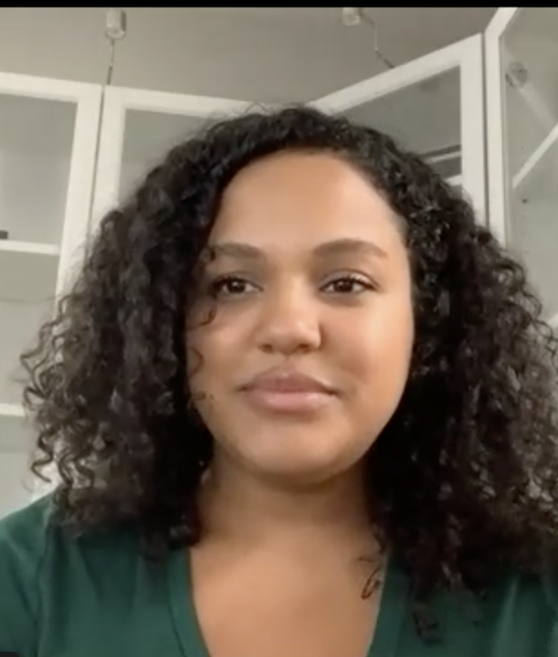
Patient Case: Cynthia
26-year-old African American female
First prenatal visit 24-weeks gestation
Opt-out HIV testing was negative
Intermittent engagement in prenatal appointments
At 28-weeks, presents to OB/GYN concerned that her partner has begun injecting drugs again after a 3-year period of abstinence
HIV test is negative
Her partner is tested and is HIV+
Notes:
0:44:22
Let’s start by meeting Cynthia

Slide 5
Repeat HIV Testing in the Third Trimester
Providers should be proactive about assessing risk of HIV in 3rd trimester¹
Recent study in Baltimore found that only 28% of women were retested for HIV despite high prevalence²
2007-2014 study of children with perinatal HIV exposure in Florida found 3rd trimester testing was not performed in a proportion of patients³
Who Should Have Repeat Testing?¹
Patients at high risk for acquiring HIV (e.g., patient or partner injection drug use, exchange sex for money or drugs, HIV+ partner, new sex partner during pregnancy, or suspected or diagnosed STI during pregnancy)
Reside in a jurisdiction of high incidence of HIV
Signs or symptoms of acute HIV
1. Panel on Antiretroviral Therapy and Medical Management of Children Living with HIV. Guidelines for the Use of Antiretroviral Agents in Pediatric HIV Infection. Available at https://clinicalinfo.hiv.gov/sites/default/files/inline-files/pediatricguidelines.pdf. Accessed July 30, 2021. 2. Liao C, et al. AIDS Patient Care STDS. 2017;31(1):20-26. 3. Trepka MJ, et al. South Med J. 2017;110(2):116-128.
Notes:
1:22:02
So what this brings up

Slide 6
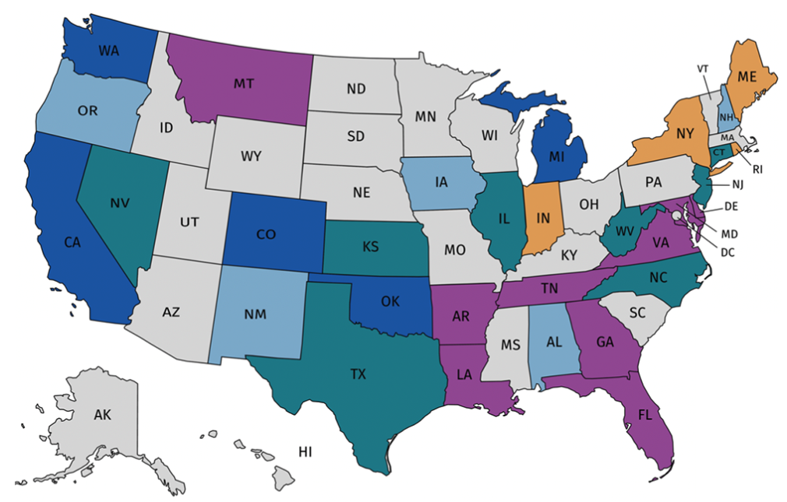
State Requirements for HIV Testing
Statutes for HIV testing during pregnancy BUT NOT specific to 3rd trimester, labor & delivery, or for newborns
Statutes for HIV testing during labor & delivery BUT NOT specific to 3rd trimester, or for newborns
Statutes for HIV testing during 3rd trimester and for newborns
Statutes for HIV testing during 3rd trimester BUT NOT specific for newborns
Statutes for HIV testing for newborns BUT NOT specific to 3rd trimester
No statutes for HIV testing during pregnancy
Division of HIV/AIDS Prevention, National Center for HIV/AIDS, Viral Hepatitis, STC, and TB Prevention, Centers for Disease Control and Prevention. Available at https://www.cdc.gov/hiv/policies/law/states/perinatal.html. Accessed August 5, 2021.
Notes:
2:28:06
So this slide actuallt shows

Slide 7
Importance of Partner Testing
Exposure to HIV through a sexual partner who is unaware of his HIV status places the woman and fetus at-risk
< 21% of women surveyed were aware of their partners’ HIV status during their current pregnancy^{1,2}
Perceptions of risk (safety of the fetus, partner fidelity), logistical considerations (access to testing, cost), and testing history contribute to desiring or declining HIV testing
1. Yee LM, et al. Sex Reprod Healthc. 2020;25:100513. 2. Yee LM, et al. J Perinatol. 2017;37(1):21-26.
Notes:
3:30:19
So how important

Slide 8
What should be the next step in HIV testing for Cynthia?
No additional testing needed at this time, counsel her on utilizing condoms with her partner
Consider that the test may have been a false negative because early in infection, prior HIV conversion, the antigen-antibody screen and HIV RNA assay will be negative
Repeat testing with an antigen/antibody combination immunoassay capable of detecting HIV-1 antibodies, HIV-2 antibodies, and HIV-1 p24 antigen
Monitor Cynthia and screen her for HIV every 6 months
I’m not sure
Notes:
4L10:15
After she says….testing for Cynthia
Answer C

Slide 9
Audience Response Rationale
What should be the next step in HIV testing for Cynthia?
No additional testing needed at this time, counsel her on utilizing condoms with her partner
Consider that the test may have been a false negative because early in infection, prior HIV conversion, the antigen-antibody screen and HIV RNA assay will be negative
Repeat testing with an antigen/antibody combination immunoassay capable of detecting HIV-1 antibodies, HIV-2 antibodies, and HIV-1 p24 antigen
Monitor Cynthia and screen her for HIV every 6 months
I’m not sure
Notes:
4:12:00
So the answer to this question
NOT AN ARS, REAL SLIDE
Answer C

Slide 10
Negative? False Negative? Discordant HIV Results Can be Seen
A woman may receive a negative result during the window period of up to 15 days post-infection when using the combined antigen/antibody immunoassay, and up to 28 days with other assays
During this time, she is viremic with a high risk of perinatal transmission to the child
Early in HIV infection, prior to HIV seroconversion, the antigen-antibody screen will be negative and the HIV RNA assay will be positive
Panel on Antiretroviral Therapy and Medical Management of Children Living with HIV. Guidelines for the Use of Antiretroviral Agents in Pediatric HIV Infection. Available at https://clinicalinfo.hiv.gov/sites/default/files/inline-files/pediatricguidelines.pdf. Accessed July 30, 2021.
Notes:
5:12:17
No Negative, false negative

Slide 11
HIV Testing Guideline Recommendations
Guidelines recommend initiating testing with an immunoassay that is capable of detecting HIV-1 antibodies, HIV-2 antibodies, and HIV-1 p24 antigen (referred to as an antigen/antibody combination immunoassay)
Individuals with a reactive antigen/antibody combination immunoassay should be tested further with an HIV-1/HIV-2 antibody differentiation assay (referred to as supplemental testing)
Individuals with a reactive antigen/antibody combination immunoassay and a non-reactive differentiation test should be tested with an FDA-approved plasma HIV RNA assay to establish a diagnosis of acute HIV infection
Panel on Antiretroviral Therapy and Medical Management of Children Living with HIV. Guidelines for the Use of Antiretroviral Agents in Pediatric HIV Infection. Available at https://clinicalinfo.hiv.gov/sites/default/files/inline-files/pediatricguidelines.pdf. Accessed July 30, 2021.
Notes:
5:54:21
So what are the HIV testing

Slide 12
What maternal viral load indicates a cesarean delivery for a woman to prevent perinatal HIV transmission?
HIV RNA > 50 copies/mL
HIV RNA > 500 copies/mL
HIV RNA > 1000 copies/mL
HIV RNA > 2500 copies/mL
I’m not sure
Notes:
7:00:00
After she says…perinatal HIV transmission
Answer C

Slide 13
Audience Response Rationale
What maternal viral load indicates a cesarean delivery for a woman to prevent perinatal HIV transmission?
HIV RNA > 50 copies/mL
HIV RNA > 500 copies/mL
HIV RNA > 1000 copies/mL
HIV RNA > 2500 copies/mL
I’m not sure
Notes:
7:01:13
The answer in this situation
Answer C

Slide 14
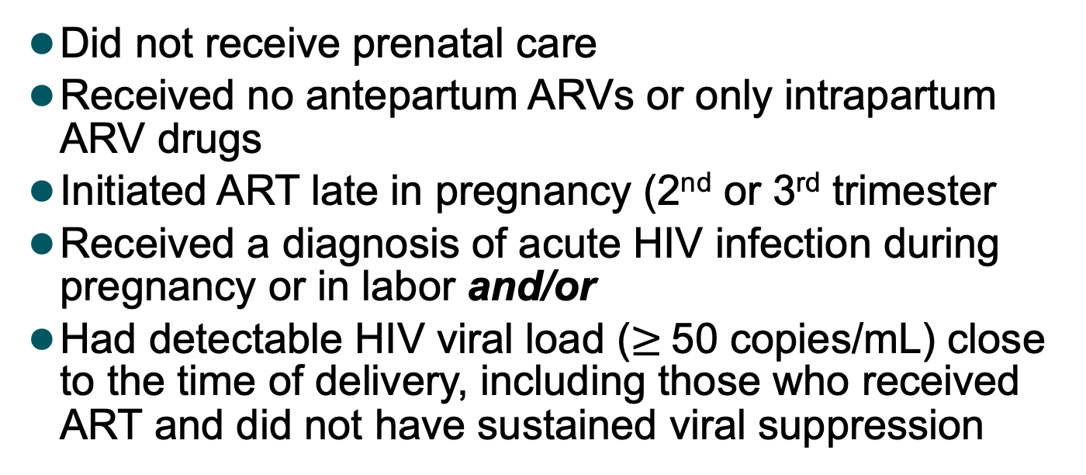
Factors Associated with High-Risk of Perinatal HIV Transmission
Did not receive prenatal care
Received no antepartum ARVs or only intrapartum ARV drugs
Initiated ART late in pregnancy (2nd or 3rd trimester
Received a diagnosis of acute HIV infection during pregnancy or in labor and/or
Had detectable HIV viral load ($≥$50 copies/mL) close to the time of delivery, including those who received ART and did not have sustained viral suppression
mL = milliliter
Panel on Antiretroviral Therapy and Medical Management of Children Living with HIV. Guidelines for the Use of Antiretroviral Agents in Pediatric HIV Infection. Available at https://clinicalinfo.hiv.gov/sites/default/files/inline-files/pediatricguidelines.pdf. Accessed July 30, 2021.
Notes:
7:13:06
So what are factors

Slide 15

Patient Case: Jackson
  Repeat testing confirms Cynthia is HIV positive
  Viral load 22,000 copies/mL
  She is initiated on ARV with a good response
  Baby boy Jackson is born at 36 wks, by cesarean section, weighing 2.9 kg
  Cynthia’s viral load at delivery is 1,200 copies/mL
  She is counseled not to breastfeed
Notes:
7:57:15
So let’s take a look back

Slide 16
Because Jackson was exposed perinatally, when should virologic testing be done?
At birth, 14-21 days, 1 to 2 months, and 4 to 6 months
At birth, and if negative, at first annual visit
At birth and 4 to 6 months after
At birth and at 18 months of age
I’m not sure
Notes:
8:33:00
After she says….testing be done
Answer A

Slide 17
Virologic Diagnostic Testing in Infants Exposed to HIV Perinatally
Virologic assays that directly detect HIV
HIV antibody tests should not be used
Plasma HIV RNA or cell-associated HIV DNA nucleic acid tests are recommended
  At birth
  14-21 days
  1 to 2 months
  4 to 6 months
A positive virologic test should be confirmed as soon as possible by repeat virology testing
  False positive results can occur with both RNA and DNA assay
Panel on Antiretroviral Therapy and Medical Management of Children Living with HIV. Guidelines for the Use of Antiretroviral Agents in Pediatric HIV Infection. Available at https://clinicalinfo.hiv.gov/sites/default/files/inline-files/pediatricguidelines.pdf. Accessed July 30, 2021.
Notes:
8:35:09
SO how do we test infants

Slide 18
Patient Case: Jackson
  At birth, PCR testing is negative
  Initiated on presumptive therapy/prophylaxis given his high risk
  At 2 weeks, Jackson’s PCR is positive and he is referred to specialty care after being started on zidovudine (ZDV), lamivudine (3TC), and nevirapine (NVP)
  HLA B5701 testing is done, and result is negative
  He is scheduled for an appointment with infectious disease
Notes:
9:19:12
So back to our

Slide 19
Virtual Clinic Visit

Slide 20
Biological Aging in Children Infected with HIV Perinatally
Persistence of HIV causing chronic immune activation is likely a key determinant in premature senescent pathway
Life-span of HIV-infected children is not yet comparable to uninfected
Premature aging exposes children to higher risk of acquiring and developing age-related chronic renal, cardiovascular, metabolic, and cerebrovascular diseases, and malignancies
ART can improve survival and quality of life
Dalzini A, et al. J Immunol Res. 2020;8041616.
Notes:
11:59:08
So why do we treat

Slide 21
Benefits of Early Treatment Initiation
Children with HIV Early Antiretroviral Therapy (CHER) trial demonstrated a 76% reduction in early mortality and 75% reduction in HIV progression among treated infants 6-12 weeks compared to delaying treatment until infants met clinical or immune criteria¹
CHER substudy found significantly better gross motor and neurodevelopmental profiles compared to deferred treatment²
Associated with improved viral suppression and reduced size of viral reservoirs^{3,4}
1. Violari A, et al. N Engl J Med. 2008;359(21):2233-2244. 2. Benki-Nugent S, et al. BMC Pediatr. 2017;17(1):24. 3. Dominguez-Rodriguez S, et al. J Acquir Immune Defic Syndr. 2019;82(5):483-490. 4. Foster C, et al. AIDS. 2017;31(13):1847-1851.
Notes:
12:39:10
So what are the benefits

Slide 22
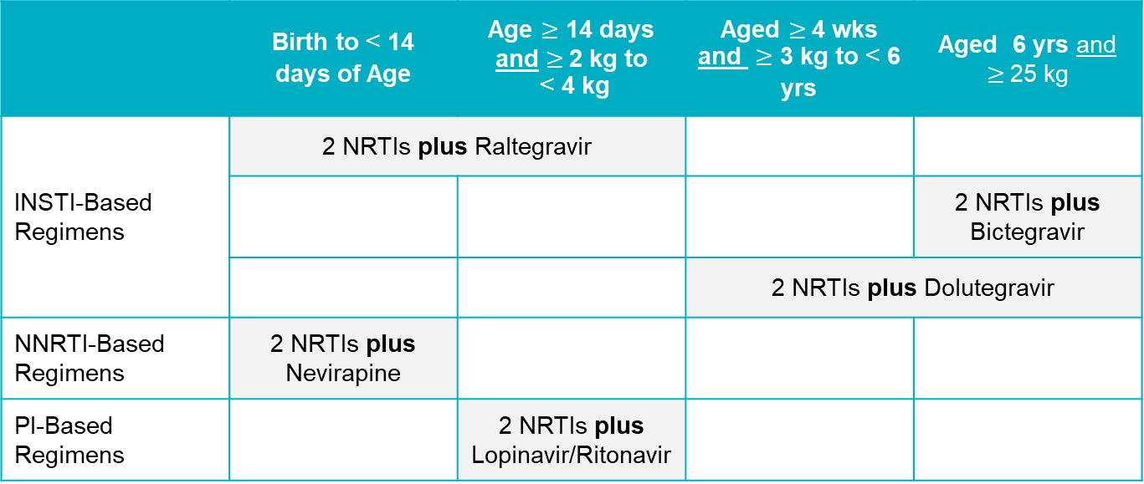
DHHS Preferred Regimen by Age, Weight, and Drug Class
 | Birth to < 14 days of Age | Age $≥$ 14 days and $≥$2 kg to < 4 kg | Aged $≥$4 wks and $≥$ 3 kg to < 6 yrs | Aged 6 yrs and $≥$25 kg
INSTI-Based Regimens | 2 NRTIs plus Raltegravir
 |  |  |  | 2 NRTIs plus Bictegravir
 |  |  | 2 NRTIs plus Dolutegravir
NNRTI-Based Regimens | 2 NRTIs plus Nevirapine
PI-Based Regimens |  | 2 NRTIs plus Lopinavir/Ritonavir
Panel on Antiretroviral Therapy and Medical Management of Children Living with HIV. Guidelines for the Use of Antiretroviral Agents in Pediatric HIV Infection. Available at https://clinicalinfo.hiv.gov/sites/default/files/inline-files/pediatricguidelines.pdf. Accessed July 30, 2021.
Notes:
13:22:12
So the DHHS

Slide 23
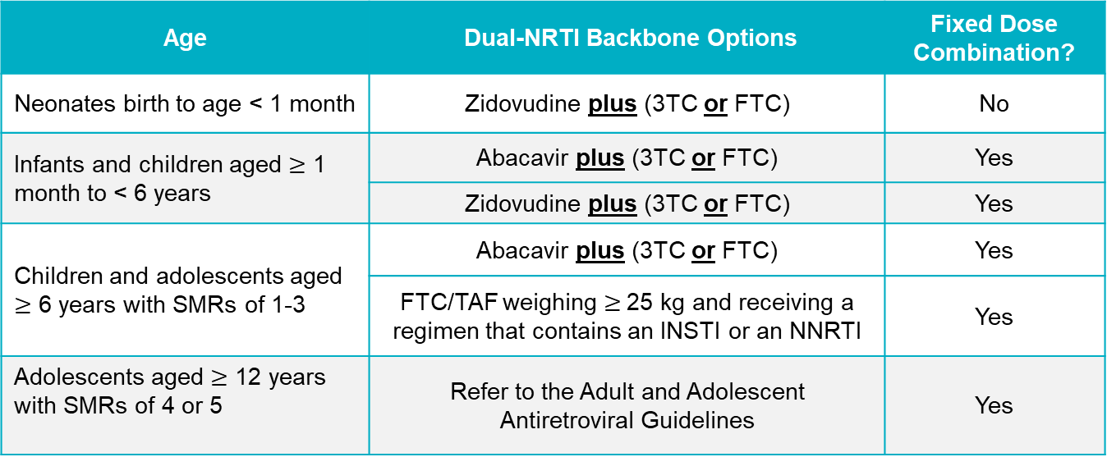
DHHS Preferred Dual-NRTI Backbone Options for Use in Combination with Other Drugs
Age | Dual-NRTI Backbone Options | Fixed Dose Combination?
Neonates birth to age < 1 month | Zidovudine plus (3TC or FTC) | No
Infants and children aged $≥$ 1 month to < 6 years | Abacavir plus (3TC or FTC) | Yes
 | Zidovudine plus (3TC or FTC) | Yes
Children and adolescents aged $≥$ 6 years with SMRs of 1-3 | Abacavir plus (3TC or FTC) | Yes
Children and adolescents aged $≥$ 6 years with SMRs of 1-3 | FTC/TAF weighing $≥$25 kg and receiving a regimen that contains an INSTI or an NNRTI | Yes
Adolescents aged $≥$ 12 years with SMRs of 4 or 5 | Refer to the Adult and Adolescent Antiretroviral Guidelines | Yes
FTC = emtricitabine; INSTI = integrase strand transfer inhibitor; NNRTI = non-nucleoside reverse transcriptase inhibitor; SMRs = standardized mortality ratios; TAF = tenofovir alafenamide
Panel on Antiretroviral Therapy and Medical Management of Children Living with HIV. Guidelines for the Use of Antiretroviral Agents in Pediatric HIV Infection. Available at https://clinicalinfo.hiv.gov/sites/default/files/inline-files/pediatricguidelines.pdf. Accessed July 30, 2021.
Notes:
14:43:05
So DHHS has preferred

Slide 24
Virtual Clinic Visit
Notes:
15:57:16
So I wanted to spend
GO FULL SCREEN WITH VIDEO

Slide 25
Treatment Adherence Counseling
Strategies to maximize adherence should be discussed before and/or at initiation of ART and again before changing regimens
Ongoing assessment of adherence and promotion of adherence at each visit is essential
In addition to viral load monitoring, at least one other method of measuring adherence should be used
Once-daily regimens and regiments with low pill burden should be prescribed whenever feasible
Panel on Antiretroviral Therapy and Medical Management of Children Living with HIV. Guidelines for the Use of Antiretroviral Agents in Pediatric HIV Infection. Available at https://clinicalinfo.hiv.gov/sites/default/files/inline-files/pediatricguidelines.pdf. Accessed July 30, 2021.
Notes:
17:38:19
So how do we
GO BACK TO REGULAR VIEW

Slide 26
Adherence Disrupters
Dependence on others for medication administration
Adult forgetfulness, changes in routine, child objections to medication
Social and health issues within a family such as substance use, poor physical or mental health, unstable housing, poverty, violence, involvement in the criminal justice system, limited social support
Panel on Antiretroviral Therapy and Medical Management of Children Living with HIV. Guidelines for the Use of Antiretroviral Agents in Pediatric HIV Infection. Available at https://clinicalinfo.hiv.gov/sites/default/files/inline-files/pediatricguidelines.pdf. Accessed July 30, 2021.
1. Cluver LD, et al. AIDS. 2015;29(Suppl 1):S57-S65. 2. Cluver L, et al. AIDS. 2018;32(8):975-983.
Notes:
18:09:11
So what can disrupt this adherence

Slide 27

Patient Case: Jackson
Jackson does well on combination of abacavir, lamivudine and lopinavir/ritonavir due to patient preference for liquid over chew tabs or mixing of oral granules (for raltegravir)
As he ages and begins attending school, Cynthia struggles with keeping him adherent to his medication
Most recent viral load is < 50 copies/mL
Notes:
18:49:11
So back to our case

Slide 28
Current Clinic Visit: Jackson
Jackson is in school full-time
Cynthia reports that he has recently experienced increasing GI problems and diarrhea
He has begun to fight her when it is time to take his medicine because he does not like the taste
He does not understand why he must take the medication
Cynthia is worried that his reaction to taking his medicine will affect his long-term HIV control
Notes:
19:02:24
Hi Cynthia
GO FULL SCREEN WITH VIDEO: She won’t talk to this, it will just be in the small window while the video is playing

Slide 29
What would be your next step for Jackson?
Maintain current regimen of abacavir, lamivudine and lopinavir/ritonavir, and assess for gastroenteritis
Switch to dolutegravir/lamivudine/tenofovir disoproxil
Switch to bictegravir/emtricitabine/tenofovir alafenamide
Switch to efavirenz, emtricitabine, and tenofovir disoproxil fumarate
I’m not sure
Notes:
20:29:00
After she says….Next step for Jackson
Can stay on full screen for this intro to the question and then go back to regular view coming out of the ARS
No right or wrong answer, except A

Slide 30
Audience Response Rationale
What would be your next step for Jackson?
Maintain current regimen of abacavir, lamivudine and lopinavir/ritonavir, and assess for gastroenteritis
Switch to dolutegravir/lamivudine/tenofovir disoproxil
Switch to bictegravir/emtricitabine/tenofovir alafenamide
Switch to efavirenz, emtricitabine, and tenofovir disoproxil fumarate
I’m not sure
Notes:
20:31:02
So for this question
No right or wrong answer, except A

Slide 31
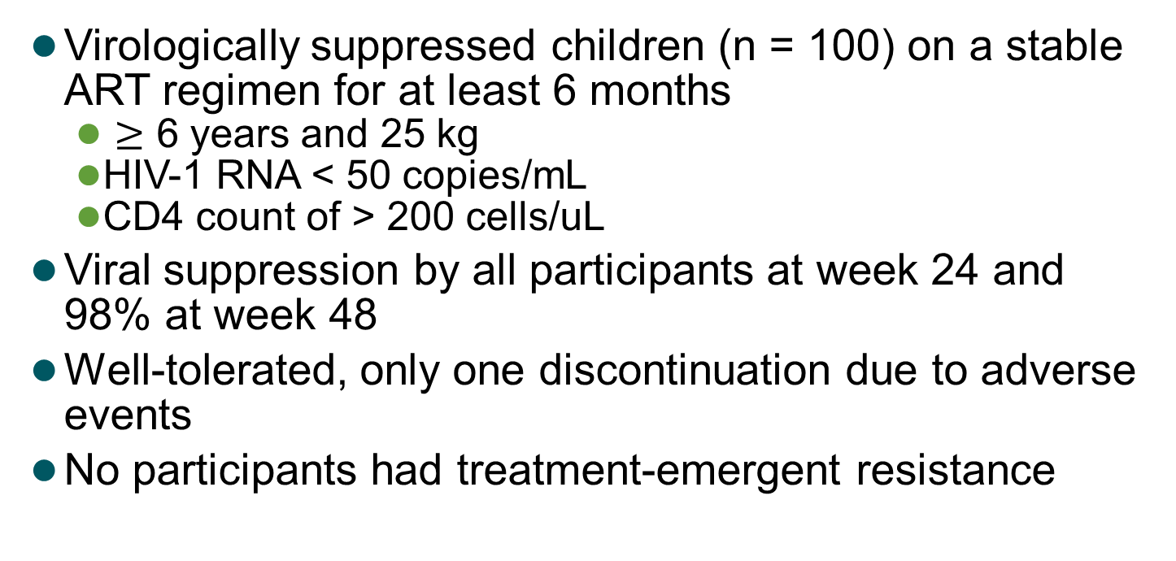
Fixed-Dose BIC/F/TAF in Children with HIV
Virologically suppressed children (n = 100) on a stable ART regimen for at least 6 months
  $≥$ 6 years and 25 kg
  HIV-1 RNA < 50 copies/mL
  CD4 count of > 200 cells/uL
Viral suppression by all participants at week 24 and 98% at week 48
Well-tolerated, only one discontinuation due to adverse events
No participants had treatment-emergent resistance
kg = kilograms; uL = microliter
Gaur AH, et al. Lancet Child Adolesc Health. 2021;S2352-4642(21)00165-6.
Notes:
20:44:20
So let’s talk about

Slide 32

ODYSSEY: Simplified Dolutegravir Dosing for Children with HIV Weighing $≥$ 20 kg
Open-label, multicentre, randomized non-inferiority, phase 2/3 trial evaluating efficacy and safety of dolutegravir + 2 NRTIs vs. standard of care over 96 wks in 700 children with HIV
DTG 30 mg dispersible tablets provide similar exposure to the 50 mg film-coated tablets
Can be used in children unable to swallow tablets
mg = milligram; wks = weeks
Bollen PDJ, et al. Lancet HIV. 2020;7(8):e533-e544.
Notes:
21:35:21
And what about dolutegravir

Slide 33

Formulations of INSTIs for Treatment in Children with HIV $≥$ 6 years
ARV Agent | Dosing and Formulation Advantages | Dosing and Formulation Disadvantages
BIC | Once-daily administration Can give with or without food Available in FDC tablets | FDC not recommended if hepatic impairment or estimated CrCl < 30mL/min FDC should not be administered with rifampin or dofetilide
DTG | Once-daily administration Can give with food Available in FDC tablets Single-agent pills available in several doses and are small in size Available as dispersible tablets for suspension | DDI with EFV, PRV/r, TPV/r, and rifampin, necessitating twice-daily dosing CNS side effects, particularly sleep disturbances
CrCl = creatinine clearance; DDI = drug-drug interaction; FDC = fixed-dose combination
Panel on Antiretroviral Therapy and Medical Management of Children Living with HIV. Guidelines for the Use of Antiretroviral Agents in Pediatric HIV Infection. Available at https://clinicalinfo.hiv.gov/sites/default/files/inline-files/pediatricguidelines.pdf. Accessed August 9, 2021.
Notes:
22:26:16
So this slide just includes

Slide 34
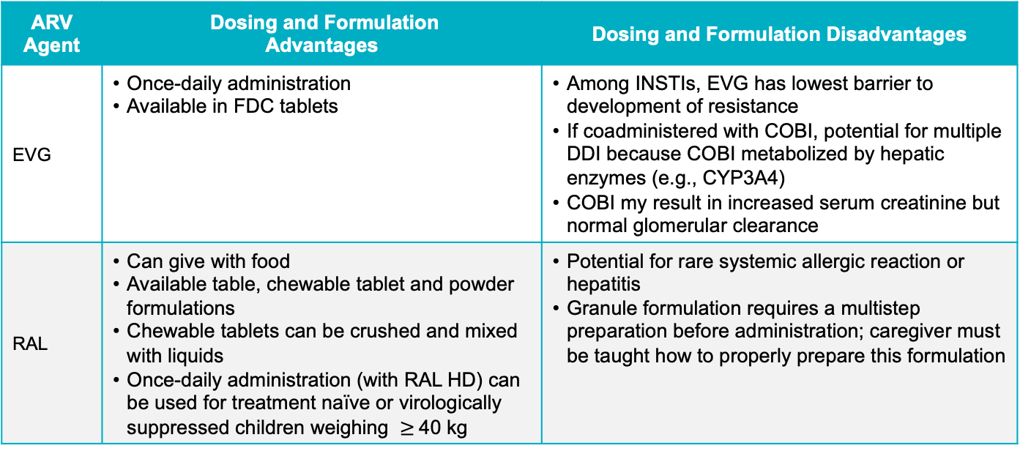
Formulations of INSTIs for Treatment in Children with HIV $≥$ 6 years
ARV Agent | Dosing and Formulation Advantages | Dosing and Formulation Disadvantages
EVG | Once-daily administration Available in FDC tablets | Among INSTIs, EVG has lowest barrier to development of resistance If coadministered with COBI, potential for multiple DDI because COBI metabolized by hepatic enzymes (e.g., CYP3A4) COBI my result in increased serum creatinine but normal glomerular clearance
RAL | Can give with food Available table, chewable tablet and powder formulations Chewable tablets can be crushed and mixed with liquids Once-daily administration (with RAL HD) can be used for treatment naïve or virologically suppressed children weighing $≥$40 kg | Potential for rare systemic allergic reaction or hepatitis Granule formulation requires a multistep preparation before administration; caregiver must be taught how to properly prepare this formulation
Panel on Antiretroviral Therapy and Medical Management of Children Living with HIV. Guidelines for the Use of Antiretroviral Agents in Pediatric HIV Infection. Available at https://clinicalinfo.hiv.gov/sites/default/files/inline-files/pediatricguidelines.pdf. Accessed August 9, 2021.
Notes:
23:50:12
If you look at

Slide 35
SMART Goals
Specific, Measurable, Attainable, Relevant, Timely
Employ HIV screening in pregnant women during pregnancy, including the 3rd trimester to be proactive about assessing risk of perinatal HIV transmission
Screen infants at risk for HIV infection at birth, 14-21 days, 1 to 2 months, and 4 to 6 months to guide decision-making
Follow guideline recommendations for treatment of children for HIV based on age and weight
Conduct ongoing monitoring and counseling of patients and caregivers to optimize treatment adherence
Notes:
25:21:11
So we can talk

Slide 36
Switching Antiretroviral Therapy (ART) in Your African American Patients: When and How
1
3
Prior Treatment Failure: Addressing the Challenge in HIV Care
www.CMEOutfitters.com/IDhub
Notes:
26:05:06
So today’s CMEO Briefcase

Slide 37
HIV Patient Education Hub
Free resources and education to inform and empower patients.
cmeoutfitters.com/HIVeducation
Notes:
26:25:19
CME Outfitters also has a

Slide 38
To Receive Credit
To receive CME/CE credit for this activity, participants must complete the post-test and evaluation online.
Participants will be able to download and print their certificate immediately upon completion.
Notes:
26:34:08
Thank you for joining me

