Slide 1
Switching Antiretroviral Therapy (ART) in Your African American Patients: When and How
Supported by an educational grant from Gilead Sciences, Inc.
Notes:
https://vimeo.com/588551710/4294fa4c00

Slide 2
Gregory D. Huhn, MD, MPHTM
COVID-19 Vaccination Coordinator and Senior Director of HIV Services
Cook County Health
Associate Professor, Department of Internal Medicine, Division of Infectious Disease
Rush University Medical Center
Chicago, IL
Notes:
0:20:08
And I’m the COVID-19

Slide 3
Learning
Objective
Integrate best practices for switching antiretroviral therapy (ART) in patients based on safety and efficacy data.
Notes:
0:34:00
Our learning objective for today

Slide 4

Patient Case: Jeffrey
  Jeffrey is a 31-year-old African American infected with HIV perinatally
  As a child, he was intermittently engaged in HIV care and treated with antiretroviral therapy (ART)
  His grandmother was his guardian and caregiver
  Following her death, he was in and out of foster care which impacted access to care and adherence to ART
Notes:
0:41:16
So let’s start with a case

Slide 5
ART History
  In early childhood, initiated AZT monotherapy, then lamivudine was added for dual NRTI therapy
  Nelfinavir was added at age 7 at approximately the same time HIV viral load testing was approved, and patient had variable viral load profile from undetectable to the 200-400 copies/mL range
  Later switched off nelfinavir to lopinavir/ritonavir for easier dosing and tolerability
mL = milliliter; NRTI = nucleoside reverse transcriptase inhibitor
Notes:
1:03:20
So in early childhood

Slide 6
ART History
  At age 16, switched to single tablet efavirenz/emtricitabine/tenofovir disoproxil fumarate (TDF)
  Better tolerated than the PI and he does well for 2 years
  Then he experienced inconsistent adherence due to depression coupled with vivid dreams, which led to virologic failure with a viral load approximately 4,500 copies/mL
PI = protease inhibitor
Notes:
1:33:16
And then at age 16

Slide 7
Resistance Testing
Genotype testing at reengagement
Mutations: K103N, M184V, L210W, K219Q
Multiclass resistance
Re-engages in care, started with elvitegravir/cobicistat/emtricitabine/TDF plus darunavir, and eventually transitioned to elvitegravir/cobicistat/emtricitabine/tenofovir alafenamide (TAF) plus darunavir
Notes:
1:57:11
So we have resistance testing

Slide 8
Current Clinic Visit
  Jeffrey is currently maintained on elvitegravir/cobicistat/emtricitabine/TAF + darunavir with virologic suppression
Notes:
2:35:04
So now Jeffrey’s
At 2:51:13
GO FULL SCREEN VIDEO

Slide 9
Audience Response Rationale
Should further resistance testing be done?
Yes
No
I’m not sure
Notes:
3:45:16
After he says….I’m not sure
Stay in full screen and we can go back to normal view when they come out of the audience response with slide 10 at 4:06:23

Slide 10
Factors to Consider Before Switching or Simplifying Therapy
Review of a patient’s full treatment history is critical before initiating a treatment switch¹
  History of multiple virologic failures or pre-treatment drug resistance
  Review of cumulative resistance test results
  Clinical response to prior regimens
  Past treatment-associated intolerance, toxicities, or adverse events
Review active medication list, including herbal supplements and over-the-counter medications, for DDIs¹
Always consider patient preference
DDIs = drug-drug interactions
1. Panel on Antiretroviral Guidelines for Adults and Adolescents. Guidelines for the Use of Antiretroviral Agents in Adults and Adolescents with HIV. Department of Health
and Human Services. https://clinicalinfo.hiv.gov/en/guidelines/adult-and-adolescent-arv/whats-new-guidelines. Accessed July 27, 2021.
Notes:
4:06:23
So what we want to do now

Slide 11
Virtual Clinic Visit
Notes:
5:48:04
GO FULL SCREEN TO VIDEO
Stay full screen until after ARS

Slide 12
To which antiretroviral agent(s) would you choose to switch Jeffrey?
Dolutegravir plus emtricitabine/TAF
Bictegravir/emtricitabine/TAF
Doravirine/lamivudine/TDF
Lamivudine/dolutegravir
Rilpivirine (RPV)/dolutegravir
I’m not sure
Notes:
7:14:10
After he says….choose to

Slide 13
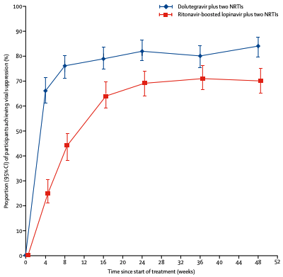

DAWNING Trial: Dolutegravir vs Lopinavir, Each With 2 NRTIs for First-Line Treatment Failure
Dolutegravir plus two NRTIs
Ritonavir-boosted lopinavir plus two NRTIs
Demonstrated that dolutegravir (DTG) was superior to PI ritonavir-boosted lopinavir in viral suppression at wk 48 when either drug administered with 2 NRTIs in treatment failures
Support DTG + 2 NRTIs as option for second-line therapy for patients with virologic failure
  Suggests one fully NRTI combined with DTG is highly effective
Proportion (95% CI) of participants achieving viral suppression (%)
Time since start of treatment (weeks)
wk = week
Aboud M, et al. Lancet Infect Dis. 2019;19(3):253-264.
Notes:
7:15:05
SO let’s take a look at some recent data
Come back to regular view

Slide 14
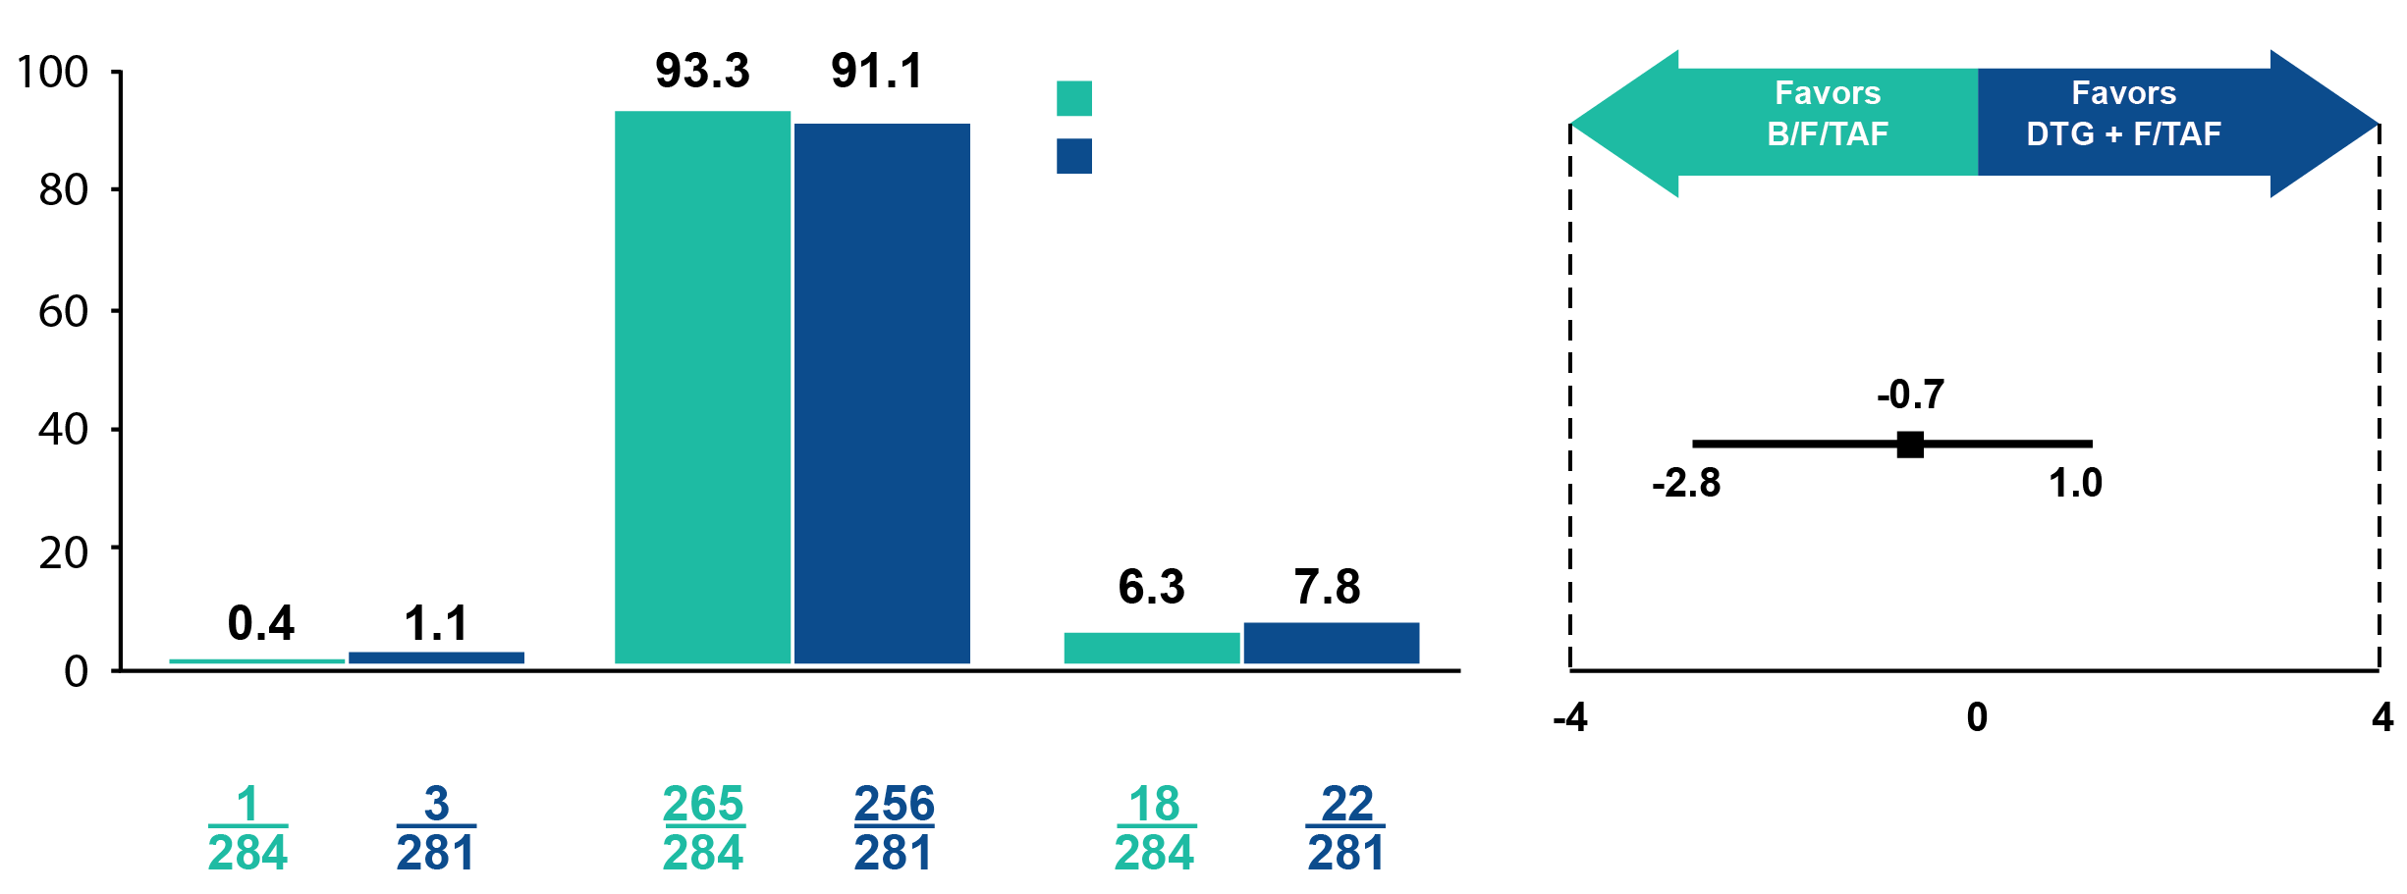
Viral Suppression Maintained at Week 48 in Patients Switched from Dolutegravir to Bictegravir
Virologic Outcome
Treatment Difference in RNA
≥ 50, %(95.001% CI)
B/F/TAF (n = 284)
DTG + F/TAF (n = 281)
HIV-1 RNA ≥ 50 c/mL
HIV-1 RNA < 50 c/mL
No Virologic Data
B/F/TAF = Bictegravir/emtricitabine/TAF
Sax PE, et al. Clin Infec Dis 2021;73(2):e485-e493.
Notes:
9:44:02
Now we see here

Slide 15
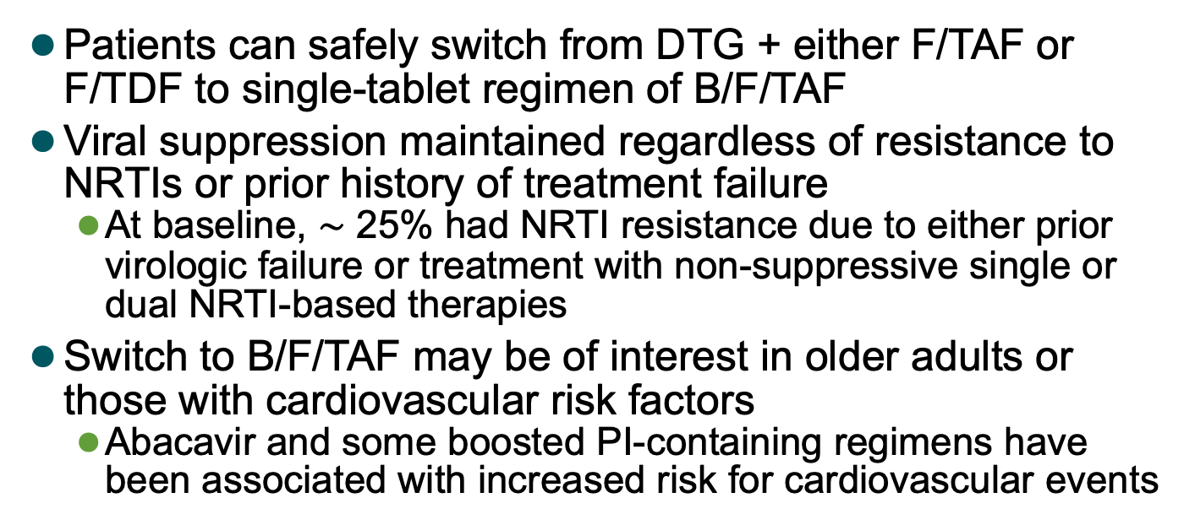
Viral Suppression Maintained In Patients Switched from Dolutegravir to Bictegravir
Patients can safely switch from DTG + either F/TAF or F/TDF to single-tablet regimen of B/F/TAF
Viral suppression maintained regardless of resistance to NRTIs or prior history of treatment failure
  At baseline, $\sim$ 25% had NRTI resistance due to either prior virologic failure or treatment with non-suppressive single or dual NRTI-based therapies
Switch to B/F/TAF may be of interest in older adults or those with cardiovascular risk factors
  Abacavir and some boosted PI-containing regimens have been associated with increased risk for cardiovascular events
Sax PE, et al. Clin Infec Dis. 2021;73(2):e485-e493.
Notes:
10:39:16
And so as a summary slide

Slide 16
BRAAVE 2020: Impact of BL Resistance on Outcomes Following Switch to B/F/TAF in Black Americans with HIV
Randomized, open-label, active-controlled phase III study evaluated switch from BL regimen (2 NRTIs + third agent) to B/F/TAF in virologically suppressed Black PLWH (N = 495)
  NRTI backbone: FTC/TAF (67%), FTC/TDF (19%), ABC/3TC (14%)
  3rd agent: INSTI (59%), NNRTI (29%), PI (6%), other (6%)
Switch to B/F/TAF non-inferior to remaining on BL regimen at wk 24
Patients with BL NRTI resistance remained suppressed at wk 24
Wk 24 Virologic Outcomes
100
98
96
96
95
97
95
96
95
80
60
HIV-1 RNA < 50 c/mL (%)
BL ARV Resistance, % | B/F/TAF (n = 330) | Continue BL Regimen (n = 165)
NRTI M184V/I | 13% 9% | 16% 12%
NNRTI | 21% | 19%
PI | 11% | 15%
40
20
n =
44
26
269
132
31
20
282
138
0
Yes
No
Yes
No
NRTI Resistance
M184V or M184I
B/F/TAF
BL Regimen
3TC = lamivudine; ABC = abacavir; BL = baseline; INSTI = integrase strand transfer inhibitor; FTC = emtricitabine; n = adults with HIV; N = number of participants; NNRTI = non-nucleoside reverse transcriptase inhibitor; PLWH = people living with HIV
Hagins DP. Presented at CROI (virtual); 2020. Abstract No. 36. Available at http://www.croiwebcasts.org/p/2020croi/croi/36. Accessed August 2, 2021.
Notes:
11:44:15
So now we look to the BRAVE

Slide 17
Virologic Outcomes Through Week 72: Resistance Subgroups*
Participants with NRTI resistance, including M184V/I, maintained virologic suppression on B/F/TAF
No treatment-emergent resistance was detected in any treatment group
Participants, %
43
43
25
25
267
269
130
131
30
30
20
20
280
282
135
136
*Includes participants with $\text{≥}$ 1 on-treatment HIV-1 RNA measurement and baseline resistance assessed by cumulative historical proviral DNA genotype.
B/F/TAF, n = 312; SBR, n = 156
Kumar P, et al. Presented at 11th IAS Conference on HIV Science; 2021. Accessed August 8, 2021.
Notes:
14:02:22
And again, we see here

Slide 18
Stable Switch: Reasons to Optimize ART in the Setting of Viral Suppression
Managing or preventing short-term or long-term adverse events
High pill burden or dosing frequency that may be impacting adherence
Pregnancy
Difficulties with food or fluid requirements
Prevent or mitigate DDIs
Reduce cost
Panel on Antiretroviral Guidelines for Adults and Adolescents. Guidelines for the Use of Antiretroviral Agents in Adults and Adolescents with HIV. Department of Health and Human Services. https://clinicalinfo.hiv.gov/en/guidelines/adult-and-adolescent-arv/whats-new-guidelines. Accessed July 27, 2021.
Notes:
14:56:16
So when we look at stable switch

Slide 19
Switch to Options: Bictegravir/F/TAF
Key Studies
GS-380-1878 Switch to B/F/TAF from boosted PI + two NRTIs (n = 577)¹ | All participants had sustained suppressed HIV RNA on boosted PI + two NRTIs After 48 weeks, B/F/TAF was non-inferior in maintaining virologic suppression vs. boosted PI + two NRTIs
GS-380-1844 Switch to B/F/TAF from DTG/ABC/3TC (n = 561)² | All participants had sustained suppressed HIV RNA on DTG/ABC/3TC After 48 weeks, B/F/TAF was non-inferior in maintaining virologic suppression vs. DTG/ABC/3TC
GS-380-1961 Switch to B/F/TAF from EVG/COBI/FTC/(TAF or TDF) (n = 470)³ | Non-pregnant women with HIV and virologic suppression on EVG/COBI/FTC/(TAF or TDF) At 48 weeks, B/F/TAF was non-inferior in maintaining virologic suppression vs. EVG/COBI/F/(TAF or TDF)
COBI = cobicistat; EVG = elvitegravir
1. Daar ES, et al. Lancet HIV. 2018;5:e347. 2. Molina J-M, et al. Lancet HIV. 2018;5:e357-e365. 3. Kityo C, et al. Acquir Immune Defic Syndr.
2019;82:321-328.
Notes:
15:42:22
So let’s take a look

Slide 20
Switch to Options: Dolutegravir
Key Studies
TANGO Switch to DTG/3TC from 3-drug or 4-drug TAF-based ART (n = 741)¹ | All participants had sustained suppressed HIV RNA on TAF-based regimen After 48 weeks, DTG/3TC was non-inferior in maintaining virologic suppression vs. TAF-based regimen
STRIIVING Switch to ABC/DTG/3TC from third agent + two NRTIs (n = 553)² | All participants had sustained suppressed HIV RNA on current ART 275 randomly assigned to immediate switch, 278 continued on current ART, switched at 24 weeks After 48 weeks, ABC/DTG/3TC was non-inferior in maintaining virologic suppression vs. current ART
SWORD-1/2 DTG + RPV from third agent + two NRTIs (n = 516)³ | All participants had sustained suppressed HIV RNA on first or second ART At 48 weeks, DTG + RPV was non-inferior in maintaining virologic suppression vs. first or second ART
TANGO: Key exclusion criteria included a history of any major NRTI or INSTI resistance-associated mutations
SWORD-1/2: Key exclusion criteria included any major resistance-associated PI, INSTI, NRTI, or NNRTI mutation or integrase resistance associated substitution R263K
1. van Wyk J, et al. Clin Infec Dis. 2020 Jan 6:ciz1243. [Epub ahead of print]. 2. Trottier B, et al. Antivir Ther. 2017;22(4):295-305.
3. Libre JM, et al. Lancet. 2018;391(10123):839-849.
Notes:
17:39:00
Let’s take a look then

Slide 21
Switch to Options: Doravirine
Key Studies
DRIVE-SHIFT Switch to DOR/3TC/TDF from boosted-PI, EVG/COBI, or NNRTI + two NRTIs (n = 670) | After 48 weeks, DOR/3TC/TDF was non-inferior in maintaining virologic suppression vs. current ART in patients with HIV-1 with high rates of virologic suppression and low rates of virologic rebound DOR/3TC/TDF was associated with a favorable lipid profile compared to a boosted-PI regimen
DOR = doravirine
Johnson M, et al. J Acquir Immune Defic Syndr. 2019;81(4):463-472.
Notes:
20:27:17
And finally we have doravirine

Slide 22
Virtual Clinical Visit
Scene 3
Notes:
21:23:12
So again, we’re revisitng
At 21:41:16 GO FULL SCREEN VIDEO

Slide 23
What do the DHHS guidelines recommend for monitoring after a regimen switch?
Monitor patients every 6 months to assess tolerability, viral suppression, and adherence
Annual monitoring, including HIV resistance-testing
Monitor patients within 3 months after a regimen switch to assess tolerability, viral suppression, adherence, and safety
Weekly monitoring for the first 3 months which may be conducted by telemedicine
I’m not sure
Notes:
22:49:08
After he says….polling questions
Correct Answer C

Slide 24
Monitoring Patients After Switching
Recommendation of DHHS guidelines is to monitor patients within 3 months after a regimen switch
  Assess tolerability
  Viral suppression
  Adherence
  Safety
When switching from a stable regimen, even if the new agent has a better safety profile, monitor potential side effects that could result when starting a new regimen
Panel on Antiretroviral Guidelines for Adults and Adolescents. Guidelines for the Use of Antiretroviral Agents in Adults and Adolescents with HIV.
Department of Health and Human Services (DHHS). https://clinicalinfo.hiv.gov/en/guidelines/adult-and-adolescent-arv/whats-new-guidelines.
Accessed August 6, 2021.
Notes:
22:50:20
And so here
GO BACK TO REGULAR VIEW

Slide 25
Follow-up After Switch
Jeffrey is switched to bictegravir/emtricitabine/TAF
You call him after two weeks and he is taking his pill daily without any tolerance issues
He comes back to clinic in one month, a viral load is obtained, and he has maintained virologic suppression
Notes:
23:43:18
So as follow up after the switch

Slide 26
SMART Goals
Specific, Measurable, Attainable, Relevant, Time-Bound
Review a patient’s full treatment history, pre-treatment drug resistance, tolerance, and active medication list when considering a regimen switch
Always factor patient preference into decision-making
High pill burden or dosing frequency may be impacting adherence and can be mitigated with single tablet regimens
Monitor patients following a switch to assess tolerability, viral suppression, and adherence
Notes:
24:21:24
And you know our goal here

Slide 27
The Pediatric Patient with HIV: Translating Data to Practice
2
3
Prior Treatment Failure: Addressing the Challenge in HIV Care
www.CMEOutfitters.com/IDhub
Notes:
26:07:17
Alright well we had our first

Slide 28
Infectious Disease Hub
A robust hub of patient education and resources for your patients to learn more about infectious disease
www.CMEOutfitters.com/IDhub
Notes:
26:24:06
We can find

Slide 29
To Receive Credit
To receive CME/CE credit for this activity, participants must complete the post-test and evaluation online.
Participants will be able to download and print their certificate immediately upon completion.
Notes:
26:30:02
Don’t forget to complete the post-test

