Slide 1
@MondayNightIBD
LIVE: Identifying the Factors That Impact Success in Your Practice
Supported by educational grants from AbbVie Inc.; Genentech, a member of the Roche Group; and Janssen Biotech, Inc., administered by Janssen Scientific Affairs, LLC.
Notes:
https://vimeo.com/474491503/34c02d9843
0:00

Slide 2

Claim ABIM MOC Credit
3 Things to Do
Actively participate in the meeting by responding to ARS
  (It’s okay if you miss answering a question or get them wrong;
  you can still claim MOC)
Complete your post-test and evaluation at the conclusion of the webcast
Be sure to fill in your ABIM ID number and DOB (MM/DD) on the evaluation so we can submit your credit to ABIM
Notes:
0:27
Today’s CME and CE activities

Slide 3
Aline Charabaty, MD, AGAF
Assistant Professor of Medicine
Johns Hopkins School of Medicine
Clinical Director of Gastroenterology
Director, Inflammatory Bowel Disease Center
Johns Hopkins - Sibley Memorial Hospital
Washington, DC
@DCharabaty
Notes:
0;46
Throughout this webinar

Slide 4
Christina Ha, MD, FACG, AGAF
Associate Professor of Medicine
Inflammatory Bowel Disease Center
Cedars-Sinai Medical Center
Los Angeles, CA
@TinaHaMD
Notes:
1:04:20
By Dr. Christina Ha

Slide 5
Learning Objectives
Apply efficacy and safety data to optimize therapy selection for patients with inflammatory bowel disease (IBD).
Identify appropriate treatment strategies for special populations with IBD such as young patients and racial/ethnic minorities.
Develop strategies such as disease monitoring, shared decision-making, and patient education in order to achieve optimal patient outcomes.
Notes:
1:21
Let’s start with our

Slide 6
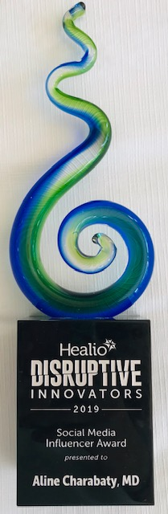
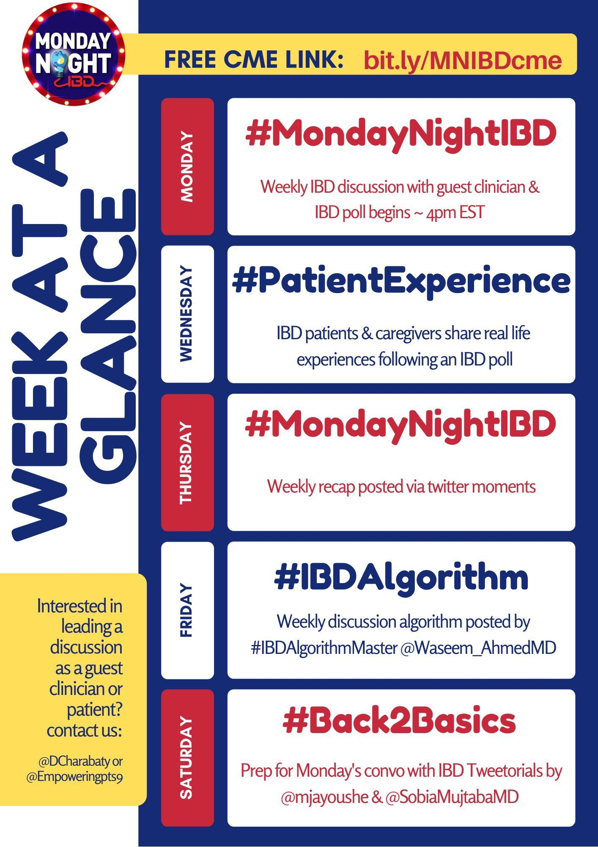
Building Community Through @MondayNightIBD
“Real life” Clinical vignette and discussion led by an IBD expert
Multidisciplinary and global discussion
  Gastrointestinal (GI) and non-GI clinicians
  Diverse practice settings and career stage
  Expertise and peer-reviewed resources
Free CME
Insight into patient experience
#Back2Basics Tweetorials
Notes:
1:54
For those of you

Slide 7
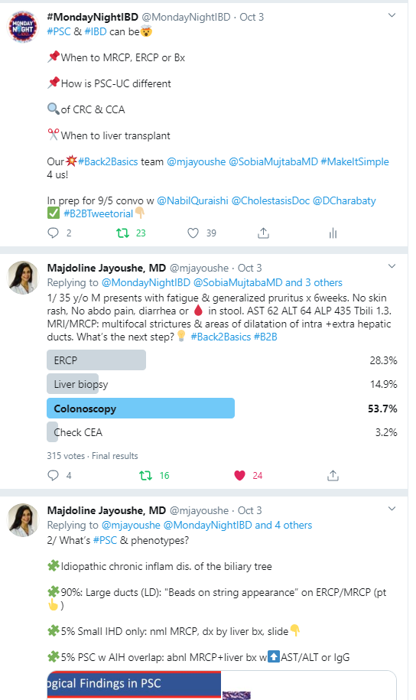
Notes:
3:03
This is really to show

Slide 8
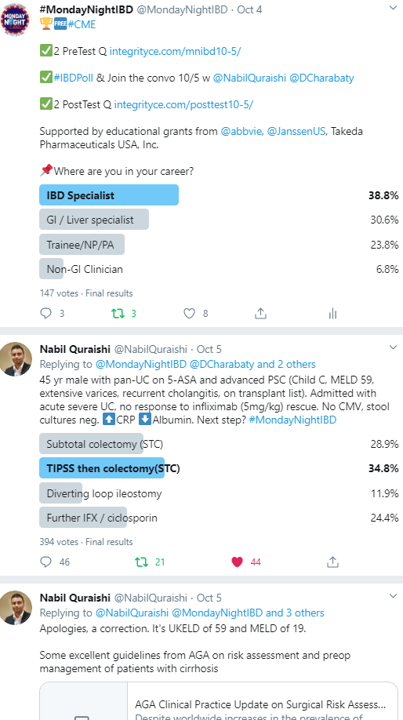
Notes:
3:33:16
On Monday, we address

Slide 9
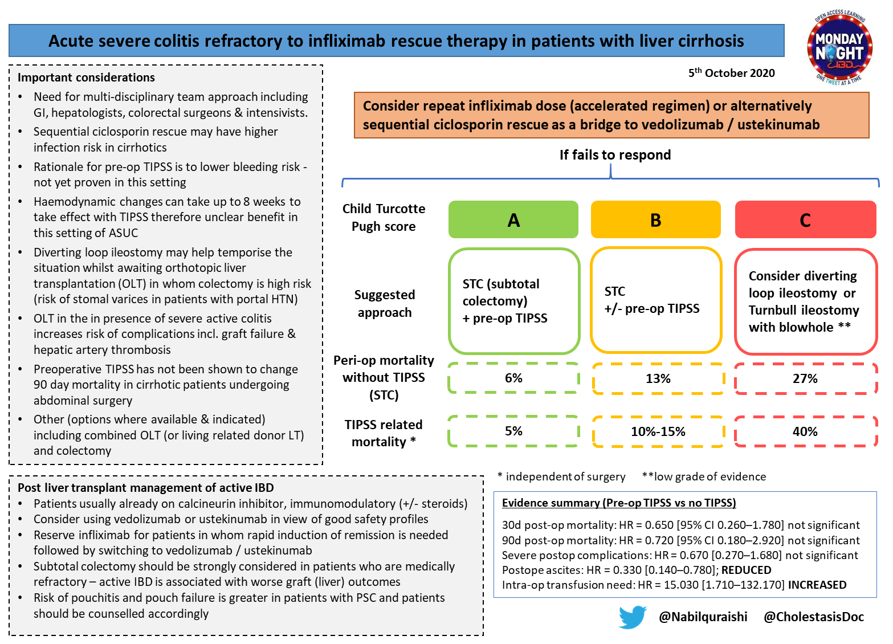
Notes:
3:57
And then at the end

Slide 10
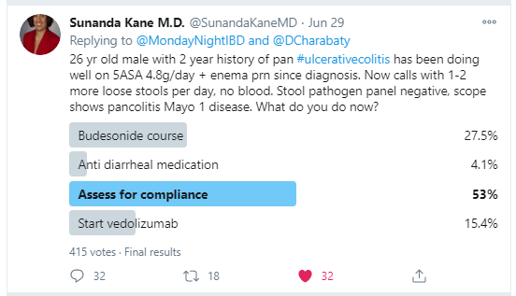
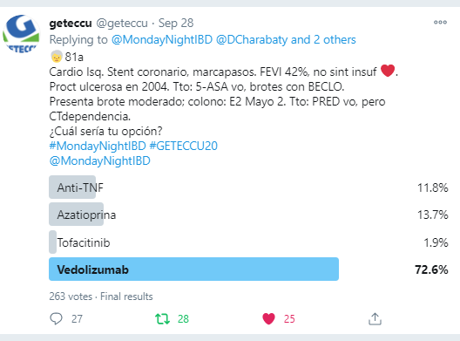
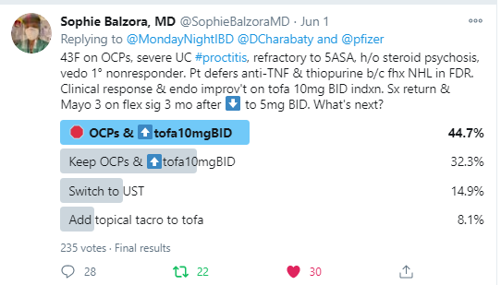
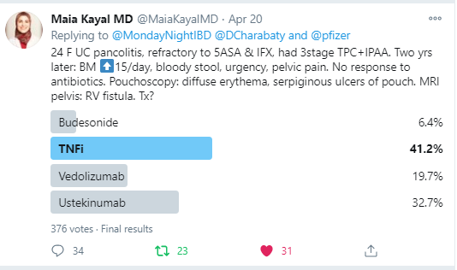
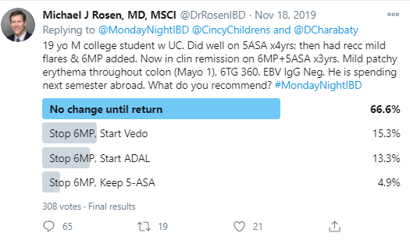
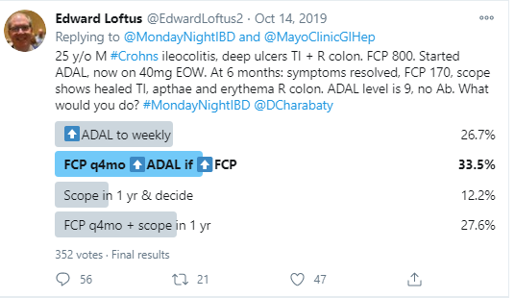
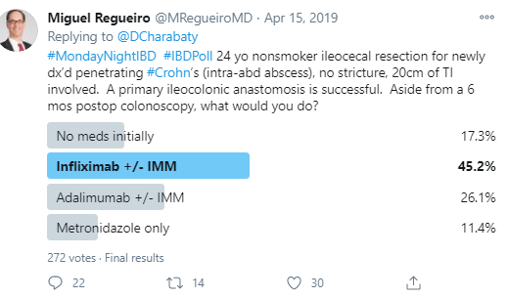
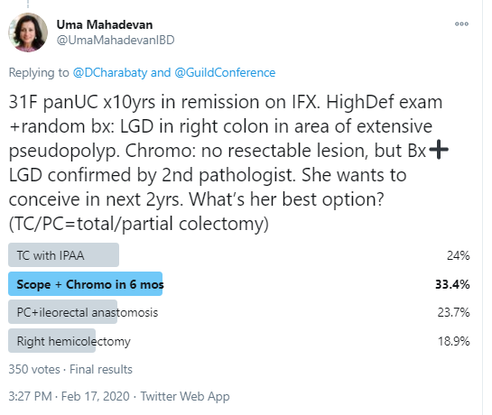
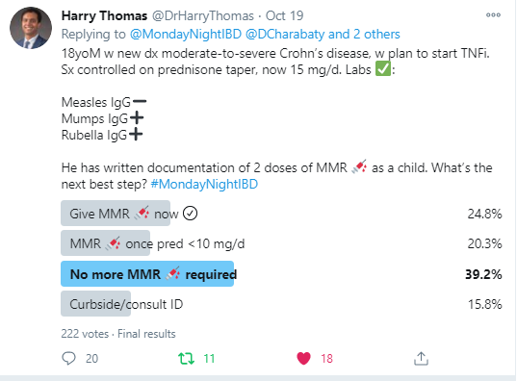
Notes:
4:20
And we really have fantastic

Slide 11
Addressing Racial and Ethnic Disparities in IBD
Notes:
5:13:12
Alright…so, let’s start our program

Slide 12
Which of the following statements is true?
The incidence of IBD in the U.S. is stable and most prevalent among Whites
The incidence of IBD in the US is increasing, with the most significant increase in non-Whites
The incidence of IBD in the US is increasing, with the most significant increase in Whites
There are wide racial and ethnic differences in the phenotypes of IBD
Notes:
5:58
After she says…participate in this poll please

Slide 13
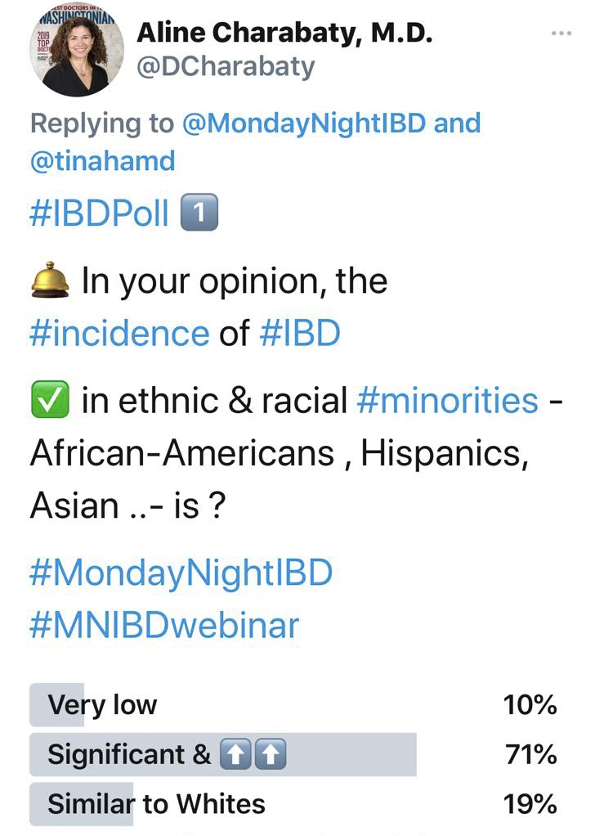
#MedTwitter Polling Results
Results recorded on October 26, 2020.
Notes:
6:02
So this is the poll we had on Twitter

Slide 14
Which of the following is true?
Results recorded on October 26, 2020.
Notes:
6:22
So we’ll see what our audience says

Slide 15
Evolving Patient Demographics in IBD
Increase in incidence of IBD in the USA
More so among racial and ethnic minorities
  Annual incidence rate for Whites 21 cases/100,000 person-years vs non-whites 13 cases/100,000
  ↑ by 39% in Whites vs 135% in non-Whites in 40 yrs
By 2050, it is estimated that 54% of the U.S. population will be minorities
  Hispanic and African American populations will increase from 30% to 45%
It is important to assess for
  Potential differences in disease characteristics, natural history, treatment response and healthcare utilization
  Access and barriers to care
Afzali A, Cross R. Inflamm Bowel Dis. 2016;22:2023-2040.; Aniwan S, et al. Therap Adv Gastroenterol. 2019;12:1-8
Notes:
6:33
I’m going to start

Slide 16
Predictors of Healthcare Utilization and IBD Care Outcomes
Ratio of Hospitalizations to Prevalence for IBD Among Racial and Ethnic Minorities¹
Predictors of Ever Requiring Steroids (n = 924)²
 | Odds Ratio | 95% CI | P Value
White | Ref | Ref | Ref
Black | 2.49 | 1.32, 4.66 | .004
Asian | 0.65 | 0.20, 2.16 | .48
Hispanic | 1.17 | 0.75, 1.85 | .49
Other | 0.86 | 0.38, 1.98 | .73
Unknown | 1.10 | 0.75, 1.85 | .49
Medicaid Insurance | 3.77 | 2.53, 5.62 | < .0001
CI = confidence interval
1. Nguyen GC, et al. J Crohns Colitis. 2014;8(4):288-295. 2. Axelrad JE, et al. Inflamm Bowel Dis. 2019;25(10):1711-1717.
Notes:
7:53
I want to share with you

Slide 17
Socioeconomic Factors Continue to Impact IBD Care
While Medicaid may help cover and reduce costs, Medicaid and low socioeconomic factors impact engagement in IBD care¹⁻³
  Underinsurance
  High personal healthcare costs
  Inconsistent access because of insurance transitions
  Increase in emergency department visits
  Increase in hospitalization
  Increase in IBD-related disability
1. Axelrad JE, et al. Inflamm Bowel Dis. 2019;25(10):1711-1717. 2. Whitfield E, et al. J Pediatr Gastroenterol Nutr. 2017;64:962-965.
3. Wherry LR, Miller S. Ann Intern Med. 2016;164:795-803.
Notes:
9:08
So even thought Medicaid

Slide 18
Which of the following best reflects your IBD practice?
The demographics of my practice have not changed very much in the past 5 years and most/all IBD patients are White
The number of African American/Black or Hispanic patients with IBD is growing in my practice
I have a diverse population in my practice, but I am not sure I can apply the data from RCT to non-White patients
Notes:
9:50
After she says…seeing in your practice

Slide 19
Addressing Racial and Ethnic Disparities in IBD Clinical Trials
Notes:
9:52
So Tina, as our audience

Slide 20
Which of the following is true?
Results recorded on October 26, 2020.
Notes:
11:34
SO this is our

Slide 21

Case Study 1: Meet Cecily
21-year-old African American woman
Symptoms x 3 weeks: intense abdominal pain followed by urgent, bloody diarrhea (10 BMs/day)
Abdominal pain and distension that results in vomiting
New joint pains in knees and ankles
Mid-back pain and stiffness in the morning
  Lost 15 lbs in 3 weeks, poor appetite
  Fatigue
Notes:
12:20
So let’s dive in to our

Slide 22
Case Study 1: Cecily
  Social History
  Smokes e-cigarettes
  Physical Exam/Labs
  Tenderness to palpation in right lower quadrant (RLQ) abdomen
  Left ankle slightly swollen and tender
  C. difficile negative
  Stool cultures negative
  C-reactive protein (CRP): 10.3 mg/L
Notes:
12:57
In terms of other relevant history

Slide 23
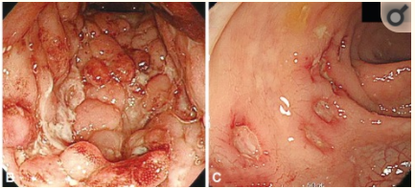
Case Study 1: Cecily
Endoscopic Features
Terminal ileum: deep mucosal ulcers with cobblestoning, ulcerated and stenotic ileocecal valve
Colon: Scattered deep ulcers throughout the colon
Path: features of chronic and severe active ileitis and colitis, no viral inclusions present
Notes:
13:29
So she gets a colonoscopy

Slide 24
Audience Response
How would you treat Cecily?
Azathioprine
Anti-TNF (adalimumab, infliximab, certolizumab pegol)
Ustekinumab
Vedolizumab
I don’t know
Notes:
14:02
After she says....how would you treat Cecily

Slide 25
Risk Factors and Initial Treatment of CD: ACG Clinical Decision Tool
Risk Factors for Poor Outcomes
Age < 30 at diagnosis
Extensive colitis
Ileal/ileocolonic involvement
Perianal/severe rectal disease
Deep ulcers
Prior surgical resection
Penetrating or stenosis disease phenotype
Smoking
Moderate-to-Severe Disease
Moderate- to High-Risk Disease
Oral corticosteroids are effective short term in alleviating symptoms Thiopurines should be considered for use for steroid sparing in CD Methotrexate (MTX) up to 25 mg/weekly IM or SC in steroid-dependent CD Anti-TNF monotherapy in CD resistant to corticosteroids, refractory to thiopurine or MTX Anti-TNF + thiopurine is more effective than thiopurine alone or anti-TNF monotherapy Vedolizumab (+/- immunomodulator) Ustekinumab in failed treatment (corticosteroids, thiopurines, MTX, anti-TNF or anti-TNF naïve)
CD = Crohn’s disease; IM = intramuscular; SC = subcutaneous;
TNF = tumor necrosis factor
Lichtenstein GR, et al. Am J Gastroenterol. 2018;113:481-517.
Notes:
14:04
Alright, so at this point

Slide 26
Few Patients with CD Proceed Through Evidence-Based Treatment Pathways
Retrospective observational study using administrative claims data
Most common treatment for CD (n = 16,260)
  Corticosteroids: 42%
  5-aminosalicylic acid (5-ASA) monotherapy: 35%
  < 5% of patients were initially treated with biologics
  Significantly fewer patients followed biologic vs. nonbiologic treatment pathways: 19% vs 81% (p < .05)
Claims data from Truven Health MarketScan Commercial and Medicare Database
Siegel CA, et al. Clin Transl Gastroenterol. 2020;11(2):e00128.
Notes:
16:53
So why is this so important

Slide 27
Differing Perceptions of Steroid Use
Physicians
Patients
75%
Patients reported ever using steroids
Patients with IBD: n = 2,398
Patients with CD: n = 1,368
Afzali A, et al. J Crohns Colitis. 2020;14(Suppl 1):S366-S367.
Notes:
18:01:22
what may be driving this

Slide 28
MD vs Patients’ Perceptions of Steroid Use
Physicians
Patients
40%
Reported that patients took steroids ≥ 4 months or ≥ 6 months in the past year
35%
Reported steroids ≥ 4 months or ≥ 6 months in the past year
Were concerned about steroid use, half were concerned about ≥ 4 months use
Were concerned about steroid use, two-thirds wished to stop as soon as disease was under control
27%
48%
Patients with IBD: n = 2,398
Patients with CD: n = 1,368
Afzali A, et al. J Crohns Colitis. 2020;14(Suppl 1):S366-S367.
Notes:
18:41
Now we have to ask ourselves

Slide 29
Systematic Review with Network Meta-Analysis:
First-Line Induction Therapy for Moderate-Severe CD
Study or Subgroup | Experimental |  | Control |  | Odds Ratio (95% CI)
 | Events | Total | Events | Total
Infliximab vs. placebo
Lemann 2006 Targan 1997 Subtotal (95% CI) | 43 12 | 57 27 84 | 22 1 | 58 24 82 | 5.03 (2.25, 11.22) 18.40 (2.16, 156.68) 6.35 (3.04, 13.28)
Adalimumab vs. placebo
CLASSIC I 2006 Watanabe 2011 Subtotal (95% CI) | 27 6 | 76 14 90 | 9 2 | 74 10 84 | 3.98 (1.72, 9.22) 3.00 (0.46, 19.59) 3.80 (1.76, 8.18)
Certolizumab pegol vs. placebo
Sandborn 2011 Subtotal (95% CI) | 68 | 215 215 | 53 | 209 209 | 1.36 (0.89, 2.08) 1.36 (0.89, 2.08)
Vedolizumab vs. placebo
GEMINI II 2013 GEMINI II 2014 Subtotal (95% CI) | 21 16 | 115 51 166 | 7 6 | 78 50 128 | 2.27 (0.91, 5.62) 3.35 (1.19, 9.47) 2.68 (1.35, 5.31)
Ustekinumab vs. placebo
UNITI-2 2016 Subtotal (95% CI) | 80 | 200 200 | 39 | 200 200 | 2.75 (1.76, 4.32) 2.75 (1.76, 4.32)
Odds Ratio
(95% CI)
Effect size was positive for all treatments except certolizumab pegol
(compared to control)
Caution applying systematic reviews to practice!
0.05
0.2
1
5
20
Favors Control
Favors Experimental
Singh S, et al. Aliment Pharmacol Ther. 2018;48:394-409.
Notes:
19:36
So which one to choose

Slide 30
Early Anti-TNF: Decrease in Corticosteroid Use
Claims data assessment of
> 3,700 patients
Three groups
  Anti-TNF w/in 30days
  Immunosuppressant to anti-TNF
  Step-up from 5-ASA and/or corticosteroids
50 -
46*
Early Anti-TNF
IMM to Anti-TNF
5-ASA and/or CS to Anti-TNF
40 -
40†
32*
30 -
24†
25*
25
Patients (%) with Continuous
Corticosteroid Use
21*
20 -
16†
15
10
12
10 -
0 -
|
|
|
Month 6
Month 12
Month 18
Month 24
*p < .05 for early anti-TNF groups vs. other groups; †p < .05 for IMM to anti-TNF group vs. other groups
CS = corticosteroids; IMM = immunosuppressant
Rubin DT, et al. Inflamm Bowel Dis. 2012;18(12):2225-2231.
Notes:
20:35
So the reason why it is important

Slide 31
Early Anti-TNF: Decrease in CD-Related Surgery
Early Anti-TNF MM to Anti-TNF Step-Up from 5-ASA and/or CS
20
p < .05
p < .05
p < .05
15
p < .05
p < .05
14
p < .05
12
11
12
Cumulative Percentage of Patients with CD-Related Surgery
9
10
9
8
7
6
6
5
5
4
0
Month 6
Month 12
Month 18
Month 24
Rubin DT, et al. Inflamm Bowel Dis. 2012;18(12):2225-2231.
Notes:
22:01
This is additional data from this group

Slide 32
Early Biologic: Decrease in ER Visits and Hospitalizations
Retrospective Observational Cohort Study of Medical and Pharmacy Claims in Patients with Moderate-Severe CD
Patients (%)
Hospitalizations
ER Visits
Hospitalizations
ER Visits
Early Biologic Users*
(n = 1,500)
Late Biologic Users†
(n = 302)
*$≥$ 1 biologic claim ≤ 12 months post CD diagnosis; †$≥$1 biologic claim 12-24 months post CD diagnosis
Ungaro RC, et al. Gastroenterology. 2020;158(6):S-725.
Notes:
22:28
How about ER visits

Slide 33
Cecily: Recap
21-year-old African American woman
Moderate to severe GI symptoms, weight loss
Peripheral and Axial joint pains
E-cigarette smoker
Colonoscopy: moderate to severe ileocolitis and stenotic ICV
Notes:
23:18
So let’s recap

Slide 34
Audience Response
Would you change how would you treat Cecily?
Azathioprine
Anti-TNF (adalimumab, infliximab, certolizumab pegol)
Ustekinumab
Vedolizumab
I don’t know
Notes:
23:45
After she says….how you would treat Cecily

Slide 35
Questions
Answers
&
Recorded on October 26, 2020
Notes:
23:48
I think maybe at this time

Slide 36
Would you change how your treat Cecily?
Results recorded on October 26, 2020.
Notes:
26:31
Alright so we have

Slide 37
Questions
Answers
&
Notes:
27:25
Tina, I want to get back

Slide 38

Case Study 2: Meet Mateo
33-year-old Hispanic man
Several weeks of non-bloody 6-8 loose BMs/day
Lost 12 lbs, fatigue
Presents to the ED with lower left quadrant (LLQ) pain and low-grade fever
Routine labs were normal
Stool studies sent
CT scan: Thickening of the transverse and left colon
ED physician prescribed antibiotics and narcotics
Notes:
32:11
To our next patient

Slide 39
Case Study 2: Mateo
  Social History
  Immigrated to the United States from Cuba 4 years ago
  Employed as a social worker
  Fatigue resulting in absenteeism “Which I cannot afford right now”
  Medical History
  Recent exposure to tuberculosis
  Physical Exam/Labs
  Moderate LLQ tenderness
  Albumin: 3.8 g/dL
  CRP: 10.3 mg/L
  Indeterminant TB test, negative chest x-ray
Notes:
32:54
Mateo came to see you

Slide 40
What is the risk of IBD in first generation immigrants, from countries with low incidence of IBD, who now live in the United States (a country with high incidence of IBD)?
The risk of IBD increases slightly but remains lower than the overall U.S. population risk
The risk of IBD increases to reach the same level as the USA population risk
The risk of IBD remains low and doesn’t increase until the next generation
I don’t know
Notes:
33:51
After she says….to our audience
Correct answer b

Slide 41
What is the risk of IBD in first generation immigrants, from countries with low incidence of IBD, who now live in the United States (a country with high incidence of IBD)?
Webcast Polling Results
Results recorded on October 26, 2020.
Notes:
34:14
And our Twitter poll

Slide 42
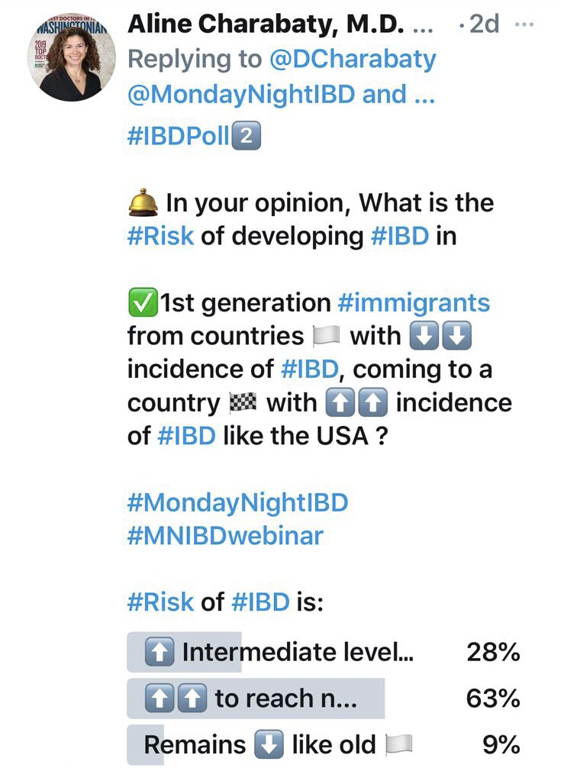
#MedTwitter Polling Results
Notes:
33:54
So this is the result of our

Slide 43
Recent Immigration Is a Risk Factor for IBD
Age of IBD Onset and Time Elapsed Between Immigration and Diagnosis Differs by
Immigration Period in Cuban Immigrants (n = 130)
In Cubans arriving after 1980 vs before 1980: (p < .001)
  Younger age at IBD diagnosis
  Shorter time from immigration to diagnosis
No differences in IBD phenotype, including type of IBD, disease location, and surgeries
p value is comparing differences across the three time-cohorts
Damas OM, et al. Aliment Pharmacol Ther. 2017;46:303-309.
Notes:
34:32
I’m going to start

Slide 44
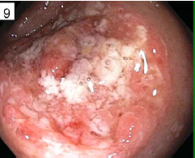
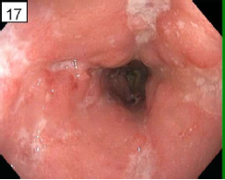
Case Study 2: Mateo
Colonoscopy:
Deep linear ulcers throughout the transverse, left colon and sigmoid with rectal sparing
Pathology: Features of chronic and severe acute colitis, no viral inclusions present
Left colon
Transverse colon
Notes:
36:21
So let’s go back to Mateo

Slide 45
Audience Response
How would you treat Mateo?
Azathioprine
Anti-TNF (adalimumab, infliximab, certolizumab pegol)
Ustekinumab
Vedolizumab
I don’t know
Notes:
36:45
After she says…treat Mateo

Slide 46
Increased IBD Severity Impacts Work Productivity
p < .01
Reported work limitations
  Fatigue: 41.8%
  Irritability: 12.2%
  Decreased motivation: 11.7%
Reasons for missing work
  Physician appointments: 39%
  Abdominal discomfort: 24.4%
  Hospital/ER visits: 22.1%
p < .01
p = .02
p < .01
N = 440, 221 diagnosed with CD
Zand A, et al. Inflamm Bowel Dis. 201521(7):1623-1630.
Notes:
36:49
Alright, so I think one of the main

Slide 47
Treatment: What Is Important to Patients with CD?
CD patients (n = 336) value:
  Short-term improvement
  Lymphoma risk
  Mode of administration
  Long-term remission rates
Almario CV, et al. Am J Gastroenterology. 2018;113(1):58-71.
Notes:
39:42
The other thing

Slide 48
Effective vs Ineffective Communication
Effective Communication:
“Let’s discuss the risks and benefits of the options to find out what is best for you”
“What questions do you have?” “Good question; many people wonder about that…”
“Feel free to call me back or send me a message later if you have more questions as you think this over”
Questions beyond GI (EIM, SH, FH..)
Ineffective Communication:
Feels rushed, provider not spending time/paying attention
Patient does not feel his/her concerns were answered
Patient does not report his/her symptoms or not asked about them
Notes:
41:03
And this really brings me to

Slide 49
#CALM: Clinical vs Tight Control Management of CD
Study Design
Clinical management group escalation driven by CDAI or prednisone use
Prednisone burst and taper
No ADA treatment
ADA 160 mg (wk 0)
80 mg (wk 2), then 40 mg every other week
ADA 40 mg every wk
ADA 40 mg every wk + AZA 2.5 mg/kg per day
Randomisation 1:1
ADA 40 mg every other week
Early randomization
ADA 40 mg every other week + AZA
Tight control group escalation driven by CDAI, FCP, CRP, or prednisone
Laboratory visit
Treatment visit
-9
-4
-1
0
11
12
23
24
35
36
48
Time (weeks)
FCP ≥ 250 µg/g
CRP ≥ 5 mg/L
CDAI ≥ 150 in tight control or CDAI > 200 in clinical management group
ADA = adalimumab; AZA = azathioprine; CRP – C-reactive protein; CDAI = Clinical Disease Activity Index; FCP = fecal calprotectin
Colombel JF, et al. Lancet. 2017;390:2779-2789.
Notes:
41:52
Following Tina’s presentation

Slide 50
CALM Trial: More Mucosal Healing and Steroid-Free Remission at Week 48 with Tight Control Monitoring
Tight control group¹
  Fewer hospitalizations
  Longer periods of remission
  Higher costs due to monitoring
  Increase quality adjusted life-years
More cost-effective strategy²
p = .010
Patients (%)
37/122
56/122
p = .009
p = .003
p = .007
p < .001
Patients (%)
1. Colombel JF, et al. Lancet. 2017;390:2779-2789. 2. Panaccione R, et al. Gut. 2020;69(4):658-664.
Notes:
43:35
So what did we find

Slide 51
Vedolizumab: Clinical Response and Remission in CD
GEMINI1 Week 6
100
90
80
70
60
50
40
30
20
10
0
Patients (%)
p = 0.02
p = 0.23
Sandborn WJ, et al. N Engl J Med. 2013;369:711-721.
Notes:
44:40
So let’s go over

Slide 52
Vedolizumab: Maintenance in CD
GEMINI2 Week 52
(N = 153)
(N = 154)
p < .001
p = .01
p = .02
Patients (%)
43.5%
39.0%
30.1%
31.7%
21.6%
21.4%
15.9%
14.4%
Sandborn WJ, et al. N Eng J Med. 2013;369(8):711-721.
Notes:
45:11
How about maintenance

Slide 53
Ustekinumab: Clinical Response in CD
p < .001
p < .001
p = .003
p < .001
p < .001
p < .001
p < .001
p = .001
p = .002
p = .001
p = .01
p = .49
Patients with Clinical Response (%)
Feagan BG, et al. N Engl J Med. 2016;375:1946-1960.
Notes:
45:36
About usteminumab

Slide 54
Ustekinumab: Clinical Remission in CD
p < .001
p < .001
p = .002
p < .001
p = .002
p = .007
p = .009
p = .005
p = .01
p = .003
p = .20
Patients in Clinical Remission (%)
p = .5
Feagan BG, et al. N Engl J Med. 2016;375:1946-1960.
Notes:
46:26
How about clinical remission

Slide 55
Ustekinumab: Maintenance in CD
IM-UNITI Week 52
p = .005
p = .02
p = .007
p = .004
66.7
59.4
53.1
Patients (%)
44.3
45.6
46.9
35.9
29.8
N = 131 128 131 128 79 78 131 128
Clinical Remission Clinical Response Remission Among Durable Clinical
Those in Remission Remission
at IM-UNITI Week 0
Feagan BG, et al. N Engl J Med. 2016;375:1946-1960.
Notes:
47:03
How about during maintanence

Slide 56
Vedolizumab vs Ustekinumab:
Comparative Effectiveness After TNF Failure
Cumulative Drug Survival Rates
VDZ
UST
Biochemical Remission
CRP ≤5 mg/L , FCP ≤250 µg/g
Corticosteroid-Free Clinical Remission
p = .004
p = .057
p = .025
46
p = .028
p = .198
19
42
33
p = .464
30
30
27
27
Proportion of Patients (%)
Proportion of Patients (%)
21
23
18
35
Biemans V, et al. J Crohn's Colitis. 2020;14(Suppl 1):S114-S116.
Notes:
47:37
Ok, so again, this brings up

Slide 57
Recap: Mateo
33-year-old Hispanic man
Social worker, high risk TB exposure
Moderate to Severe Crohn’s colitis
Notes:
48:51
So let’s go back to Mateo

Slide 58
Audience Response
Now, what would you recommend for Mateo?
Azathioprine
Anti-TNF (adalimumab, infliximab, certolizumab pegol)
Ustekinumab
Vedolizumab
I don’t know
Notes:
49:10
Treatment for Mateo

Slide 59
Now, What would you recommend for Mateo?
Results recorded on October 26, 2020.
Notes:
49:13
Alright so again we see a drop in azathioprine

Slide 60
Questions
Answers
&
Recorded on October 26, 2020
Notes:
53:19
So you know, a lot of our audience

Slide 61
Pipeline: Emerging Therapies in CD
Agent | Mechanism of Action
Etrolizumab Abrilumab | Anti-integrin
Ontamalimab | Fully human, immunoglobulin G₂ antihuman mucosal addressin cell adhesion molecule-1 (MADCAM1)
Guselkumab Mirikizumab Risankizumab Brazikumab | Anti-IL-23
Estrasimod Ozanimod | Sphingosine 1-phosphate receptor 1 (S1P1) modulator
Upadacitinib Filgotinib | JAK1 Inhibitors
None of the agents is FDA-approved for the treatment of CD
Lawton R. Published November 19, 2019. Available at https://www.biospace.com/article/inflammatory-bowel-disease-insight-report-current-therapies-drug-pipeline-and-outlook/. Accessed October 23, 2020.
Notes:
55:39:02
There are a number of agents

Slide 62
Etrolizumab as Induction Therapy in Moderate-to-Severe CD
 | Etrolizumab 105 mg SC Q4W (n = 120) | Etrolizumab 210 mg SC Wks 0, 2, 4, 8,12 (n = 121) | Placebo (n = 59)
Symptomatic Remission: CDAI < 150
Wk 6 | 15.0 (10.4-12.1) | 25.6 (19.7-32.6) | 8.5 (4.2-16.4)
Wk 10 | 15.8(11.2-22.1) | 27.3 (21.2-34.4) | 8.5 (4.2-16.4)
Wk 14 | 20.8(15.4-27.5) | 24.8 (18.9-31.8) | 11.9 (6.6-20.5)
Endoscopic Improvement: ≥ 50% reduction from baseline SES-CD
Wk 14 | 21.0 (15.6-27.8) | 17.4 (12.4-23.7) | 3.4 (1.1-9.7)
Treatment with etrolizumab was well-tolerated and resulted in clinically meaningful improvement in patients with moderate-to-severe disease
Selinger C, et al. Gut. 2018;67:A53.
Notes:
56:57
Let’s delve a little more

Slide 63
SMART Goals
Specific, Measurable, Attainable, Relevant, Timely
Raise awareness among the IBD care team about social determinants of health that may impact the care and outcomes of racial and ethnic minority patients
Take action early to treat with biologics, with long-term outcomes in mind
Long-term remission best positions patients for improved functioning and quality of life
Educate your patients about their disease to empower them to be active participants in the management of their IBD
Notes:
58:15
I hope we were able to achieve

Slide 64
Questions
Answers
&
Recorded on October 26, 2020
Notes:
1:00:48
So we’re going to take some

Slide 65
How likely are you to share these learnings with your team
Extremely likely
Likely
Somewhat likely
Not likely at all
Notes:
1:12:59
After she says…with this last question

Slide 66
How to Collect Credit for this Activity
To receive CME/CE credit, click on the link to complete the post-test and evaluation online.
www.cmeoutfitters.com/TST43743
Be sure to fill in your ABIM ID number and DOB (MM/DD) on the evaluation so we can submit your credit to ABIM.
Participants can print their certificate or statement of credit immediately.
Notes:
1:13:01
To receive credit

Slide 67
Visit the
Gastroenterology Hub
Free resources and education to educate health care providers and patients on gastroenterology, including Crohn’s disease
www.cmeoutfitters.com/gastrohub/
Notes:
1:13:16:
Tina, I want to thank you

Slide 68
How to Collect Credit for this Activity
To receive CME/CE credit, click on the link to complete the post-test and evaluation online.
www.cmeoutfitters.com/TST43743
Be sure to fill in your ABIM ID number and DOB (MM/DD) on the evaluation so we can submit your credit to ABIM.
Participants can print their certificate or statement of credit immediately.
Notes:
1:14:00
And fund more studies

