Slide 1
Looking Ahead: Integrating Emerging Therapies and Tools in Early-Stage Alzheimer’s Disease
Supported by educational grants from Biogen MA, Inc. and Eisai Inc.
Notes:
https://vimeo.com/473242255/cd09d52c3b
0:00

Slide 2
CME Outfitters, LLC, is the accredited provider for this continuing education activity.
Notes:
0:17:03
Today’s activity is brought to you

Slide 3
Claim ABIM MOC Credit
3 Things to Do
Actively participate in the meeting by responding to polling questions (It’s okay if you miss answering a question or get them wrong; you can still claim MOC)
Complete your post-test and evaluation at the conclusion of the webcast
Be sure to fill in your ABIM ID number and DOB (MM/DD) on the evaluation so we can submit your credit to ABIM
Notes:
0:26:12
Today’s CME/CE activity is also

Slide 4
CME for MIPS Improvement Activity
How to Claim this Activity as a CME for MIPS Improvement Activity
Actively participate by responding to ARS questions
Complete activity post-test and evaluation at the link provided
Over the next 90 days, actively work to incorporate improvements in your clinical practice from this presentation
Complete the follow-up survey from CME Outfitters in approximately 3 months
CME Outfitters will send you confirmation of your participation to submit to CMS attesting to your completion of a CME for MIPS Improvement Activity
Notes:
0:48:16
You can also claim this activity

Slide 5
Sharon Cohen, MD, FRCPC
Behavioural Neurologist, Medical Director, and Principal Investigator
Toronto Memory Program
Assistant Professor, University of Toronto
Toronto, Canada
Notes:
0:54:17
As mentioned, I’m Sharon

Slide 6
Mark Brody, MD, CPI
President, Principal Investigator
Brain Matters Research
Delray Beach, FL
Notes:
1:05:03
I’d like to welcome

Slide 7
Pierre N. Tariot, MD
Director, Banner Alzheimer's Institute
Research Professor of Psychiatry
University of Arizona College of Medicine
Phoenix, AZ
Notes:
1:19:22
I would also like to

Slide 8
Learning Objective
1
Recognize the clinical presentation of early-stage AD.
Notes:
1:38:07
Let me now review our learning objective

Slide 9
Learning Objective
2
Assess the safety and efficacy of emerging therapies and their potential role in the treatment continuum of patients with early-stage AD.
Notes:
1:46:17
Our second objective

Slide 10
Learning Objective
3
Integrate multimodal imaging and biomarker strategies into the diagnostic process of AD to inform clinical decision-making.
Notes:
1:57:25
Our final objective is

Slide 11
Audience Response
Among your patients aged 65 and older, what percentage of your patients do you estimate to have MCI or dementia?
None
1%-10%
11%-25%
26%-50%
51%-100%
Notes:
2:16
After she says….vote now

Slide 12
Among your patients 65 and older, what % do you estimate to have MCI or dementia?
Responses recorded on October 8, 2020.
Notes:
2:18
I’m going to turn to Mark

Slide 13
Diagnosis in Clinical Practice Reflects Under-Diagnosis, Misdiagnosis, and Late Diagnosis
Only 50% of individuals with AD are diagnosed
Diagnosis made several years into symptoms
Misdiagnosis in 25%-50%
Many challenges to diagnosis
Difficulty differentiating from normal aging
Comorbidities offer an “alternative diagnosis”
Fear, ageism, lack of awareness by patient/family
Lack of physician skill and resources
Lack of a simple test!
Alzheimer’s Association. Alzheimer’s Dement. 2020;16(3):391-460. The Gerontological Society of America (GSA). 2017. https://www.geron.org/images/gsa/kaer/gsa-kaer-toolkit.pdf.
Notes:
2:56
Excellent yes…And in terms of underestimating

Slide 14
What Is Early AD?
Early symptomatic phases of AD: MCI due to AD and mild AD dementia
Not to be confused with “early-onset AD”
Early AD
Preclinical or asymptomatic AD
MCI due to AD, also called prodromal AD
Mild dementia due to AD
Moderate dementia due to AD
Severe dementia due to AD
No symptoms
Very mild symptoms that do not interfere with everyday activities
Symptoms interfere with some everyday activities
Symptoms interfere with many everyday activities
Symptoms interfere with most everyday activities
MCI = mild cognitive impairment
Alzheimer’s Association. Alzheimer’s Dement. 2020;16(3):391-460.
Notes:
3:21
So when we want to focus on

Slide 15
Age-Related Cognitive Decline vs. AD
Signs of AD | Typical Age-Related Changes
Poor judgment and decision-making | Making a bad decision occasionally
Inability to manage a budget | Missing a monthly payment
Losing track of the date or the season | Forgetting which day it is and remembering later
Difficulty having a conversation | Sometimes forgetting which word to use
Misplacing things and being unable to retrace steps to find them | Losing things from time to time
Alzheimer’s Association. Alzheimer’s Dement. 2020;16(3):391-460.
Notes:
3:59
In age related cognitive change

Slide 16
Early Diagnosis and Intervention May Help Reduce the Burden of AD
A treatment introduced in 2025 that delays AD onset by 5 years would substantially reduce the burden of AD
Early detection facilitates:
Patient autonomy in care decisions
Benefits for care partners: education, support, planning
Early intervention, including medications that reduce symptoms
More appropriate overall medical care and better health outcomes for people with dementia
Delayed institutionalization and reduced healthcare costs
Alzheimer’s Association. Alzheimer’s Dement. 2020;16(3):391-460. Alzheimer’s Association. 2015. https://www.alz.org/media/Documents/changing-the-trajectory-r.pdf. Alzheimer’s Association. 2018. https://www.alz.org/aaic/downloads2018/Sun-clinical-practice-guidelines.pdf. Judge D, et al. Int J Alzheimer’s Dis. 2019;2019:4942562.
Notes:
6:05
I’m a big proponent

Slide 17
What Clinicians Assess to Identify AD and Follow Its Progression
Function
Behavior
Cognition
Neurological features
Notes:
7:20
So you’ve got this Venn Diagram

Slide 18
The Clinical Evaluation of Suspected MCI or Dementia
Routine
History
Evolution of illness: cognition, function, behavior
Social, developmental
Medical/surgical
Medications
Allergies
Habits
Family illnesses
Mental Status Exam
Neurological Exam
Office neuropsychological testing
MoCA, fluency, clock
Labs
CT/MRI
As lndicated in Certain Clinical Scenarios
Syphilis serology
Sedimentation rate
Chest X-ray
Electrocardiogram
Urinalysis
Drug levels
HIV testing
Lyme serology
EEG
PET/SPECT
FDG (glucose)
Amyloid
APOE genotyping
CSF (Aβ42/tau: done rarely)
Biopsy, autopsy, research biomarkers
APOE = apolipoprotein E; CSF = cerebrospinal fluid; CT = computed tomography; EEG = electroencephalogram; FDG = fluorodeoxyglucose; HIV = human immunodeficiency virus; MoCA = Montreal Cognitive Assessment; MRI = magnetic resonance imaging; PET = positron emission tomography; SPECT = single photon emission CT
Langa KM, Levine DA. JAMA. 2014;312(23):2551-2561.
Notes:
7:46
So in terms of the clinical

Slide 19
In-Clinic Cognitive Testing
No standard
Practitioner preference
Should include:
Attention
Orientation
Short- and long-term memory
Language
Visuospatial abilities
Executive functioning
2018 AAN guidance recommends the use of a brief, validated cognitive assessment instrument to assess for cognitive impairment during the annual wellness visit
AAN = American Academy of Neurology
Cordell CB, et al. Alzheimer’s Dement. 2013;9(2):141-150. Petersen RC, et al. Neurology. 2018;90(3):126-135. McKhann GM, et al. Alzheimer’s Dement. 2011;7(3):263-269.
Notes:
8:57
In terms of in-clinic cognitive testing

Slide 20
Common Cognitive Screening Tools
Tool | Description
MMSE^{1,2} | Screens for cognitive impairment; does not evaluate executive functioning or capture impairments in ADL; scores 20-26 considered mild, 10-19 moderate AD, and < 10 as severe AD
Clock-Drawing Test^{3,4} | Patient is asked to draw the face of a clock indicating the time of 2:45; scoring criteria include closed circle, numbers in correct position, all 12 numbers correct, and clock hands in correct positions
Mini-Cog⁵ | Combines 3-word recall and clock-drawing task
ADL = activities of daily living; MMSE = Mini-Mental State Examination
1. Folstein MF, et al. J Psychiatr Res. 1975;12(3):189-198.; 2. Feldman HH, et al. Neurology. 2005;65(suppl 3):S10-S17.; 3. Sunderland T, et al. J Am Geriatr Soc. 1989;37(8):725-729.; 4. Shulman KI. Int J Geriatr Psychiatry. 2000;15(6):548-561.; 5. Borson S, et al. J Am Geriatr Soc. 2003;51(10):1451-1454.
Notes:
10:01
So here are some examples

Slide 21
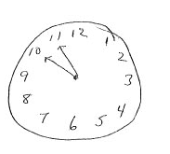
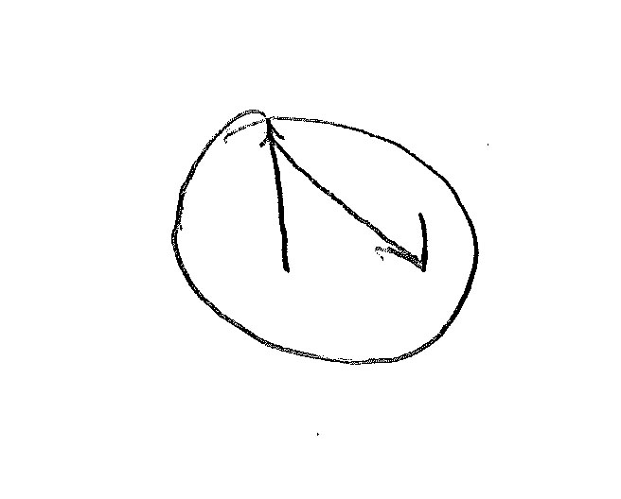
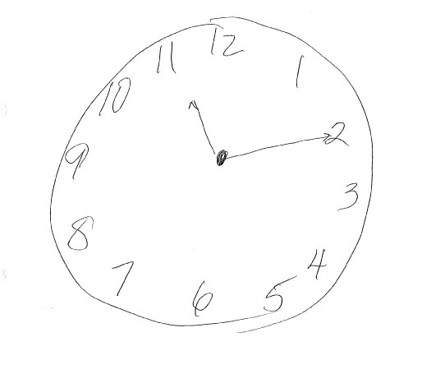
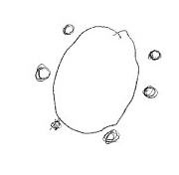
Clock Drawings
Notes:
10:35
Here’s some examples of clock

Slide 22
Audience Response
What percentage of the time do you use a validated cognitive screening tool in patients age ≥ 65 who have (or whose care partners have) concerns about their memory or cognition?
0% of the time
1% - 25% of the time
26% - 50% of the time
51% - 75% of the time
76% - 100% of the time
Notes:
11:08
After she says…another question

Slide 23
What % of the time do you use a validated cognitive screening tool in patients age ≥ 65 who have (or whose care partners have) concerns about their memory or cognition?
Responses recorded on October 8, 2020.
Notes:
11:10
Pierre, what do you think about

Slide 24
Functional Changes in Dementia
Instrumental ADL Usually Affected in Early Stages
Handling finances
Taking medications
Housekeeping
Independent travel
Shopping
Preparing meals
Using telephone
Personal ADL Usually Affected in Middle Stages
Bathing
Toileting
Dressing
Grooming
Walking
Eating meals
Albert MS, et al. Alzheimer’s Dement. 2011;7(3):270-279.; McKhann GM, et al. Alzheimer’s Dement. 2011;7(3):263-269.
Notes:
12:10
Well, functionally, the normal activities

Slide 25
Functional Assessment Staging (FAST): Seven Stages of AD
No one patient will experience the same symptoms or progress at the same rate
Stage 1: No impairment – Appears normal
Stage 2: Very mild decline – No noticeable cognitive decline
Stage 3: Mild decline – Mild functional deficits; “forgetful; misplacing things, trouble planning; family/friends may start noticing difficulties.
Stage 4: Moderate decline – Family and friends notice problems with recalling events/personal history and difficulty completing tasks
Stage 5: Moderate-severe decline – Care needed; increased confusion, agitation, can no longer manage personal affairs
Stage 6: Severe – Needs help with dressing and personal hygiene; lack of awareness; depression; incontinence; wandering; trouble remembering name of spouse
Stage 7: Very severe decline – Full-time care needed; institutionalized
Developed by Barry Reisberg, MD, Clinical Director of the NYU School of Medicine's Silberstein Aging and Dementia Research Center
Sclan SG, Reisberg B. Int Psychogeriatr. 1992;4(Suppl 1):55-69.
Notes:
13:33
The first stage

Slide 26
Relationship of FAST Stages to MMSE Scores
FAST Stages | Decline | AD Diagnosis | MMSE Score*
Stage 1 | None | None | 30
Stage 2 | Very mild | None | 26-29
Stage 3 | Mild | MCI or mild AD
Stage 4 | Moderate | Mild AD | 21-25
Stage 5 | Moderate-severe | Moderate AD | 11-20
Stage 6 | Severe | Moderate-severe AD
Stage 7 | Very severe | Severe AD | 0-10
*These are estimates and the MMSE scores between stages will have some overlap
Perneczky R. Am J Geriat Psych. 2006;14:139-144.
Notes:
15:21
So we’ve talked about
move from this slide to the next at 15:27, so that this slide ends with "functional changes" and the next slide begins with "and now I'd like"

Slide 27
Pathophysiology of Alzheimer’s Disease
An Animated Tour
Notes:
15:27
And now I’d like to
At 15:45 GO FULL SCREEN TO THE VIDEO ANIMATION
At 16:51 “So as you can see” GO BACK TO SIDE BY SIDE showing this slide image

Slide 28
A Proposed Temporal Progression of AD(s)
Genetic Factors APP mutations Presenilin 1,2 mutations APOE4 alleles Family history APOE2 alleles protect APP/BACE mutation protects
Environmental Factors Head injury Toxins
Age
Endogenous Factors Diet Cardiovascular risk factors Diabetes Smoking Education Menopause Physical/mental activity
Protective Factors Estrogen? Anti-inflammatory drugs?
Net effect = stress and vulnerability to stress
Molecular Phenotype
INITIAL STRESSORS Proximal apoptosis APP dysregulation Impaired neurotrophic function Oxidative stress Excitotoxicity
Clinical Phenotype
Normal
FAILED STRESS RESPONSE Cell cycle dysregulation Kinase/phosphatase dysfunction Protein misfolding Altered DNA repair Vascular/membrane dysfunction
CELL INJURY Inflammation Cytoskeletal dysfunction Synaptic dysfunction Mitochondrial damage
CELL DEATH Distal apoptosis Neurotransmitter failure
Neuropathology
Normal
Normal
Tangles, plaques
Tangles, plaques neurodegeneration
Normal
MCI
Dementia
The figure depicts apparently continuous processes, though they are likely to be asynchronous. Yaari R, et al. Expert Opinion. 2008;3(7):745-760.
Notes:
17:12
This is what I call my slide

Slide 29
Learning Objective
2
Assess the safety and efficacy of emerging therapies and their potential role in the treatment continuum of patients with early-stage AD.
Notes:
19:09
Let’s move to the second learning objective

Slide 30
Current Treatments and Gaps
Available treatments approved by FDA for AD
ChE inhibitors: donepezil, galantamine, rivastigmine (mild to severe AD)
NMDA receptor antagonist: memantine (moderate to severe AD)
Potential Benefits | Limitations
May improve clinical symptoms May delay emergence of new symptoms | Effectiveness varies but generally only modest benefit Duration may be limited Not indicated for MCI Do not slow or reverse neurodegenerative process
ChE = cholinesterase; FDA = U.S. Food and Drug Administration; NMDA = N-methyl-D-aspartate
Grossberg GT, et al. J Alzheimer’s Dis. 2019;67(4):1157-1171.; Cummings JL, et al. Ann Clin Transl Neurol. 2015;2(3):307‐323.
Notes:
19:30
Well we have some

Slide 31
Important Trends in AD Clinical Trials
Intervening at earlier stages of disease
Biomarkers to define cohorts and demonstrate effect
Targeting high-risk cohorts
Disease modification > symptom treatment
Diversity in mechanism of action:
Amyloid therapies, tau therapies, neuroprotective strategies, innate immunity, neurotransmitters, other
DMT = disease modifying therapies
Cummings J, et al. Alzheimer’s Dement (N Y). 2020;6(1):e12050.
Notes:
20:48
Thank you, Mark, yes, so…You’re quite right

Slide 32
Audience Response
Which of the following is an anti-amyloid therapy that has completed pivotal phase III trials for AD?
A. Aducanumab
B. Escitalopram
C. Masitinib
D. I don’t know
Notes:
21:40
After she says….drug development

Slide 33
Which of the following is an anti-amyloid therapy that has completed pivotal phase III trials for AD?
Responses recorded on October 8, 2020.
Notes:
21:44
Ok fair enough, a very honest

Slide 34
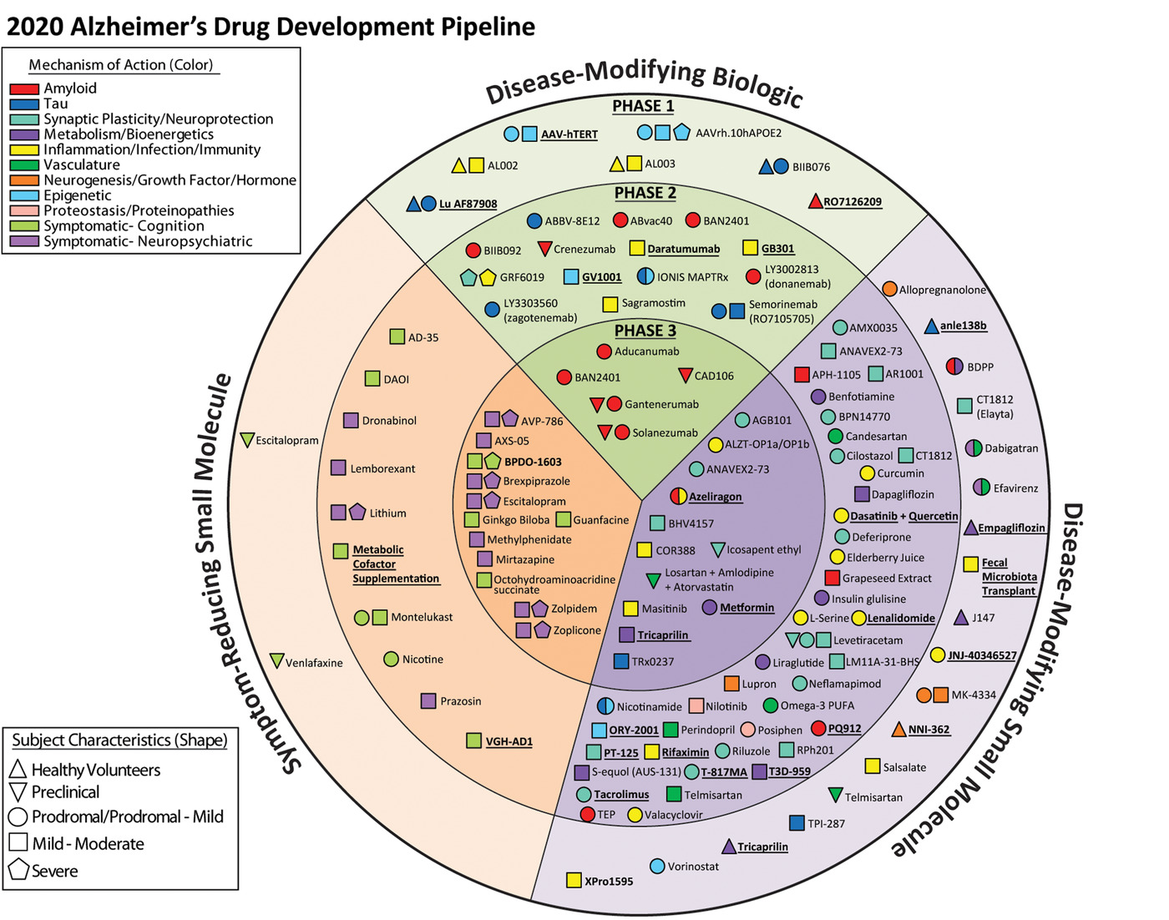
2020 AD Drug Development Pipeline
Mechanism of Action (Color)
Amyloid
Tau
Synaptic plasticity/neuroprotection
Metabolism/bioenergetics
Inflammation/infection/immunity
Vasculature
Neurogenesis/growth factor/hormone
Epigenetic
Proteostasis/proteinopathies
Symptomatic – cognition
Symptomatic - neuropsychiatric
Subject Characteristics (Shape)
Healthy volunteers
Preclinical
Prodromal/prodromal – mild
Mild to moderate
Severe
Cummings J, et al. Alzheimer’s Dement (N Y). 2020;6(1):e12050.
Notes:
22:31
If we turn to

Slide 35
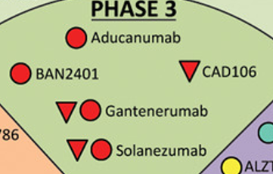
2020 AD Drug Development Pipeline
Mechanism of Action (Color)
Amyloid
Tau
Synaptic plasticity/neuroprotection
Metabolism/bioenergetics
Inflammation/infection/immunity
Vasculature
Neurogenesis/growth factor/hormone
Epigenetic
Proteostasis/proteinopathies
Symptomatic – cognition
Symptomatic - neuropsychiatric
Subject Characteristics (Shape)
Healthy volunteers
Preclinical
Prodromal/prodromal – mild
Mild to moderate
Severe
Cummings J, et al. Alzheimer’s Dement (N Y). 2020;6(1):e12050.
Notes:
23:28
If we just zoom in on the Phase 3

Slide 36
The Amyloid Hypothesis
Anti-amyloid approaches have dominated the AD pipeline over the past 15 years
Persistent high hopes based on belief in key role of amyloid in AD pathophysiology
Recently, renewed interest due to greater appreciation of:
Amyloid subtypes and differing contributions to AD
Impact of dose, timing, and duration of intervention
Aisen PS, et al. J Prev Alzheimer’s Dis. 2020;7(3):146-151.
Notes:
23:47
There has been

Slide 37
Phase III Trials of Anti-Amyloid Monoclonal Antibodies
Agent | Trial | Status
Aducanumab | ENGAGE and EMERGE in early AD | In review for FDA approval
BAN2401 | Clarity AD in early AD | Ongoing
 | AHEAD 3-45 in preclinical asymptomatic AD | Ongoing
Gantenerumab | GRADUATE 1 and 2 in early AD | Ongoing
 | DIAN-TU in familial AD | Failed
 | SCarlet RoAD and Marguerite RoAD in early AD | Failed
Solanezumab | A4 Study in preclinical asymptomatic AD | Ongoing
 | DIAN-TU in familial AD | Failed
 | EXPEDITION 1-3 | Failed
Crenezumab | API-ADAD in preclinical PSEN1 E280A carriers | Ongoing
 | CREAD in early AD | Failed
Bapineuzumab | Trials in mild-to-moderate AD | Failed
A4 = Anti-Amyloid Treatment in Asymptomatic Alzheimer’s; API-ADAD = Alzheimer’s Prevention Initiative Autosomal Dominant Alzheimer's Disease; DIAN-TU = Dominantly Inherited Alzheimer Network Trials Unit
Cummings J, et al. Alzheimer’s Dement (N Y). 2020;6(1):e12050.; Tolar M, et al. Alzheimer’s Res Ther. 2020;12(1):95.
Notes:
24:23
Yeah so this slide focuses

Slide 38
Mechanism of Action of Emerging AD Therapies
An Animated Tour
Notes:
27:00
Let’s turn to another 3-D animation
At 27:10 GO FULL SCREEN TO THE ANIMATION

Slide 39
Aducanumab Phase III Studies: ENGAGE and EMERGE in Early AD
Patients had clinical diagnosis of MCI due to AD or mild AD dementia and confirmed AD pathology in Aβ-PET imaging
Two dosing regimens (low and high) and placebo
Subjects randomized 1:1:1 to intravenous (IV) infusion every 4 weeks
Primary outcome measure: CDR-SB at 18 months
Both trials were discontinued following a prespecified futility analysis in March 2019; a larger dataset became available later
EMERGE met all primary, secondary, and biomarker outcomes
Results from an ENGAGE subgroup support EMERGE findings
CDR-SB = clinical dementia rating sum of boxes
Budd Haeberlein S, et al. EMERGE and ENGAGE Topline Results: Two Phase 3 Studies to Evaluate Aducanumab in Patients With Early Alzheimer’s Disease. Presented at: 2019 Clinical Trials in Alzheimer’s Disease [CTAD]; December 5, 2019; San Diego, CA.; 221AD301 Phase 3 Study of Aducanumab (BIIB037) in Early Alzheimer's Disease (ENGAGE). ClinicalTrials.gov Identifier: NCT02477800. First Received 2015.; 221AD302 Phase 3 Study of Aducanumab (BIIB037) in Early Alzheimer's Disease (EMERGE). ClinicalTrials.gov Identifier: NCT02484547. First Received 2015.
Notes:
28:29 GO BACK TO SIDE BY SIDE
Pierre can you tell us

Slide 40
EMERGE: Primary and Secondary Endpoints at Week 78
 |  | Difference vs. Placebo (%)* p Value
 | Placebo Decline (n = 548) | Low Dose (n = 543) | High Dose (n = 547)
CDR-SB | 1.74 | -0.26 (-15%) .0901 | -0.39 (-22%) .0120
MMSE | -3.3 | -0.1 (-3%) .7578 | 0.6 (-18%) .0493
ADAS-Cog 13 | 5.162 | -0.701 (-14%) .1962 | -1.400 (-27%) .0097
ADCS-ADL-MCI | -4.3 | -0.7 (-16%) .1515 | 1.7 (-40%) .0006
Intent to treat (ITT) population
*Difference vs. placebo at Week 78. Negative percentage means less progression in the treated arm ADAS-Cog 13 = AD Assessment Scale-Cognitive Subscale (13-item); ADCS-ADL-MCI = AD Cooperative Study-ADL Inventory (MCI version)
Budd Haeberlein S. EMERGE and ENGAGE Topline Results: Phase 3 Studies of Aducanumab in Early Alzheimer’s Disease. Presented at: 2020 Alzheimer’s Association International Conference; July 27-30, 2020.
Notes:
30:50
Here are the clinical

Slide 41
EMERGE: Adverse Events
Safety Population* | Placebo (n = 547) | Low Dose (n = 544) | High Dose (n = 547)
Any event, n (%) | 476 (87.0) | 477 (87.7) | 505 (92.3)
ARIA-E | 12 (2.2) | 140 (25.7) | 186 (34.0)
ApoE ℇ4 carriers | 7/371 (1.9) | 109/366 (29.8) | 154/362 (42.5)
ApoE ℇ4 non-carriers | 5/173 (2.9) | 31/171 (18.1) | 32/179 (17.9)
Headache | 83 (15.2) | 106 (19.5) | 106 (19.4)
ARIA-H, micro-hemorrhage | 38 (6.9) | 88 (16.2) | 102 (18.6)
Nasopharyngitis | 90 (16.5) | 70 (12.9) | 87 (15.9)
ARIA-H, superficial siderosis | 14 (2.6) | 50 (9.2) | 73 (13.3)
Fall | 68 (12.4) | 64 (11.8) | 69 (12.6)
Treatment discontinuation due to AE, n (%) | 16 (2.9) | 42 (7.7) | 48 (8.8)
Symptoms reported in patients with ARIA included: headache, dizziness, visual disturbances, nausea, and vomiting
ARIA-E episodes generally resolved within 4-16 weeks
The majority of patients who experienced ARIA were able to continue investigational treatment
AE = adverse event; ARIA = amyloid-related imaging abnormality; ARIA-E = ARIA due to vasogenic edema; ARIA-H = ARIA due to micro-/macro-hemorrhages
*Patients randomized to placebo who accidentally received active dose are summarized under active groups (four in ENGAGE and one in EMERGE). All safety data presented are from the placebo-controlled period. This table includes patients who received at least one dose of investigational treatment.
Budd Haeberlein S. EMERGE and ENGAGE Topline Results: Phase 3 Studies of Aducanumab in Early Alzheimer’s Disease. Presented at: 2020 Alzheimer’s Association International Conference; July 27-30, 2020.
Notes:
31:49
In terms of adverse events

Slide 42
BAN2401 Phase III Study in Early AD
Clarity AD
Enrolling ~ 1,500 patients with early AD
Biweekly IV infusion
Primary outcome: CDR-SB at 18 months
Expected completion: 2023
A Study to Confirm Safety and Efficacy of BAN2401 in Participants With Early Alzheimer's Disease (Clarity AD). ClinicalTrials.gov Identifier: NCT03887455. First Received 2019.; Lynch SY, et al. BAN2401 in early Alzheimer’s disease: a placebo-controlled, double-blind, parallel-group, 18-month study with open-label extension phase to confirm safety and efficacy (CLARITY AD). Clinical Trials on Alzheimer's Disease 2019.
Notes:
33:33
This is the BAN2401 study

Slide 43
Gantenerumab Phase III Studies in Early AD
GRADUATE 1 and 2
Each enrolling ~1,000 patients
Subcutaneous injection of 1,020 mg every 4 weeks
105 mg and 225 mg used in previous phase III trials
Up to 1,200 mg used in 104-week OLE study
Primary outcome: CDR-SB at 18 months
Expected completion: 2023
Efficacy and Safety Study of Gantenerumab in Participants With Early Alzheimer's Disease (AD). ClinicalTrials.gov Identifier: NCT03444870. First Received 2018. Safety and Efficacy Study of Gantenerumab in Participants With Early Alzheimer's Disease (AD). ClinicalTrials.gov Identifier: NCT03443973. First Received 2018. Klein G, et al. Alzheimer’s Res Ther. 2019;11(1):101.
Notes:
34:30
And gantenerumab, do you want to say

Slide 44
Non-Amyloid Approaches to AD Therapeutics
Tau-targeting therapies
Neurotrophin receptor modulation
Anti-microbial strategies
Anti-inflammatory response
Vascular approaches
Non-pharmacological approaches
Lifestyle intervention strategies
Photobiomodulation
Neurostimulation
Gauthier S, et al. J Prev Alzheimer’s Dis. 2020:1-6.
Notes:
35:18
As we hold our breath

Slide 45
Learning Objective
3
Integrate multimodal imaging and biomarker strategies into the diagnostic process of AD to inform clinical decision-making.
Notes:
39:48
Let’s turn to our third objective

Slide 46
Role of Biomarkers in AD Diagnosis
Allow us to define AD biologically and to diagnose by ruling in AD rather than ruling out other causes
Major strides in imaging and non-imaging biomarkers over the past decade
Several biomarkers available for clinical use; others used in clinical trials and undergoing validation for clinical use
Helpful in confirming diagnosis in typical and atypical presentations of AD as well as in early stages and where comorbidities confound clinical diagnosis
Staffaroni AM, et al. Semin Neurol. 2017;37(5):510-537.
Notes:
40:01
We’ve talked about clinical presentation

Slide 47
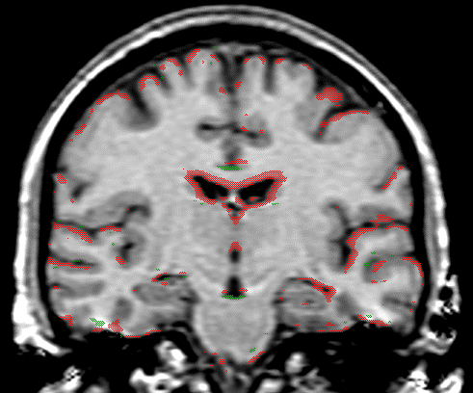
Biomarkers to Guide Diagnosis and Improve Treatment of AD
Neuronal activity FDG PET
Cognitive, functional profile
Brain atrophy Structural MRI
Diagnosis
Treatment
Amyloid / tau load PET
Cognitive reserve fMRI
Genetic risk profile
CSF / blood biomarkers
Sabbagh MN, et al. Neurol Ther. 2017;6(Suppl 1):83-95.
Notes:
40:55
The point of this slide

Slide 48
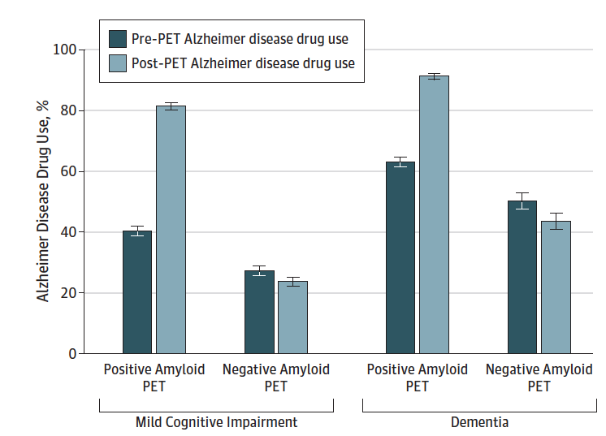
Growing Evidence for Amyloid-β PET Utility in Routine Clinical Practice
Increases diagnostic confidence¹
For 62% of 870 patients
Leads to changes in diagnosis²
Among 16,000 Medicare patients, 25.1% changed from AD to non-AD and 10.5% from non-AD to AD
Diagnosis revised in 31.3% of 1,142 cases in an aggregated analysis
Reduces number and cost of diagnostic investigations in patients with atypical presentation³
Informs prognosis⁴
Amyloid-β CSF+/PET+ (N = 318) participants had elevated CSF (p)tau levels and worse cognitive performance compared to CSF+/PET- (N = 80) and CSF-/PET- (N = 306) at baseline, and greater tau uptake at 5 years
Leads to Changes in Treatment²
Pre-PET AD drug use
Post-PET AD drug use
AD Drug Use, %
Positive Amyloid PET
Negative Amyloid PET
Positive Amyloid PET
Negative Amyloid PET
Mild Cognitive Impairment
Dementia
1. Fantoni ER, et al. J Alzheimer’s Dis. 2018;63(2):783-796. 2. Carswell CJ, et al. J Neurol Neurosurg Psychiatry. 3. Reimand J, et al. Neurology. 2020;10.1212/WNL.0000000000010739. 2018;89(3):294-299. 4.Rabinovici GD, et al. JAMA. 2019;321(13):1286-1294.
Notes:
43:35
As Pierre was alluding

Slide 49
Blood-Based Biomarkers in AD
Plasma amyloid (Aβ42/40)
Various plasma p-tau isoforms (e.g., p-tau217)
Plasma NfL
NfL = neurofilament light-chain
Baldacci F, et al. Expert Rev Mol Diagn. 2020;20(4):421-441.
Notes:
45:45
Yeah, hold onto your hats

Slide 50
How Will the Role of Biomarkers Change with Approval of an Aβ-Targeted DMT?
Increased patient awareness → more patients reporting concerns / requesting evaluation
Greater use of biomarkers in earlier stages of disease
Evidence of amyloid pathology will be required for insurance coverage of Aβ-targeted drug
Use of biomarkers to monitor treatment response
Accelerated development of new techniques for diagnosis and monitoring as well as new therapies
Notes:
46:40
So let’s think about

Slide 51
Case Study
Mr. Smith, a 73-year-old man, comes for his yearly check-up accompanied by his wife. After reviewing the conditions on his problem list, his wife mentions that she has had concerns about his forgetfulness. Mr. Smith is quick to point out that he doesn’t feel that forgetfulness interferes with his activities. After asking Mr. Smith whether he would allow his wife to speak, the patient’s wife elaborates, “Over the past year, our children and I have noticed that he often asks the same question repeatedly. He didn’t used to do this. He doesn’t seem to be paying attention to what I am saying because he hardly ever remembers our conversations. If I ask him to go pick up some things in town, he usually comes back empty-handed or with only a few of the things I asked him to get. He doesn’t remember appointments. Yet, he has had no difficulties with driving or with directions and he is still an excellent handy man.”
What should a health care provider do in this situation?
Knopman DS, Petersen RC. Mayo Clin Proc. 2014;89(10):1452-1459.
Notes:
47:28
We’re going to turn to a case study now

Slide 52
Audience Response
What should a health care provider do in this situation?
Document that Mr. Smith has age-related cognitive decline
Have a longer conversation with Mr. Smith to informally examine his cognition and memory
Use a validated screening tool such as MMSE or MoCA Order a brain MRI for Mr. Smith
Refer Mr. Smith to a dementia specialist
Notes:
48:31
After she says….do in this situation

Slide 53
What should a health care provider do in this situation?
Responses recorded on October 8, 2020.
Notes:
48:34
Ok great

Slide 54
What Can Clinicians Do Today?
Early, accurate diagnosis is key
Increases the likelihood for patients to be involved in decision-making and planning for their future
Early use of symptomatic treatments provide greater clinical and quality-of-life benefits
Lifestyle matters: diet, exercise, brain games
Modifiable risk factors: Low education, smoking, physical inactivity, depression, hypertension, diabetes, obesity
Partner/family engagement
Encourage patients with AD to enroll in clinical trials
Recruitment is the bottleneck to studying investigational therapies
Cummings JL, et al. Ann Clin Transl Neurol. 2015;2(3):307‐323. Goldfarb D, et al. J Clin Psychiatry. 2019;80(2):MS18002BR1C. Petersen RC, et al. Neurology. 2018;90(3):126-135.
Notes:
49:54
I think the biggest thing

Slide 55
SMART Goals
Specific, Measurable, Attainable, Relevant, Timely
Appropriate screening in primary care
Tiered approach to diagnostic investigations
Early intervention – symptomatic treatments may help
Monitor disease progression
Patient and family support, education
Notes:
52:12
Let’s wrap up

Slide 56
CME Outfitters
AFTER
THE SHOW
Questions & Answers Recorded on October 8, 2020
Notes:
53:16
There are a lot of questions

Slide 57
To Receive Credit
To receive CME/CE credit click on the link to complete the post-test and evaluation online.
www.cmeoutfitters.com/TST43705
Be sure to fill in your ABIM ID number and DOB (MM/DD) on the evaluation so we can submit your credit to ABIM
Participants can print their certificate or statement of credit immediately.
Notes:
1:24:06
I want to remind people to receive

Slide 58
CME for MIPS Improvement Activity
How to Claim this Activity as a CME for MIPS Improvement Activity
Complete activity post-test and evaluation at the link provided
Over the next 90 days, actively work to incorporate improvements in your clinical practice from this presentation
Complete the follow-up survey from CME Outfitters in approximately 3 months
CME Outfitters will send you confirmation of your participation to submit to CMS attesting to your completion of a CME for MIPS Improvement Activity
Notes:
1:24:16
And if you’d like to

Slide 59
Visit the Alzheimer’s Disease Hub
Free resources for clinicians and patients
https://www.cmeoutfitters.com/AlzHub/
Notes:
1:24:26
Again, thank you to my faculty

Slide 60
To Receive Credit
To receive CME/CE credit click on the link to complete the post-test and evaluation online.
www.cmeoutfitters.com/TST43705
Be sure to fill in your ABIM ID number and DOB (MM/DD) on the evaluation so we can submit your credit to ABIM
Participants can print their certificate or statement of credit immediately.
Notes:
1:24:51
Once again

